Slide 1
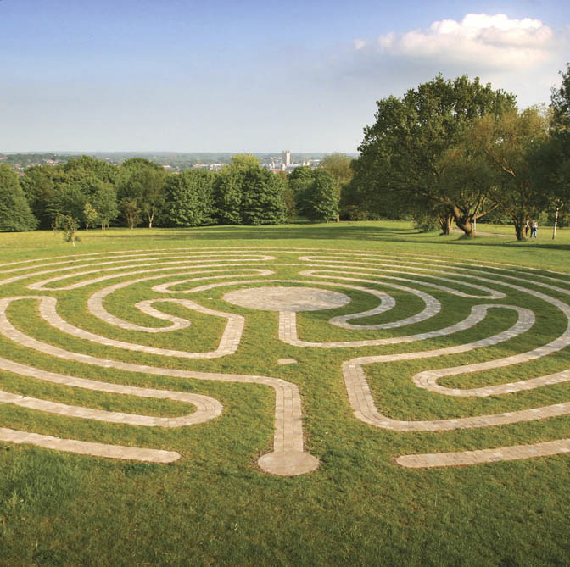
AI Systems
Lecture 3
Ensemble Models

Slide 2
Ensemble models
training
Place all the factor for all model
x
inference
Make predictions by aggregating multiple trained models
Improve predictions
As long as models are sufficiently diverse (misclassifications are not correlated)
E.g. train three different models: SVM, Logistic Regression, DecisionTree, use VotingClassifier to classify based on most common predicted class (“hard” voting)
If models provide a probability for each class (predict_proba) “soft” voting can be used: predict class with highest average probability across all models
Average model irregularities (decrease variance, reduce overfitting)
A way to obtain independent models using the same algorithm is training on different random subsets (samples) of the training set. If sampling is done with replacement this is called Bagging/Boostrapping otherwise is called Pasting.
bagging methods work best with strong and complex models (e.g., fully developed decision trees), in contrast with boosting methods which usually work best with weak models (e.g., shallow decision trees).
Parallelise training
Each of the model can be trained in parallel, particularly useful if each model is trained on a sample using bagging or pasting
SVM
y₁
X,y
X,y
Logit R
y₂
voting / averaging
X,y
X,y
y₃
DT
DT
X₁,y₁
X,y
X₂,y₂
DT
X₃,y₃
DT

Slide 3
Example in Sklearn: votingclassifier
from sklearn.ensemble import RandomForestClassifier, VotingClassifier
from sklearn.linear_model import LogisticRegression
from sklearn.svm import SVC
from sklearn.metrics import accuracy_score
log_clf = LogisticRegression()
rnd_clf = RandomForestClassifier()
svm_clf = SVC(probability=False)
#set probability to True for voting='soft' below
voting_clf = VotingClassifier(
estimators = [('lr',log_clf), ('rf',rnd_clf), ('svm',svm_clf)],
voting='hard'
)
for clf in (log_clf, rnd_clf, svm_clf,voting_clf):
clf.fit(x_train,y_train)
y_pred = clf.predict(x_test)
print(clf.__class__.__name__,accuracy_score(y_test,y_pred))

Slide 4
Example in Sklearn: Bagging/Pasting
from sklearn.ensemble import BaggingClassifier
from sklearn.tree import DecisionTreeClassifier
from sklearn.metrics import accuracy_score
bag_clf = BaggingClassifier(
DecisionTreeClassifier(), n_estimators=50,
max_samples=1000, bootstrap=True, n_jobs=-1, oob_score=True
)
#set bootstrap to False for pasting
bag_clf.fit(x_train,y_train)
print ("OOB score",bag_clf.oob_score_)
y_pred = bag_clf.predict(x_test)
print (accuracy_score(y_test,y_pred))

Slide 5
Random Patches/Subspaces
BaggingClassifier by default does bootstrapping (samples with replacement) on the training :
max_samples int or float, default=1.0
The number of samples to draw from X to train each base estimator (with replacement by default, see bootstrap for more details). If int, then draw max_samples samples. If float, then draw max_samples * X.shape[0] samples.
bootstrap bool, default=True
Whether samples are drawn with replacement. If False, sampling without replacement is performed.
This results in training each ensemble on about 63% of available data, 37% of samples are not used for each classifier (called out-of-bag samples)
You can ask to validate each sample on the oob instances by setting oob_score=True (see previous slide), oob_score gives the average
BaggingClassifier supports sampling features as well, but it is off by default:
max_features int or float, default=1.0 The number of features to draw from X to train each base estimator (without replacement by default, see bootstrap_features for more details). If int, then draw max_features features. If float, then draw max_features * X.shape[1] features.
bootstrap_features bool, default=False Whether features are drawn with replacement.
When random subsets of the dataset are drawn as random subsets of the features, then the method is known as Random Subspaces.
Finally, when base estimators are built on subsets of both samples and features, then the method is known as Random Patches.

Slide 6
Random forest/extra trees
Random Forest is an optimised model for Random Patches with Decision Trees as a base model
SkLearn default parameters results in
Sampling a number of features which is proportional to the square root of the total number of features
Boostrapping samples with a sample size equal to the dataset size
No limit to the tree depth, but then tree depth is naturally limited by the reduced number of features
Performance of Random Forest in many scenarios can be competitive with Neural Networks approaches
Extra Trees
A version of RF where the splitting thresholds for attributes are random (instead of using an optimal splitting point like standard decision trees do
Faster than RF as finding optimal splitting thresholds is one of the most computationally expensive part of DT

Slide 7
BOOSTING
The key idea in boosting is to train predictors sequentially, with each predictor trying to improve the results of the previous predictor
After each model is trained the prediction error is used to train the next instance of the model
In Boosting normally the base predictor models used are weak learners (i.e. learners that are just slightly better than random guessing), e.g. in the case of decision trees trees that are very shallow, such as decision stumps (max_depth=1)
DT
X₁,y₁
e₁
X,y
X₂,y₂
DT
e₂
X₃,y₃
DT

Slide 8
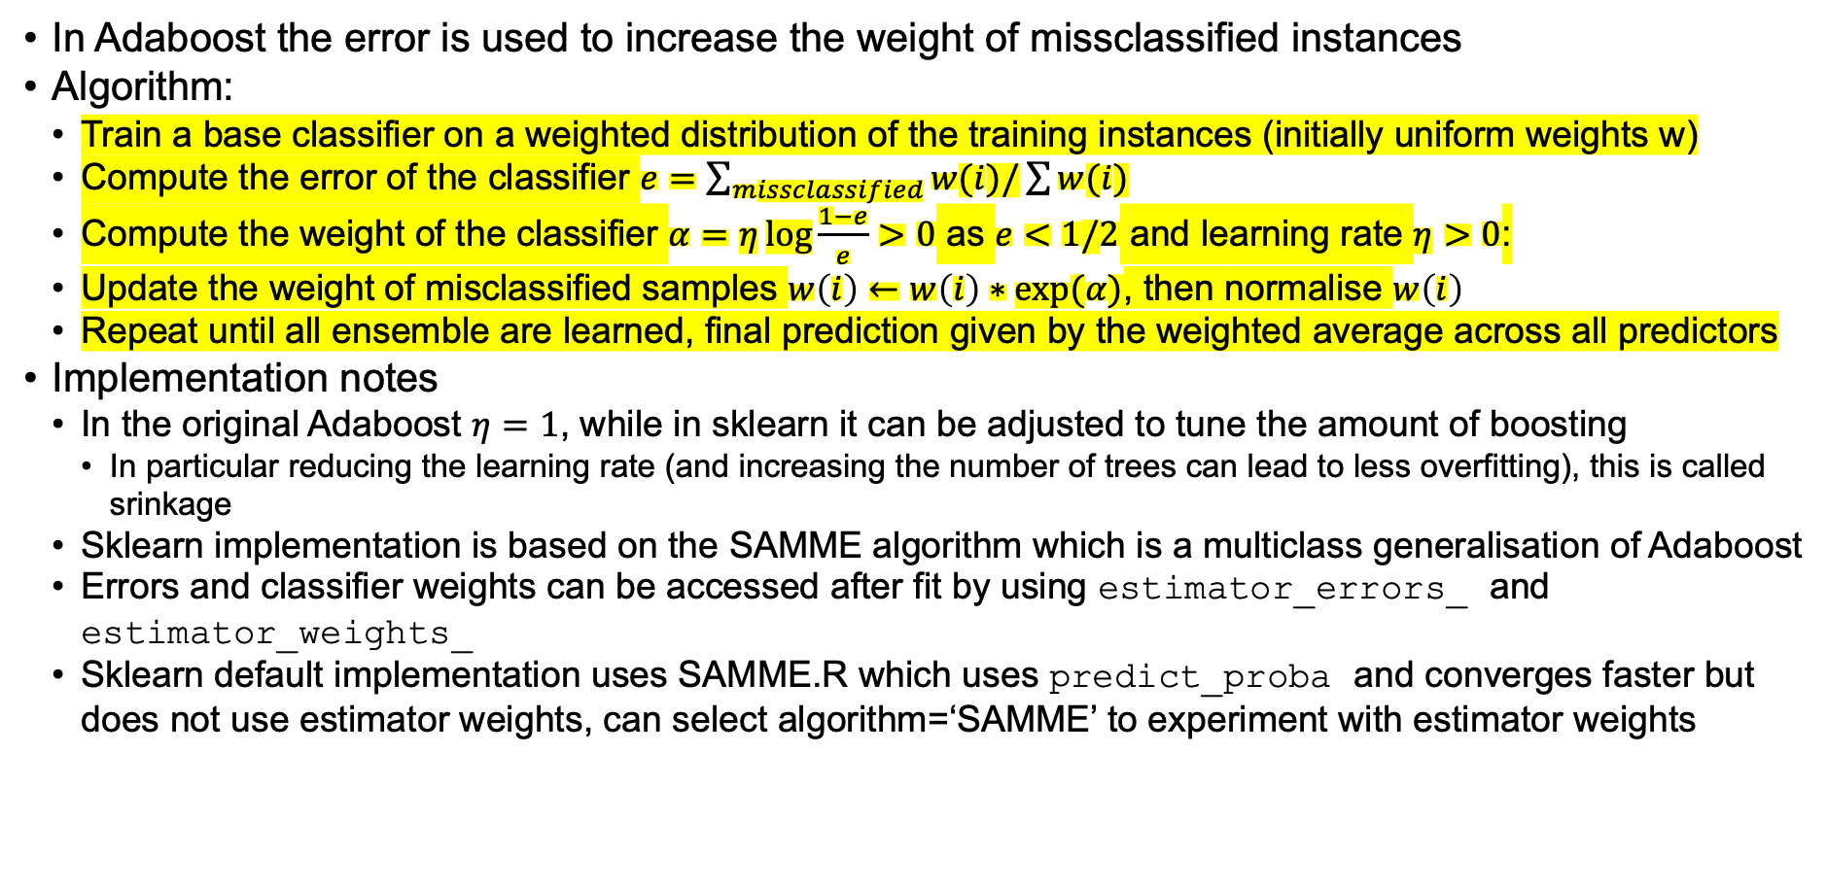
ADAboost
In Adaboost the error is used to increase the weight of missclassified instances
Algorithm:
Train a base classifier on a weighted distribution of the training instances (initially uniform weights w)
Compute the error of the classifier $e=\sum_{missclassified}{w(i)/\sum{w(i)}}$
Compute the weight of the classifier $α=η\log{\frac{1−e}{e}}>0$ as $e<1/2$ and learning rate $η>0$:
Update the weight of misclassified samples $w\left(i\right)←w\left(i\right)∗exp⁡(α)$, then normalise $w\left(i\right)$
Repeat until all ensemble are learned, final prediction given by the weighted average across all predictors
Implementation notes
In the original Adaboost $η=1$, while in sklearn it can be adjusted to tune the amount of boosting
In particular reducing the learning rate (and increasing the number of trees can lead to less overfitting), this is called srinkage
Sklearn implementation is based on the SAMME algorithm which is a multiclass generalisation of Adaboost
Errors and classifier weights can be accessed after fit by using estimator_errors_ and estimator_weights_
Sklearn default implementation uses SAMME.R which uses predict_proba and converges faster but does not use estimator weights, can select algorithm=‘SAMME’ to experiment with estimator weights
Notes:
Weight error and improve

Slide 9
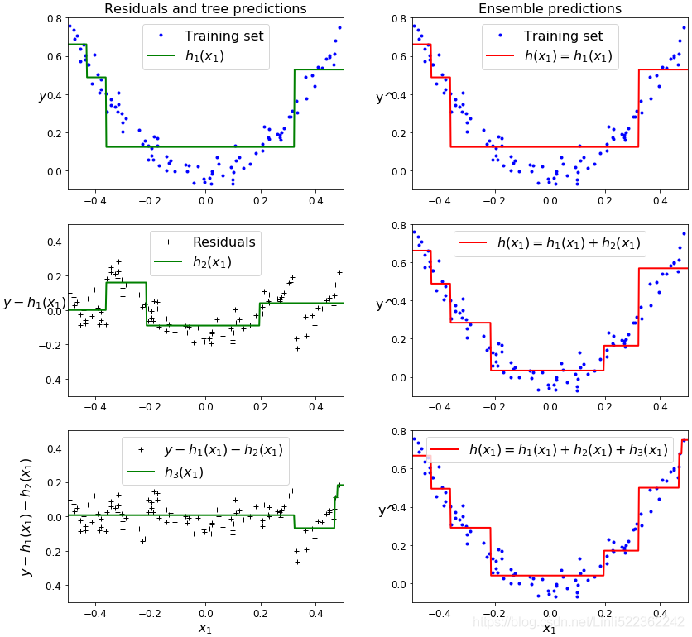
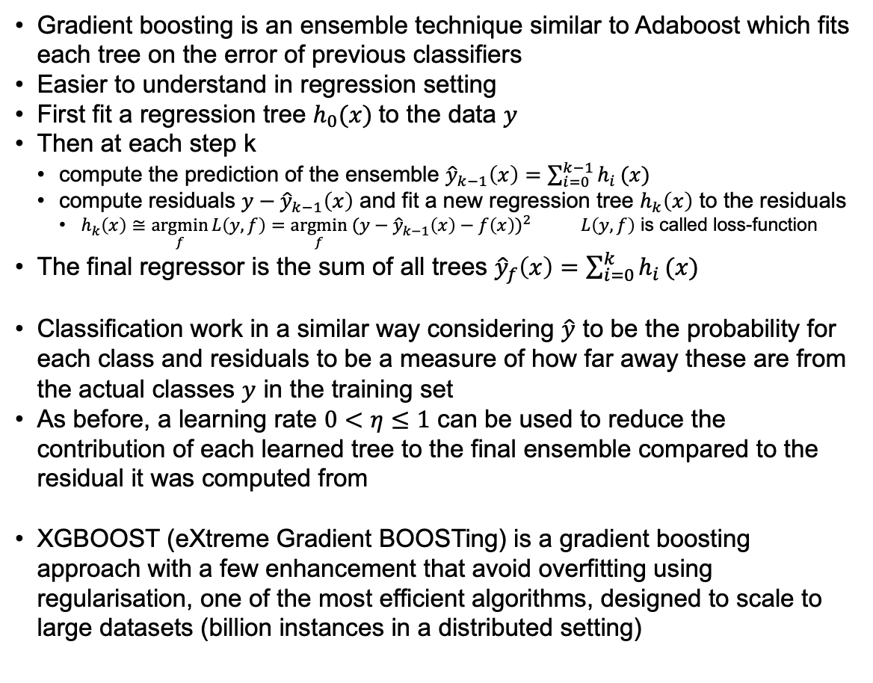
Gradient TREE boosting
Gradient boosting is an ensemble technique similar to Adaboost which fits each tree on the error of previous classifiers
Easier to understand in regression setting
First fit a regression tree $h_{0}(x)$to the data $y$
Then at each step k
compute the prediction of the ensemble ${\hat{y}}_{k−1}\left(x\right)=\sum_{i=0}^{k−1}{h_{i}}(x)$
compute residuals $y−{\hat{y}}_{k−1}\left(x\right)$ and fit a new regression tree $h_{k}\left(x\right)$ to the residuals
$h_{k}\left(x\right)≅\underset{f}{argmin}{L\left(y,f\right)={\underset{f}{argmin} (y−{\hat{y}}_{k−1}\left(x\right)−f\left(x\right))}^{2}}$ $L\left(y,f\right)$ is called loss-function
The final regressor is the sum of all trees ${\hat{y}}_{f}\left(x\right)=\sum_{i=0}^{k}{h_{i}}(x)$
Classification work in a similar way considering $\hat{y}$ to be the probability for each class and residuals to be a measure of how far away these are from the actual classes $y$ in the training set
As before, a learning rate $0<η≤1$ can be used to reduce the contribution of each learned tree to the final ensemble compared to the residual it was computed from
XGBOOST (eXtreme Gradient BOOSTing) is a gradient boosting approach with a few enhancement that avoid overfitting using regularisation, one of the most efficient algorithms, designed to scale to large datasets (billion instances in a distributed setting)

Slide 10
REFERENCES
Boosting/Adaboost
SAMME (adaboost generalisation to multiclass used in sklearn, contains also detail of the original Adaboost) https://hastie.su.domains/Papers/samme.pdf
Why boosting works https://web.archive.org/web/20150119081741/http://oz.berkeley.edu/~breiman/arcall96.pdf
The original Adaboost https://www.face-rec.org/algorithms/Boosting-Ensemble/decision-theoretic_generalization.pdf
GRADIENT TREE BOOSTING
A gentle introduction to gradient boosting https://www.ccs.neu.edu/home/vip/teach/MLcourse/4_boosting/slides/gradient_boosting.pdf
Gradient boosting in classification https://blog.paperspace.com/gradient-boosting-for-classification/
paper https://projecteuclid.org/journals/annals-of-statistics/volume-29/issue-5/Greedy-function-approximation-A-gradient-boostingmachine/10.1214/aos/1013203451.full
XGBOOST
overview https://towardsdatascience.com/https-medium-com-vishalmorde-xgboost-algorithm-long-she-may-rein-edd9f99be63d
paper https://arxiv.org/pdf/1603.02754.pdf
Xgboost in python https://www.datacamp.com/community/tutorials/xgboost-in-python

