Slide 1

COMP8270/PROGRAMMING FOR ARTIFICIAL INTELLIGENCE

Slide 2
overview:
Image Recognition
MNIST
Keras Project

Slide 3
Image Recognition

Slide 4
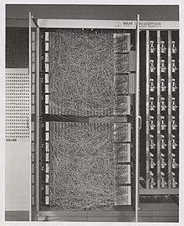
Machine Vision: Roots
Rosenblatt 1957: The Perceptron
Implemented in hardware
400 Photocells
Recognizable modern “neuron”
Linear methods
Simple computers

Slide 5
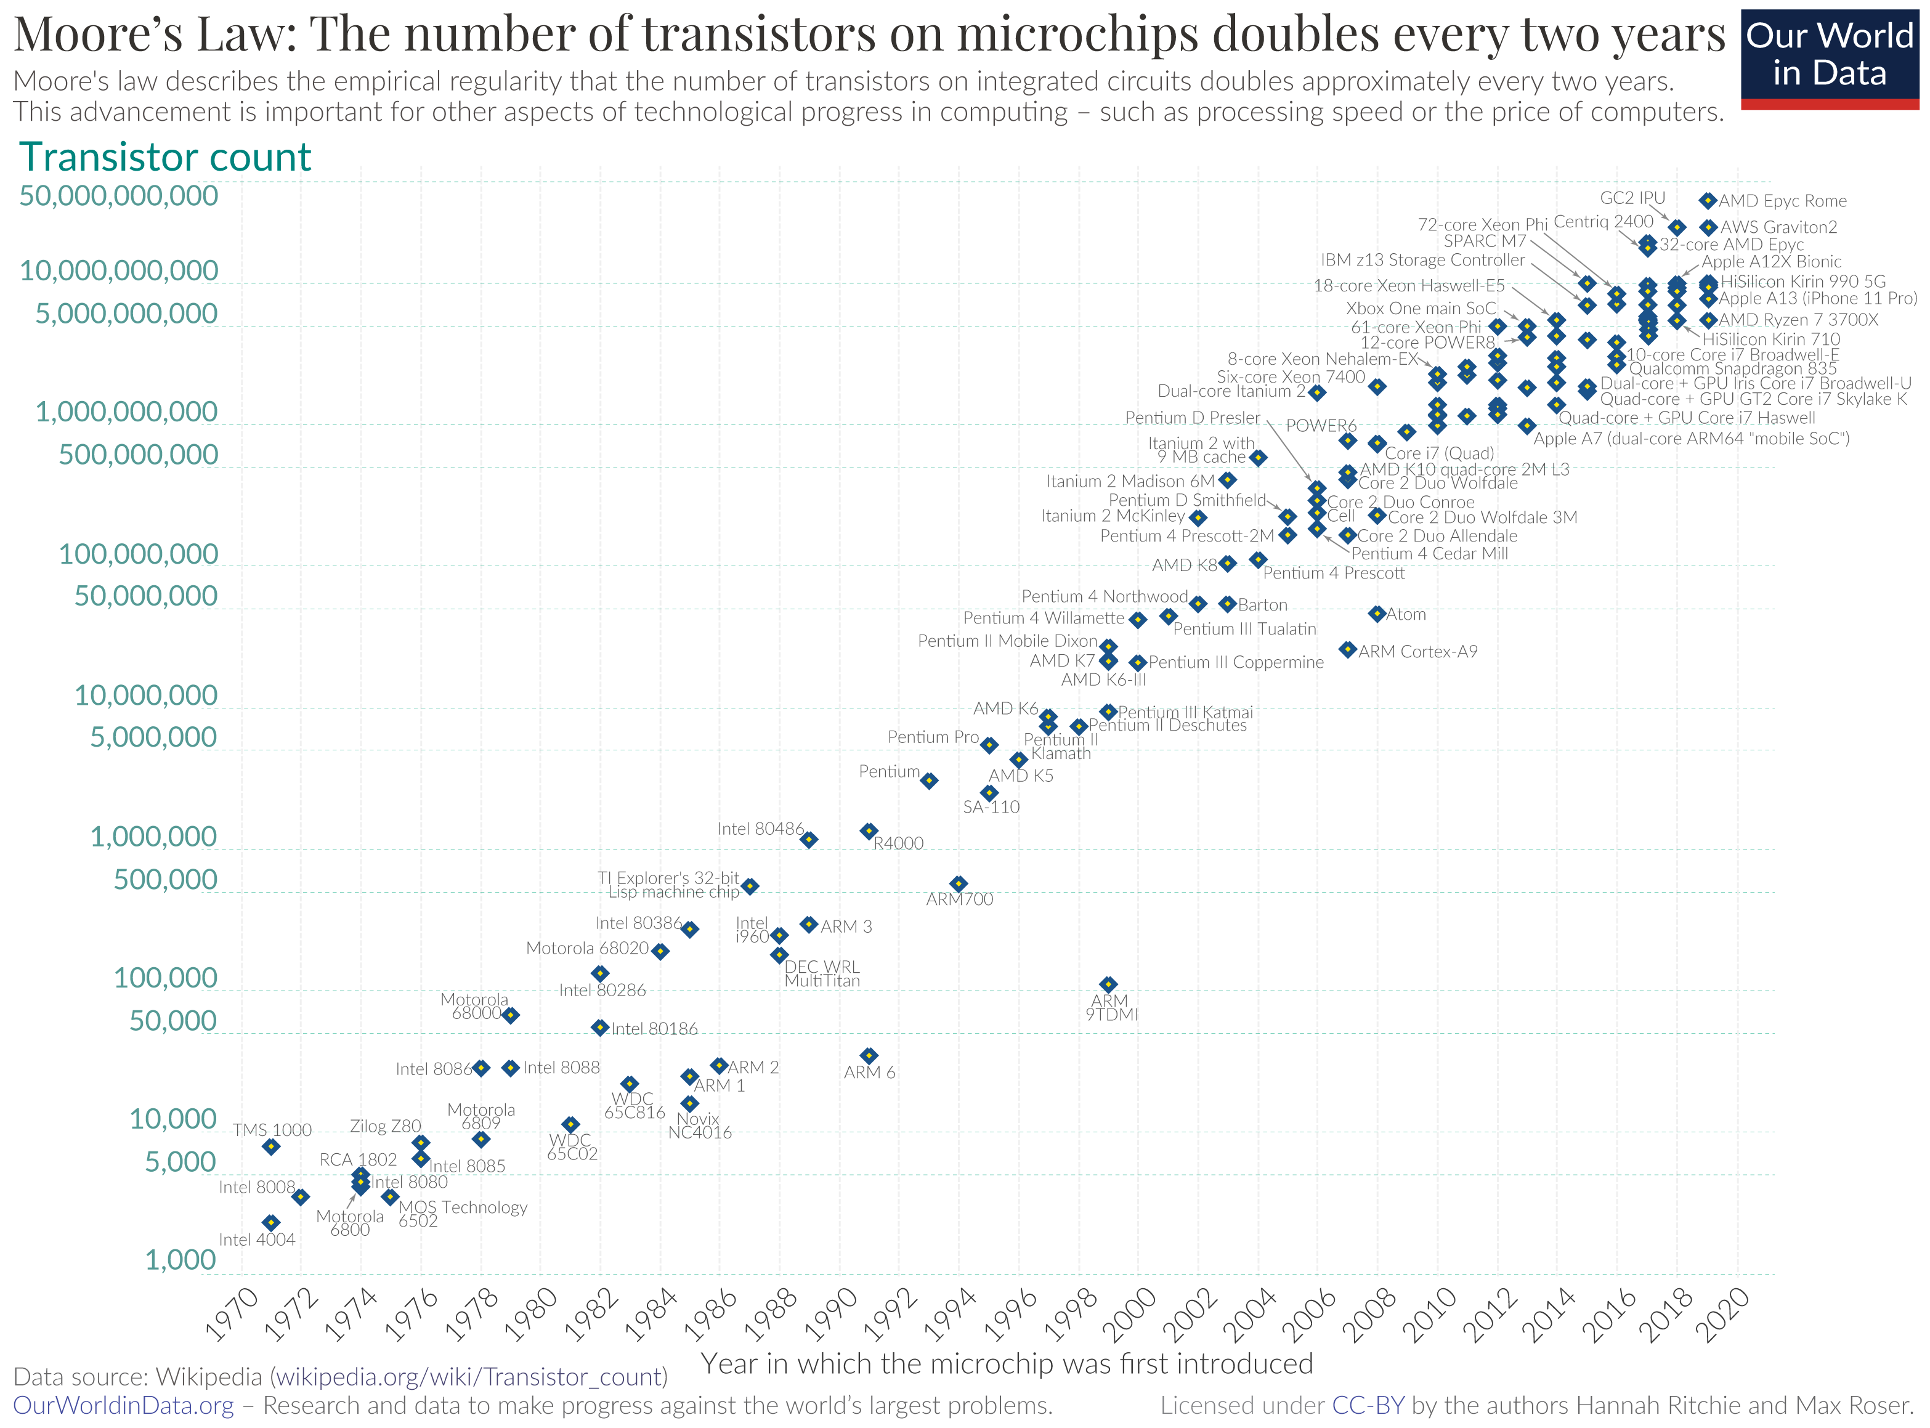

Slide 6
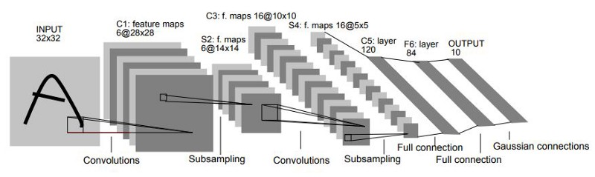
LeNet5 1998
Adapted from, Y. LeCun et al, “Gradient-Based Learning Applied to Document Recognition”, Proc. of the IEEE 1998
1986 (Rumelhart, Hinton and Williams) – Use calculus to train ANNs (Error Backpropagation)
Computers growing exponentially more powerful.
1989 Y. LeCun et al. used bprop for vision
Recognized hand-written zip codes

Slide 7
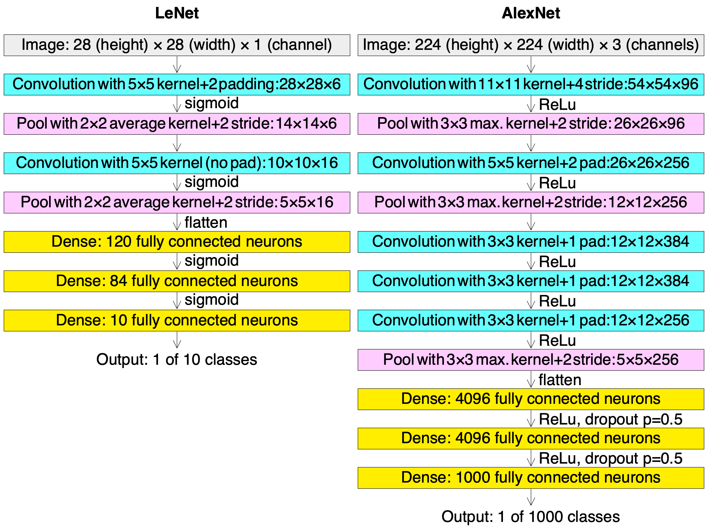
By Cmglee - Own work, CC BY-SA 4.0, https://commons.wikimedia.org/w/index.php?curid=104937230

Slide 8
Milestones
1989 – Recognizing letters as well as digits (LeCun)
Convolutional Neural Network (CNN)
2006 ImageNet database conceived (Fei Fei Li)
14,197,122 images and even more annotations (labels)
2010 ImageNet competition
2012 AlexNet (Alex Krizhevsky)
First to really leverage GPUs. Set an ImageNet record.
PhD student of G.Hinton
GPUs now the de rigueur

Slide 9
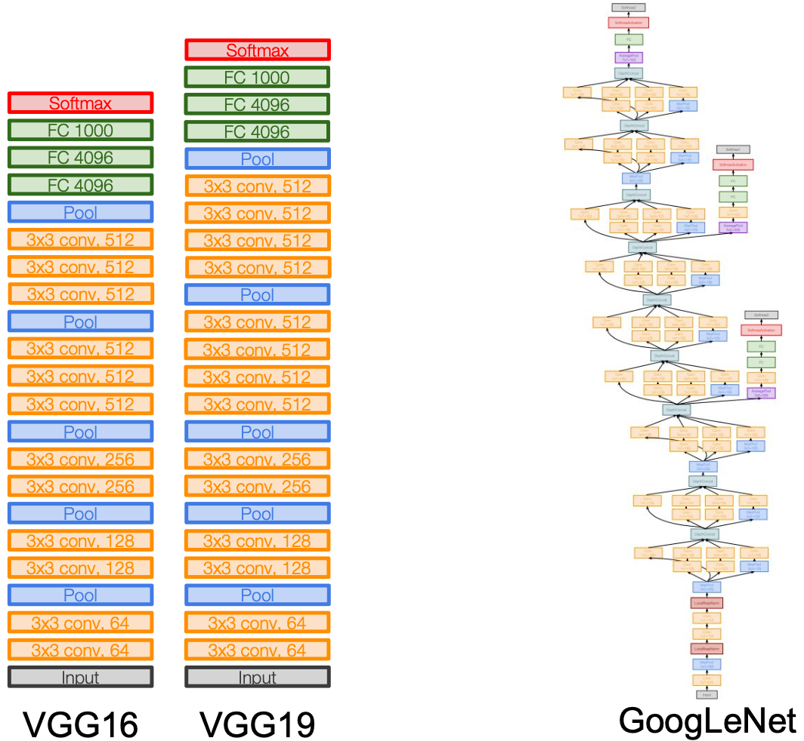

Slide 10
The MNIST Data Set

Slide 11
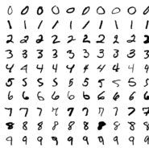
The MNIST Data Set
Modified National Institute of Standards and Technology
60,000 hand-written digits and labels for training
10,000 hand-written digits and labels for testing.
In the 1990s it was a popular dataset.
Each digit is a 28x28 array of bytes.
Byte implies 256 shades of b&w

Slide 12
The First Digit in the Set
00 00 00 00 00 00 00 00 00 00 00 00 00 00 00 00 00 00 00 00 00 00 00 00 00 00 00 00
00 00 00 00 00 00 00 00 00 00 00 00 00 00 00 00 00 00 00 00 00 00 00 00 00 00 00 00
00 00 00 00 00 00 00 00 00 00 00 00 00 00 00 00 00 00 00 00 00 00 00 00 00 00 00 00
00 00 00 00 00 00 00 00 00 00 00 00 00 00 00 00 00 00 00 00 00 00 00 00 00 00 00 00
00 00 00 00 00 00 00 00 00 00 00 00 00 00 00 00 00 00 00 00 00 00 00 00 00 00 00 00
00 00 00 00 00 00 00 00 00 00 00 00 03 12 12 12 7e 88 af 1a a6 ff f7 7f 00 00 00 00
00 00 00 00 00 00 00 00 1e 24 5e 9a aa fd fd fd fd fd e1 ac fd f2 c3 40 00 00 00 00
00 00 00 00 00 00 00 31 ee fd fd fd fd fd fd fd fd fb 5d 52 52 38 27 00 00 00 00 00
00 00 00 00 00 00 00 12 db fd fd fd fd fd c6 b6 f7 f1 00 00 00 00 00 00 00 00 00 00
00 00 00 00 00 00 00 00 50 9c 6b fd fd cd 0b 00 2b 9a 00 00 00 00 00 00 00 00 00 00
00 00 00 00 00 00 00 00 00 0e 01 9a fd 5a 00 00 00 00 00 00 00 00 00 00 00 00 00 00
00 00 00 00 00 00 00 00 00 00 00 8b fd be 02 00 00 00 00 00 00 00 00 00 00 00 00 00
00 00 00 00 00 00 00 00 00 00 00 0b be fd 46 00 00 00 00 00 00 00 00 00 00 00 00 00
00 00 00 00 00 00 00 00 00 00 00 00 23 f1 e1 a0 6c 01 00 00 00 00 00 00 00 00 00 00
00 00 00 00 00 00 00 00 00 00 00 00 00 51 f0 fd fd 77 19 00 00 00 00 00 00 00 00 00
00 00 00 00 00 00 00 00 00 00 00 00 00 00 2d ba fd fd 96 1b 00 00 00 00 00 00 00 00
00 00 00 00 00 00 00 00 00 00 00 00 00 00 00 10 5d fc fd bb 00 00 00 00 00 00 00 00
00 00 00 00 00 00 00 00 00 00 00 00 00 00 00 00 00 f9 fd f9 40 00 00 00 00 00 00 00
00 00 00 00 00 00 00 00 00 00 00 00 00 00 2e 82 b7 fd fd cf 02 00 00 00 00 00 00 00
00 00 00 00 00 00 00 00 00 00 00 00 27 94 e5 fd fd fd fa b6 00 00 00 00 00 00 00 00
00 00 00 00 00 00 00 00 00 00 18 72 dd fd fd fd fd c9 4e 00 00 00 00 00 00 00 00 00
00 00 00 00 00 00 00 00 17 42 d5 fd fd fd fd c6 51 02 00 00 00 00 00 00 00 00 00 00
00 00 00 00 00 00 12 ab db fd fd fd fd c3 50 09 00 00 00 00 00 00 00 00 00 00 00 00
00 00 00 00 37 ac e2 fd fd fd fd f4 85 0b 00 00 00 00 00 00 00 00 00 00 00 00 00 00
00 00 00 00 88 fd fd fd d4 87 84 10 00 00 00 00 00 00 00 00 00 00 00 00 00 00 00 00
00 00 00 00 00 00 00 00 00 00 00 00 00 00 00 00 00 00 00 00 00 00 00 00 00 00 00 00
00 00 00 00 00 00 00 00 00 00 00 00 00 00 00 00 00 00 00 00 00 00 00 00 00 00 00 00
00 00 00 00 00 00 00 00 00 00 00 00 00 00 00 00 00 00 00 00 00 00 00 00 00 00 00 00

Slide 13
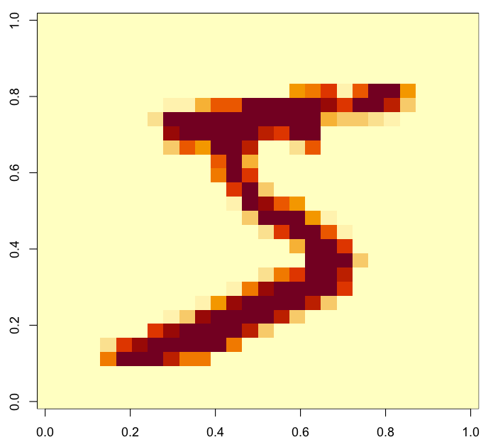
The First Digit in the Set

Slide 14
Our Plan:
Neural Network
Softmax
{ 0, 1, 2, 3, 4, 5, 6, 7, 8, 9 }

Slide 15
Data Layout
28 x 28 = 784 inputs
[[row₀],
[row₁],
.
.
.
[row₂₇]]
Neural Network
Softmax
{ 0, 1, 2, 3, 4, 5, 6, 7, 8, 9 }

Slide 16
28 x 28 = 784 pixels
[[row₀], [row₁], . . . , [row₂₇]]
Feature Detection (CNN)
Neural Network
Softmax
{ 0, 1, 2, 3, 4, 5, 6, 7, 8, 9 }

Slide 17
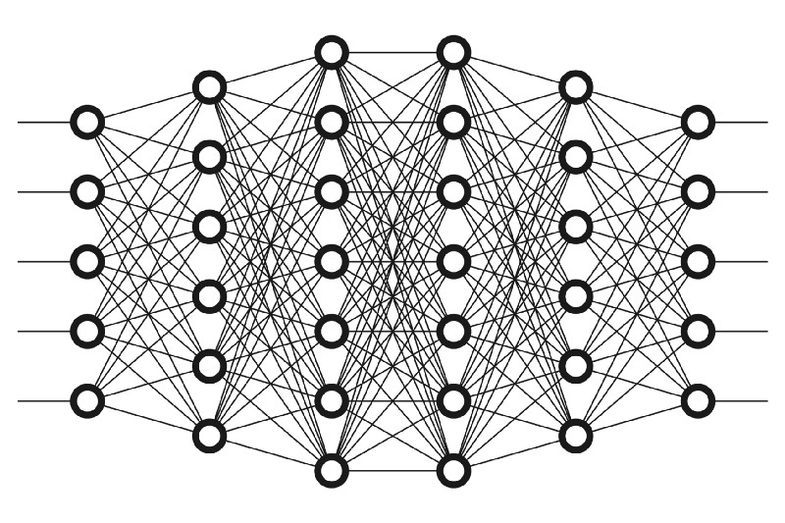
A CNN Neural Network
Neural
Network
Conv
Max
Pool
Conv
Max
Pool
Conv
Max
Pool
Conv
Max
Pool
Conv
Max
Pool
Conv
Max
Pool
Conv
Max
Pool
Conv
Max
Pool
Conv
Max
Pool
Conv
Max
Pool
Convolutional elements filter image features and reduce dimensionality. E.g., 28x28 → 25x25
Maxpool summarizes and highlights features. E.g. 25x25→22x22

Slide 18
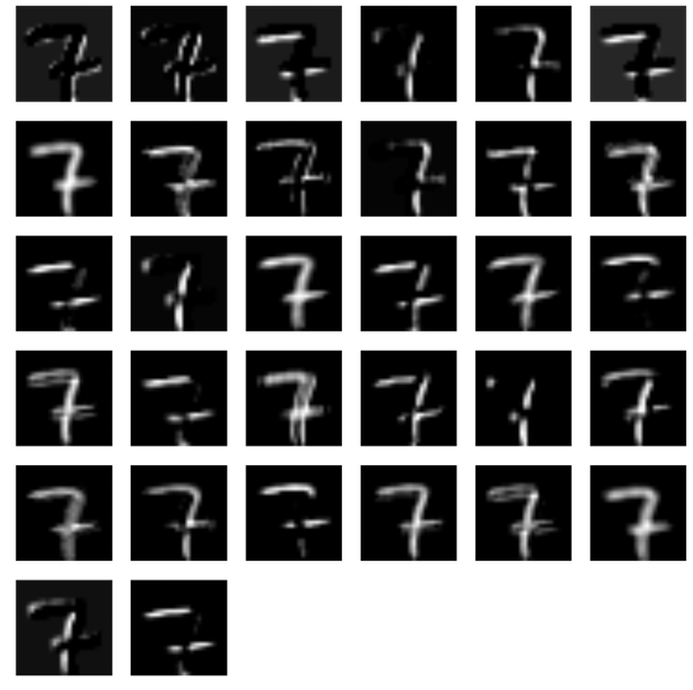
A Filter Example

Slide 19
Keras

