Slide 1
Advanced Vectorless Towards Exhaustive DVD Signoff
mPower Summit, May 12th, 2026
Notes:
All the names

Slide 2
Goal/Motivation
Traditional DVD analysis is only as good as the activity vectors used. But the true worst drop may occur when a rare combination of nearby aggressors switches in the same timing window as a victim instance.
Coverage problem:
There are too many legal switching combinations to simulate exhaustively, while practical vectors cover only a small fraction of realistic scenarios.
Goal:
Find the worst realistic voltage drop per victim instance by searching timing-feasible local switching combinations

Slide 3
Worst-case IR-drop is a constrained switching problem
What drives the drop
What makes it hard
Many instances switching in the same neighborhood
Switching currents overlap in time
Overlap is bounded by per-instance timing windows
Millions of instances
Each with a window, not a fixed time
Enumerating legal combinations is impractical
Key observation
High-frequency victim impact is local. Distant switching contributes a smoother low-frequency background.

Slide 4
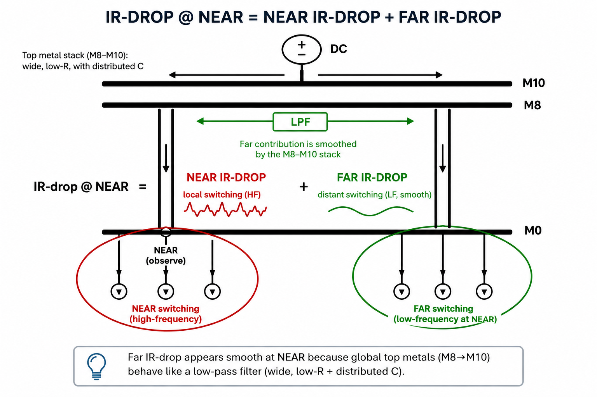
Decomposition: near + far
Far (VCD-driven): fixed context, smoothed by the M8–M10 low-pass stack
Near (optimized): victim + nearby aggressors, switching times within timing windows

Slide 5
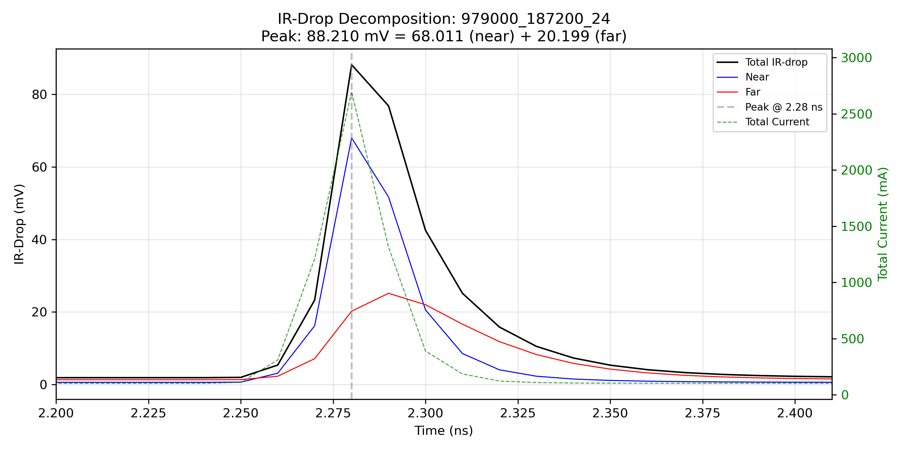
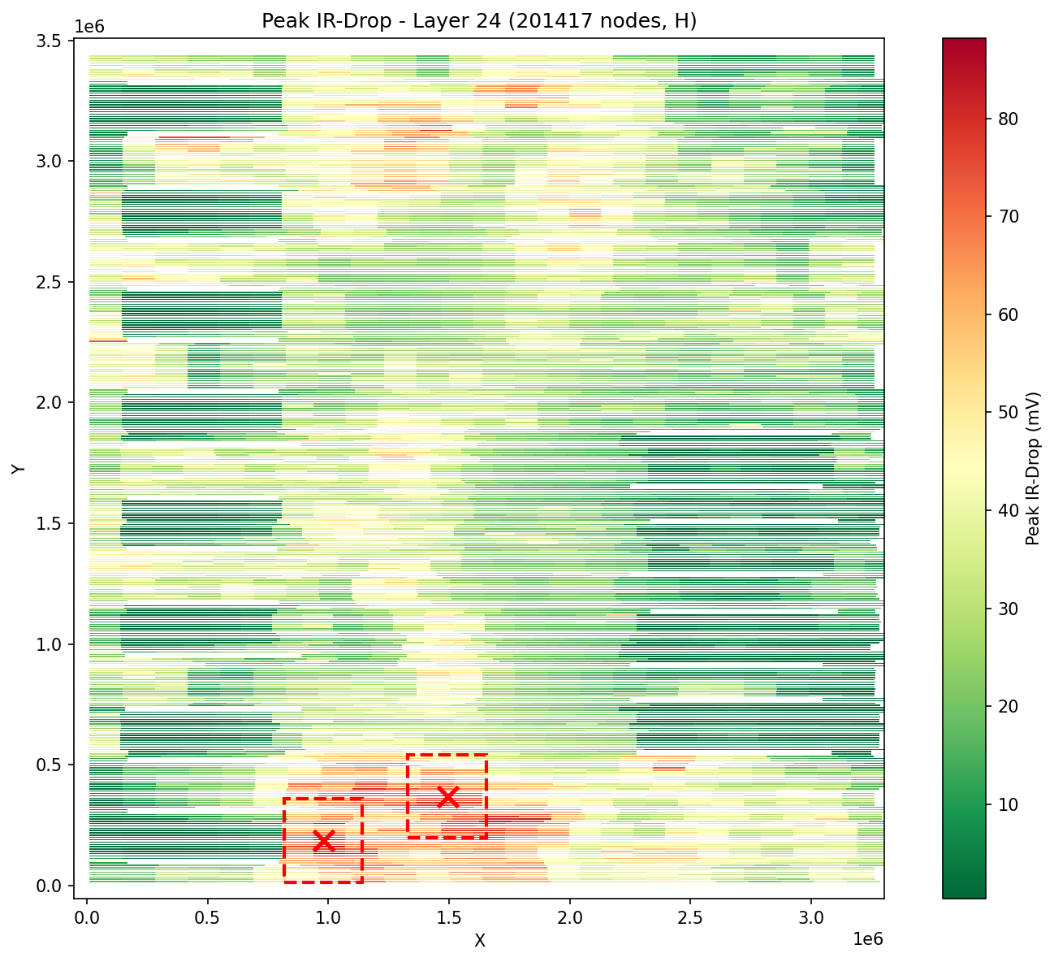
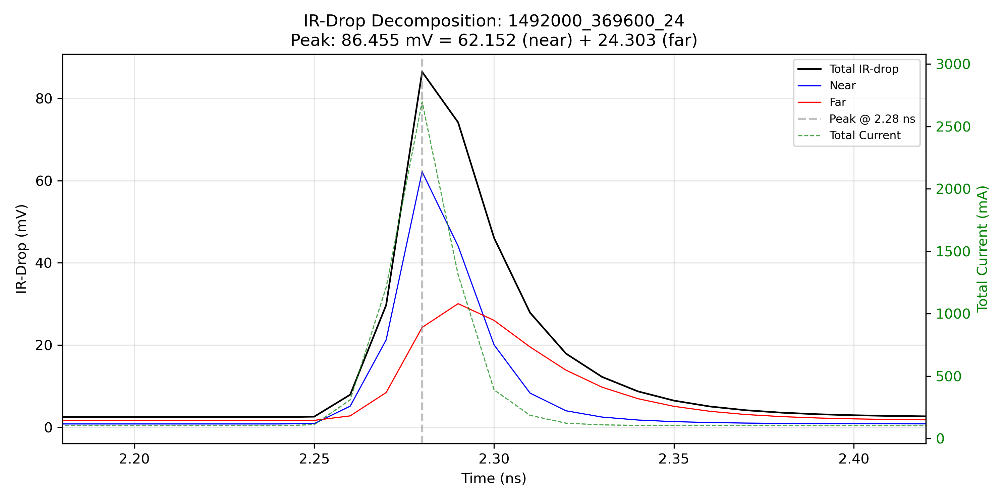
Decomposition: near + far - Minion

Slide 6
Algorithm overview
1
Far context
2
Blame
3
Near optimization
Full-chip transient with VCD
Treated as fixed background
Yields ΔV_far(t) at every node
Find the top-K aggressors for each design instance
Top-K aggressors from blame
Optimize switching within timing windows
Yields ΔV_near,opt(t)
→
→
Input: activity vectors (VCD/Vectorless)
Worst-case dynamic IR-drop at the victim:

Slide 7
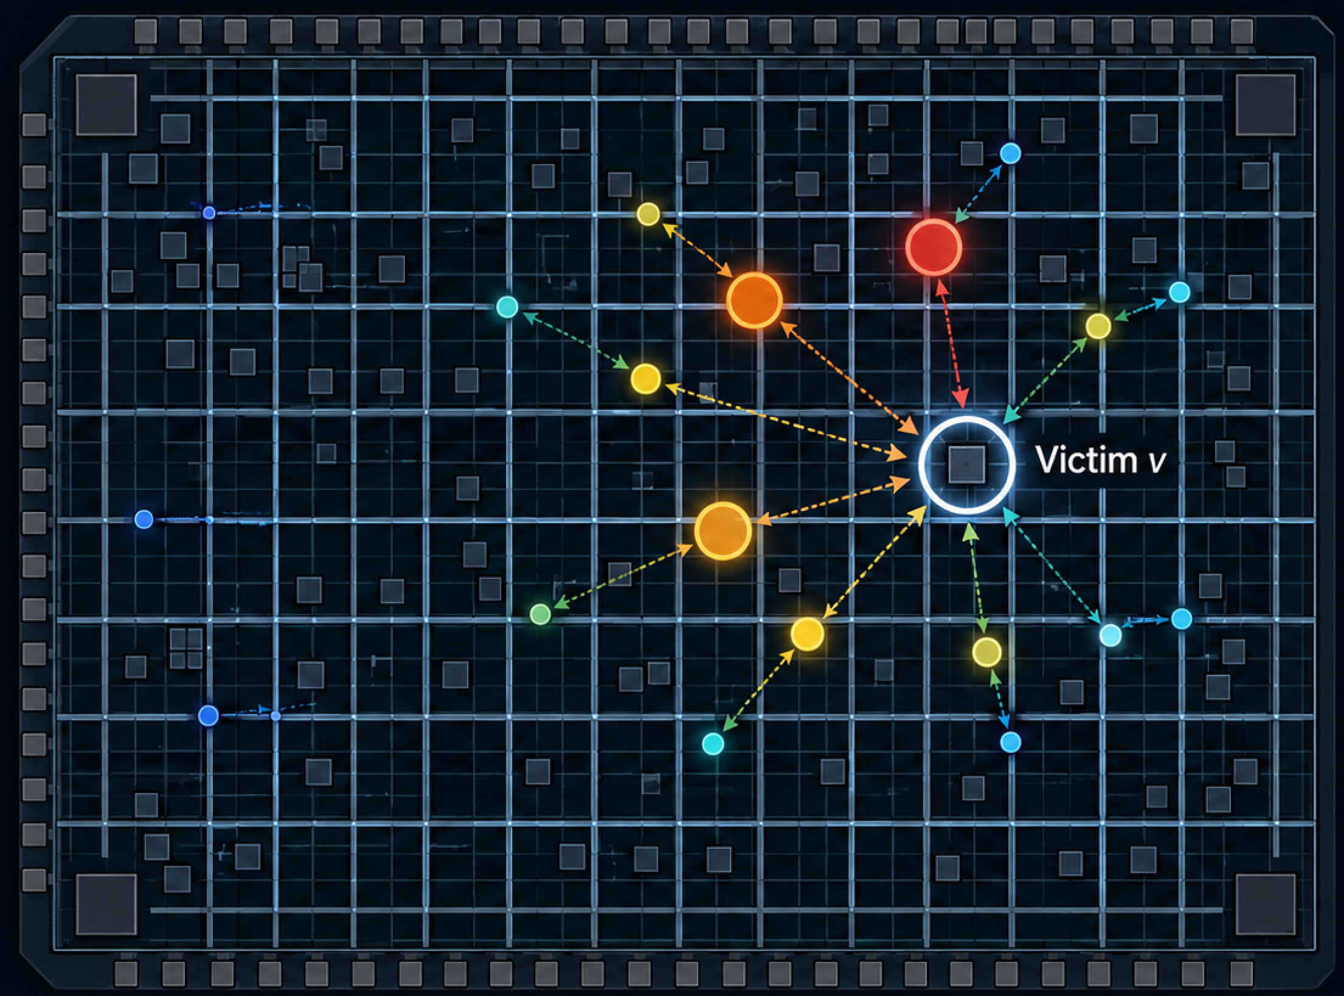
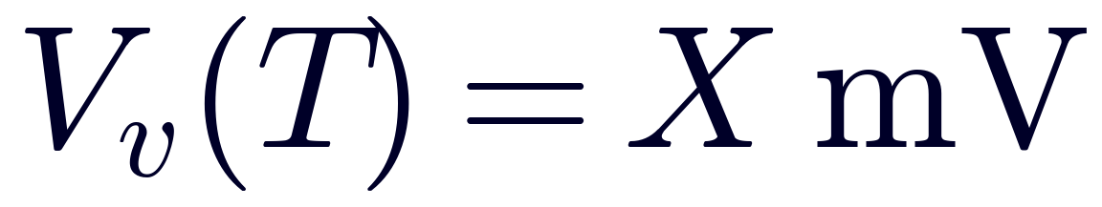
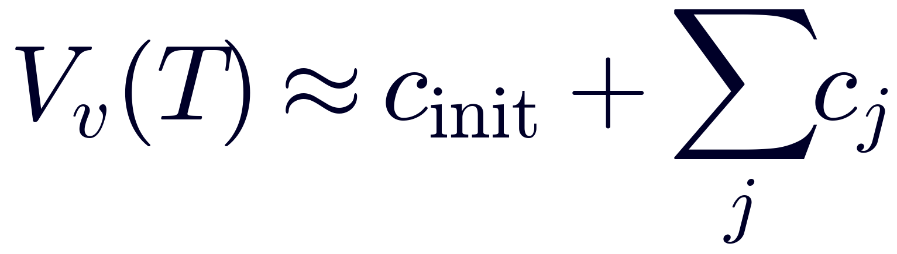
The Blame Question
IR-drop at victim node v
At time T, the victim sees its worst IR-drop.
Question:
Which switching instances caused it,
and how many mV did each contribute?
Goal:
c_j: contribution from aggressor instance j
c_init: residual initial-condition contribution
top-K: largest positive c_j

Slide 8
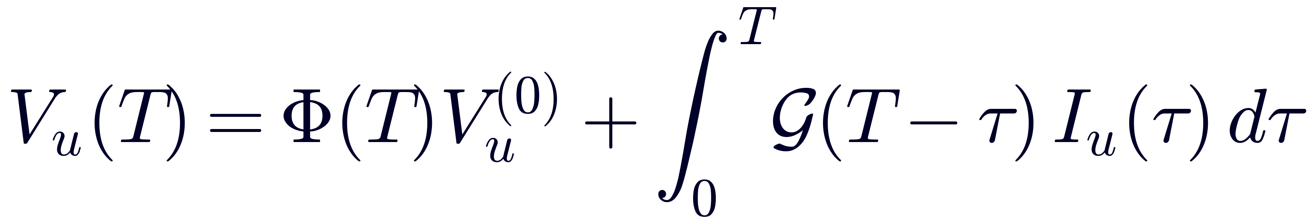
Linear IR-drop model
Reduced system
positive V_u is IR drop
LTI variation of parameters

Slide 9
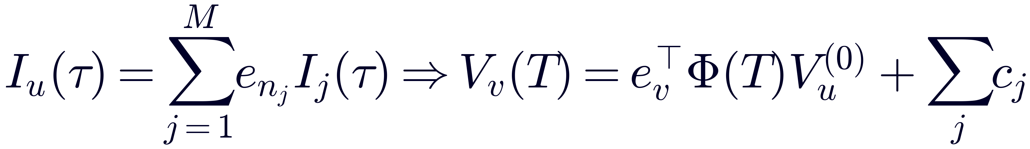
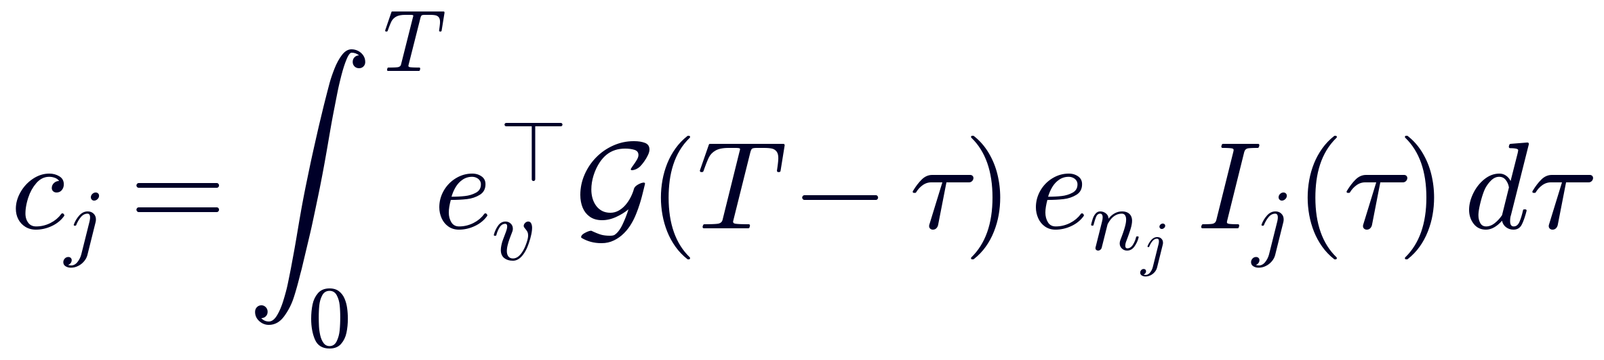
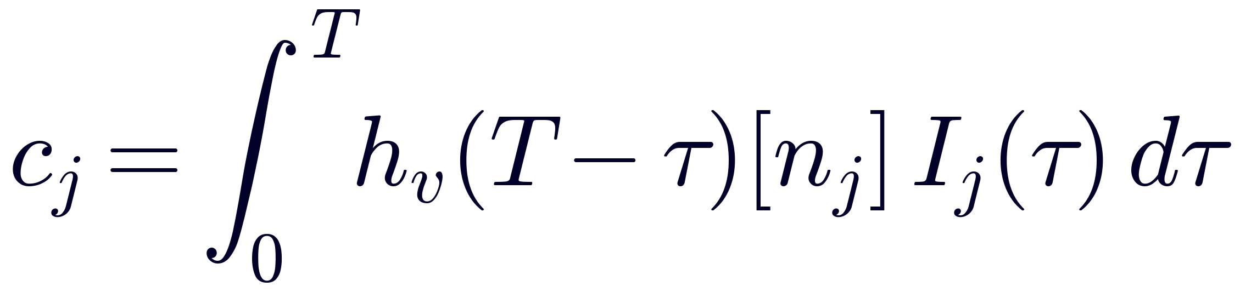
Per-instance contribution and sensitivity kernel
Per-source decomposition:
Define the victim sensitivity field, then:

Slide 10
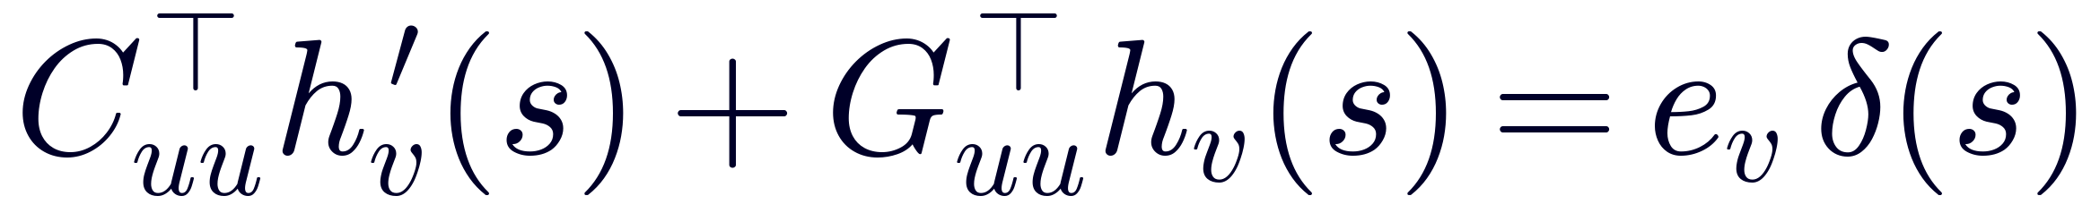
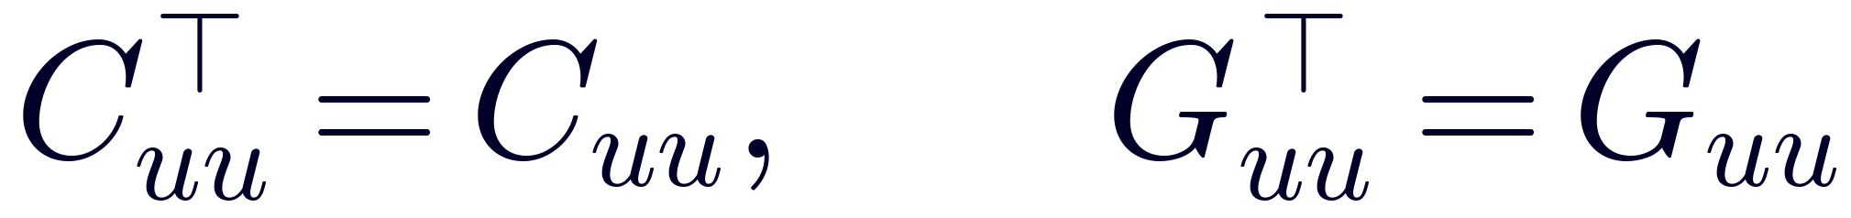
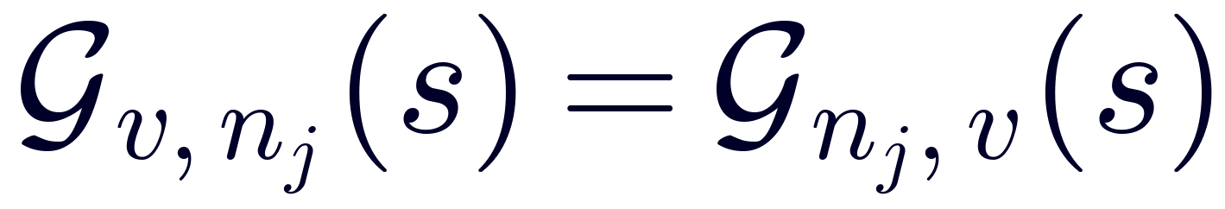
Reciprocity
Adjoint sensitivity equation:
Symmetric RC:
Inject a unit current impulse at the victim and observe the response at each aggressor node.
Reciprocity:
one victim-centered response ⇒ all aggressor sensitivities

Slide 11
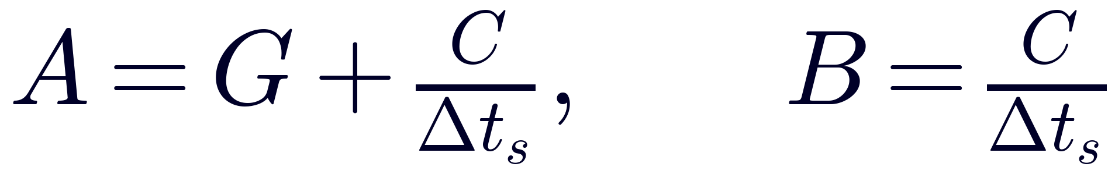
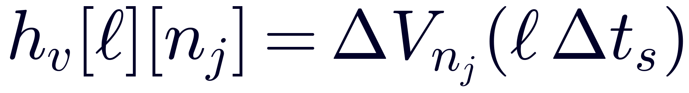
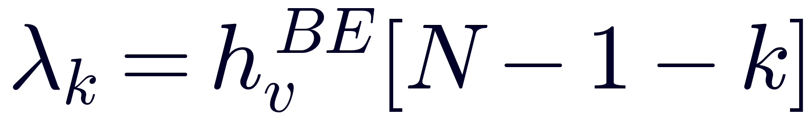
Discrete kernel: one forward BE transient
BE matrices (same A the forward engine already factors):
BE-discretize the kernel equation C·h_{v}′(s) + G·h_{v}(s) = e_{v}·δ(s) — symmetric G, C, so no transposes:
This is exactly a stock forward BE transient that:
starts from the no-load DC state — all loads off, so every node sits at its pad voltage V_{dd} (zero IR-drop, V_{u} = 0),
injects a unit current pulse at victim v (width one Δt_{s}) at step 0,
then runs source-free (free decay).
Pad cancellation. V ≡ V_{dd} is the exact steady state of the pulse-free grid, so by superposition V(t) = V_{dd} − V_{pulse}(t): the recorded IR-drop ΔV = V_{dd} − V(t) is the pure pulse response — no reference-run subtraction:
(unit pulse — for a pulse of amplitude I_{p}, divide by I_{p})
h_{v}[ℓ] = voltage probe of one ordinary transient, ℓ steps after the victim pulse. No adjoint code.

Slide 12
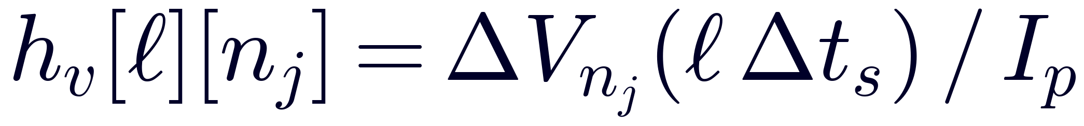
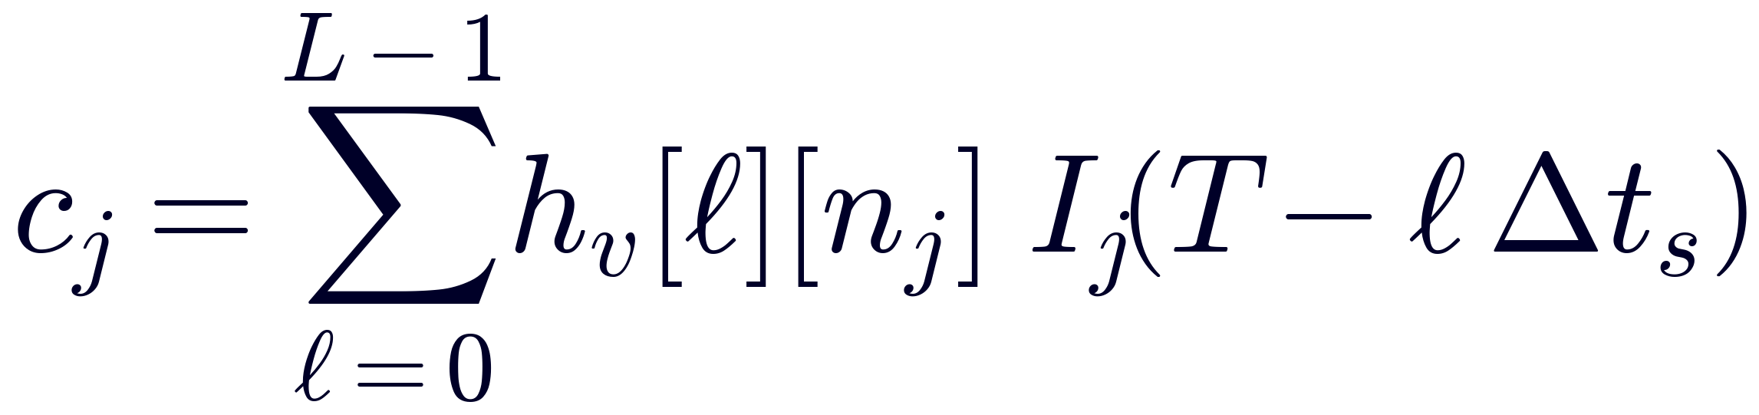
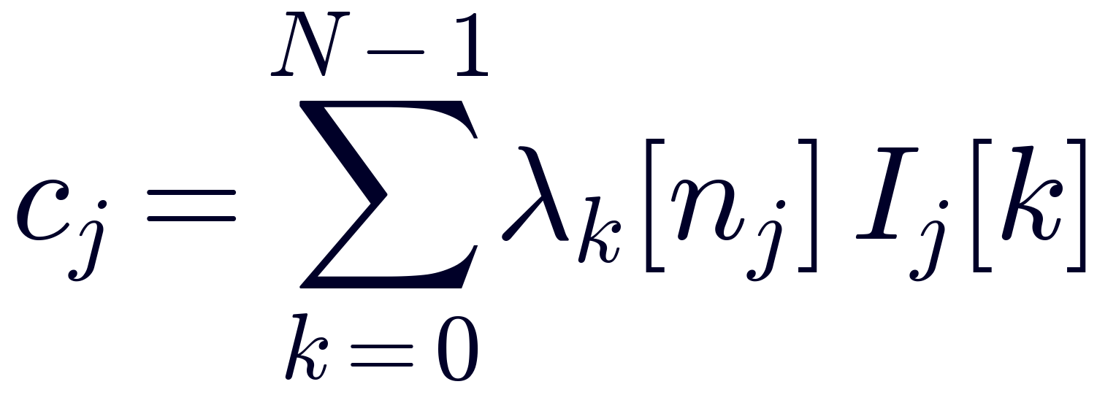
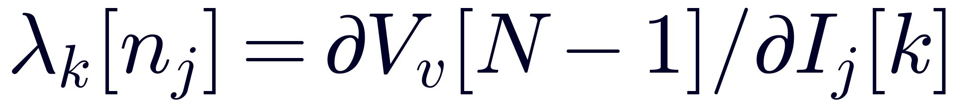
mPower recipe: one transient + a correlation
Reuse the existing forward engine. Blame = one special transient run + a post-processing sum.
Step 1 — kernel run (transient iterations)
zero out all instance current sources
add one synthetic load at victim v: rectangular pulse, amplitude I_{p}, width one Δt_{s}
initial condition = no-load DC operating point (all nodes at V_{dd} — zero IR-drop)
run L steps (L = memory window, a few grid RC constants); probe voltages at aggressor nodes only
Step 2 — blame accumulation (post-processing)
Lag-reversed pairing: freshest sample h_{v}[0] pairs with the aggressor current at observation time T.
Rank |c_{j}| → top-K. Interpretation: h_{v}[ℓ][n_{j}] = ∂V_{v}(T) / ∂I_{j}(T − ℓΔt_{s}).

Slide 13
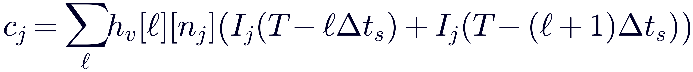
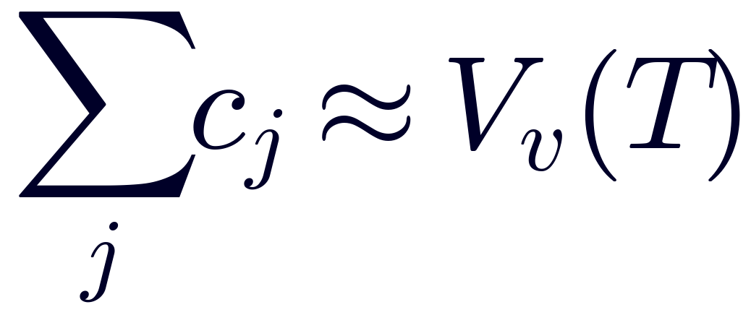

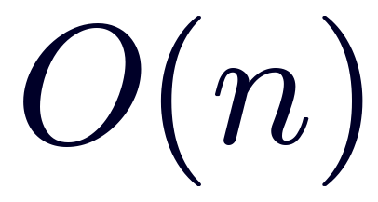
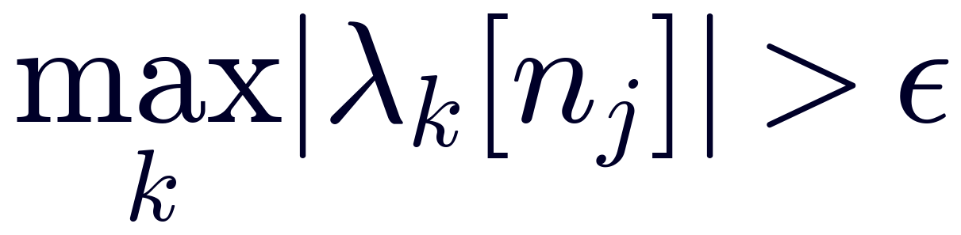
Requirements, cost, validation
Exactness conditions (all hold for an RC PDN)
Integrator-consistent kernel — BE shown. TR variant: A = G + 2C/Δt_{s}, B = 2C/Δt_{s} − G, same kernel run, but each sample pairs with two adjacent current samples:
BE kernels are smoother (no TR ringing).
Symmetric G, C — buys reciprocity / self-adjointness
Pads at constant voltage (Dirichlet) — guarantees exact background cancellation
Same Δt_{s} as the target analysis; one kernel run per victim
Cost & memory
Pruning
One extra L-step transient per victim, plus O(M·L) correlation
O(probed aggressors × L) for dumped waveforms (or O(n + M) if streamed)
Active aggressors only in [T − LΔt_{s}, T]
Spatial: keep nodes with max_{ℓ} |h_{v}[ℓ][n_{j}]| > ε
Validation — cross-check against mPower's own forward run:

Slide 14
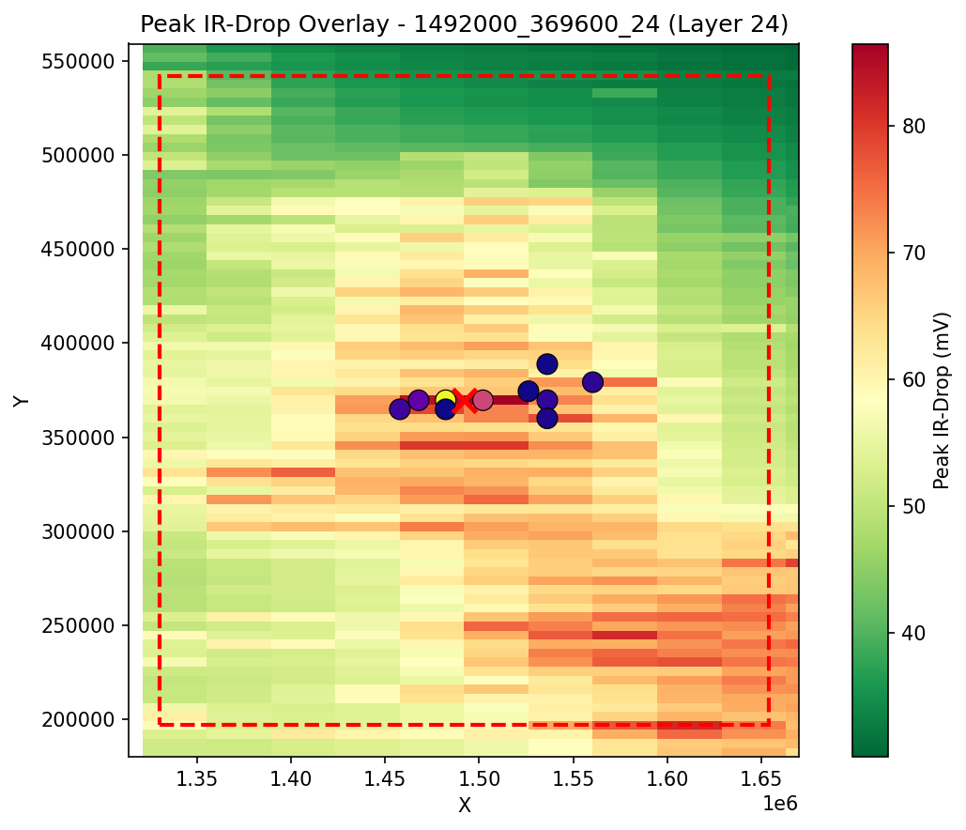
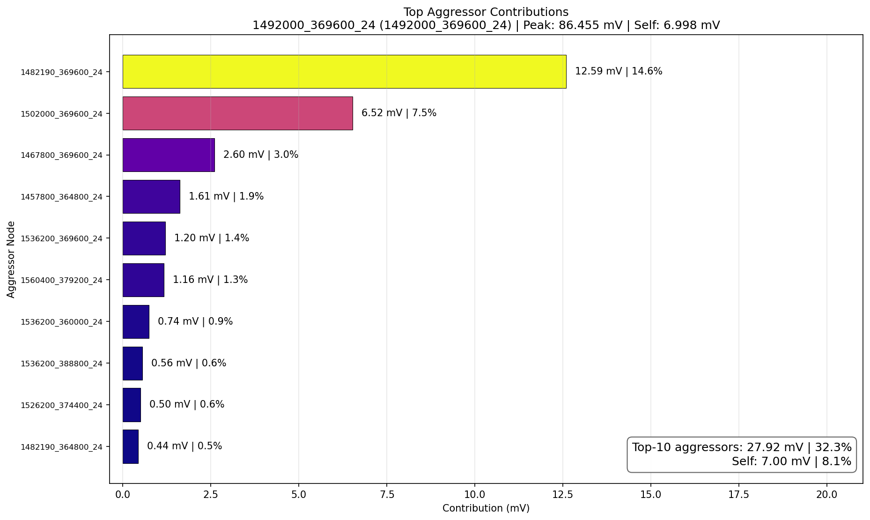
Example Blame Assignment - Minion

Slide 15
Next step
Covered today
Decomposition: ΔV_v = ΔV_far,VCD + ΔV_near,opt
Per-instance blame at a chosen victim from a single backward sweep
TBD — Step 3 of the optimization flow
Given the top-K aggressor set A from blame, optimize switching times {t_j ∈ W_j}_{j ∈ A} to maximize ΔV_v(T) subject to per-instance timing-window constraints.

