Slide 1
Slide 1 — Title
Blame Assignment for Dynamic IR-Drop
Per-instance contribution using a victim sensitivity kernel
PDN Analysis Team March 2026

Slide 2
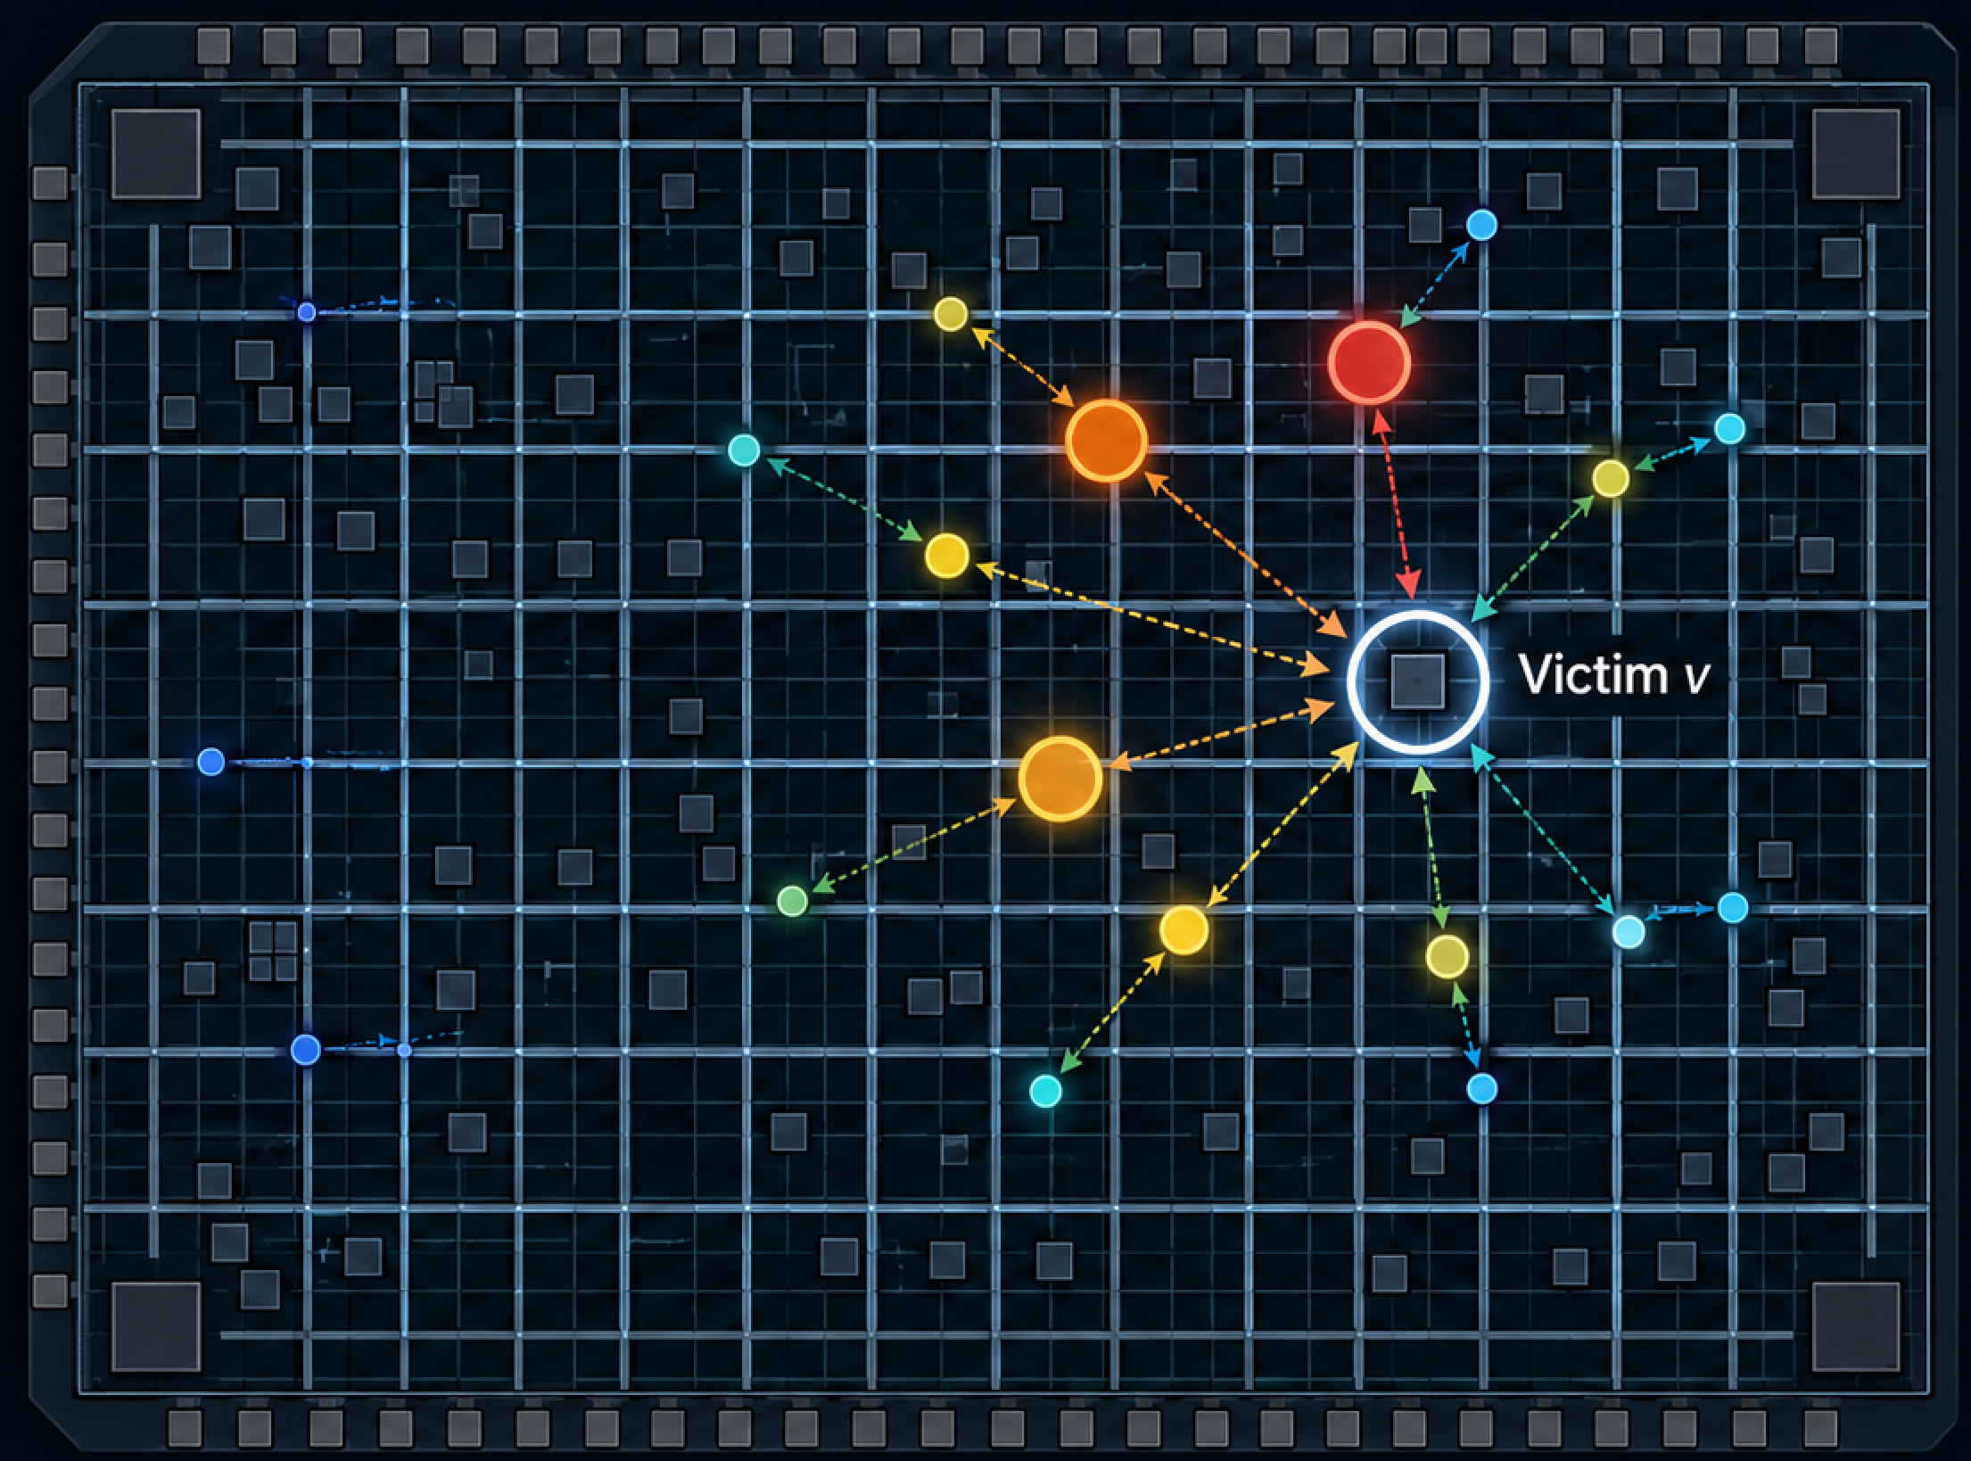
Slide 2 — The Blame Question
IR-drop at victim node $v$
At time $T$, the victim sees its worst IR-drop:
$$V_{v}(T)=X\text{ mV}$$
Question:
Which switching instances caused it, and how many mV did each contribute?
Goal:
Vv(T)≈cinit+j​cj
$c_{j}$: contribution from aggressor instance $j$
$c_{\text{init}}$: residual initial-condition contribution
top-$K$: largest positive $c_{j}$

Slide 3
Slide 3 — Linear IR-Drop Model
Use $V_{u}(t)>0$ for positive IR-drop.
$$C_{uu}{\dot{V}}_{u}(t)+G_{uu}V_{u}(t)=I_{u}(t)$$
Victim IR-drop:
$$V_{v}(t)=e_{v}^{⊤}V_{u}(t)$$
LTI solution:
$$V_{u}(T)=Φ(T)V_{u}^{(0)}+\int_{0}^{T}{G}(T−τ)I_{u}(τ)dτ$$
$$Φ(s)=e^{−C_{uu}^{−1}G_{uu}s}$$
$$G(s)=Φ(s)C_{uu}^{−1}$$
$$G_{i,j}(s)=\text{IR-drop at }i\text{ from unit impulse at }j$$
Notes:
Boundary / pad effects are baseline or known forcing.
Initial condition is separate from switching-current blame.

Slide 4
Slide 4 — Per-Instance Contribution and Sensitivity Kernel
Single-node stamp:
$$I_{u}(τ)=\sum_{j=1}^{M}{e_{n_{j}}}I_{j}(τ)$$
Then:
Vv(T)=ev⊤Φ(T)Vu(0)+j​cj
$$\boxed{c_{j}=\int_{0}^{T}{e_{v}^{⊤}}G(T−τ)e_{n_{j}} I_{j}(τ)dτ}$$
Define victim sensitivity field:
$$\boxed{h_{v}(s)=G(s)^{⊤}e_{v}}$$
Then:
$$e_{v}^{⊤}G(s)e_{n_{j}}=h_{v}(s)[n_{j}]$$
$$\boxed{c_{j}=\int_{0}^{T}{h_{v}}(T−τ)[n_{j}] I_{j}(τ)dτ}$$
Multi-pin stamp: replace $h_{v}[n_{j}]$ with $s_{j}^{⊤}h_{v}$.

Slide 5
Slide 5 — Reciprocity Interpretation
Adjoint sensitivity equation:
$$C_{uu}^{⊤}h_{v}^{′}(s)+G_{uu}^{⊤}h_{v}(s)=e_{v}δ(s)$$
For symmetric RC:
$$C_{uu}^{⊤}=C_{uu}, G_{uu}^{⊤}=G_{uu}$$
so this is equivalent to:
Inject a unit impulse at the victim and observe the response at each aggressor node.
Reciprocity:
$$G_{v,n_{j}}(s)=G_{n_{j},v}(s)$$
Practical meaning:
$$\boxed{\text{one victim-centered response}⇒\text{all aggressor sensitivities}}$$

Slide 6
Slide 6 — From $h_{v}(s)$ to Discrete $λ_{k}$
Continuous sensitivity in lag $s$:
$$C^{⊤}h_{v}^{′}(s)+G^{⊤}h_{v}(s)=e_{v}δ(s)$$
Backward Euler lag kernel:
$$A=G+\frac{C}{Δt_{s}}, B=\frac{C}{Δt_{s}}$$
$$\boxed{h_{v}^{BE}[0]=A^{−⊤}e_{v}}$$
$$\boxed{A^{⊤}h_{v}^{BE}[ℓ]=B^{⊤}h_{v}^{BE}[ℓ−1]}$$
Target time:
$$T=t_{N−1}$$
Current at step $k$ has lag:
$$ℓ=N−1−k$$
Therefore:
$$\boxed{λ_{k}=h_{v}^{BE}[N−1−k]}$$
Key message:
$λ_{k}$ is the time-reversed BE-discrete victim sensitivity kernel.

Slide 7
Slide 7 — Backward Sweep and Accumulation
Initialize:
$$\boxed{λ_{N−1}=A^{−⊤}e_{v}}$$
Sweep backward:
$$\boxed{A^{⊤}λ_{k}=B^{⊤}λ_{k+1}} k=N−2,…,0$$
Single-node aggressor contribution:
$$\boxed{c_{j}=\sum_{k=0}^{N−1}{λ_{k}}[n_{j}] I_{j}[k]}$$
Interpretation:
$$λ_{k}[n_{j}]=\frac{∂V_{v}[N−1]}{∂I_{j}[k]}$$
Units:
$$λ_{k}[n_{j}] [Ω]⋅I_{j}[k] [A]=c_{j} [V]$$
No explicit $Δt_{s}$:
$λ_{k}$ is the BE-discrete sensitivity.
$I_{j}[k]$ is the same current sample used by BE.
For symmetric RC:
$$A^{⊤}=A, B^{⊤}=B$$

Slide 8
Slide 8 — Complexity, Pruning, and Validation
Definitions:
$n$: number of PDN unknowns
$M$: number of aggressor instances
$N$: number of time steps in the blame window
$H=NΔt_{s}$: sensitivity horizon
Adjoint blame cost:
$$O\left(N⋅(\text{solve}+\text{SpMV}+M)\right)$$
Memory:
$$O(n+M)$$
Practical filters:
active instances in $[T−H,T]$
spatial sensitivity:
$$\max_{k}|λ_{k}[n_{j}]|>ϵ$$
optional bound:
$$|c_{j}|≤∥γ_{j}∥_{1}∥I_{j}∥_{∞}$$
Validation:
Vv(T)≈cinit+j​cj
If the initial state is removed or relaxed:
Vv(T)≈j​cj
Key takeaway:
$$\boxed{\text{One victim sensitivity sweep gives per-instance IR-drop blame.}}$$

