Slide 1

World Happiness: Contributing Factors
Team 5

Slide 2
What Determines Happiness?
Education?
Money?
Health?
Job?
Notes:
Motivation & Summary Slide
Define the core message or hypothesis of your project.
Describe the questions you asked, and why you asked them
Describe whether you were able to answer these questions to your satisfaction, and briefly summarize your findings

Slide 3
Overview
Motivation
Questions
Data Sources
Data Exploration
Data Analysis
Discussion
Conclusion

Slide 4
Questions
Is a country’s happiness related to other factors of that country?
What measurements would be worthwhile to investigate?
How might each measurement be correlated with happiness?
Where can we find this data?

Slide 5


World Happiness vs. World Bank Data
Notes:
Data Compared World Bank vs World Happiness Report
Population
% of Adult Population
Total Unemployment
Female/male Unemployment
Access to Electricity
Infant Mortality
Female/Male Life Expectancy
GDP
Military Expenditure (%GDP)
Total Labor Force
Vs
Country Happiness Score

Slide 6
Data Sources
World Happiness Report
The World Happiness Report is a publication of the Sustainable Development Solutions Network, powered by data from the Gallup World Poll.
The World Happiness Report is a landmark survey of the state of global happiness that ranks 156 countries by how happy their citizens perceive themselves to be.
World Bank Group Open Data
The World Bank Group works in every major area of development. We provide a wide array of financial products and technical assistance, and we help countries share and apply innovative knowledge and solutions to the challenges they face.
DataBank is an analysis and visualization tool that contains collections of time series data on a variety of topics.
Notes:
Data Set explination

Slide 7
Data Sources
World Happiness Report
Looked at 2015-2019 scores
Isolated Happiness score
An index score utilizing a national average of the responses to the main life evaluation question asked in the Gallup World Poll (GWP), which uses the Cantril Ladder
Notes:
What data we pulled

Slide 8
Data Sources
World Bank Group
Looked at Countries data from 2015-2019 for:
Population
% of Adult Population
Total Unemployment
Female/male Unemployment
Access to Electricity
Infant Mortality
Female/Male Life Expectancy
GDP
Military Expenditure (%GDP)
Total Labor Force
Notes:
What data we pulled

Slide 9
Data Exploration
World Bank Indicators: The Quest for Complete Data
Outliers: What to do with them?
Some variables just aren’t related
Merging two sets of data?
Eliminate incomplete variables and substitute others
Turns out, they’re alright
But no correlation is still a relationship
Inner join them!

Slide 10
Data Exploration
Display
Organize
Merge
Inner Join
Clean
Display

Slide 11
2019 World Happiness vs. World Bank Data
Notes:
Data Compared World Bank vs World Happiness Report
Population
% of Adult Population
Total Unemployment
Female/male Unemployment
Access to Electricity
Infant Mortality
Female/Male Life Expectancy
GDP
Military Expenditure (%GDP)
Total Labor Force
Vs
Country Happiness Score

Slide 12
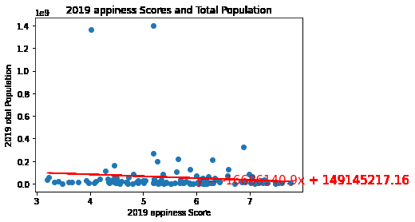
Population

Slide 13
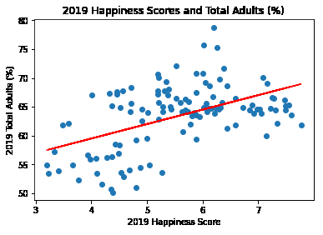
Adult Population

Slide 14
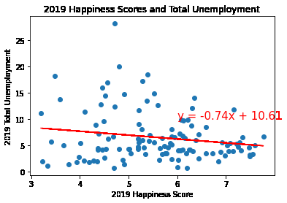
Total Unemployment

Slide 15
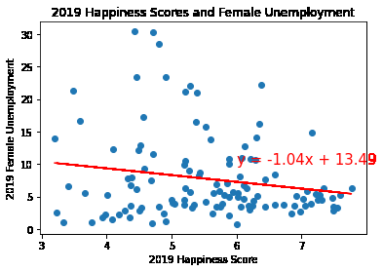
Female Unemployment

Slide 16
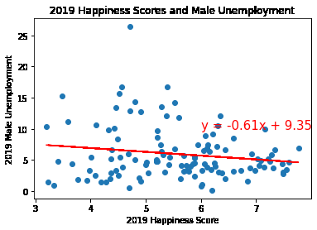
Male Unemployment

Slide 17
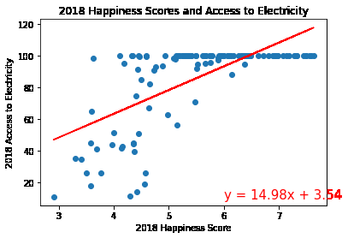
Access to Electricity

Slide 18
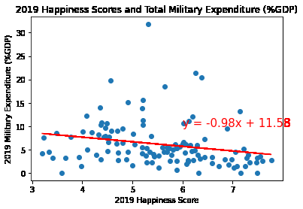
Military Expenditure (%GDP)

Slide 19
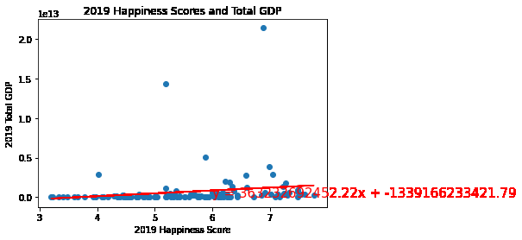
GDP

Slide 20
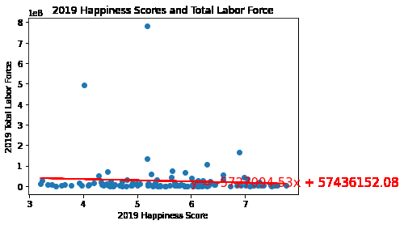
Total Labor Force

Slide 21
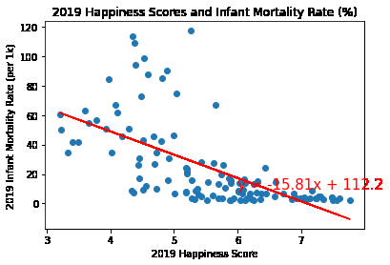
Infant Mortality

Slide 22
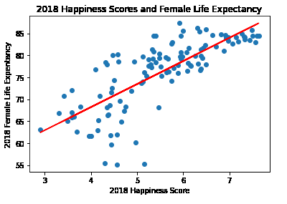
Female Life Expectancy

Slide 23
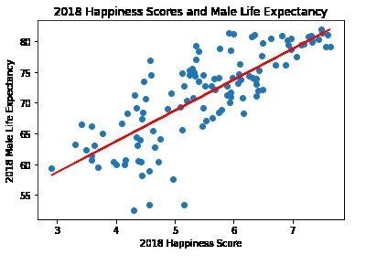
Male Life Expectancy

Slide 24
Discussion
Correlations
Population % Adult
Access to Electricity
Infant Mortality
Female/male Life Expectancy
No Correlations
Total Population
Unemployment
Military Expenditure
GDP
Labor Force

Slide 25
Discussion
Correlations (cnt.)
Population % Adult
Moderate positive correlation
0.5 correlation
Access to Electricity
Moderate negative correlation
0.66 correlation
Infant Mortality
Moderate negative correlation
-0.63 correlation
Female Life Expectancy
Strong positive correlation
0.76 correlation
Male Life Expectancy
Strong positive correlation
0.79 correlation

Slide 26
Conclusion
Happiness is a tricky factor to predict
A good mixture of data that when compared has no correlation
Accurate predictor of a country's happiness
Health!
Notes:
Moderate:
Population % Adult
Moderate positive correlation
0.5 correlation
Access to Electricity
Moderate negative correlation
-0.66 correlation
Infant Mortality
Moderate negative correlation
-0.63 correlation
Strong:
Female Life Expectancy
Strong positive correlation
0.76 correlation
Male Life Expectancy
Strong positive correlation
0.79 correlation

Slide 27
Conclusion
Difficulties
Finding complete data vs. finding variables we thought would correlate
Additional Questions
Across year comparisons – are these variables changing over time?
Variables with less data – can we still work with them? How would we do that?

Slide 28
Questions

