Slide 1
Module 4 Implementing Disaster Recovery by Using NetApp Cloud Volumes ONTAP
1
Notes:
Instructor Notes
Student Notes

Slide 2
This module focuses on enabling you to do the following:
Use OnCommand Cloud Manager to establish a SnapMirror relationship between ONTAP software on-premises and Cloud Volumes ONTAP software in a hybrid cloud environment
Use the SnapMirror destination in the cloud as the disaster recovery site
Bring data back on-premises on recovery
Notes:
Instructor Notes
Student Notes

Slide 3
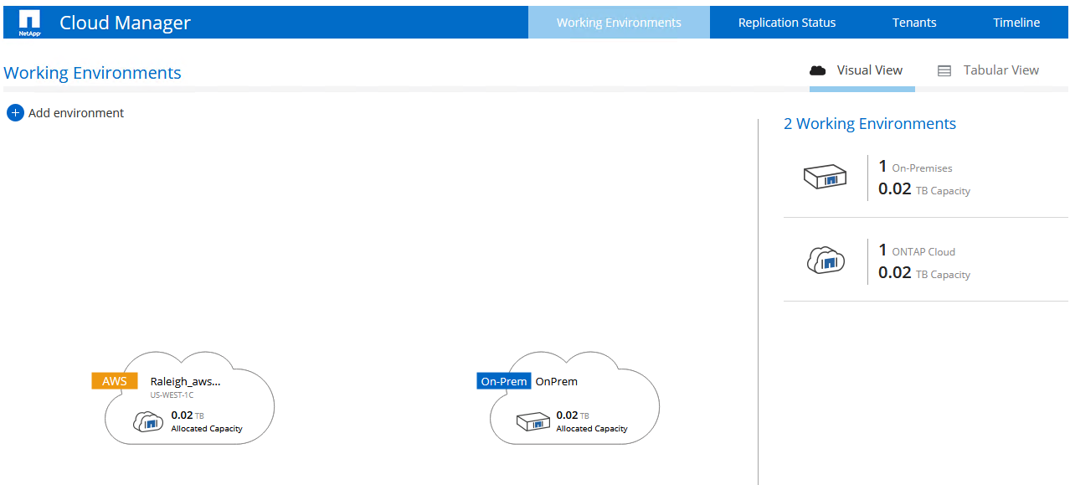
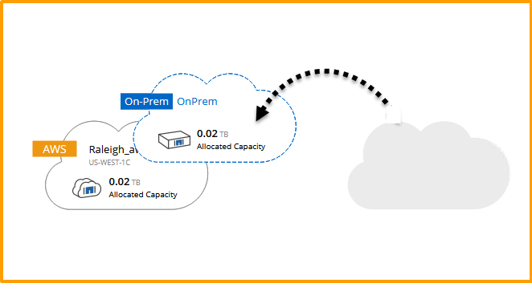
Creating a Data Protection Relationship
The Cloud Manager drag-and-drop feature
Notes:
Instructor Notes
Student Notes
In this example, you discover two systems that are used to create a data-protection relationship. On the right is the primary data stored in an ONTAP cluster that is located in an on-premises data center. On the left is a Cloud Volumes ONTAP instance, which is the backup target.
To create this relationship, simply drag the ONTAP cluster icon to the Cloud Volumes ONTAP icon. This action initiates the Replication Setup wizard.

Slide 4
Creating a Data Protection Relationship
Additional steps
The Cloud Manager UI guides you through the following steps:
Select a source volume.
Define a destination volume and maximum transfer rate.
Set a replication policy (mirror or backup).
Select a replication schedule.
Notes:
Instructor Notes
Mirror = SnapMirror, Backup = SnapVault
Student Notes
You are asked to select a source volume.
You also need to specify a destination volume. Cloud Manager automatically creates this volume on the destination system, which, in this example, is the Cloud Volumes ONTAP instance. You can set the maximum transfer rate. By default, the rate is unlimited.
You then choose the type of replication to perform on the volume. There are two default replication policies: mirror and backup.
The mirror policy is typically used for disaster recovery.
The backup policy is typically used for long-term retention of backup copies.
You select a replication schedule, or you can select a one-time copy.

Slide 5
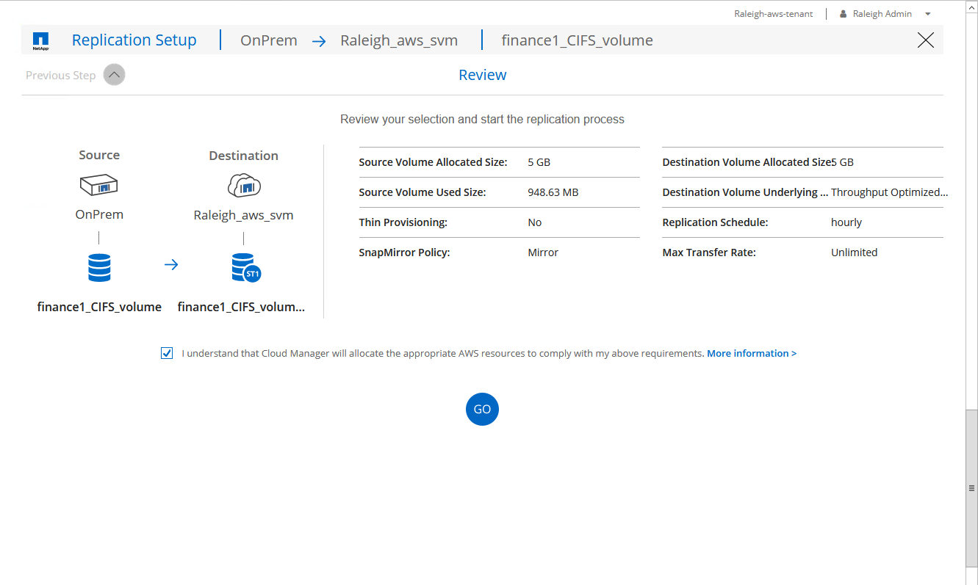
Creating a Data Protection Relationship
Review
Review again, and then click Go.
Notes:
Instructor Notes
Student Notes

Slide 6


Hands-On Activity
Module 4: Implementing Disaster Recovery by Using NetApp Cloud Volumes ONTAP
Exercise 1:
Configure and Manage Disaster Recovery in the Data Fabric
This exercise requires approximately 45 minutes.

Slide 7





AWS
N. Virginia Region
On-Premises Data Center
VPC
Jump Host/
CIFS Client
10.221.0.0/16
Availability Zone 1
Public Subnet
10.221.16.0/20
Write Data
W2k16 Amazon EC2 Instance
NATGW
Update Data
SnapMirror Reverse Resync
Continue to access and update your data in the cloud.
IGW
SnapMirror Reverse Resync
VGW
Availability Zone 2
Private Subnet 10.221.0\.0/20
SnapMirror break
RedHat Linux Instance
RedHat Linux Instance
Cloud Manager
Cloud Volumes
Initial SnapMirror
SnapMirror update
Aws: Amazon Web Services | Amazon EC2: Amazon Elastic Compute Cloud
Notes:
Instructor Notes
The instructor can choose to use this slide here to talk about what the student will do in the labs and/or use it at the end of the module to give a summary of what they did in the lab.
Explanation for the slide:
We will use OCCM that gives us an enterprise class management capability for multiple cloud environments and a simple drag and drop mechanism to move data across the data Fabric.
We will use the jumphost in the on-prem data center as a cifs client and write some data into a volume in the on-prem data center. For this we need to create a share and map a network drive from the client to the share.
[Animation]We will establish a snapmirror relationship between the on prem and the ONTAP Cloud by simply dragging and dropping the ontap environment on the AWS Cloud environment in OCCM.
[Animation]We will update the data in the On-prem environment by writing more data using the cifs client.
[Animation]We will update the snapmirror relationship so that new data is copied over.
[Animation][Animation]In a real world scenario, if the on-prem goes down due to a disaster situation, we will break the snapmirror relationship.
[Animation]We will provide continuous access to the data from the cloud. For this we will provide cifs access through a windows ec2 instance.Again for this we need to create a share in the ONTAP Cloud instance and map a network drive to this share.
[Animation]Now, let us assume that the on-prem data center is recovered and operational
[Animation]
[Animation]We will do a Reverse Resync operation and snapmirror back all the data from the cloud to on-prem
[Animation]As a final step, we will re-establish the original and source and destination relationship with another SnapMirror Resync.
So let us go to the lab and do these steps.

Slide 8

ACTION: Share Your Experiences
Roundtable questions for the exercise
What was your experience with using Cloud Manager for creating, updating, and managing a SnapMirror relationship? (Compare and contrast with the CLI or OnCommand System Manager.)
When you mapped the share in the destination volume during the disaster recovery scenario, which domain did you join?
8
Notes:
Instructor Notes
Question 1: No exact answers here, just an open ended question about using OCCM.
Question 2: The On-Prem domain controller (learn.netapp.local)
Student Notes
If you encounter an issue, notify your instructor immediately so that it can be resolved promptly.

Slide 9

Module Review
This module focused on enabling you to do the following:
Use Cloud Manager to establish a SnapMirror relationship between ONTAP software on-premises and Cloud Volumes ONTAP software in a hybrid cloud environment
Use the SnapMirror destination in the cloud as the disaster recovery site
Bring data back on-premises on recovery
9
Notes:
Instructor Notes
Student Notes

