Slide 1
Module 6 NetApp Cloud Volumes ONTAP Data Tiering
1
Notes:
Instructor Notes
Student Notes

Slide 2

About This Module
This module focuses on enabling you to do the following:
Explain data tiering
Describe the tiering policies
Configure data tiering in Cloud Volumes ONTAP in Amazon Web Services (AWS)
Notes:
Instructor Notes
Remember that in this module, we are discussing Data tiering of CVO. This is not the Cloud Tiering Service we briefly saw in module 1(DF_Overview)
We discuss Data tiering in AWS and in Azure, but in the hands-on lab activity, we do data tiering in CVO in AWS.
Student Notes

Slide 3


Data Tiering
Cloud Volumes ONTAP supports data tiering in AWS and in Microsoft Azure.
Data tiering is powered by FabricPool technology.
The system’s capacity limit is spread across the performance tier and the cloud tier.
You do not need to install a feature license to enable data tiering.
You do not need to create the cloud tier (either an Amazon Simple Storage Service [Amazon S3 or S3] bucket or an Azure Blob container). OnCommand Cloud Manager does that for you.
AWS or Azure
Performance Tier
Cloud Tier
Notes:
Instructor Notes
The System’s capacity limit is spread across the performance tier and the cloud tier:
CVO has limits on storage capacity (without tiering) based on license (which picks a particular VM type that has limits). With the same available capacity limits, when tiering is used, we can store more data in the performance tier because part of the data (cold data) is stored in S3.
You do not need to create the capacity tier (either an S3 bucket or an Azure Blob container). Cloud Manager does that for you:
This S3 bucket will be only available to your AWS account. This is in the lab exercise.
Student Notes
You can enable data tiering when you use specific configurations and features:
Data tiering is supported with Cloud Volumes ONTAP Standard, Premium, and BYOL, starting with version 9.2 in AWS and version 9.4 in Microsoft Azure.
Data tiering is not supported in Azure with the DS3_v2 virtual machine type.
In AWS, the performance tier can be general-purpose solid-state drives (SSDs), provisioned IOPS SSDs, or throughput optimized HDDs.
In Azure, the performance tier can be either premium SSD-managed disks or standard HDD-managed disks.
Data tiering is supported with AWS-managed encryption and Azure-managed encryption.
Thin provisioning must be enabled on volumes.

Slide 4
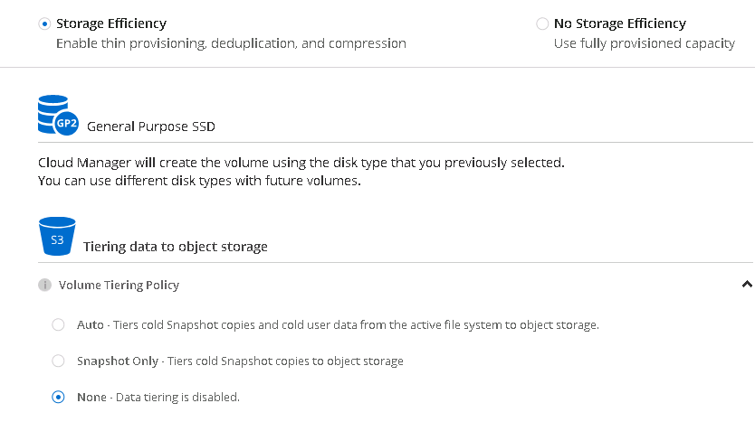
Data Tiering
Cloud Manager
Cloud Manager is used to configure data tiering in AWS and Azure.
This tiering is not the same as the cloud tiering available as a service from NetApp Cloud Central.
Currently, Cloud Tiering Service enables tiering of infrequently accessed data from the on-premises, high-performance AFF storage to the cloud tier.
Notes:
Instructor Notes
Highlight what Cloud Tiering does vs Tiering from Cloud Volumes ONTAP to Object Storage in the Cloud.
Cloud Tiering is available from NetApp Cloud Central in preview mode.
Tiering policy can be set up during the creation of CVO. Note that the tiering policy Backup will not show up in Cloud Manager when you create a volume. The only options will be Auto, Snapshot only or None.
When you use drag and drop for creating SnapMirror relationship, you can set the tiering policy as either Backup or None for the destination DP volume.
Tiering Policy can be changed after the CVO has been deployed:
From CloudManager from the Volume menu
or using System Manager you can select the Volume-> More Actions -> Change Tiering Policy.
Student Notes

Slide 5

Data Tiering in AWS
Cloud Volumes ONTAP uses Amazon Elastic Block Store (Amazon EBS or EBS) as a performance tier for hot data.
It uses S3 as a cloud tier for cold data.
A Cloud Volumes ONTAP working environment uses an S3 bucket for all tiered data from the system.
AWS
EBS
S3
General Purpose SSDs
Provisioned IOPS SSDs
Throughput Optimized HDDs
S3 Standard
S3 Standard-Infrequent Access
S3 One Zone-Infrequent Access
Notes:
Instructor Notes
S3 standard is the default. You can change it to other levels like Standard-Infrequent Access or One Zone-Infrequent Access from Cloud Manager.
Student Notes
Standard: Ideal for frequently accessed data that is stored across multiple Availability Zones
Standard-Infrequent Access: For infrequently accessed data that is stored across multiple Availability Zones
One Zone-Infrequent Access: For infrequently accessed data that is stored in a single Availability Zone
Access costs are higher if you do access the data, so you must take that into consideration before you change the tiering level.
When you change the tiering level, cold data starts in the standard storage class and moves to the storage class that you selected if the data is not accessed after 30 days.
The tiering level is system wide. It is not per volume.
A Cloud Volumes ONTAP working environment uses an S3 bucket for all tiered data from the system. A different S3 bucket is not used for each volume. This condition includes a high-availability (HA) working environment. Cloud Manager creates an S3 bucket and names it fabric-pool-cluster unique identifier.

Slide 6
Data Tiering in Azure
Cloud Volumes ONTAP uses Azure-managed disks as a performance tier for hot data.
Cloud Volumes ONTAP uses Azure Blob Storage as a cloud tier for cold data.
Azure
SSD/HDD
Blob
Premium Storage SSDs
Standard Storage HDDs
Hot Storage Tier
Cool Storage Tier
Notes:
Instructor Notes
By default, Cloud Volumes ONTAP tiers cold data to the Azure hot storage tier, which is ideal for frequently accessed data.
Can be changed to cool storage tier via cloud manager.
Student Notes
By default, Cloud Volumes ONTAP tiers cold data to the Azure hot storage tier, which is ideal for frequently accessed data.
If you do not plan to access the cold data, you can reduce your storage costs. You can change a system’s tiering level to the Azure cool storage tier after you deploy Cloud Volumes ONTAP. The cool tier is ideal for infrequently accessed data that resides in the tier for at least 30 days.
Access costs are higher if you do access the data, so you must take that into consideration before you change the tiering level.
When you change the tiering level, cold data starts in the hot storage tier and moves to the cool storage tier if the data is not accessed after 30 days.
The tiering level is system wide. It is not per volume.
A Cloud Volumes ONTAP working environment uses an Azure Blob container for all tiered data from the system. A different container is not used for each volume. Cloud Manager creates a storage account with a container for each Cloud Volumes ONTAP system. The name of the storage account is random.

Slide 7
Tiering Policies
Snapshot only
Aggregate is at 50% capacity. (Starting in ONTAP 9.5 the minimum capacity threshold is adjustable)
Tier cold Snapshot copies.
Cooling period is 2 days.
Auto
Aggregate is at 50% capacity.
Tier cold data blocks (includes Snapshot copies and user data from the active file system).
Cooling period is 31 days.
Random reads: Cold data moves back to performance tier.
Sequential reads: (for example, antivirus scan): Cold data remains in cloud tier.
Backup
Destination volume (SnapMirror volume or SnapVault volume) starts in cloud tier.
Activate destination volume: Data moves gradually to performance tier as it is read.
None
Data is prevented from moving to cloud tier
Notes:
Instructor Notes
Student Notes
To enable data tiering, you must select a volume tiering policy when you create, modify, or replicate a volume. You can select a different policy for each volume.
Some tiering policies have an associated minimum cooling period, which sets the time that user data in a volume must remain inactive for the data to be considered "cold" and moved to the cloud tier.
Cloud Volumes ONTAP supports the following tiering policies:
Snapshot Only:
After an aggregate has reached 50% capacity, Cloud Volumes ONTAP tiers cold user data of Snapshot copies that are not associated with the active file system to the cloud tier. The cooling period is approximately two days.
If read, cold data blocks on the cloud tier become hot and are moved to the performance tier.

Slide 8
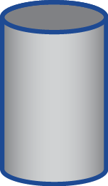
Data Tiering with Primary Data
Tiering Policy: Snapshot Only, Snapshot data is tiered
Provisioned storage
Hot data in active filesystem
Snapshot copies
Cold data in active filesystem
Azure or AWS disks
Object storage
Primary System

Slide 9
Tiering Policies
Snapshot only
Aggregate is at 50% capacity.
Tier cold Snapshot copies.
Cooling period is 2 days.
Auto
Aggregate is at 50% capacity.
Tier cold data blocks (includes Snapshot copies and user data from the active file system).
Cooling period is 31 days.
Random reads: Cold data moves back to performance tier.
Sequential reads: (for example, antivirus scan): Cold data remains in cloud tier.
Backup
Destination volume (SnapMirror volume or SnapVault volume) starts in cloud tier.
Activate destination volume: Data moves gradually to performance tier as it is read.
None
Data is prevented from moving to cloud tier
Notes:
Instructor Notes
Student Notes
To enable data tiering, you must select a volume tiering policy when you create, modify, or replicate a volume. You can select a different policy for each volume.
Some tiering policies have an associated minimum cooling period, which sets the time that user data in a volume must remain inactive for the data to be considered "cold" and moved to the cloud tier.
Cloud Volumes ONTAP supports the following tiering policies:
Snapshot Only:
After an aggregate has reached 50% capacity, Cloud Volumes ONTAP tiers cold user data of Snapshot copies that are not associated with the active file system to the cloud tier. The cooling period is approximately two days.
If read, cold data blocks on the cloud tier become hot and are moved to the performance tier.

Slide 10
Data Tiering with Primary Data
Tiering Policy: Auto, Inactive data and Snapshot data are tiered.
Provisioned storage
Hot data in active file system
Snapshot copies
Cold data in active file system
Azure or AWS disks
Object storage
Primary System

Slide 11
Tiering Policies
Snapshot only
Aggregate is at 50% capacity.
Tier cold Snapshot copies.
Cooling period is 2 days.
Auto
Aggregate is at 50% capacity.
Tier cold data blocks (includes Snapshot copies and user data from the active file system).
Cooling period is 31 days.
Random reads: Cold data moves back to performance tier.
Sequential reads: (for example, antivirus scan): Cold data remains in cloud tier.
Backup
Destination volume (SnapMirror volume or SnapVault volume) starts in cloud tier.
Activate destination volume: Data moves gradually to performance tier as it is read.
None
Data is prevented from moving to cloud tier
Notes:
Instructor Notes
Student Notes
To enable data tiering, you must select a volume tiering policy when you create, modify, or replicate a volume. You can select a different policy for each volume.
Some tiering policies have an associated minimum cooling period, which sets the time that user data in a volume must remain inactive for the data to be considered "cold" and moved to the cloud tier.
Cloud Volumes ONTAP supports the following tiering policies:
Snapshot Only:
After an aggregate has reached 50% capacity, Cloud Volumes ONTAP tiers cold user data of Snapshot copies that are not associated with the active file system to the cloud tier. The cooling period is approximately two days.
If read, cold data blocks on the cloud tier become hot and are moved to the performance tier.

Slide 12

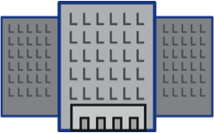

Data Tiering with Primary Data
Tiering Policy: Backup, Meta data remains in backup destination, backup data is tiered
Primary System
Secondary System
NetApp SnapMirror Software
Provisioned storage
Meta data
Backup Data
On-Premises
Data Center
NetApp SnapVault Software
Azure or AWS disks
Object storage

Slide 13


Hands-On Activity
Module 6: NetApp Cloud Volumes ONTAP Data Tiering
Exercise 1:
Tier Backup Data to Amazon Simple Storage Service
This exercise requires approximately 30 minutes.
Notes:
Instructor Notes In this lab the students configure data tiering on the destination volume of the SnapMirror.
Student Notes
See your Exercise Guide.

Slide 14

ACTION: Share Your Experiences
Roundtable questions for the exercise
If you lose the destination volume, can the S3 data be used as a backup?
14
Notes:
Instructor Notes
Question 1: No! It does not contain meta-data, so no way to reconstruct the original data in ONTAP
Student Notes
If you encounter an issue, notify your instructor immediately so that it can be resolved promptly.

Slide 15
Module Review
This module focused on enabling you to do the following:
Cloud Volumes ONTAP supports data tiering in both AWS and Azure.
There are four different data tiering policies that you can attach to a volume to enable tiering:
Snapshot only
Auto
Backup
None
You can use Cloud Manager to configure tiering policy at the following times:
When you create a volume
When you set up a SnapMirror relationship
You can use OnCommand System Manager to change the policy afterwards.
15
Notes:
Instructor Notes
Tiering policy can be configured when you use
standard license or
Premium
BYOL license.
A tiering policy can be selected in the wizard while creating the CVO.
You can modify it later by accessing the System Manager and choosing the volume for which you want to change the tiering policy and select More Actions -> Change Tiering Policy.
The tiering policy Backup will not appear in the pull-down list unless the volume type is DP.
Student Notes

