Slide 1
Module 7 NetApp Cloud Volumes ONTAP High Availability
1
Notes:
Instructor Notes
Student Notes

Slide 2

About This Module
This module focuses on enabling you to do the following:
Explain high availability of Cloud Volumes ONTAP
Describe the high-availability (HA) architecture of Cloud Volumes ONTAP in Amazon Web Services (AWS) and Azure
Deploy Cloud Volumes ONTAP high availability in AWS by using OnCommand Cloud Manager
Notes:
Instructor Notes
Student Notes

Slide 3


Why High Availability?
Business continuity
Regulation compliance
Protection against failures
Cloud provider data center outage, hardware failures, or maintenance operations
Zero downtime and no data loss
Automatic failover and failback processes

Slide 4
Recovery Point Objective and Recovery Time Objective
An HA configuration maintains high availability of your data as follows:
The recovery point objective (RPO) is 0 seconds.
Data is transactionally consistent with no data loss.
The recovery time objective (RTO) is 60 seconds.
In an outage, data should be available in 60 seconds or less.
This condition is true for Cloud Volumes ONTAP high availability on the following:
AWS
Azure

Slide 5
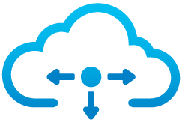

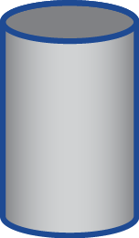
Cloud Volumes ONTAP HA Architecture for Single AZ
Single availability Zone
Customer AWS VPC
Cloud Manager
Mediator
Cloud Manager deploys the HA nodes and the mediator node in the same AZ.
NODE-A
NODE-B
Data Aggregates
Data Aggregates
Node A
Data Disks
Node B
Data Disks
Synchronous
Replication
Node B
Data Disks
Node A
Data Disks
Availability Zone A
VPC: Virtual Private Cloud
Notes:
Instructor Notes
The mediator node detects when a node failure happens and will trigger the takeover. It will also update the route tables so that clients can be routed to the functioning node for data access and for management.
Why do we need Floating IP addresses for Data Access when we have HA nodes spread across multiple Availability Zones:
A subnet cannot span more than one availability zone (AZ) in AWS. Therefore, IP address range of a subnet is routable only within a single AZ.
Because of this, the IP address assigned to an instance in one AZ cannot be reassigned to another instance in a different AZ.
Therefore, when a failover occurs, clients cannot continue to use the same IP address that they were using for NAS data access because the IP addresses cannot failover to the node serving data.
In order to overcome the AWS limitation, we, rely on “floating” IPs addresses for failover between nodes in different AZs.
Floating IP addresses are outside the range of the VPC CIDR. In order to route to these addresses within AWS, they must not overlap with any CIDR range in the same AWS region.
Clients connect to the floating IP address rather than the IP address of the node itself. When a node failure (or even an entire AZ failure) is detected, the floating IP address is “moved” to an instance in another AZ. (Mediator takes care of detection of failure, updates to route tables)
Note: Floating Ips are not the same as AWS Elastic Ips. They are only relevant for CVO HA.
Please keep in mind the following limitation:
The floating IP solution works well if the client is in the same VPC as the CVO HA node. However, if the client is not in the same VPC, AWS routing does not support routing to these Floating IP addresses that are outside of the CIDR range for the VPC.
Student Notes
In AWS, Cloud Volumes ONTAP HA configurations include the following components:
Two Cloud Volumes ONTAP nodes whose data is synchronously mirrored between each other.
A mediator instance that provides a communication channel between the nodes to help in storage takeover and giveback processes.
The mediator instance runs the Linux OS on a t2.micro instance and uses one Amazon Elastic Block Store (Amazon EBS) magnetic disk that is approximately 8 GB.
Storage takeover and giveback:
If a node goes down, the other node can serve data for its partner to provide continued data service.
Clients can access the same data from the partner node because the data was synchronously mirrored to the partner.
After the node reboots, the partner must resynchronize data before it can return the storage. The time that it takes to resynchronize data depends on how much data was changed while the node was down.
A Cloud Volumes ONTAP HA configuration across multiple Availability Zones can enable high availability if a Cloud Volumes ONTAP node fails or an Availability Zone becomes unavailable.
When a Cloud Volumes ONTAP HA configuration is spread across multiple Availability Zones, floating IP addresses are required for NAS data access from within the VPC. The floating IP addresses can migrate between nodes when failures occur. These floating IP addresses are not natively accessible to clients that are outside of the VPC. You should review requirements for floating IP addresses and route tables before you deploy an HA configuration across multiple Availability Zones.
For iSCSI, Cloud Volumes ONTAP uses multipath I/O and asymmetric logical unit access (or ALUA) to manage path failover between the active-optimized and indirect data paths.

Slide 6

High Availability with Synchronous Replication in multiple Availability Zones
Cloud Volumes ONTAP software high availability enables the following:
Multi-Availability Zone (AZ) high availability and failover
Multi-AZ synchronous data replication with zero RPO
Enterprise applications in the cloud
AWS
SyncMirror Software
Availability Zone A
Availability Zone B
Notes:
Instructor Notes
Student Notes A Cloud Volumes ONTAP HA configuration provides nondisruptive operations and fault tolerance.
RPO and RTO
An HA configuration maintains high availability of your data as follows:
The recovery point objective (RPO) is 0 seconds.
Your data is transactionally consistent with no data loss.
The recovery time objective (RTO) is 60 seconds.
In an outage, data should be available in 60 seconds or less.

Slide 7
Cloud Volumes ONTAP HA Architecture for Multiple AZ
Multiple Availability Zones
Node A Node B
192.168.10.2
Floating IP addresses in one or more route tables
192.168.10.3
192.168.10.4
Customer AWS VPC
Availability Zone C
Cloud Manager deploys the HA nodes and the mediator node in three different AZs.
Mediator
Cloud Manager
For iSCSI, asymmetric logical unit access (ALUA) manages path failover.
NODE-A
NODE-B
Data Aggregates
Data Aggregates
Node A
Data Disks
Node B
Data Disks
Synchronous
Replication
Node B
Data Disks
Node A
Data Disks
Availability Zone A
Availability Zone B
VPC: Virtual Private Cloud
Notes:
Instructor Notes
The mediator node detects when a node failure happens and will trigger the takeover. It will also update the route tables so that clients can be routed to the functioning node for data access and for management.
Why do we need Floating IP addresses for Data Access when we have HA nodes spread across multiple Availability Zones:
A subnet cannot span more than one availability zone (AZ) in AWS. Therefore, IP address range of a subnet is routable only within a single AZ.
Because of this, the IP address assigned to an instance in one AZ cannot be reassigned to another instance in a different AZ.
Therefore, when a failover occurs, clients cannot continue to use the same IP address that they were using for NAS data access because the IP addresses cannot failover to the node serving data.
In order to overcome the AWS limitation, we, rely on “floating” IPs addresses for failover between nodes in different AZs.
Floating IP addresses are outside the range of the VPC CIDR. In order to route to these addresses within AWS, they must not overlap with any CIDR range in the same AWS region.
Clients connect to the floating IP address rather than the IP address of the node itself. When a node failure (or even an entire AZ failure) is detected, the floating IP address is “moved” to an instance in another AZ. (Mediator takes care of detection of failure, updates to route tables)
Note: Floating Ips are not the same as AWS Elastic Ips. They are only relevant for CVO HA.
Please keep in mind the following limitation:
The floating IP solution works well if the client is in the same VPC as the CVO HA node. However, if the client is not in the same VPC, AWS routing does not support routing to these Floating IP addresses that are outside of the CIDR range for the VPC.
Student Notes
In AWS, Cloud Volumes ONTAP HA configurations include the following components:
Two Cloud Volumes ONTAP nodes whose data is synchronously mirrored between each other.
A mediator instance that provides a communication channel between the nodes to help in storage takeover and giveback processes.
The mediator instance runs the Linux OS on a t2.micro instance and uses one Amazon Elastic Block Store (Amazon EBS) magnetic disk that is approximately 8 GB.
Storage takeover and giveback:
If a node goes down, the other node can serve data for its partner to provide continued data service.
Clients can access the same data from the partner node because the data was synchronously mirrored to the partner.
After the node reboots, the partner must resynchronize data before it can return the storage. The time that it takes to resynchronize data depends on how much data was changed while the node was down.
A Cloud Volumes ONTAP HA configuration across multiple Availability Zones can enable high availability if a Cloud Volumes ONTAP node fails or an Availability Zone becomes unavailable.
When a Cloud Volumes ONTAP HA configuration is spread across multiple Availability Zones, floating IP addresses are required for NAS data access from within the VPC. The floating IP addresses can migrate between nodes when failures occur. These floating IP addresses are not natively accessible to clients that are outside of the VPC. You should review requirements for floating IP addresses and route tables before you deploy an HA configuration across multiple Availability Zones.
For iSCSI, Cloud Volumes ONTAP uses multipath I/O and asymmetric logical unit access (or ALUA) to manage path failover between the active-optimized and indirect data paths.

Slide 8
Cloud Volumes ONTAP High Availability in Multiple Availability Zones in AWS
Floating IP addresses
High availability of your data is ensured if a failure occurs:
An AZ failure
An instance that runs a Cloud Volumes ONTAP node failure
Three floating IP addresses are required for NAS data access from within the VPC.
Must be outside of the Classless Inter-Domain Routing (CIDR) blocks of all VPCs in the region
Can migrate between nodes when failures occur
You provide the floating IP addresses to Cloud Manager when deploying Cloud Volumes ONTAP high availability.
No floating IP addresses are needed for HA nodes in the same AZ.
Notes:
Instructor Notes
We did not mention anything about Single availability Zone architecture previously.
When you discuss the last bullet, please mention that HA nodes and the mediator can all be deployed in a single availability zone as well. For this, we are taking advantage of an AWS feature called ‘spread placement group’. In the spread placement group, the VMs will be spread across racks in the same AZ. (This is similar to the method that Azure CVO is using in HA called Availability Sets where the VMs are spread across fault domains (i.e. different racks in the data center). )
Student Notes
Deploying an HA configuration in multiple AZs ensures high availability of your data if a failure occurs with an AZ or an instance that runs a Cloud Volumes ONTAP node. You should understand how NAS IP addresses affect data access and storage failover.
These floating IP addresses are not natively accessible to clients that are outside of the VPC.
When deployed in multiple AZs, Cloud Volumes ONTAP high availability includes a separate set of IP addresses for NAS clients that are outside of the VPC. These IP addresses are static. They cannot migrate between nodes.
Three floating IP addresses are required:
One floating IP address is for cluster management, one is for NFS/CIFS data on node 1, and one is for NFS/CIFS data on node 2.
You must specify three floating IP addresses that are outside of the CIDR blocks for all VPCs in the AWS region in which you deploy the HA configuration. You can think of the floating IP addresses as a logical subnet that is outside of the VPCs in your region.

Slide 9
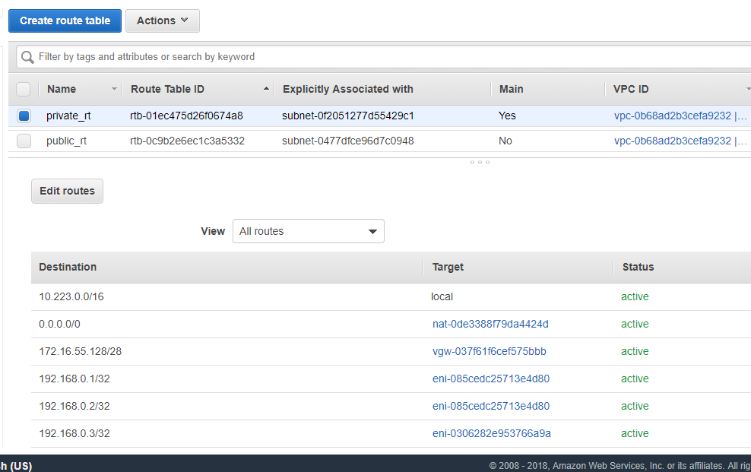
Route Table
Route entries are automatically added or modified by using floating IPs.
Notes:
Instructor Notes
OCCM deploying CVO HA takes care of this.
Route tables will be later updated on failover.

Slide 10


Cloud Volumes ONTAP High Availability in Azure
Architecture
VNet
Same Resource Group
VMs (Cloud Volumes ONTAP nodes)
In one availability set
In separate Update Domains and Fault Domains
Storage
Nodes share a data aggregate
There is a single copy of data
Each node can access the other node’s storage
Azure guarantees data availability
ILB
Node A
Azure
Load
Balancer
Node B
Cloud Manager
Data Aggregate
Azure
Page Blobs
Node A
....
Azure
Page Blobs
Node B
....
Subnet A
ILB: Internal load balancing | VNet: Azure Virtual Network | VM: Virtual machine
Notes:
Instructor Notes
HA in Azure is coming in 9.5
Student Notes
Azure Standard Load Balancer: The load balancer manages incoming traffic to the Cloud Volumes ONTAP HA pair.
2 VMs
Same resource group (logical grouping)
Availability Set configuration: Guarantees that VMs are distributed across multiple isolated hardware nodes in a cluster, resulting in separate Update Domains (UDs) and Fault Domains (FDs).
Storage: Customer data resides on premium storage page blobs. Each node has access to the other node’s storage.
Only one copy of the data (Azure guarantees data availability with three copies.)
Storage Configurations
You can use an HA pair as an active-active configuration, in which both nodes serve data to clients. You can also use the HA pair as an active-passive configuration, in which the passive node responds to data requests only if it has taken over storage for the active node.

Slide 11
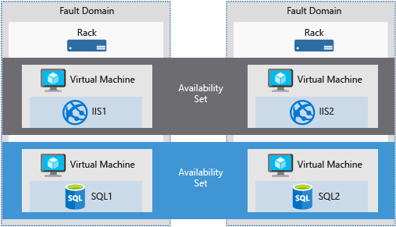
Fault Domain in Azure
Availability set
Notes:
Instructor Notes
A fault domain is a logical group of hardware in Azure that shares a common power source and network switch. You can think of it as a rack within an on-premises datacenter.
As you create VMs within an availability set, the Azure platform automatically distributes your VMs across these fault domains.
The first two VMs in an availability set will be provisioned into two different racks so that if the network or the power failed in a rack, only one VM would be affected. Fault domains are also defined for managed disks attached to VMs.

Slide 12


Hands-On Activity
Module 7: NetApp Cloud Volumes ONTAP High Availability
Exercise 1:
Implement Cloud Volumes ONTAP High Availability
This exercise requires approximately 60 minutes.
Notes:
Instructor Notes In this lab the students configure a new VPC environment with 3 subnets (using a Cloud Formation script). Launch OCCM or peer VNets? Deploy HA across multiple availability zones. Connect client, power down node client is connected to and validate that client can access data on the second node.
Student Notes
See your Exercise Guide.

Slide 13

ACTION: Share Your Experiences
Roundtable questions for the exercise
How did you specify that you need the HA nodes to be in different AZs?
How many floating IP addresses did you provide when you deployed the Cloud Volumes ONTAP high availability in AWS?
What did you need to do to include routes to the floating IP addresses?
13
Notes:
Instructor Notes
Question 1: You provide that info in OCCM when you deploy CVO HA
Question 2: 3 (2 data IPs one on each node and one for Cluster management) and 4th one is optional for SVM management
Question 3: We just had to choose the route tables associated that needed updates. The actual updates to RT are done automatically.
Student Notes
If you encounter an issue, notify your instructor immediately so that it can be resolved promptly.

Slide 14
Module Review
You can deploy Cloud Volumes ONTAP in HA mode in AWS and Azure.
In AWS, HA nodes can be in the same AZ or in different AZs.
Floating IPs are needed for NAS data access when HA nodes are deployed in multiple AZs.
HA nodes in Azure are deployed in separate Fault Domains but within the same resource group.
Notes:
Instructor Notes
Student Notes

