Slide 1
Module 8 Cloud Sync Service
Notes:
Instructor Notes
Student Notes

Slide 2

About This Module
This module focuses on enabling you to do the following:
Understand Cloud Sync offerings
Implement data migration by using Cloud Sync service
Notes:
Instructor Notes
Student Notes

Slide 3
Cloud Sync Service
A data management service that enables seamless and secure synchronization of data between private and public clouds and object stores
Capable of reducing data transfer times from hours to minutes through continuous data synchronization
Charged by the hour based on the number of synchronization relationships that are created
Ideal for analytics and big data applications because it puts data in the cloud where scalable compute resources can be tasked to process it
Notes:
Instructor Notes
It is better than robocopy and rsync in terms of performance.
Cloud Sync is based on XCP but is better.
Student Notes

Slide 4

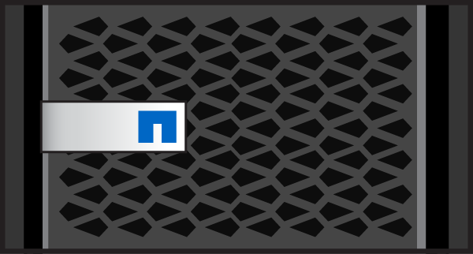
How Does Cloud Sync Service Work?
Continuously synchronize data to the cloud
Avoid long upload times
Achieve data synchronization between on-premises storage and Amazon Simple Storage Service (Amazon S3 or S3)
Choose what data to synchronize and set the schedule
Cloud Sync
Amazon or Azure Object Store
Run cloud-based services on demand
Trigger services such as EMR, Redshift, and HDInsight with data in object stores
Scale out compute resources nearly instantaneously
Source Data
Results
NFS / CIFS
NFS / CIFS
Deliver results automatically
Data Center
Optimize data transfer
Synchronize from cloud object storage to on-premises storage
Verify automatically
Notes:
Instructor Notes
In the diagram, we are using AWS as an example.
But we can also use Azure Blobs or Storage Grid Object stores.
Student Notes

Slide 5
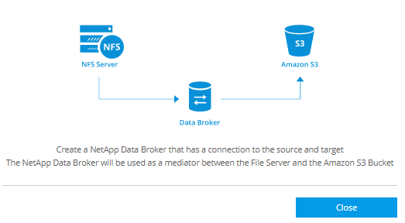
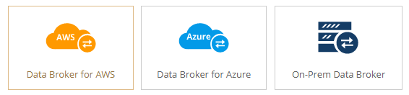
Data Broker: Powering Cloud Sync Service
Data Broker is the agent for data transformation.
Data Broker serves as the mid point between the source and target.
Data Broker works with API against S3 and natively with NFS (v3 and v4), CIFS, and Amazon Elastic File System (EFS).
Deploy Data Broker in Amazon Web Services (AWS) or Azure or on-premises.

Slide 6
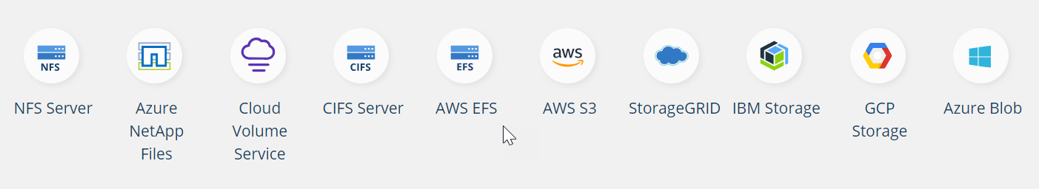
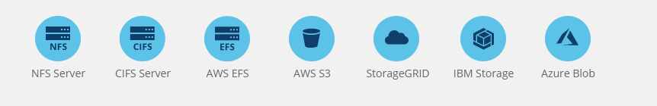
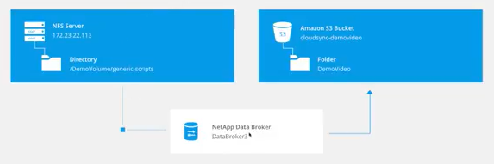
Synchronization Relationships
Source and Target
Source and Target Requirements
Notes:
Instructor Notes
The link provided on this slide takes you to the documentation page that gives you all the supported source and target combinations.
You can open up this link to show the students that not all source and target combinations are possible.
Student Notes Set up synchronization relationships from the source and the target.

Slide 7
Cloud Sync API
Enables automation and management of Cloud Sync service
Can perform operations on resources that are categorized as the following:
NetApp Data Brokers
Relationships
Storages
Users
Many more
Provides interactive API documentation through a Swagger interface
Constructs curl commands
Base URL: /api
Reference Documentation: https://cloudsync.netapp.com/docs/
Notes:
Instructor Notes
More info can be found from the link to the API documentation page.
The url will start with https://cloudsync.netapp.com/api/

Slide 8


Hands-On Activity
Module 8: Cloud Sync Service
Exercise 1:
Synchronize Data From On-Premises to Amazon Simple Storage Service
This exercise requires approximately 30 minutes.
Notes:
Instructor Notes In this lab the students configure data tiering on the destination volume of the SnapMirror.
Student Notes
See your Exercise Guide.

Slide 9



AWS
N. Virginia Region
On-Premises Data Center
VPC
Jump Host/
CIFS Client
10.221.0.0/16
Availability Zone us-east-1a
Public Subnet: 10.221.16.0/20
10.221.16.0/20
W2k16 Amazon EC2 Instance
NATGW
IGW
VPN Connection
Private Subnet 10.221.0.0/20
VGW
Availability Zone us-east-1b
S3
RedHat Linux Instance
RedHat Linux Instance
Cloud Manager
Cloud Volumes
Data Broker
ONTAP Cluster
VPC: Virtual Private Cloud | Amazon EC2: Elastic Compute Cloud
Notes:
Instructor Notes
The students will implement this scenario.
Student Notes
Use the existing setup:
On-premises cluster with a CIFS client
Existing VPC with Cloud Volumes ONTAP in a private subnet and a CIFS client in the public subnet
Create an S3 bucket in AWS.
Perform the cloud synchronization.

Slide 10

ACTION: Share Your Experiences
Roundtable questions for the exercise
Does Cloud Sync service synchronize new data to the destination every time that the source data changes?
10
Notes:
Instructor Notes
Question 1: No by default it synchronizes once a day at midnight by default. It can also be done on demand.
Student Notes
If you encounter an issue, notify your instructor immediately so that it can be resolved promptly.

Slide 11
Module Review
This module focused on enabling you to implement data migration by using Cloud Sync service.
Notes:
Instructor Notes
Student Notes

