Slide 1


Presentation By Patriarch Pam VUG/SEN/24/12478

Slide 2
Truck-View Mechanical Engineering Website
Web-Based Service Booking & Management System
This Project is a full-stack web application for a vehicle service company, built with modern technologies to manage content dynamically, accept bookings, and display company information professionally.

Slide 3
Introduction / Background
Mechanical service businesses face difficulties managing bookings, tracking services, and engaging customers online.
Truck-View aims to digitize service requests, improve customer engagement, and simplify workshop management.

Slide 4
Problem Statement
Customers face delays in booking services due to manual processes.
Service providers struggle with manual record-keeping.
Lack of a centralized system leads to missed opportunities and customer dissatisfaction.

Slide 5
Objectives
Build a user-friendly web application for mechanical service bookings.
Enable easy management of services and customer requests.
Provide real-time updates and contact options (call, WhatsApp).
Maintain a professional online presence for TruckView.

Slide 6
Scope of the Project
User Features: Service browsing, booking requests, and contact.
Admin Features: Manage services, view bookings, update content.
Limited to mechanical service management, not logistics.

Slide 7
Technologies Used
Frontend: Next.js, React, Tailwind CSS
Backend / CMS: Strapi
Database: Strapi default DB
Hosting / Deployment: GitHub Pages (frontend), Strapi locally or via server

Slide 8
System Architecture
User Device (Browser/Mobile)
↓
Frontend: React/Next.js (Vercel)
↓
Backend API: Strapi (Render)
↓
Database: PostgreSQL (Cloud)
External: WhatsApp API, Google Maps
Admin connects to the Strapi Admin Dashboard to manage content

Slide 9
Features / Modules
1. Home Page: Service showcase, company info, branding
2. Services Page: List of services, detailed descriptions
3. Booking Request: Form submission for service booking
4. Contact Page: Tap-to-call, WhatsApp, email
5. Admin Panel: Add/update services, view customer requests

Slide 10
Demo Flow (What I'll Show)
1. Open the homepage and show the responsive UI
2. Navigate to Services and select a service
3. Fill the booking form and submit (show validation)
4. Show backend booking record in Strapi Admin
5. Demonstrate contact via WhatsApp/call link

Slide 11
Database / ERD
Tables: Users, Services, Bookings, Contact Messages
Relationships: One user can make many bookings; One service can have many bookings

Slide 12
Deployment
Frontend hosted on GitHub Pages
Backend hosted locally (for demonstration)
Deployed using Next.js build + Strapi API
Full deployment possible on cloud server in the future

Slide 13
Challenges / Limitations
Strapi API limited to local testing (no public backend yet)
Limited gallery images due to content availability
Mobile responsiveness adjustments needed
Time constraints prevented advanced features
Laptop issues that prevented completion

Slide 14
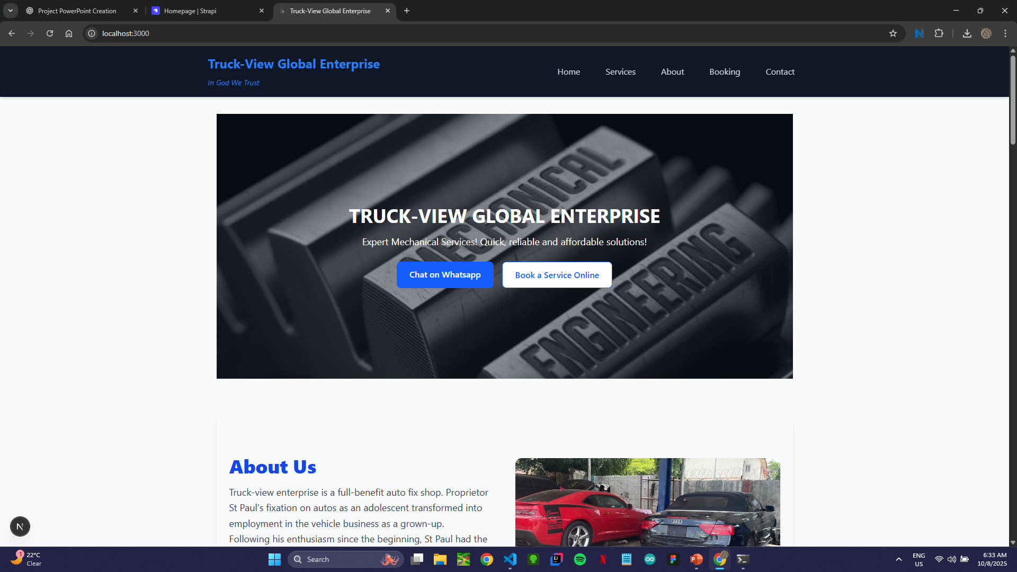
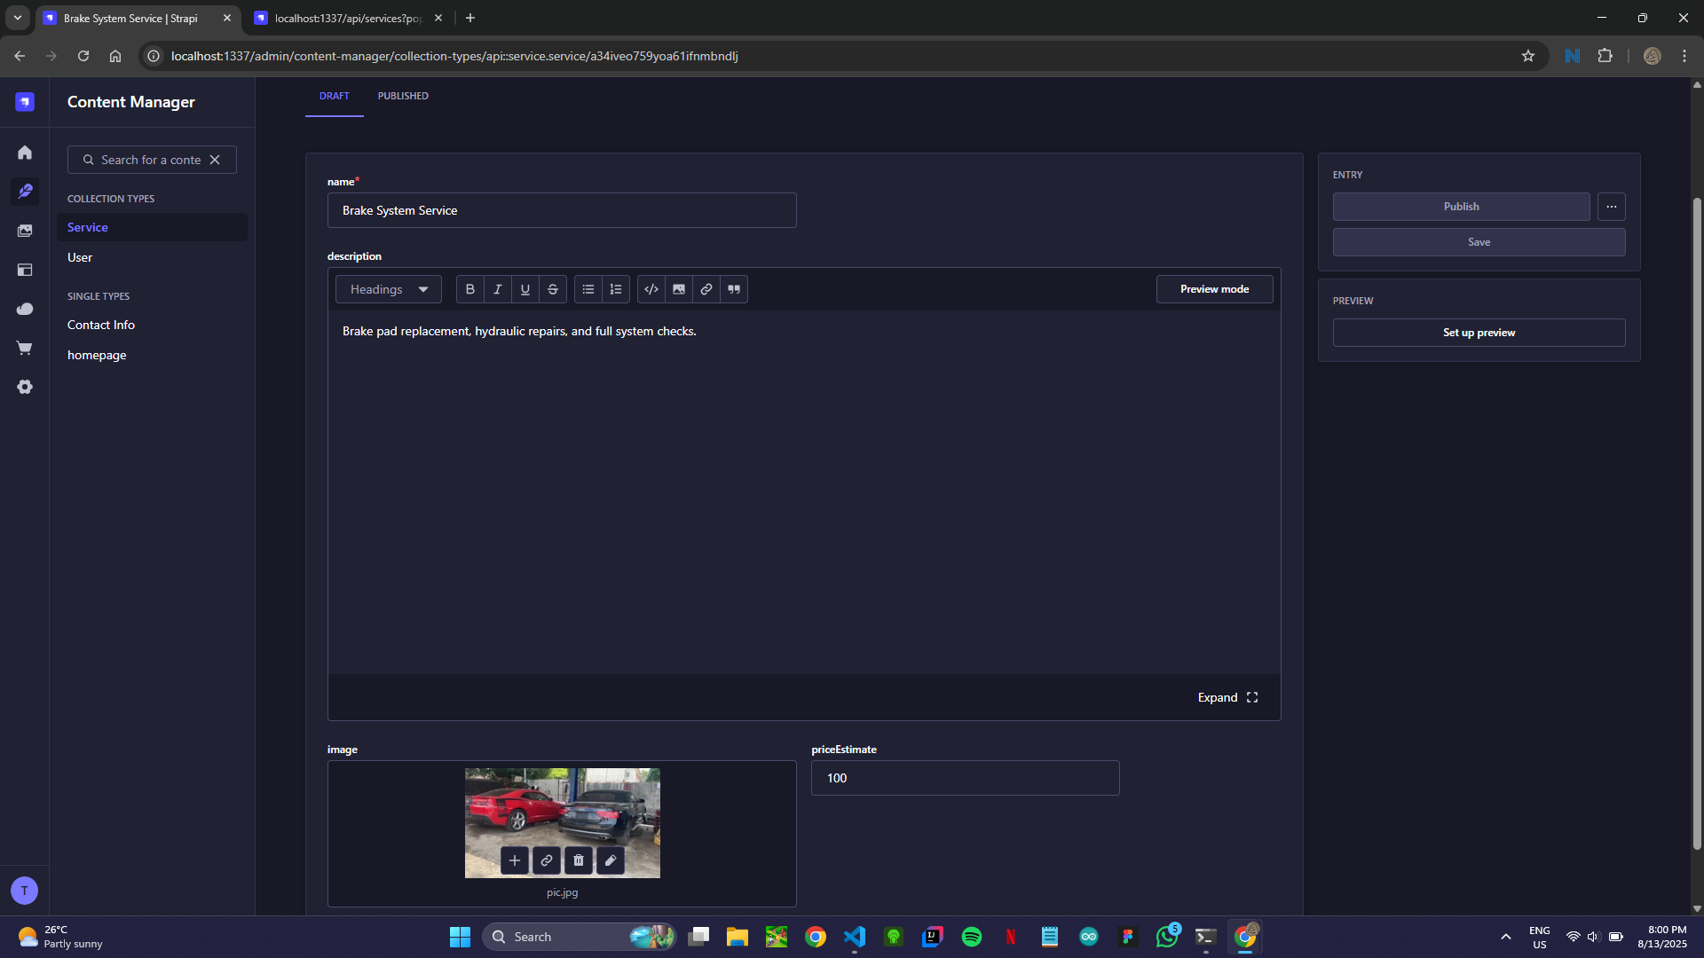
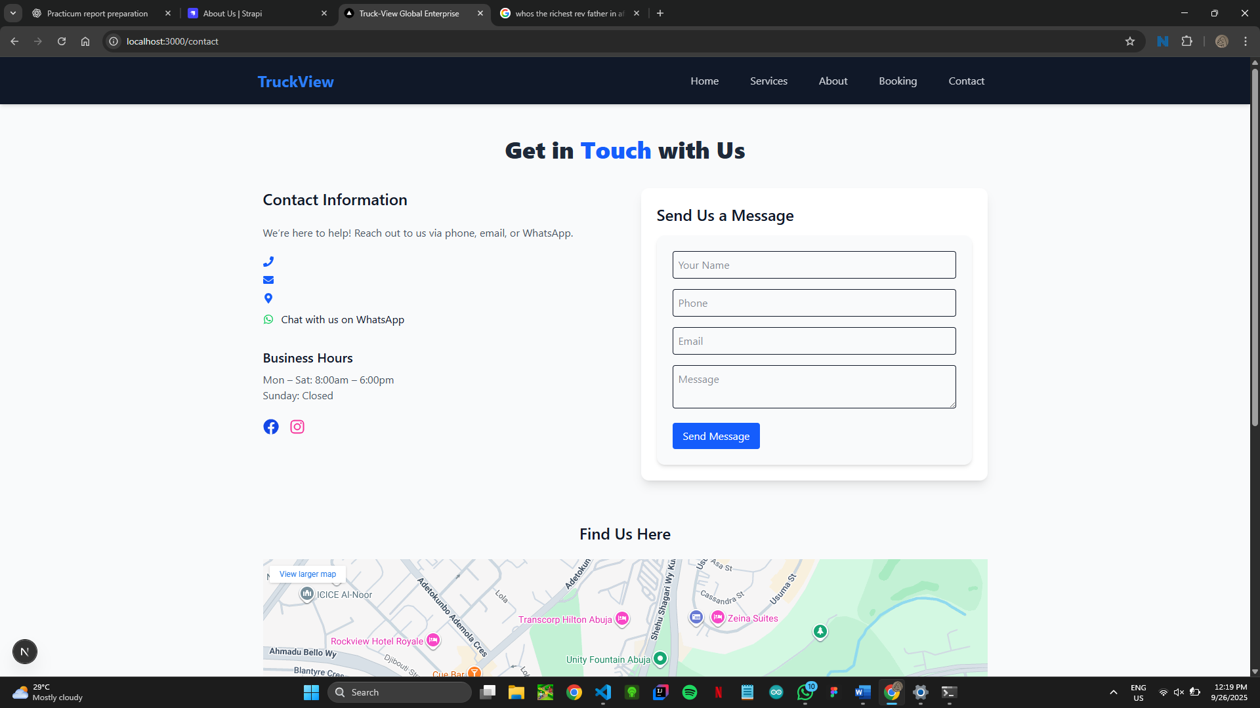
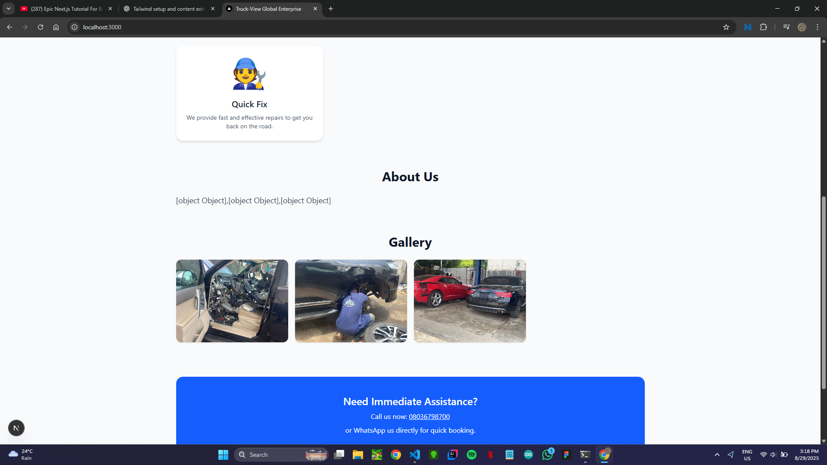
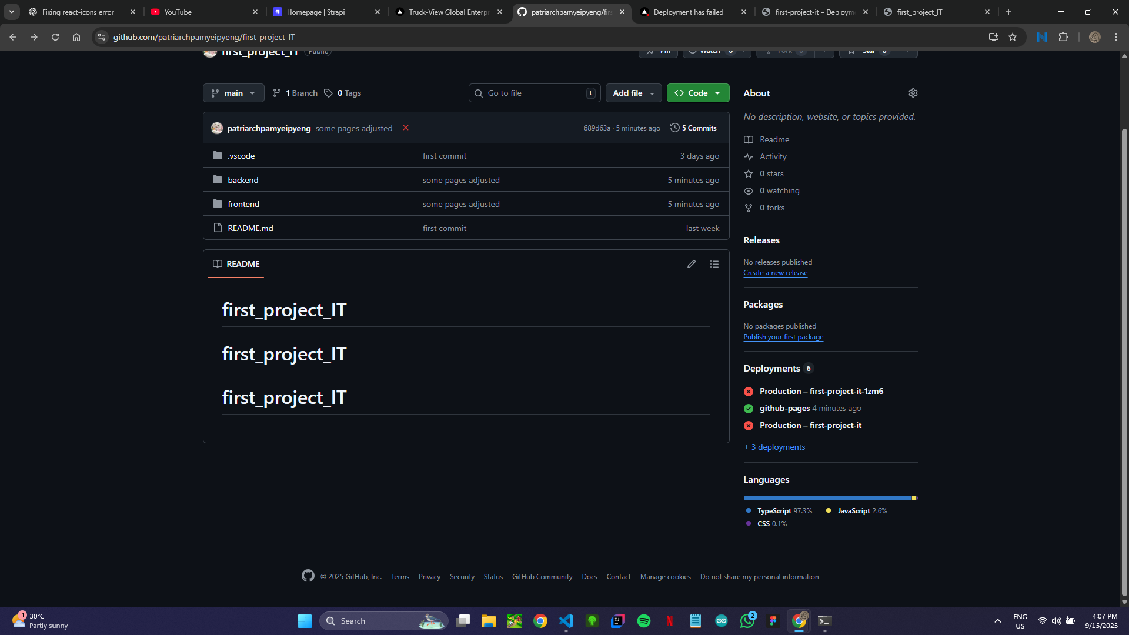
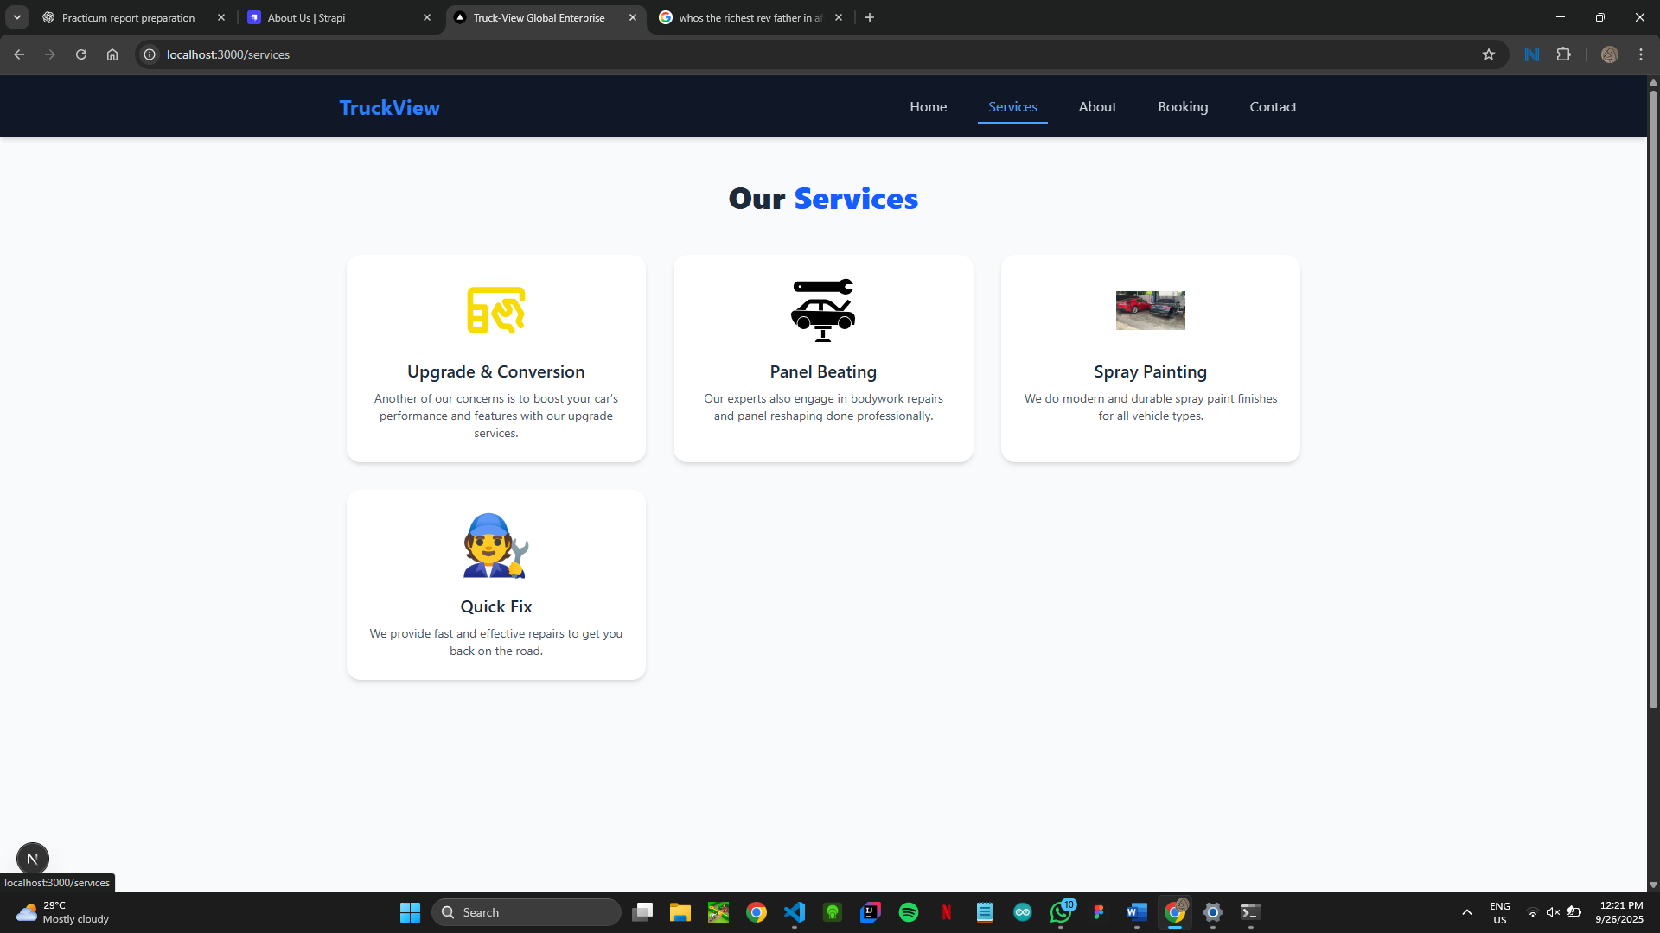
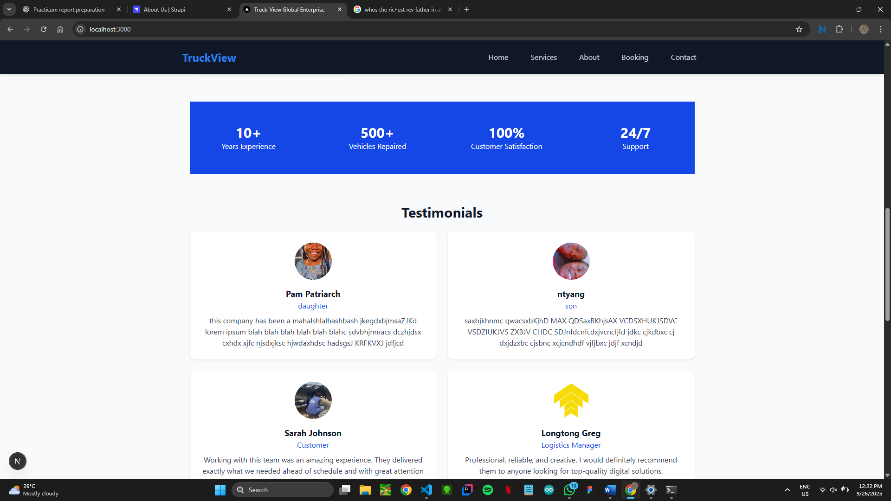
Screenshots / Demo

Slide 15
Future Improvements
1. Open the homepage and show the responsive UI
2. Navigate to Services and select a service
3. Fill the booking form and submit (show validation)
4. Show backend booking record in Strapi Admin
5. Demonstrate contact via WhatsApp/call link

Slide 16
Conclusion / Recommendations
Project successfully built a functional service booking website
Improves customer experience and workshop management
Future improvements: full deployment, notifications, analytics dashboard

Slide 17
References / Acknowledgements
Tools: Next.js, Strapi, Tailwind CSS
Inspiration from the Truck-View website
Supervisors, classmates, or family support

Slide 18
Thank You!!
Any Questions?

