Slide 1

Exploratory Data Analysis
DANA 4800-01
November 26, 2023

Slide 2




Our Team
Andy Nguyen
Thaise Neves Soares
Le Van Huan
Patricia Tating
25% contribution
Proposal & presentation development, literature review, education univariate analysis
25% contribution
Proposal & presentation development, literature review, education bivariate analysis
25% contribution
Proposal & presentation development, data collection, marital status univariate & income bivariate analysis
25% contribution
Proposal & presentation development, income univariate analysis, conclusion & recommendation

Slide 3
Agenda
Data Collection
Problem Statement
Literature Review
Analysis
Conclusion & Recommendation

Slide 4
Data Collection
About the dataset:
iFood is a Brazilian online food ordering and food delivery platform.
This dataset is from iFood’s marketing campaign posted in GitHub.
Contains observations for 2205 customers.
Originally 38 variables – for this study we will only look at 5 variables.
Possible bias:
Selection Bias: The dataset might only include data from customers who interacted with the marketing campaigns.
Response Bias: People may be hesitant to provide accurate income information.
Variables | Descriptions | Types | Units of measurement
AcceptedSummary | 1 if customer accepted the offer in the campaign, 0 otherwise. | Categorical
Education | Customer's level of education | Categorical
MaritalStatus | Customer's marital status | Categorical
Income | Customer's yearly household income | Numerical | Real Brazil 1 R$ = 0.28$
MntTotal | Total amount of everything purchased in last 2 years | Numerical | Real Brazil 1 R$ = 0.28$

Slide 5
Problem Statement
What is the sample proportion of customer segments based on their marital status?
What is the sample proportion of customer segments based on their education level?
Is there an association between educational level and customer’s acceptance of the marketing campaigns?
What is the quartile ranking of customers’ income?
What is the relationship between income and amount spent by customers?

Slide 6
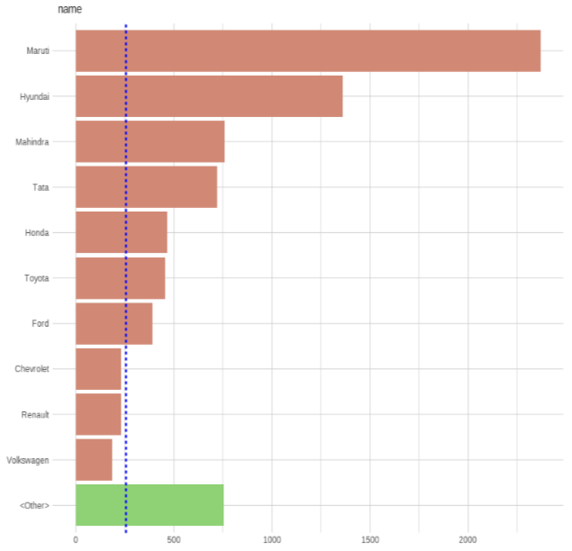
Literature Review
Data set: User Car Data dataset consists of different types of used car on the market across all region
Research objective: to perform explanatory data analysis of user car dataset to prepare for machine learning model
Analyses:
Used bar plot to display frequency of car category level.
Maruti, Hyundai, Mahindra are the top 3 brands, which take up more than 50% of all cars in this market.
Distribution of car types on the market

Slide 7
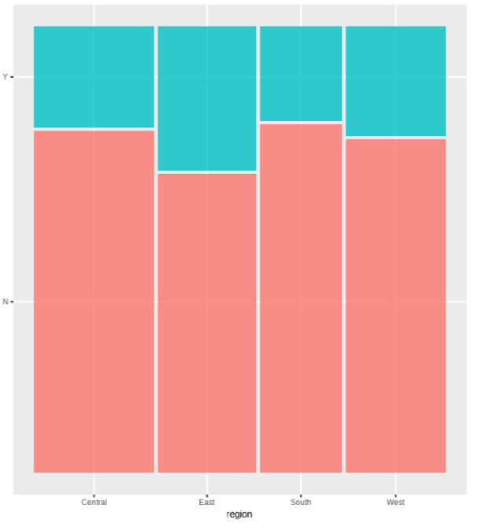
Literature Review
Used Chi-square to see whether different regions have difference in car sold.
Number of car sold is relatively independent with the region where it was posted.
Distribution of sold car across regions
NOT Sell yet
SOLD
Central East South West

Slide 8
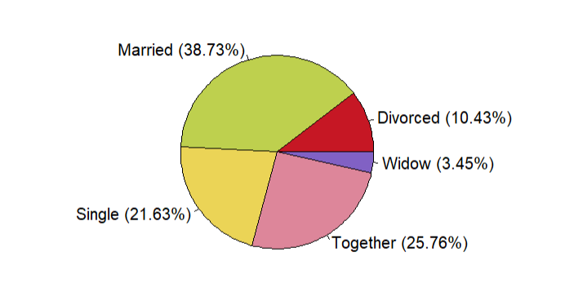
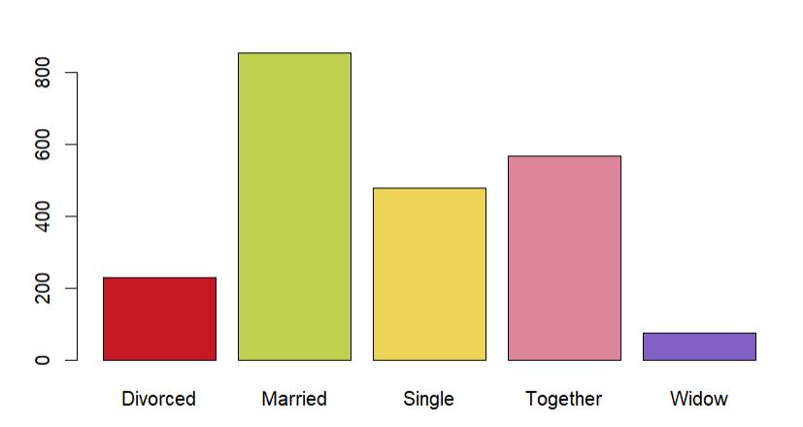
What is the sample proportion of customer segments based on their marital status?
Most customers are married (39%), followed by those in relationships, but not married (26%), and then singles (22%). Divorced and widowed customers make up smaller percentages.

Slide 9
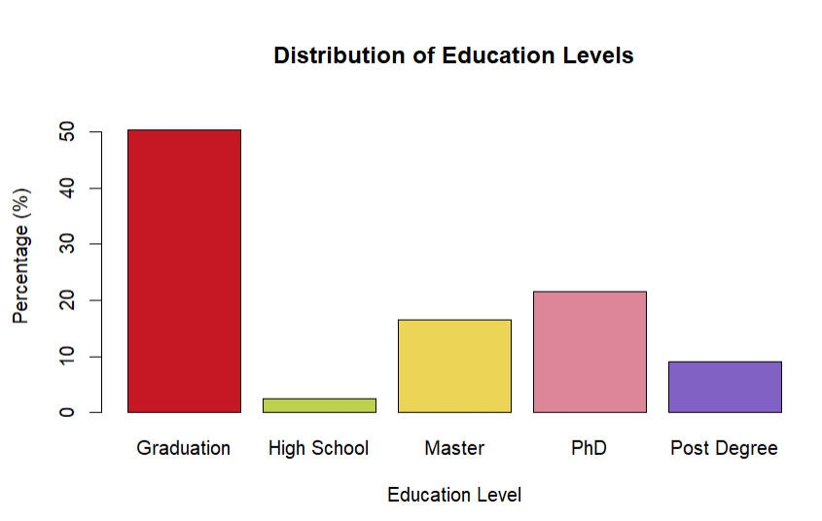
What is the sample proportion of customer segments based on their education level?
Well-educated customer base with 50% holding Bachelor's degree, 22% holding Ph.D., and 17% holding Master’s degree, contributing to their substantial income.

Slide 10
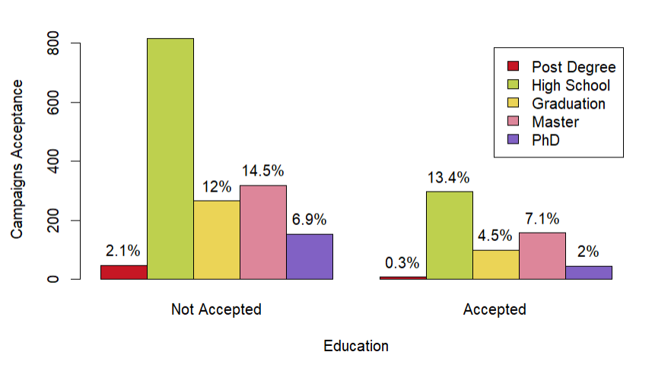
Is there an association between educational level and customer’s acceptance of the marketing campaigns?
The two-groups of bars look alike so we can assume that the customer's education level and campaign acceptance are independent to each other.

Slide 11
Is there an association between educational level and customer’s acceptance of the marketing campaigns?
Performing Chi-Square Test
Hypothesis:
H0: Education and Campaign Acceptance are independent among all subjects in the population.
Ha: Education and Campaign Acceptance are not independent among all subjects in the population.
X-squared = 15.663, df = 4, p-value = 0.003506
DF 4 correspond to a Decision Point of 9.49
Since the chi-squared value of 15.663 is greater than 9.49, we reject the null hypothesis and conclude that Education and Campaign Acceptance are not significantly independent of each other among all subjects in the population.

Slide 12
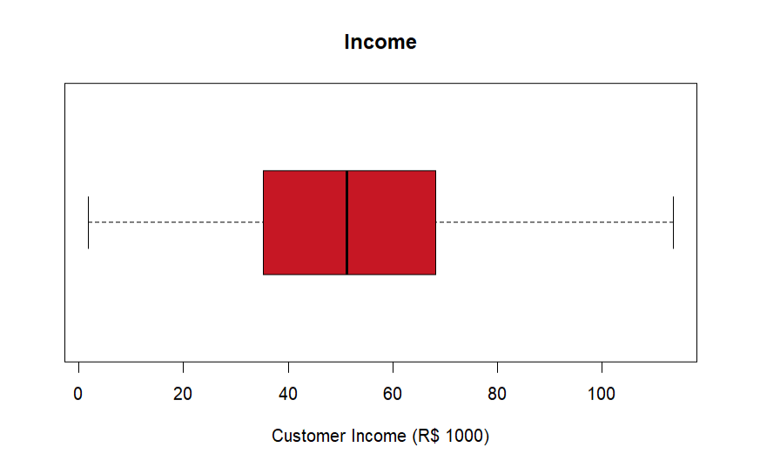
What is the quartile ranking of customers’ income?
IQR: R$ 33,085
1st Quartile: R$ 35,196
2nd Quartile (Median): R$ 51,287
3rd Quartile: R$ 68,281
Minimum Income: R$ 1,730
Maximum Income: R$ 113,734
Average Income: R$ 51,622
The distribution is approximately symmetrical with the mean and median almost equal.

Slide 13
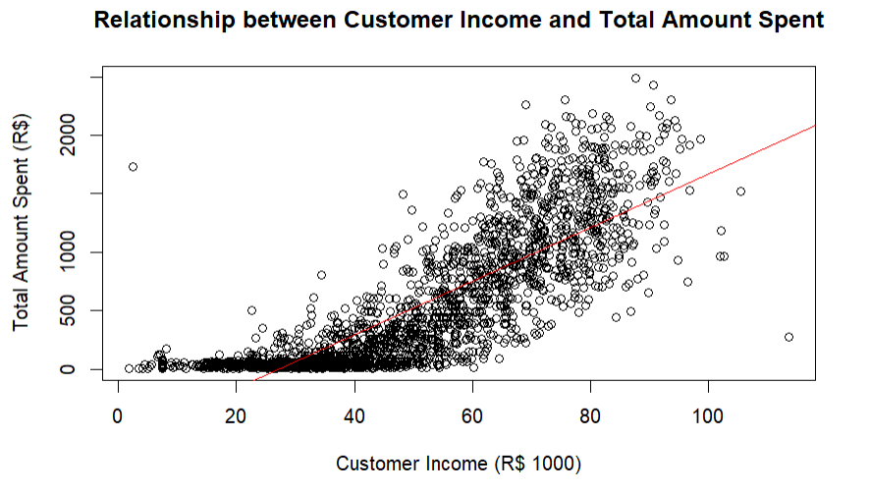
What is the relationship between income and amount spent by customers?
There is a strong, linear, positive relationship between customer income and total amount spent
For every extra thousand R$ earned, households are expected to spend R$22 more
Correlation coefficient = 0.82
Total amount spent = -619 + 23*(Income)

Slide 14
Conclusion & Recommendation
Conclusion | Recommendation
Majority of the customers are in relationships comprising of 64.49% of married and common-law partners. | Customize marketing campaigns for couples. Conduct further study with a drill-down analysis on single customer’s product preferences to craft strategies for market penetration.
Customers consist predominantly of individuals with a high level of education, with half of the sample population holding a bachelor's degree. | The management at iFood might consider expanding their reach to a different customer demographic through introduction of a different product or low-cost brand. Include customers with high level of education in marketing campaigns.
The level of customer education and the receptiveness to marketing campaigns are influenced by each other based on chi-square test.

Slide 15
Conclusion & Recommendation
Conclusion | Recommendation
Customers have been segmented as per the quartile rank: 1st Quartile: R$ 35,196 2nd Quartile (Median): R$ 51,287 3rd Quartile: R$ 68,281 | Tailor marketing promotions to resonate with customer segments whose income surpasses the median, as they are statistically inclined to exhibit higher spending patterns. Conduct further study with a drill-down analysis on the high-income segment’s product preference.
There is a strong, linear, positive correlation between customer income and total amount spent.

Slide 16
Thank you!
Presented by
Andy Nguyen
Thaise Neves Soares
Van Huan Le
Patricia Tating

