Slide 1
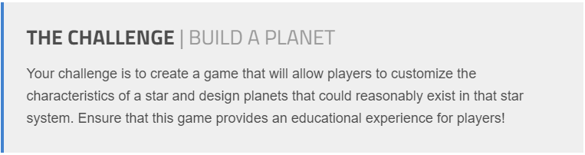
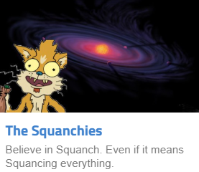



Slide 2
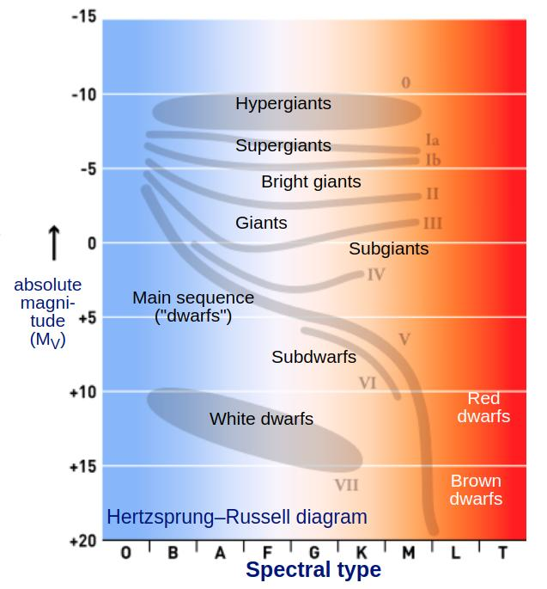
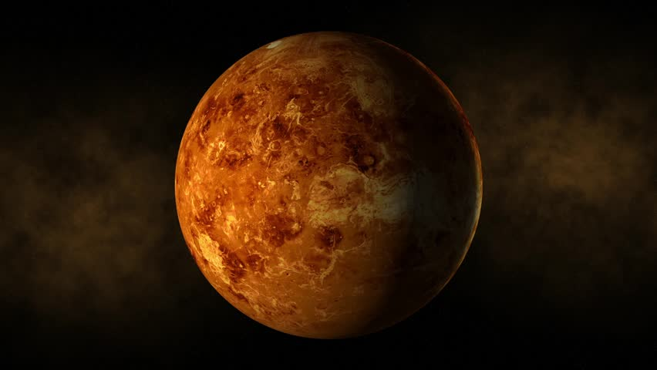
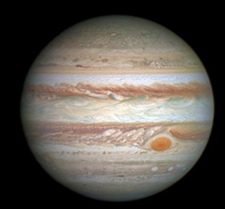
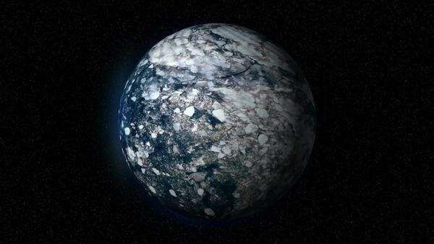
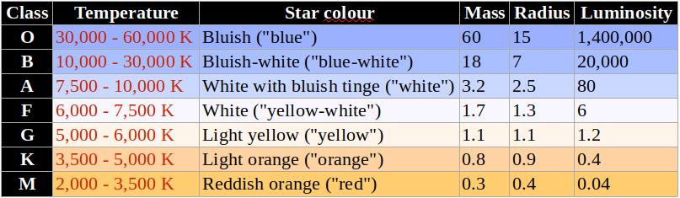
Background
Stars, Planets and Habitable Zones
Rocky
Gas
Ice

Slide 3
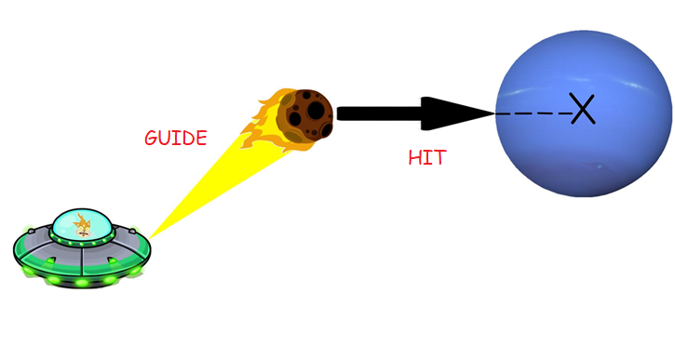
Armageddon It!
Game Story
Player: - spaceship from a super advanced civilization
Purpose: - help a new solar system to form
Gameplay: - capture and slingshot asteroids into planets
Score: - maximize the potential survivors by having as many planets as possible in Goldilocks Zone

Slide 4

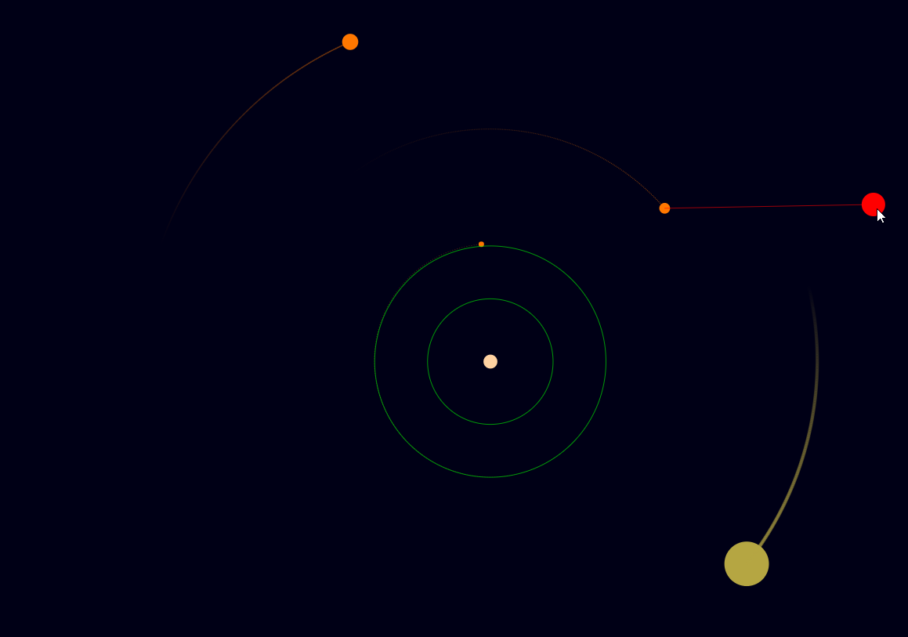
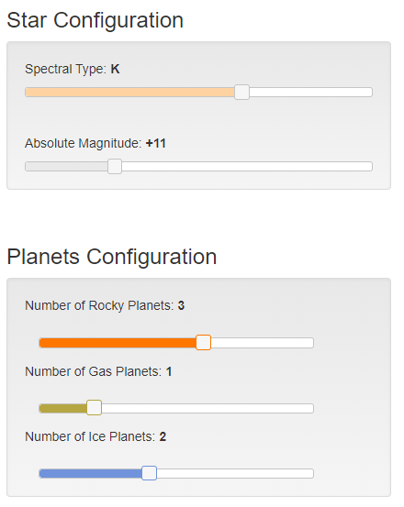
Armageddon It!
Gameplay

Slide 5




Armageddon It!
Technologies

Slide 6

Armageddon It!
Live Demo + Q&A
https://patriciaalbu.github.io/armageddon-it/

