Slide 1

BBC Micro:bit and programming
Dr. Patricia Charlton
Patricia.charlton@open.ac.uk
As part of Institute of Coding

Slide 2
Links
BBC micro:bit https://www.microbit.co.uk/
Micro Python programming
Mu Python Editor https://codewith.mu/#download
(Micro)Python guide https://www.microbit.co.uk/python-guide
BBC micro:bit MicroPython latest documentation: https://microbit-micropython.readthedocs.io/en/latest/index.html
Charlton P, Poslad S. A Sharable Wearable Maker Community IoT Application, 12th Int. Conf. on Intelligent Environments, IE’16, Sep. 14-16, London, UK, pp. 16 - 23, DOI: 10.1109/IE.2016.12, accessed via https://www.researchgate.net/publication/308267280_A_Sharable_Wearable_Maker_Community_IoT_Application

Slide 3
Introduction
What is electronics? What experiences do we have already?
What do we know about BBC Micro:bit?
Let’s take a quick look at the device – what can we find on the device?
What do we already know about programming?

Slide 4
BBC Micro:bit 1
Designed to more inclusive to get a wider range of people interested in digital electronics and processing
1. Small enough (1/2 a credit card in size) to take anywhere
2. Simple enough for beginners to experiment with and get started with to create and explore ideas
3. Extensible, flexible and adaptable to enable advanced ideas to be designed and crafted
4. Sustainable in both cost and imagination - low cost extensible device to create interesting applications & experiments
5. Able to support both formal and informal education
6. Be fun, innovative and creative to use, and,
7. Be usable by just about anyone who wants to explore technology and create something personally purposeful.

Slide 5
BBC Micro:bit 2
Some differences between Micro:bit versus other microcontrollers, e.g., Arduino are:
Less I/O channels
On board display (actuators): 5 *5 LED matrix can show text as scrolling letters
On board pushbutton (actuators) - programmable
On board sensors: 3-axis magnetometer (compass direction), 3 axis accelerometer (motion)
Temperature etc. can be derived
On board radio link: BLE vs. proprietary protocols
N.B. H/W add-ons are not needed for the micro:bit for some common actuators and sensors, else these increases the device size, cost, multi-device integration complexity

Slide 6
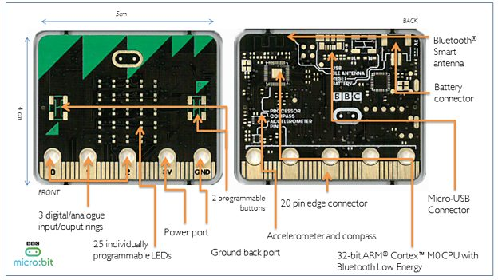
BBC Micro:Bit 3

Slide 7
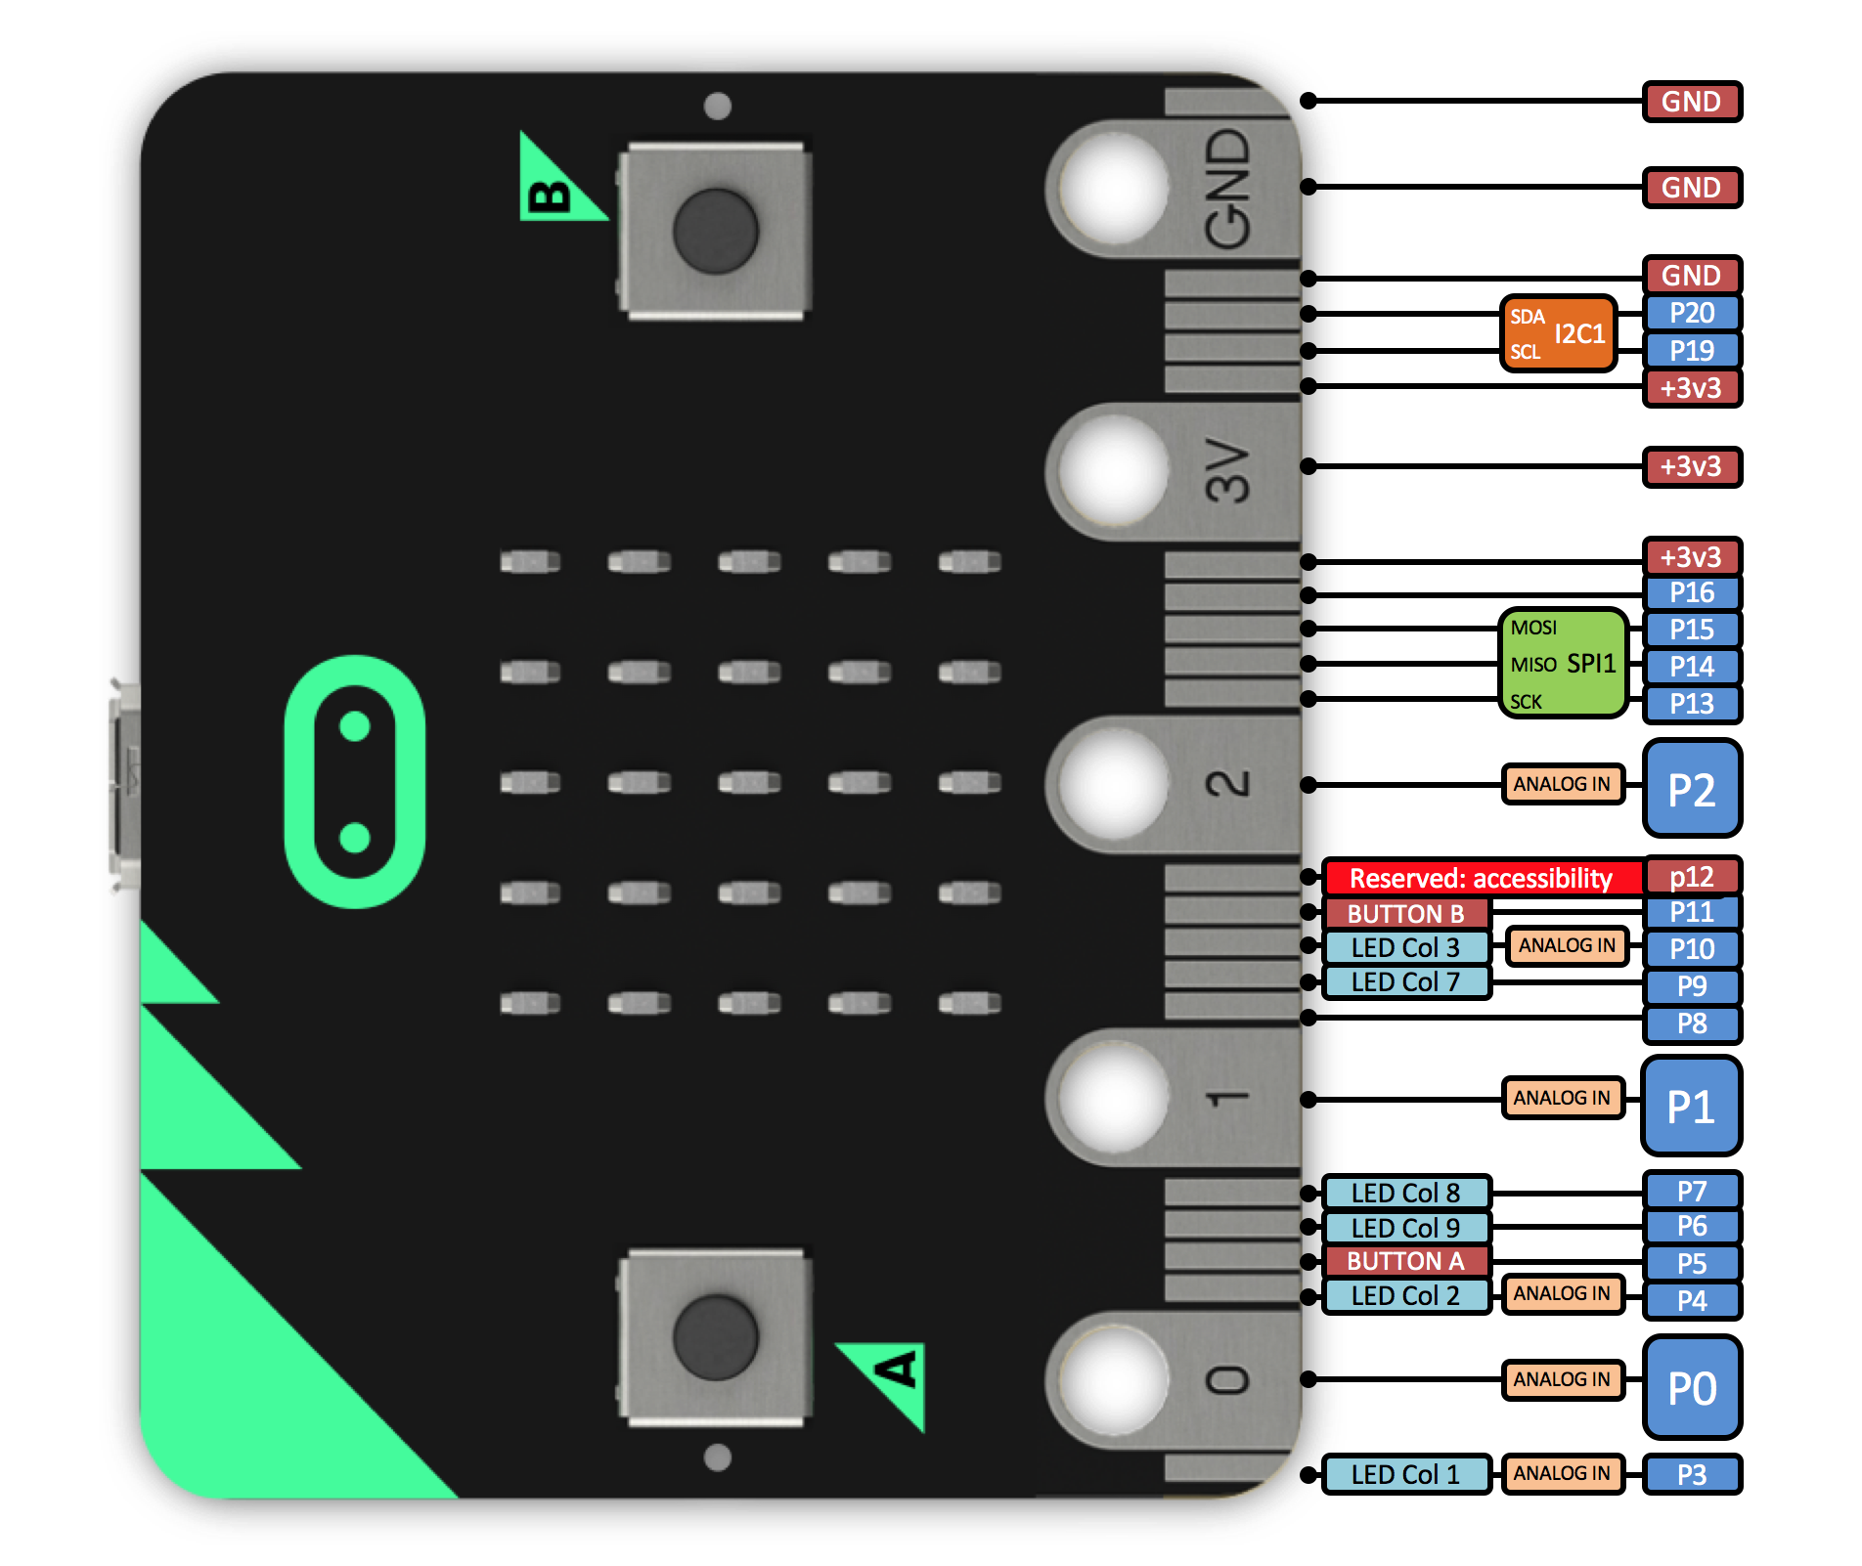
BBc Micro:bit 4

Slide 8
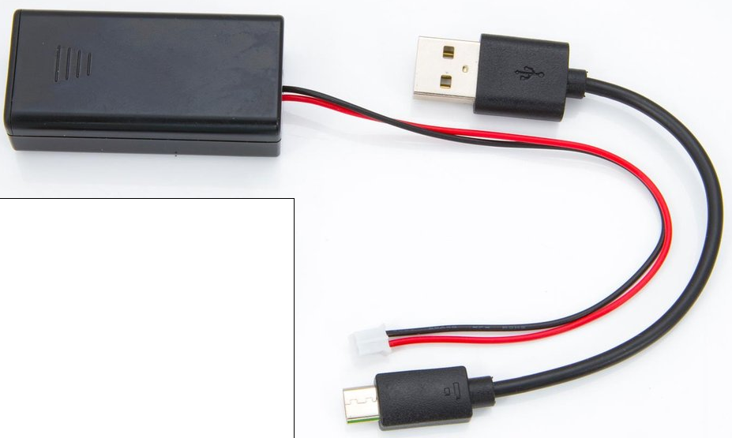
How to power the Micro:bit
Via a Micro USB to normal USB lead, same one as used for charging up an Android phone
Via a battery cable attached to a 2 x AAA Battery holder terminated with a JST-PH connector to plug into the Micro:bit, costs about £2
Don’t use both, use 1 or the other to power the Micro:bit
2
1

Slide 9
Editing and downloading Python code onto the Micro:bit
Once executable code is downloaded or flashed to the Micro:bit (using the mu editor flash button) that is compatible with it, it automatically executes it
Some source code is interpreted (e.g., Python, Javascript) on the device, some source code needs to be compiled into an executable form to execute it (e.g., Touch Develop)
If you download and install the Mu python editor it is set up to download the code (via the download button) to the micro:bit if connected via a USB port
If you use online web version then the .hex file will need to be copied across to the micro:bit.

Slide 10
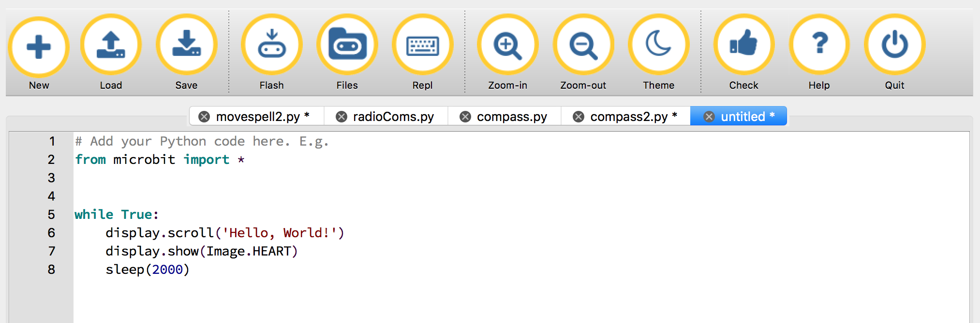
Getting started in mu - Hello world classic
What does the code mean?
Program is in a loop to repeat itself forever
1st action is scroll text
2nd action display an image
3rd action is sleep - a delay in mS

Slide 11
Input pin and push-button as simple actuators
from microbit import *
while True:
if button_a.is_pressed():
# if pin0.read_digital():
# if pin0.is_touched():
display.show(Image.HAPPY)
else:
display.show(Image.SAD)

Slide 12
Input pin and push-button as simple actuators 2
Controllers, control other hardware devices that change the state of the physical environment via actuators
What does the code mean?
The program allows us to use 3 different actuators to change the default sad face to a happy face
Either by pressing button a
Or by something conductive between pin 0 and 3V = take care not to short-circuit pin 0 to 3V use something that has a resistance
Or by touching pin 0 with respect to ground – body is acting as a large capacitor to create a circuit

Slide 13
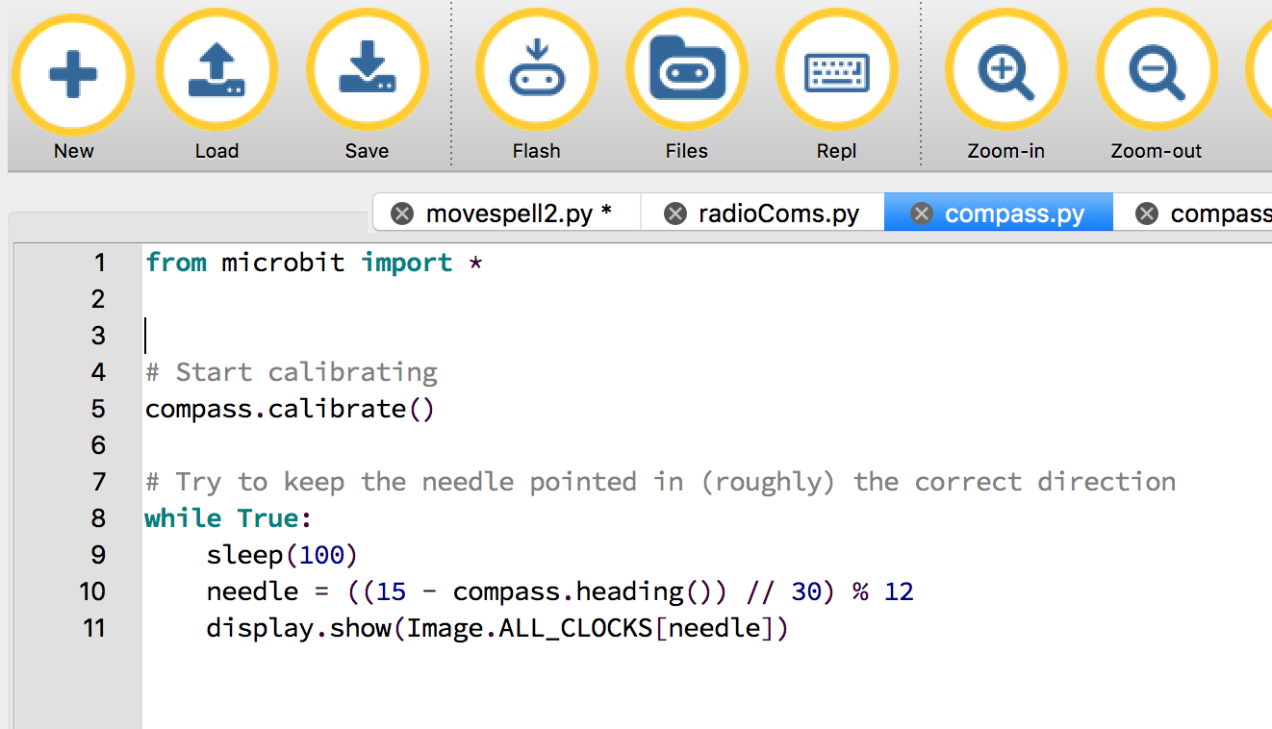
Sensing direction: compass

Slide 14
Sensing direction: compass 2
What does the code mean?
If you don’t understand a line of code, look it up in the micropython guide, link was given earlier
Some sensors need to be calibrated (or configured) before use, e.g., compass, else the sensor data may produce is meaningless data
There after, when the 3 pixels on the micro;bit display line up that ‘3 dot line’ points to north
Private Investigation
How can you tell the compass is working correctly? Can you estimate where North should be, i.e., based upon landmarks?
What happens if you comment out the calibrate line of code
Does a phone map app that uses a compass require calibration?

Slide 15
Sensing the degree of motion
from microbit import *
while True:
reading = accelerometer.get_x()
if reading > 20:
display.show("R")
elif reading < -20:
display.show("L")
else:
display.show("-")

Slide 16
Sensing the degree of motion 2
Several common devices know make use of motion sensors:
Mobile phone knows which up to show the images on its screen
Game controllers steer and move around in games
These use an accelerometer as this program example does to do this
Such Accelerometers work in 3 directions or along three axes:
X - tilting from left to right.
Y - tilting forwards and backwards.
Z - moving up and down.
What does the code mean?
Here’s a very simple spirit-level that uses get_x to measure how level the device is along the X axis
If we hold the device flat it should display -; however, rotate it left or right and it’ll show L and R respectively.
Private investigations:
How can we use this to step count – pedometer?
How can make this orientation independent to sense the degree of movement overall along any axes?

Slide 17
Sensing temperature 1
from microbit import *
while True:
temp = temperature()
display.show(str(temp))
#display.scroll(str(temp) + ‘C’)
sleep(500)
N.B,. The earlier comment about the on-board (or internal) system temperature versus the (derived) external (or ambient) environment measurement differences
What does the code mean?

Slide 18
Sensing temperature 2
Let’s investigate the use temperature sensor so that you can keep a log of the temperature in different rooms.
Think of the functions needed?
Sense temperature –
Anything else
Private investigations
How do we cross-check, calibrate the temperature sensor to verify it measures correctly?
How to link the physical world state to the wider context or conditions?, e.g., to relate the temp the location and time?
How do we process / combine / aggregate / fuse multiple sensor measurements in nearby locations?

Slide 19
Radio of things

Slide 20
Micro:bit Wireless Support 2
import radio
import random
from microbit import display, Image, button_a, sleep
# Create the "flash" animation frames. Can you work out how it's done?
flash = [Image().invert()*(i/9) for i in range(9, -1, -1)]
# The radio won't work unless it's switched on.
radio.on()
# Event loop.
while True:
# Button A sends a "flash" message.
if button_a.was_pressed():
radio.send('flash') # a-ha
# Read any incoming messages.
incoming = radio.receive()
if incoming == 'flash':
# If there's an incoming "flash" message display
# the firefly flash animation after a random short
# pause.
sleep(random.randint(50, 350))
display.show(flash, delay=100, wait=False)
# Randomly re-broadcast the flash message after a
# slight delay.
if random.randint(0, 9) == 0:
sleep(500)
radio.send('flash') # a-ha

Slide 21
Micro:bit Wireless Support 3
What does the code mean?
What can you do to make this more interesting? What kind of messages

