Slide 1
NetLogo
7.0
Session 2
Agent-Based Modelling in the Social Sciences

Slide 2

ABM with NetLogo
NetLogo
Goals
Introduction to NetLogo – Basic concepts
Lab 1: Introduction to coding in NetLogo
  Creating variables
  Creating breeds
  Creating turtles
  Creating buttons and sliders
  Creating basic procedures
Agent-Based Modelling in the Social Sciences

Slide 3

ABM with NetLogo
NetLogo
NetLogo is a programmable modeling environment for simulating natural and social phenomena. It was authored by Uri Wilensky in 1999 and has been in continuous development ever since at the Center for Connected Learning and Computer-Based Modeling. (Wilensky, U. 1999)
NetLogo was designed under two main principles:
A very accessible programming language able to be used for any individual without any particular training on programing
A programming language able to be used to create highly complicated models
Uri Wilensky
Agent-Based Modelling in the Social Sciences

Slide 4
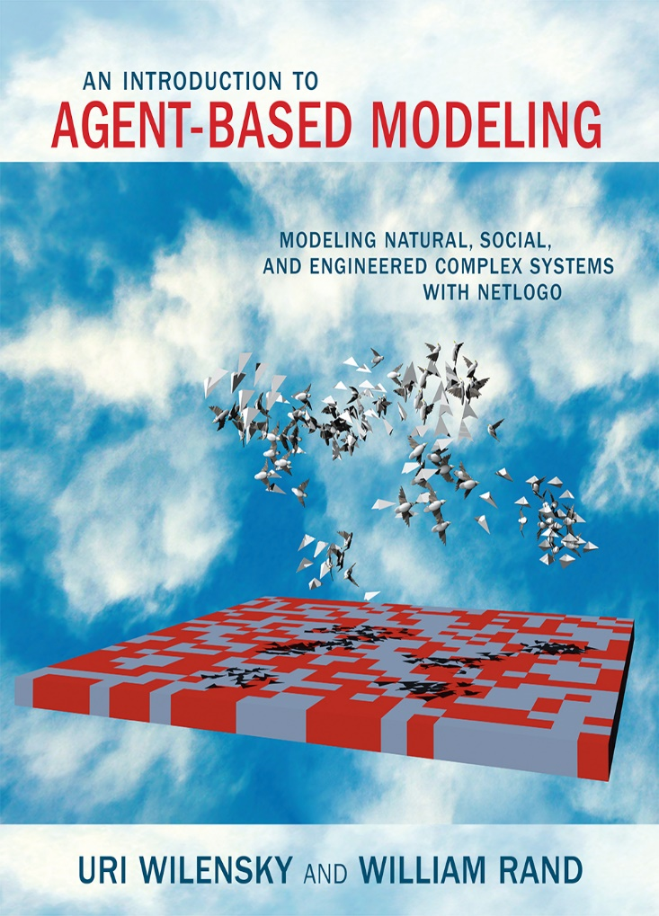
ABM with NetLogo
NetLogo
NetLogo is a programmable modeling environment for simulating natural and social phenomena. It was authored by Uri Wilensky in 1999 and has been in continuous development ever since at the Center for Connected Learning and Computer-Based Modeling. (Wilensky, U. 1999)
NetLogo was designed under two main principles:
A very accessible programming language able to be used for any individual without any particular training on programing
A programming language able to be used to create highly complicated models
Agent-Based Modelling in the Social Sciences

Slide 5

Why
NetLogo?
Agent-Based Modelling in the Social Sciences

Slide 6
ABM with NetLogo
Why
NetLogo?
Because is easy!!!
It’s being used in many scientific fields (It’s the most widely used platform for ABMs)
It’s well documented
It’s a free and open source software
Cross-platform: runs on Mac, Windows, Linux.
It’s an object-oriented programming language.
Agent-Based Modelling in the Social Sciences

Slide 7
Object-oriented programing
Object A
----------------
Attribute A1
Attribute A2
Attribute An
----------------
Procedure PA1
Procedure PA2
Procedure PAn
Computational entities
Agent-Based Modelling in the Social Sciences

Slide 8
Object-oriented programing
Object A
----------------
Attribute A1
Attribute A2
Attribute An
----------------
Procedure PA1
Procedure PA2
Procedure PAn
Object B
----------------
Attribute B1
Attribute B2
Attribute Bn
----------------
Procedure PB1
Procedure PB2
Procedure PBn
message
Agent-Based Modelling in the Social Sciences

Slide 9
Object-oriented programing
Object A
----------------
Attribute A1
Attribute A2
Attribute An
----------------
Procedure PA1
Procedure PA2
Procedure PAn
Object B
----------------
Attribute B1
Attribute B2
Attribute Bn
----------------
Procedure PB1
Procedure PB2
Procedure PBn
message
Because of this, somebody thought:
Aha! This resembles something!
Agent-Based Modelling in the Social Sciences

Slide 10


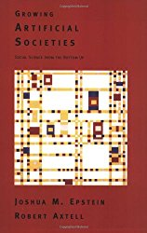
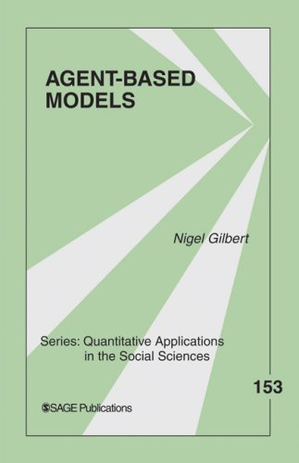
Object-oriented programing
Object A
----------------
Attribute A1
Attribute A2
Attribute An
----------------
Procedure PA1
Procedure PA2
Procedure PAn
Object B
----------------
Attribute B1
Attribute B2
Attribute Bn
----------------
Procedure PB1
Procedure PB2
Procedure PBn
Causation as Generative Process
Computational Sociology
message
Joshua M. Epstein
Nigel Gilbert
Because of this, somebody thought:
Aha! This resembles something!
Agent-Based Modelling in the Social Sciences

Slide 11
Object-oriented programing
Object A
----------------
Attribute A1
Attribute A2
Attribute An
----------------
Procedure PA1
Procedure PA2
Procedure PAn
Object B
----------------
Attribute B1
Attribute B2
Attribute Bn
----------------
Procedure PB1
Procedure PB2
Procedure PBn
Agent A
----------------
Property A1
Property A2
Property An
----------------
Activity PA1
Activity PA2
Activity PAn
Agent B
----------------
Property B1
Property B2
Property Bn
----------------
Activity PB1
Activity PB2
Activity PBn
message
message
Agent-Based Modelling in the Social Sciences

Slide 12
Object-oriented programing
Object A
----------------
Attribute A1
Attribute A2
Attribute An
----------------
Procedure PA1
Procedure PA2
Procedure PAn
Object B
----------------
Attribute B1
Attribute B2
Attribute Bn
----------------
Procedure PB1
Procedure PB2
Procedure PBn
Agent A
----------------
Property A1
Property A2
Property An
----------------
Activity PA1
Activity PA2
Activity PAn
Agent B
----------------
Property B1
Property B2
Property Bn
----------------
Activity PB1
Activity PB2
Activity PBn
message
message
Agent 1
----------------
# links
----------------
Spread rumor
Agent 2
----------------
# links
----------------
No Spread rumor
message
Agent-Based Modelling in the Social Sciences

Slide 13

ABM with NetLogo
Why
NetLogo?
NetLogo performs poorly when the number of agents and procedures is high
Emma Norling, Bruce Edmonds, and Ruth Meyer (2013)
Agent-Based Modelling in the Social Sciences

Slide 14
Definition
NetLogo
Basic
concepts
Agent-Based Modelling in the Social Sciences

Slide 15
ABM with NetLogo
Agents
Who receives orders?
How to give orders?
Where save information?
Agent-Based Modelling in the Social Sciences

Slide 16
Who receives orders?
Agents
Who receives orders?
Agents!!!
Entities that follows instructions
Observer
Turtles
Patches
Links
Agent-Based Modelling in the Social Sciences

Slide 17

Who receives orders?
Observer
Observer
Thesis supervisor:
"A simulation you must implement"
Agent-Based Modelling in the Social Sciences

Slide 18
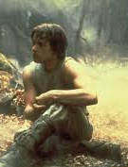
Who receives orders?
Observer
Observer
Thesis supervisor:
"A simulation you must implement"
Yes, my master
Agent-Based Modelling in the Social Sciences

Slide 19

Who receives orders?
Observer
Observer
Turtles
Thesis supervisor:
"A simulation you must implement"
Yes, my master
Agent-Based Modelling in the Social Sciences

Slide 20
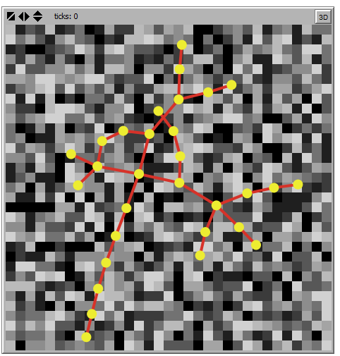
Who receives orders?
Now, observer tells turtles, patches and links what to do…
Agent-Based Modelling in the Social Sciences

Slide 21
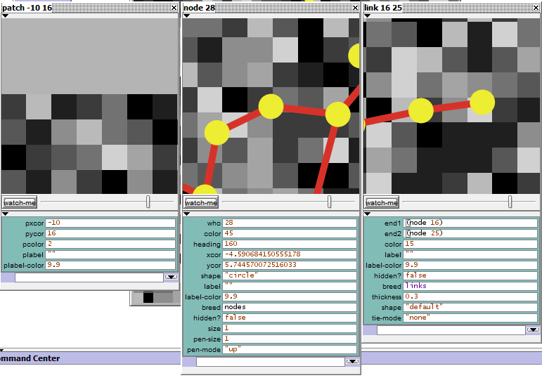
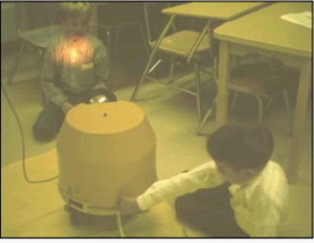
Who receives orders?
Turtles
Turtles
A robot, 1971 (it looks like a turtle)
Agent-Based Modelling in the Social Sciences

Slide 22
Who receives orders?
Patches
Patches
Agent-Based Modelling in the Social Sciences

Slide 23
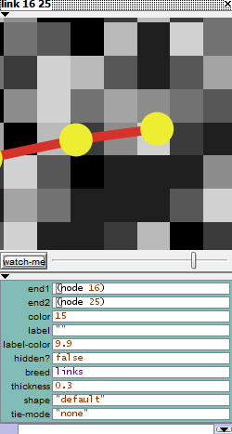
Who receives orders?
Links
Links
Agent-Based Modelling in the Social Sciences

Slide 24
ABM with NetLogo
How to give orders?
Who receives orders?
How to give orders?
Where save information?
Agent-Based Modelling in the Social Sciences

Slide 25
ABM with NetLogo
How to give orders?
build-in NetLogo. Examples: hide-turtle / die / face / forward
ask
It’s a par excellence built-in procedure in NetLogo
It’s used to order different tasks to the agents.
You can order to a single turtle:
ask turtle 1 [ forward 1]
;; Or you can order to an agentset (set of turtles)
ask turtles [forward 1]
Primitives
Commands
Procedures
Reports
Agent-Based Modelling in the Social Sciences

Slide 26
ABM with NetLogo
How to give orders?
Defined by the observer.
Structure:
to walk -> walk is the name of the procedure
ask turtles [fd 1] -> the content
end -> to end the procedure
to get_older
ask turtles [die]
end
to live
walk
get_older
end
Primitives
Commands
Procedures
Reports
Agent-Based Modelling in the Social Sciences

Slide 27
ABM with NetLogo
How to give orders?
Commands
A reporter is an instruction created by the user for computing a value (like a function in R)
to-report absolute-value [number] -> number is the input
ifelse number >= 0
[report number ]
[ report (number * number) ]
end
Reports
Agent-Based Modelling in the Social Sciences

Slide 28
ABM with NetLogo
Agents
Who receives orders?
How to give orders?
Where save information?
Agent-Based Modelling in the Social Sciences

Slide 29
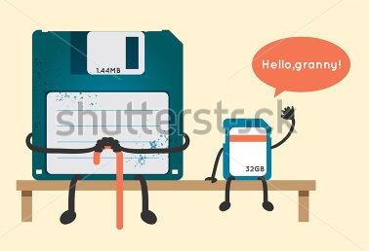
Variables
Variables
Variables
Where do agents store the information?
Agent-Based Modelling in the Social Sciences

Slide 30
Variables
Variables
Variables
Globals
Turtles
In-built
Types
Agents
Patches
Created by user
Links
Locals
Agent-Based Modelling in the Social Sciences

Slide 31
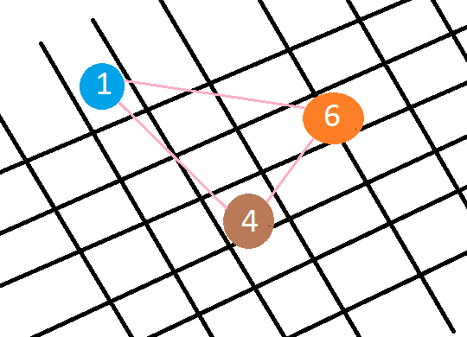
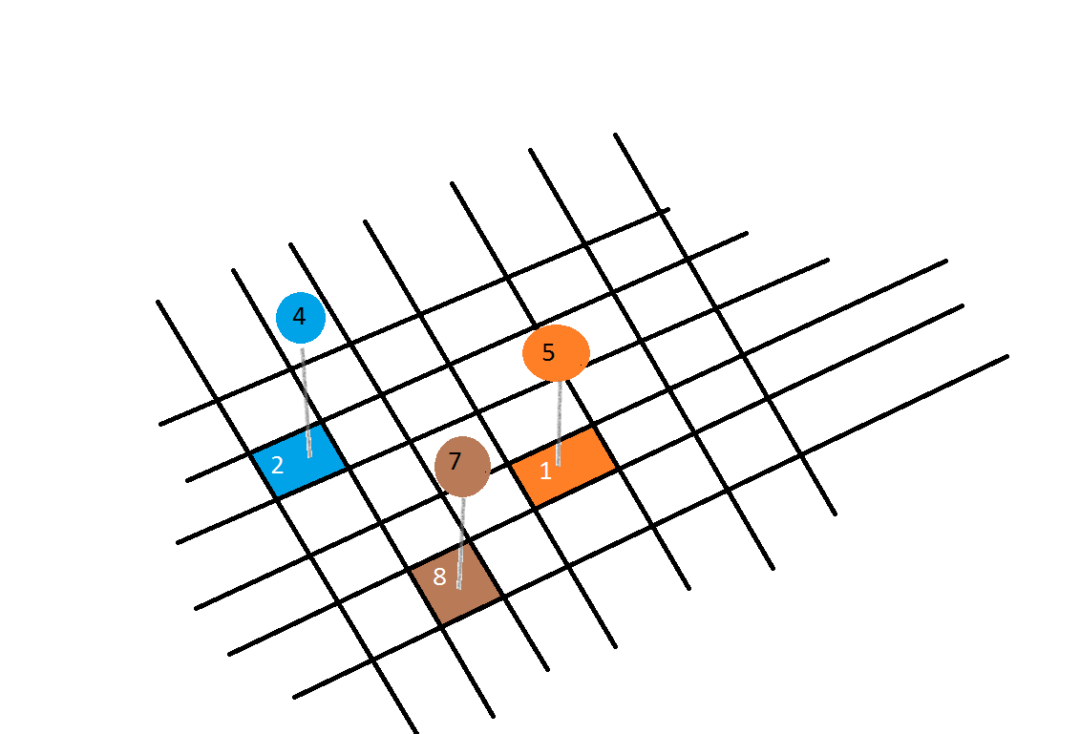
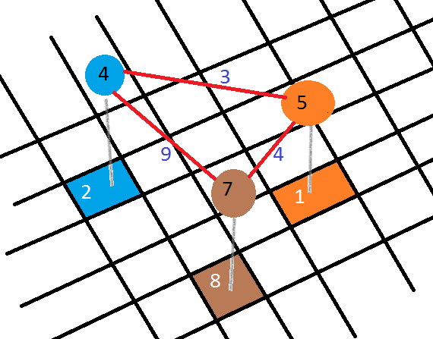
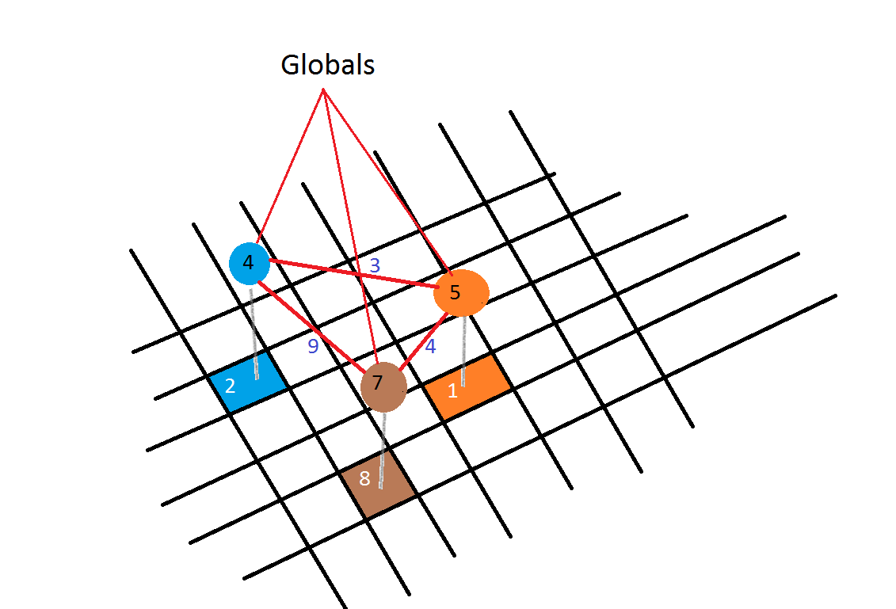
Interaction
Interaction
Between agents
and patches
Among agents
B) Interactions
Between agents,
Patches and links
Between all
Agent-Based Modelling in the Social Sciences

Slide 32
Definition
Take a Look at
NetLogo
Agent-Based Modelling in the Social Sciences

Slide 33
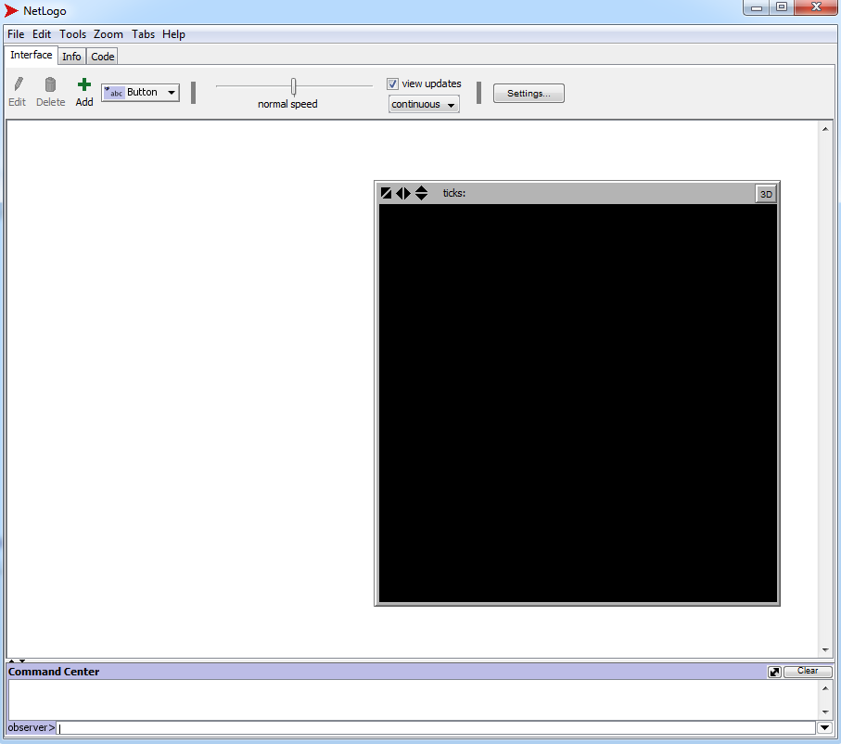
ABM with NetLogo
NetLogo
Agent-Based Modelling in the Social Sciences

Slide 34
ABM with NetLogo
NetLogo
World (coordinates)
command center output window
command center: to give instructions to the agents
Agent-Based Modelling in the Social Sciences

Slide 35
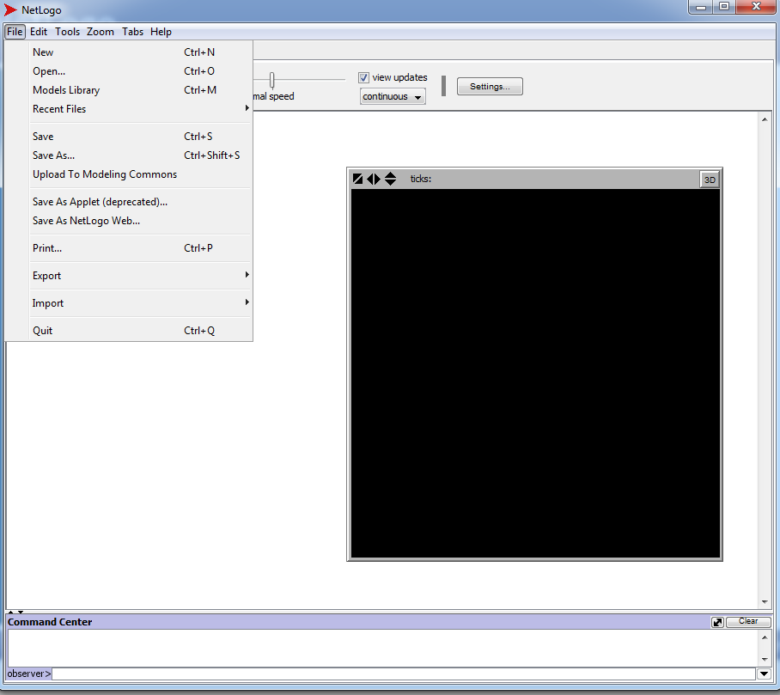
ABM with NetLogo
NetLogo
Agent-Based Modelling in the Social Sciences

Slide 36
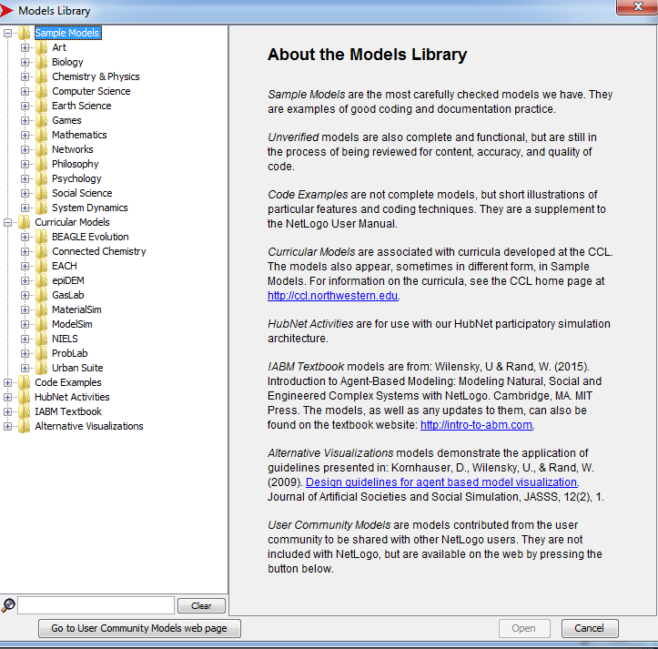
ABM with NetLogo
NetLogo
Agent-Based Modelling in the Social Sciences

Slide 37
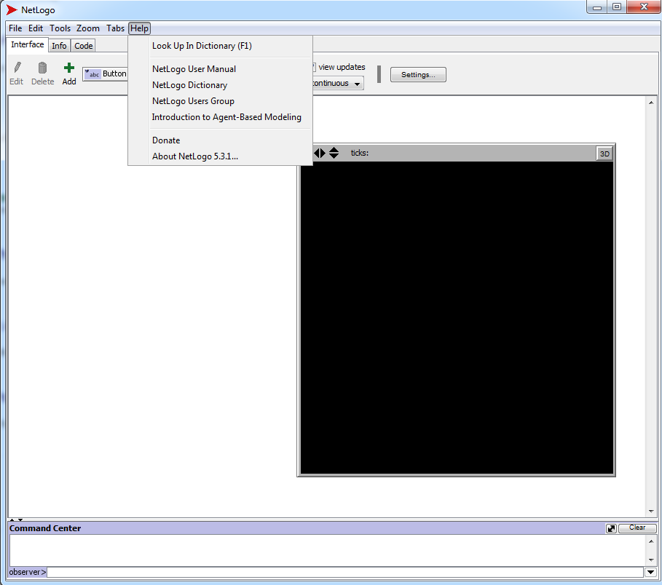
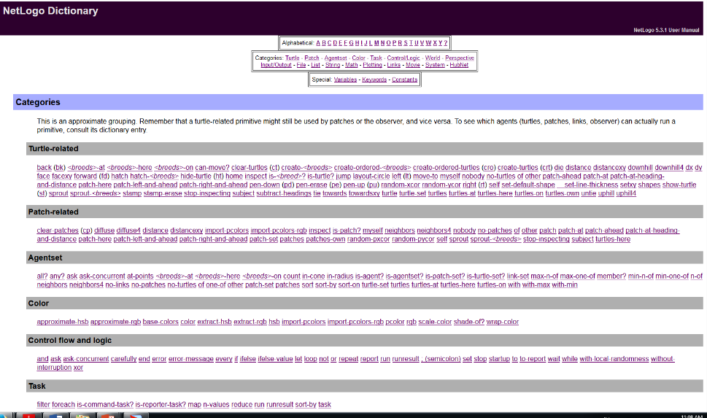
ABM with NetLogo
NetLogo
Agent-Based Modelling in the Social Sciences

Slide 38
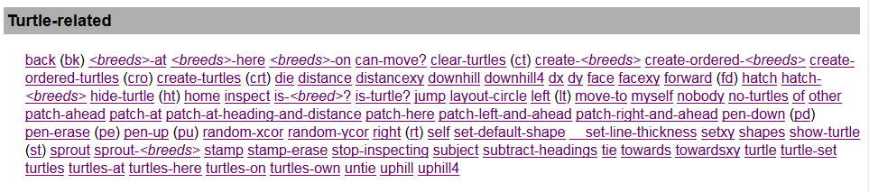
ABM with NetLogo
NetLogo
Agent-Based Modelling in the Social Sciences

Slide 39
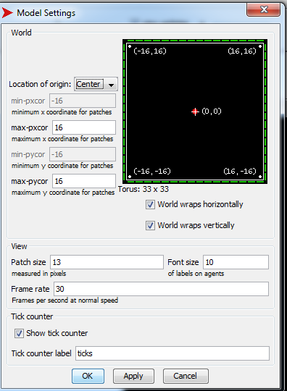
ABM with NetLogo
NetLogo
Agent-Based Modelling in the Social Sciences

Slide 40
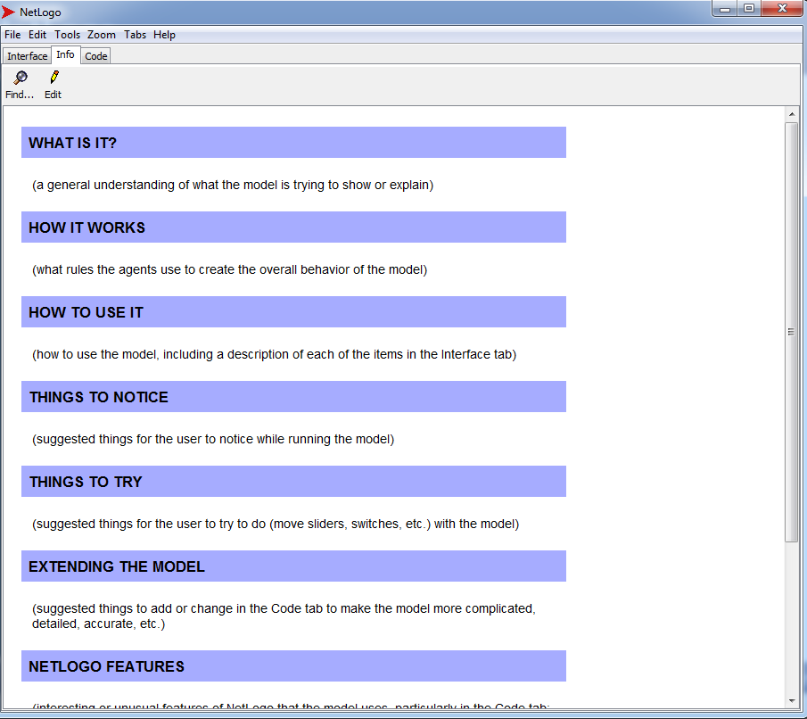
ABM with NetLogo
NetLogo
Agent-Based Modelling in the Social Sciences

Slide 41
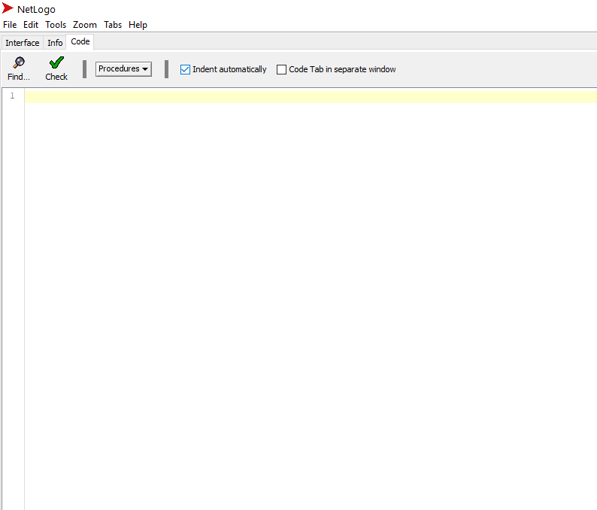
ABM with NetLogo
NetLogo
Agent-Based Modelling in the Social Sciences

Slide 42
Definition
Typical
Model
structure
Agent-Based Modelling in the Social Sciences

Slide 43
ABM with NetLogo
NetLogo
 | Model structure
Initial conditions Declare initial variables Global / turtles / patches / links | to setup …. end
Agent procedures | Turtles- procedures Patches-procedures Links-procedures
User-procedures | reports
Run simulation | to go [simulation] end
Update | Plots Aggregated information Visualization
Agent-Based Modelling in the Social Sciences

Slide 44
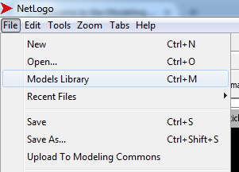
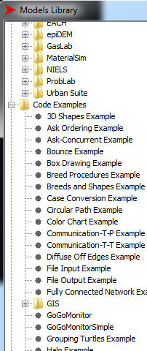
ABM with NetLogo
Why
NetLogo?
How to start with NetLogo?
Taking this course!!!
NetLogo User Manual: file:///C:/Program%20Files%20(x86)/NetLogo%205.1.0/docs/index.html
NetLogo Dictionary: file:///C:/Program%20Files%20(x86)/NetLogo%205.1.0/docs/index2.html
NetLogo User groups: https://groups.yahoo.com/neo/groups/netlogo-users/info
Modelling Commons: http://modelingcommons.org/account/login
NetLogo Models Library:
Agent-Based Modelling in the Social Sciences

Slide 45
Definition
Let’s start!
Simple task!
Agent-Based Modelling in the Social Sciences

Slide 46

ABM with NetLogo
NetLogo
Coding procedures [lab_1.nlogo]
Let’s go to NetLogo!!!
Agent-Based Modelling in the Social Sciences

