Slide 1
NetLogo
7.0
Agent-Based Modelling in the Social Sciences

Slide 2

ABM with NetLogo
NetLogo
Overview last week
Defining turtle variables
Creating monitors
Creating plots (histograms and lines)
Creating a histograms
Creating choosers
Flowcharts
Make behavioral experiments
Basic models:
  Creating a basic model 1: Simple economy (simple turtle interaction)
  Creating a basic model 2: Fire model (simple patch-based interaction)
  Creating a basic model 3: Toni’s problem (simple turtle-based interaction with movement)
  Creating a basic model 4: Model 3: Intervention timing (simple turtle-based interaction with movement)
  Creating a basic model 4: Schelling model of segregation (simple patch-based interaction)
Agent-Based Modelling in the Social Sciences

Slide 3
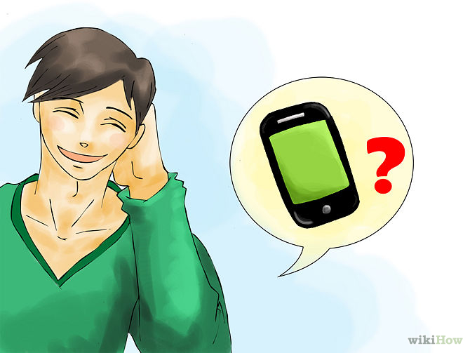
ABM with NetLogo
NetLogo
Model 3:
Toni’s problem
Problem statement:
Toni is a single guy who is looking for a partner. In order to do that, he goes to a Rock Festival to collect as many phone numbers as possible. However, he is uncertain about which of the following strategies to pursue to maximize the number of phone numbers:
1) Staying in the center of the Festival all day.
2) Walking around in a circle.
3) Walking randomly through the Festival.
Agent-Based Modelling in the Social Sciences

Slide 4
ABM with NetLogo
NetLogo
Let´s help Toni to figure it out!
Assumptions:
The Rock Festival is a square field where people walk around in a random fashion.
When Toni meets someone (both on the same patch), he asks for her phone number. People always give their phone numbers to Toni (Deterministic model).
If Toni meets two persons on the same patch, he can only ask one of them (randomly) for her number.
Toni cannot ask the number of the same person twice.
Agent-Based Modelling in the Social Sciences

Slide 5
ABM with NetLogo
Flow
chart
Agents & environment
Toni
Persons
Global variables
Festival
setup
Toni walks / Persons walk
Is there anybody at current Toni’s place?
yes
no
How many?
Go
Only 1
More than 1
Toni picks 1
Is she been asked before?
no
yes
Toni gets a new number
Agent-Based Modelling in the Social Sciences

Slide 6

ABM with NetLogo
NetLogo
Let’s go to NetLogo!!!
File: lab2_4.Nlogo
Agent-Based Modelling in the Social Sciences

Slide 7
ABM with NetLogo
NetLogo
Staying in the center of the Festival all day.
2) Walking around in a circle.
3) Walking randomly through the Festival.
Agent-Based Modelling in the Social Sciences

Slide 8
ABM with NetLogo
NetLogo
Model 3: Intervention timing
A policymaker is evaluating which non-pharmaceutical interventions he must implement in order to prevent the spread of a virus. Since there is a lot of uncertainty about how to proceed, she needs more information to make a decision. One piece of information she needs to know is how effective would be the intervention given to the current diffusion rate of the virus.
Potential interventions
Close borders (hard = nobody can get in or get out from a specific region)
Social distance (hard = only 5% of the population can move around)
Nothing
Agent-Based Modelling in the Social Sciences

Slide 9
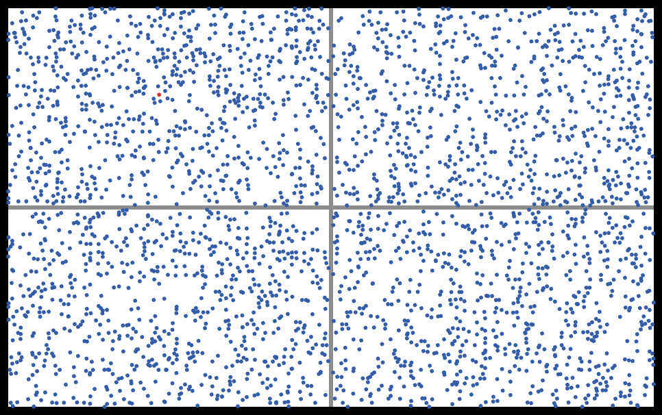
ABM with NetLogo
NetLogo
Assumptions:
The world ("country") is composed of 4 regions as described in the figure.
People move randomly over the world.
There is one agent which carries the virus and is able to infect others.
Transmission occurs when an infected agent is in the same patch with another non-infected.
The recovery time for an infected agent is 20 days (ticks). After that she is not contagious anymore.
Agent-Based Modelling in the Social Sciences

Slide 10
ABM with NetLogo
Flow
chart
Agents & environment
Agents
Initiator
Global variables
World (regions)
Interventions
setup
Agents walk
Infected and non-infected same patch?
no
Calculate % infected
yes
Non-infected becomes infected
Go
recovery time minus one for intected
Calculate % infected
If (% infected > threshold ) [ Activate intervention]
This threshold is the variable of interest in the model
Agent-Based Modelling in the Social Sciences

Slide 11
ABM with NetLogo
NetLogo
Let’s go to NetLogo!!!
File: lab2_6.Nlogo
Agent-Based Modelling in the Social Sciences

Slide 12
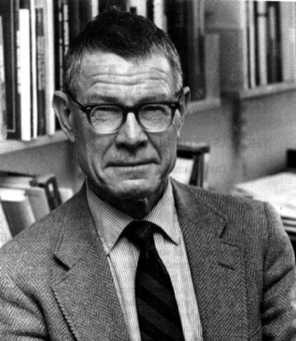
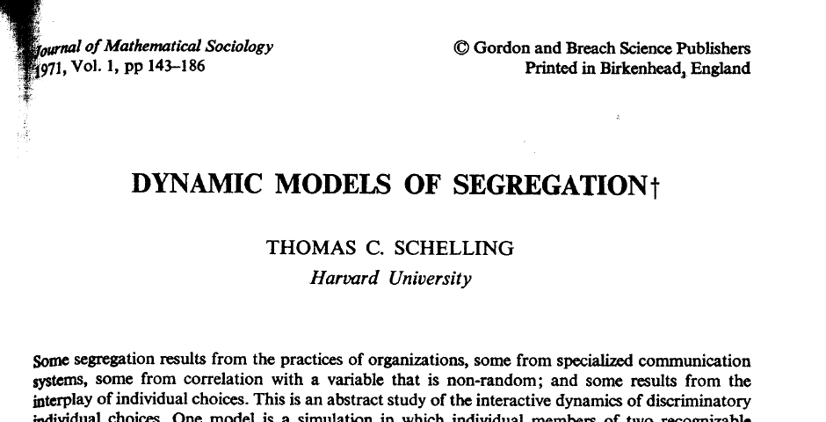
ABM with NetLogo
Segregation Model
Agent-Based Modelling in the Social Sciences

Slide 13
ABM with NetLogo
Flow
chart
Agents
Agents:
Colors
Location
distribution
setup
Agents update happiness
Agents decide
Go
All agents have decided?
yes
output
no
yes
Stop model
Are all agents happy?
Agent-Based Modelling in the Social Sciences

Slide 14
ABM with NetLogo
Flow
chart
Agents
Agents:
Colors
Location
distribution
setup
Agents decide
Agents update happiness
Pick one agent
Agents decide
Happy?
Go
yes
no
Find another place
All agents have decided?
Move
yes
output
Slot is empty?
no
yes
Stop model
Are all agents happy?
yes
no
Agent-Based Modelling in the Social Sciences

Slide 15
ABM with NetLogo
Flow
chart
Agents
Agents:
Colors
Location
distribution
setup
Agents decide
Agents update happiness
Happy?
Pick one agent
If %-similar agents in my neighborhood are greater of my tolerance level (threshold)?
Yes -> Happy
No -> Unhappy
Agents decide
Happy?
Go
yes
no
Find another place
All agents have decided?
Move
yes
output
Slot is empty?
no
yes
Stop model
Are all agents happy?
yes
no
Agent-Based Modelling in the Social Sciences

Slide 16
ABM with NetLogo
NetLogo
Let’s go to NetLogo!!!
File: lab2_5.Nlogo
Agent-Based Modelling in the Social Sciences

Slide 17
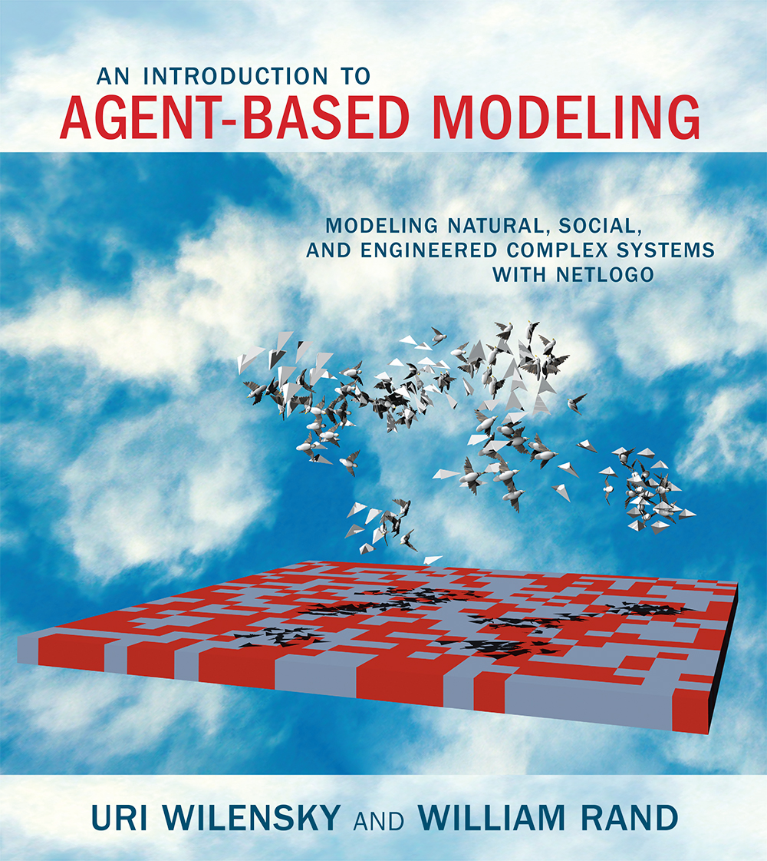
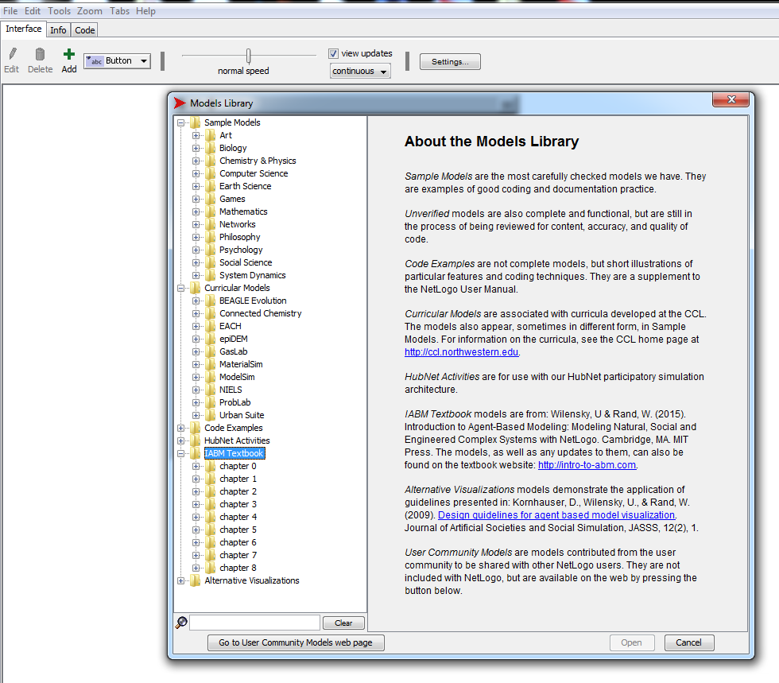
ABM with NetLogo
NetLogo
Agent-Based Modelling in the Social Sciences

