Slide 1

ABM with NetLogo
Outline of Session 11
ODD Protocol
ABM Evaluation
ECABM
Final exam guidelines
Mock exam
Agent-Based Modelling in the Social Sciences

Slide 2
ABM with NetLogo
The ODD protocol
Agent-Based Modelling in the Social Sciences

Slide 3
ABM with NetLogo
The ODD protocol is a template that researchers use to summarize their ABMs.
The purpose of the ODD is only to show the most relevant aspect of the models so that "others" can get a clear and general picture of what the model is about.
It is not a fixed template and modelers are allowed to removing/adding other items.
Agent-Based Modelling in the Social Sciences

Slide 4
ABM with NetLogo
What is the goal of your model? Making predictions to inform policy decisions? Exploring theoretical insights about certain individual mechanisms or other aspects such as policy interventions, the physical environment, etc.?
Agent-Based Modelling in the Social Sciences

Slide 5
ABM with NetLogo
What kind of entities are in the system? Individuals? Houses? Stores?
What variables have those entities? (age, income, size, etc.)
How does the world look like? It is a lattice? network-based? Which variables do they have?
Agent-Based Modelling in the Social Sciences

Slide 6
ABM with NetLogo
Flow chart
Schedule
You do not have to specify in detail the processes but only give a general flow chart of the model.
Agent-Based Modelling in the Social Sciences

Slide 7
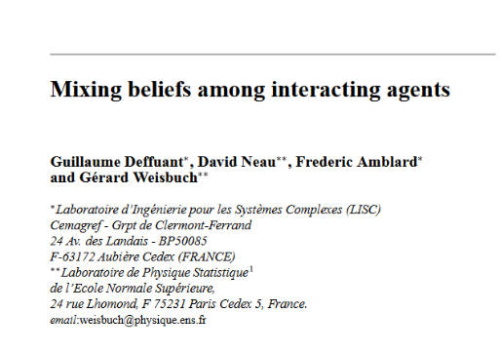
ABM with NetLogo
Global variable d & u
# Agents
Agents’ variable: opinion
Agents
Pick randomly one agent(i)
Agent i selects other agent (j)
Compare current opinions
Abs diff current opinions i & j < d
no
nothing
yes
Adjust agents’ opinions (i ,j)
output
All agents have selected other?
opinion
distribution
no
yes
Agent-Based Modelling in the Social Sciences

Slide 8
ABM with NetLogo
Key outcome in the model?
What is the main interaction(s) in your model?
Describe the decision rule? How is it works? Is it deterministic or stochastic?
Agent-Based Modelling in the Social Sciences

Slide 9
ABM with NetLogo
Key model parameters:
What are the parameter values used to initialize your model?
Agent-Based Modelling in the Social Sciences

Slide 10
ABM with NetLogo
Are you using empirical data to adjust your parameters? Which ones? Or theoretical distributions?
Agent-Based Modelling in the Social Sciences

Slide 11
ABM with NetLogo
If in your flow chart you describe two main processes (e.g., evaluate and move). In this section, you describe the details of each of them
Agent-Based Modelling in the Social Sciences

Slide 12
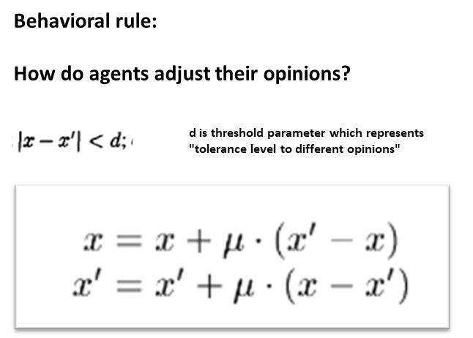
ABM with NetLogo
Agents
Global variable d & u
# Agents
Agents’ variable: opinion
Pick randomly one agent(i)
Agent i selects other agent (j)
Compare current opinions
Abs diff current opinions i & j < d
no
nothing
yes
Adjust agents’ opinions (i ,j)
output
All agents have selected other?
opinion
distribution
no
yes
Agent-Based Modelling in the Social Sciences

Slide 13
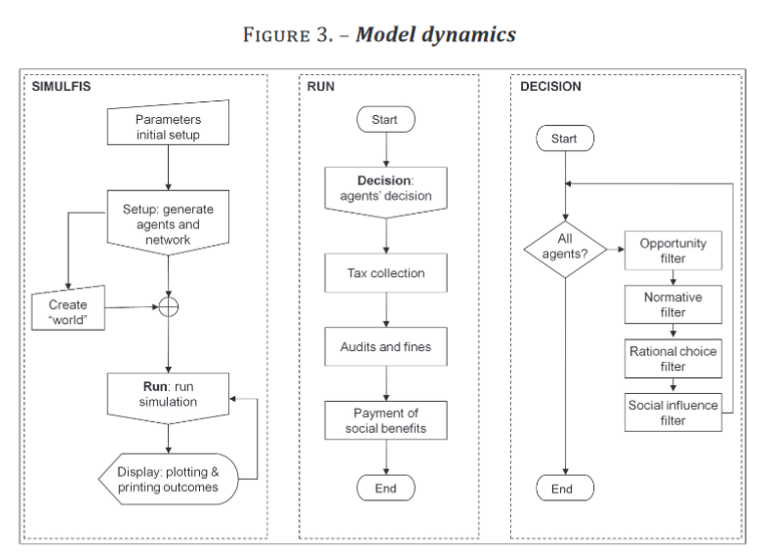
ABM with NetLogo
Agent-Based Modelling in the Social Sciences

Slide 14
ABM with NetLogo
Evaluating ABM
Agent-Based Modelling in the Social Sciences

Slide 15
The cycle of modeling
Theoretical Model
Structure – Components - Behavior
REALITY (target system)
Agent-Based Modelling in the Social Sciences

Slide 16
The cycle of modeling
Theoretical Model
Structure – Components - Behavior
ABM Model
REALITY (target system)
Agent-Based Modelling in the Social Sciences

Slide 17
The cycle of modeling
Theoretical Model
Structure – Components - Behavior
ABM Model
parameters
DATA - THEORY
REALITY (target system)
Agent-Based Modelling in the Social Sciences

Slide 18
The cycle of modeling
Theoretical Model
Structure – Components - Behavior
Broadly, we evaluate models in three levels
ABM Model
run
Results
parameters
DATA - THEORY
REALITY (target system)
Agent-Based Modelling in the Social Sciences

Slide 19
The cycle of modeling
Theoretical Model
Characterization
Structure – Components - Behavior
ABM Model
Results
parameters
DATA - THEORY
REALITY (target system)
Agent-Based Modelling in the Social Sciences

Slide 20
The cycle of modeling
Theoretical Model
Structure – Components - Behavior
ABM Model
Results
parameters
Parameterization
DATA - THEORY
REALITY (target system)
Agent-Based Modelling in the Social Sciences

Slide 21

The cycle of modeling
Decision
factors
Schelling
types
# decisions
# non-X
Theoretical Model
Structure – Components - Behavior
Calibration (tuning)
ABM Model
Results
parameters
Measure
Measure
DATA - THEORY
REALITY (target system)
Agent-Based Modelling in the Social Sciences

Slide 22
ABM with NetLogo
Theoretical Model
ABM Model i
ABM Model
Results
Replication robustness
parameters
Structure – Components - Behavior
DATA - THEORY
REALITY
Agent-Based Modelling in the Social Sciences

Slide 23
ABM with NetLogo
Theoretical Model
Uncertainty
Input uncertainty: Data used to define parameters
Model uncertainty: The process described in our model, the structure of our model (model schedule, vision, decision rule)
Two types of analysis:
sensitivity and validation analysis.
ABM Model
Results
parameters
Structure – Components - Behavior
DATA - THEORY
REALITY
Agent-Based Modelling in the Social Sciences

Slide 24
ABM with NetLogo
Theoretical Model
Sensitivity analysis
How sensitive is your model to the modification of certain parameter values?
Take as a reference as a baseline, the macro outcome of interest
Different distribution for some random variables
Local sensitive analysis:
+/- 5% for each parameter. Parameter by parameter
Global sensitive analysis (testing all possible combination of parameters)
Problem: five parameters with 10 values each = 100 000 simulations X 50 realizations each = 5 millions
ABM Model
Results
parameters
Structure – Components - Behavior
DATA - THEORY
REALITY
Agent-Based Modelling in the Social Sciences

Slide 25
ABM with NetLogo
Theoretical Model
Model external validation:
Our model is a good/reasonable/ representation of the world?
It is important when the goal is to explain/answering real-world questions:
Why validate?
To the extent that a model has been validated, insights from the model are transferable to real-world systems.
ABM Model
Results
parameters
Structure – Components - Behavior
DATA - THEORY
REALITY
Agent-Based Modelling in the Social Sciences

Slide 26
ABM with NetLogo
Philosophical Issues with validation:
How do we know the model takes into account all the relevant elements in the real world?
Is it possible to know all the elements?
Even if we knew all the relevant elements, we want to include them all in the model (much more realism) or we want to include only some of them in order to have a more tractable model.
Different models produce same patterns
Theoretical Model
ABM Model
Results
parameters
Structure – Components - Behavior
DATA - THEORY
REALITY
Agent-Based Modelling in the Social Sciences

Slide 27
ABM with NetLogo
Model verification (internal validation)
Does the implementation of the model correspond to the conceptual model?
Prints, prints and more prints
Theoretical Model
ABM Model
Results
parameters
Structure – Components - Behavior
DATA - THEORY
REALITY
Agent-Based Modelling in the Social Sciences

