Slide 1
    Today:
    ECABM
    Final exam guidelines
    Mock exam
Agent-Based Modelling in the Social Sciences

Slide 2
Empirically Calibrated Agent-Based Simulation Models in the Social Sciences
The outline of my talk:
1. Recap Agent-Based Modeling (ABM) in the Social Sciences
2. Empirically Calibrated Agent-Based Modeling (ECABM) in the Social Sciences
3. Application: Schools' Priority Rules and Ethnic School Segregation

Slide 3
Agent-Based Modeling (ABM) in the Social Sciences
Empirically Calibrated Agent-Based Modeling (ECABM) in the Social Sciences
Application:
Schools' Priority Rules and Ethnic School Segregation

Slide 4

Agent-Based Modeling (ABM) in the Social Sciences
Empirically Calibrated Agent-Based Modeling (ECABM) in the Social Sciences
Application:
Schools' Priority Rules and Ethnic School Segregation

Slide 5
Agent-Based Modeling (ABM) in the Social Sciences
Empirically Calibrated Agent-Based Modeling (ECABM) in the Social Sciences
action
Application:
Schools' Priority Rules and Ethnic School Segregation

Slide 6
Agent-Based Modeling (ABM) in the Social Sciences
Empirically Calibrated Agent-Based Modeling (ECABM) in the Social Sciences
action
Decision context?
**Interaction**
Application:
Schools' Priority Rules and Ethnic School Segregation

Slide 7
Agent-Based Modeling (ABM) in the Social Sciences
Empirically Calibrated Agent-Based Modeling (ECABM) in the Social Sciences
. . .
action
Decision context?
**Interaction**
Application:
Schools' Priority Rules and Ethnic School Segregation

Slide 8
Agent-Based Modeling (ABM) in the Social Sciences
Empirically Calibrated Agent-Based Modeling (ECABM) in the Social Sciences
. . .
action
Decision context?
**Interaction**
When we analyze the social world in this way, we will see that:
Application:
Schools' Priority Rules and Ethnic School Segregation

Slide 9
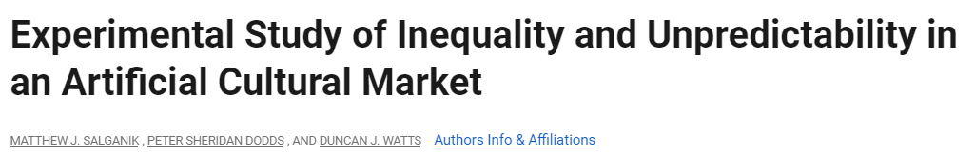
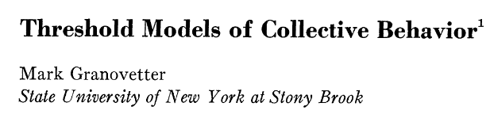
Agent-Based Modeling (ABM) in the Social Sciences
Empirically Calibrated Agent-Based Modeling (ECABM) in the Social Sciences
. . .
action
Decision context?
**Interaction**
When we analyze the social world in this way, we will see that:
We only know one realization of many other possibilities.
Application:
Schools' Priority Rules and Ethnic School Segregation

Slide 10

Agent-Based Modeling (ABM) in the Social Sciences
Empirically Calibrated Agent-Based Modeling (ECABM) in the Social Sciences
. . .
action
Decision context?
**Interaction**
When we analyze the social world in this way, we will see that:
We only know one realization of many other possibilities.
Individual motivations can produce unexpected macro-outcomes.
Application:
Schools' Priority Rules and Ethnic School Segregation

Slide 11

Agent-Based Modeling (ABM) in the Social Sciences
Empirically Calibrated Agent-Based Modeling (ECABM) in the Social Sciences
. . .
action
Scale Free Network
The Analytical sociology approach:
A social scientist aims to elucidate an empirical phenomenon by examining a collection of entities and processes (agents, actions, and interactions) that are spatially and temporally structured to consistently produce the desired phenomenon (Hedström and Swedberg, 1998)
Application:
Schools' Priority Rules and Ethnic School Segregation

Slide 12
Agent-Based Modeling (ABM) in the Social Sciences
Empirically Calibrated Agent-Based Modeling (ECABM) in the Social Sciences
. . .
action
ABMs
Application:
Schools' Priority Rules and Ethnic School Segregation

Slide 13
Agent-Based Modeling (ABM) in the Social Sciences
Empirically Calibrated Agent-Based Modeling (ECABM) in the Social Sciences
. . .
action
ABMs
Macro outcome
ABMs are computer simulations where artificial agents interact within a specific environment according to a predefined set of individual rules (Miller and Page 2007)
Application:
Schools' Priority Rules and Ethnic School Segregation

Slide 14
Agent-Based Modeling (ABM) in the Social Sciences
Phenomenon
X
Empirically Calibrated Agent-Based Modeling (ECABM) in the Social Sciences
Application:
Schools' Priority Rules and Ethnic School Segregation

Slide 15
Agent-Based Modeling (ABM) in the Social Sciences
translate
Phenomenon
X
ABM
Components/Parameters:
Agent types
Behavior types
Interactions
Geographical distributions
And so forth
Modelers believe are crucial to understand X
Empirically Calibrated Agent-Based Modeling (ECABM) in the Social Sciences
Application:
Schools' Priority Rules and Ethnic School Segregation

Slide 16
Agent-Based Modeling (ABM) in the Social Sciences
translate
Phenomenon
X
ABM
Components/Parameters:
Agent types
Behavior types
Interactions
Geographical distributions
And so forth
Macro outcome
Empirically Calibrated Agent-Based Modeling (ECABM) in the Social Sciences
Simulation
results
time
Application:
Schools' Priority Rules and Ethnic School Segregation

Slide 17
Agent-Based Modeling (ABM) in the Social Sciences
translate
Phenomenon
X
ABM
X
Components/Parameters:
Agent types
Behavior types
Interactions
Geographical distributions
And so forth
Macro outcome
Empirically Calibrated Agent-Based Modeling (ECABM) in the Social Sciences
Simulation
results
time
Application:
Schools' Priority Rules and Ethnic School Segregation

Slide 18
Agent-Based Modeling (ABM) in the Social Sciences
translate
Phenomenon
X
ABM
X
Components/Parameters:
Agent types
Behavior types
Interactions
Geographical distributions
And so forth
Macro outcome
Empirically Calibrated Agent-Based Modeling (ECABM) in the Social Sciences
Simulation
results
time
Application:
Schools' Priority Rules and Ethnic School Segregation

Slide 19
Agent-Based Modeling (ABM) in the Social Sciences
translate
Phenomenon
X
ABM
X
Components/Parameters:
Agent types
Behavior types
Interactions
Geographical distributions
And so forth
Macro outcome
Empirically Calibrated Agent-Based Modeling (ECABM) in the Social Sciences
Simulation
results
time
Validation
Validation (external) is the fitness between these two lines.
Validity equates with how good a model represents the reality (Eker, 2020)
Application:
Schools' Priority Rules and Ethnic School Segregation

Slide 20
Agent-Based Modeling (ABM) in the Social Sciences
translate
Phenomenon
X
ABM
X
Components/Parameters:
Agent types
Behavior types
Interactions
Geographical distributions
And so forth
Macro outcome
Empirically Calibrated Agent-Based Modeling (ECABM) in the Social Sciences
Simulation
results
time
Calibration
Calibration involves selecting model parameters that yield dynamics closely resembling those observed in a specific dataset, as assessed by a given criterion
Application:
Schools' Priority Rules and Ethnic School Segregation

Slide 21
Agent-Based Modeling (ABM) in the Social Sciences
translate
Phenomenon
X
ABM
X
Components/Parameters:
Agent types
Behavior types
Interactions
Geographical distributions
And so forth
Macro outcome
Empirically Calibrated Agent-Based Modeling (ECABM) in the Social Sciences
Simulation
results
time
Empirical calibration
Application:
Schools' Priority Rules and Ethnic School Segregation

Slide 22
Agent-Based Modeling (ABM) in the Social Sciences
translate
Phenomenon
X
ABM
X
Components/Parameters:
Agent types
Behavior types
Interactions
Geographical distributions
And so forth
Macro outcome
Empirically Calibrated Agent-Based Modeling (ECABM) in the Social Sciences
Simulation
results
time
Empirical calibration
Use empirical data to fix your parameters in order to enhance the realism of your ABM.
Application:
Schools' Priority Rules and Ethnic School Segregation

Slide 23

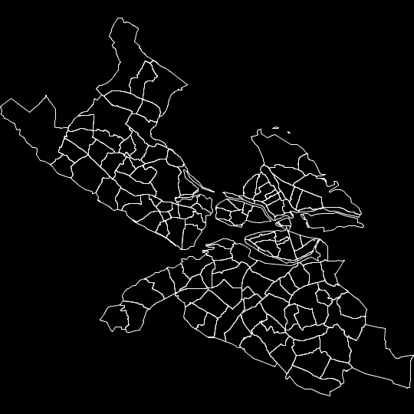
Agent-Based Modeling (ABM) in the Social Sciences
translate
Phenomenon
X
ABM
X
Components/Parameters:
Agent types
Behavior types
Interactions
Geographical distributions
And so forth
Macro outcome
Empirically Calibrated Agent-Based Modeling (ECABM) in the Social Sciences
Simulation
results
time
Empirical calibration
Use empirical data to fix your parameters in order to enhance the realism of your ABM.
Individual behavior: experimental data, statistical models, qualitative information.
Population characteristics: Survey data, register data, census data.
Physical environment: Google Maps data, road data
Application:
Schools' Priority Rules and Ethnic School Segregation

Slide 24
Agent-Based Modeling (ABM) in the Social Sciences
translate
Phenomenon
X
ABM
X
Components/Parameters:
Agent types
Behavior types
Interactions
Geographical distributions
And so forth
Macro outcome
Empirically Calibrated Agent-Based Modeling (ECABM) in the Social Sciences
Simulation
results
time
Empirical calibration
Use empirical data to fix your parameters in order to enhance the realism of your ABM.
But, when do we want to empirically calibrate our ABM?
Individual behavior: experimental data, statistical models, qualitative information.
Population characteristics: Survey data, register data, census data.
Physical environment: Google Maps data, road data
Application:
Schools' Priority Rules and Ethnic School Segregation

Slide 25
Agent-Based Modeling (ABM) in the Social Sciences
+
Empirically Calibrated Agent-Based Modeling (ECABM) in the Social Sciences
Data
-
- Complexity/realism +
Application:
Schools' Priority Rules and Ethnic School Segregation

Slide 26
Agent-Based Modeling (ABM) in the Social Sciences
+
Empirically Calibrated Agent-Based Modeling (ECABM) in the Social Sciences
Data
-
- Complexity/realism +
Application:
Schools' Priority Rules and Ethnic School Segregation
Theoretical Abstractions (Boero and Squazzoni, 2005)
Very popular at the beginning (Casini and Manzo, 2016)
The goal is:
Development of new theories or mechanisms
Evaluating the macro implications of micro mechanisms
e.g., Schelling model, Axelrod model

Slide 27
The goal is:
Serving as a virtual 'laboratory' for testing policy interventions
Predicting future population dynamics (Bruch and Atwell, 2013).
Studying how certain processes unfold over time
These models aim at different combinations of (Casini and Manzo, 2016):
“theoretical realism”
empirical calibration
empirical validation
e.g., models developed during the COVID-19 epidemic.
Agent-Based Modeling (ABM) in the Social Sciences
+
Empirically Calibrated Agent-Based Modeling (ECABM) in the Social Sciences
Data
-
- Complexity/realism +
Application:
Schools' Priority Rules and Ethnic School Segregation

Slide 28
The goal is:
Serving as a virtual 'laboratory' for testing policy interventions
Predicting future population dynamics (Bruch and Atwell, 2013).
Studying how certain processes unfold over time
These models aim at different combinations of (Casini and Manzo, 2016):
“theoretical realism”
empirical calibration
empirical validation
e.g., models developed during the COVID-19 pandemic.
Agent-Based Modeling (ABM) in the Social Sciences
+
Empirically Calibrated Agent-Based Modeling (ECABM) in the Social Sciences
Data
observed
phenomenon
-
Macro outcome
Validate
- Complexity/realism +
Simulation
results
time
Application:
Schools' Priority Rules and Ethnic School Segregation

Slide 29
The goal is:
Serving as a virtual 'laboratory' for testing policy interventions
Predicting future population dynamics (Bruch and Atwell, 2013).
Studying how certain processes unfold over time
These models aim at different combinations of (Casini and Manzo, 2016):
“theoretical realism”
empirical calibration
empirical validation
e.g., models developed during the COVID-19 pandemic.
Agent-Based Modeling (ABM) in the Social Sciences
+
Empirically Calibrated Agent-Based Modeling (ECABM) in the Social Sciences
Data
observed
phenomenon
-
Macro outcome
Validate
- Complexity/realism +
Simulation
results
time
Application:
Schools' Priority Rules and Ethnic School Segregation
Simulation
results
Macro outcome
Virtual laboratory
Intervention
time

Slide 30
Agent-Based Modeling (ABM) in the Social Sciences
+
Enhance realism between the model and the target and enable reliable inferences by equipping the model with realistic assumptions regarding simulation components.
Reduce the number of parameters in simulations.
Input data aids in excluding competing mechanisms
Data
-
Empirically Calibrated Agent-Based Modeling (ECABM) in the Social Sciences
- Complexity/realism +
"The scale depends upon the purpose: a map good for hiking requires a large scale and lots of detail, a map designed to show the relationships of countries and continents needs a very small scale as we find in world globes“
(Morgan, M. S., 2012)
"...you see whether a ship or skyscraper is going to blow down by testing a model of it. And that is the same kind of things we do in a simulation where we build a model and we try the application of a policy in the model instead of the real world”
(Gilbert, N., 2018)
Application:
Schools' Priority Rules and Ethnic School Segregation

Slide 31
Agent-Based Modeling (ABM) in the Social Sciences
Empirically Calibrated Agent-Based Modeling (ECABM) in the Social Sciences
Application:
Schools' Priority Rules and Ethnic School Segregation

Slide 32


Agent-Based Modeling (ABM) in the Social Sciences
Schools’ priority rules and ethnic school segregation
Goal
Evaluating the effect of school admission priority rules* on school ethnic segregation.
*Priority rules refer to the guidelines schools adhere to when determining which students receive placement in the event of oversubscription
Empirically Calibrated Agent-Based Modeling (ECABM) in the Social Sciences
Application:
Schools' Priority Rules and Ethnic School Segregation

Slide 33
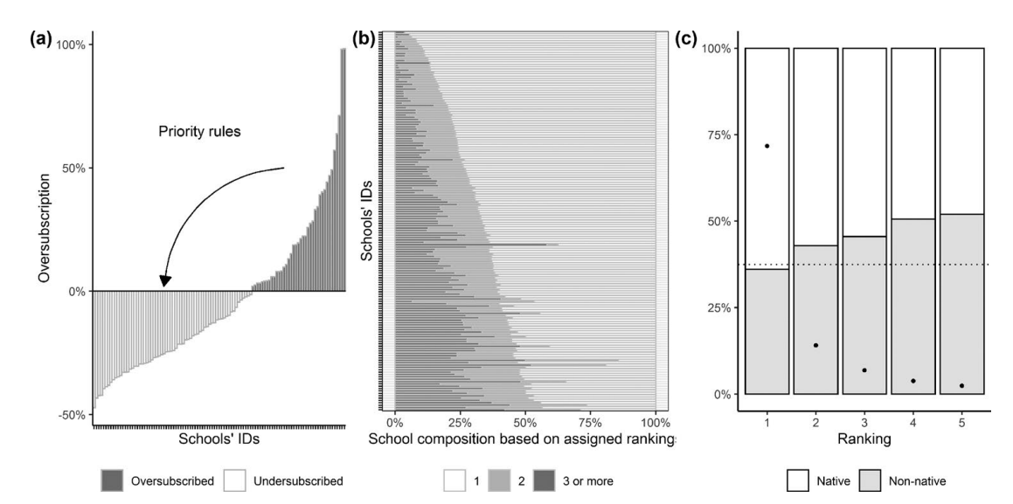
Agent-Based Modeling (ABM) in the Social Sciences
Schools’ priority rules and ethnic school segregation
Motivation
First, the number of oversubscribed seats in schools is significant and it tends to increase over time, resulting in a decreasing share of students obtaining their first preference.
Second, since these rules determine student allocation, they also affect the ethnic composition of schools, thereby influencing school segregation.
Third, priority rules are established by educational authorities and are therefore subject to modification for the purpose of promoting ethnic integration within schools.
Empirically Calibrated Agent-Based Modeling (ECABM) in the Social Sciences
Application:
Schools' Priority Rules and Ethnic School Segregation

Slide 34
Agent-Based Modeling (ABM) in the Social Sciences
Schools’ priority rules and ethnic school segregation
Data
We use Swedish register data provided by Statistics Sweden on 9th-grade students applying for secondary education between 2013–2017.
Students’ and schools’ spatial socio-demographic characteristics
Students’ rank-ordered lists of preferred programs submitted to the admission office.
The admission process for upper secondary education in Stockholm is organized by the Stockholm Admission Office, which handles applications for all municipalities of Stockholm County together with the municipalities of Gnesta and Håbo.
Empirically Calibrated Agent-Based Modeling (ECABM) in the Social Sciences
Application:
Schools' Priority Rules and Ethnic School Segregation

Slide 35
Agent-Based Modeling (ABM) in the Social Sciences
Schools’ priority rules and ethnic school segregation
Modelling students’ rank-ordered lists
Four different groups of students:
  - high-performance native
  - low-performance native
  - high-performance non-native
  - low-performance non-native
At the school level:
  Proportion of natives at school
  Average grades of students admitted at schools
  School size
  Average income at schools
  School ownership
  School acceptance rate.
Interactions:
  Distance between students’ homes and schools’ geographic coordinates
  Difference between the student grade and school mean grades
  Proportion of 9th-grade classmates applying to school
  Difference between students’ parents’ income and average school income.
Conditional logit model (McFadden, 1974)
Empirically Calibrated Agent-Based Modeling (ECABM) in the Social Sciences
Application:
Schools' Priority Rules and Ethnic School Segregation

Slide 36
Agent-Based Modeling (ABM) in the Social Sciences
Schools’ priority rules and ethnic school segregation
ABM flowchart
1. Assigning attributes to schools (spatial location, ethnic and socioeconomic composition, admission grades, size, school capacity, and program supply)
2. Assigning attributes to students. (ethnic background, family income, spatial location, grades, and students’ program preferences)
3. Ranking formation.
4. Students apply.
5. Allocation. Once all the students´ rankings have been formed, students apply, and schools allocate them following any of the three priority rules.
6. Non-allocated students.
7. Enrollment in secondary schools. Once all applicants are allocated across schools,
they start their 1st level of secondary education and current 3-level students at secondary schools are removed from the simulation.
8. Measuring school segregation.
9. Steps 3-8 are repeated for 10 rounds.
Empirically Calibrated Agent-Based Modeling (ECABM) in the Social Sciences
Application:
Schools' Priority Rules and Ethnic School Segregation

Slide 37
Agent-Based Modeling (ABM) in the Social Sciences
Schools’ priority rules and ethnic school segregation
ABM flowchart
1. Assigning attributes to schools (spatial location, ethnic and socioeconomic composition, admission grades, size, school capacity, and program supply)
2. Assigning attributes to students. (ethnic background, family income, spatial location, grades, and students’ program preferences)
3. Ranking formation.
4. Students apply.
5. Allocation. Once all the students´ rankings have been formed, students apply, and schools allocate them following any of the three priority rules.
6. Non-allocated students.
7. Enrollment in secondary schools. Once all applicants are allocated across schools,
they start their 1st level of secondary education and current 3-level students at secondary schools are removed from the simulation.
8. Measuring school segregation.
9. Steps 3-8 are repeated for 10 rounds.
Empirically Calibrated Agent-Based Modeling (ECABM) in the Social Sciences
In case of school oversubscription:
Grade-based
Distance-based
Random-based
Application:
Schools' Priority Rules and Ethnic School Segregation

Slide 38
Agent-Based Modeling (ABM) in the Social Sciences
Schools’ priority rules and ethnic school segregation
Empirically Calibrated Agent-Based Modeling (ECABM) in the Social Sciences
Ranking validation
Application:
Schools' Priority Rules and Ethnic School Segregation

Slide 39
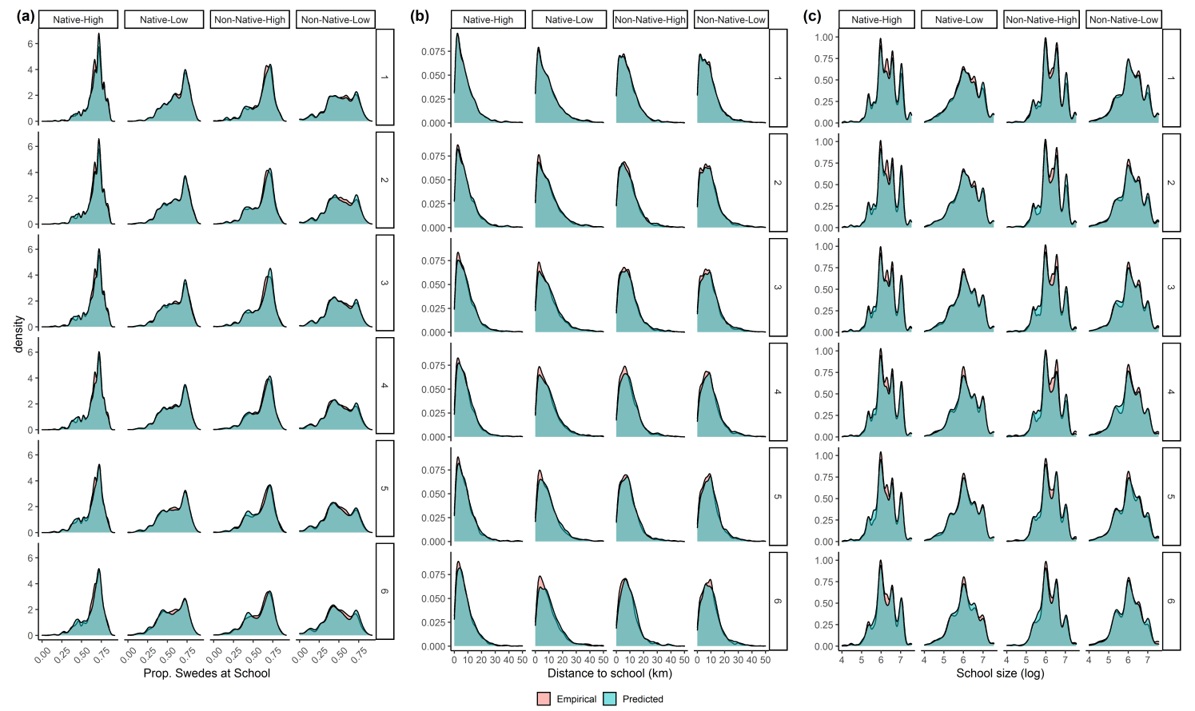
Agent-Based Modeling (ABM) in the Social Sciences
Schools’ priority rules and ethnic school segregation
Empirically Calibrated Agent-Based Modeling (ECABM) in the Social Sciences
Ranking validation
Application:
Schools' Priority Rules and Ethnic School Segregation

Slide 40
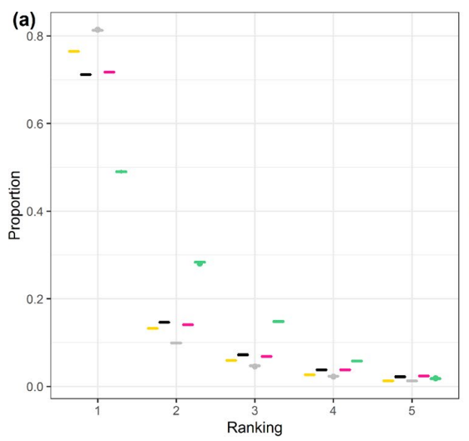
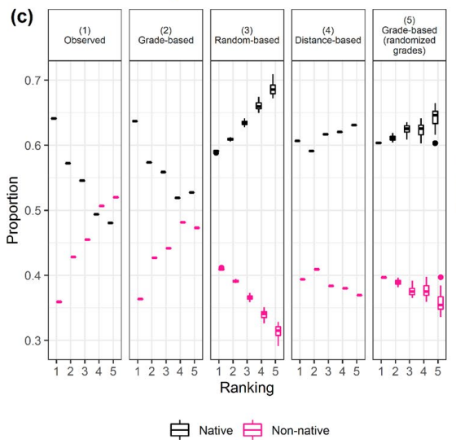
Agent-Based Modeling (ABM) in the Social Sciences
Schools’ priority rules and ethnic school segregation
Empirically Calibrated Agent-Based Modeling (ECABM) in the Social Sciences
ABM validation
Application:
Schools' Priority Rules and Ethnic School Segregation

Slide 41
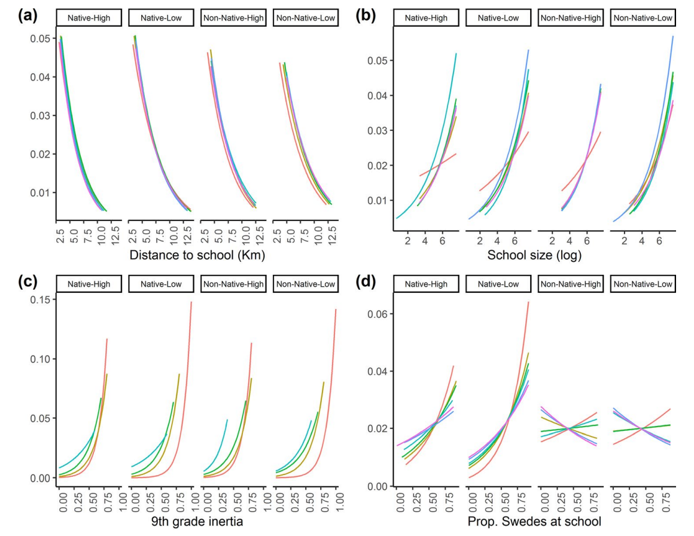

Agent-Based Modeling (ABM) in the Social Sciences
Schools’ priority rules and ethnic school segregation
Empirically Calibrated Agent-Based Modeling (ECABM) in the Social Sciences
Students´
ranking preferences
Application:
Schools' Priority Rules and Ethnic School Segregation

Slide 42
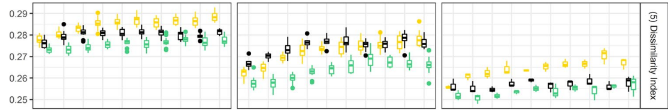
Agent-Based Modeling (ABM) in the Social Sciences
Schools’ priority rules and ethnic school segregation
Empirically Calibrated Agent-Based Modeling (ECABM) in the Social Sciences
Application:
Schools' Priority Rules and Ethnic School Segregation

Slide 43
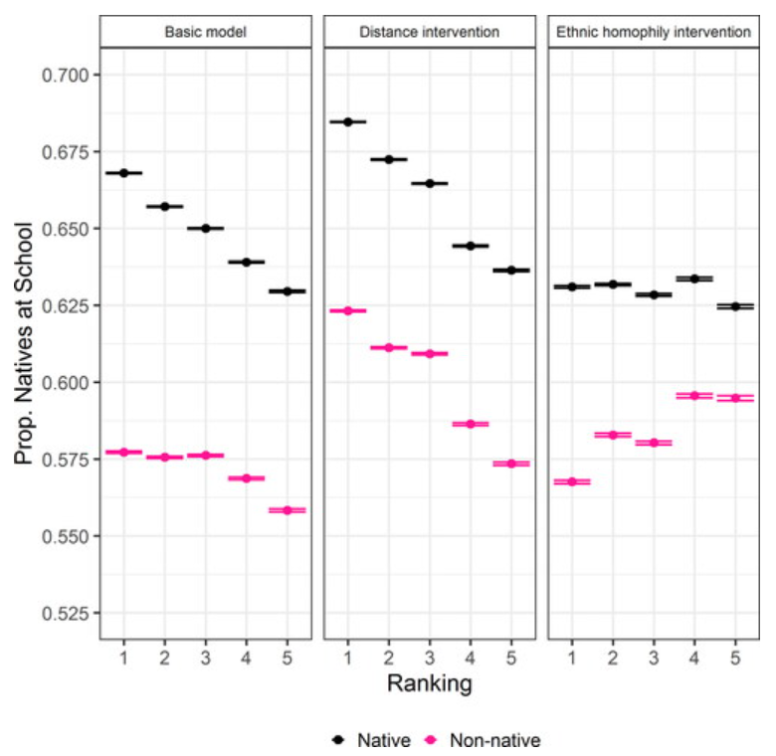
Agent-Based Modeling (ABM) in the Social Sciences
Schools’ priority rules and ethnic school segregation
Empirically Calibrated Agent-Based Modeling (ECABM) in the Social Sciences
Application:
Schools' Priority Rules and Ethnic School Segregation

Slide 44
Agent-Based Modeling (ABM) in the Social Sciences
Schools’ priority rules and ethnic school segregation
Conclusions
Grade-based and distance-based priority rules intensify school segregation compared with a random-based criterion. We show that both criteria increase segregation through distinct mechanisms.
In the grade-based priority, the grade disparity between ethnic groups and the school-ethnic-composition hierarchy of native students are responsible for this effect.
In home-proximity assignments and the correlation between school and residential segregation explain the increase in the distance-based criterion.
Finally, the use of empirical data on ABMs depends to a large extent on the use of the ABMs results
Empirically Calibrated Agent-Based Modeling (ECABM) in the Social Sciences
Application:
Schools' Priority Rules and Ethnic School Segregation

