Slide 1
NetLogo
7.0
Agent-Based Modelling in the Social Sciences

Slide 2

ABM with NetLogo
NetLogo
Announcements
Agent-Based Modelling in the Social Sciences

Slide 3
ABM with NetLogo
NetLogo
Units overview
Mixing Beliefs' Model
Networks (basic primitives)
Basic Diffusion Model (based on Centola’s model)
Agent-Based Modelling in the Social Sciences

Slide 4
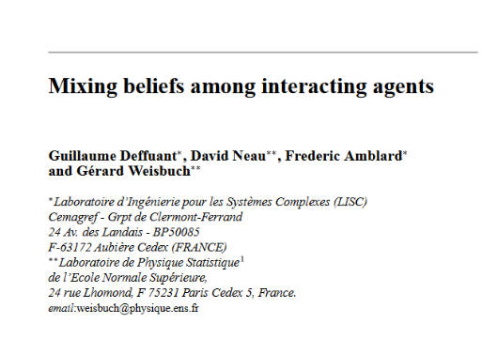

ABM with NetLogo
Mixing beliefs
Model topic:
Opinion dynamics (Macro outcome)
Initial statement:
Most models about opinion dynamics are based on binary opinions. Actors update their opinions either by social influence or according to their own experience.
However (I wanna write a paper about this!), not all opinions are binary and not all individuals interact with everyone.
Goal: this paper relaxes the binary assumption evaluating:
(1) what would happen if opinions were a continuous variable and opinion adjustments only took place when two opinions' difference is below a given threshold.
(2) how restrictions on interactions affect (1)?
Agent-Based Modelling in the Social Sciences

Slide 5

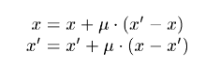
ABM with NetLogo
Mixing beliefs
Behavioral rule:
How do agents adjust their opinions?
d is threshold parameter which represents "tolerance level to different opinions"
Agent-Based Modelling in the Social Sciences

Slide 6
ABM with NetLogo
Flow
chart
Global variable d & u
# Agents
Agents’ variable: opinion
Agents
setup
Basic Model
Pick randomly one agent(i)
Agents can interact with all other agents.
Network structure = fully connected
Agent i selects other agent (j)
Compare current opinions
Abs diff current opinions i & j < d
Go
no
nothing
yes
Adjust agents’ opinions (i ,j)
output
All agents have selected other?
opinion
distribution
no
yes
Agent-Based Modelling in the Social Sciences

Slide 7

ABM with NetLogo
NetLogo
Let’s go to NetLogo!!!
lab4_1.Nlogo
Agent-Based Modelling in the Social Sciences

Slide 8
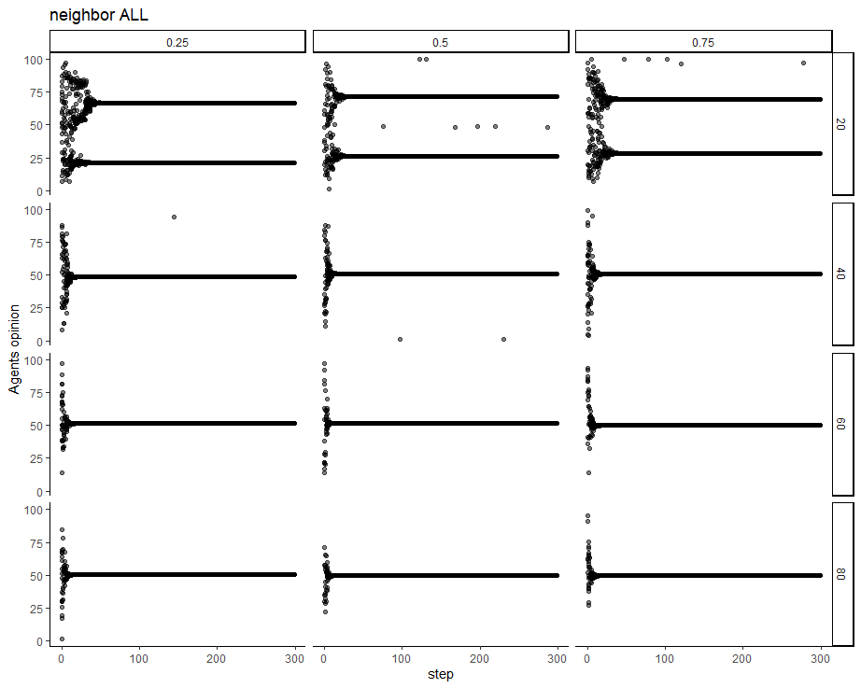
ABM with NetLogo
NetLogo
Experiment 1
Agent-Based Modelling in the Social Sciences

Slide 9
ABM with NetLogo
Flow
chart
Global variable d & u
# Agents
Agents’ variable: opinion
setup
Basic Model
Agents
How would a different network structure change my results?
What is the effect of networks on belief polarization?
Pick randomly two agents (i.j)
Agents can interact with all other agents.
Network structure = fully connected
Compare current opinions
Abs diff current opinions i & j < d
Go
no
nothing
yes
Adjust agents’ opinions (i ,j)
output
opinion
distribution
Agent-Based Modelling in the Social Sciences

Slide 10
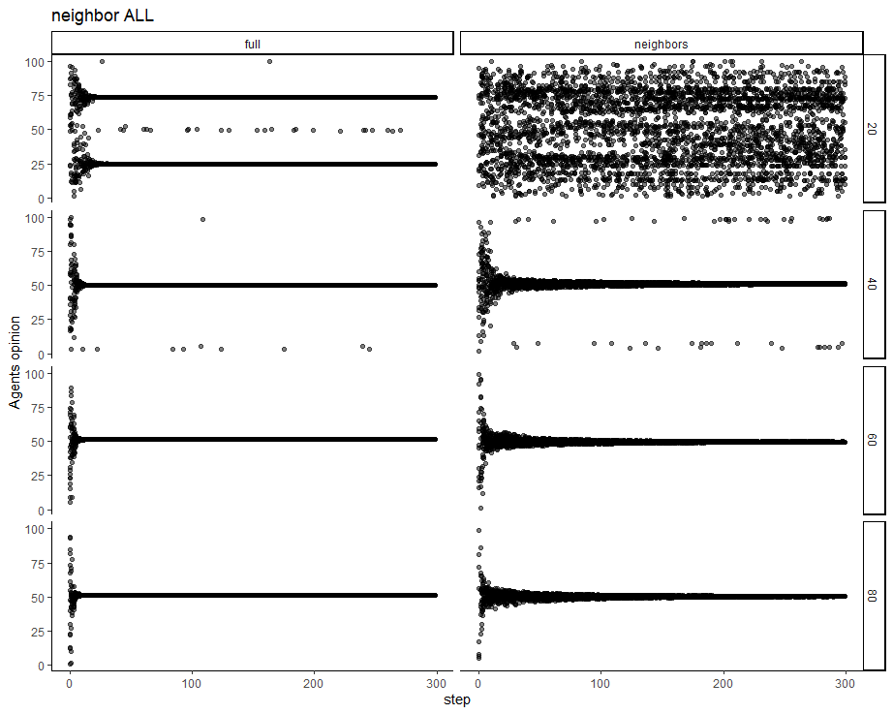
ABM with NetLogo
NetLogo
Experiment 2
Agent-Based Modelling in the Social Sciences

Slide 11
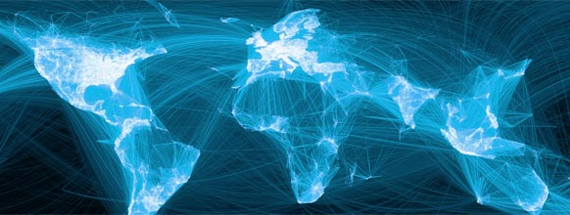
ABM with NetLogo
Networks
Network 1: basic primitives
Network 2: diffusion model
Agent-Based Modelling in the Social Sciences

Slide 12
ABM with NetLogo
Networks
Let’s go to NetLogo!!!
Lab4_2.nlogo
Network 1: basic primitives
Network 2: diffusion models
Agent-Based Modelling in the Social Sciences

Slide 13
ABM with NetLogo
NetLogo
Diffusion Model - Basic model
Drawing on the complex-contagion model, we want to implement a diffusion model with the following goal:
(A) Examine how different network structures affect diffusion processes. We want to evaluate the network effect of three different types of networks: SW, SF, and RN
(B) We want to model two types of diffusion processes: (1) agents spread information when they have heard the information from at least one other agent, or (2) agents spread the information according to an individual threshold.
Agent-Based Modelling in the Social Sciences

Slide 14
ABM with NetLogo
Flow
chart
Agents:
Type: only one
Decision rule: Chooser -> "simple" or "complex”
Random Threshold
Inititator (red turtle)
Global output variable
Network:
Chooser: "SW", "Random" or "SF”
Agents - Networks
setup
Diffuse
Pick up red agents (X)
X agents spread information to their neighbors
Go
Turn red?
output
no
Count infected
yes
nothing
Agent-Based Modelling in the Social Sciences

Slide 15
ABM with NetLogo
NetLogo
NetLogo Extensions
Netlogo wegpage -> extensions
https://github.com/NetLogo/NetLogo/wiki/Extensions
For our diffusion model we will use the extension ”Network”
It is an inbuilt extension
Among other things, it allows us to implement different types of networks
Agent-Based Modelling in the Social Sciences

Slide 16
ABM with NetLogo
Networks
Let’s go to NetLogo!!!
Lab4_3.nlogo
Agent-Based Modelling in the Social Sciences

Slide 17
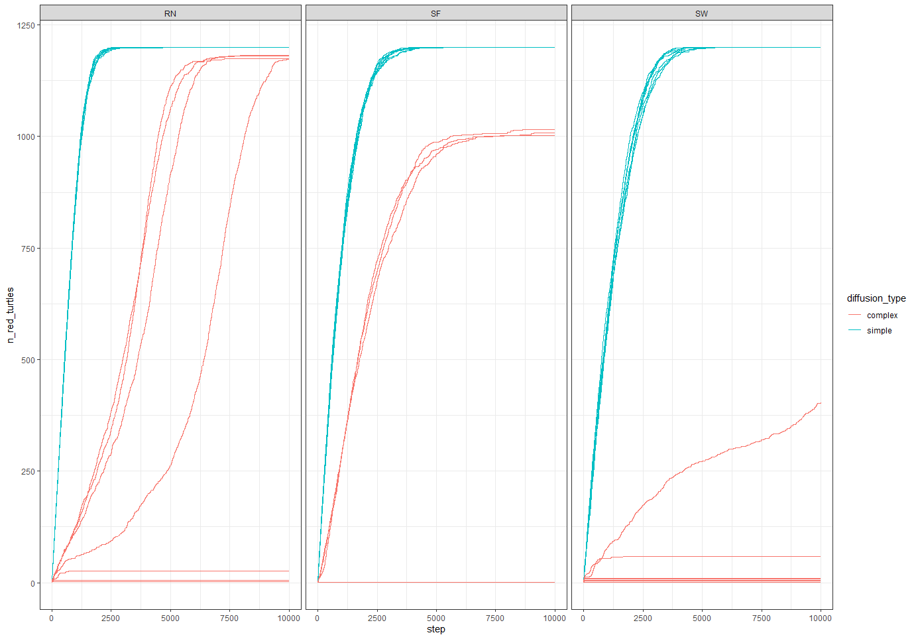
ABM with NetLogo
Networks
Agent-Based Modelling in the Social Sciences

