Slide 1
NetLogo
7.0
Agent-Based Modelling in the Social Sciences

Slide 2

ABM with NetLogo
LISTS
Let’s go to NetLogo!!!
File: lab5_1.Nlogo
Agent-Based Modelling in the Social Sciences

Slide 3

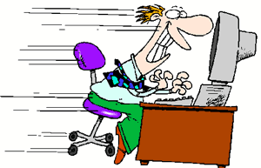
ABM with NetLogo
NetLogo
Importing data
Let’s go to NetLogo!!!
File: lab5_2.Nlogo
Agent-Based Modelling in the Social Sciences

Slide 4
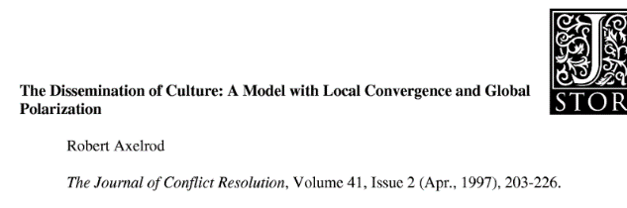

ABM with NetLogo
R. Axelrod
Puzzle:
If highly heterogeneous persons are constantly interacting all the time, why do not ending up sharing the same culture (beliefs, attitudes, behavior, etc.)? Why do not get homogeneous?
Previous explanations:
Social differentiation: Group members want to keep distances from other groups.
Fads and fashions: some persons want to be different from others.
Geographic isolation
Agent-Based Modelling in the Social Sciences

Slide 5
ABM with NetLogo
R. Axelrod
However, previous explanations do not consider “the fundamental principle of human communication”: the transfer of ideas occurs most frequently between individuals who are similar in their culture.
So, similarity among people fosters the interaction among them.
And, the more people interact with each other, the more similar they become.
Agent-Based Modelling in the Social Sciences

Slide 6
ABM with NetLogo
R. Axelrod
Assumptions:
Culture is composed of many features/attributes. Each of them has different traits.
The change of one feature depends on the presence or absence of another.
There is a random distribution of traits for each cultural attribute.
Agents can only interact with adjacent neighbors
Agent-Based Modelling in the Social Sciences

Slide 7
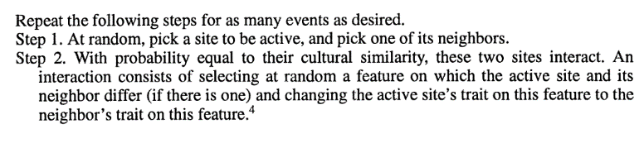

ABM with NetLogo
R. Axelrod
Model specification:
Cultural features
a | b | c | d | e
language | diet | technology | Organization | Social norms
Traits per features
(A)
8 | 2 | 3 | 3 | 0
(B)
6 | 7 | 7 | 3 | 0
Probability of interaction = 40%
<- cultural similarity
(A)
6 | 2 | 3 | 3 | 0
<- After the interaction
Agent-Based Modelling in the Social Sciences

Slide 8
ABM with NetLogo
R. Axelrod
Model output:
“Number of stable regions”.
“Region” -> groups of agents who share the same traits features.
“Stable regions” -> resulting patterns where any new modification in the model is impossible because agents are so much equal or so much different than a new interaction becomes impossible.
Agent-Based Modelling in the Social Sciences

Slide 9
ABM with NetLogo
NetLogo
Let’s go to NetLogo!!!
File: lab5_3.Nlogo
Agent-Based Modelling in the Social Sciences

Slide 10
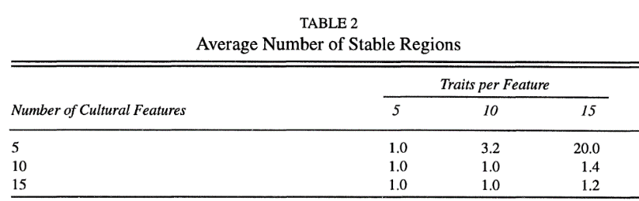
ABM with NetLogo
R. Axelrod
Model results
Main results: (1) the more cultural features, the greater the convergence, (2) the more traits for features, the greater the number of subcultures.
More generally: macro polarization takes place even when the micro-behavior aims convergence
Agent-Based Modelling in the Social Sciences

Slide 11
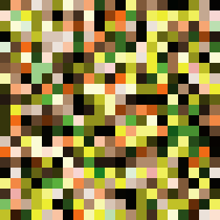

ABM with NetLogo
R. Axelrod
Tick = 0
Tick = 1 490 021
Setup:
Cultural features = 5
Traits per features = 15
World size = 20 X 20
4 Neighborhoods
Agent-Based Modelling in the Social Sciences

Slide 12
ABM with NetLogo
R. Axelrod
Lessons learned:
“intuition is not a very good guide for predicting what even a very simple dynamic model will produce” (Axelrod,1997)
Agent-Based Modelling in the Social Sciences

