Slide 1

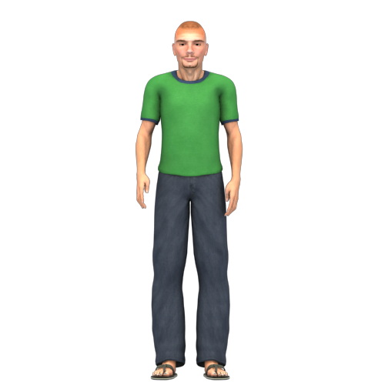
J-P Sansonnet, 10 feb 2011
Specification of the char DOM structure in DIVAlite
List of char constituents
drag* contains all the elements of char:
resize* is the area for resizing the char at bottom feet (optional if drag is also used for resizing)
click* area where the character can be clicked, double-clicked, shiftclicked
balloon* area where the text is printed
pict* where a .gif, .png can be displayed
img* is not a div but the container of the animation .png files
where * stands for number 1 to n of character on page: pict1, pict2, pict2 etc.
div drag* is used to drag the char (and to resize ?)
all elements in drag have relative position to posx, posy of drag*
all elements in drag are resized when char is resized
pict*
I have an idea!
balloon*
drag*
posx, posy
img*
click*
resize*

