Slide 1


INF4057
SOFTWARE Architecture
2023/2024 Session
Course Lecturer: Dr. KIMBI Xaveria

Slide 2
COURSE CONTENT
(1) Motivating Example and Basic Terminologies
(2) Why Software Architecture: An illustrative Example
(3) The Main Concepts in Software Architecture
(4) Architectural Design Principles
(5) Software Architectural Styles
(6) Event-driven Micro-service Architecture
(7) Clean Architecture
(7) Study of Frameworks and Deployment Architectures
(8) Cloud-based Architectures
(9) Deployment of Mircroservice Architecture
    - Continuous integration with Wercker Platform
    - Continuous Integration with Circleci Platform
    - Deployment of microservice architecture to a Private Cloud, Public Cloud or Data Center.
(10) Working with DevOps Architectures
(11) Architectural Analysis: Architectural Evaluation using various techniques
(12) Translating an Architecture into a Descriptive Mathematical models

Slide 3
References:
Software Architecture for developers - Simon Brown
Software Architecture Cesare Pautasso
Software Architecture In Pratice Fourth Edition - Len Bass, Paul Clements,
Software Architecture Patterns - Mark Richards

Slide 4
Course Objective and Development Attitude
Course Description:
To provide a sound technical exposure to the concepts, principles, techniques, architectural styles, and best practices in software architecture and software design.
Course Objectives: Upon successful completion of this course, the students will be able to:
Develop skills with several software architectural principles and techniques to design a well structured system architecture for large-scale systems.
Develop skills for designing and deploying mircroservice architecture in large organizations. Conceptualize and coordinate designs, addressing technological aspects of architecture.
Practicals: Designing Event-Driven Mircro-service Applications Using Apache Kafka/Apache Flume Ecosystem
Translate architectural designs to mathematical models.
Acquire techniques and practices suitable for designing complex and large- scale systems.
Choose an architectural models for a real life project.
Development attitude: A collaborative research-oriented approach in groups of 5

Slide 5
Evaluation Method
A three-phased evaluation method will be adopted:
CC evaluation at the end of first five lessons (Quiz1/Practicals) = CC1
CC evaluation in the form of class discussion = CC2
CC1 + CC2 = CC
TP evaluation of two real live projects:
General Examination:
CC = 20% TP = 30% EE = 50%

Slide 6
Today's Lecture
Problem Solving for the Big Picture (Software Development)
In the beginning of Software Development Versus Today’s Software Development
Introduction to Software Architecture
What is Software Architecture?
The Goal of Software Architecture
Principles of Software Architectural Design
Architectural Drivers
Architectural Structures and Views.
System Analysis Versus System Design
Design Strategies for Software Architecture

Slide 7
Problem Solving for the Big Picture -
(Motivating Example and Basic Terminologies)
Suppose you're planning a trip from Yaounde to Bamenda. There are two major aspects that you need to keep in mind:
What do you need to do before starting the trip?
What do you need to do during the trip to ensure that you stay on the right track?
Generally, there are two extreme options in planning for such a trip:
(1) Take your car and start driving. Figure things out along the way without any preconceived plan.
(2) Make a very detail plan for your journey: Service your care, make a well structure plan including - figure out the route, note down the directions at every junction, plan for contingencies such as a flat tire, plan where you're going to stop, and so on.
The first scenario allows you to execute fast. The problem is that, more likely than not, your trip will be very adventurous. Most likely, your route will not be optimal. If you want to update your friend in Bamenda on when you'll be reaching the destination, your estimates will vary wildly based on your current situation.
Without a long-term plan, your trip will be devastating unlike a well planned trip.

Slide 8
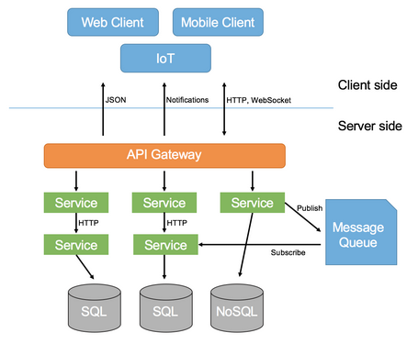
An example of a
Client-Server architectural

Slide 9
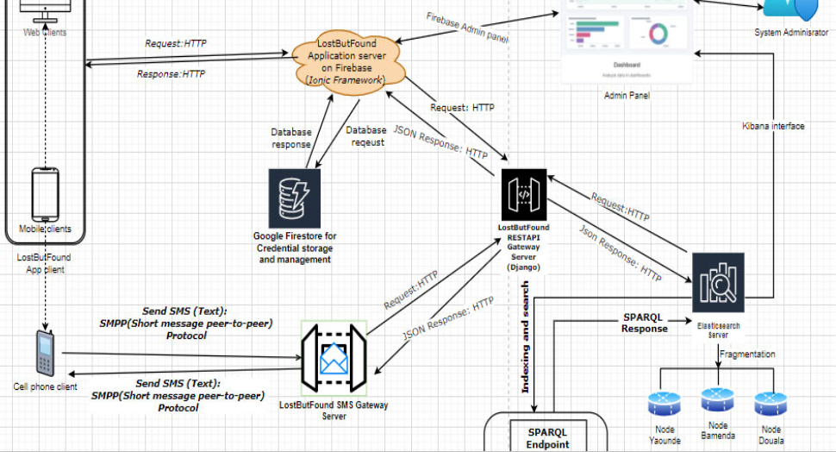

Slide 10
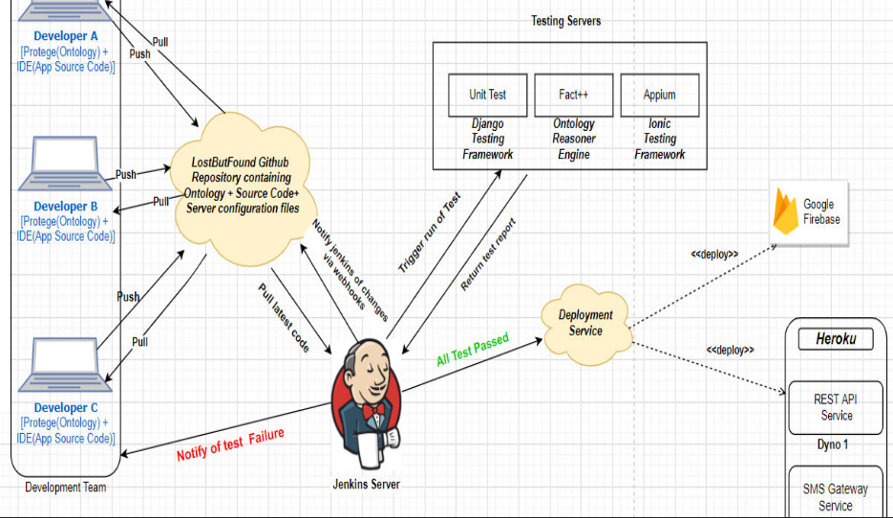

Slide 11
Are the above architectures identical?
Every system has its own architecture and they are not identical.
Discuss

Slide 12
In the beginning of Software Development
Versus
Today’s Software Development
Let us access software developmental changes w.r.t. to our society
Apache Kafka Ecosystem: Event-driven Architecture for distributed system, one of the most popular messaging systems for distributed applications. It provides fault tolerance, scalability, and high availability for efficient data streaming and messaging in large-scale applications. (Producer API, Consumer API, Streams API, Connector API, ...)
Apache Flume Ecosystem: Event-driven Architecture for distributed system
Both are distributed data systems with different architectures

Slide 13
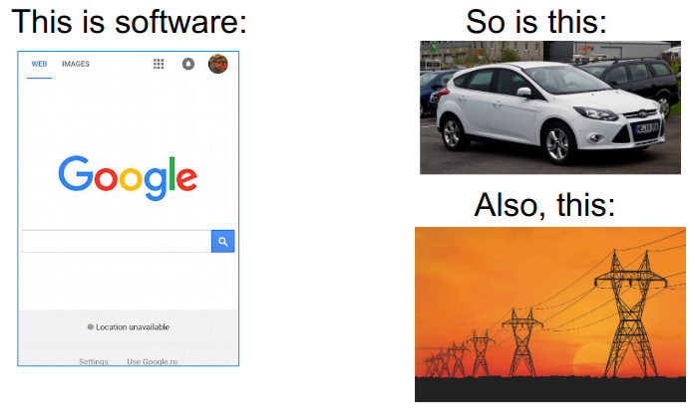
Our Society Highly Depends on Software
Are the above systems software controlled?

Slide 14
Our Society Depends Highly on Software
.
Question: Software development has evolved drastically such that our society highly depends on software. Despite this advancement, is there a single software that can be used in all sectors?
In the beginning software, software was small both physically and in scope. e.g FORTRAN a language for scientific computing, COBOL, BASIC, PASCAL
As software started to grow up;
Languages like C introduce file linking -Enables organization of code and reuse of code.
SIMULA-67, Smalltalk introduce objects -Enables organization of code into focused units that work with other objects to perform larger tasks.
And Today – We have more object-oriented programming languages like Java, Python, etc
Frameworks, Containers, etc
All that above have different software architectures on which they were constructed
Software architecture has equally evolved overtime.
Practicals: Designing Event-Driven Mircro-service Applications Using Apache Kafka Ecosystem

Slide 15
- Our Society Highly Depends on Software
Software development has been the fastest-growing technology in human history. Despite the advancement, there is not single software that can be used in all sectors.
Why?
Answer: Software requirements varies from one system to another, therefore, there is no architecture that encompasses the entire spectrum of software design and development possibilities, hence no single software that can function in all sectors for different purposes.

Slide 16
What is Software Architecture?
The word “architecture” means many different things to many different people, and there are many different definitions published on the Internet.
If you look at most software systems, they’re actually composed of multiple deployable units (e.g. applications or datastores), each of which might be built using different technologies.

Slide 17
What is Software Architecture?
Software architecture (SA) defines (describes):
The components of the software system and how the components use each other’s functionality and data.
I.e The major components of SUT and how well these components communicate
A software architecture is a creative activity that describes the various software components and their relationships based on customers’ requirements.
An example: client-server Architecture
Servers provide some kind of service; clients request and consume services applications are located with clients
E.g. running on PCs and workstations;
Data storage is treated as a server:
E.g. using a DBMS such as SQL, Postgres, Ingres, Sybase or Oracle
Consistency checking is located with the server
Advantages:
Breaks the system into manageable components➢Makes the control and data persistence mechanisms clearer
Variants:
Thick clients have their own services, thin ones get everything from servers

Slide 18
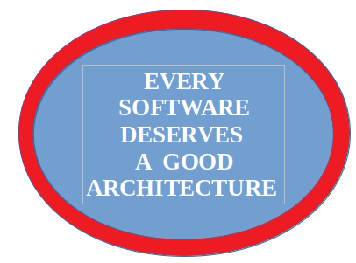
Software architecture is a critical bridge between software requirements and implementation
Software architecture =
Software Components +
The Relationship among them

Slide 19
The network is part of the architecture
The database is part of the architecture
The X framework is part of the architecture
Architecture is more than just a list of
products that are used in a project
Technology shapes an architecture, but an architecture should not only be bound tothe technologies that form it (technology changes too fast)

Slide 20
The benefits of software architecture
Does your software system have a well-defined structure?
Is everybody on the team implementing features in a consistent way?
Is there a consistent level of quality across the codebase?
Do team members share the same vision for how the software will be
built?
Does everybody on the team have the necessary amount of technical
guidance?
Is there an appropriate amount of technical leadership?

Slide 21
What is Architectural-Based Development
and
how can the complexity of large software be managed?

Slide 22
Why Architectural-based development
Application architecture style help define the basic characteristics and behavior of an application at a glance.
For example, some architecture pattern naturally lend themselves toward highly scalable applications, whereas other architecture naturally lend themselves toward applications that are highly agile.
Though systematic way, knowing the design principle, characteristics, strengths, and weaknesses of each architecture style is necessary in order to choose the one that meets the specific business needs and goals. Architecture styles are templates for concrete software architectures. They specific the system-wide structure properties of an application, and have an impact on the architecture level of its sub system. To choose the right architectural style, architect have to rely on business goals and quality attributes.
The selection of an architectural style is therefore a fundamental design decision when developing a software system.
The easiest way to describe the methodology of your research, is through the used of a well structured architecture.

Slide 23
Why Architectural-based development
Are you looking for means to communicate between stakeholder and others parties in the development team?
Representations of software architecture (SA) are an enabler for communication between all parties (stakeholders) interested in the development of a computer-based system. (A big picture) – I.e SA is a blueprint with which you construct your software; SA dispicts the structure of the system but hide the implementation details
Separation of Concerns: The main advantage of architectural-based development is the architectural separation of concerns, thereby reducing system complexity.
It reveals early design decisions about a system
SA seeks to build a bridge between business requirements and technical requirements by understanding use cases, and then finding ways to implement those use cases in the software.
SA helps in managing complexity, scalability, and reliability of software systems
SA will assist the development team to detect if there is any mismatch between system requirements and actual software.

Slide 24
Why Software Architecture?
The role of the Software Architect:
A Software Architect presents an overview of the (system) architecture including:
- technical constraints such as an OS, hardware, API gateways, or middle-ware prescribed for use
- other systems with which the system must interact
- architectural approaches used to meet quality attribute requirements

Slide 25
Why Software Architecture?
The role of the Software Architect:
It outlines the elements needed for making and executing a blueprint for a successful software product.
Why will project owners wish to incorporate architectural design in their projects?
Software architecture is an art - meaning there are various ways of representing the same architecture based on the view point of the system analyst.
Inadequate requirements will lead to a vague solution
Vague problem ---------->> vague solution
In order to bridge the gap, the Software Architect needs to model the system.
Can you define your project goals?
Can you define your methodology?

Slide 26
Analysis in the Design Process
Recall the following concepts in Software Engineering:
System Analysis Versus System Design
Is there any difference between System Analysis and System Design?
Is there any difference between Architecture and Design

Slide 27
All architecture is design but not all design is architecture.
Why: Because all architectures are based on design principles.
Architecture represents the significant design decisions that shape a system, where significance is measured by the cost of change.

Slide 28
System Analysis is a process of collecting and analyzing the requirements of the system whereas System Design is a process of creating a design for the system to meet the requirements.
Design is the process of making decisions; analysis is the process of understanding those decisions, so that the design may be evaluated.

Slide 29
System Analysis Vs System Design
System Analysis
It is the study of the existing system to identify the problem areas.
It is a process of understanding the system requirements and its environment.
It involves gathering and understanding the user’s requirements.
It involves analyzing the system in terms of its current and future needs
I.e
What is the problem?
what happens in the current system?
Have you understood domain analysis
what is required in the new system?
Results (Outcome of Analysis phase):SRSD
- Detail understanding of requirements and domain properties

Slide 30
System Analysis Vs System Design
Software Design
Software design is a creative activity in which you identify software components and their relationships, based on a customer’s requirements.
System Design is the process of creating a design for the system to meet the requirements. System design is the process of designing the architecture, components, modules, interfaces, and data for a system to satisfy the specified requirements. It involves the design of the system architecture, components, modules, interfaces, and data

Slide 31
System design Investigates “how to build a solution”
How will the new system work?
How can we solve the problem that the analysis phase identified?
Results in a solution to the problem. I.E The purpose of Design phase in the Software Development Life Cycle is to produce a solution to a problem given in the SRS(Software Requirement Specification) document. The output of the design phase is Software Design Document (SDD)
-An architectural design to provide solution to the identified problem
- A working system that satisfies the requirements: Hardware + Software + ‘Peopleware’
- Focuses on building technical solutions
Separate activities but not necessary sequential

Slide 32
Architectural Design Concepts: Cohesion and Coupling
Coupling and cohesion are methods to measure the relationship between and within modules. A software system is divided into multiple modules, where each and every module are capable of performing a function independently. This technique is known as Modularization
Coupling is the degree of inter-dependencies between software modules.
Cohesion is the degree of intra-dependencies within the functionalities in a software component.

Slide 33
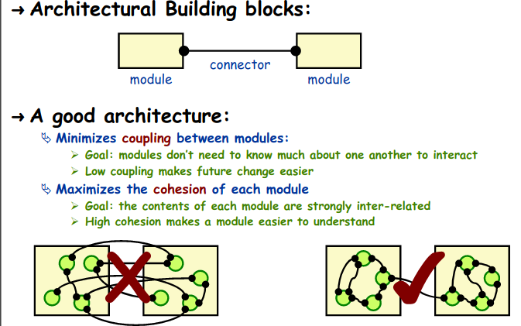
Cohesion and Coupling

Slide 34
Software Architecture seeks to establish the following:
(1) Which kind of components and connectors are used?
(2) How is data communicated through the system

Slide 35
Quality Attributes in Software Architecture
(Architectural Drivers)
Interoperability: Ability of a system or different systems to operate successfully by communicating and exchanging information with other external systems written and run by external parties. I.e The degree to which two or more systems (components) can usefully exchange information
Maintainability: Ability of the system to undergo changes with a degree of ease
Correctness: Accountability for satisfying all requirements of the system.
Scalability -----

Slide 36
Principles of Architectural Design Process
This technique consists of five steps that are performed iteratively
The following are the main principles of software architectural design process:-
1- Understand the research problem
2- Identify design elements and their relationships
3- Evaluate the architectural design
4- Transform the architecture design

Slide 37
Principles of Architectural Design Process
(1) Understand the Research Problem:
This is the most crucial step because it affects the quality of the design that follows.
Without a clear understanding of the problem, it is not possible to create an effective solution.
Many software projects are considered failures because they did not actually solve a valid business problem.
Architectural requirement analysis is a principal indicator to bridge the gab between the problem domain and solution domain
As a researcher, a good understanding of your research problem will lead to a well-structured research questions.
Research problem representation: Motivating Example, Motivation Scenario, Illustrative Example, etc.

Slide 38
Principles of Architectural Design Process
(2) Identify Key Design Elements and their Relationships (Candidate Architecture):
In this phase, the Software Architecture builds a baseline for defining the system boundaries and the context of the system (scope).
This step is divided into the following set of activities:
(a) Start by identifying architectural components, relationships between the components and define high level-business objectives – Use Cases.
The Software Architect carries out the process of system decomposition or reverse engineering by decomposing the system into its main components based on functional requirements and non-functional requirements by adopting the principles of Separation of Concerns and attribute-driven design.
Architecturally significant use cases are identified,
(b) Communication: Which API are necessary for effective communication between design elements?
In this step, the first validation of the architecture is done by describing a number of system instances and this step is referred to as Functionality Based Architectural Design.
(c) Determining relevant technologies: Identify deployment topology based on the application type
(d) Selection of a reference architecture.
(e) Deduce the first draft of the Candidate Architecture

Slide 39
Candidate architectures include an application type, deployment architecture, architectural style, technology choices, quality attributes, and crosscutting concerns. If a candidate architecture satisfies the requirements and issues, then it becomes a baseline architecture and is refined in further iterations.

Slide 40
Principles of Architectural Design Process
(3) Evaluate the architectural design:
- The architecture is evaluated with respect to quality attributes.
- The Software Architect evaluates the architectural design to see if it is good enough to be implemented.
*Evaluate Architecture with stakeholders
- It involves evaluating the architecture for conformance to architectural quality attributes requirements.
- If the observed quality attribute does not meet its user’s requirements, then a new design must be created.
- These questions must always come in mind:
At a glance, can all the use’s requirements be met?
Is the architecture good enough to meet user’s requirements?
Is there a mismatch between the user’s requirements and the SA?

Slide 41
Principles of Architectural Design Process
(4) Transform the Architectural Design:
Revisit requirements
This step performed after an evaluation of the architectural design.
The architectural design must be revisited until it completely satisfies the quality attributes.
This candidate architecture is further refined through a series of iterations until it is deemed acceptable after an evaluation is performed.

Slide 42
Attribute-driven Design
Attributes driven design (ADD) is an approach to defining software architectures by basing the design process on the architecture’s quality attribute requirements.
In ADD, architectural design follows a recursive decomposition process where at each state in the decomposition architectural tactics and patterns are chosen to satisfy a set of quality attribute scenarios .
The architecture designed using the ADD method represents the high-level design choices documented as containers for functionality and interactions among the containers using views. The nature of the project determines the views; most commonly one or more of the following are used: a module decomposition view, a concurrency view, and a deployment view.
The architecture is critical for achieving desired quality and business goals, and providing the framework for achieving functionality. Architects use the following steps when designing an architecture using the ADD method:

Slide 43
Attribute-driven Design
1. Choose the module to decompose. The module to start with is usually the whole system. All required inputs for this module should be available (constraints, functional requirements, quality requirements)
2. Refine the modules according to these steps:
a. Choose the architectural drivers from the set of concrete quality scenarios and functional requirements. This step determines what is important for this decomposition.
b. Choose an architectural style/pattern that satisfies the drivers. Create (or select) the style/pattern based on the tactics that can be used to achieve the drivers. Identify child modules required to implement the tactics.
c. Instantiate modules and allocate functionality from use cases, and represent the results using multiple views.
d. Define interfaces of the child modules. The decomposition provides modules and constraints on the types of module interactions. Document this information in the interface document of each module.
e. Verify and refine the use cases and quality scenarios and make them constraints for the child modules. This step verifies that nothing important was forgotten and prepares the child modules for further decomposition or implementation.
3. Repeat the steps 2 and 3 for every module that needs further decomposition.

Slide 44
Architectural Views
Software architecture is about components, connectors and connections.
An important goal is to correctly identify the essential components of the system under consideration.
Once the components are correctly identified, the next aim is to identify how different components (subparts) gel with each other, how they communicate, what are the dependability and what are the connections. When the subparts and the dependencies are put together, we should have successfully assembled the required system with all its desired features.

Slide 45
Architectural Viewpoints
When a software system needs to be developed, there are many external components (people, other software systems, other hardware systems, etc) that have to interface with the system under study (SUT).
Different stakeholders have different interests in the system, and so their perspectives of viewing the same system are different.
The stakeholders’ requirements may overlap or may be different from each other.
This “stakeholder” influence on architecture makes it clear that there can be different perspectives of viewing the software architecture of one system. These perspectives have been traditionally called “architectural views”
The Software Architect has to balance all these different perspectives and then come up with an architecture that satisfies all stakeholders to the maximum possible extent.
Viewpoints of different stakeholders may lead to different views of the same system, and these views when integrated will form the complete architectural description of the software system being designed.

Slide 46
Different authors have proposed a different set of architectural views as the most suitable ones. The most popular among them is the “4+1” view model proposed by Phillipe Kruchten. The four main views according to this model are:
(1) Logical View (Module View)
(2) Process View
(3) Deployment View
(4) Physical View

Slide 47
Logical View (Module View)
The logical view is concerned about the output(s) of the system and how it will affect the end users. For this purpose the logical view attempts to defragment the system into a set of modules or abstractions. This decomposition serves two purposes; it enables functional analysis, and it also helps in identification of common mechanisms and design elements that are common across the system.
Process View (Component-and-Connector View):
This view deals with concurrency and distribution, system integrity, and fault tolerance. This view tries to explain which components interact, and how they do so. It tries to explain the connections between different components from a run-time perspective.

Slide 48
Development View (Allocation View)
This view describes the static organization of the software in its development environment. It deals with modules, work allocation, costs and planning. It also involves monitoring of project progress, software reuse, and security.
Physical View (Deployment View):
This view describes the mapping(s) of the software onto the hardware and reflects its distributed aspects. It looks into system requirements like reliability and performance. It maps the various elements identified in the above three views. These views, combined with a 5th the view, which is “use cases or scenarios”, represents the entire architecture. Figure 1 represents Kruchten’s “4+1” view model

Slide 49
Exercise/TD
What are those indicators that could show that your software has a good architecture?
Explain the following concepts as used in SA
(I) Functionality Based Architectural Design.
(II) Attribute-driven Design
What are them major differences between:
(i) Monolithic Architecture and Micro-service Architecture.
(ii) System Analysis and System Design

Slide 50
Answers to Exercise/TD
What are those indicators that could show that your software has a good architecture?
A good architecture:
(I) Adopts Functionality Based Architectural Design approach
(II) Adopts Attribute-driven Design approach
(III) Minimizes coupling between modules
(iv) Maximizes cohesion of each modules
Explain the following concepts as used in SA
(I) Functionality Based Architectural Design.
(II) Attribute-driven Design

Slide 51
Exercise/TD 1
(A) You have been recruited newly as a Senior DevOps Software Architect of a large Software Firm. The Enterprise software architecture design of this firm was a Monolithic Architecture. You are tasked with improving the operational processes of this firm by enhancing the existing software.
List five (5) drawbacks that the organization might be facing by using a monolithic software architecture.
Propose to the management of this firm five (5) advantages a Microservice architecture will bring to the organization.
Assuming your proposal of a Microservice architecture has been accepted by the management and you are now faced with the task of building of a Microservice architecture. What are your expectations?
Hints:
- Choose any open source application of your choice.
- Identify sub components and their corresponding communication gateways, explain the concept of attribute driven-design, state architectural drivers for the system with concrete reasons, explain the principles of good Architectural Design Process.
- State the technology to be used for deployment with concrete reasons
- Presents a draft of the microservice architecture.
- With reference to the chosen system, attempt to deduce a mathematical description of your architecture. deduce a mathematical description of your architecture.
(B) Choose any open source social networking system of your choice (Facebook, YouTube, WhatsApp, Facebook Messenger, Instagram, Twitter, WeChat, TikTok) and study its architecture.
Use it to learn how to apply architectural concepts and best practices to the systems.
Assuming, you are to develop a new social networking application of your choice, present a draft of the interrelated components including the corresponding APIs.
(C) Explain four (4) challenges to software architectural success.

Slide 52
Software Architecture Styles
How can we archived a goal-oriented/purpose driven architecture for an IS?

Slide 53
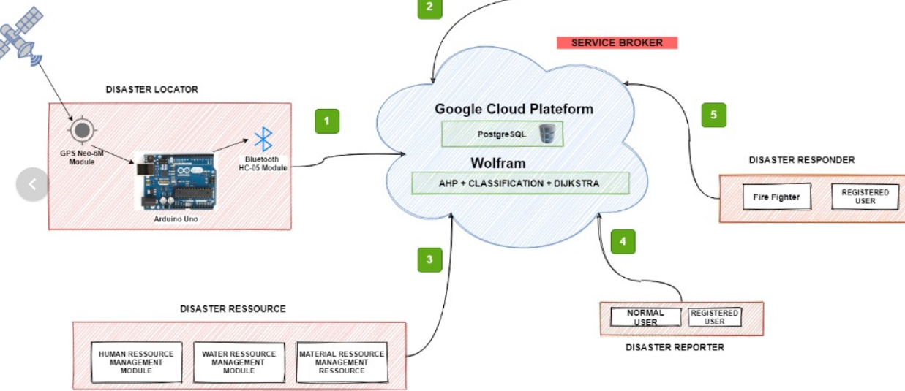
A SOA for Fire Disaster Management

Slide 54
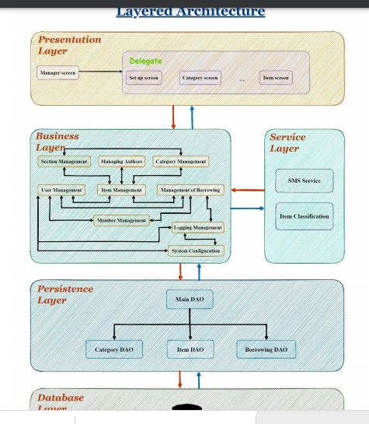
A layered Architecture for LMS

Slide 55
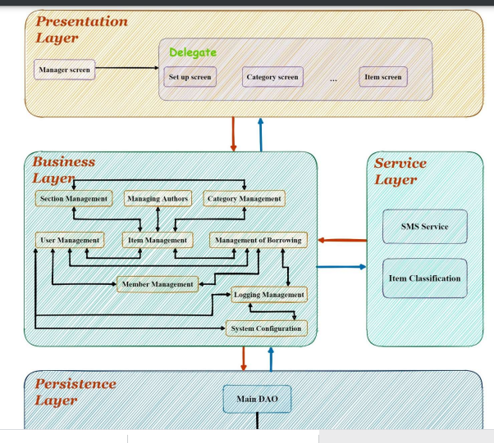

Slide 56
What is a Software Architecture Style?
An architectural style defines:
the components of the software system
how the components use each other’s functionality and data
How control is managed between the components
- An architectural style describes how Software elements/components interconnect together in order to share data.
a family of systems or a class of architectures in terms of a pattern of structural organization

Slide 57
Architectural style seeks to establish the following:
(1) Which kind of components and connectors are used?
(2) How is data communicated through the system?

Slide 58
Software Architectural Styles
Microservice Architecture
Service-Oriented Architecture
Layered/Hierarchical Architecture
Client-Server Architecture
Model View Controller (MVC)
Object-Oriented Architecture
Broker Architecture
N-Tier Architecture
2-Tier Architecture
Message Bus Architecture
Object-Oriented Architecture
Each of these styles is appropriate for some classes of problems, but none is suitable for all problems

Slide 59
Why will project owners wish to incorporate architectural design in their projects?
What are the various Software Elements/Components/ or Design Elements that a Project owner needs to include into his projects?

Slide 60
Microservice Architecture

Slide 61
Objectives:
Microservice Architecture
Today’s lecture gives the brief introduction on the evolution on microservices (monolithic to mircoservice way), concept of microservice with its benefits and how to define a microservice.
To understand the model-driven and design-driven approaches for developing applications of a microservices system.

Slide 62
Microservice Architecture
Microservice Architecture is an architectural style for distributed systems " has sprung up over the last few years to describe a particular way of designing software applications as suites of independently deployable services. While there is no precise definition of this architectural style, there are certain common characteristics around organization around business capability, automated deployment, intelligence in the endpoints, and decentralized control of languages and data.
In short, the microservice architectural style is an approach to developing a single application as a suite of small services, each running in its own process and communicating with lightweight mechanisms, often an HTTP resource API. These services are built around business capabilities and independently deployable by fully automated deployment machinery. There is a bare minimum of centralized management of these services, which may be written in different programming languages and use different data storage technologies.
To start explaining the microservice style it's useful to compare it to the monolithic style: a monolithic application built as a single unit withour APIs.

Slide 63
In a monolithic application, functions are woven directly into the individual components that make up the application, rather than separated into independent units of functional logic.
When a monolithic application is componentized, it's possible to spread a feature across multiple components. That means that those components are now tightly coupled, and that, in turn, limits how well they exploit the benefits of cloud-native microservices

Slide 64
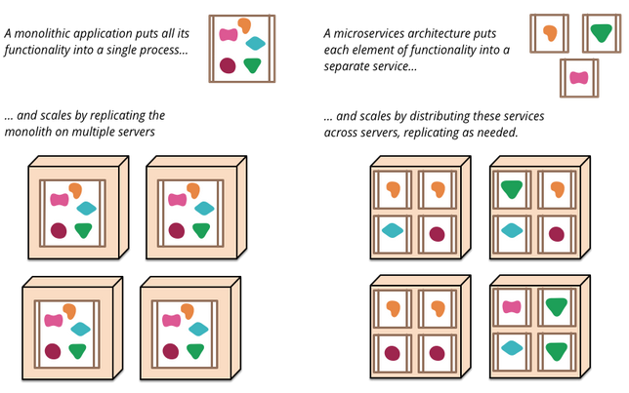

Slide 65
These frustrations have led to the microservice architectural style: building applications as suites of services. As well as the fact that services are independently deployable and scalable, each service also provides a firm module boundary, even allowing for different services to be written in different programming languages. They can also be managed by different teams .
Is there any difference between a distributed monolithic architecture and a mircoservice architecture?

Slide 66
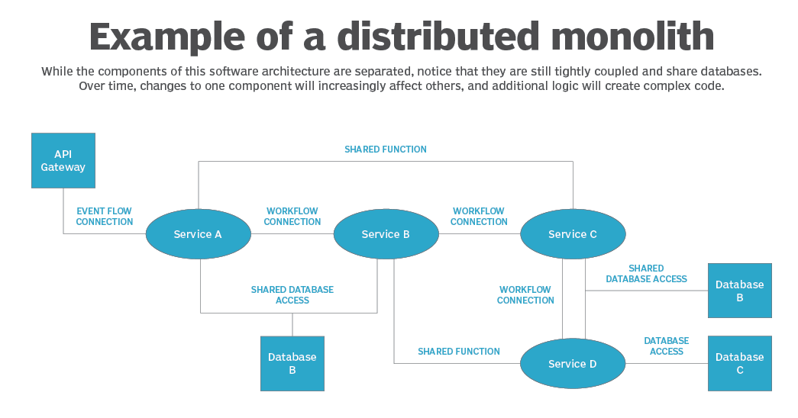

Slide 67
This diagram could potentially represent two contrasting design styles. Some architects, for example, could use this to illustrate a cloud-native microservices application. Others, however, would call it a perfect example of the functional relationships within a distributed monolith. The difference between these two perspectives lies not in the component or workflow design, but in how the components actually map to specific features and the functional logic behind them.

Slide 68
Drawbacks of Monolithic Architecture
Less Scalability
Less reusability
Tight coupling between components
Maintenance cost is high
Slow deployment

Slide 69
Characteristics of a Microservice Architecture
(1) Componentization via Services
One main reason for using services as components (rather than libraries) is that services are independently deployable. If you have an application [4] that consists of a multiple libraries in a single process, a change to any single component results in having to redeploy the entire application. But if that application is decomposed into multiple services, you can expect many single service changes to only require that service to be redeployed. That's not an absolute, some changes will change service interfaces resulting in some coordination, but the aim of a good microservice architecture is to minimize these through cohesive service boundaries and evolution mechanisms in the service contracts.
Microservice architecture decomposes a service to form high cohesion and low coupling.

Slide 70
(2) Decentralized Data Management
Decentralization of data management presents in a number of different ways.
As well as decentralizing decisions about conceptual models, microservices also decentralize data storage decisions. While monolithic applications prefer a single logical database for persistant data, enterprises often prefer a single database across a range of applications - many of these decisions driven through vendor's commercial models around licensing. Microservices prefer letting each service manage its own database, either different instances of the same database technology, or entirely different database systems Decentralized Data Management.
(3) Evolutionary Design
Microservice practitioners, usually have come from an evolutionary design background and see service decomposition as a further tool to enable application developers to control changes in their application without slowing down change. Change control doesn't necessarily mean change reduction - with the right attitudes and tools you can make frequent, fast, and well-controlled changes to software.

Slide 71
Advantages of Microservice Architecture
Highly Scalable
Highly maintainable
Rapid deployment
Reusability of services
Fault tolerant in case one service goes down, the other service keep working.

Slide 72
The Microservice Way
Speed and safety are the two key aspect of the microservices.
These two keys are affected with the every single decision made about the software.
The microservices way is about finding the balance between these two key aspect at scale:
Speed and Safety at Scale and in Harmony.
The Microservices Way

Slide 73
The complexity of the software system increases as it scales in the form of functional scope, operational magnitude and change frequency.
The Speed of Change:
- The desire of speed is the desire of immediately releasing the changes in the software into the production environment.
- Microservice architecture must be modularized, in order to achieve cohesion of service – dependences bewteen modules are reduced.
- Cohesion of service is achieved by defining the right service boundaries and analyzing the semantics of the system.
- Modularized services can be deployed independently, resulting in the increasing delivery speed.
The Safety of Change:
- The risk of damage can be minimize by restricting the rate of change to those releases in the production environments. Thus optimizing the production environments for safety.

Slide 74
The Speed of Change:
- The desire of speed is the desire of immediately releasing the changes in the software into the production environment.
The Safety of Change:
- The risk of damage can be minimize by restricting the rate of change
to those releases in the production environments. Thus optimizing the
production environments for safety.

Slide 75
The Speed of Change:
- The desire of speed is the desire of immediately releasing the changes in the software into the production environment.
The Safety of Change:
- The risk of damage can be minimize by restricting the rate of change
to those releases in the production environments. Thus optimizing the
production environments for safety.

Slide 76
At Scale:
- The software should be build to work when demand grows beyond the initial expectation .This is know as building the system at scale.
- Systems that work at scale don’t break when under pressure.
- Built-in mechanisms are incorporated in the systems to increase capacity in a safe way.
In Harmony:
- Microservice architecture is said to be at harmony when organization succeeds to maintain the system stability while increasing their change velocity.

Slide 77
Designing Microservice Architecture and Establishing Foundations
A microservice design model consist of five parts: Service, Solution, Process and Tools, Organization and Culture
The very first step of a service design process is to design the process itself.
Processes and Tools: The behaviour of the system depends on the process and tools used to build the microservice system.
Tools and processes are related to software development, code deployment, maintenance, and product management in the microservice system.
- Development using a container – Docker
-Different APIs
- Public Cloud, Private Cloud, Data Center.
- Chosing the right virtual machine
- Depoyment Platforms: Herroku, Octopus Deploy,
- Continuous integration with Wercker Platform
- Continuous Integration with Circleci Platform

Slide 78
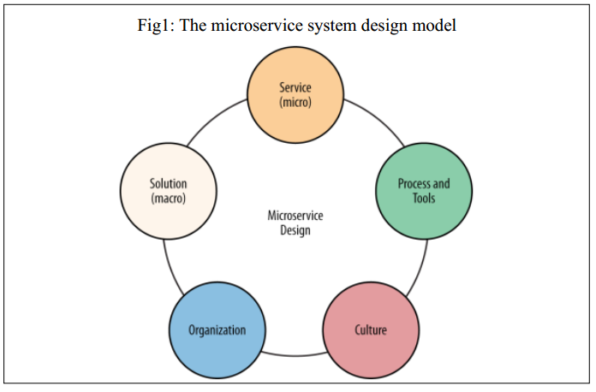

Slide 79
Service-Oriented Architecture (SOA)
A service-oriented architecture is an architectural style/approach (framework) for building systems or applications that use a set of services over a network. A service is an implementation of a well-defined piece of business functionality.
SOA is an architectural style that supports integration of business processes as linked services that may be accessed when needed over a network.
SOA is a software architectural style or design paradigm that uses services over a network as the main building component.
This architectural style describes a collection of distributed components that provide and/or consume services.
Service consumers are able to use these services without any detailed knowledge of their implementation.
This allows for easy maintainability, as each service can be altered without affecting the otherservices of the system. Additionally, each service can be tested independently of each other,which can be useful in pinpointing potential defects

Slide 80
The choice to use an SOA approach in the development of an architecture depends on several factors including the architecture’s ultimate ability to meet functional and quality attribute requirements. Usually, an architecture needs to satisfy many quality attribute requirements in order to achieve the organization’s business goals. In almost all cases, trade-offs have to be made between these requirements. In some cases, satisfying these requirements may be easier using an SOA; on others, it may be more difficult. If an SOA is being considered, several questions need to be asked; for example:
• What effect will the choice of an SOA have on the business goals?
• Which quality attribute requirements will be positively impacted and which will be negatively impacted by the use of the SOA?
• What take-offs need to be made among the quality attributes?

Slide 81
A diagrammatic view of a general purpose SOA

Slide 82
Client-Server Architecture
Client-server architecture is one of the two prevailing models for network programming, the other being peer-to-peer. Almost every application that requires some sort of communication between clients uses one of these two of theses architectures.

Slide 83
Layered Architecture

Slide 84
Layered Architecture /Hierarchical Architecture
Organizes the system into a set of layers (or abstract machines) each of which provide a set of services.
Organizes the system into layers with related functionality associated with each layer. A layer provides services to the layer above it so the lowest-level layers represent core services that are likely to be used through out the system

Slide 85
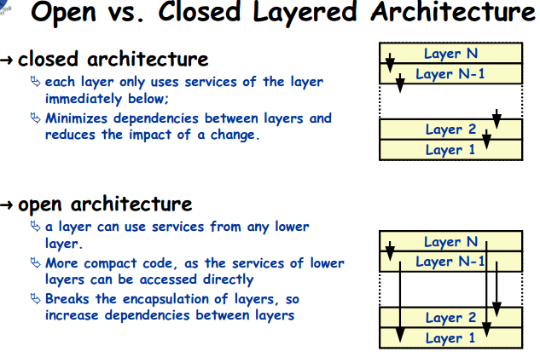

Slide 86
Team Presentation/TD
Project 1: Design and Implementation of a Real Time Embedded System for the Identification and Retrieval of Missing Documents.
Project 2: Distributed Service-Oriented Architecture for Fire Disaster Management
(A) With respect to your the above TP projects: (In class)
- Identify the research problem
- Choose an architectural style with concrete reasons (Start by identifying design elements/components and their relationship)
- Produce the first draft of your chosen architectural style
(B) Explain in details, the following architectural styles:
- Service-Oriented Architecture
- Micro-Service Architecture
- Client-Server Architecture
(C) Look for a good research paper in relation to the above TP topics:
- Identify the research problem solved in the paper
- The research methodology of the paper
- The limitations of the paper

Slide 87
TD/Exercises
You have been asked to conduct a research on two projects given below:
Project 1: Design and Implementation of a Microservice-oriented System for the Identification and Retrieval of Missing Documents.
Project 2: Design and Implementation of a Microservice-oriented System for Disaster Management
Project 3: Domain-Driven Microservice Architecture for Educational Management System
(a) Identify your research problem for any of the above projects
(b) Clearly state the requirements for the system
(c) Identify five architectural drivers for the system
(d) Describe hierarchical architecture in detail, depicting the architectural view for the system and hence explain 4 software architectural design patterns.
(e) Recommend a research methodology for your chosen project.

Slide 88
DEPLOYMENT OF MICROSERVICE ARCHITECTURE

Slide 89
DEPLOYMENT OF MICROSERVICE ARCHITECTURE
Deployment of microservice architecture to a Private Cloud, Public Cloud or Data Center.
N/B: Use any deployment technology of your choice

Slide 90
Wercker is a Docker based continuous delivery platform which is used by software developers to build and deploy their applications and Microservices.
Using Wercker developers can create Docker containers on their desktop, automate their build and deploy processes, testing them on their desktop, and then deploy them to various cloud platforms like Heroku, AWS and Rackspace.
The command-line interface of Wercker is open-sourced. The business behind Wercker, also called Wercker, was founded in 2012 and acquired by Oracle Corporation in 2017.

Slide 91
Continuous Integration with
Circleci Platform
CircleCI is a modern platform used for continuous integration (CI) and continuous delivery (CD) i.e. CI/CD platform. The CircleCI Enterprise solution is installable inside a private cloud or a data center and is free to try for a limited time.
CircleCI automates build, test, and deployment of software.
CircleCI can also be configured to deploy code to various environments like AWS CodeDeploy, AWS EC2 Container Service (ECS), AWS S3, Google Container Engine (GKE), Heroku etc.
Check the website http://circleci.com and sign up with a new account for free or login using your GitHub account.
Firstly, you need to set up a configuration file circle.yml to tell CircleCI how to build the app. Figure 5.20 below depicts the code for circle.yml file.

Slide 92
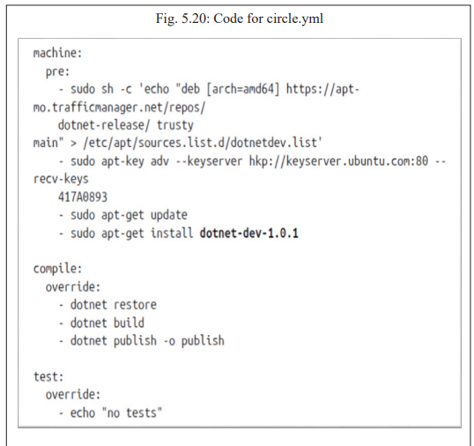
Figure 5.20 below depicts the code for circle.yml file.

Slide 93
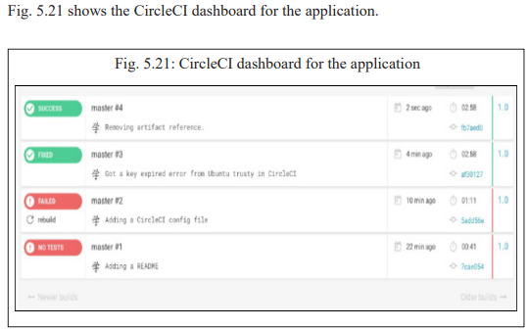
Figure 5.21 shows the CircleCI dashboard for the application

Slide 94
Architectural evaluation.
According to the software architectural design, software quality attributes will be evaluated, the students in their various groups performs software architecture design evaluation activities.
Source code analysis: Source code will be analyzed of the selected project at the module level, students will exchange their group work and API and other relating systems will be verified for proper integration with respect to the software architectural design.

