Slide 1
ICT302 FT02
Secure QR Code Development
VAFPQR
Patricia Orenza | 35075567
Lim Yu Jun Felixia | 35544256
Roy Hojin Yoo | 34845454
Alvin Yeow | 35475756
Vanessa Tan | 35235647
Gu Qiyu | 35139306
Notes:
WHOLE TEAM — brief cold open (~20 sec, not counted in the 6x per-person split).
Patricia: Welcome the panel, introduce the team by name, and state in one sentence what the system does (secure QR code authentication with tamper detection) before moving to the agenda slide.

Slide 2
Table of contents
01
02
03
04
05
06
Introduction
Problem
Objectives, Solution, Methodology
Team Process & Timeline
Promo Video
Additional Features,
Future Developments

Slide 3
01
Introduction

Slide 4
VAFPQR Goals
Mission
Vision
To create a future where every QR code can be trusted, making secure digital interactions the global norm.
To safeguard digital interactions by providing an intelligent QR authentication platform that verifies authenticity, detects tampering in real time, and delivers secure, backward-compatible solutions that protect users and organizations from QR code fraud.

Slide 5
323%
2 billion
1 trillion+
Increase in QR Codes usage over the last 5 years
QR code scans happen worldwide daily in 2026
QR code scans globally in 2025
First for the technology
Sources: QRTRAC 2026, Wave Connect 2026, Uniqode 2026, IMQRScan 2026

Slide 6

$12.04B $33.14B
Global QR code market size prediction from 2025 to 2030
Sources: QRTRAC 2026, Wave Connect 2026, Uniqode 2026, IMQRScan 2026

Slide 7
02
Problem

Slide 8
587%
12%
716,000+
Rise in QR code phishing reports the past 2 years
Of all phishing attacks used a QR code (from 0.8% in 2021)
Unique malicious QR codes detected by Mimecast in a single quarter of 2025
Sources: Keepnet Labs 2026, ECCU 2026, Acronis 2026, Access Newswire (Jun 2026), UK Action Fraud

Slide 9





Gaps in QR Codes Usage
Redirection to phishing or malicious sites
Lack of Verification
Lack of visibility on QR Codes usage
Physical tampering or altering of QR Codes

Slide 10
03
Objectives, Solution, Methodology

Slide 11
Our Objectives
QR code generator
QR codes must be time-limited
QR codes can not be out of the norm to ensure backwards compatibility.
Telemetry and Metrics on QR usage
Authentication
Only people who use our mobile app can scan our QR codes
Mobile application
Easy to use
Reports of tampering with the QR code can be sent
Metrics on QR usage
Notes:
Backwards compatibility is to ensure a wider adoption of our QR Code system.

Slide 12
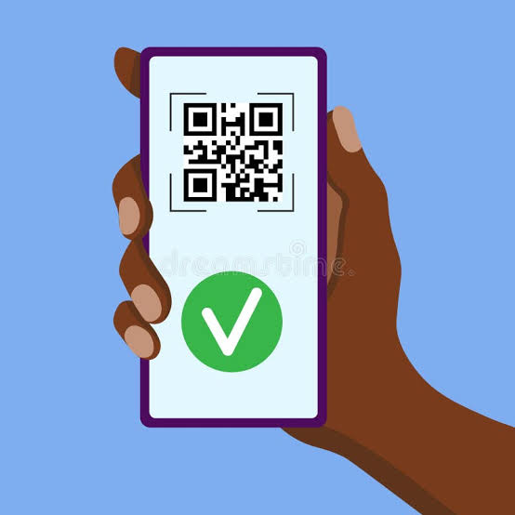
Our Solution
QR code generation and validation
Secure QR code generation:
  Generates cryptographic QR codes that integrates JWT payloads
QR code validation:
  Checks cryptographic signatures, expiration dates and blacklists.
Redirect system:
  Routes directing users to the correct destinations based on the status of the code.
Backwards compatibility:
  Guarantees that native camera application is capable of reading the underlying URL.

Slide 13
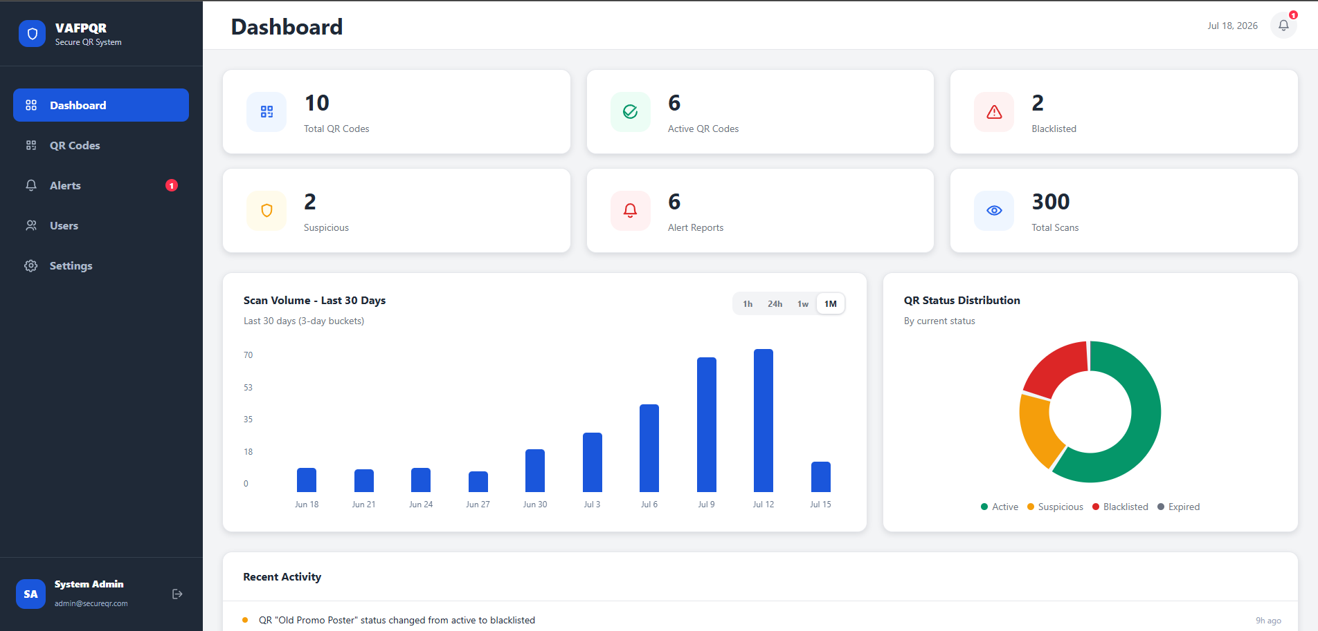
Our Solution
Mobile application and session security
Mobile application:
  Utilize device’s camera hardware for scanning and transmit verification requests with device metadata
Session security:
  Implement HTTPS and utilized Expo SecureStore to safely store JWTs.
Administration and blacklist control
Blacklist control:
  Eliminates threats by letting operators to modify token statuses and prevent future routing.
Admin dashboard:
  Role-based visual control panel for authorized users to generate QR codes, observe metrics and handle blacklists.

Slide 14
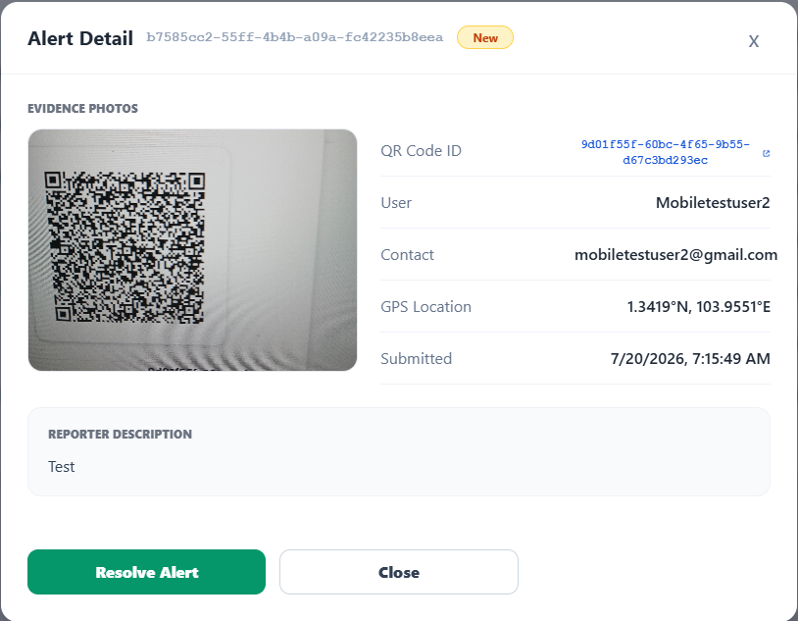
Our Solution
Tampering reports and analytics
Tampering report:
  Allow users to report suspicious QR codes.
Scan analytics:
  Telemetry system logs incoming scan timestamps, IP and user-agent details for tracking.

Slide 15

Our Hybrid Methodology
Waterfall & Agile
Requirements were gathered directly from clients Peter Cole and Mike Groeneweg, analyzed by the team, and implemented across multiple iterations of development and testing to refine the build to better meet the requirements.

Slide 16
04
Team Process & Timeline

Slide 17
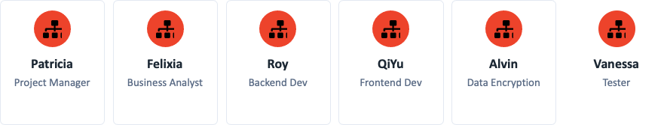

Roles Allocation

Slide 18
Communication Channel
Channel | Purpose
WhatsApp | Weekly updates, quick questions, reminders
Microsoft Teams and Face-to-Face | Weekly meetings, supervisor Client discussions
OneDrive | Document storage, meeting minutes, reports
GitHub | Source code management
Email | Formal client & supervisor communication
Meeting Structure:
Weekly meetings
2-3 hours per week
Each member shares: accomplishments, next steps, challenges
Meeting minutes documented and stored in OneDrive

Slide 19
Team Timeline
Sprints | Dates | Focus
Sprint 1 | 6 May – 12 May | Group Allocation
Sprint 2 | 13 May - 23 May | Allocation of roles, Team Charter
Sprint 3 | 13 May - 6 June | Project Management Plan, Initial requirements gathering
Sprint 4 | 6 June – 19 June | Requirements and Analysis document finalisation, Design Document, Front-end and Back-end setup
Sprint 5 | 20 June – 3 July | Design Document completion, Self and Peer Evaluation, QR generation endpoint, verification endpoint
Sprint 6 | 4 July – 17 July | QR Code Landing Page, Admin dashboard pages, Mobile Application pages, Android APK installer package, Mobile scanner screen, tamper alert reporting, Check encryption
Sprint 7 | 18 July – 31 July | Demo, APK Virus Testing, Full system testing, bug resolution, Final Presentation Slides, Final documentation writing and document amendments

Slide 20
Key Milestones
Deliverable | Due Date
Team Charter | 23 May 2026
PMP V1.0 | 6 June 2026
R&A Document | 8 June 2026
Design Document | 27 June 2026
SPE1 | 27 June 2026
Final Submission | 1 August 2026
Presentation & Promo Video | 1 August 2026
SPE2 | 1 August 2026

Slide 21
05
Promo Video

Slide 22
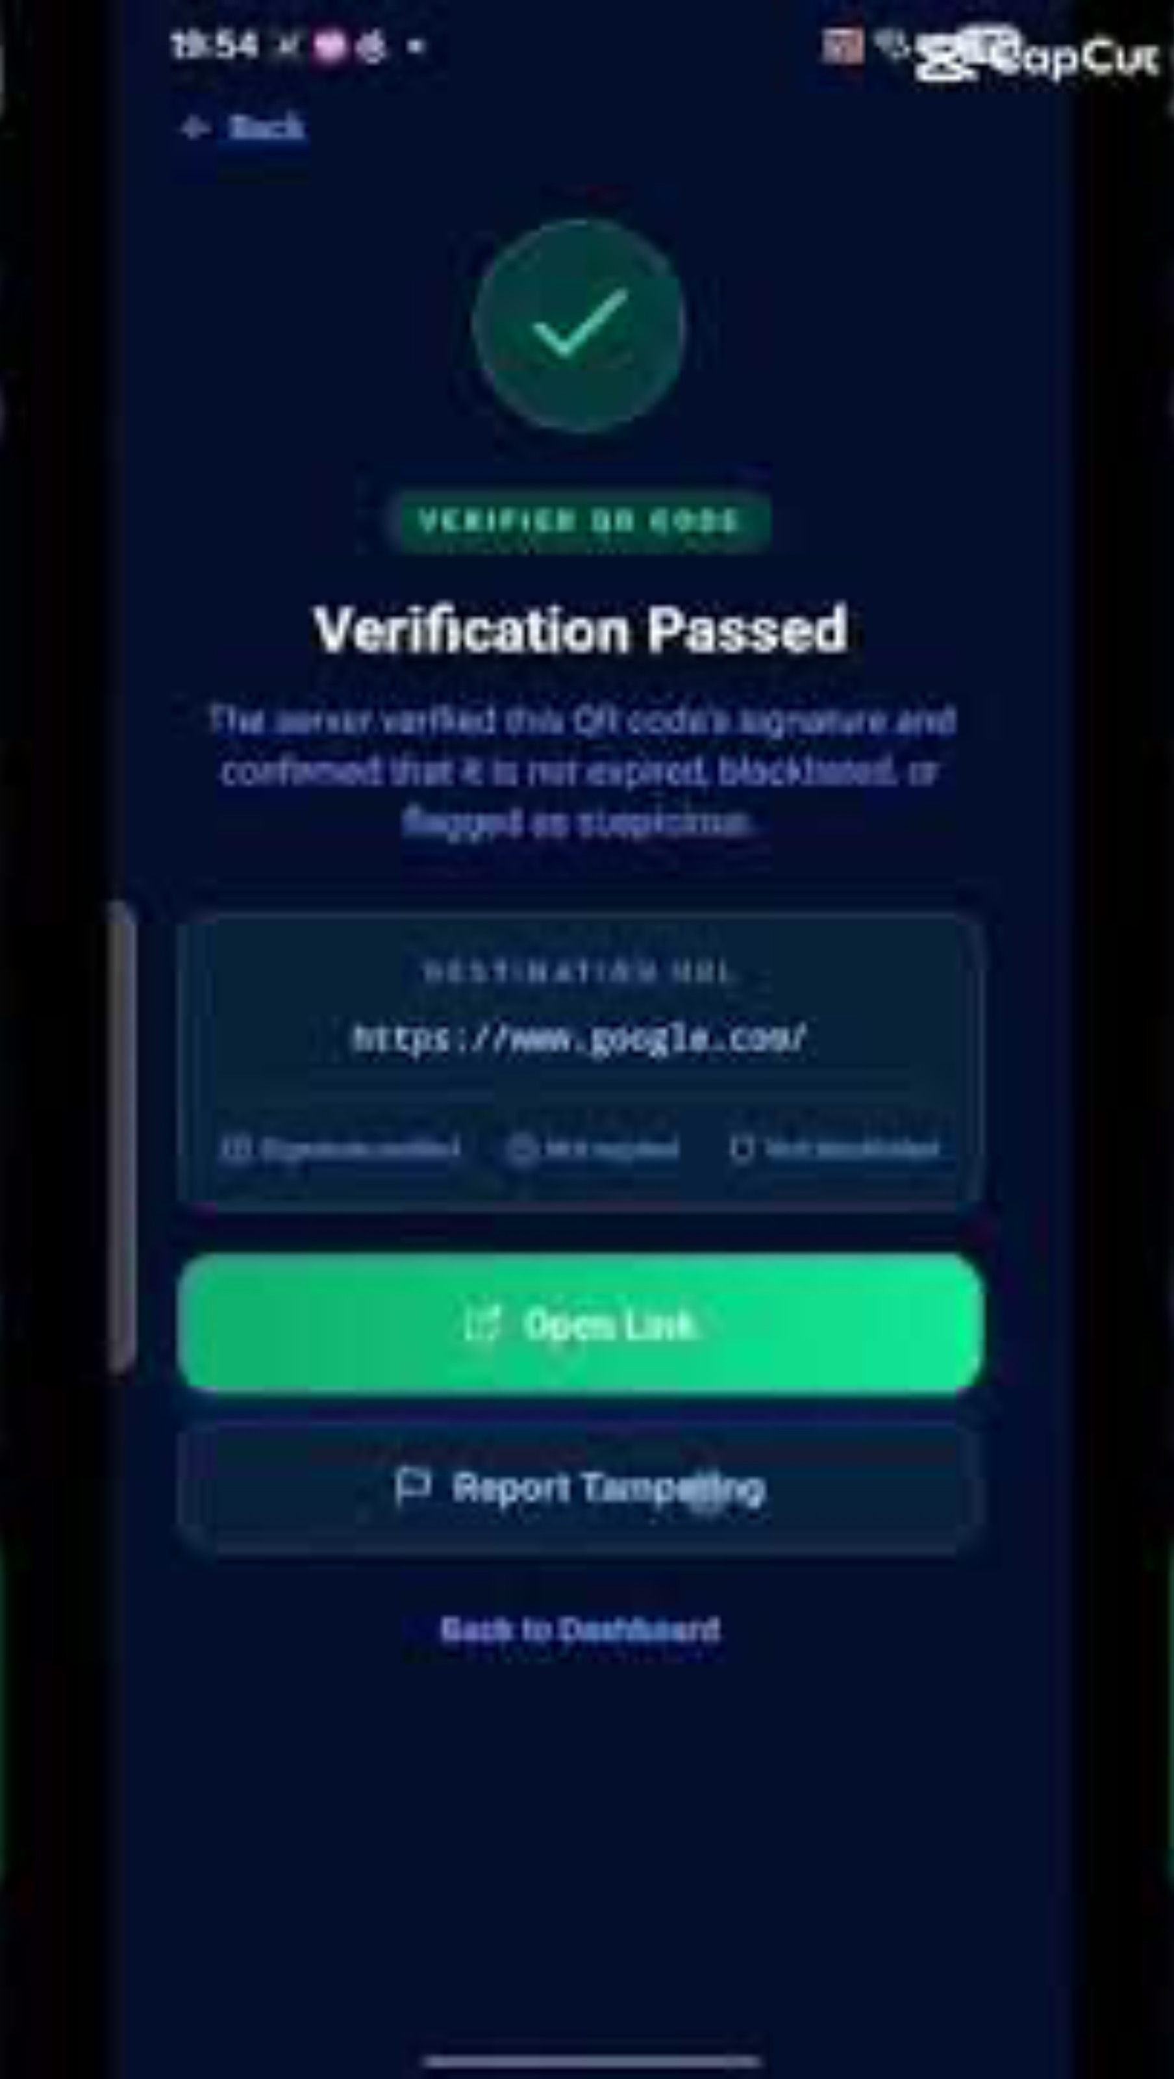
VAFPQR Video

Slide 23
06
Additional Features, Future Developments

Slide 24
Future Additional Features
Data Protection
Automated Backup & Restore
Secondary Backup Database
Monitoring & Analytics
Real-Time Security Alerts
Advanced Analytics Dashboard
Release Security
VirusTotal APK Screening
APK Hash Verification

Slide 25
Q&A

Slide 26
Thank You!

