Slide 1
Result Query
SQL Advanced Optimization

Slide 2
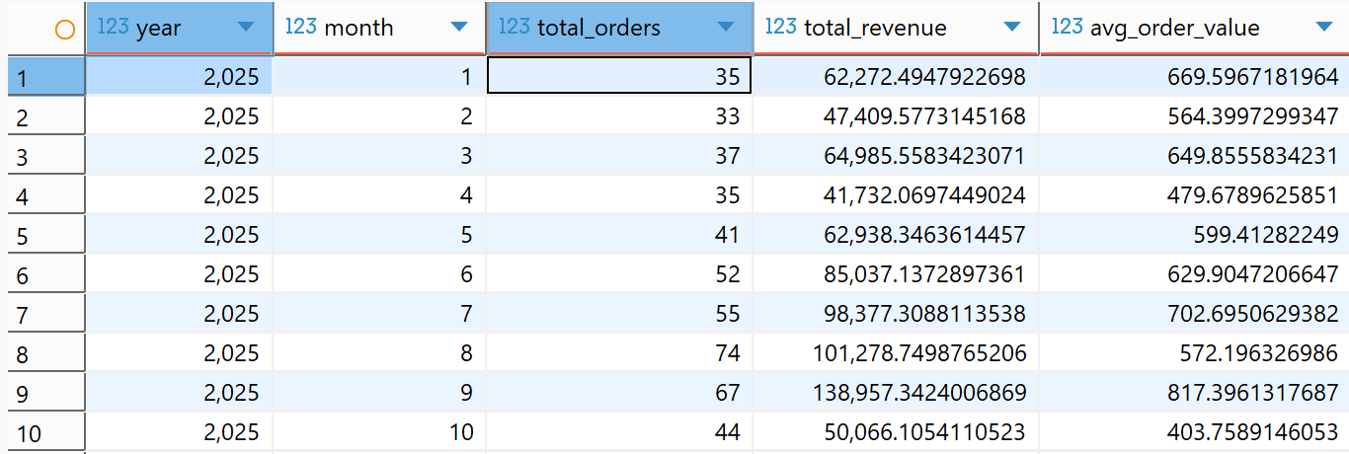
T1 — Monthly Performance
Insight: The 9th month of 2025 was the best-performing month overall, achieving the highest revenue driven by a high total order count and the highest average order value (AOV). Total orders, revenue, and AOV show variation, but it's worth investigating why there was a fairly significant decline in the 10th month.

Slide 3
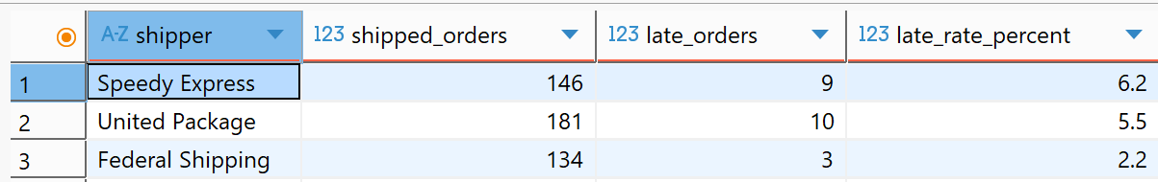
T2 — Shipper SLA (YTD)
Insight: Federal Shipping is the best-performing carrier, with a delay rate of only 2.2%, while Speedy Express is the worst-performing carrier compared to the other two. The company could prioritize using Federal Shipping for deliveries that require high punctuality. In addition, an investigation should be conducted into Speedy Express to understand the root cause of its high delay rate and find ways to improve it, or reduce order allocation to them.

Slide 4
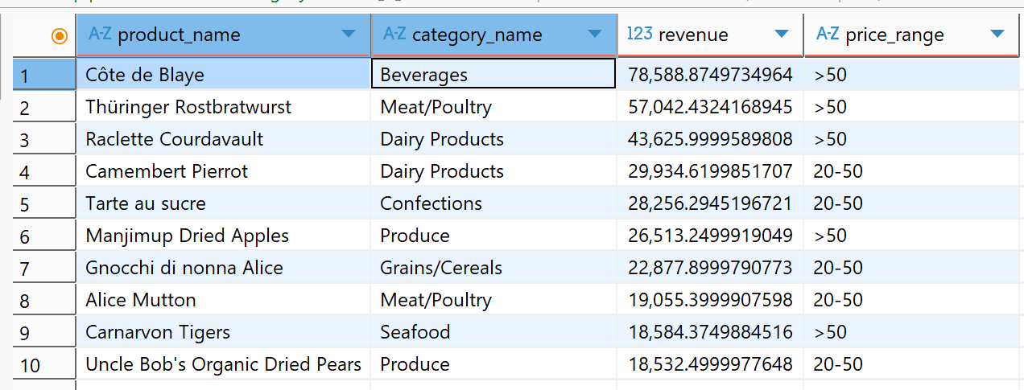
T3 — Top 10 Products by Revenue (YTD)
Insight: The products contributing the most revenue are Côte de Blaye and the Beverages category, so the company could focus on these products and categories to maintain revenue momentum. In addition, investing in products priced above 50 within the Meat/Poultry and Dairy Products categories is important for growth, as these categories show significant cumulative revenue potential.

Slide 5
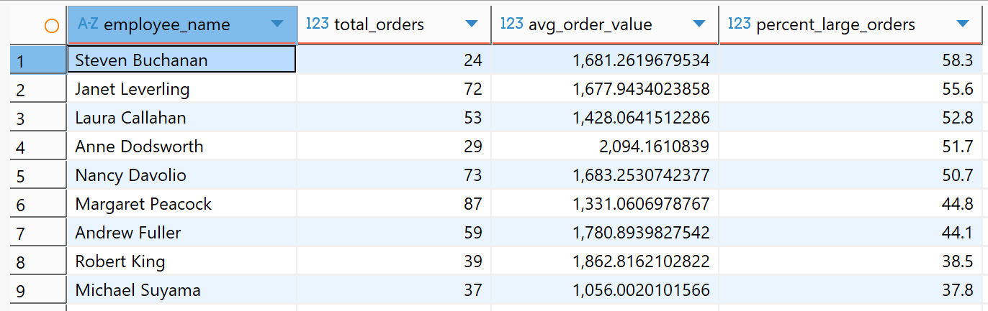
T4 — Sales Rep Scorecard (YTD)
Insight: It can be seen that Margaret Peacock has the highest total order count, while Anne Dodsworth has the highest AOV and Steven Buchanan has the highest percentage of large orders. A deeper analysis could be done on the strategies possibly used by Anne Dodsworth and Steven Buchanan, and consider whether these strategies could be taught to high-volume employees like Margaret Peacock, in order to increase their AOV.

Slide 6
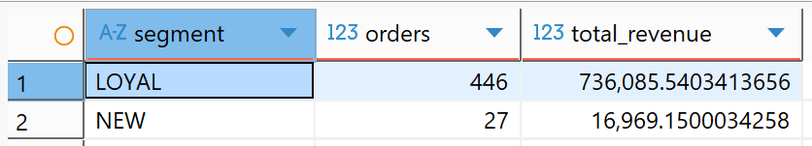
T5 — New vs Loyal Customers (YTD)
Insight: Loyal customers contribute significantly to transactions. To maintain this, a customer loyalty program could be implemented. As for new customers, since their total revenue is still relatively small, marketing strategies could also be applied to increase sales or boost the number of repeat orders, encouraging them to become loyal customers.

