Slide 1
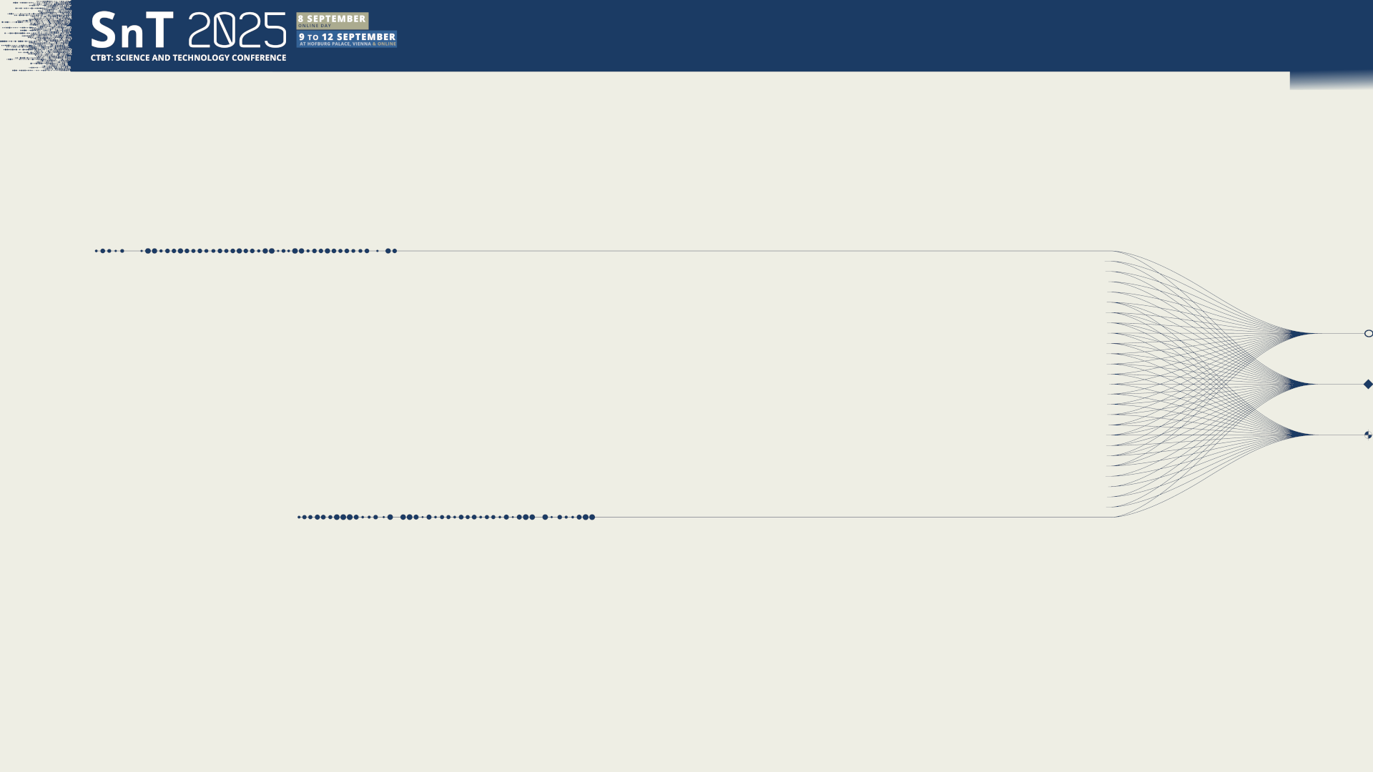


T1.3 - 299
A Portable Experimental Buoy for Coastal Acoustic Monitoring as a Potential Complement to the IMS Hydroacoustic Network: Applications on the Argentinian Continental Shelf
Prario, I; Bos, P; Marques Rojo, R; Cinquini, M; Blanc, S.
Argentinian Navy Research Office & UNIDEF (CONICET)
Presentation Date: 11 September 2025

Slide 2
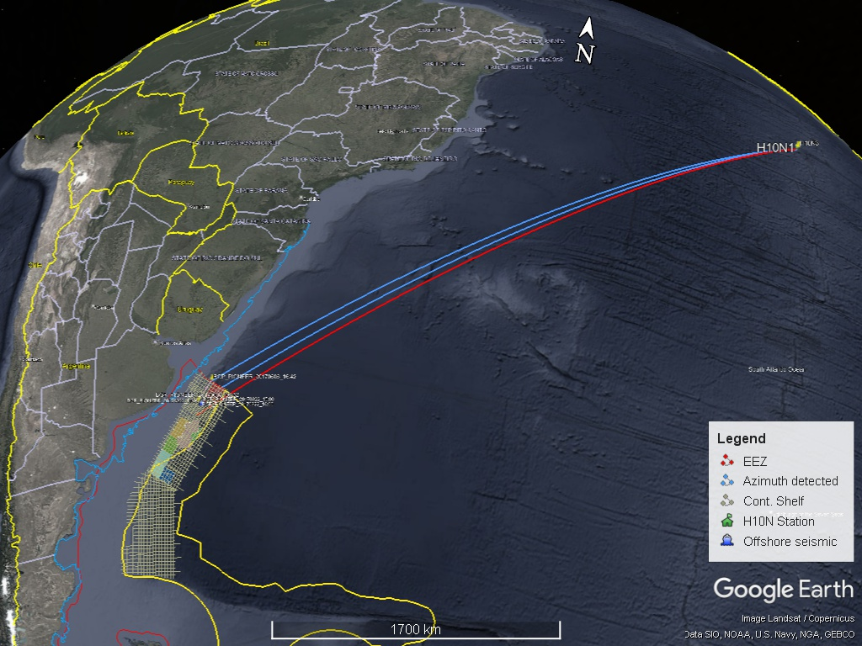
T1.3 - 299
A Portable Experimental Buoy for Coastal Acoustic Monitoring
Prario, I; Bos, P; Marques Rojo, R; Cinquini, M; Blanc, S.
Background
Airgun array used in seismic surveys generate sound pulses 5–60 Hz that can propagate over ocean-basin scales.
Under favourable conditions, signals reach CTBT IMS hydroacoustic (HA) stations with high SNR.
On the Argentinian Continental Shelf, airgun signals detected at H10N can be used to validate long-range propagation models ⁽¹⁾.
Limitations: highly directional sources and shallow-water propagation reduce detectability.
Challenge: synchronize ground-truth airgun shots with H10N recordings, actual Source Levels.
⁽¹⁾ SnT2021 P1.3-494 An inverse problem approach for acoustic Transmission Loss estimation from the analysis of signals generated by seismic air-gun arrays. SnT2023 O1.3-536 Analysis of bathymetric effects on long-range acoustic propagation using 2D and 3D Transmission Loss models in signals generated by airgun arrays.

Slide 3
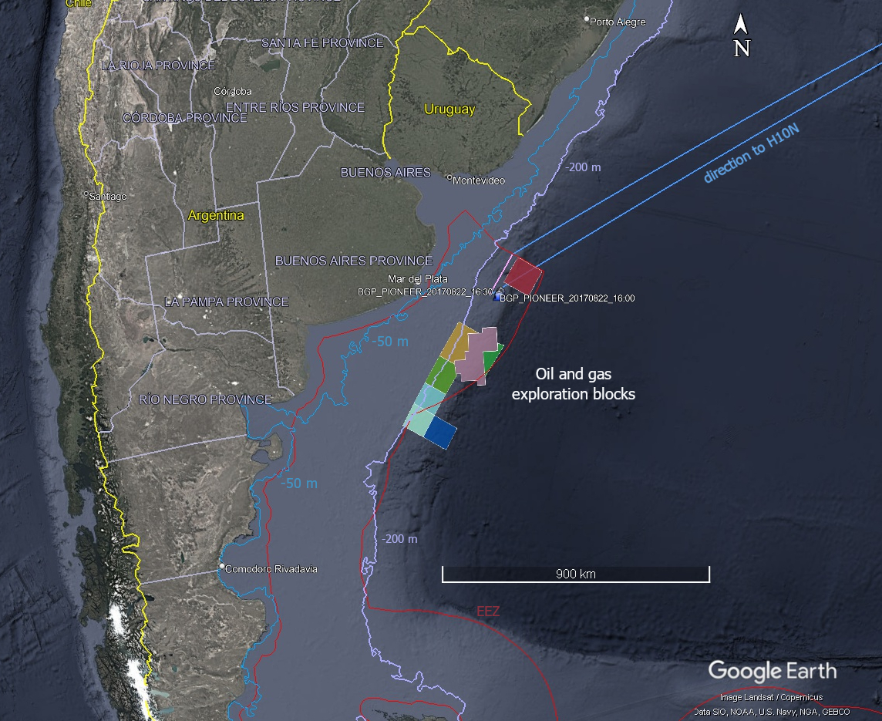
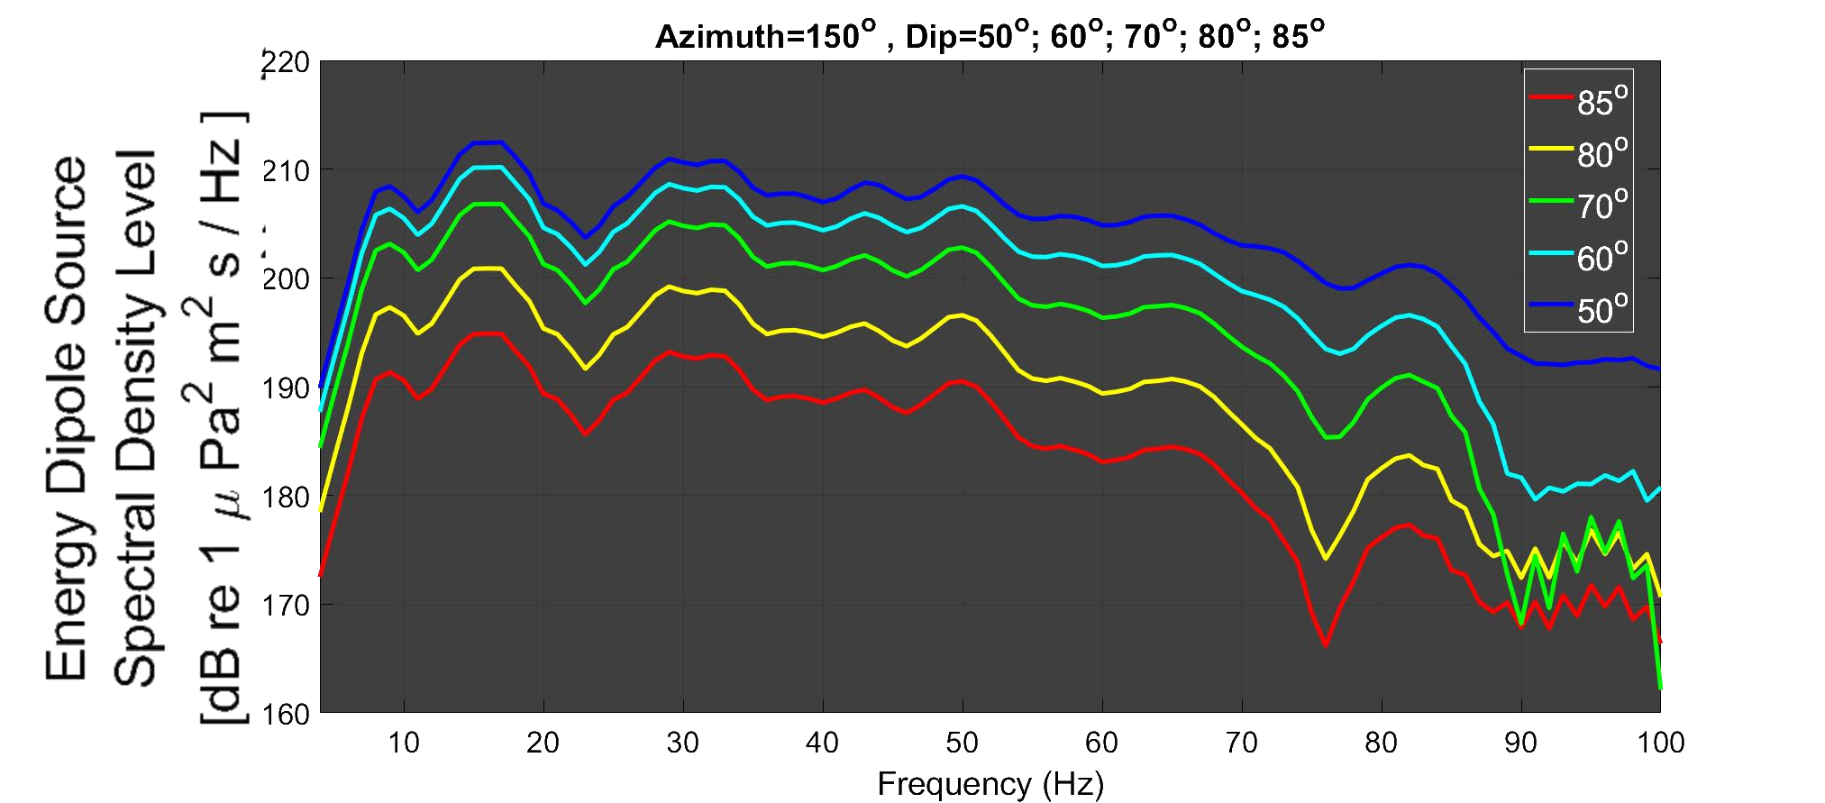
T1.3 - 299
A Portable Experimental Buoy for Coastal Acoustic Monitoring
Prario, I; Bos, P; Marques Rojo, R; Cinquini, M; Blanc, S.
Motivation
Seismic surveys are conducted in offshore oil & gas exploration blocks.
Large dataset of high-amplitude impulsive signals ► basin-scale propagation analysis.
Airgun array source levels simulated with an open-source airgun modelling software⁽²⁾: Energy source level ~ 190 - 210 dB re 1µPa²m²s within 5 Hz – 70 Hz band (HA10 direction).
Need for local measurement of airgun shots signals or other underwater noise sources on the Continental Shelf ► selection of semi-permanent sites for buoy-deployed hydrophones.
(2) Sertlek, H. O., and Ainslie, M. A. (2015). “AGORA: Airgun Source Signature Model: Its application for the Dutch Seismic Survey,” in Proceedings of Underwater Acoustics Conference and Exhibition, Crete, Greece, pp. 439–446,

Slide 4
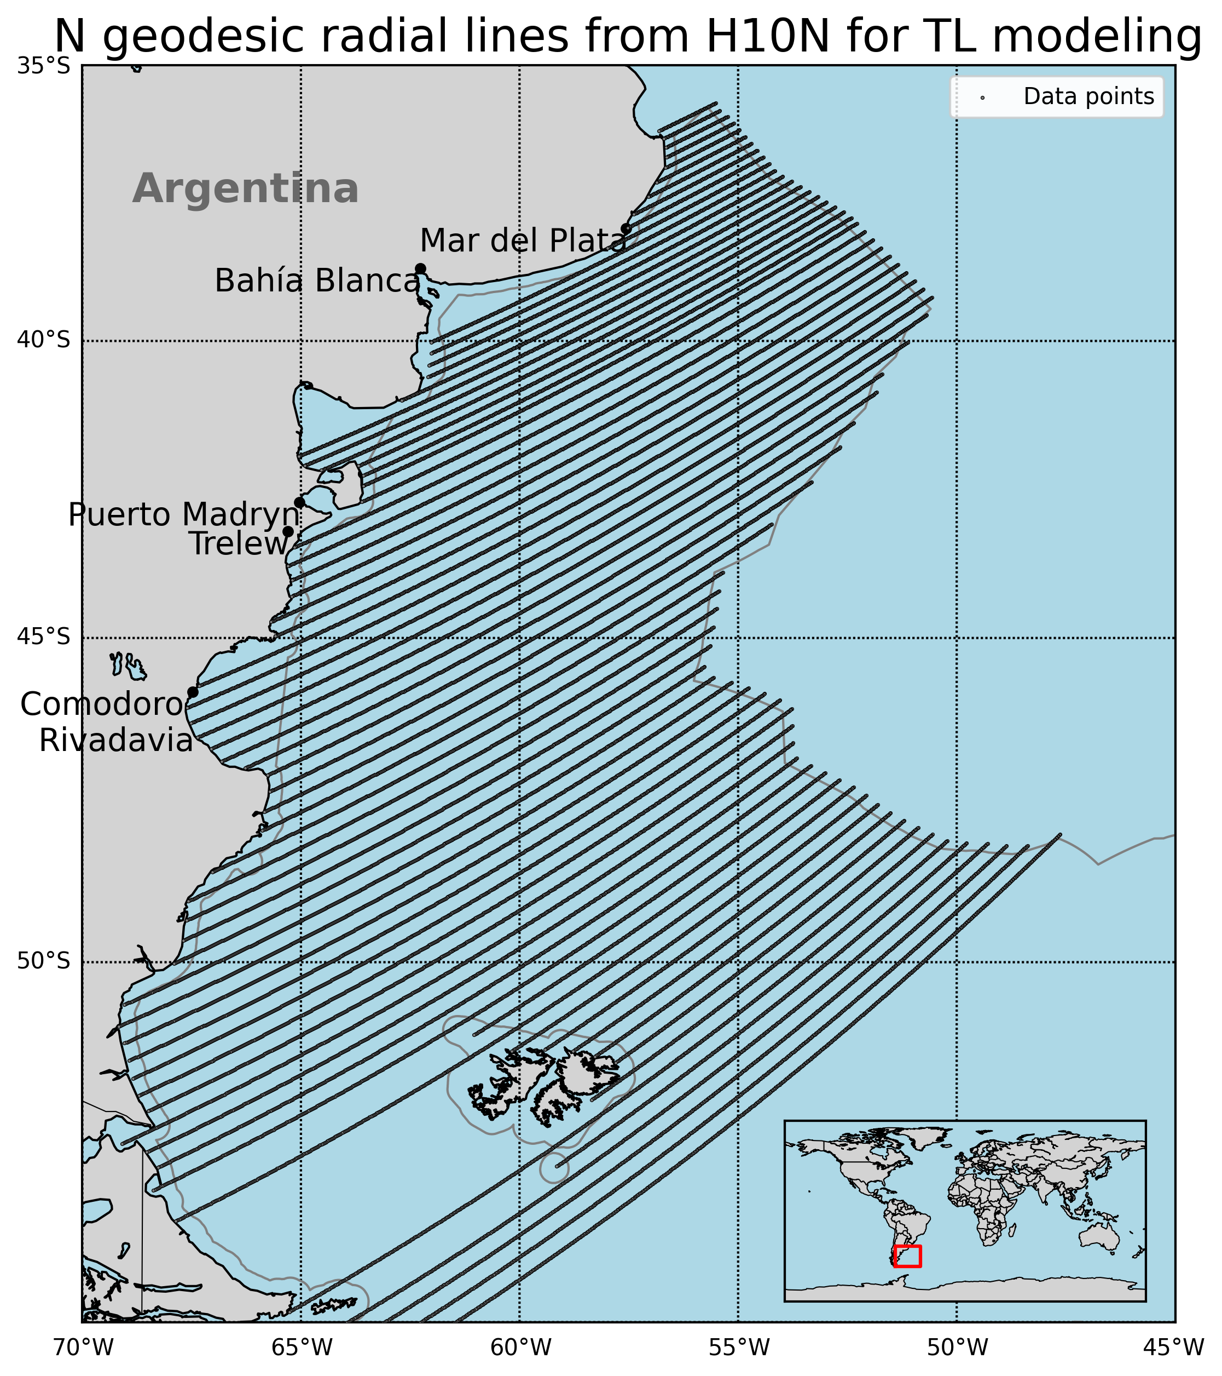
T1.3 - 299
A Portable Experimental Buoy for Coastal Acoustic Monitoring
Prario, I; Bos, P; Marques Rojo, R; Cinquini, M; Blanc, S.
Current acoustic coverage in Argentinian Continental Shelf
Goal: identify candidate shallow-water sites (depth z < 200 m) for improved local monitoring.
Acoustic coverage areas of the HA10 station: preliminary analysis using 2D Parabolic Equation (PE) model RAM (Range-dependent Acoustic Model, Julia implementation).
Acoustic scenario:
Oceanographic databases: T, S profiles from Copernicus; bathymetry from GEBCO.
Frequencies band analyzed: 2 Hz < f < 100 Hz.
Transmission Loss (TL) computed along Nx2D radial transects from H10N.
Source depth = 8 m (typical for airgun array).
Maximum coverage analysis: High impulsive source levels⁽³⁾; TL < 200 dB; NL ~ 80 dB re 1µPa².
⁽³⁾ Dekeling, R.P.A., et al. Monitoring Guidance for Underwater Noise in European Seas, Part III

Slide 5
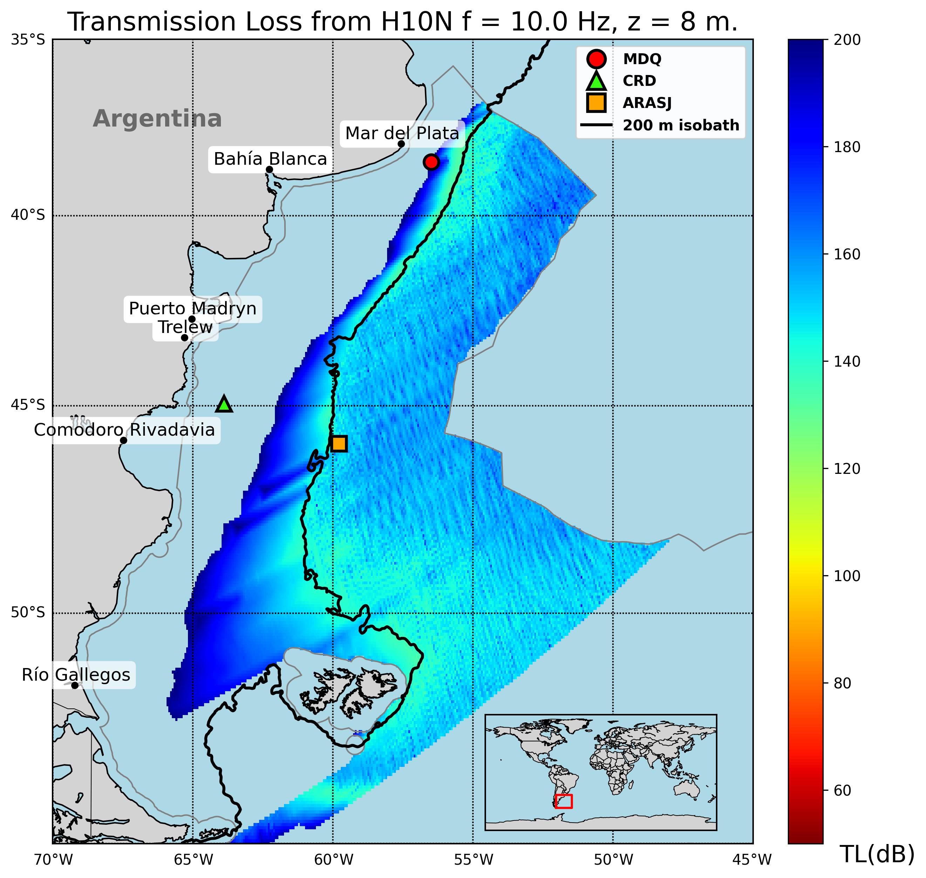
T1.3 - 299
A Portable Experimental Buoy for Coastal Acoustic Monitoring
Prario, I; Bos, P; Marques Rojo, R; Cinquini, M; Blanc, S.
Offshore Argentina coverage of Ascension station H10N
Strong frequency dependence:
Low frequencies (f < 10 Hz): coastal shadow zones, TL > 200 dB.
Higher frequencies (10 Hz < f < 80 Hz): partial coverage, but limited in shallow waters.
Argentinian continental slope acts as an acoustic filter.
Coastal coverage gaps: long-range IMS hydroacoustic stations miss nearshore regions.
Local minima of TL in the continental slope (ARA San Juan wreckage, signal of 2017 implosion event was detected in two IMS-HA stations⁴)
Offshore candidate sites identified: 1-MDQ, 2-CRD
⁽⁴⁾ Prario, I., Cinquini, M., Marques Rojo, R. et al. Characterization of the Acoustic Event Associated with the Loss of the ARA San Juan Submarine Based on Long-Range Measurements by CTBTO’s Hydrophone Stations. Pure Appl. Geophys. 180, 1317–1342 (2023). https://doi.org/10.1007/s00024-022-03090-0.

Slide 6
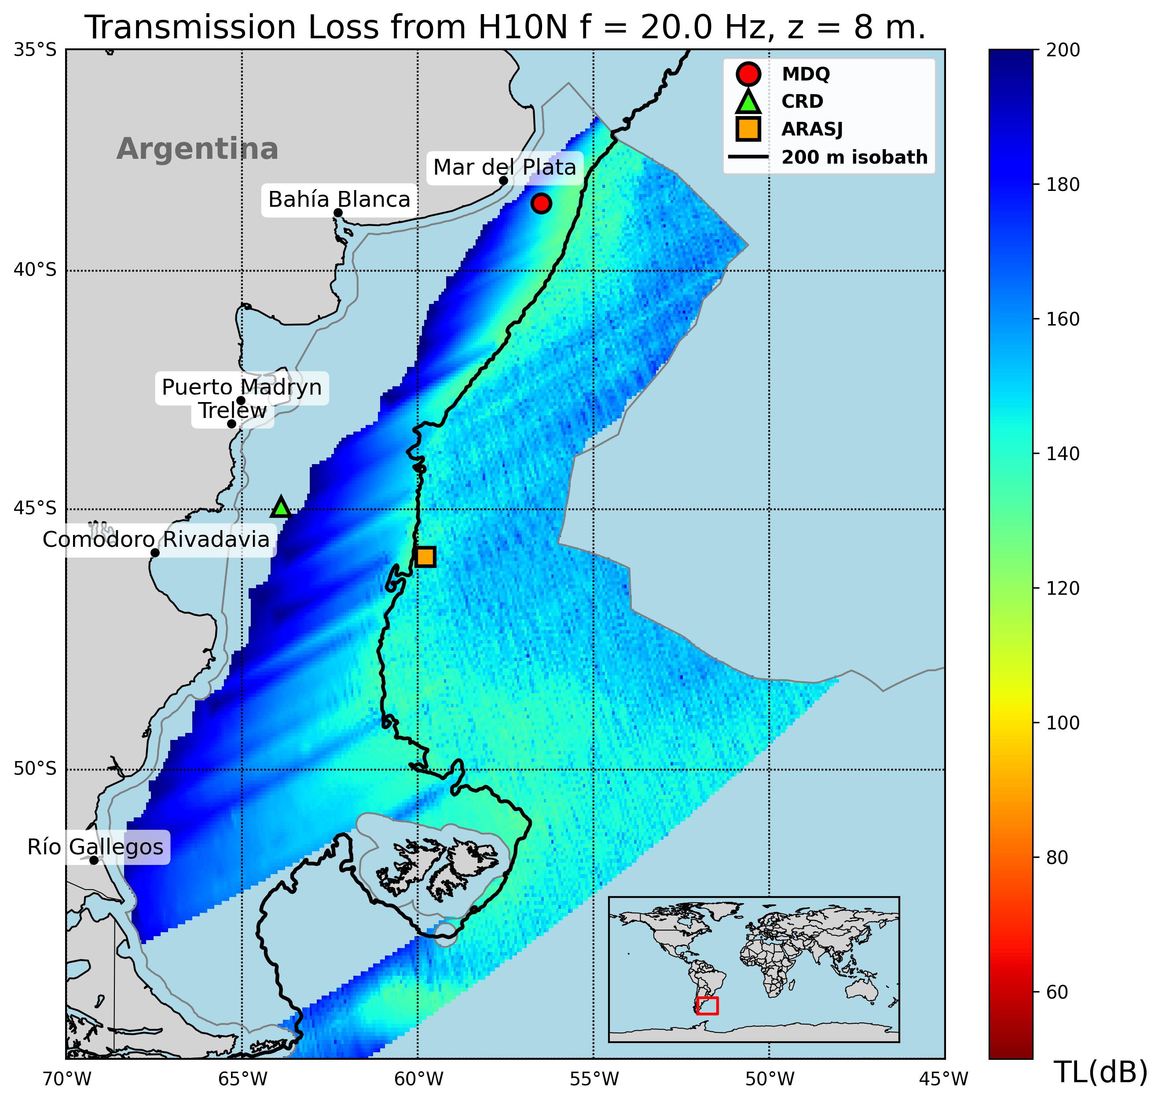
T1.3 - 299
A Portable Experimental Buoy for Coastal Acoustic Monitoring
Prario, I; Bos, P; Marques Rojo, R; Cinquini, M; Blanc, S.
Offshore Argentina coverage of Ascension station H10N
Strong frequency dependence:
Low frequencies (f < 10 Hz): coastal shadow zones, TL > 200 dB.
Higher frequencies (10 Hz < f < 80 Hz): partial coverage, but limited in shallow waters.
Argentinian continental slope acts as an acoustic filter.
Coastal coverage gaps: long-range IMS hydroacoustic stations miss nearshore regions.
Local minima of TL in the continental slope (ARA San Juan wreckage, signal of 2017 implosion event was detected in two IMS-HA stations⁴)
Offshore candidate sites identified: 1-MDQ, 2-CRD
⁽⁴⁾ Prario, I., Cinquini, M., Marques Rojo, R. et al. Characterization of the Acoustic Event Associated with the Loss of the ARA San Juan Submarine Based on Long-Range Measurements by CTBTO’s Hydrophone Stations. Pure Appl. Geophys. 180, 1317–1342 (2023). https://doi.org/10.1007/s00024-022-03090-0.

Slide 7
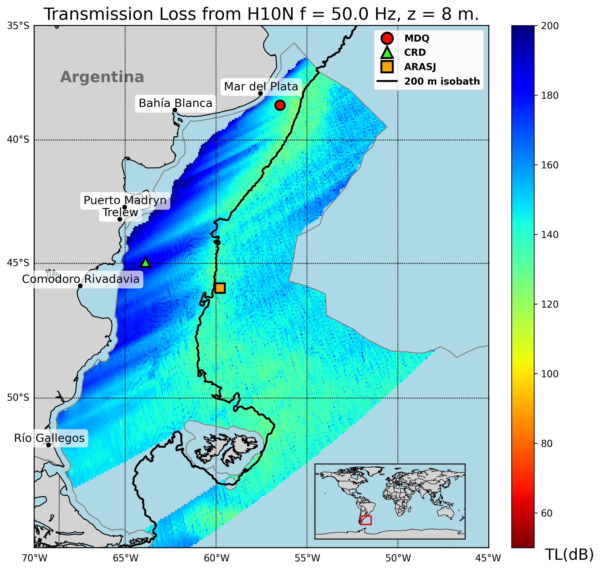
T1.3 - 299
A Portable Experimental Buoy for Coastal Acoustic Monitoring
Prario, I; Bos, P; Marques Rojo, R; Cinquini, M; Blanc, S.
Offshore Argentina coverage of Ascension station H10N
Strong frequency dependence:
Low frequencies (f < 10 Hz): coastal shadow zones, TL > 200 dB.
Higher frequencies (10 Hz < f < 80 Hz): partial coverage, but limited in shallow waters.
Argentinian continental slope acts as an acoustic filter.
Coastal coverage gaps: long-range IMS hydroacoustic stations miss nearshore regions.
Local minima of TL in the continental slope (ARA San Juan wreckage, signal of 2017 implosion event was detected in two IMS-HA stations⁴)
Offshore candidate sites identified: 1-MDQ, 2-CRD
⁽⁴⁾ Prario, I., Cinquini, M., Marques Rojo, R. et al. Characterization of the Acoustic Event Associated with the Loss of the ARA San Juan Submarine Based on Long-Range Measurements by CTBTO’s Hydrophone Stations. Pure Appl. Geophys. 180, 1317–1342 (2023). https://doi.org/10.1007/s00024-022-03090-0.

Slide 8
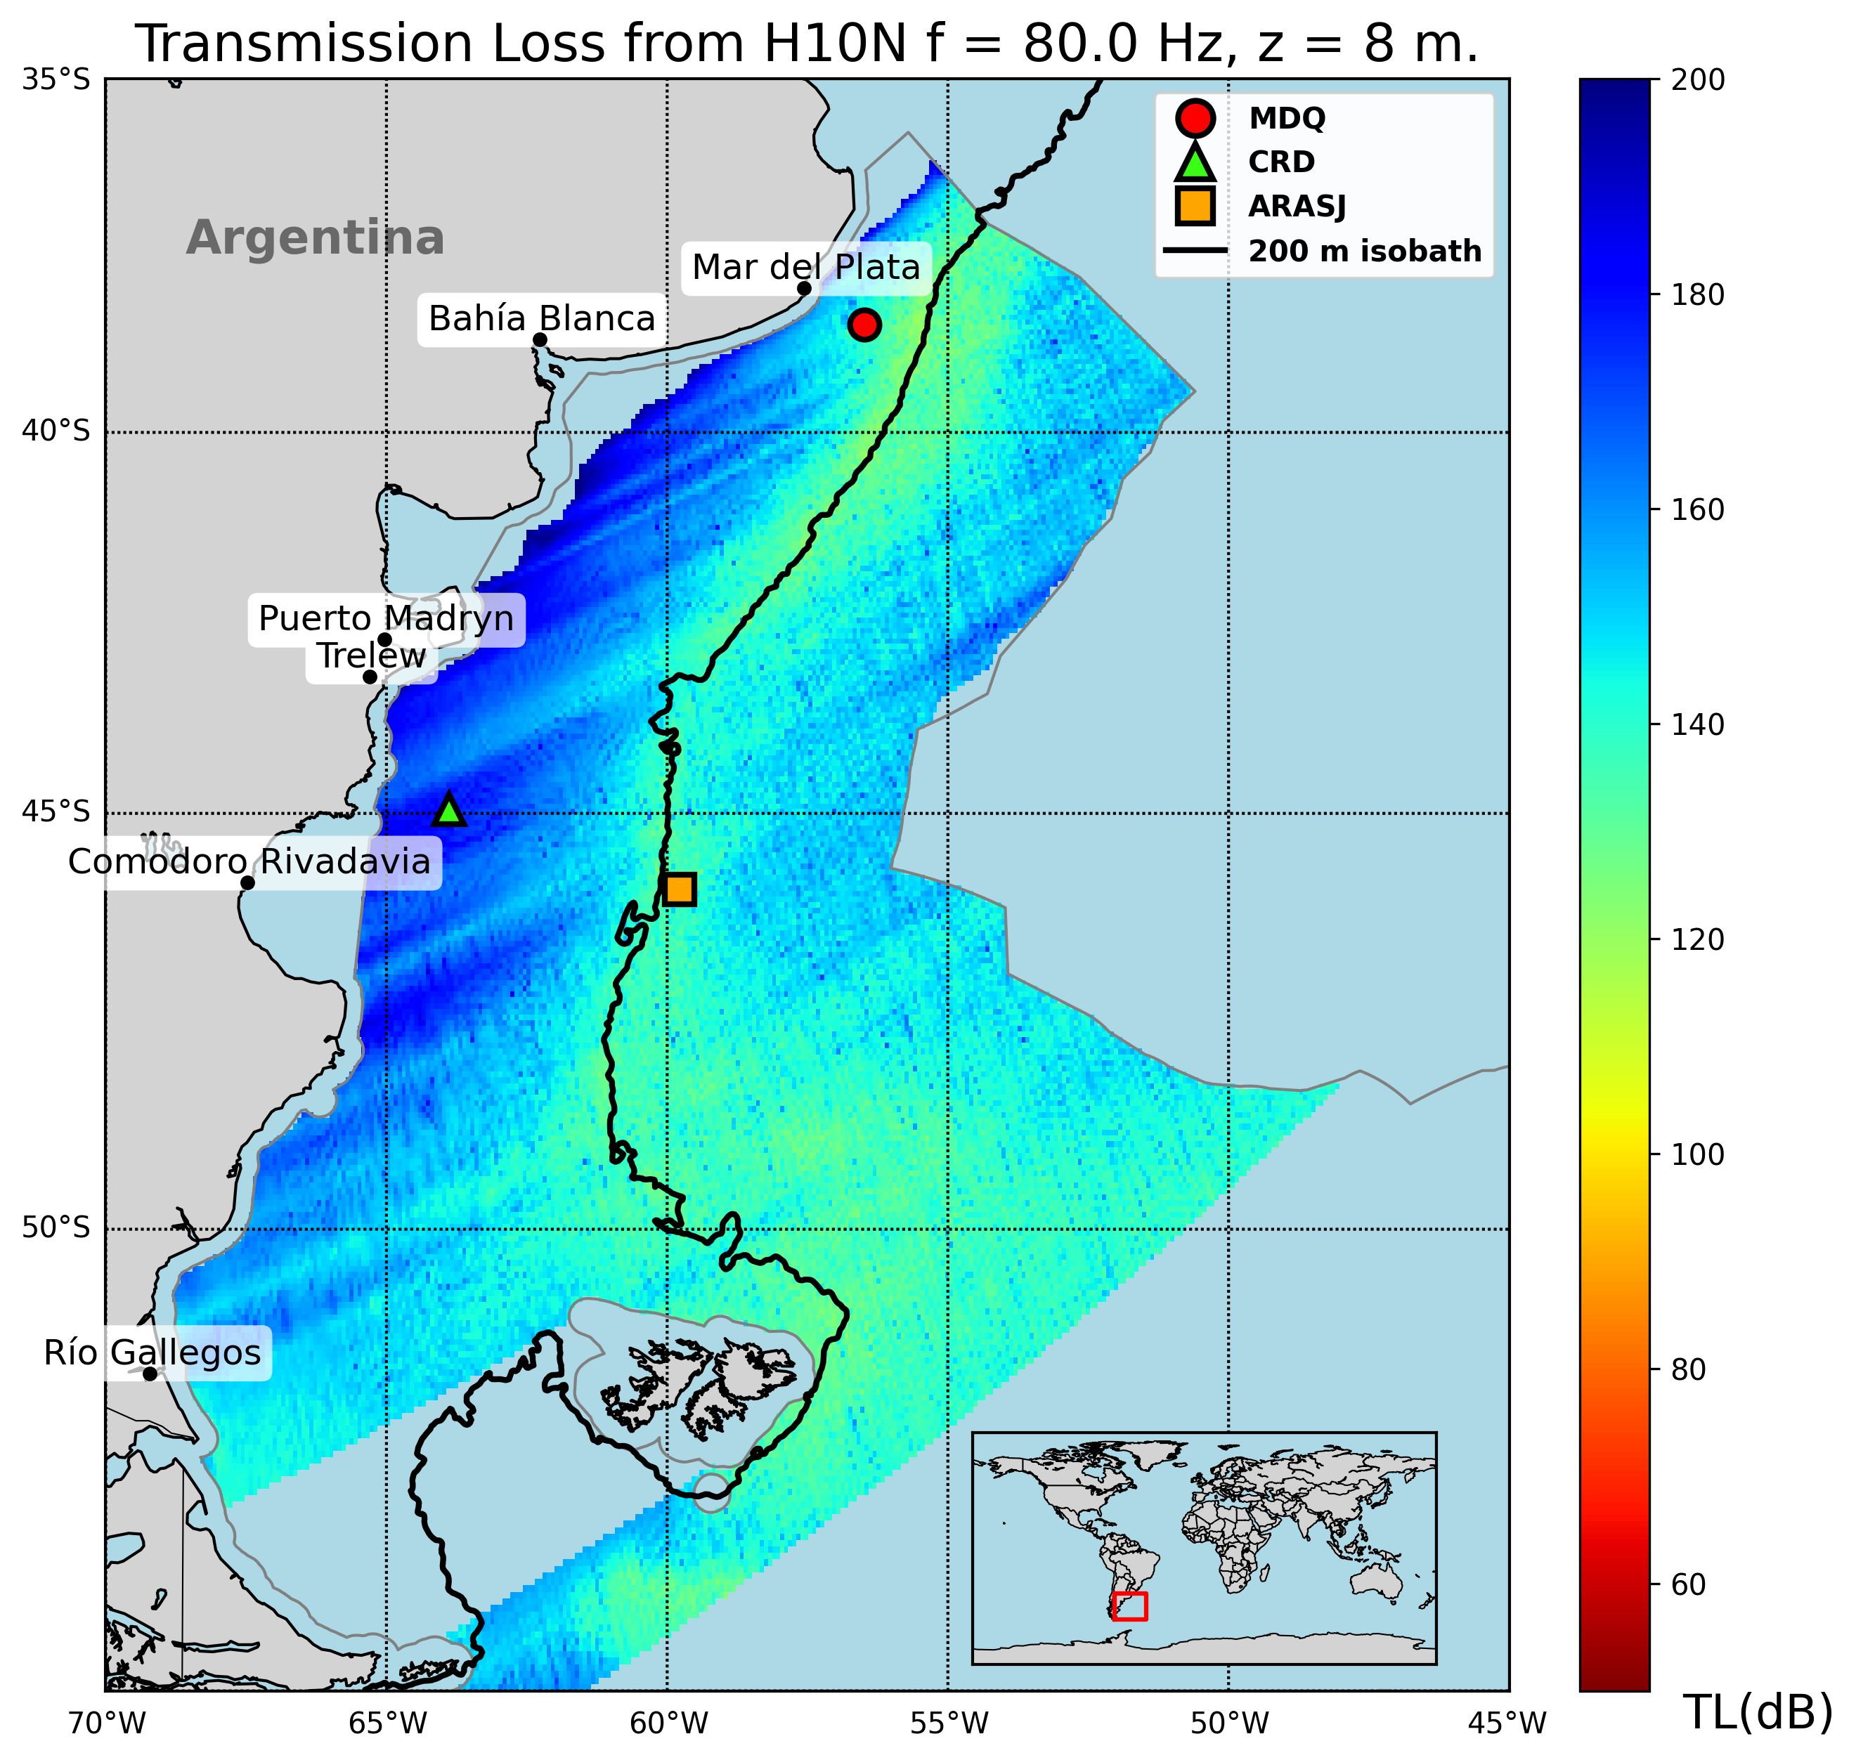
T1.3 - 299
A Portable Experimental Buoy for Coastal Acoustic Monitoring
Prario, I; Bos, P; Marques Rojo, R; Cinquini, M; Blanc, S.
Offshore Argentina coverage of Ascension station H10N
Strong frequency dependence:
Low frequencies (f < 10 Hz): coastal shadow zones, TL > 200 dB.
Higher frequencies (10 Hz < f < 80 Hz): partial coverage, but limited in shallow waters.
Argentinian continental slope acts as an acoustic filter.
Coastal coverage gaps: long-range IMS hydroacoustic stations miss nearshore regions.
Local minima of TL in the continental slope (ARA San Juan wreckage, signal of 2017 implosion event was detected in two IMS-HA stations⁴)
Offshore candidate sites identified: 1-MDQ, 2-CRD
⁽⁴⁾ Prario, I., Cinquini, M., Marques Rojo, R. et al. Characterization of the Acoustic Event Associated with the Loss of the ARA San Juan Submarine Based on Long-Range Measurements by CTBTO’s Hydrophone Stations. Pure Appl. Geophys. 180, 1317–1342 (2023). https://doi.org/10.1007/s00024-022-03090-0.

Slide 9
T1.3 - 299
A Portable Experimental Buoy for Coastal Acoustic Monitoring
Prario, I; Bos, P; Marques Rojo, R; Cinquini, M; Blanc, S.
Offshore Argentina coverage of Ascension station H10N
Strong frequency dependence:
Low frequencies (f < 10 Hz): coastal shadow zones, TL > 200 dB.
Higher frequencies (10 Hz < f < 80 Hz): partial coverage, but limited in shallow waters.
Argentinian continental slope acts as an acoustic filter.
Coastal coverage gaps: long-range IMS hydroacoustic stations miss nearshore regions.
Local minima of TL in the continental slope (ARA San Juan wreckage, signal of 2017 implosion event was detected in two IMS-HA stations⁴)
Offshore candidate sites identified: 1-MDQ, 2-CRD
⁽⁴⁾ Prario, I., Cinquini, M., Marques Rojo, R. et al. Characterization of the Acoustic Event Associated with the Loss of the ARA San Juan Submarine Based on Long-Range Measurements by CTBTO’s Hydrophone Stations. Pure Appl. Geophys. 180, 1317–1342 (2023). https://doi.org/10.1007/s00024-022-03090-0.

Slide 10
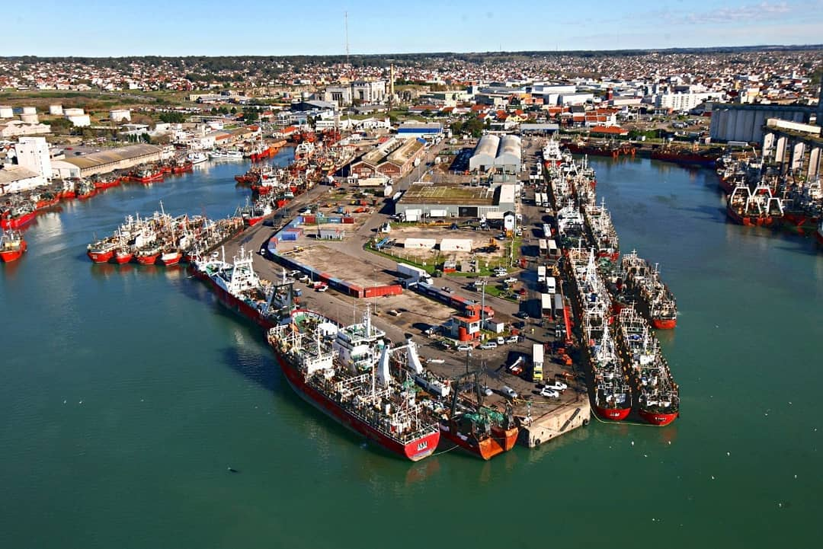
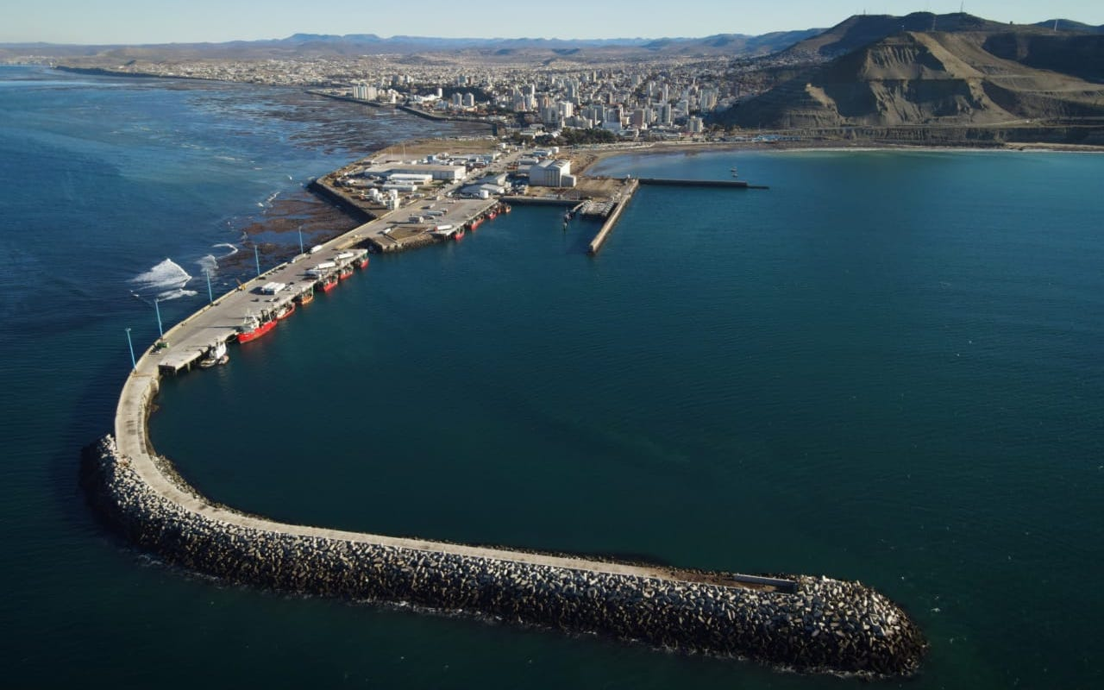
T1.3 - 299
A Portable Experimental Buoy for Coastal Acoustic Monitoring
Prario, I; Bos, P; Marques Rojo, R; Cinquini, M; Blanc, S.
Offshore Argentina coverage of Ascension station H10N
Strong frequency dependence:
Low frequencies (f < 10 Hz): coastal shadow zones, TL > 200 dB.
Higher frequencies (10 Hz < f < 80 Hz): partial coverage, but limited in shallow waters.
Argentinian continental slope acts as an acoustic filter.
Coastal coverage gaps: long-range IMS hydroacoustic stations miss nearshore regions.
Local minima of TL in the continental slope (ARA San Juan wreckage, signal of 2017 implosion event was detected in two IMS-HA stations³)
Offshore candidate sites identified: 1-MDQ, 2-CRD
⁽⁴⁾ Prario, I., Cinquini, M., Marques Rojo, R. et al. Characterization of the Acoustic Event Associated with the Loss of the ARA San Juan Submarine Based on Long-Range Measurements by CTBTO’s Hydrophone Stations. Pure Appl. Geophys. 180, 1317–1342 (2023). https://doi.org/10.1007/s00024-022-03090-0.

Slide 11
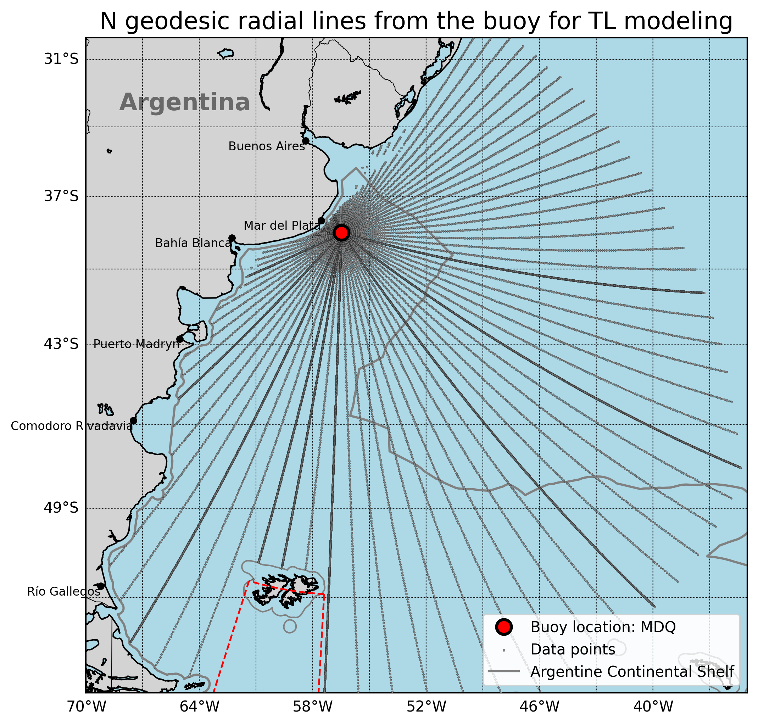
T1.3 - 299
A Portable Experimental Buoy for Coastal Acoustic Monitoring
Prario, I; Bos, P; Marques Rojo, R; Cinquini, M; Blanc, S.
Coverage of candidate 1 station (offshore Mar del Plata - MDQ)
Specific goal:
Assess acoustic coverage over the continental shelf and adjacent waters.
Acoustic scenario:
Frequency range: 2 Hz – 100 Hz (results shown at 10, 20, 50, 80 Hz).
Source depth = 8 m (typical airgun tow depth).
Receiver depth (hydrophone) = 40 m.
T, S profiles from Copernicus.
Bathymetry from GEBCO database.
Seabed properties from Jensen et al.
NL~80-85 dB re 1µPa²
Simulation:
2D PE with RAM.jl.
Transmission Loss (TL) along Nx2D radial transects from the candidate location.

Slide 12
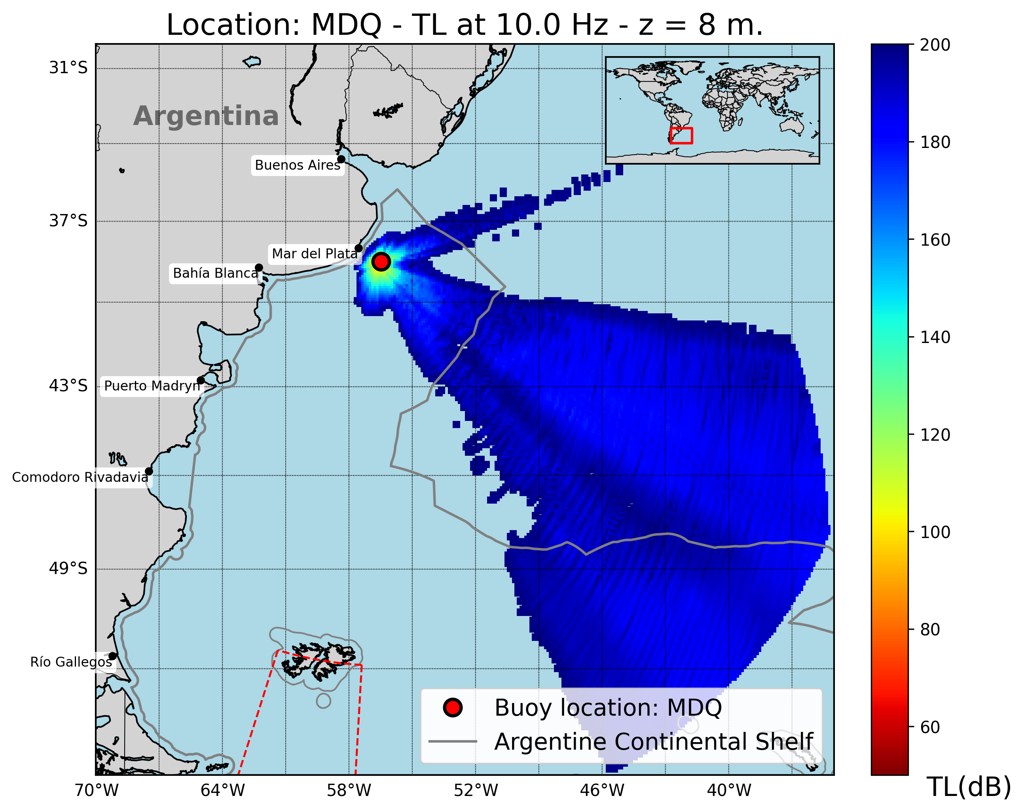
T1.3 - 299
A Portable Experimental Buoy for Coastal Acoustic Monitoring
Prario, I; Bos, P; Marques Rojo, R; Cinquini, M; Blanc, S.
Coverage of candidate 1 station (offshore Mar del Plata - MDQ)
Strong frequency dependence: low frequencies (f < 10 Hz) show larger shadow zones.
Filtering effect: continental slope reduces transmission at low frequencies ( f < 20 Hz).
Improved coverage at 50 Hz < f < 80 Hz band across shelf and slope.
Shallow-water gap: limited detectability close to the coast (depth z < 200 m ).
Implication: buoy-deployed hydrophones at MDQ station enhances monitoring in northern shelf region.

Slide 13
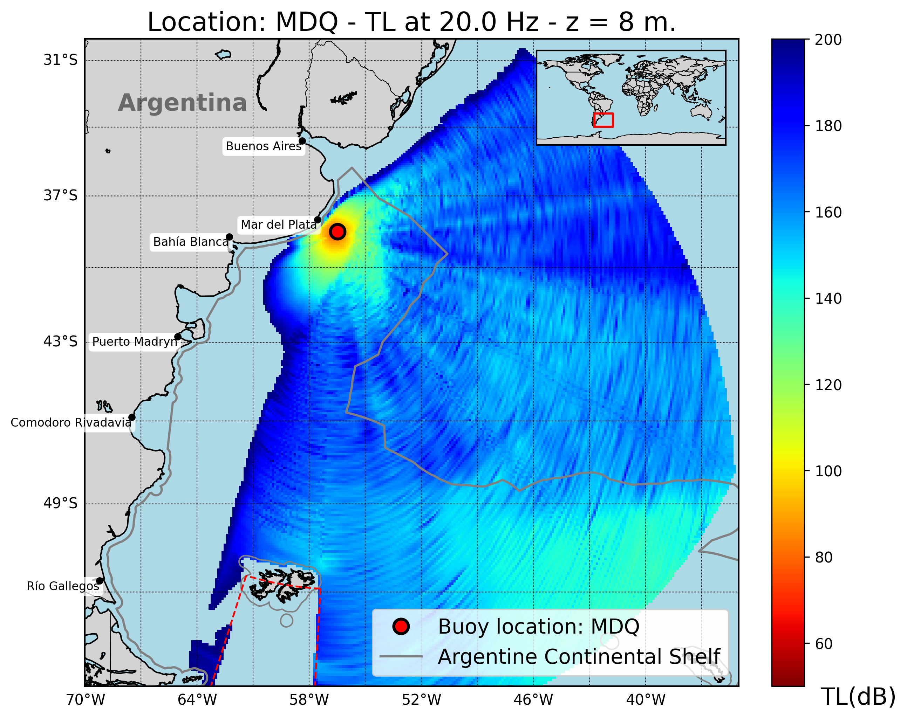
T1.3 - 299
A Portable Experimental Buoy for Coastal Acoustic Monitoring
Prario, I; Bos, P; Marques Rojo, R; Cinquini, M; Blanc, S.
Coverage of candidate 1 station (offshore Mar del Plata - MDQ)
Strong frequency dependence: low frequencies (f < 10 Hz) show larger shadow zones.
Filtering effect: continental slope reduces transmission at low frequencies ( f < 20 Hz).
Improved coverage at 50 Hz < f < 80 Hz band across shelf and slope.
Shallow-water gap: limited detectability close to the coast (depth z < 200 m ).
Implication: buoy-deployed hydrophones at MDQ station enhances monitoring in northern shelf region.

Slide 14
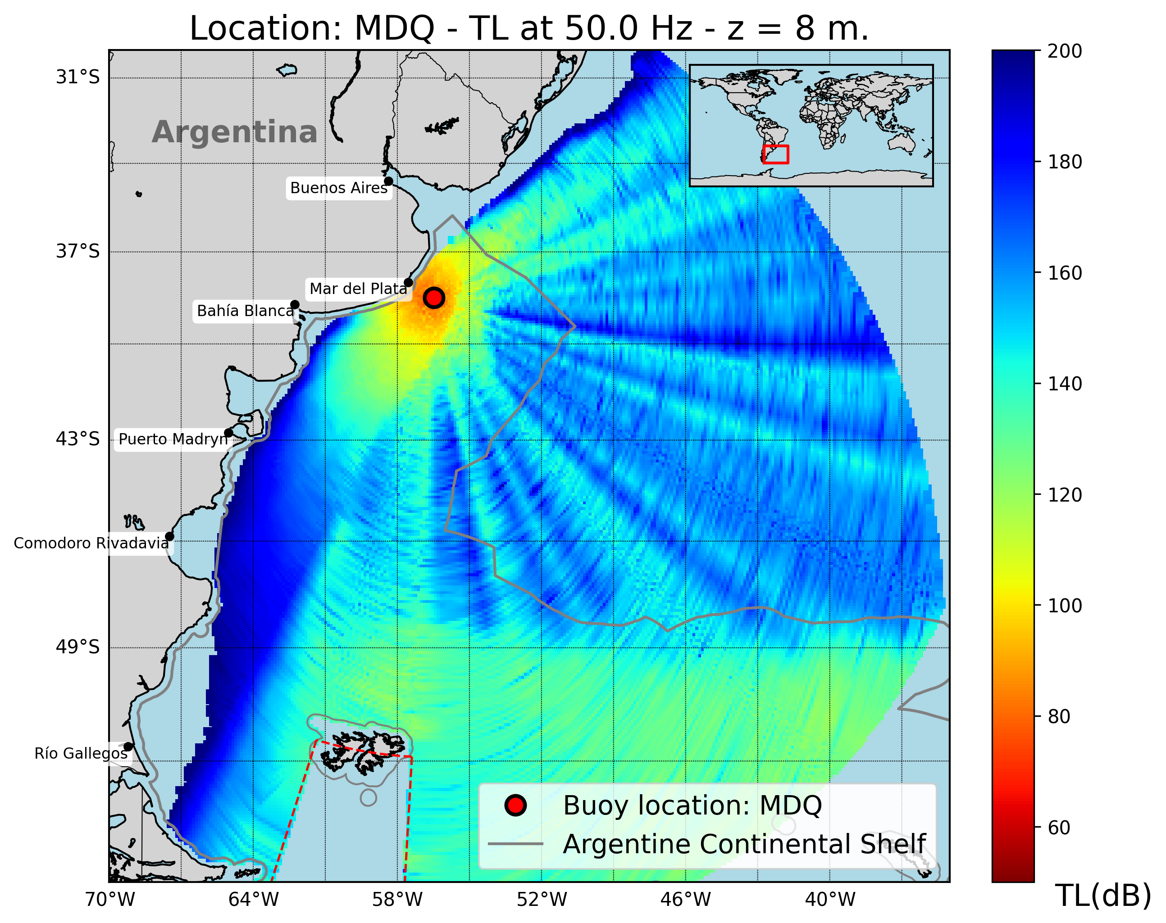
T1.3 - 299
A Portable Experimental Buoy for Coastal Acoustic Monitoring
Prario, I; Bos, P; Marques Rojo, R; Cinquini, M; Blanc, S.
Coverage of candidate 1 station (offshore Mar del Plata - MDQ)
Strong frequency dependence: low frequencies (f < 10 Hz) show larger shadow zones.
Filtering effect: continental slope reduces transmission at low frequencies ( f < 20 Hz).
Improved coverage at 50 Hz < f < 80 Hz band across shelf and slope.
Shallow-water gap: limited detectability close to the coast (depth z < 200 m ).
Implication: buoy-deployed hydrophones at MDQ station enhances monitoring in northern shelf region.

Slide 15
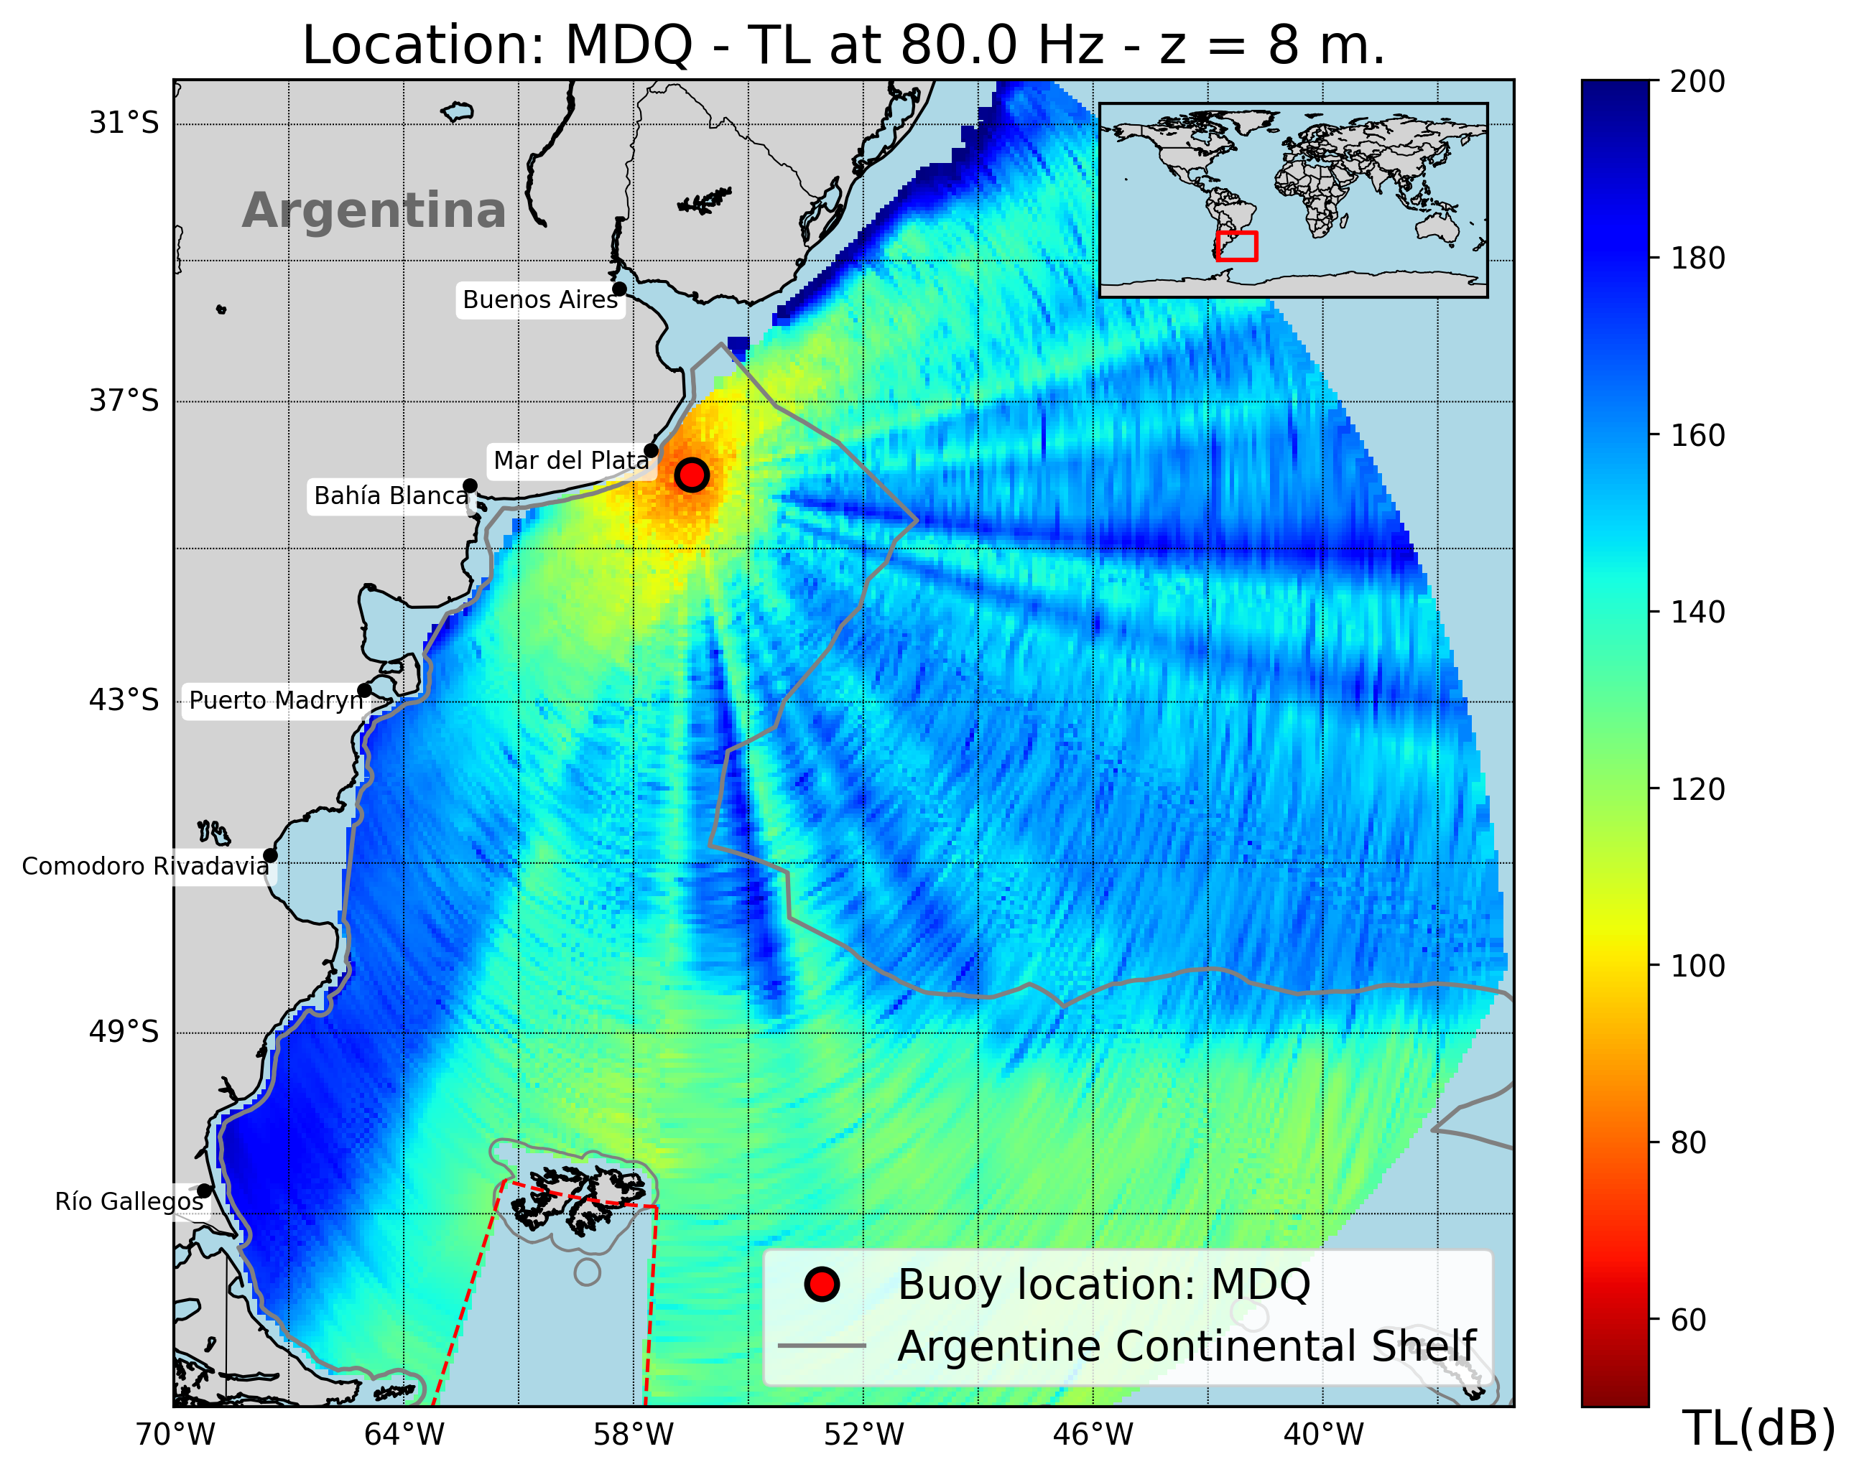
T1.3 - 299
A Portable Experimental Buoy for Coastal Acoustic Monitoring
Prario, I; Bos, P; Marques Rojo, R; Cinquini, M; Blanc, S.
Coverage of candidate 1 station (offshore Mar del Plata - MDQ)
Strong frequency dependence: low frequencies (f < 10 Hz) show larger shadow zones.
Filtering effect: continental slope reduces transmission at low frequencies ( f < 20 Hz).
Improved coverage at 50 Hz < f < 80 Hz band across shelf and slope.
Shallow-water gap: limited detectability close to the coast (depth z < 200 m ).
Implication: buoy-deployed hydrophones at MDQ station enhances monitoring in northern shelf region.

Slide 16
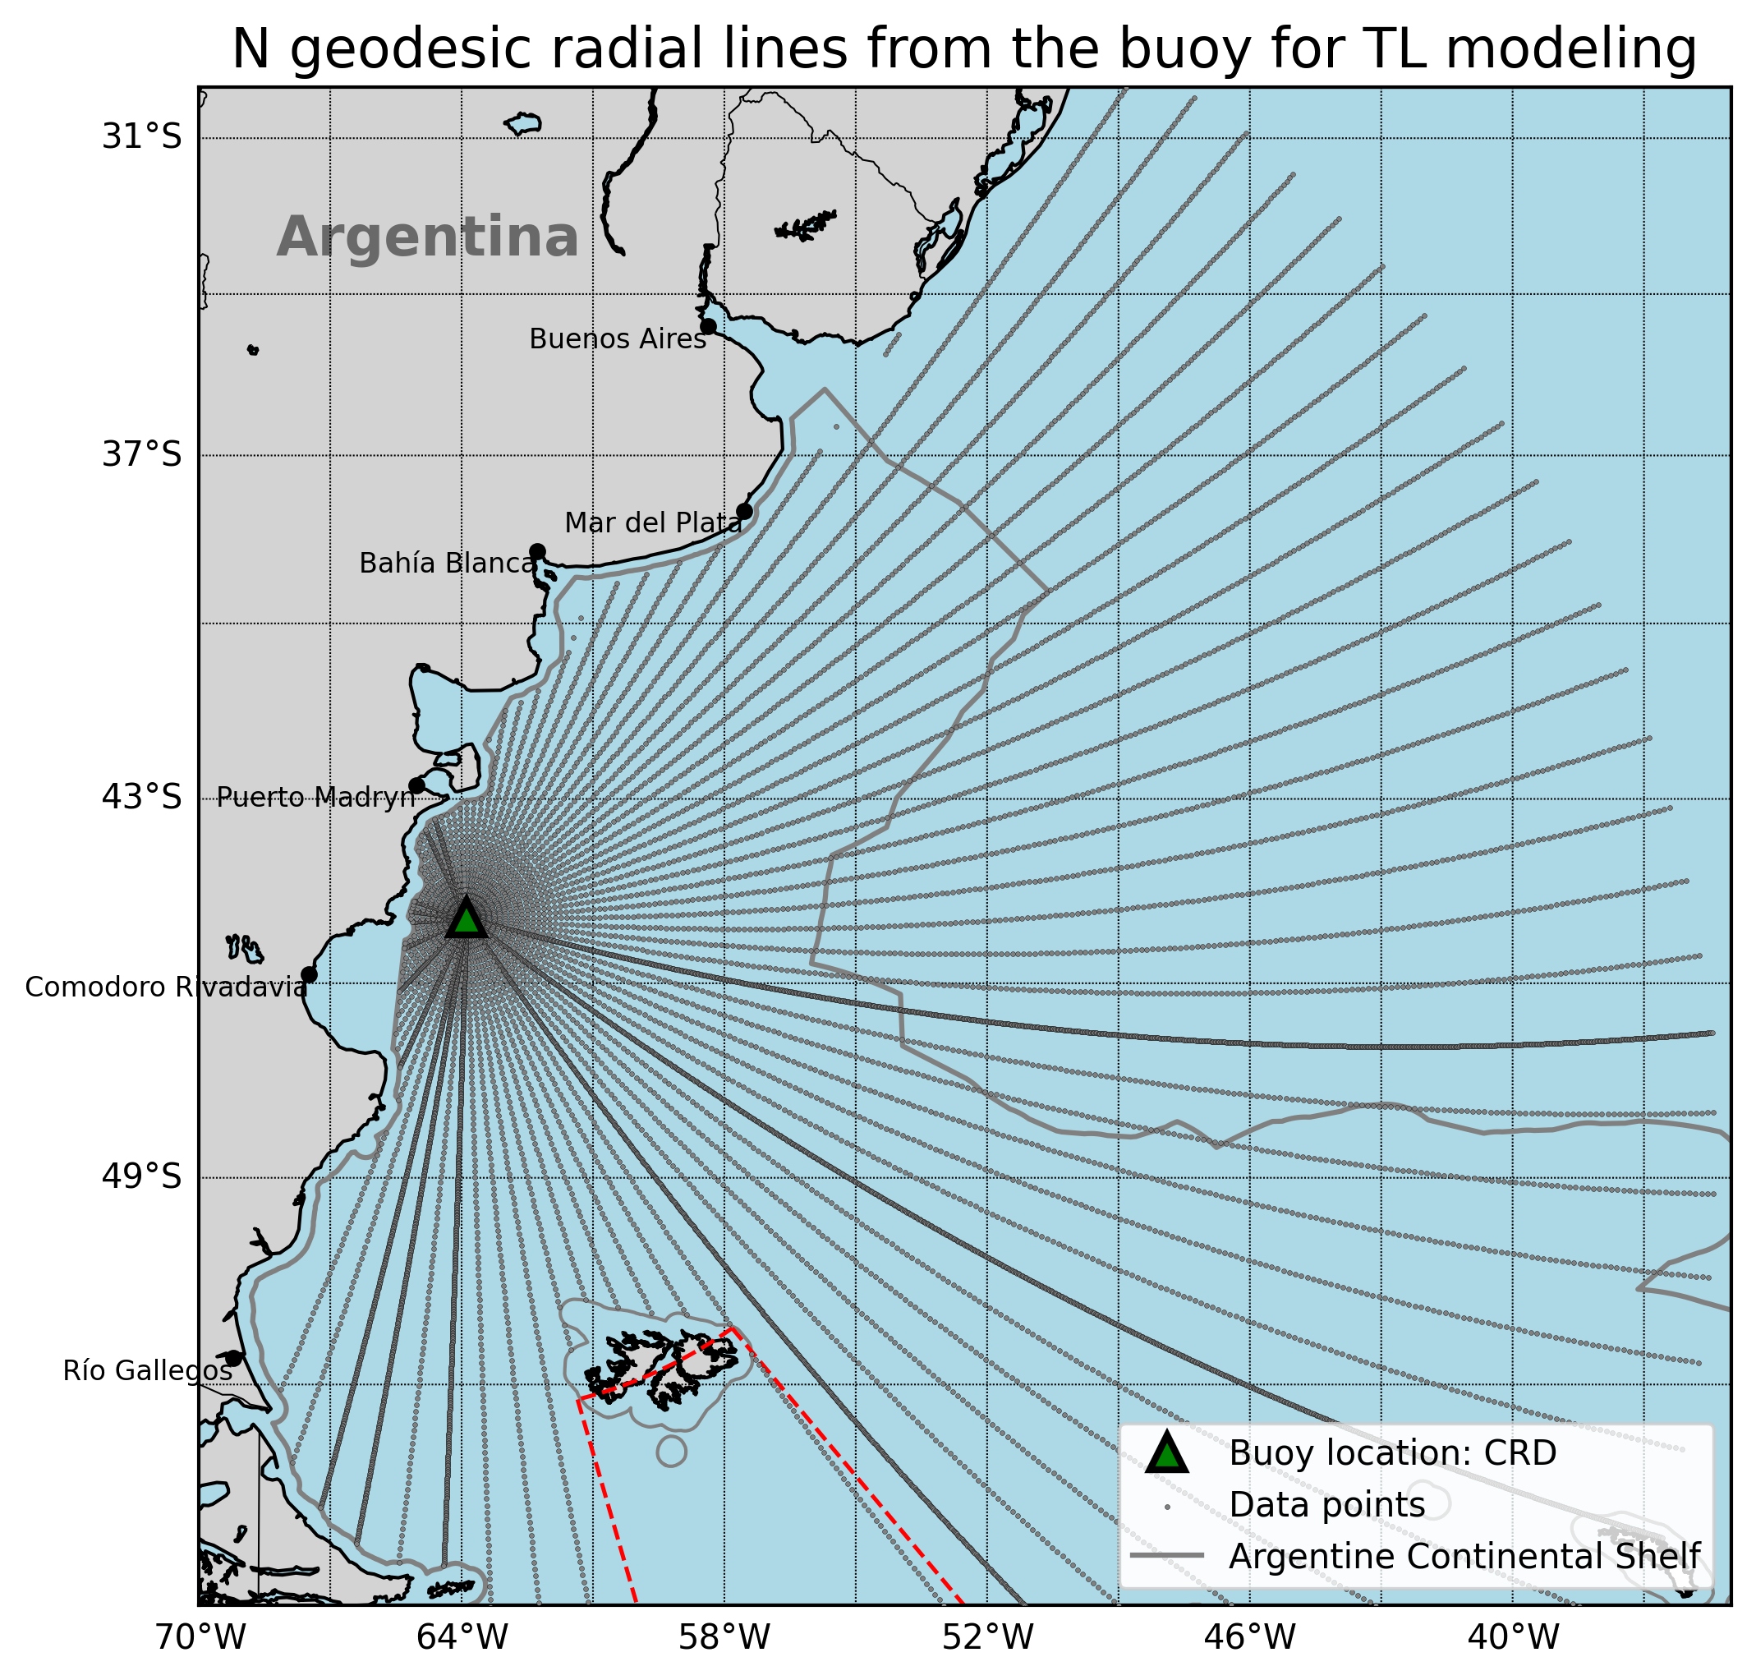
T1.3 - 299
A Portable Experimental Buoy for Coastal Acoustic Monitoring
Prario, I; Bos, P; Marques Rojo, R; Cinquini, M; Blanc, S.
Coverage of candidate 2 station (offshore Comodoro Rivadavia - CRD)
Specific goal:
Assess acoustic coverage over the continental shelf and adjacent waters.
Acoustic scenario:
Frequency range: 2 Hz – 100 Hz (results shown at 10, 20, 50, 80 Hz).
Source depth = 8 m (typical airgun tow depth).
Receiver depth (hydrophone) = 40 m.
T, S profiles from Copernicus.
Bathymetry from GEBCO database.
Seabed properties from Jensen et al.
NL~80-85 dB re 1µPa²
Simulation:
2D PE with RAM.jl.
Transmission Loss (TL) along Nx2D radial transects from the candidate location.

Slide 17
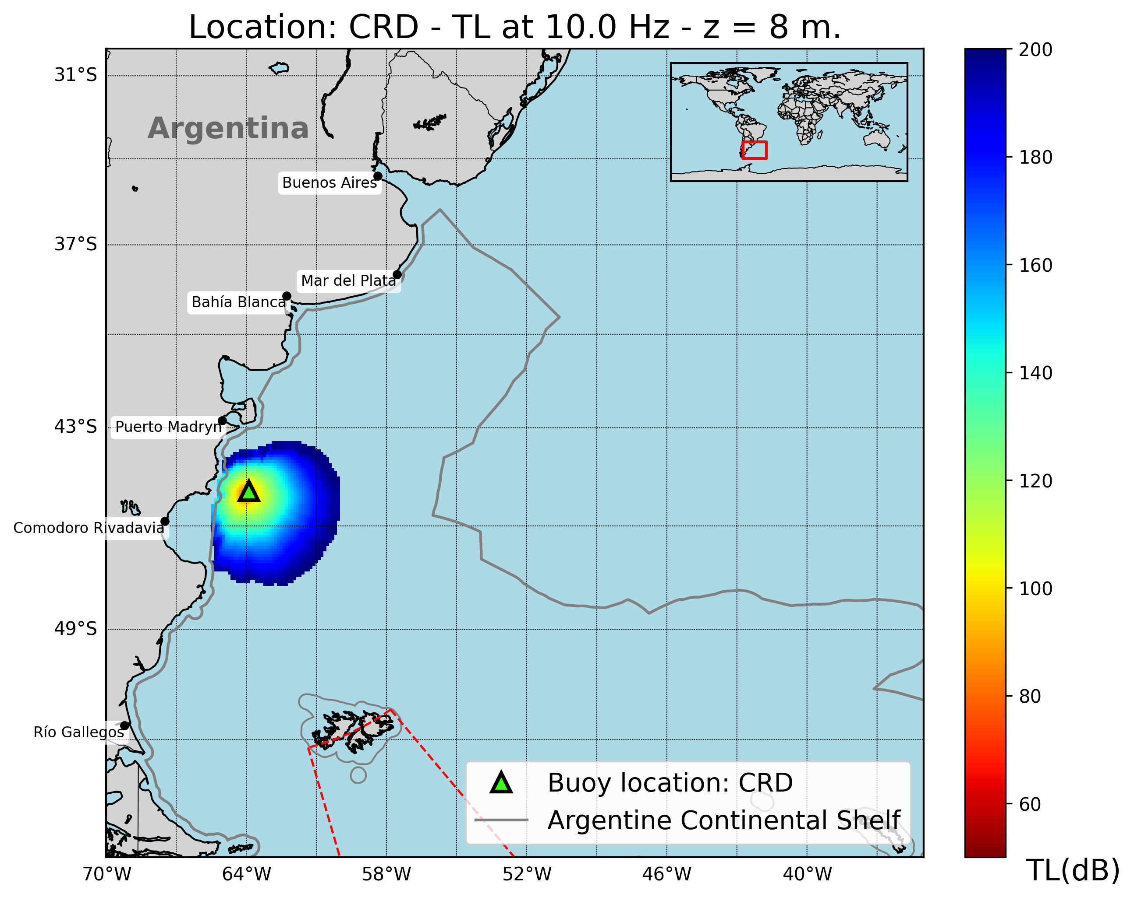
T1.3 - 299
A Portable Experimental Buoy for Coastal Acoustic Monitoring
Prario, I; Bos, P; Marques Rojo, R; Cinquini, M; Blanc, S.
Coverage of candidate 2 station (offshore Comodoro Rivadavia - CRD)
Marked frequency variation: stronger propagation loss at 10 Hz – 20 Hz band rather than at 50 Hz – 80 Hz band.
Continental slope creates coastal shadow zones at low frequencies.
Broader mid-frequency coverage compared to MDQ station, extending farther offshore.
Shallow-water limitations remain near coastlines.
Implication: buoy-deployed hydrophones at CRD station can improve coverage in southern shelf and can complement MDQ station.

Slide 18
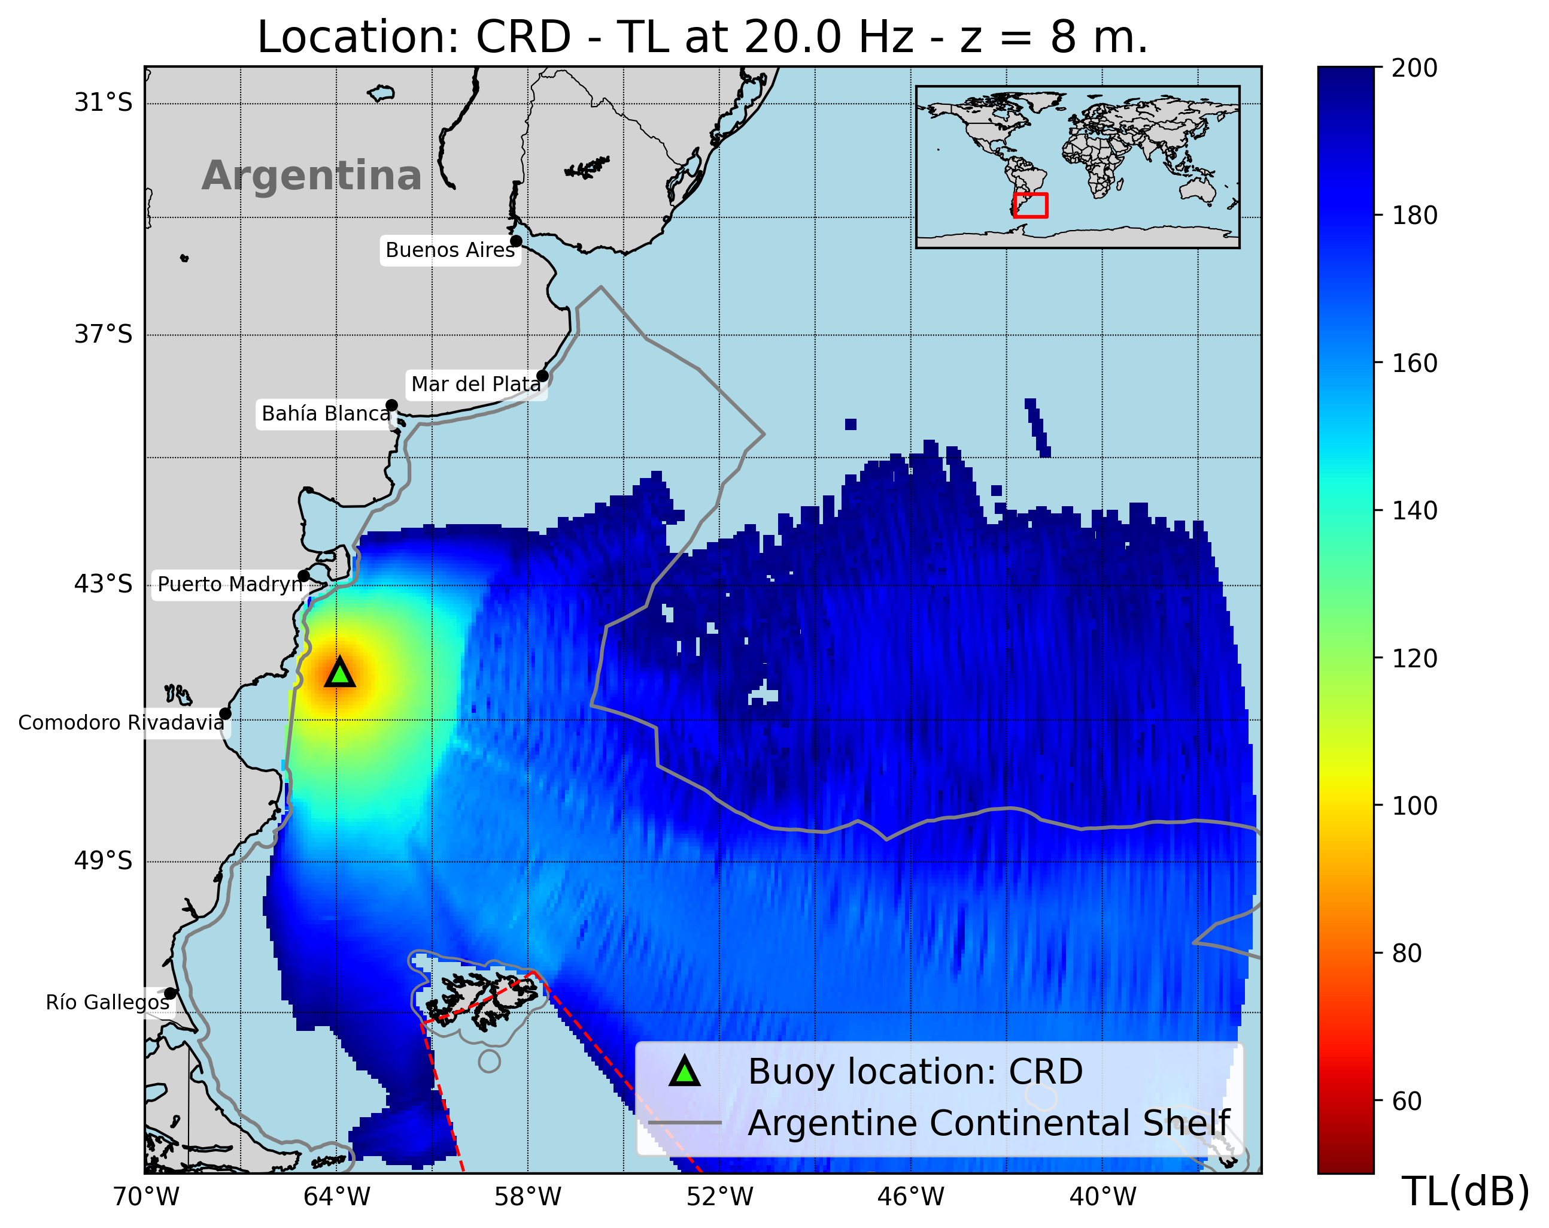
T1.3 - 299
A Portable Experimental Buoy for Coastal Acoustic Monitoring
Prario, I; Bos, P; Marques Rojo, R; Cinquini, M; Blanc, S.
Coverage of candidate 2 station (offshore Comodoro Rivadavia - CRD)
Marked frequency variation: stronger propagation loss at 10 Hz – 20 Hz band rather than at 50 Hz – 80 Hz band.
Continental slope creates coastal shadow zones at low frequencies.
Broader mid-frequency coverage compared to MDQ station, extending farther offshore.
Shallow-water limitations remain near coastlines.
Implication: buoy-deployed hydrophones at CRD station can improve coverage in southern shelf and can complement MDQ station.

Slide 19
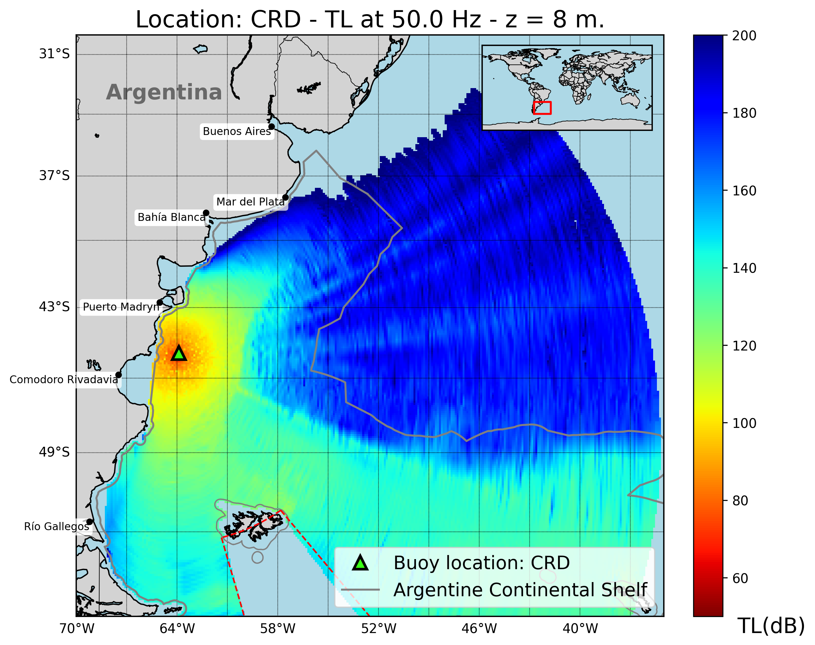
T1.3 - 299
A Portable Experimental Buoy for Coastal Acoustic Monitoring
Prario, I; Bos, P; Marques Rojo, R; Cinquini, M; Blanc, S.
Coverage of candidate 2 station (offshore Comodoro Rivadavia - CRD)
Marked frequency variation: stronger propagation loss at 10 Hz – 20 Hz band rather than at 50 Hz – 80 Hz band.
Continental slope creates coastal shadow zones at low frequencies.
Broader mid-frequency coverage compared to MDQ station, extending farther offshore.
Shallow-water limitations remain near coastlines.
Implication: buoy-deployed hydrophones at CRD station can improve coverage in southern shelf and can complement MDQ station.

Slide 20
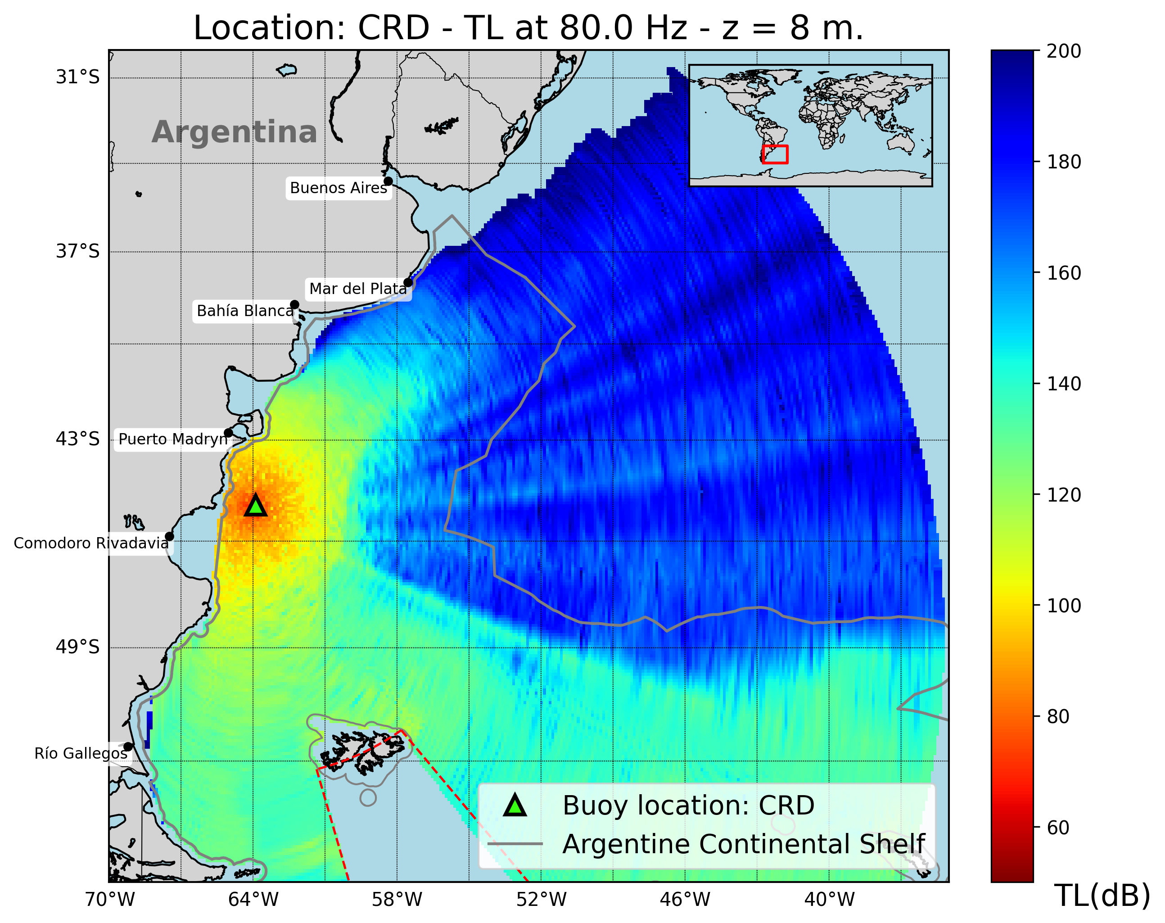
T1.3 - 299
A Portable Experimental Buoy for Coastal Acoustic Monitoring
Prario, I; Bos, P; Marques Rojo, R; Cinquini, M; Blanc, S.
Coverage of candidate 2 station (offshore Comodoro Rivadavia - CRD)
Marked frequency variation: stronger propagation loss at 10 Hz – 20 Hz band rather than at 50 Hz – 80 Hz band.
Continental slope creates coastal shadow zones at low frequencies.
Broader mid-frequency coverage compared to MDQ station, extending farther offshore.
Shallow-water limitations remain near coastlines.
Implication: buoy-deployed hydrophones at CRD station can improve coverage in southern shelf and can complement MDQ station.

Slide 21
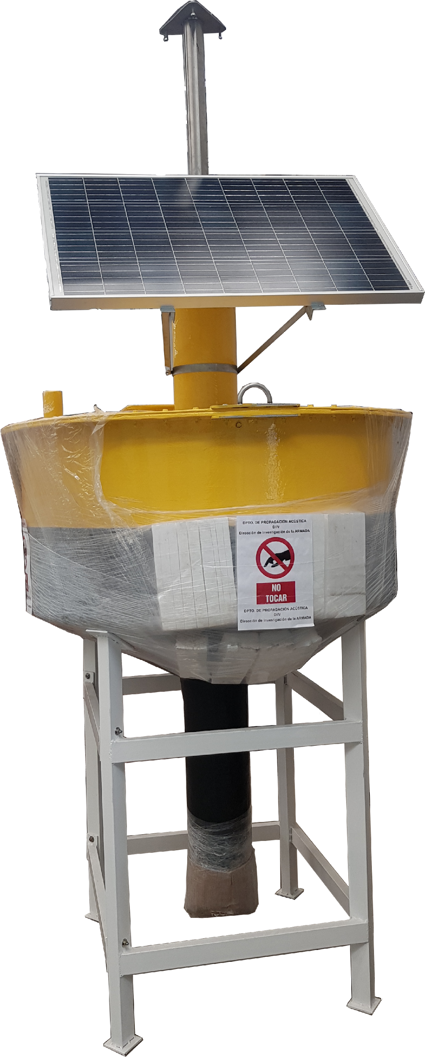
T1.3 - 299
A Portable Experimental Buoy for Coastal Acoustic Monitoring
Prario, I; Bos, P; Marques Rojo, R; Cinquini, M; Blanc, S.
Buoy Platform design for hydrophones deployment in selected stations
Main objetives:
Characterization of ambient noise or underwater sound sources on the Argentinian continental shelf.
Contributing to the understanding of shallow-water acoustic propagation.
Potentially contribute to the understanding of long-range propagation using additional data from IMS-HA network.
This custom-designed buoy is a prototype platform developed for the deployment of hydrophone array at near-shore semi-permanent stations.

Slide 22
T1.3 - 299
A Portable Experimental Buoy for Coastal Acoustic Monitoring
Prario, I; Bos, P; Marques Rojo, R; Cinquini, M; Blanc, S.
Buoy Platform design for hydrophones deployment in selected stations
Features:
A Glass-Reinforced Plastic hull for corrosion resistance and lightweight performance.
3 mooring lines for stable position.
Stand-alone operation with solar power system.
A sealed electronics compartment and a central mast for sensors, antennas, satellite transmission and GPS.
Harsh marine conditions: strong currents and waves up to 4 meters.

Slide 23
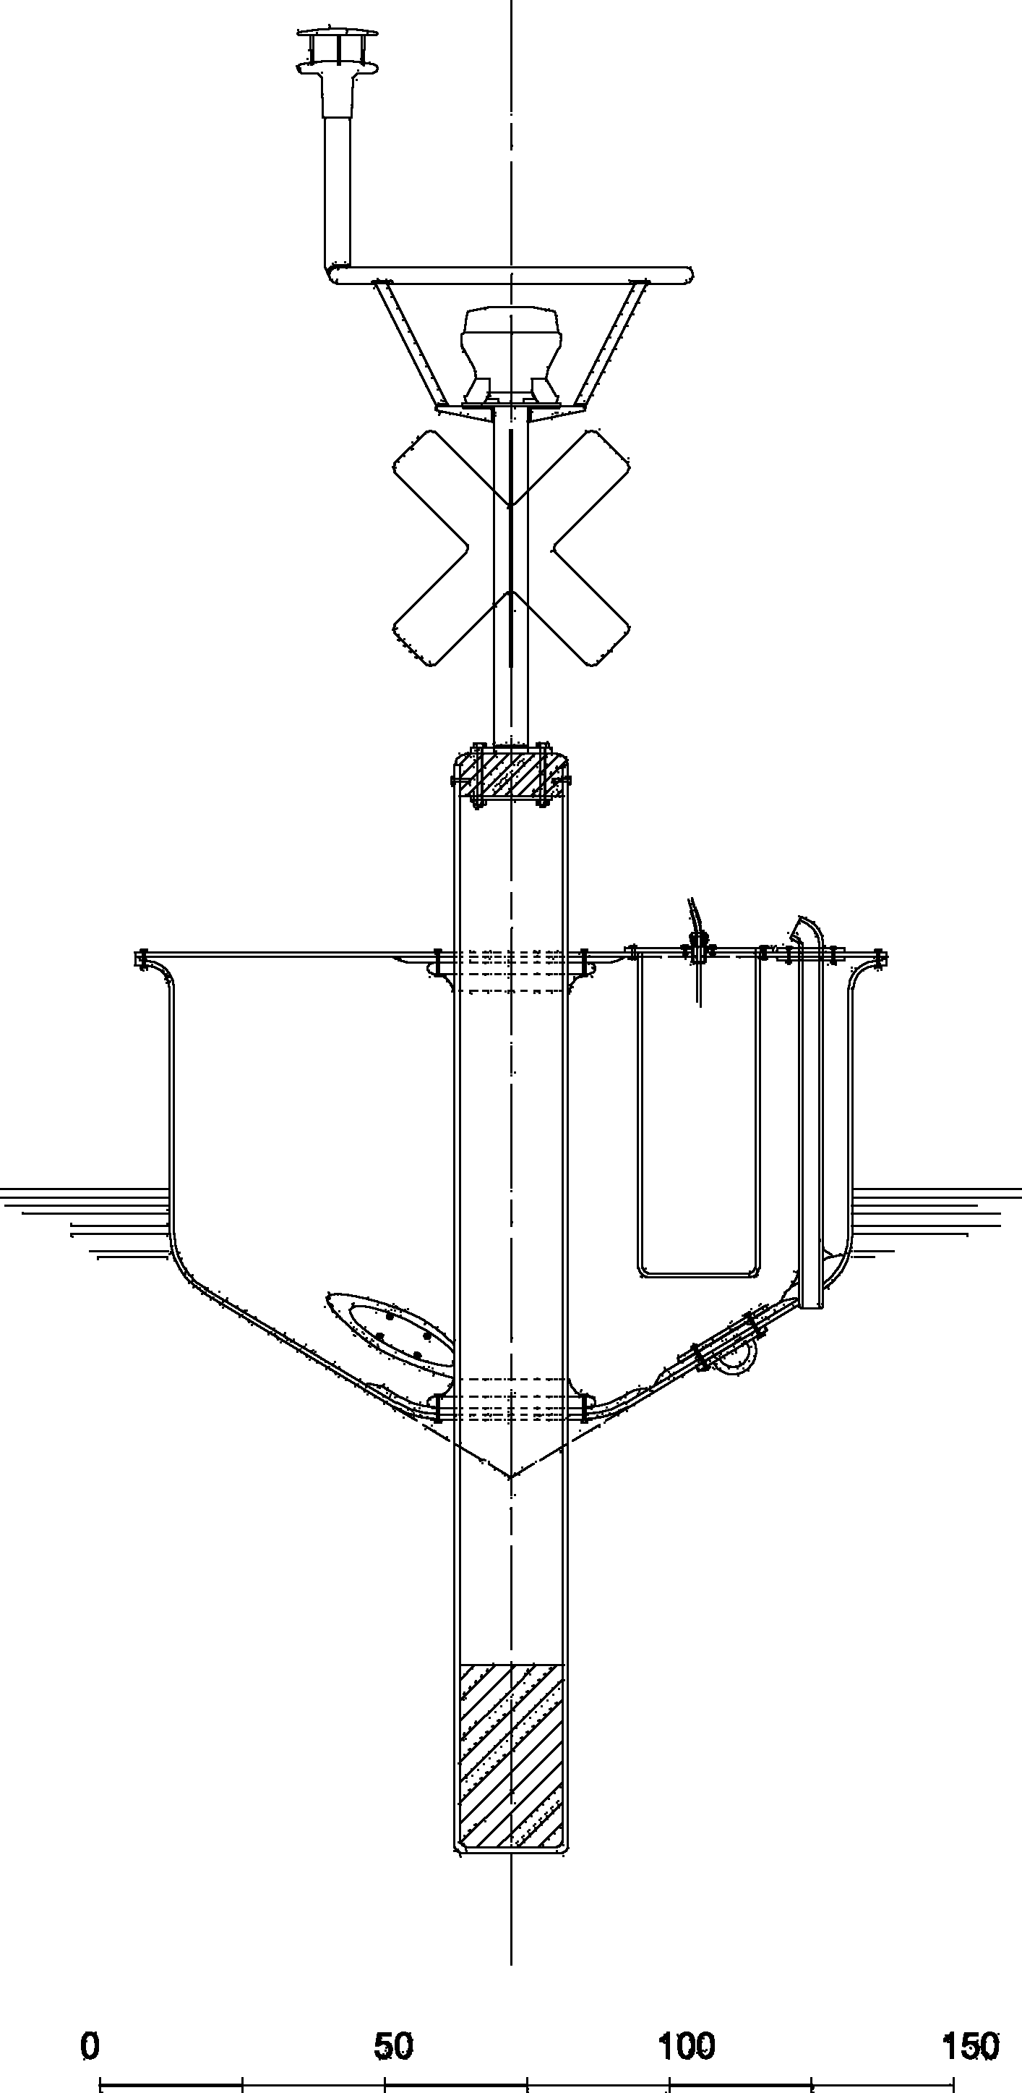
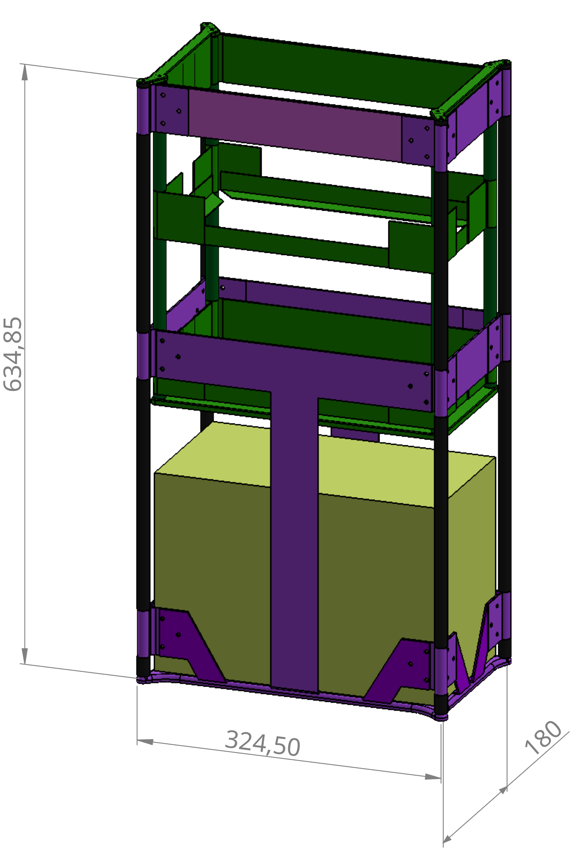
T1.3 - 299
A Portable Experimental Buoy for Coastal Acoustic Monitoring
Prario, I; Bos, P; Marques Rojo, R; Cinquini, M; Blanc, S.
Buoy Electronics Rack
Removable, lift-out aluminum rack houses:
Fanless embedded computer
24-bit audio interface for broadband hydrophone digitization
Low-noise hydrophone preamplifiers
AIS-AtoN (Automatic Identification System)
Satellite modem for telemetry and command
Deep-cycle battery with solar charge controller

Slide 24
T1.3 - 299
A Portable Experimental Buoy for Coastal Acoustic Monitoring
Prario, I; Bos, P; Marques Rojo, R; Cinquini, M; Blanc, S.
Layered Architecture of the Embedded System
🔝 Orchestrator Layer
Coordinates overall system flow.
Decides which FSM to activate and when.
Handles high-level internal and external events.
🔁 State Machine Layer (FSM)
Manages module behaviour based on current state.
React to events, executes actions, changes states.
⚙️ Low-Level Driver Layer
Interfaces directly with hardware.
Performs device I/O and peripheral configuration.
Task Manager (System Orchestrator)
Event reporting through message queues
Signals to FSM
Finite State Machine (FSM)
Calls to driver methods
Return status (OK / ERROR)
Low-Level Driver

Slide 25
T1.3 - 299
A Portable Experimental Buoy for Coastal Acoustic Monitoring
Prario, I; Bos, P; Marques Rojo, R; Cinquini, M; Blanc, S.
Layered Architecture of the Embedded System
🔝 Orchestrator Layer
Coordinates overall system flow.
Decides which FSM to activate and when.
Handles high-level internal and external events.
🔁 State Machine Layer (FSM)
Manages module behaviour based on current state.
React to events, executes actions, changes states.
⚙️ Low-Level Driver Layer
Interfaces directly with hardware.
Performs device I/O and peripheral configuration.
Task Manager (System Orchestrator)
Event reporting through message queues
Signals to FSM
Finite State Machine (FSM)
Calls to driver methods
Return status (OK / ERROR)
Low-Level Driver

Slide 26
T1.3 - 299
A Portable Experimental Buoy for Coastal Acoustic Monitoring
Prario, I; Bos, P; Marques Rojo, R; Cinquini, M; Blanc, S.
Layered Architecture of the Embedded System
🔝 Orchestrator Layer
Coordinates overall system flow.
Decides which FSM to activate and when.
Handles high-level internal and external events.
🔁 State Machine Layer (FSM)
Manages module behaviour based on current state.
React to events, executes actions, changes states.
⚙️ Low-Level Driver Layer
Interfaces directly with hardware.
Performs device I/O and peripheral configuration.
Task Manager (System Orchestrator)
Event reporting through message queues
Signals to FSM
Finite State Machine (FSM)
Calls to driver methods
Return status (OK / ERROR)
Low-Level Driver

Slide 27
T1.3 - 299
A Portable Experimental Buoy for Coastal Acoustic Monitoring
Prario, I; Bos, P; Marques Rojo, R; Cinquini, M; Blanc, S.
Layered Architecture of the Embedded System
🔝 Orchestrator Layer
Coordinates overall system flow.
Decides which FSM to activate and when.
Handles high-level internal and external events.
🔁 State Machine Layer (FSM)
Manages module behaviour based on current state.
React to events, executes actions, changes states.
⚙️ Low-Level Driver Layer
Interfaces directly with hardware.
Performs device I/O and peripheral configuration.
Task Manager (System Orchestrator)
Event reporting through message queues
Signals to FSM
Finite State Machine (FSM)
Calls to driver methods
Return status (OK / ERROR)
Low-Level Driver

Slide 28
T1.3 - 299
A Portable Experimental Buoy for Coastal Acoustic Monitoring
Prario, I; Bos, P; Marques Rojo, R; Cinquini, M; Blanc, S.
State Machine Design Pattern
This generic FSM pattern is used across multiple modules to manage their internal logic and execution flow.
DISABLE: The module is inactive and resources are released.
INIT: Initializes hardware and internal variables.
TEST: Performs self-checks and verifies correct functionality.
ERROR: Captures faults and attempts recovery or shutdown.
IDLE: Waits for commands or events.
RUN JOB: Executes the main task or acquisition.
Transitions are triggered by internal events or commands.
Each FSM has a scheduler, message_handler and update functions
DISABLE
INIT
TEST
ERROR
IDLE
RUN JOB

Slide 29
T1.3 - 299
A Portable Experimental Buoy for Coastal Acoustic Monitoring
Prario, I; Bos, P; Marques Rojo, R; Cinquini, M; Blanc, S.
State Machine Design Pattern
This generic FSM pattern is used across multiple modules to manage their internal logic and execution flow.
DISABLE: The module is inactive and resources are released.
INIT: Initializes hardware and internal variables.
TEST: Performs self-checks and verifies correct functionality.
ERROR: Captures faults and attempts recovery or shutdown.
IDLE: Waits for commands or events.
RUN JOB: Executes the main task or acquisition.
Transitions are triggered by internal events or commands.
Each FSM has a scheduler, message_handler and update functions
DISABLE
INIT
TEST
ERROR
IDLE
RUN JOB

Slide 30
T1.3 - 299
A Portable Experimental Buoy for Coastal Acoustic Monitoring
Prario, I; Bos, P; Marques Rojo, R; Cinquini, M; Blanc, S.
State Machine Design Pattern
This generic FSM pattern is used across multiple modules to manage their internal logic and execution flow.
DISABLE: The module is inactive and resources are released.
INIT: Initializes hardware and internal variables.
TEST: Performs self-checks and verifies correct functionality.
ERROR: Captures faults and attempts recovery or shutdown.
IDLE: Waits for commands or events.
RUN JOB: Executes the main task or acquisition.
Transitions are triggered by internal events or commands.
Each FSM has a scheduler, message_handler and update functions
DISABLE
INIT
TEST
ERROR
IDLE
RUN JOB

Slide 31
T1.3 - 299
A Portable Experimental Buoy for Coastal Acoustic Monitoring
Prario, I; Bos, P; Marques Rojo, R; Cinquini, M; Blanc, S.
State Machine Design Pattern
This generic FSM pattern is used across multiple modules to manage their internal logic and execution flow.
DISABLE: The module is inactive and resources are released.
INIT: Initializes hardware and internal variables.
TEST: Performs self-checks and verifies correct functionality.
ERROR: Captures faults and attempts recovery or shutdown.
IDLE: Waits for commands or events.
RUN JOB: Executes the main task or acquisition.
Transitions are triggered by internal events or commands.
Each FSM has a scheduler, message_handler and update functions
DISABLE
INIT
TEST
ERROR
IDLE
RUN JOB

Slide 32
T1.3 - 299
A Portable Experimental Buoy for Coastal Acoustic Monitoring
Prario, I; Bos, P; Marques Rojo, R; Cinquini, M; Blanc, S.
State Machine Design Pattern
This generic FSM pattern is used across multiple modules to manage their internal logic and execution flow.
DISABLE: The module is inactive and resources are released.
INIT: Initializes hardware and internal variables.
TEST: Performs self-checks and verifies correct functionality.
ERROR: Captures faults and attempts recovery or shutdown.
IDLE: Waits for commands or events.
RUN JOB: Executes the main task or acquisition.
Transitions are triggered by internal events or commands.
Each FSM has a scheduler, message_handler and update functions
DISABLE
INIT
TEST
ERROR
IDLE
RUN JOB

Slide 33
T1.3 - 299
A Portable Experimental Buoy for Coastal Acoustic Monitoring
Prario, I; Bos, P; Marques Rojo, R; Cinquini, M; Blanc, S.
State Machine Design Pattern
This generic FSM pattern is used across multiple modules to manage their internal logic and execution flow.
DISABLE: The module is inactive and resources are released.
INIT: Initializes hardware and internal variables.
TEST: Performs self-checks and verifies correct functionality.
ERROR: Captures faults and attempts recovery or shutdown.
IDLE: Waits for commands or events.
RUN JOB: Executes the main task or acquisition.
Transitions are triggered by internal events or commands.
Each FSM has a scheduler, message_handler and update functions
DISABLE
INIT
TEST
ERROR
IDLE
RUN JOB

Slide 34
T1.3 - 299
A Portable Experimental Buoy for Coastal Acoustic Monitoring
Prario, I; Bos, P; Marques Rojo, R; Cinquini, M; Blanc, S.
State Machine Design Pattern
This generic FSM pattern is used across multiple modules to manage their internal logic and execution flow.
DISABLE: The module is inactive and resources are released.
INIT: Initializes hardware and internal variables.
TEST: Performs self-checks and verifies correct functionality.
ERROR: Captures faults and attempts recovery or shutdown.
IDLE: Waits for commands or events.
RUN JOB: Executes the main task or acquisition.
Transitions are triggered by internal events or commands.
Each FSM has a scheduler, message_handler and update functions
DISABLE
INIT
TEST
ERROR
IDLE
RUN JOB

Slide 35
T1.3 - 299
A Portable Experimental Buoy for Coastal Acoustic Monitoring
Prario, I; Bos, P; Marques Rojo, R; Cinquini, M; Blanc, S.
Conclusions
A new deployment for underwater noise measurement was developed for shallow waters on the Argentinian continental shelf: application to impulsive sound monitoring
Potential relevance for basin-scale propagation analysis using impulsive signals detected by the IMS hydroacoustic network.
The low-cost prototype buoy for coastal acoustic monitoring is in its final integration stage, designed for robustness with a static mooring system.
Proposed deployment sites (MDQ and CRD) were selected to enhance detection in previously uncovered regions.
This platform paves the way for a scalable coastal monitoring system supporting baseline studies of shallow water soundscapes and long-range propagation analysis.

Slide 36
T1.3 - 299
A Portable Experimental Buoy for Coastal Acoustic Monitoring
Prario, I; Bos, P; Marques Rojo, R; Cinquini, M; Blanc, S.
Thank you!

Slide 37
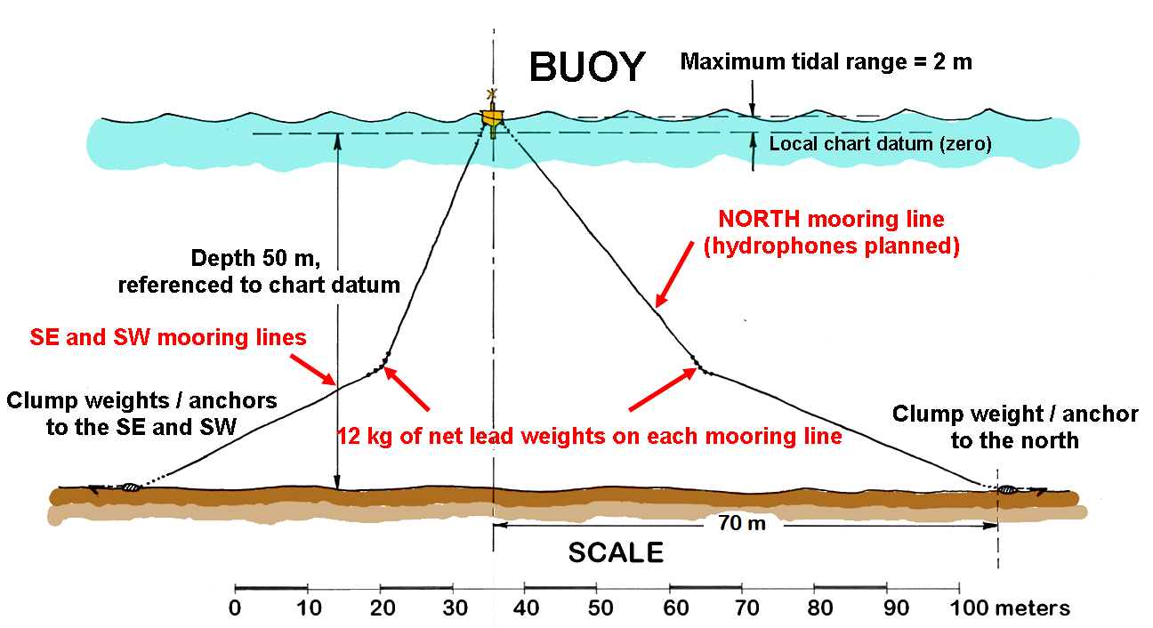
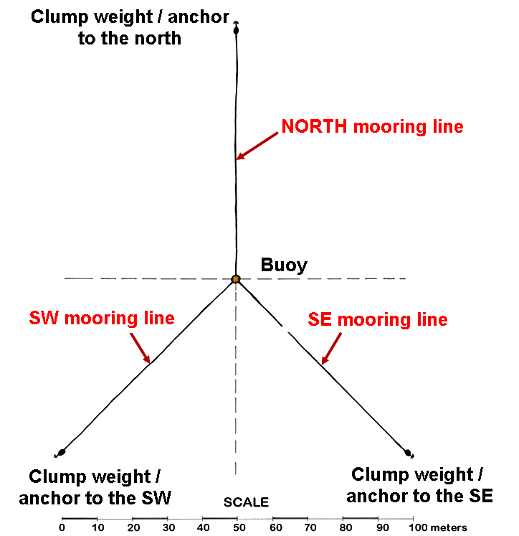
T1.3 - 299
A Portable Experimental Buoy for Coastal Acoustic Monitoring
Prario, I; Bos, P; Marques Rojo, R; Cinquini, M; Blanc, S.
SCHEMATIC OF THE BUOY MOORING SYSTEM WITH HYDROPHONES

