Slide 1
Digital Right Management DRM
Next Media Project
Metropolia
Olli Alm & Patrick Ausderau

Slide 2
Why?
In analog form, copy is
time consuming
lost of quality
high cost
slow transmission
In digital form (no separation from content and container)
fast
perfect copy
almost no cost (disc space, bandwidth, electricity)
fast and exponential transmission (few minutes)

Slide 3
Goal
Secure and distribute content only to the people whom it is meant for.
With permissions
if the user can copy the content
if he can print it
limit the number of device that can access
…
Extreme implementation: pay per view

Slide 4
Protected by the law
WIPO Copyright Treaty (WCT) of 1996
Article 11 Obligations concerning Technological Measures
Contracting Parties shall provide adequate legal protection […] against the circumvention of effective technological measures that are used by authors […]
Article 12 Obligations concerning Rights Management Information
Contracting Parties shall provide adequate […] remedies against any person knowingly performing any of the following acts […]
to remove or alter any electronic rights management information without authority
to distribute, import for distribution, broadcast or communicate to the public, without authority, works or copies of works knowing that electronic rights management information has been removed or altered without authority […]

Slide 5
Protected by the law
Signatories countries (89)
USA: Digital Millennium Copyright Act of 1998
EU: DIRECTIVE 2001/29/EC on the harmonisation of certain aspects of copyright and related rights in the information society
Finland: COPYRIGHT LEGISLATION of 2010
China, Japan, Canada, Russian Federation,…
Did not sign
India, Brazil,…

Slide 6
Opponents
Foundations/organizations
Free Software foundation (FSF)
Electronic Frontier Foundation (EFF)
La Quadrature du Net
…
Politics
Pirate Party
European Green Party
…

Slide 7
Opponents view and proposition
No DRM and legalize sharing
Useful for culture
Better accessibility
More diversity
Access to orphan and out of print works
Doesn’t prevent authors/publisher to make money
Propose a flat-rate tax on internet subscribers and/or blank media
Reward authors
Fund new cultural projects
Participate in archiving for future generation

Slide 8
Existing DRM limitations
Lack of standard
Analog hole
Proprietary code to wrap standard (e.g. epub, pdf) that confuse users
Fair use limitations (offer, resell, borrow, remix, backup copy)
What if vendor goes bankrupt? Who really own the content?
Location problem
DRM free once in public domain?
Cost

Slide 9
Our studies
Standard
Better resistance
Identify the copy of work (with or without user authentication) for a better fair use
Key / token approaches
On the cloud / offline access
Open source

Slide 10
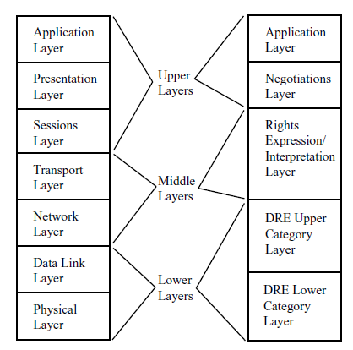
Standard
the development of standards promoted the integration of independently developed solutions
A breakdown of the OSI data communications layers and the proposed DRM layers into upper, middle, and lower layers.
Source: The Role of Architecture in DRM Vendor Economics
Pramod A. Jamkhedkar, Gregory L. Heileman 2005 - University of New Mexico

Slide 11
Better resistance
Security by obscurity
Risk: break once, break everywhere
Software uniqueness (e.g. MediaSnap)
Tamper-resistant hardware
Trusted Computing Group
Next -Generation Secure Computing Base
Source: DIGITAL RIGHTS MANAGEMENT: THE TECHNOLOGY BEHIND THE HYPE
Mark Stamp 2003 - San Jose State University

Slide 12
Key / token
Cryptography != DRM (user has the key)
Adobe Adept DRM
strong DRM mechanism
weak obfuscation to hide the per-user key
Source: Circumventing Adobe ADEPT DRM for EPUB
i♥cabbages 2009
Token approach?
One access at a time
New key for each access with temporal limitation
Identify the copy (not necessary the user)

Slide 13
In progress
On Cloud / Offline
Open Source DRM?
GNU GPL3, section 3
No covered work shall be deemed part of an effective technological measure under any applicable law fulfilling obligations under article 11 of the WIPO copyright treaty adopted on 20 December 1996, or similar laws prohibiting or restricting circumvention of such measures.
the GNU GPL does not restrict what people do in software, it just stops them from restricting others.
Source: GNU GENERAL PUBLIC LICENSE Version 3
Free Software Foundation 2007

Slide 14
Library and DRM
Many fair uses in the law for institutions (library, museum, hospital, school, prison,…)
Facilitate archiving
Deposit of “exemplar”
DRM free for research (provided that content is not further distributed)
Possible to make accessible out of print work
...
To be carefully double check

Slide 15
Questions / comments
Thank You!

