Slide 1

E-book protection
WP seminar 12.12.2012
Patrick Ausderau

Slide 2
Introduction
E-Book Statistic (2012 French survey)
Ways to Fight Copyright Infringement
Technical protection comparison
DRM
Lightweight DRM
Watermark/Social DRM
DRM-free
Conclusion

Slide 3
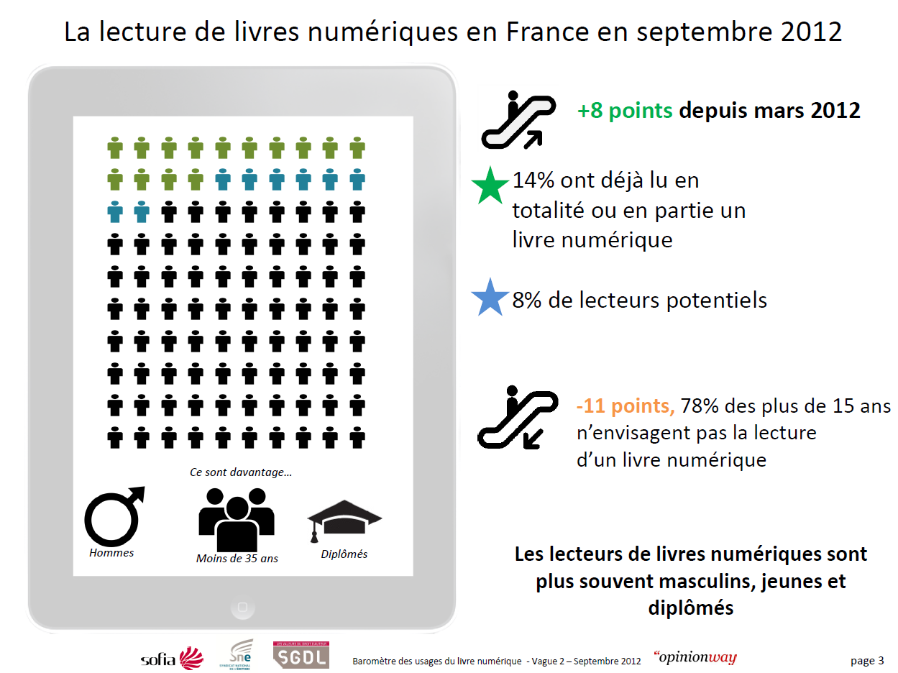
Reading of digital books in France in September 2012
14% have already fully or partly read an e-book
8% potential readers
78% of people older than 15years old do not envisage to read e-book
Men
under 35 years old
graduated
E-book readers are more often men, young and graduated
Notes:
http://www.opinion-way.com/pdf/barometre_livre_numerique_-_vague_2_-_pour_presentation_orale_vf.pdf

Slide 4
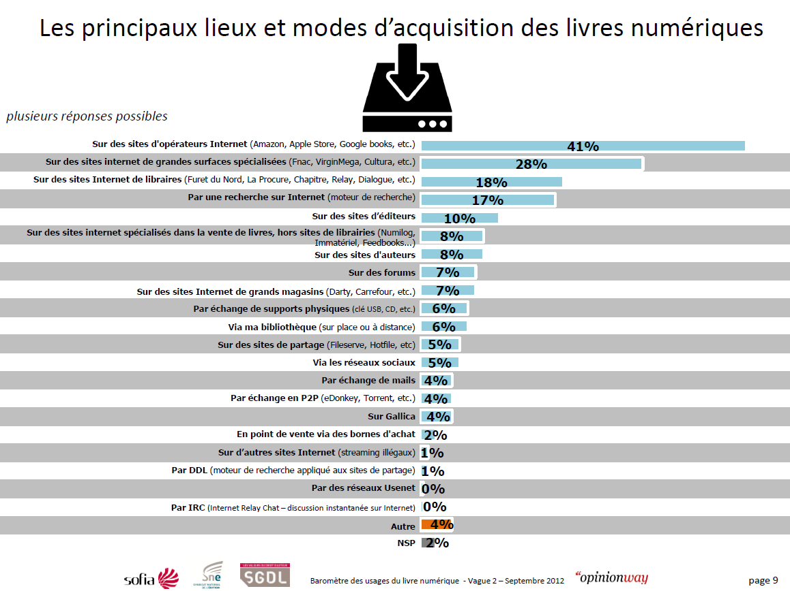
The main places and methods of acquiring digital books
multiple possible answers
Internet operator websites (Amazon, Apple Store, Google books, etc.)
Media specialized stores’ websites (Fnac, VirginMega, Cultura, etc.)
Bookstores’ websites (Furet du Nord, La Procure, Chapitre, Relay, etc.)
Legal:
Web-store Publishers Author Library
Search the Web (search engine )
Publishers’ websites
E-book specialized web-stores, but not bookstore (Numilog, Feedbooks…)
Authors’ websites
Forums
Department stores’ websites (Darty, Carrefour, etc.)
Physical medium exchange (USB stick, CD, etc.)
Library (on site or remote)
File sharing websites (Fileserve, Hotfile, etc.)
Social Sharing
Social networks
Email exchanges
P2P exchange (eDonkey, Torrent, etc.)
Gallica (French National Library)
In stores through interactive kiosk
Other websites (illegal streaming)
Illegal Distribution
DDL (search engine for file sharing websites)
Usenet
IRC (Internet Relay Chat)
Others
Not specified

Slide 5
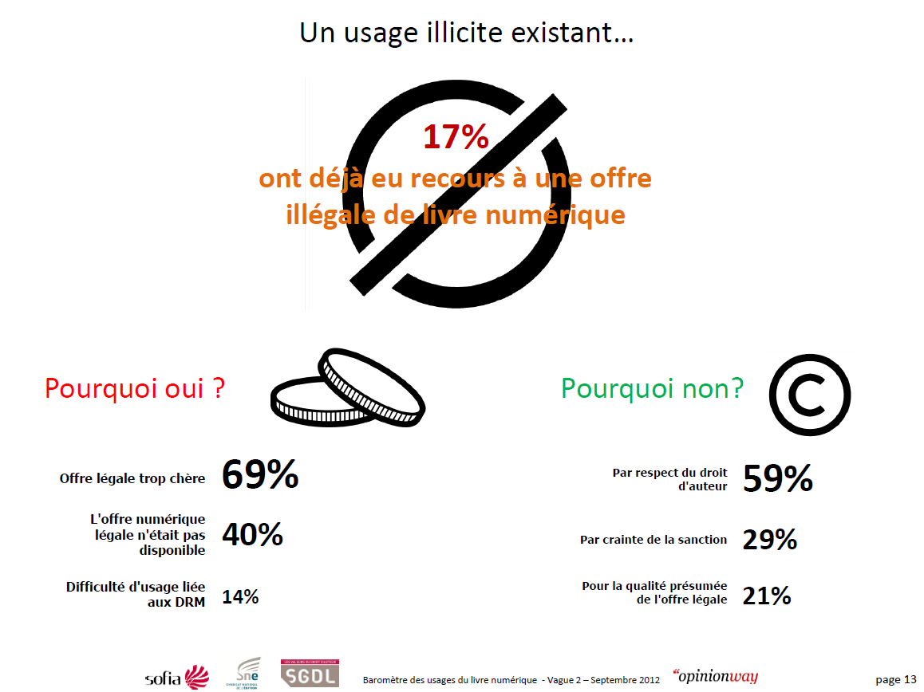
A illicit usage exist…
Already had recourse to an illegal offer of digital book
Why yes?
Why no?
Legal offer
too expensive
Respect for
copyright
Legal offer
did not exist
Fear sanction
Usage difficulties
due to DRM
Hope for better quality

Slide 6
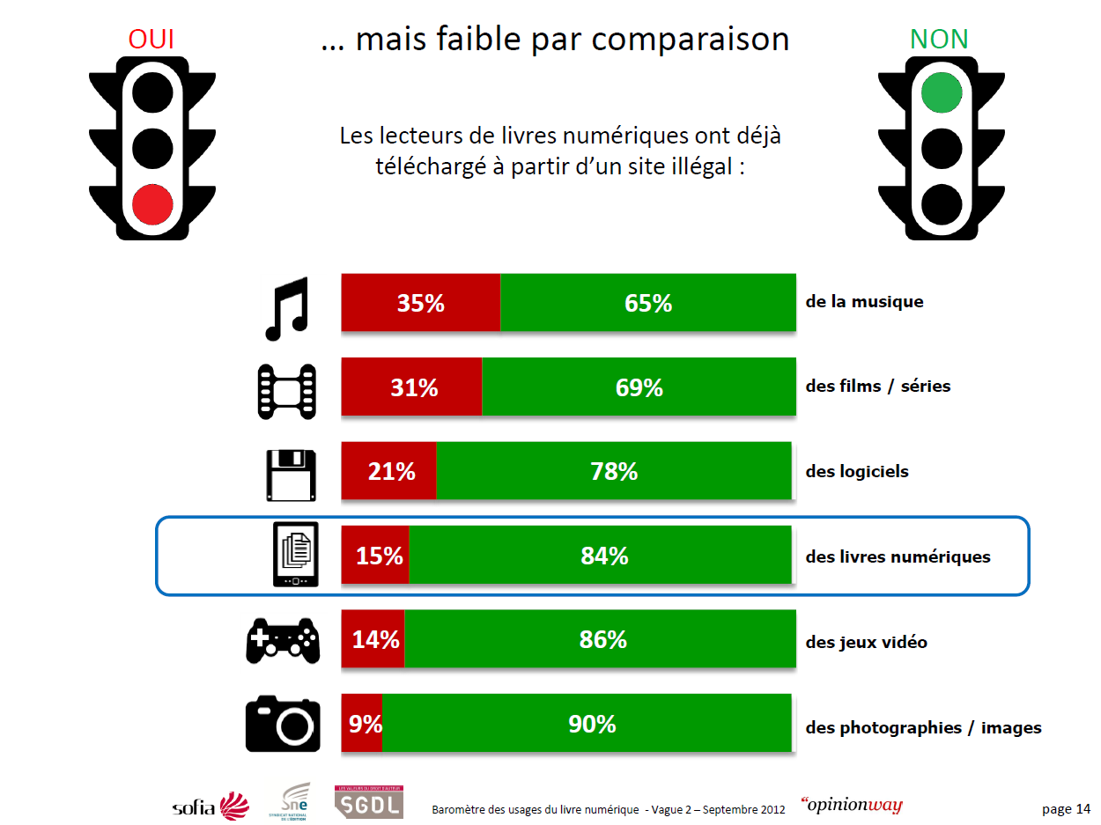
YES
… but low compare to
NO
Digital book readers already downloaded from a illegal website:
Music
Movies / TV series
Software
Digital books
Games
Photography / images

Slide 7
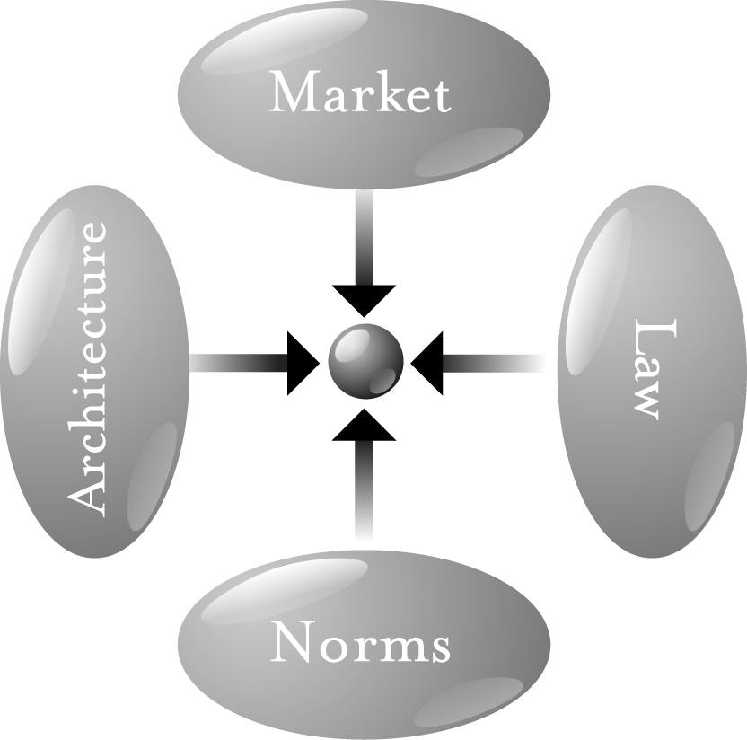
Ways to Fight Copyright Infringement
Market
Make e-book cheaper?
Price transparency?
Easy to access
Richer collection available
Remove DRM?
Norms (Behavioral)
Educate public about copyright
Notes:
http://codev2.cc/download+remix/Lessig-Codev2.pdf (chapter 7)
http://idpf.org/sites/idpf.org/files/digital-book-conference/presentations/db2012/DB2012_Bill_Rosenblatt.pdf

Slide 8
Ways to Fight Copyright Infringement
Legislation: adapting copyright law
WIPO Copyright Treaty (WCT) of 1996
Article 11 Obligations concerning Technological Measures
Article 12 Obligations concerning Rights Management Information
USA: Digital Millennium Copyright Act of 1998
EU: DIRECTIVE 2001/29/EC on the harmonisation of certain aspects of copyright and related rights in the information society
Finland: COPYRIGHT LEGISLATION of 2010
Legalize non-market file sharing & consumer fee
Organizations: FSF, EFF, La Quadrature du Net
Politics: Pirate Party, European Green Party
Country: Brazil (turned up side down under Rousseff), France/Netherlands (3c-da.org), Switzerland (copyright working group (result for fall 2013))
Notes:
http://www.wipo.int/wipolex/en/treaties/text.jsp?file_id=177635
http://www.copyright.gov/legislation/dmca.pdf
http://eur-lex.europa.eu/LexUriServ/LexUriServ.do?uri=OJ:L:2001:167:0010:0019:EN:PDF (chapter III)
http://www.finlex.fi/en/laki/kaannokset/1961/en19610404.pdf (chapter 5a)
http://europeangreens.eu/euroarchive/fileadmin/logos/pdf/policy_documents/resolutions/Montreuil/3._Digital_rigths_are_civil_rights.pdf
http://piraattipuolue.fi/english/
http://www.gnu.org/philosophy/freedom-or-copyright.html
http://www.sharing-thebook.com/
http://direitorio.fgv.br/sites/direitorio.fgv.br/files/Marco%20Civil%20-%20English%20Version%20sept2011.pdf
http://falkvinge.net/2012/11/21/brazil-squanders-chance-at-geopolitical-influence-kills-internet-rights-bill-in-political-fiasco/
http://www.3c-da.org
http://www.ejpd.admin.ch/content/ejpd/fr/home/dokumentation/mi/2012/2012-08-09.html
http://www.un.org/en/documents/udhr/index.shtml#a27
Article 27.
(1) Everyone has the right freely to participate in the cultural life of the community, to enjoy the arts and to share in scientific advancement and its benefits.
(2) Everyone has the right to the protection of the moral and material interests resulting from any scientific, literary or artistic production of which he is the author.

Slide 9
Ways to Fight Copyright Infringement
Architecture (technical)
Currently 3 approaches
DRM
Encrypted e-book and authentication/signing server
Prevention approach
Watermark / Social DRM
Invisible and visible user information combination
A posteriori/social approach
DRM-free
No protection
Web/collaborative approach
And an upcoming
Lightweight DRM
Password protected e-book, decrypted by application
Prevention/social approach
No optimal solution

Slide 10
Digital Right Management (DRM)
Pros
Cons
Strong encryption
Tie to user/device
Permission control
Expiry date & time
Recovery from crack
Forward and delete
Proprietary, no standard
Crack exist
Cost
Fair use limitations
Privacy concern
License VS owning
Lock-in
Market fragmentation or monopoly
Notes:
Adobe Content server (+ signing) cost:
the license $8000 + $2000 per year support. ($2495 for the installation and configuration).
signing one e-book permanently will $0.22 (or $0.08 for a 0-60 day expiring).

Slide 11
EPUB Lightweight DRM (IDPF)
Pros
Cons
Standard
Permission control
Expiry date & time
Work offline
More user freedom and ownership
Cheaper than DRM
Extensibility
No release date yet
No decision
Patent problem
License/cost unclear
No recovery from crack
Open source dilemma
Notes:
Pwd = password

Slide 12
Watermark and Social DRM
Pros
Cons
More user freedom and ownership
Cheap
Find original owner when illegal copy is found
Modification detection
One click crack
Web-crawler not included
No permission control
Original owner can be punished from third-party activities
Notes:
http://publishingperspectives.com/2012/09/booxtream-on-social-drm-as-a-better-option-for-e-books/
the web version is charged per epub: € 0.60 if you only do a few a year; €0.10 for 50,000; and lower rates for larger quantities.

Slide 13
DRM-free
Pros
Cons
User full freedom
Economically viable (SF/fantasy, Scientific/IT)
Crowd funding
Synergy with paper
License (CC, Copyheart, Copyfarleft)
Better circulation of culture/knowledge
Irreversible decision
Copyright collecting agency/publishers/vendor reticence
Not practicable for some model

Slide 14
Conclusion
For high value content (company documentation, trading secrets) where both ends agree, hard DRM is a good option.
Otherwise the limitations of the hard DRM outweigh the advantages
If you trust your reader at 100% go DRM-free
If you don’t then prefer watermark/social DRM or lightweight DRM
Action at the others level
Politics
Education
Market

Slide 15
Questions / comments
Thank You!

