Slide 1











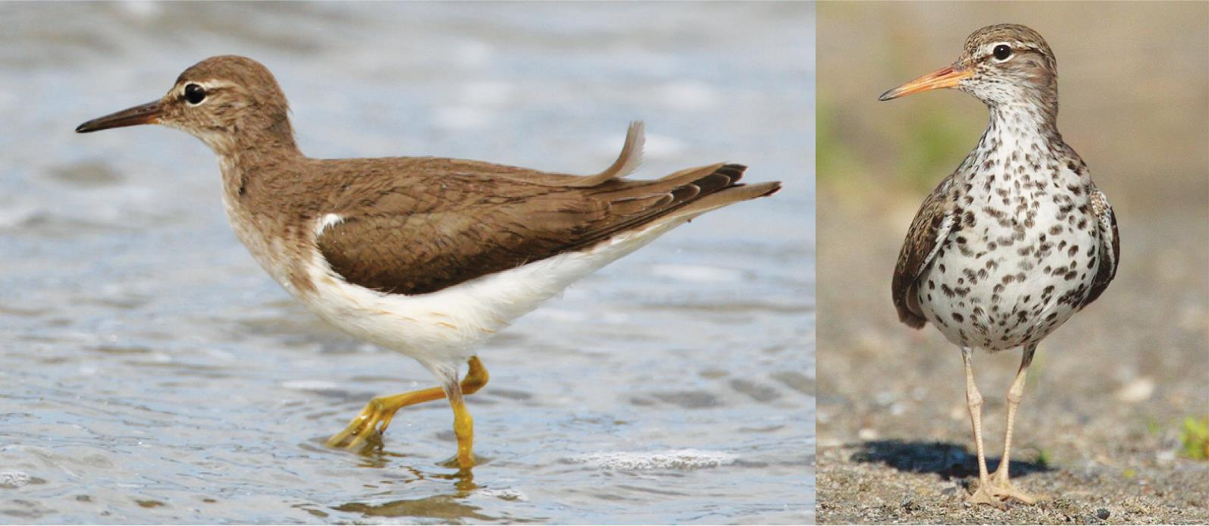

ANALYSIS OF HEPATITIS C VIRUS PROPAGATION AMONG
SPOTTED SANDPIPER (Actitis macularius) POPULATIONS
Anderson de Jesus Falcão da Silva (IFPA), Patrick Douglas Corrêa Pereira (McGill); Emanuel Ramos da Costa (UFPA); Nara Gyzely Morais Magalhães(SEDUC); Diandra Araújo da Luz (AFYA), Cristovam Guerreiro Diniz(IFPA).
Corresponding Author: andersondejesusfalcaodasilva@gmail.com
THEMATIC AREA AND ODS
MATERIALS AND METHODS
The discovery of these hepaciviruses in birds such as Actitis macularius opens new perspectives for research, especially concerning the understanding of viral spread dynamics among different animal
FIELD OF KNOWLEDGE/SUBFIELD: 04
Biological Sciences | Immunology.
RELATED ODS: ODS03 Good Health and Well- being - Ensure healthy lives and promote well- being for all at all ages.
Bird Collectiono
The birds were collected on Otelina Island, in the Amazon estuary in Bragança-PA, using mist nets.
populations and potentially to humans. Although the
discovery phase of these viruses is ongoing,
significant advancements in genomic technologies
allow for the exploration of the evolution and
INTRODUCTION
Perfusion
The animals were anesthetized and perfused with saline solution and RNA later, followed by craniotomy.
transmission patterns of these pathogens beyond what is known about human HCV.
Seasonally, birds migrate due to prolonged
It is crucial to emphasize that while initial HCV infection in humans is generally asymptomatic, the absence of appropriate treatment can lead to serious complications such as acute and chronic hepatitis, liver cirrhosis, and even hepatocellular carcinoma (Bletsa et al., 2020). Therefore, a comprehensive characterization of these hepaciviruses, both
droughts and harsh winters (Nunes; Tomas, 2008). Annually, around 40 species of
Scolopacidae migrate to coastal regions of the Southern Hemisphere in search of food, shelter, and rest. The Bragantina region in northeastern
Sequencing
The sequencing and chip reading were performed using the Ion 540 Chip and the Ion S5 GeneStudio System.
Pará hosts a great diversity of these
birds, (Actitis 2008).
including the Spotted Sandpiper
macularius) (Campos; Naiff;
Araújo,
may become
Virus Search
The virus search was conducted using
Name Numreads Covbases Coverege Rate_hit
During migration, some birds
the VIRTUS2 pipeline, with the
a
NC_009823.1 Hepatitis C virus genotype 2, Complete genome | 1 | 48 | 0,494285 | 1,22978E-08
NC_038882.1 Hepatitis C virus (Isolate H77) genotype 1, Complete cds | 2 | 41 | 0,427128 | 2,45957E-08
NC_005950.1 Snow goose hepatitis B virus, Complete genome | 2 | 87 | 2,876998 | 2,45957E-08
infected and spread viruses (Araújo et al., 2018), acting as zoonotic reservoirs (Hubálek, 2004) and propagating serious diseases (Verhagen et al., 2014). To prevent viral epidemics, research
genome of Calidris pugnax as reference.
Table 1: Hepacivirus Viral Species Found in the Telencephalon of Actitis macularius.
on viral populations in hosts and their
Virus Identification
The NCBI Viral Genomes RefSeq
CONCLUSIONS
environments is essential (Bexfield; Kellam, 2011). Hepatitis C is a public health issue, with around 170 million people infected worldwide (Lauer et al., 2001). Studying the presence of HCV in migratory birds is crucial, especially in Brazil, which holds 18% of the world’s avian diversity (Rahman et al., 2021). We investigated the presence of HCV in the transcriptome of the Spotted Sandpiper (Actitis macularius).
database was used as the viral sequence repository.
Our findings suggest that the autumn migration of the migratory bird Actitis macularius contributes to the spread of Hepacivirus. To prevent potential pandemics, it is crucial to understand the dissemination of pathogens across different ecosystems through the transcriptome analysis of various species.
RESULTS AND DISCUSSION
In the present study, a total of 627 viral species were identified in the telencephalon of Actitis macularius, including a virus from the genus
Hepacivirus. This finding is significant
REFERENCES
considering that the hepatitis C virus (HCV), the
most well-known hepacivirus, has been predominantly associated with mammals, but recent studies have revealed its presence in a surprisingly wide variety of species, including marine animals, fish, reptiles, and birds (Chu et
al., 2019). The metatranscriptomic approach used by
Porter et al. (2020) also identified
hepaciviruses in Australian marsupials, birds, and reptiles, broadening our understanding of the distribution of these viruses in nature.
Figure 1: Spotted Sandpiper (Actitis macularius). On the left, non-breeding plumage; on the right, breeding plumage.

