Slide 1



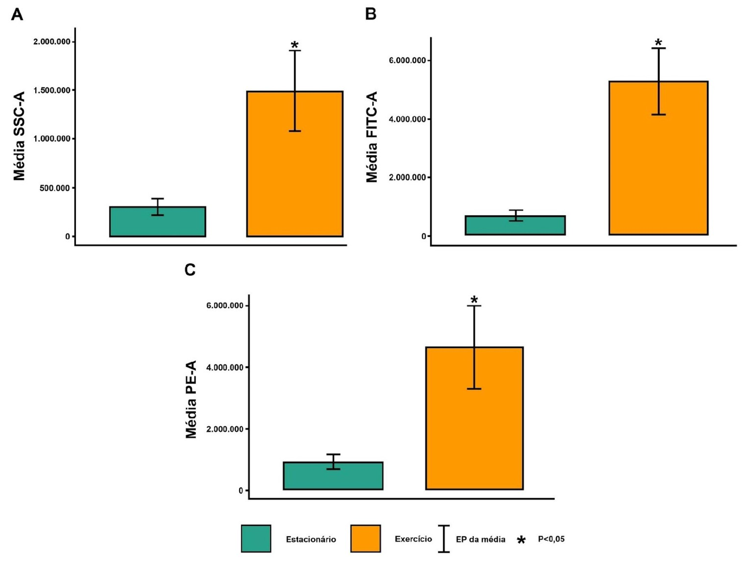



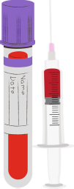





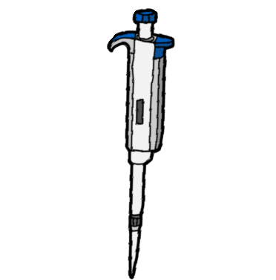


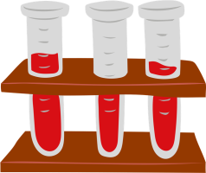
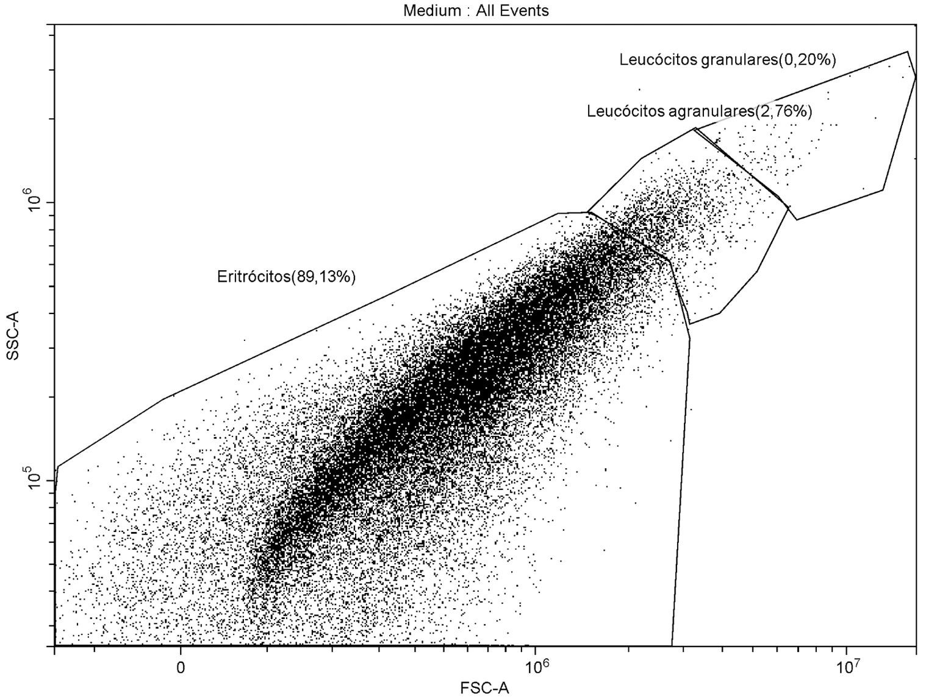
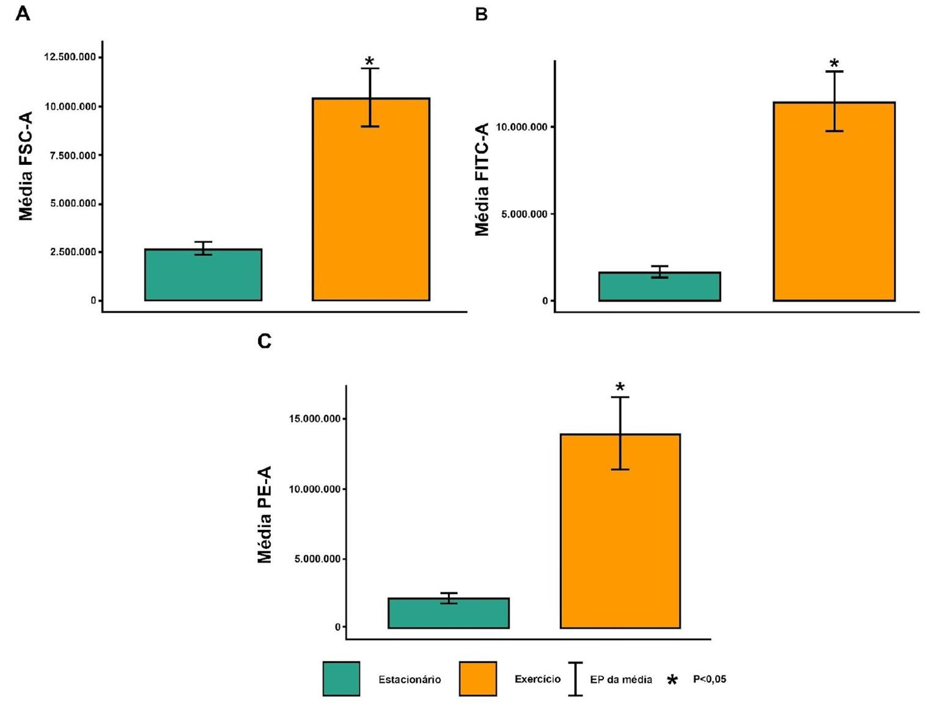

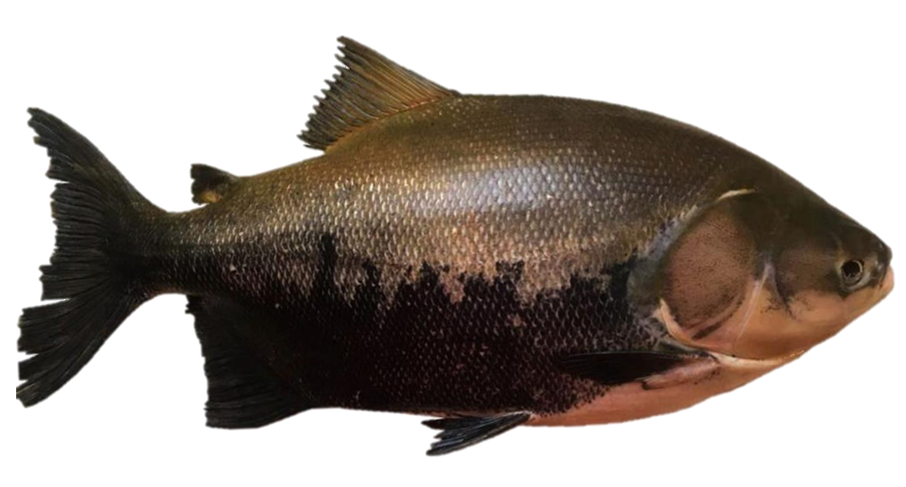
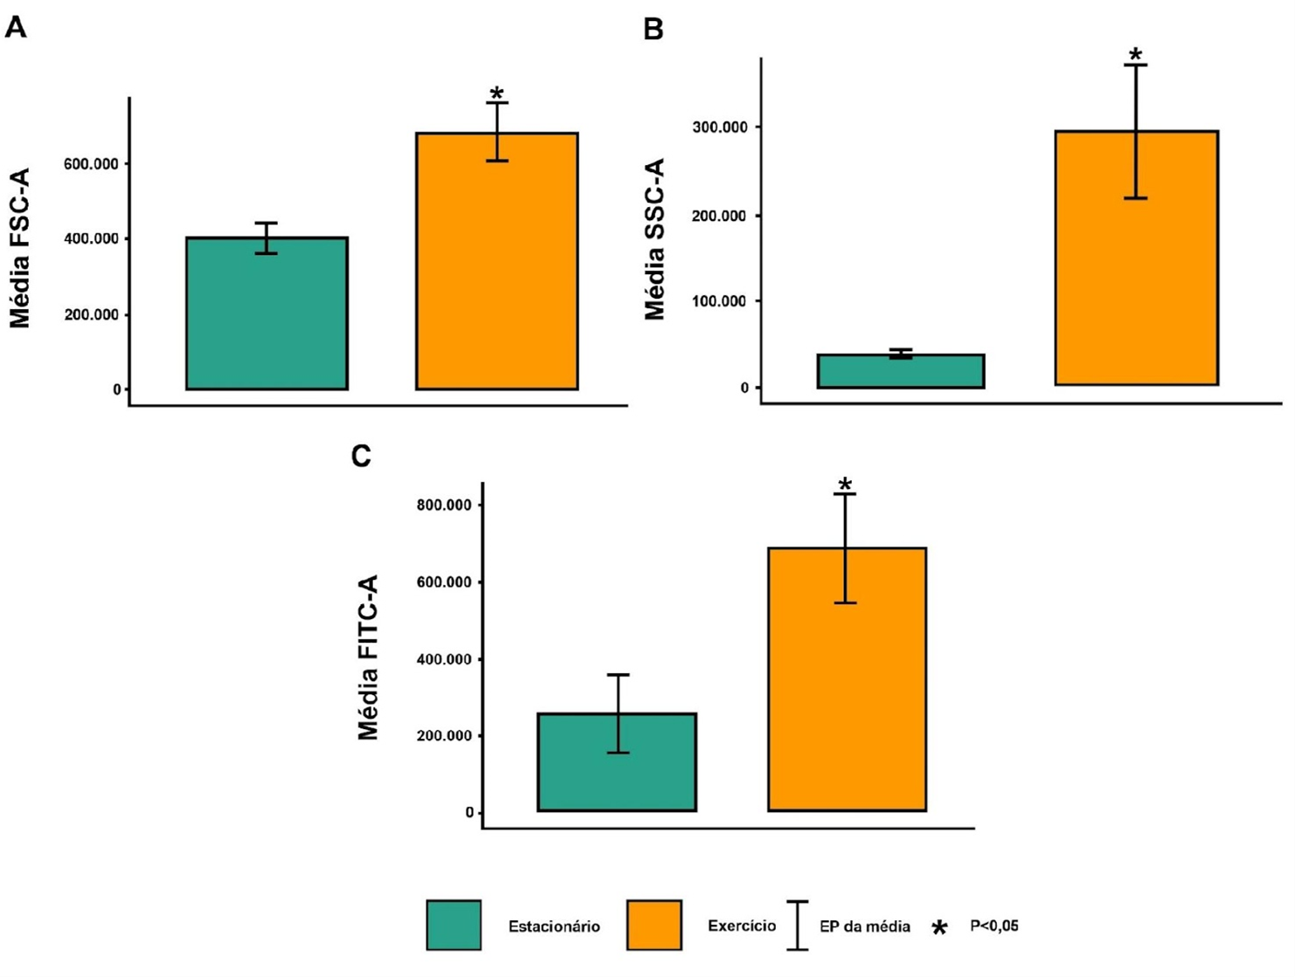



EFFECTS OF PHYSICAL EXERCISE ON THE HEMATOLOGY OF TAMBAQUI
Colossoma macropomum.
Flávia Ribeiro dos Santos (IFPA), Andressa Nayha do Carmo Reis (IFPA); Patrick Douglas Corrêa Pereira (McGill); Mauro André Damasceno de Melo (IFPA), Nara Gyzely Morais Magalhães (SEDUC); Cristovam Guerreiro Diniz (IFPA)
Author: santosflavia814@gmail.com
THEMATIC AREA AND ODS
2.1 Blood collection and sample preparation.
Field of Knowledge/Subfield: 02 Biological Sciences / Physiology and Immunology
Related ODS: ODS14: Life Below Water - Conservation and sustainable use of the oceans, seas, and marine
resources for sustainable development.
Anesthesia with Eugenol 0.40 mL/L and intracardiac puncture.
1. INTRODUCTION
10 mg of DiOC6(3) in 1.747 mL of dimethyl sulfoxide.
Hematology is fundamental for understanding health,
400 µg of Acridine Orange in 1 mL of the DiOC6 solution.
immune response, and adaptation to stimuli, providing essential information about blood cells (De Paiva et al.,
Graph 2 – Estimation of cellular complexity (A), relative green fluorescence intensity (B), and relative fluorescence intensity emitted by RNA (C) of agranular leukocytes from the experimental groups of Colossoma macropomum.
2013). Physical exercise, although it may initially
destabilize homeostasis, promotes adaptations that benefit
10 µL of blood + 1.950 mL of DPBS + 40 µL of dye cocktail.
health and physical performance, highlighting the
importance of combining hematological knowledge with the effects of exercise to optimize the development of organisms (Araujo, 2013; Kyu et al., 2016; Lavie et al., 2021).
For tambaqui (Colossoma macropomum), a significant fish in aquaculture due to its rapid growth rate and adaptability, understanding the effects of exercise on its hematology is crucial, especially given the scarcity of studies in this area. The tambaqui is economically valuable and offers insights into survival strategies and adaptation to environmental challenges (De Paiva et al., 2013; Val; De Oliveira, 2021). Thus, this study aims to evaluate the effects of physical exercise on the hematology of tambaqui.
Figure 2 – Analysis by flow cytometry using CytExpert
2.4 software (Beckman Coulter, Inc.), displaying the distribution of different cell populations in a blood sample from *Colossoma macropomum*. SSC (Side Scatter) on the Y-axis and FSC (Forward Scatter) on the X-axis, corresponding to cellular complexity and size, respectively.
Graph 3 – Estimation of cellular size (A), relative green fluorescence intensity (B), and relative fluorescence intensity emitted by RNA (C) of granular leukocytes from the experimental groups of Colossoma macropomum.
2.2 Statistical analysis
Shapiro-Wilk test: Used to assess the normality of the data. Student's T-test: Employed to compare two groups with normal distribution. Mann-Whitney U test: Used to compare two groups with non-normal distribution. The significance level set was p < 0.05.
4. CONCLUSION
Figure 1 – Tambaqui (Colossoma macropomum)
In summary, our results suggest that physical exercise
stimulation can induce morphological changes in
2. MATERIALS AND METHODS
3. RESULTS AND DISCUSSION
erythrocytes and leukocytes, increase DNA and RNA content, and promote hyperpolarization of membranes. These changes may reflect an improvement in oxygen transport and a strengthening of the immune response in Colossoma macropomum.
In this study, adult tambaqui were used from two captive
environments. The first environment, with physical
exercise stimulation, featured a centralized island and measured 8.0 meters in diameter and 1.60 meters in depth. The second environment, without exercise stimulation, was slightly larger, measuring 8.58 meters in diameter and 1.70 meters in depth, and did not have a central island.
5. REFERENCES
Both tanks were equipped with biological filters composed of crushed stone beds, which supported aerobic microorganisms to convert and oxidize organic matter. These filters, operated in series, were configured to maximize nitrification and ensure water quality.
Graph 1 – Estimation of cell size (FSC) (A), complexity (SSC) (B), and green fluorescence intensity (FITC) (C) of erythrocytes from the experimental groups of Colossoma macropomum.

