Slide 1




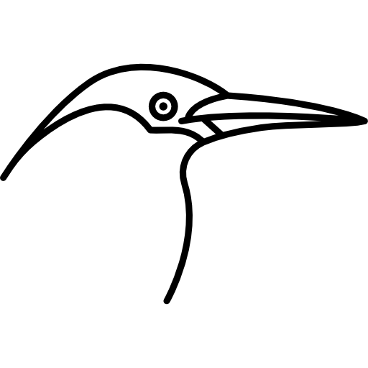





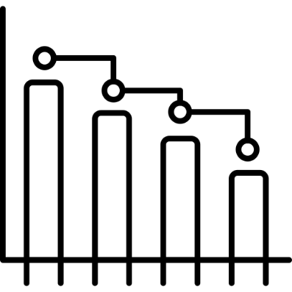
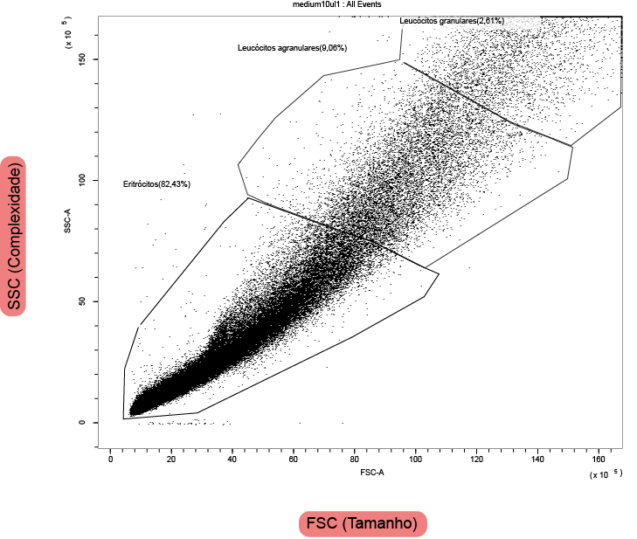
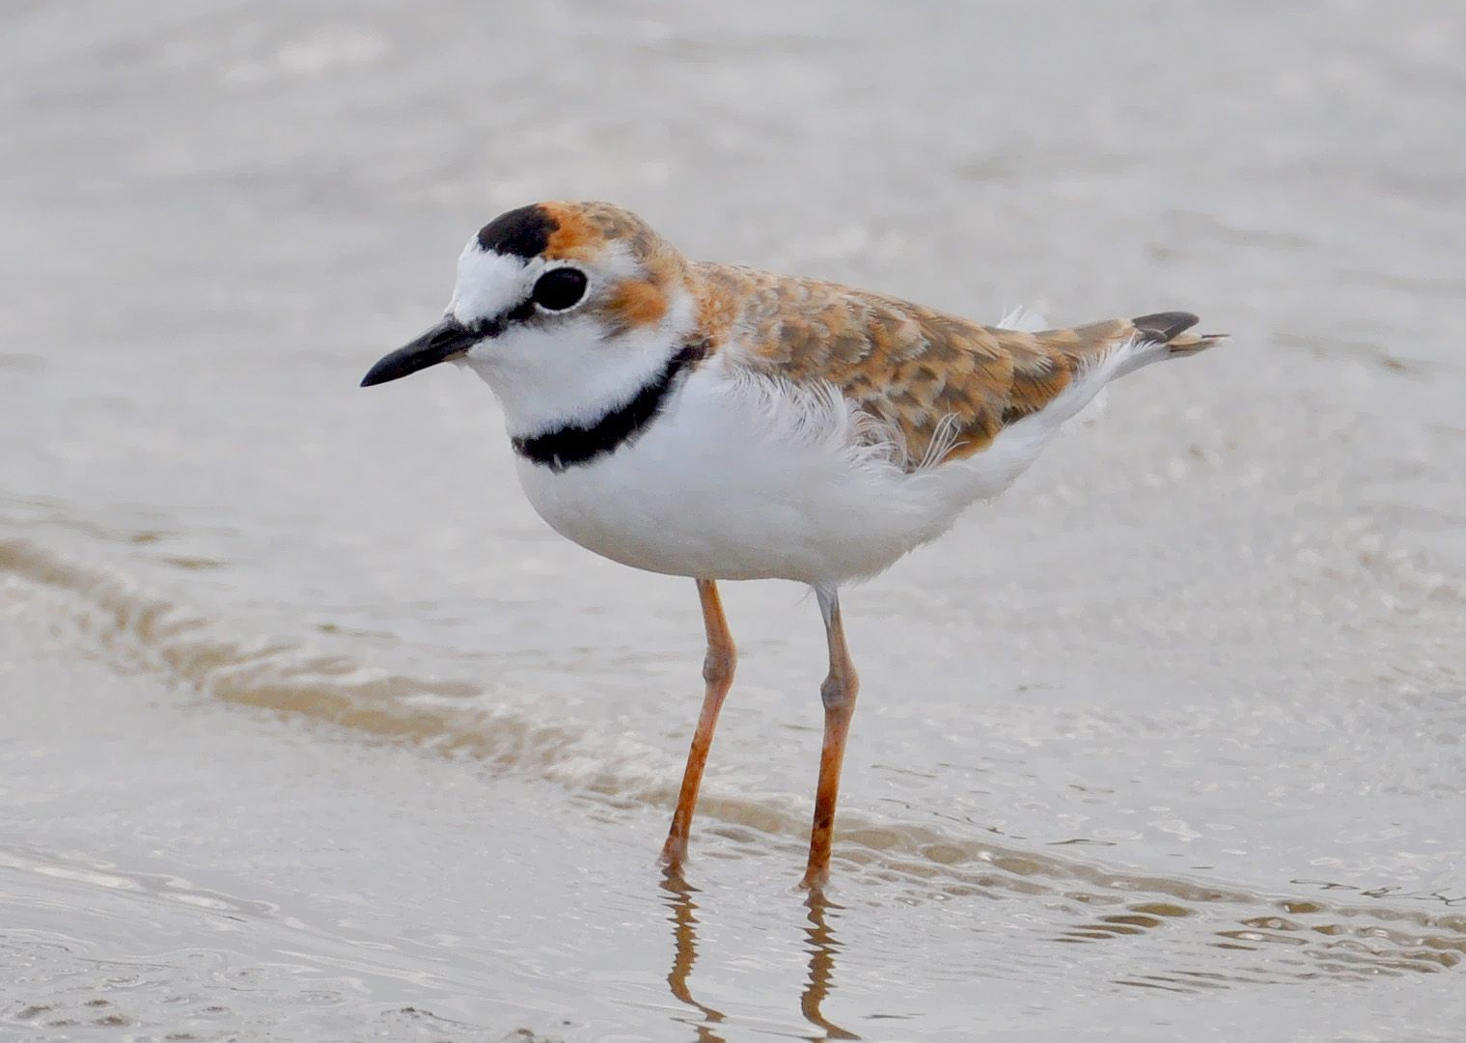


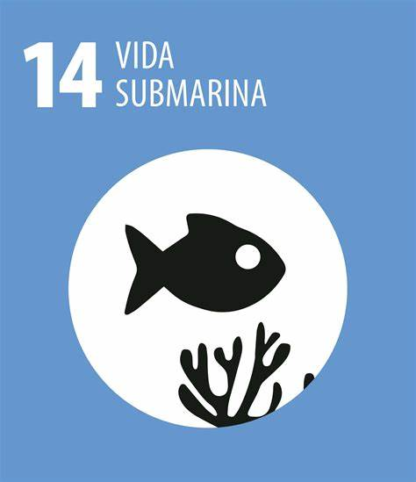
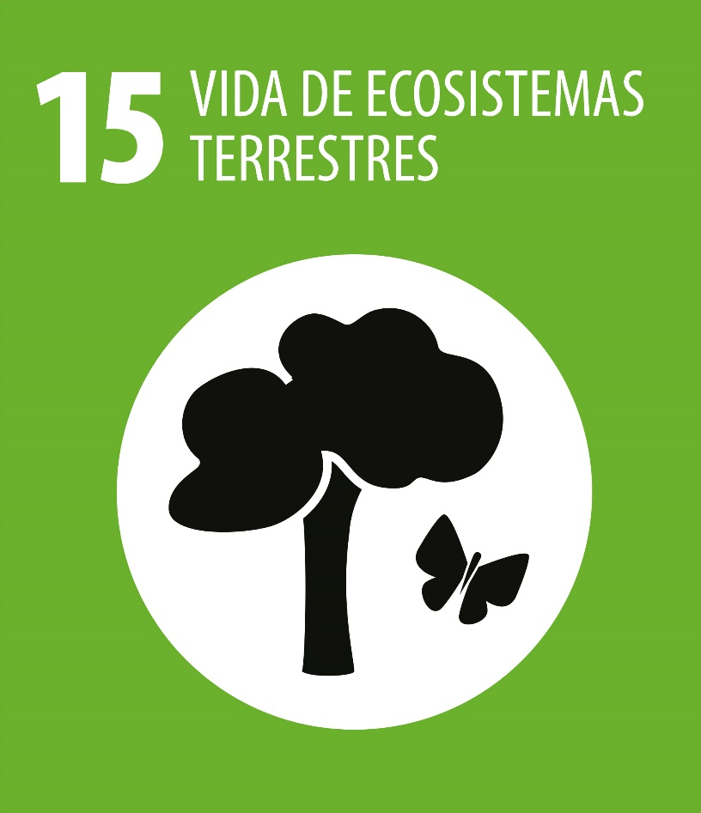
HEMATOLOGICAL CHARACTERIZATION OF Charadrius collaris ON THE BRAGANTINA COAST: IMPLICATIONS FOR THE SPECIES’ HEALTH AND ECOLOGY
Julia Gabriella Lopes da Silva (IFPA), Jhon Carlos do Nascimento Costa (PPBCM/IFPA); Flávia Ribeiro dos Santos (PPBCM/IFPA); Nara Gyzely de Morais Magalhães (PPBCM/IFPA), Cristovam Guerreiro Diniz (PPBCM/IFPA)
Corresponding Author: lopesjgs.julia@gmail.com
THEMATIC AREA AND ODS
MATERIALS AND METHODS
RESULTS AND DISCUSSION
Field of Knowledge/Subfield: Area 02 - Biological Sciences | Subfields: Oceanography, General Biology, Genetics, Botany, Zoology, Morphology, Physiology, Biochemistry, Biophysics, Pharmacology, Immunology, Microbiology, Parasitology, Ecology.
Related ODS: ODS14, ODS15.
Parameters | A1 | A2 | A3 | A4 | A5 | Mean ± Standard Deviation
Weight (g) | 28 | 27 | 26 | 26 | 28 | 27.4 ± 1.14
Beak (cm) | 1.42 | 1.44 | 1.48 | 1.45 | 1.45 | 1.45 ± 0.04
Tarsus (cm) | 2.92 | 2.90 | 2.95 | 2.88 | 2.85 | 2.90 ± 0.35
Right wing (cm) | 13.5 | 13.4 | 13.0 | 13.1 | 13.3 | 13.21 ± 0.34
8th Primary (cm) | 7.5 | 7.3 | 7.2 | 7.4 | 7.3 | 7.31 ± 0.14
Active molting | No | No | Yes | No | No | -
Reproductive plumage | No | No | No | No | No | -
Collection of five individuals of Charadrius collaris
INTRODUCTION
Blood collection and preparation of the obtained samples.
Table 1 – Morphometric data and information on molting and plumage.
Plovers of the Charadriidae family, such as the Collared Plover (Charadrius collaris), are shorebirds found along the northern coast of Brazil, with coastal areas, including the Bragantina coast and parts of the Amazon, being essential for the conservation of these populations (Morrison & Ross, 1989; Rodrigues, 2000; Mma, 2002; Rodrigues, 2007).
Hematology provides tools for the monitoring and reintroduction of wild birds, aiding in the detection of diseases and assessing the health status of populations (Vila, 2013). This study aims to perform hematological profiling of these birds using flow cytometry techniques, integrating morphological and hematological information to contribute to conservation strategies and species management.
Parameters | Mean ± Standard Deviation | Variation Range
Erythrocytes | 94.405 ± 27.453 cells/0.05µL | 61.923
Agranular leukocytes | 9.613 ± 5.753 cells/0.05µL | 15.426
Granular leukocytes | 2.263 ± 734 cells/0.05µL | 1.920
Total cells | 104.685 ± 35.214 cells/0.05µL
Samples processed using the CytoFlex flow cytometer (Beckman Coulter, Inc.).
Table 2 – Summary of blood cell counts.
Total cells
The individuals showed an average weight of 27.4 ± 1.14 g, an average beak length of 1.45 ± 0.04 cm, a tarsus length of 2.90 ± 0.35 cm, a right wing length of 13.21 ± 0.34 cm, and an 8th primary length of 7.31 ± 0.14 cm. None of the birds displayed reproductive plumage, and only one bird showed active molting (Table 1).
Additionally, the average erythrocyte count was 94.405 ± 27.453 cells/0.05µL. The average agranular leukocyte count was 9.613 ± 5.753 cells/0.05µL, and the granular leukocyte count was 2.263 ± 734 cells/0.05µL. The total number of blood cells (erythrocytes and leukocytes) was 104.685 ± 35.214 cells/0.05µL (Table 2).
CONCLUSIONS
Figure 2 – Analysis by flow cytometry using CytExpert software version 2.4 (Beckman Coulter, Inc.), showing the distribution of different cell populations in a blood sample of Charadrius collaris. FSC (Forward Scatter Area) on the X-axis and SSC (Side Scatter Area) on the Y-axis, corresponding to size and complexity, respectively.
.
The absence of extreme values or values outside the expected ranges suggests hematological stability, potentially reflecting a healthy and stable environment for the studied birds. Although the results indicated a favorable hematological condition, longitudinal studies and a more comprehensive analysis are necessary for a complete evaluation of the health and adaptation of these birds to the environment.
Figure 1 – Collared Plover (Charadrius collaris).
REFERENCES

