Slide 1



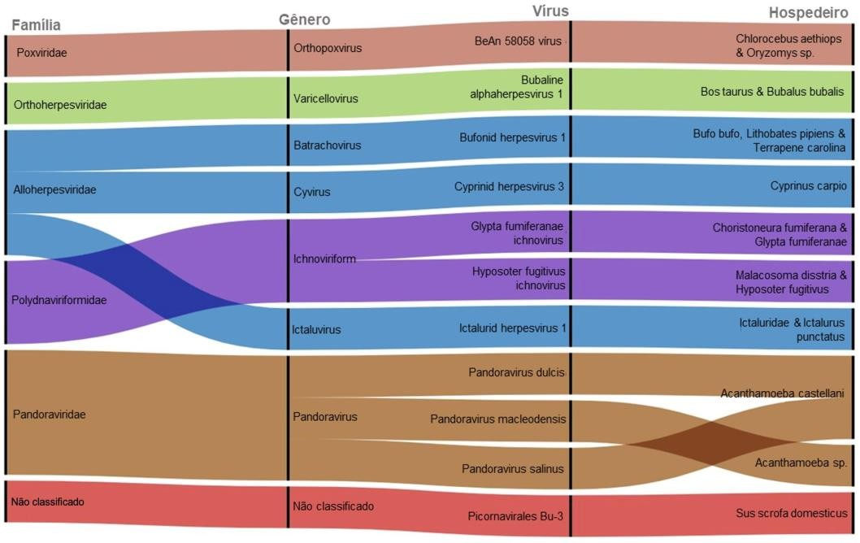









CHARACTERIZATION OF THE METAVIROME OBTAINED FROM THE NEUROTRANSCRIPTOME OF THE FISH
SPECIES Colossoma macropomum
Yarlei da Gama Furtado (IFPA), Patrick Douglas Corrêa Pereira (McGill); Mauro André Damasceno de Melo (IFPA); Nara Gyzely de Morais Magalhães (IFPA), Cristovam Guerreiro Diniz (IFPA)
Author: yaleigama@gmail.com
Thematic Area and ODS MATERIALS AND METHODS
FIELD OF KNOWLEDGE: Area 02 BIOLOGICAL SCIENCE/GENETICS RELATED ODS: ODS03
Collection of
animals
Standard environment aquarium;
Evaluation of parameters;
Eugenol, 90s.
...
.....
INTRODUCTION
A large portion of our current knowledge about viruses that infect fish is based on the study of pathogenic viruses in symptomatic hosts. However, the recent rise of next-generation metagenomic sequencing (mNGS) has led to the discovery that fish harbor a greater number of viruses than any other class of vertebrates (Geoghegan et al., 2018; Silva et al., 2020; Perry et al., 2022). Most RNA virus families previously thought to infect only mammals have now been described in bony fish (Geoghegan et al., 2018). For instance, research on dead or moribund Chinook salmon (Oncorhynchus
Perfusion and craniotomy
...
.....
RNA later®;
Separation of the telencephalon;
15 to 20 minutes;
12 hours at -20°C before sequencing.
Extracion
...
.....
Standard TRIzol® protocol;
Purification of mRNA;
Conversion to cDNA.
Figure 1 – RAWGraphs 2.0: Alluvial Diagram. Correlation and proportion.
tshawytscha) revealed the first coronavirus
Ion Chef (Thermo Fisher)
Ion540
Ion S5 GeneStudio System
Six families were detected, among which is Poxviridae, a well-known family of viruses that can cause severe diseases in both vertebrates and invertebrates. This family includes hosts that are part of human consumption, such as cattle. Viruses of the genus Orthopoxvirus are responsible for transmitting bovinepox, which can infect humans (Silva et al., 2008), while viruses from the genus Parapoxvirus infect agricultural and wild animals across various regions of the world, potentially causing mild zoonotic infections in humans (Delhon, 2022; Espinoza, 2022).
(Coronaviridae) associated with fish, the Pacific
NGS
...
....
Chip
salmon nidovirus (Mordecai et al., 2019). Although these viruses retain several key characteristics of other
filoviruses, they are genetically distinct from
ebolaviruses and marburgviruses (which are known to cause lethal diseases in humans) (Hume et al., 2019). Similarly, hepadnaviruses, previously known only in mammals and birds, infect amphibians and fish (Dill et al., 2016). The viromes found in wild freshwater fish are comparatively less studied than those of their marine counterparts. In most cases, these studies have been conducted in response to mortality events (Sibley et al., 2016) or in aquaculture environments (Hierweger et al., 2021). The lack of data on the viromes of wild freshwater fish represents a potentially significant gap in knowledge. Lundberg et al. (2000) estimated that 10,000 species of fish reside in freshwater bodies, constituting 40% of all fish species (Lundberg et al., 2000). Based on this information, it will be possible to direct resources and implement appropriate preventive measures in cases of zoonotic or interspecific spillover, aiming to minimize the impact of potential epidemics and protect public health. In this context, the objective was to construct a database containing the molecular information of the different viruses found in the
Identification of viral products
...
.....
VIRTUS 2
VIRTUS 1
Heatmapper
Adobe Illustrator
CONCLUSION
This research has highlighted that delving into the characteristics and focused studies of each virus is of utmost importance for understanding their nature. In addition to having effective knowledge regarding viruses of interest, learning about the species belonging to the same family and genus, as well as those that should be of concern regarding infection in humans or even domestic animals, is crucial. The study of hosts also helps us understand how viruses may have infected other animals. Therefore, new investigations into the viruses considered significant could provide strategies and approaches for better comprehension and prevention of potential epidemics.
RESULTS AND DISCUSSION
A total of 303 viruses were found in the metavirome of the
species *C. macropomum*, including bacteriophages.
Eleven viruses of interest were detected, distributed across
six families, namely: Poxviridae, Orthoherpesviridae,
Alloherpesviridae, Polydnaviriformidae,Pandoraviridae, and Picornaviridae.
neurotranscriptome of Colossoma macropomum,
identifying and characterizing the main families present in the metavirome.
REFERENCES

