Slide 1

Orbital data centers.
For truck stops.
Y
SUMMER ’26 / DECK 1
01
Notes:
**PARKER:** STOPLINK builds orbital data centers for truck stops. We host the essential infrastructure of the American interstate.
*[Dead straight.]*

Slide 2
WHAT WE DO
We sell airline miles
to truck stops.
Truck stops buy miles to reward diesel purchases.
Drivers redeem them for flights on existing airlines.
The loyalty app lives in an orbital data center.
02
Notes:
**PARKER:** Specifically, a rewards app. Truck stops buy airline miles from us to reward diesel purchases and keep drivers coming back. Drivers redeem those miles for flights on existing airlines. The app lives in our orbital data center.

Slide 3
THE ORBITAL LAYER
The data center
hosts the app.
01
02
03
Fuel purchase
Orbital server
Airline miles
Driver buys diesel
App + rewards database
Balance + flight booking
03
Notes:
**NADAV:** A driver buys diesel. The purchase reaches our app in orbit. The app updates their miles balance and lets them book a flight. That is it.
**PATRICK:** It is literally just hosting the fucking app. We have made a gas-station rewards database launch-critical.

Slide 4
REVENUE MODEL
We sell
miles.
Hosting revenue: $0. Miles revenue: all of it.
04
Notes:
**PARKER:** We sell miles. One hundred percent of our planned revenue. We are not selling compute, and we are not an airline.
**PATRICK:** People who drive for a living earn enough points to finally stop fucking driving.

Slide 5
A REAL BUSINESS UNDER THE COSTUME
Fuel in. Flights out.
01
Truck stops buy miles
to bring drivers back to their locations.
02
Customers earn miles
when they buy fuel and food.
03
We pay for real flights
on existing airlines when miles are redeemed.
04
We keep the difference
after reward and operating costs.
05
Notes:
**PARKER:** Truck stops pay us for miles. Drivers earn them on fuel and food. When drivers redeem, we buy an actual airline ticket. We keep the difference after rewards and operating costs.
**PATRICK:** The first airline with no airplanes. Our fleet has never been late. Our fleet is a font.

Slide 6

OUR RESPONSE TO AWS + REGULATORY RISK
$600M
hosting bill.
AWS asked us to pick a region. We picked orbit.
06
Notes:
**NADAV:** We were worried about AWS, control of our data, and regulators. So we spent six hundred million dollars moving the app to space.
**PATRICK:** AWS asked us to pick a region. Nadav selected “away.”
**PARKER:** Our lawyer said orbit does not fix the regulatory problem.
**PATRICK:** We asked Will how much higher the rocket goes.

Slide 7

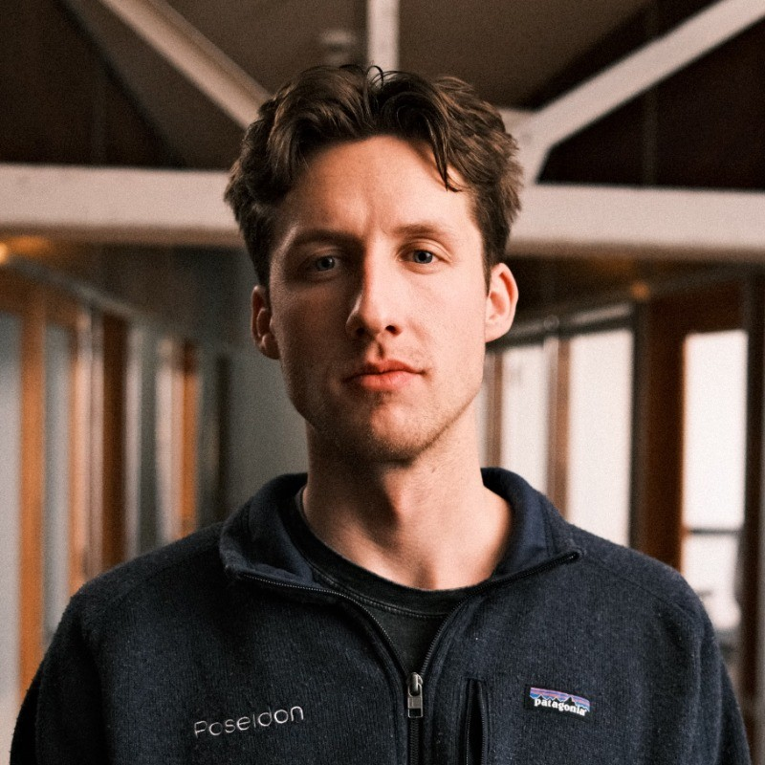
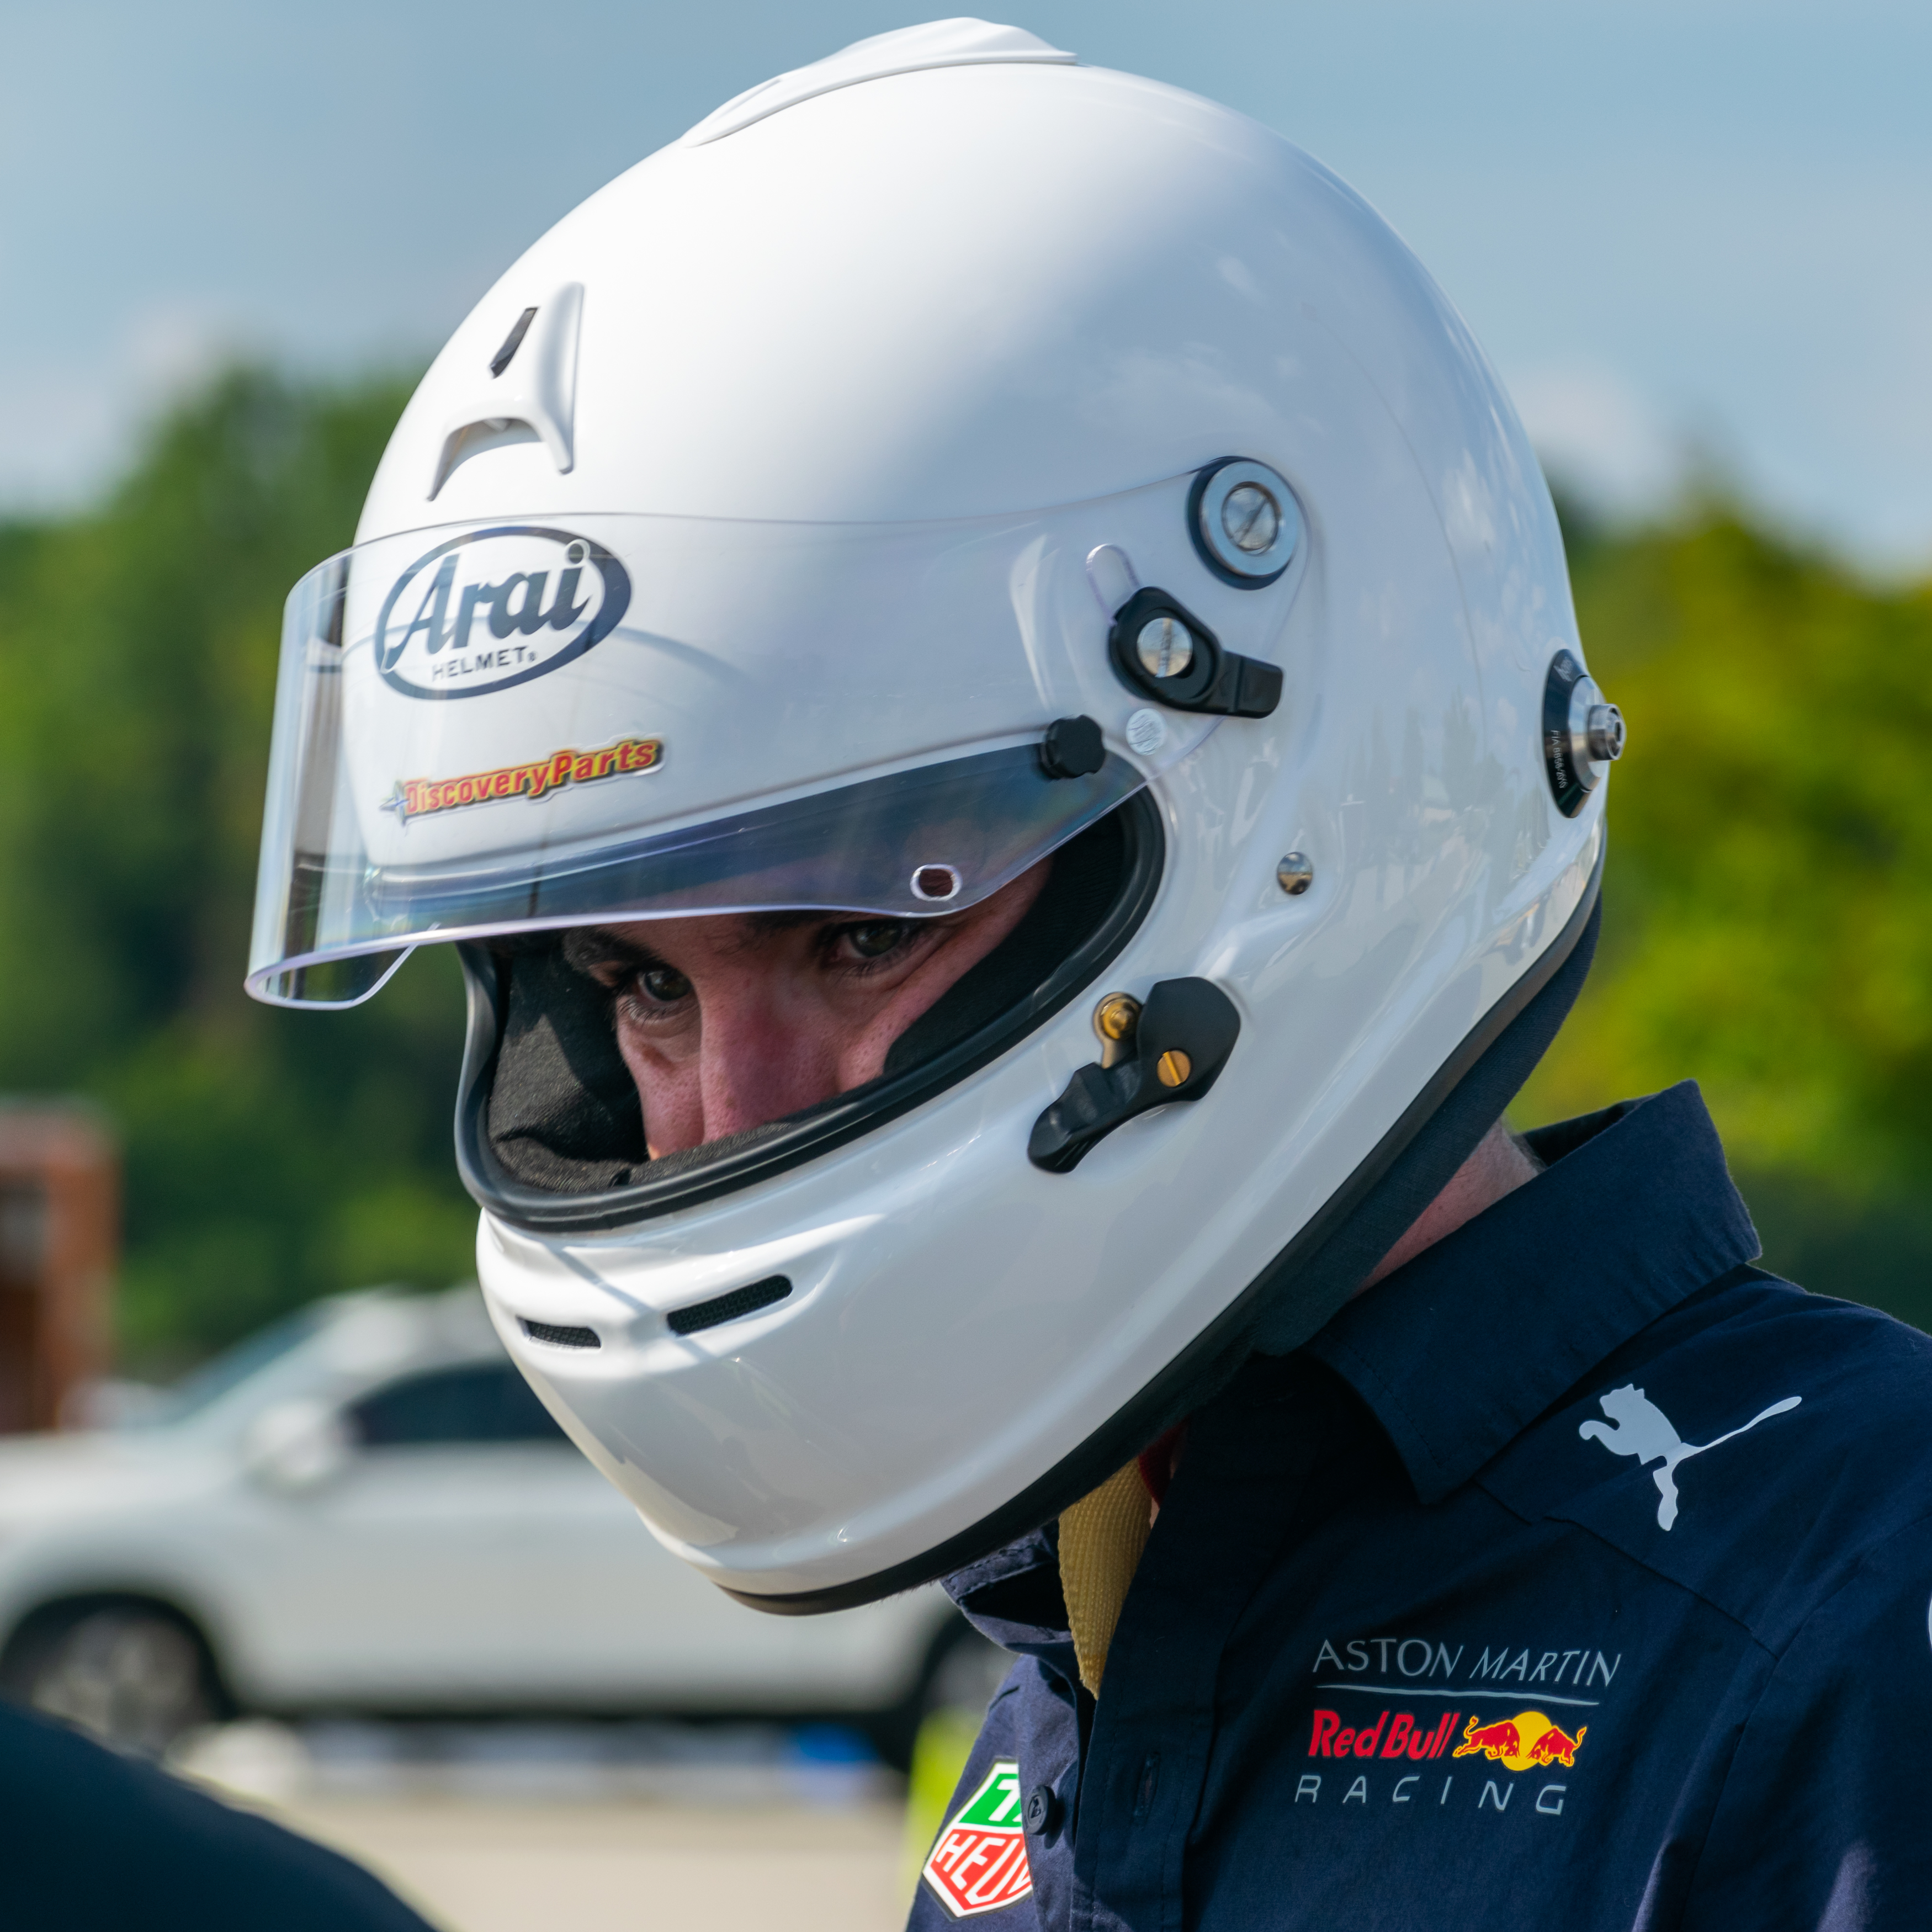
FORBES 30 UNDER 30. FEDERAL 30 TO LIFE.
Two Forbes 30u30.
One emergency contact.
NADAV SHOVAL
PARKER TENNEY
PATRICK FINLEY
he/him
he/him
he/him
Forbes 30 Under 30
Forbes 30 Under 30
Beat Starship at racing
Head of miles
Head of valuation
Emergency contact
07
Notes:
**PATRICK:** Nadav and Parker are both Forbes 30 Under 30. Our next milestone is federal 30 to life. I am Patrick, the emergency contact. They each get one phone call.
*[Pause. Optional tag: I am also the guy in the documentary saying, “Looking back, there were signs.”]*
**PATRICK:** I beat the Starship guys at racing. So I’ve already delivered a loss to Starship. This time I’m asking them to invest in it.

Slide 8

TECHNICAL DILIGENCE
We have Will.
He spent 12 years at SpaceX.
We spent 12 minutes with his headshot.
WILL HELTSLEY
Due diligence complete.
08
Notes:
**NADAV:** Will spent twelve years at SpaceX.
**PATRICK:** We spent twelve minutes with his headshot. Due diligence complete.
*[Pause.]*

Slide 9
STOPLINK
Invest in dollars.
Get returns
in miles.
Subject to availability.
09
Notes:
**PARKER:** Truck stops are the customers. Miles are the product. The orbital data center hosts the app.
**NADAV:** Invest in dollars.
**PATRICK:** Get returns in miles. Subject to availability.
*[Stop.]*

