Slide 1
CSE10101 aka CAPP30391
The big honking slide deck of

Slide 2
1/13: Feast day of St. Hilary, Doctor of the Church (and patron against snake bites)

Slide 3
1/13
Welcome back!
Syllabus!
Laptops!
Screencasty gadget!
Python Notebooks!
And… PollEverywhere!

Slide 4
Topic
A smallish demo of
IPython notebook features and annoyances
Renaming notebooks and naming directories
Python features and exploratory use for a data-presentation task.
Q&A

Slide 5
Next Time
Another short demo
Data types and variables

Slide 6
1/15: St. Paul the Hermit

Slide 7
Recap 1/13
Class orientation
Bring laptops!
Some elements of Python (plotting)

Slide 8
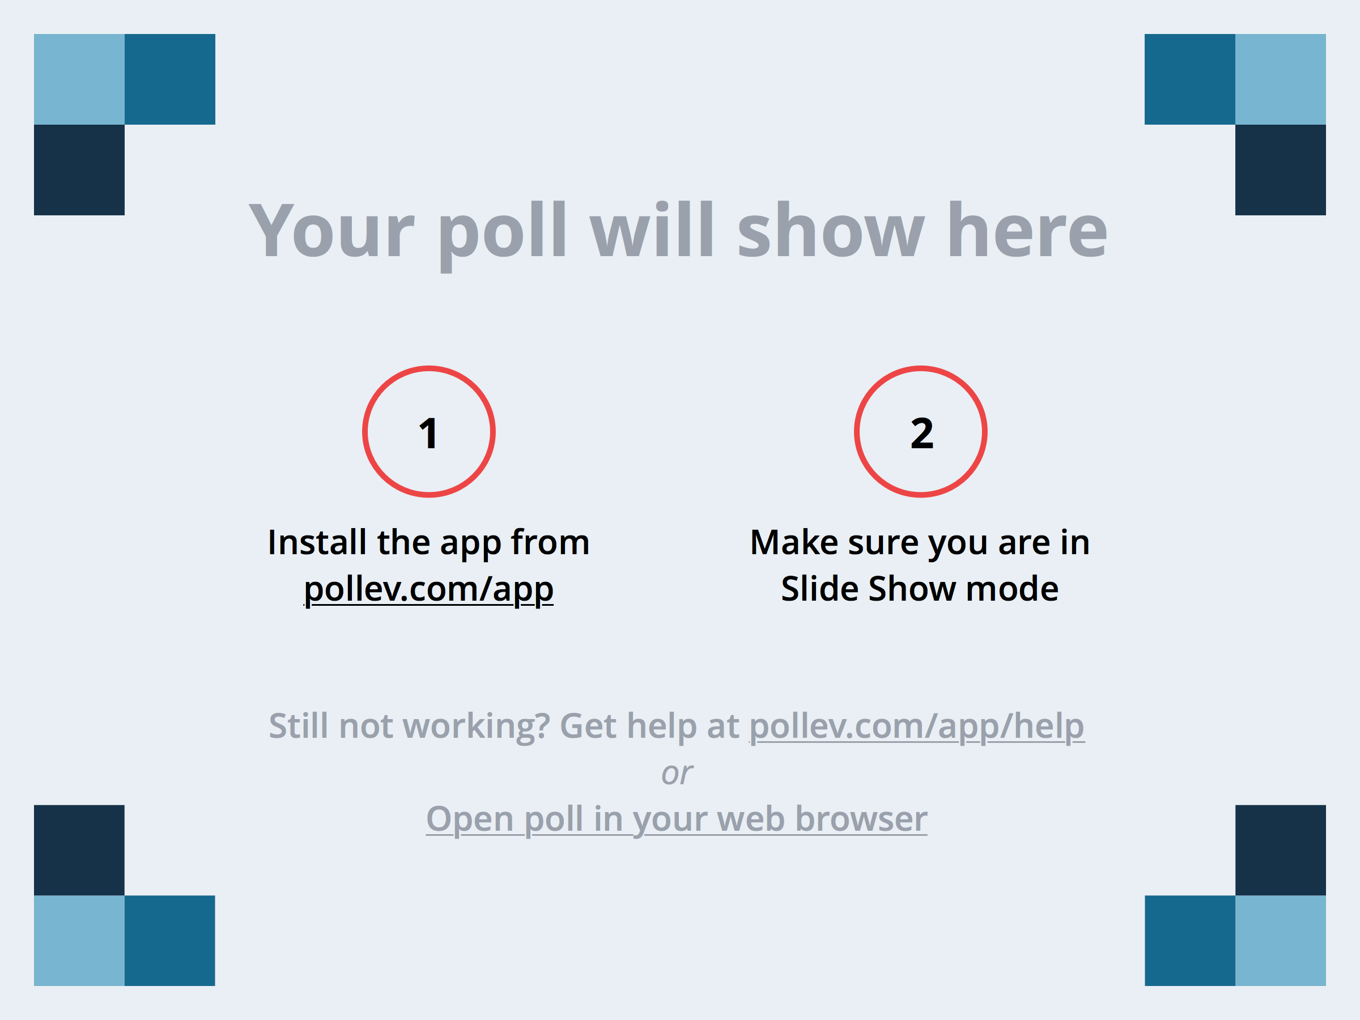
Notes:
Choose the most correct answer
https://www.polleverywhere.com/multiple_choice_polls/PofBeJJBRESzNHM

Slide 9
Today’s topics
Python-as-calculator
In-class activity with a live demo from a class participant
More on the plotting demo
Word-count demo
Setting the stage for next week

Slide 10
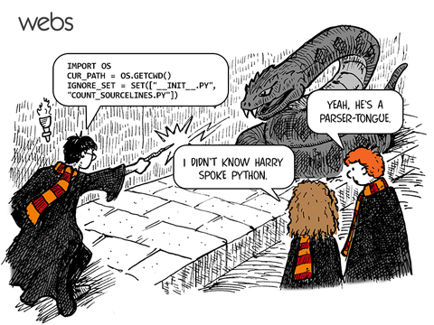

Slide 11
1/20: Feast of St. Fabian, Pope and martyr

Slide 12
Notes:
How was that first homework assignment?
https://www.polleverywhere.com/multiple_choice_polls/IfiJi4jTlZZPufP

Slide 13
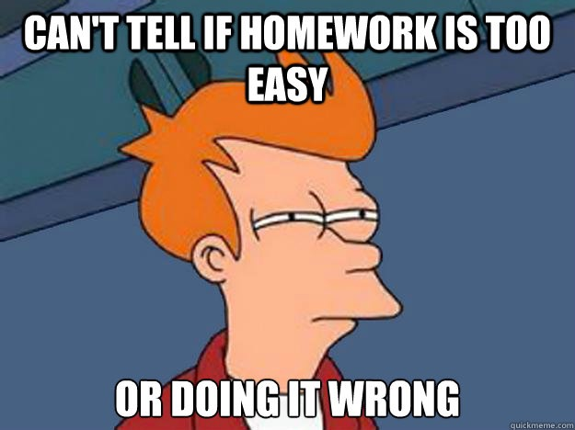

Slide 14
We’re here to help!
TA Office Hours
Nicole: Mondays 10am-12pm & Wednesdays 12pm-2pm in 212 Cushing, and feel free to email me for help or to setup an appointment—Fridays are very open!
Shuyang: Wednesdays 6pm-9pm in the Engineering Library (1st Floor of Fitzpatrick Hall)

Slide 15
Python Documentation
https://www.python.org/ (easy to remember)
https://docs.python.org/2/ (direct link)

Slide 16
Today’s Agenda
Chapter 2: Variables, expressions and statements (oh my!)
Type check
Keywords and illegal variable names
Remembering PEMDAS
Modulus operator
Asking the user for input
Comments (!!!)
Mnemonic variable names
Debugging (!!!)
Hamlet Analytics

Slide 17
Notes:
Python reserves 31 keywords for its use—which one of the following words IS NOT a keyword in Python?
https://www.polleverywhere.com/multiple_choice_polls/Kxcru6q90ECMCid

Slide 18
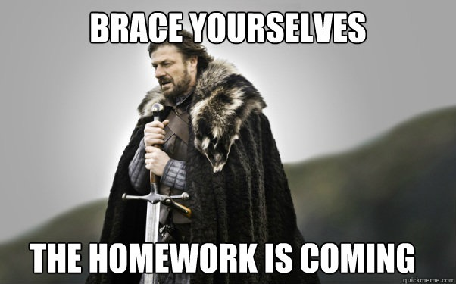

Slide 19
1/22: St. Vincent, martyr

Slide 20
1/27: St. Angela Merici, founder of Company of St. Ursula (first women’s teaching order)

Slide 21
1/29: (no feast) SG, Bro. Juniper

Slide 22
2/3: St. Blase, patrom saint of those with throat ailments

Slide 23
2/5: St. Agatha, patron saint of foundry workers and Alpine guides

Slide 24
2/10: St. Scholastica, patron saint of nuns, and twin sister of St. Benedict

Slide 25
2/12: (no feast) St. Apollonia, patron saint of dentists

Slide 26
2/17: Blessed Luke Belludi

Slide 27
2/19: St. Conrad of Piacenza, hermit

Slide 28
2/24: no feast

Slide 29
2/26: St. Porphyry of Gaza, ascetic

Slide 30
3/3: St. Catherine Drexel (founder of Xavier Univ. in New Orleans)

Slide 31
3/5: St. John Joseph of the Cross (noted ascetic)

Slide 32
3/17: DUH

Slide 33

http://shamrocktechnologies.net/

Slide 34
3/19: St. Joseph, husband of Mary and patron of Belgium, fathers, Happy Death, and Peru (among others)

Slide 35
3/24: St. Catherine of Genoa

Slide 36
3/26: (no feast) Blessed Didacus Joseph of Cadiz, preacher

Slide 37
3/31: St. Stephen of Mar Saba, hermit

Slide 38
4/2: St. Francis of Paola, patron of sailors and founder of Hermits of St. Francis of Assisi

Slide 39
4/7: St. John Baptist de la Salle, patron saint of teachers, founder of Christian Brothers

Slide 40
4/9: St. Casilda, convert

Slide 41
4/14: Blessed Peter Gonzalez (another patron of sailors)

Slide 42
4/16: St. Bernadette Soubiros

Slide 43
4/21: St. Anselm, father of Scholasticism

Slide 44
2/23: St. George, martyr and patron of England, etc.)

Slide 45
4/28: St. Peter Chanel, martyr and patron of Oceania

