Slide 1
CSE10101 aka CAPP30391
The big honking slide deck of

Slide 2
1/13: Feast day of St. Hilary, Doctor of the Church (and patron against snake bites)

Slide 3
1/13
Welcome back!
Syllabus!
Laptops!
Screencasty gadget!
Python Notebooks!
And… PollEverywhere!

Slide 4
Topic
A smallish demo of
IPython notebook features and annoyances
Renaming notebooks and naming directories
Python features and exploratory use for a data-presentation task.
Q&A

Slide 5
Next Time
Another short demo
Data types and variables

Slide 6
1/15: St. Paul the Hermit

Slide 7
Recap 1/13
Class orientation
Bring laptops!
Some elements of Python (plotting)

Slide 8
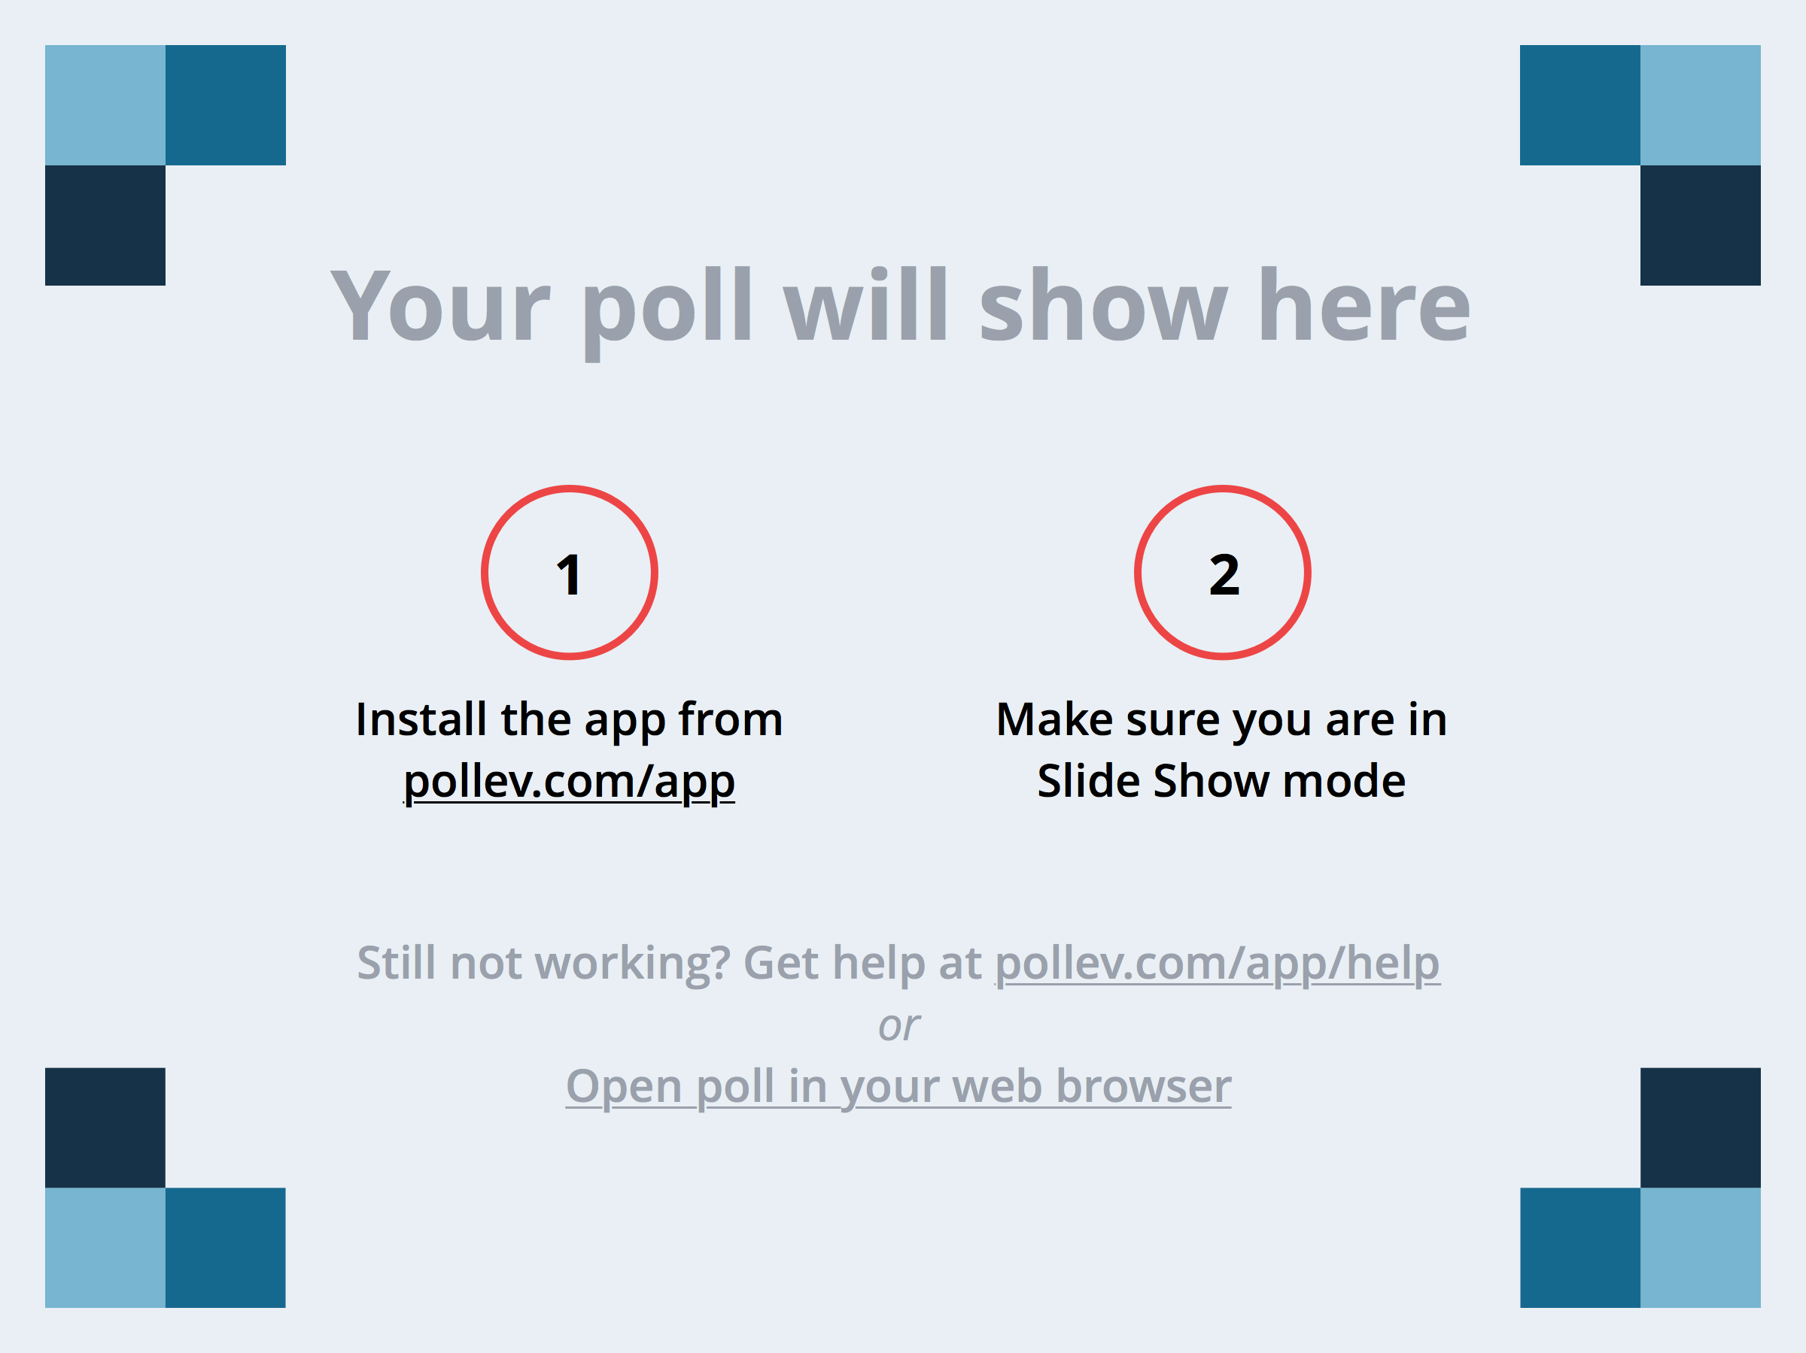
Notes:
Choose the most correct answer
https://www.polleverywhere.com/multiple_choice_polls/PofBeJJBRESzNHM

Slide 9
Today’s topics
Python-as-calculator
In-class activity with a live demo from a class participant
More on the plotting demo
Word-count demo
Setting the stage for next week

Slide 10
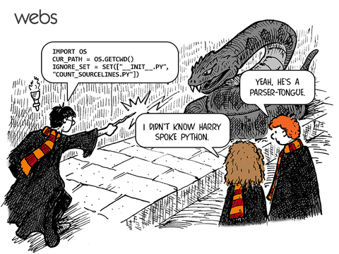

Slide 11
1/20: Feast of St. Fabian, Pope and martyr

Slide 12
Notes:
How was that first homework assignment?
https://www.polleverywhere.com/multiple_choice_polls/IfiJi4jTlZZPufP

Slide 13
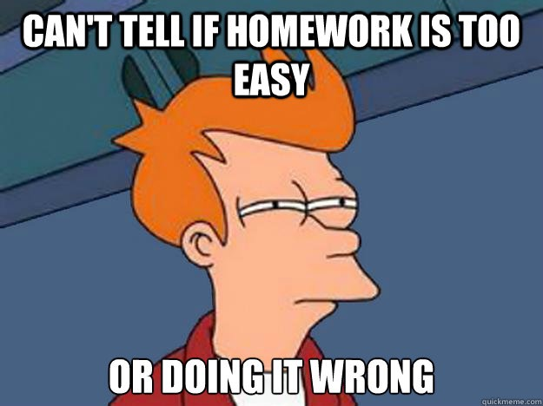

Slide 14
We’re here to help!
TA Office Hours
Nicole: Mondays 10am-12pm & Wednesdays 12pm-2pm in 212 Cushing, and feel free to email me for help or to setup an appointment—Fridays are very open!
Shuyang: Wednesdays 6pm-9pm in the Engineering Library (1st Floor of Fitzpatrick Hall)

Slide 15
Python Documentation
https://www.python.org/ (easy to remember)
https://docs.python.org/2/ (direct link)

Slide 16
Today’s Agenda
Chapter 2: Variables, expressions and statements (oh my!)
Type check
Keywords and illegal variable names
Remembering PEMDAS
Modulus operator
Asking the user for input
Comments (!!!)
Mnemonic variable names
Debugging (!!!)
Hamlet Analytics

Slide 17
Notes:
Python reserves 31 keywords for its use—which one of the following words IS NOT a keyword in Python?
https://www.polleverywhere.com/multiple_choice_polls/Kxcru6q90ECMCid

Slide 18
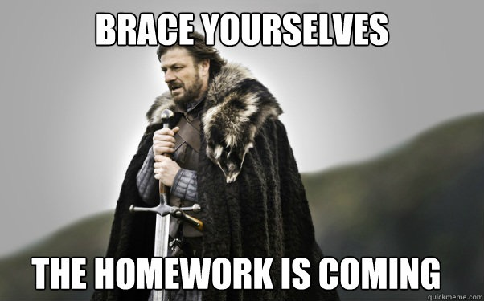

Slide 19
1/22: St. Vincent, martyr

Slide 20
Today’s Agenda
Resolve any remaining systems issues
Chapter 3: Conditional execution
More on iteration (loops)
Lots of interactive exercises!

Slide 21
1/27: St. Angela Merici, founder of Company of St. Ursula (first women’s teaching order)

Slide 22
1/29: (no feast) SG, Bro. Juniper

Slide 23
2/3: St. Blase, patrom saint of those with throat ailments

Slide 24
2/5: St. Agatha, patron saint of foundry workers and Alpine guides

Slide 25
2/10: St. Scholastica, patron saint of nuns, and twin sister of St. Benedict

Slide 26
2/12: (no feast) St. Apollonia, patron saint of dentists

Slide 27
2/17: Blessed Luke Belludi

Slide 28
2/19: St. Conrad of Piacenza, hermit

Slide 29
2/24: no feast

Slide 30
2/26: St. Porphyry of Gaza, ascetic

Slide 31
3/3: St. Catherine Drexel (founder of Xavier Univ. in New Orleans)

Slide 32
3/5: St. John Joseph of the Cross (noted ascetic)

Slide 33
3/17: DUH

Slide 34

http://shamrocktechnologies.net/

Slide 35
3/19: St. Joseph, husband of Mary and patron of Belgium, fathers, Happy Death, and Peru (among others)

Slide 36
3/24: St. Catherine of Genoa

Slide 37
3/26: (no feast) Blessed Didacus Joseph of Cadiz, preacher

Slide 38
3/31: St. Stephen of Mar Saba, hermit

Slide 39
4/2: St. Francis of Paola, patron of sailors and founder of Hermits of St. Francis of Assisi

Slide 40
4/7: St. John Baptist de la Salle, patron saint of teachers, founder of Christian Brothers

Slide 41
4/9: St. Casilda, convert

Slide 42
4/14: Blessed Peter Gonzalez (another patron of sailors)

Slide 43
4/16: St. Bernadette Soubiros

Slide 44
4/21: St. Anselm, father of Scholasticism

Slide 45
2/23: St. George, martyr and patron of England, etc.)

Slide 46
4/28: St. Peter Chanel, martyr and patron of Oceania

