Slide 1
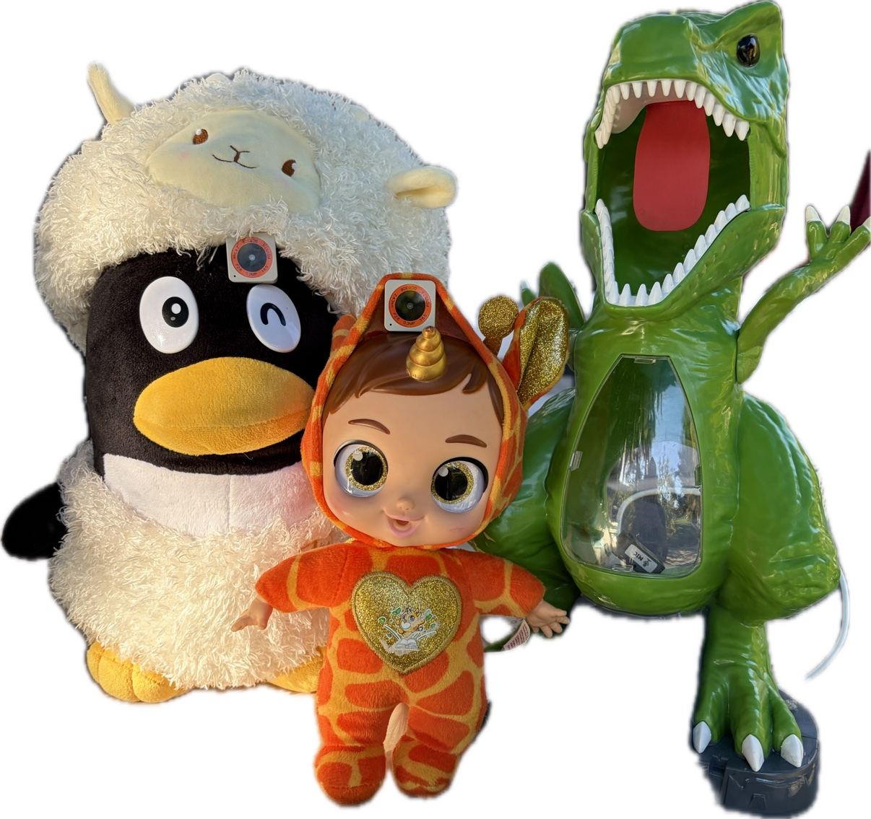



GEMMA HARDWARE HACKATHON · PHYSICAL AI, IoT & ROBOTICS
Dyno, Sage & Penny
Three plush friends who see you, listen, and learn with you. Powered by Gemma, entirely in the room.
Dyno
Sage
Penny
The real cast. Each forehead holds a camera, mic and speaker.
No cloud anywhere in the loop.
Notes:
Hi! Meet Dyno, Sage and Penny. They're three plush friends who can see who's in front of them, hear a child without anyone pressing a button, and talk back in their own voices. All of it runs on a computer at the table, with no cloud. Disney would start with the characters, not the chips, so that's what we'll do.

Slide 2





Once upon a time, homework was lonely
THE STORY · PIXAR'S STORY SPINE
Once upon a time… a third grader sat alone with a worksheet and a screen.
Every day… asking for help felt harder than guessing.
One day… three plush friends sat down at the table, and they could see and hear.
Because of that… the child got to ask questions, explain answers, and teach a curious dinosaur.
Until finally… homework felt like playing with friends, and the child became the teacher.
Notes:
Pixar plans every film with a story spine, so here's ours. Homework time is often a kid alone with a worksheet, and asking for help can feel harder than guessing. One day three plush friends sit down at the table with them. Because of that, the child gets to ask questions, explain answers, and teach a curious dinosaur. Until finally, the child is the one teaching. That last beat is the heart of the whole project.

Slide 3
Same hardware, three different hearts
MEET THE CAST
Dyno
Sage
Penny
a green dinosaur
a baby in a unicorn suit
a penguin in a woolly hat
The curious one
The careful one
The imaginative one
Asks the questions a shy kid might not.
Reads, explains, and gives hints, never just the answer.
Turns right answers into wordplay and make-believe.
“Rawr! What's that?”
“Let's figure it out together.”
“Imagine numbers in party hats!”
Notes:
Every toy has identical hardware: a camera, a mic and a speaker on an ESP32 board. What makes them different is character. Dyno is curious and asks the questions a shy kid might not. Sage is careful: she reads, explains, and gives hints instead of answers. Penny is the imaginative one: she always gets the facts right, then turns them into wordplay and make-believe.

Slide 4

The child becomes the teacher
THE MAGIC MOMENT
Dyno: Rawr! What's seven times eight? Can you teach me?
Child: It's fifty-six! Seven groups of eight.
Being right is nice.
Being the one who explains is magic.
Sage: That's right, and you explained it perfectly.
Penny: Fifty-six! I imagine seven rows of eight penguins!
Dyno's curiosity hands the child the chalk. Gemma writes every line, and the facts always stay right.
Dyno: Rawr! You're a great teacher!
Notes:
Here's the moment we built everything around. Dyno is curious, so instead of lecturing, Dyno asks the child to teach him seven times eight. The child explains it, Sage confirms it, and Penny adds her imaginative twist: seven rows of eight penguins. Every line comes from Gemma, and the facts stay right. Disney would call this the emotional beat: the child gets to be the expert in the room.

Slide 5
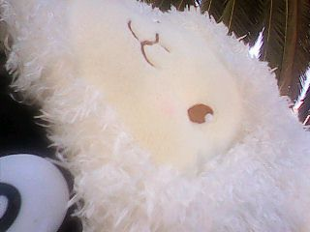




Every toy knows who it's looking at
EYES THAT KNOW YOU
The child
Any face it doesn't know becomes “the child” it's playing with.
Family
Faces enrolled from a few photos, greeted by name.
Each other
A tag on each toy's chest, so Dyno can tell Penny from Sage.
Pets and books
A LiteRT object detector (Pi and Jetson build) spots dogs, cats and books.
A real frame from Dyno's camera: Penny's woolly hat, up close (320 × 240).
Notes:
Each toy's camera tells it who's there. An unknown face is the child it's playing with. Family members get recognized from a few enrolled photos and greeted by name. The toys recognize each other by a tag on their chests. Pets and books come from an object detector built for LiteRT on the Pi or Jetson build. Whatever is biggest and most centered is what a toy is 'looking at'. This photo is a real frame from Dyno's camera, looking at Penny's woolly hat.

Slide 6








Thin toys, one brain at the table
BEHIND THE CURTAIN
The brain, on the table
Each toy
camera
mic
Listen
See
Think
Speak
Wi-Fi
7.6 ms
Hears a voice start and stop, no button.
Faces, tags, pets and books.
Gemma 4 E2B writes every line.
Piper gives each toy its own voice.
speaker
ESP32-S3 Atom
each line of speech reaches its toy in about 0.2 s
Today: Gemma via llama.cpp with Whisper on an Intel Mac. Ready to run: a LiteRT-LM build for Raspberry Pi 5 and Jetson, where Gemma hears the audio directly.
Notes:
Behind the curtain, the toys are deliberately thin. They only sense and speak. Each Atom streams its mic and answers camera requests over a local Wi-Fi hotspot with about 8 milliseconds of round trip. The brain listens for when a child starts and stops talking, looks through all three cameras, asks Gemma what each toy should say, and voices it with Piper. To be precise about today: on this Intel Mac, Gemma runs through llama.cpp with Whisper for speech. The LiteRT-LM build for a Pi 5 or Jetson is written and packed, and on those devices Gemma hears the audio directly.

Slide 7

It's arithmetic, not a preference
WHY THE BRAIN LIVES OUTSIDE THE TOY
2.6 GB
÷
8 MB
=
~320×
Gemma 4 E2B model file
memory inside each toy
too big to fit
The toy keeps what it's good at: being hugged.
The brain does what it's good at: thinking.
Notes:
Why not put Gemma inside the toy? The Gemma 4 E2B model file is about 2.6 gigabytes. The ESP32 inside each toy has 8 megabytes of memory. That's roughly 320 times too small. So the toy keeps what it's good at, being soft and huggable, and the brain at the table does the thinking.

Slide 8

We kept plussing it
PLUSSING: WALT'S WORD FOR MAKING IT BETTER, AGAIN AND AGAIN
Three mysteries solved
The silent mic
The sound chip spoke in the other stereo channel, so every mic heard nothing.
The camera that couldn't JPEG
This sensor has no JPEG encoder, so each toy compresses its own pictures.
Three toys, one name
Every board reported the same ID, so the brain thought all three were Dyno.
Notes:
Walt Disney called it plussing: always making the thing a little better. Our first version made a child wait over eleven seconds just for a toy's voice to arrive. Compressing the audio got that to about three, and hosting the Wi-Fi on the Mac got it to a fifth of a second. Along the way we solved three hardware mysteries: a mic that heard nothing because the sound chip talked in the other stereo channel, a camera with no JPEG encoder, and three boards that all claimed the same ID.

Slide 9





Magic that stays in the room
BUILT FOR A PARENT'S TRUST
Nothing leaves the room
No recordings kept
School-day topics
No cloud, ever. The toys talk to a computer on the table over local Wi-Fi.
Speech lives in memory and is deleted as soon as Gemma has heard it.
Subjects, homework, toys and games. Off-topic chat gets kindly steered back.
Hints, not answers
Feelings first
Family data on a leash
Homework help that keeps the child thinking.
A sad child hears kindness, and a nudge to tell a grown-up they trust.
Enrolled faces stay on the brain and are wiped with one command.
Notes:
Disney parks run on trust, and so should a toy that listens to a child. Nothing leaves the room. Speech is kept in memory only until Gemma hears it, then deleted. The toys stick to school subjects, homework, toys and games, and steer other topics back kindly. They give hints instead of answers. If a child sounds sad, kindness comes first, along with a suggestion to tell a grown-up they trust. Enrolled family faces never leave the brain and can be wiped with one command.

Slide 10




TO BE CONTINUED
Come meet Dyno, Sage & Penny
Snappier
A bigger cast
More ways to play
LiteRT-LM on a Jetson: published benchmarks show the first word in about 0.9 s.
Every new friend is the same thin client. Just add a toy.
A motion sensor in every toy: shake, tilt and high-five games.
github.com/patrick-hanley/sentient
Thank you. Ask Penny a times-table question.
Notes:
Where it goes next: on a Jetson with LiteRT-LM, published benchmarks put Gemma's first word at under a second. The cast can grow, since every new friend is just another thin client. And each Atom already has a motion sensor, so shake, tilt and high-five games are next. The code is public on GitHub. Thank you! Come ask Penny a times-table question.

