Slide 1
Plush Intelligence
Plush friends with a brain.
powered by Gemma, on a Mac.
Physical AI, IoT & Robotics track
No cloud anywhere in the loop.
Notes:
60-second pitch: Three plush toys that talk to each other and to a kid. Gemma can't run on an ESP32 — the E2B model is about 135 MB in INT4 against roughly 8 MB of PSRAM — so the brain sits at the table on a Mac. Every toy carries a camera, a mic, and a speaker; the router is external. Three toys today is inventory, not a limit.

Slide 2
The idea
Storytime friends that talk — to each other, and to a kid.
• Kids learn by teaching — a playful friend invites kids to explain their ideas.
• Kids learn by asking — a curious friend asks the questions a shy kid might not.
• Kids learn by listening — a careful friend reads the story out loud, patiently.
• No screens — the friends are plush. The intelligence lives in the room, not in an app.
Google Gemma Hardware Hackathon • AGI House, Hillsborough • Oct 24, 2026

Slide 3
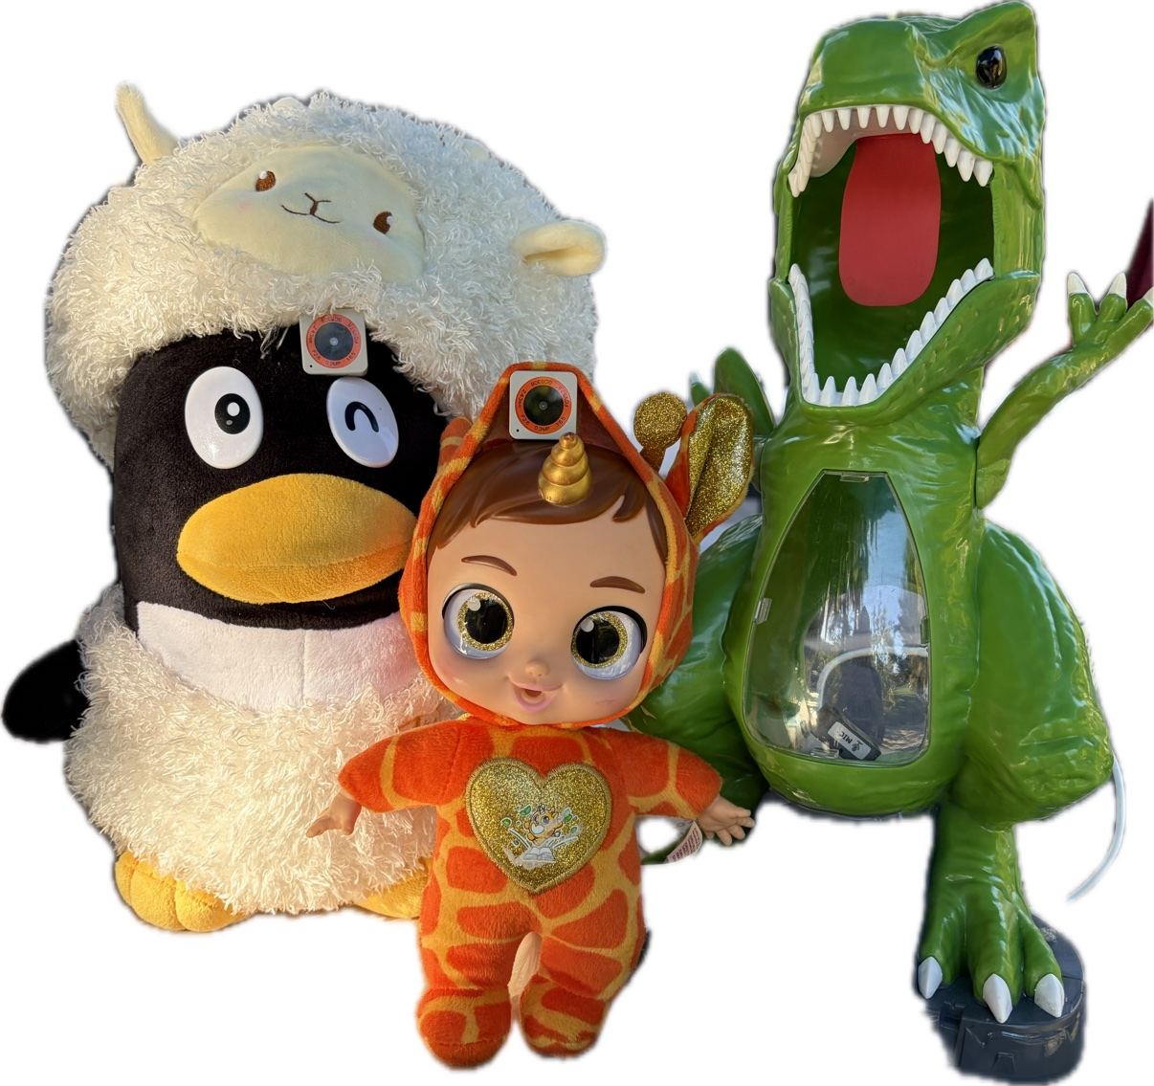
Meet the cast
Three personalities today. The cast can grow — there is no toy limit.
• Dyno — curious green dinosaur. Asks questions, wonders out loud.
• Sage — careful baby unicorn. Explains things, reads the story.
• Penny — silly penguin in a white hat. Whimsical, silly, and careful with facts.
• Every toy — camera + mic + speaker. Same hardware, different personality.
Google Gemma Hardware Hackathon • AGI House, Hillsborough • Oct 24, 2026

Slide 4
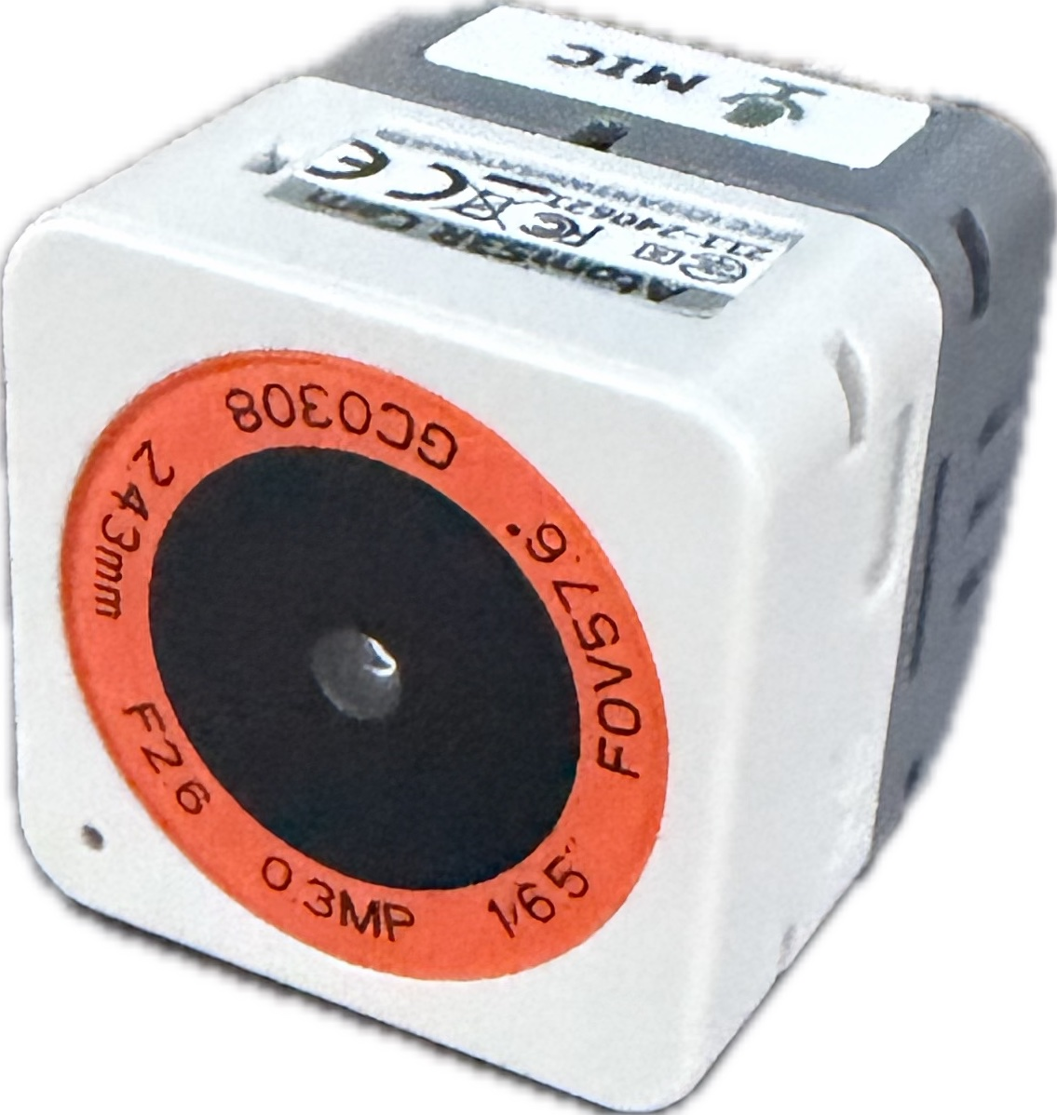
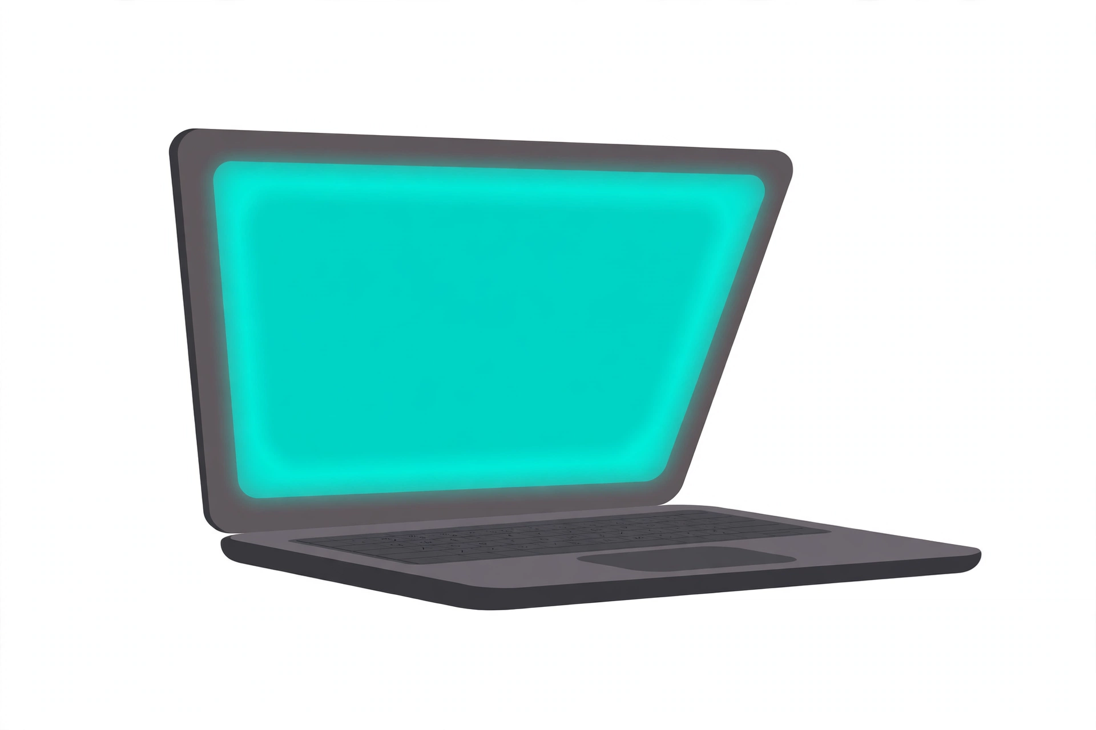
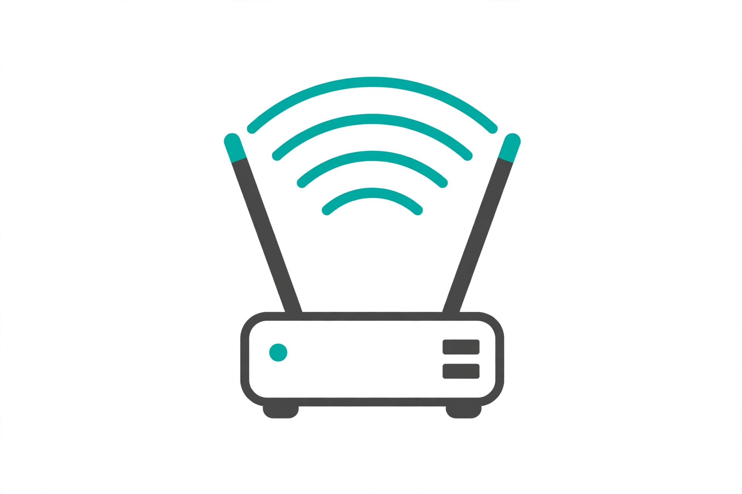
How it works
Thin toys, one external brain. One live mic at a time.
Toys
Brain
Router
• camera + mic + speaker each
• sense and speak — don't think
• Mac (Apple Silicon)
• Gemma 4 E2B on LiteRT-LM
• the whole conversation happens here
• external, not in any toy
• the brain hosts the session
Director
Sees
No cloud
• one live mic at a time
• idle toys just listen
• new toys cost almost no extra inference
• faces — family and each other, recognized alike
• pets and books, QVGA at 1–2 fps
• every byte stays in the room
• nothing leaves the table
Google Gemma Hardware Hackathon • AGI House, Hillsborough • Oct 24, 2026

Slide 5
Why the brain lives outside the toy
It's arithmetic, not a preference.
Gemma E2B in INT4 ≈ 135 MB
ESP32-S3 PSRAM ≈ 8 MB
135 ÷ 8 ≈ 17× too big. So the model sits at the table, and the toys stay soft.
The toy keeps what it's good at: being hugged. The Mac does what it's good at: thinking.
Google Gemma Hardware Hackathon • AGI House, Hillsborough • Oct 24, 2026

Slide 6
Gemma thinks. Piper speaks.
The voice is a renderer, not a second brain.
• Gemma — hears the audio directly and writes every word.
• Piper TTS — turns Gemma's text into speech on the Mac — 16 kHz PCM back to the toy.
• Distinct voices — one Piper voice per toy — pitch and pace matched to its personality.
• No audio stored — utterances live in RAM only and are deleted after Gemma reads them.
• Honest line — if a judge asks: the conversation is Gemma, the voice synthesis is Piper.
Google Gemma Hardware Hackathon • AGI House, Hillsborough • Oct 24, 2026

Slide 7
The demo
Scripted scene first, then free chat.
• Scripted scene — a 2-minute story the toys perform together.
• Free chat — then the toys talk with the judges, live, through Gemma.
• Canned fallback — if the live loop falters, the same scene runs canned — one tap, same code path.
• Privacy — no audio is stored. No real kids in the demo.
• No claims — no educational-efficacy claims. Just plush holding a conversation.
Google Gemma Hardware Hackathon • AGI House, Hillsborough • Oct 24, 2026
Notes:
If the live loop falters, say so out loud and tap the canned scene. Judges reward the honesty, and the scene is the same code path.

Slide 8
What's next
Today is a demo. The architecture is the product.
• More toys — no limit on cast size — a fourth, fifth, or twentieth toy is just another thin client.
• More fun voices — faster on-device synthesis, more distinct personalities per toy.
• More senses — leveraging the 9-axis IMU in each toy — movement, gestures, and play — not the camera.
Thank you — come talk to the toys.
Code: github.com/patrick-hanley/sentient
Google Gemma Hardware Hackathon • AGI House, Hillsborough • Oct 24, 2026

