Slide 1
Analysis of Global Fire Weather Index Trend and Its Correlation to The Oceanic Nino Index in the Amazon Rainforest Region
Patrick Naylor

Slide 2
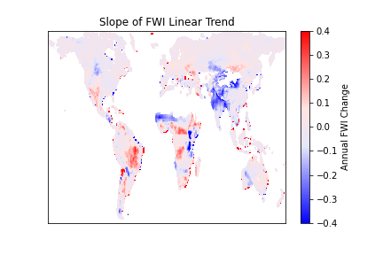
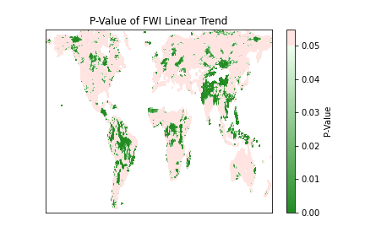
Global FWI Annual Trend

Slide 3
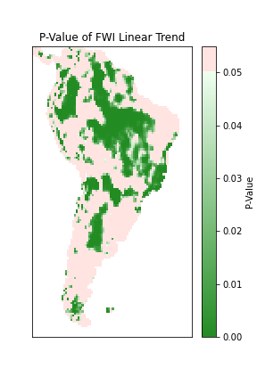
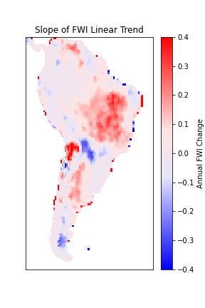
Amazon Rainforest Region Annual FWI Trend

Slide 4
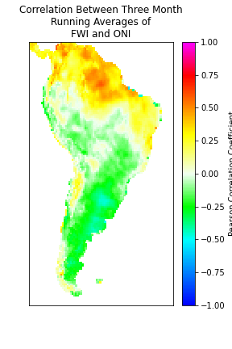
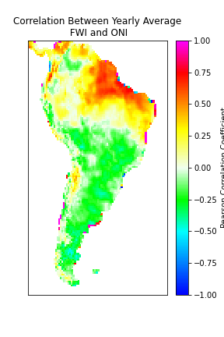
Correlation Between FWI and ONI

