Slide 1
Residential stands Zimbabwe Business model

Slide 2
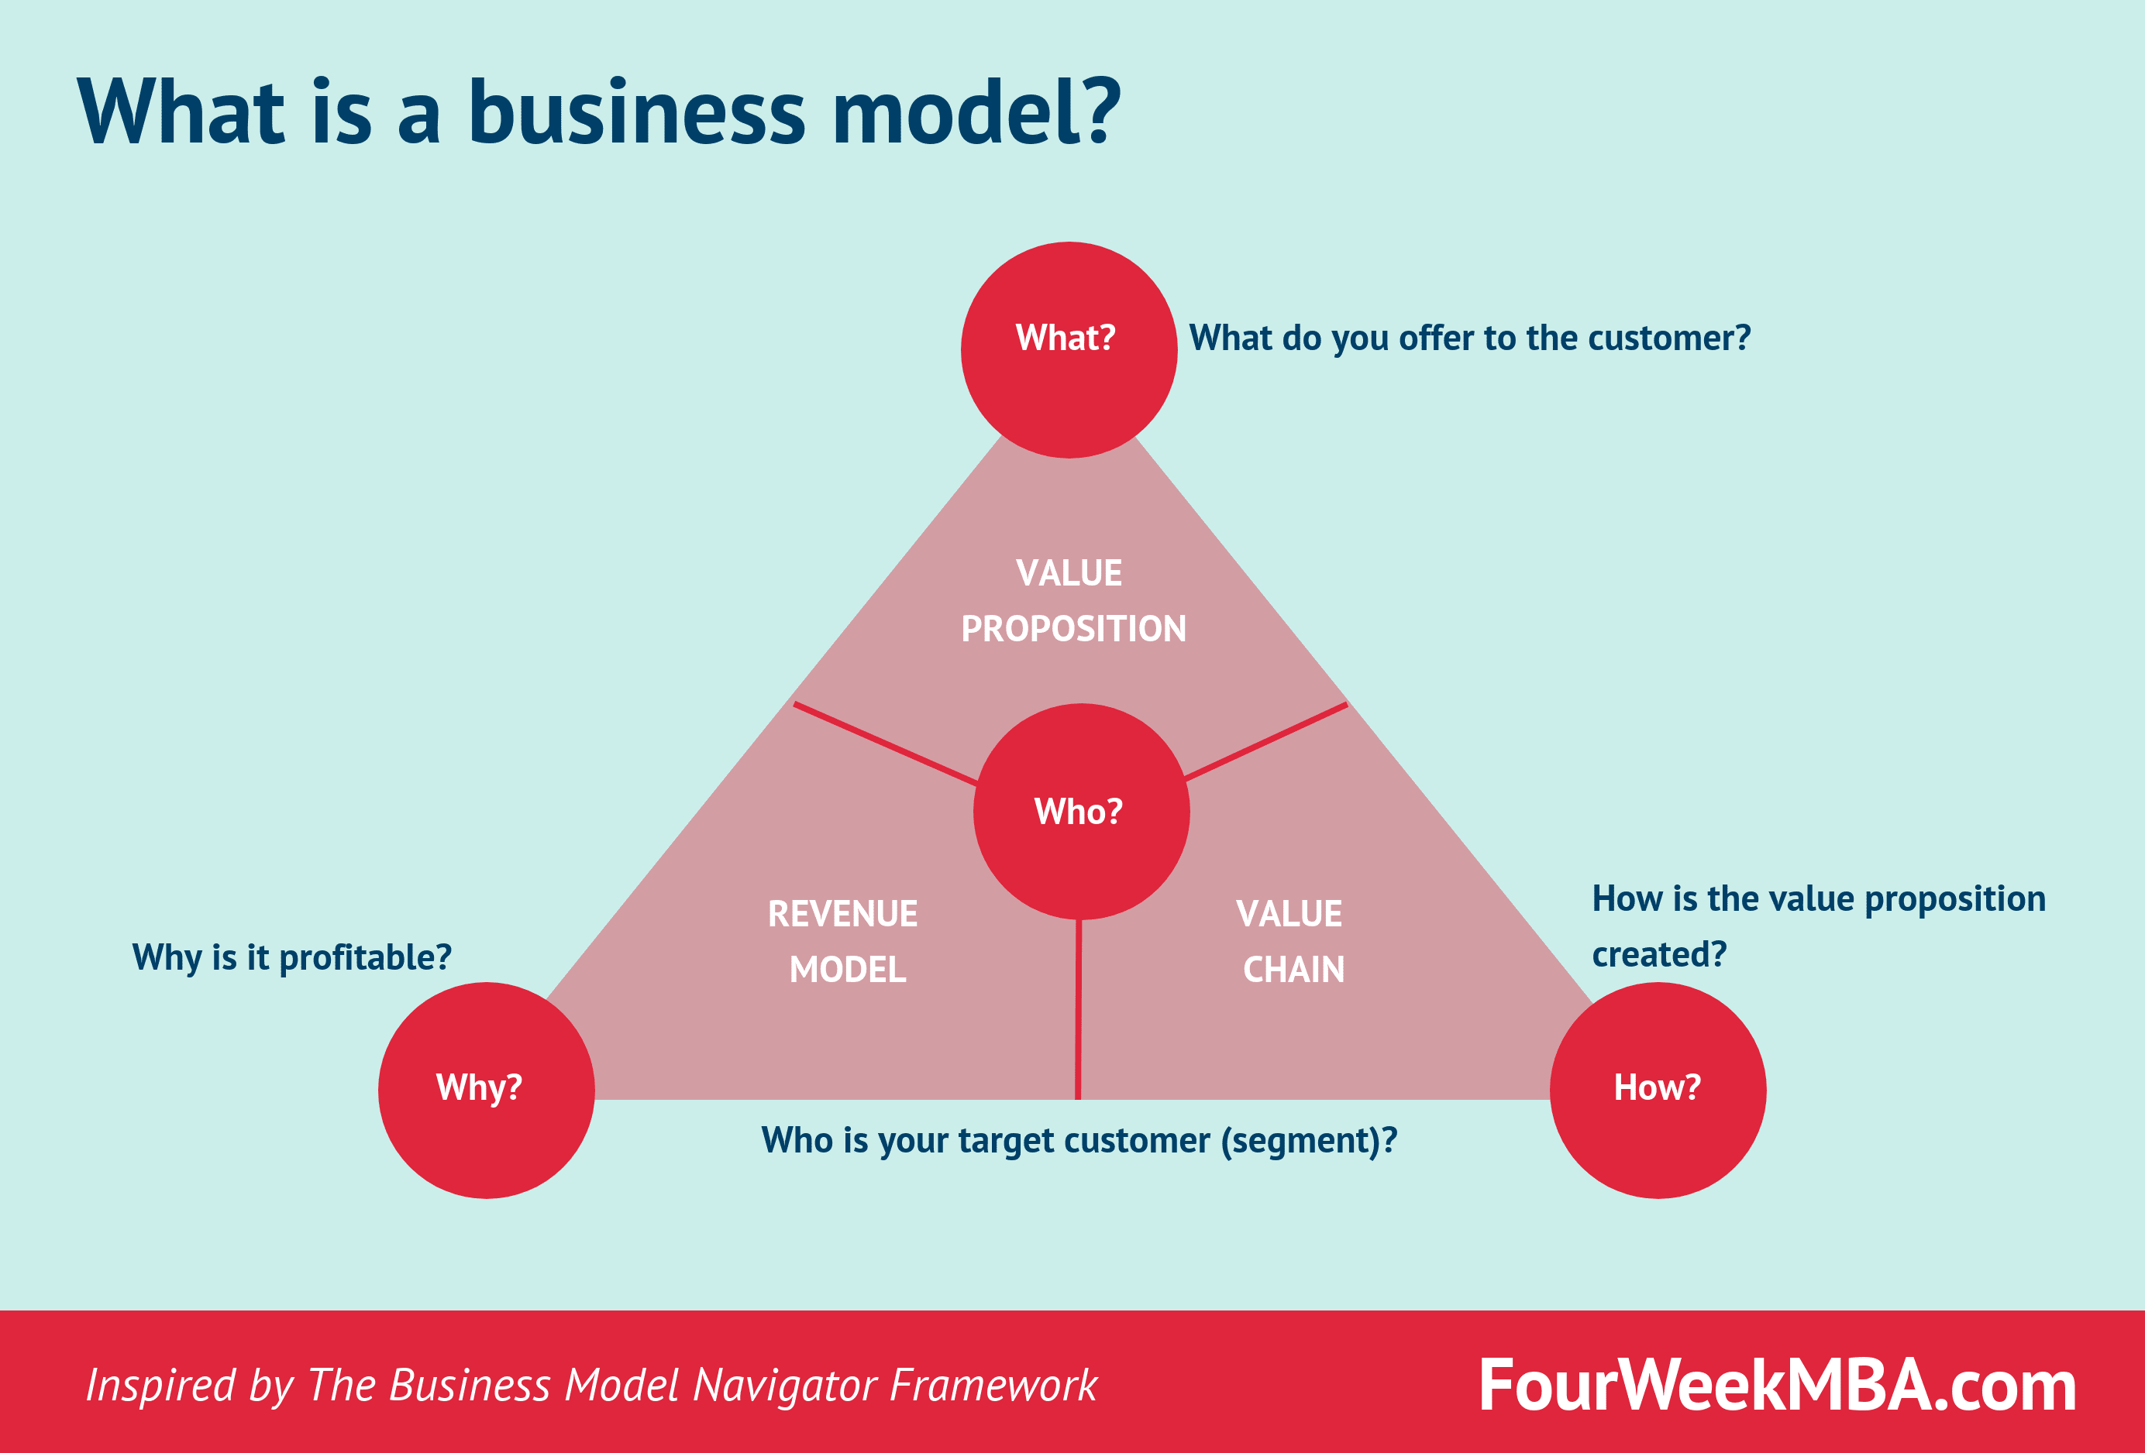
BUSINESS MODEL
This is a description of how our business makes money, through the explanation of “how you deliver value to your customers at an appropriate cost.”
It consists of three major aspects which are important for the business, namely;
Value proposition
Revenue model
Value chain

Slide 3

Value proposition
This is a marketing statement which we used to summarize why a consumer should use our services. It consists of the following;
the benefits of our services
what makes them valuable
our intended customer’s main problem
current service providers

Slide 4

The benefits of our service
The stands being offered already have been approved by the city council, and their documents are available as proof of genuine stands on sale.
Important information and presentation for the stands is also made visible, which includes:
Prices
Location
Pictorial location
Most likely suitable type of a house
Current residential development

Slide 5

What makes our benefits valuable?
Boost Customer Loyalty.
Bolster business growth.
Enhance business reputation.
Identify communication bottlenecks and lack of clarity information about the stands.
Happy customers will help you attract new business
Great customer service opens doors for new partnerships and other opportunities

Slide 6

Our intended customers’ main problem
Here in Zimbabwe, some stand owners, and those who are looking for stands; they are facing a problem on possessing illegal stands for the some of the stand owners, leading to demolition of their infrastructures
For those who are still looking for stands, due to the rapid growth of urbanization, some of these people turn to fall into trap of illegal stands being offered, which have no adequate documentation and payment for the stand.
This leads to great loss of resources, which have been used in the building of the infrastructure.

Slide 7

Current services providers
The city council
They provide legal stands, since its their department which works hand-in-hand with the Ministry of Lands.
Their stands have legal documents.
Land barons
They also provide stands, hence their stands are illegal, not proven by the state, thus no state proven documents of the existence of the stands.

Slide 8

Revenue model
This is our framework for generating financial income. A revenue model is a conceptual structure that states and explains the revenue earning strategy of the business. However our business is a non profit, hence no revenue is being made.

Slide 9

Value chain
This is a set of activities that a firm operating in a specific industry performs in order to deliver a valuable product for the market. For our business we don’t look at the support activities, which are linked with the firm infrastructure, human resource management

Slide 10
Primary Activities
Inbound logistics
Here the business receives the available stands certified for sale by the state from the ministry of lands and city council.
Operations
Here is where the business take producers to convert the input to output, thus labeling, branding, and packaging lands of the same location for the data to be in order and well presentable.
Outbound logistics
Now the business is delivering the service to the general public, thus posting the available stands on the website.
Marketing and Sales
Now the business starts to advertise the available on social media, to address to many people who get information through sourcing social media platforms, like run ads on Instagram or build an email list for email marketing.

Slide 11
Secondary /Support Activities
Procurement
Here our business do the acquisition of the inputs, thus the stands, from the city council. Works hand – in – hand with the Inbound logistics.
Technological Development
This includes equipment, hardware, software, procedures, and technical knowledge; being used by the business

