Slide 1
Lab2 Image classification

Slide 2
Pytorch tutorial
https://youtu.be/MrnQ5LgcNBI
https://youtu.be/QAY6sfca6wI
Pytorch version is 0.4 in this tutorial
Official tutorial
https://pytorch.org/tutorials/
莫凡
https://www.youtube.com/watch?v=lAaCeiqE6CE&list=PLXO45tsB95cJxT0mL0P3-G0rBcLSvVkKH
You can only use pytorch in this Lab!!

Slide 3
Get the files for Lab2
Decompress the files with command
tar xvf ~dlad22_ta_01/Lab02.tar

Slide 4
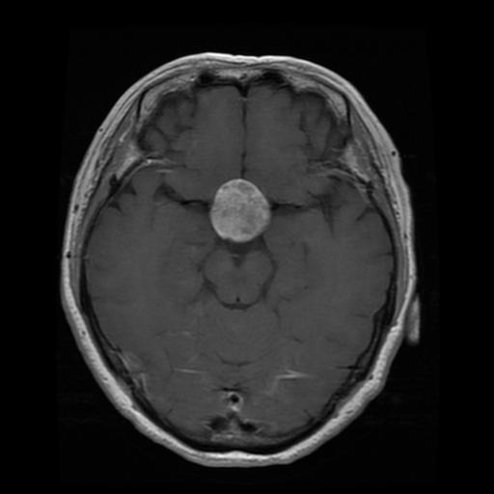
Dataset – brain MRI images
Classify brain tumor
no_tumor
pituitary_tumor
meningioma_tumor
glioma_tumor

Slide 5
Tasks in this lab
1. In “Lab2_ResNet18.ipynb”
Build Resnet18 by yourself
(You can’t call the model directly with this command)
Achieve at least 80% validation accuracy
(put the screenshot in your report)

Slide 6
Tasks in this lab
2. In “Lab2_advance.ipynb”
Do your best to improve accuracy
Calling different models with pretrained weight is allowed
Basically any methods you learn are allowed
(Exception: Label test data yourself or find more training data online)
Upload your result to Kaggle

Slide 7
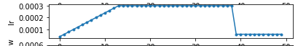
Tasks in this lab
3. Write a report
Required
Compare resnet18 with and without pretrained
Screenshot of task1 (>80% accuracy)
Visualize feature maps in different layers and provide your observation
Implement learning rate schedule: warmup
(show your code and make a graph)
More
Description of your model
Description of your hyper parameter
Difficulties you encounter and how you solve it
Any other improvements you make

Slide 8
Score
Validation accuracy in Task 1 >80% (40%)
Report (30%)
Performance Rank in Kaggle (30%)

Slide 9
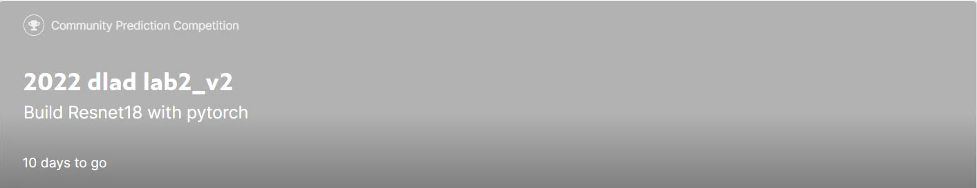
Kaggle
Create Kaggle account first
Team name should be your student ID
Competition URL:
https://www.kaggle.com/t/560fbc6b93484515b0c916209f67a01c
Submit your result to Kaggle

Slide 10
Upload to Kaggle
Prediction
Write the prediction to csv file (ID_result.csv)
Two column: ID,label
Evaluation
Categorization accuracy
Upload to Kaggle

Slide 11
Reminder
Submit Deadline : 2 week (2022/10/19 11:59 PM)
Upload 3 files to new e3
Lab2_advance.ipynb
Lab2_ResNet18.ipynb
StudentID_report.pdf (example: 310510131_report.pdf)
Submit your result to Kaggle

Slide 12
Notice!!!
Change your team name to your student ID
If TA can not find your ID, you will lose 20% of score in this lab
You only have 20 times maximum daily submissions

Slide 13
Shut down your kernel !!!!!
Remember to SHUTDOWN the kernel
To release resources for others.

Slide 14
Supplement: ResNet18
paper
Deep Residual Learning for Image Recognition
https://openaccess.thecvf.com/content_cvpr_2016/papers/He_Deep_Residual_Learning_CVPR_2016_paper.pdf

Slide 15
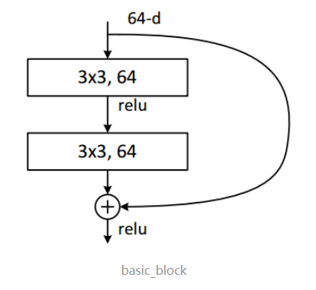
Supplement: ResNet18
Basic Residual Block

Slide 16
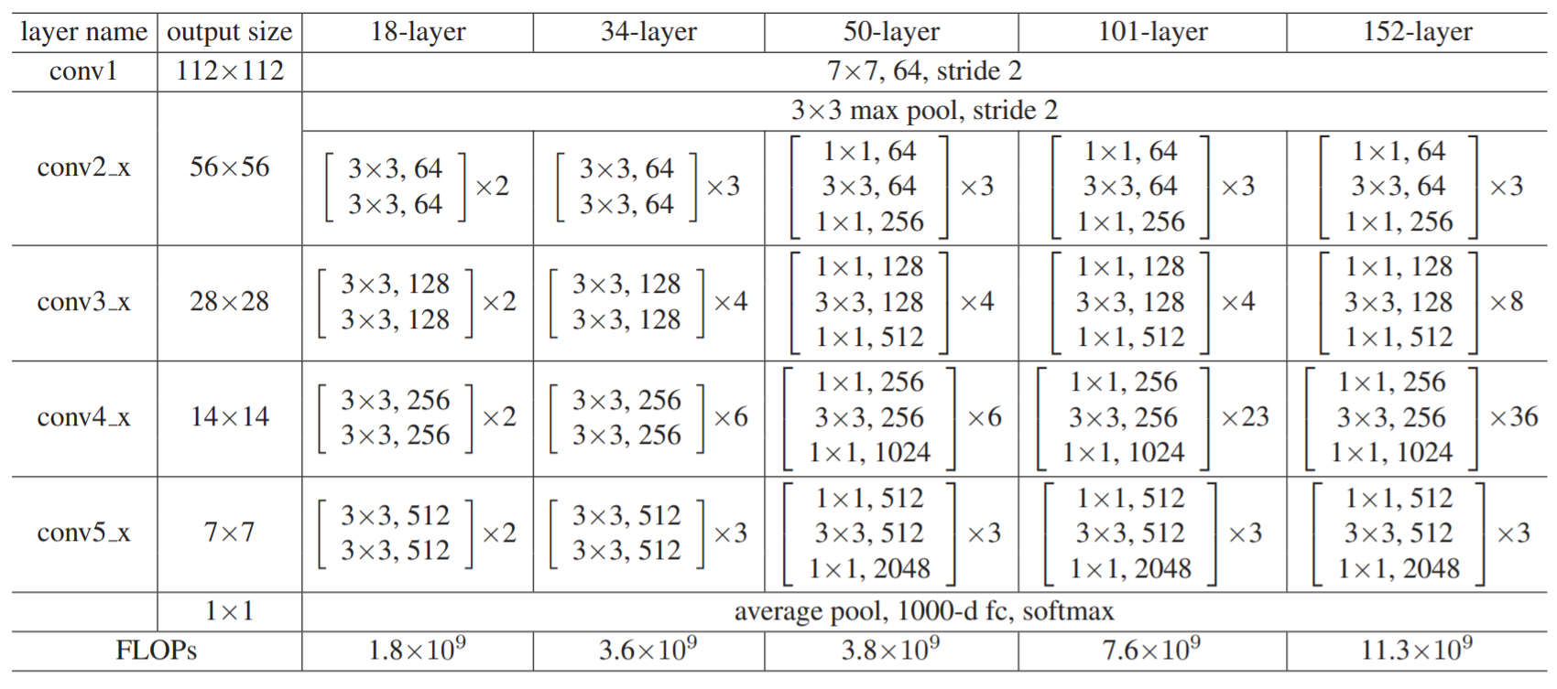
Supplement: ResNet18
Architecture

