Slide 1
DLAD Lab3 Semantic Segmentation & Object Detection

Slide 2
Download File
tar xvf ~dlad22_ta_02/lab3.tar
Please reserve enough time for this lab !!!

Slide 3
Semantic Segmentation

Slide 4

Requirements:
Use pytorch
Use the data we provide to train your model
Without other data (augmentation is allowed)
Without pretrained model
Without calling any full network package
For example : Do not

Slide 5
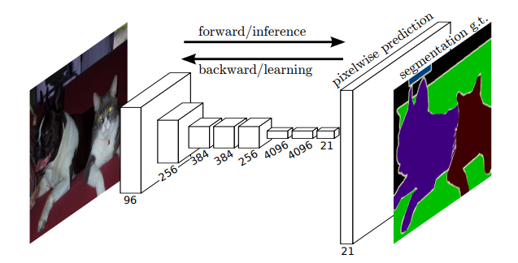
Fully Convolution Network
How to inference lots of pixel?
Pixels to pixels training
Encoder and decoder
Downsampling and upsampling

Slide 6
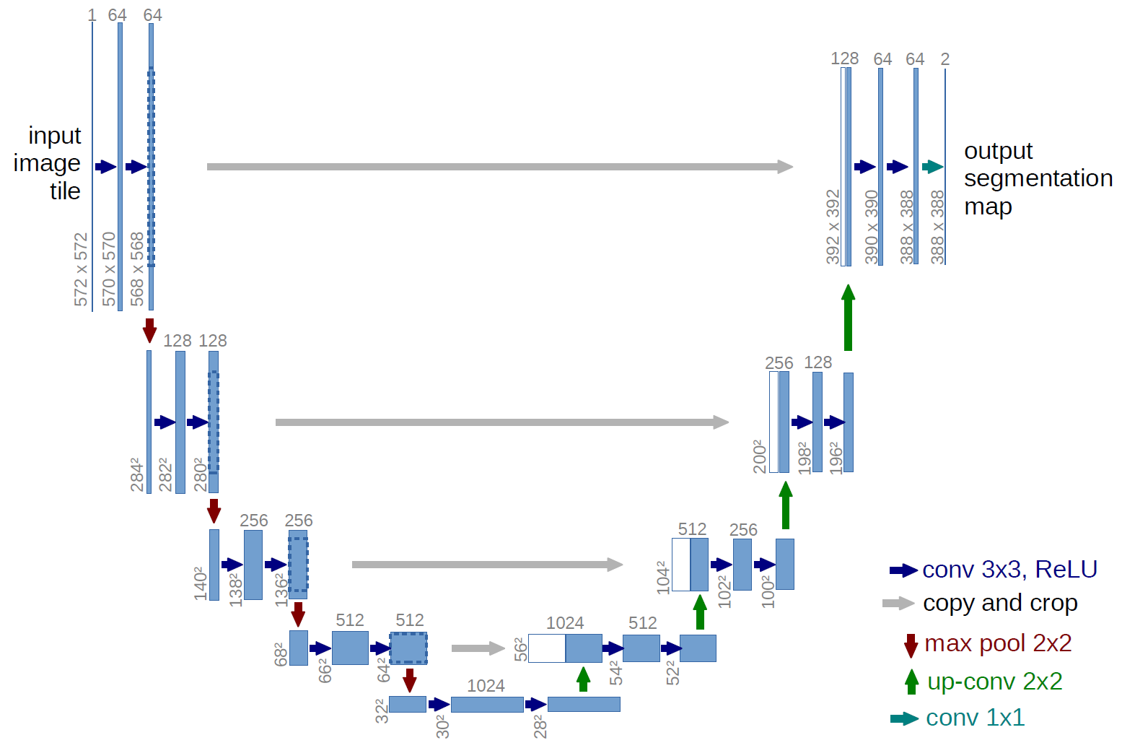
U-Net
Based on fully convolution network
Symmetric contracting/expanding path
Skip connections

Slide 7
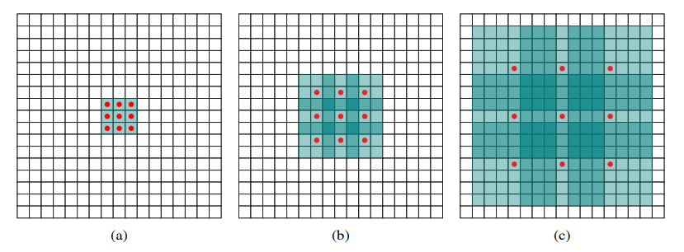
Problems of Vanilla CNN
Vanilla CNN uses pooling layer to reduce computation and increase the receptive field
Is there any way to increase the receptive field without information loss?
Dilated convolution

Slide 8
How to Upsample?
Use traditional upsampling method
Bilinear, nearest, ….
Use transpose convolution layer(deconvolution)
Learn how to upsample

Slide 9
Other Tips
Data augmentation
RandomHorizontalFlip
RandomCrop , ….
Multi-scale
Loss function
Skip connection

Slide 10
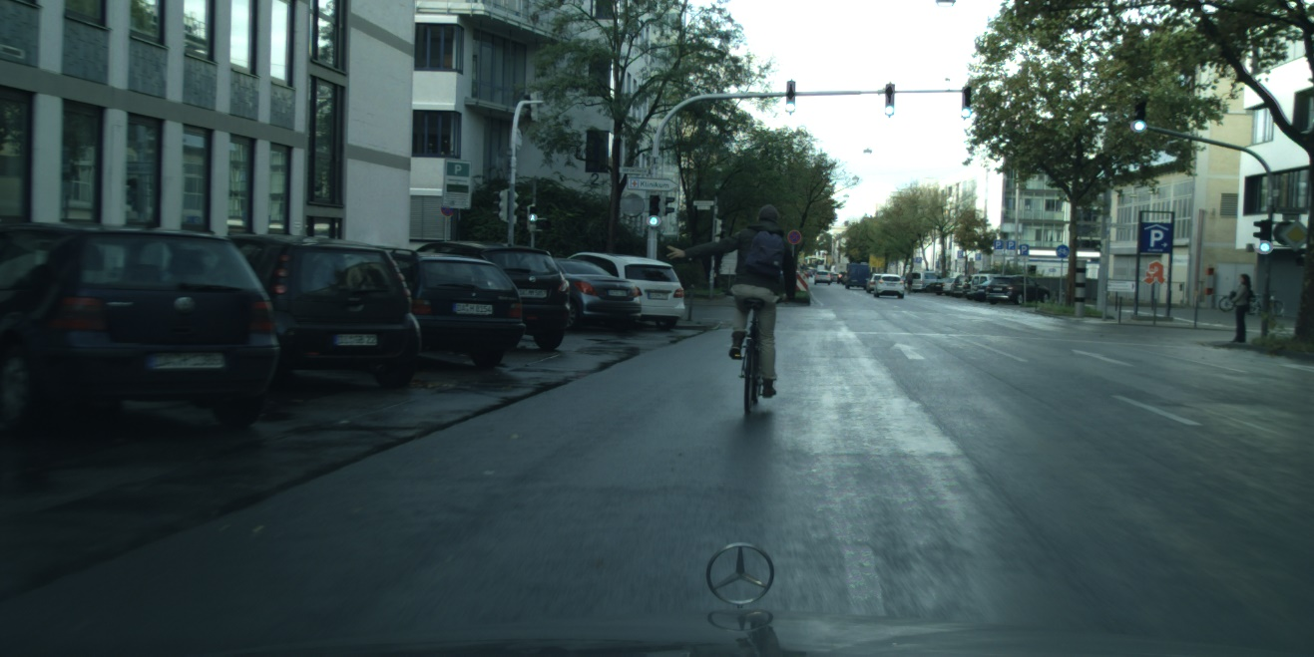
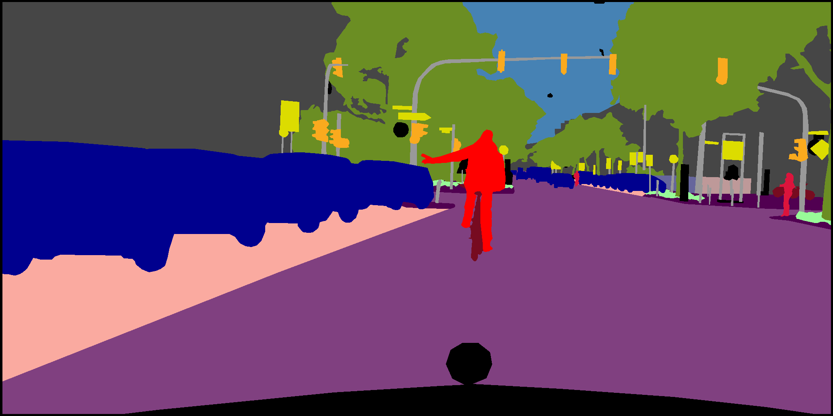
Dataset: Cityscapes
An RGB image with an RGB semantic segmentation image
Original size is 1024x2048
I will give you original size!
image
label

Slide 11
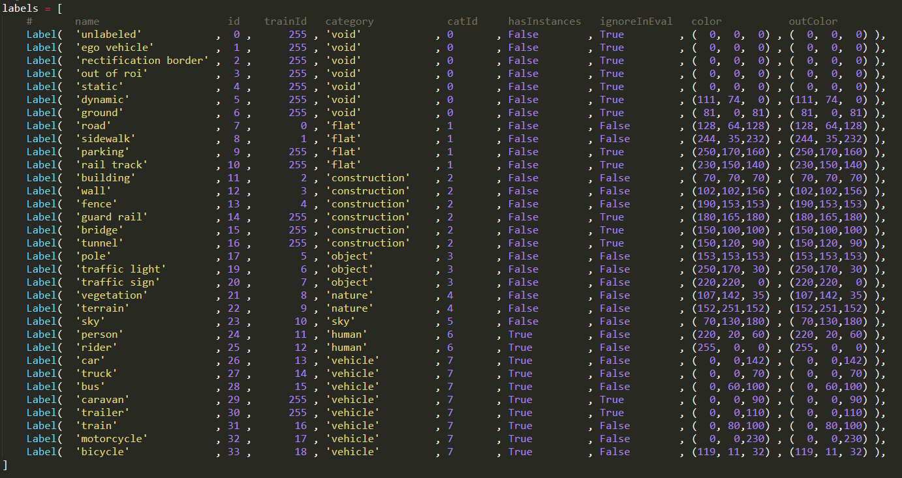
Classes of Label
There are 34 classes and 8 kinds of categories
Some labels will be ignored during evaluation
I label them as train Id 255

Slide 12
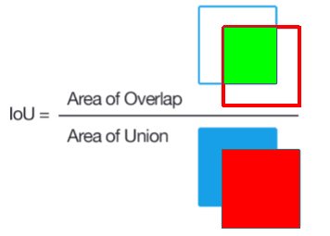

Model Evaluation
Evaluation metric: Mean Intersection over Union(mIoU)
For each class, IoU is determined as :
$IoU=\frac{True Positive}{True Positive+False Positive+Flase Negative}$
mIoU is calculated by averaging the over all classes

Slide 13
Grading Rules(1/2)
Report (10%)
You should build this UNET network and save your code in (studentID_UNET.py) , then upload all of your code to new E3
Show your studentID_UNET.py code in your report
You will not get any report scores if the requirements are not fulfilled

Slide 14
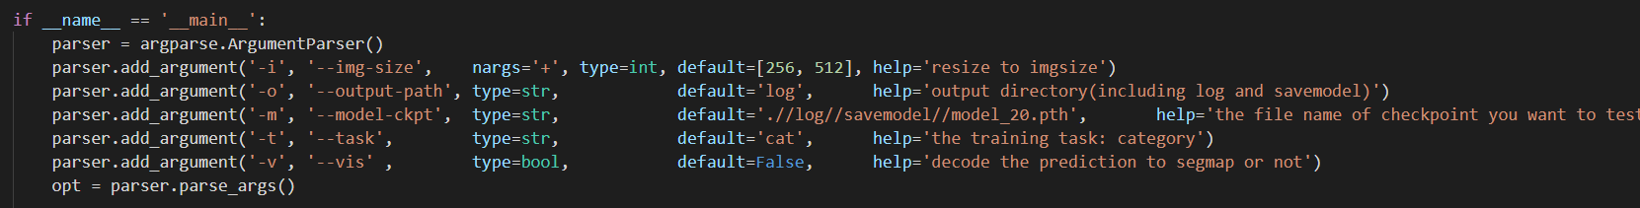
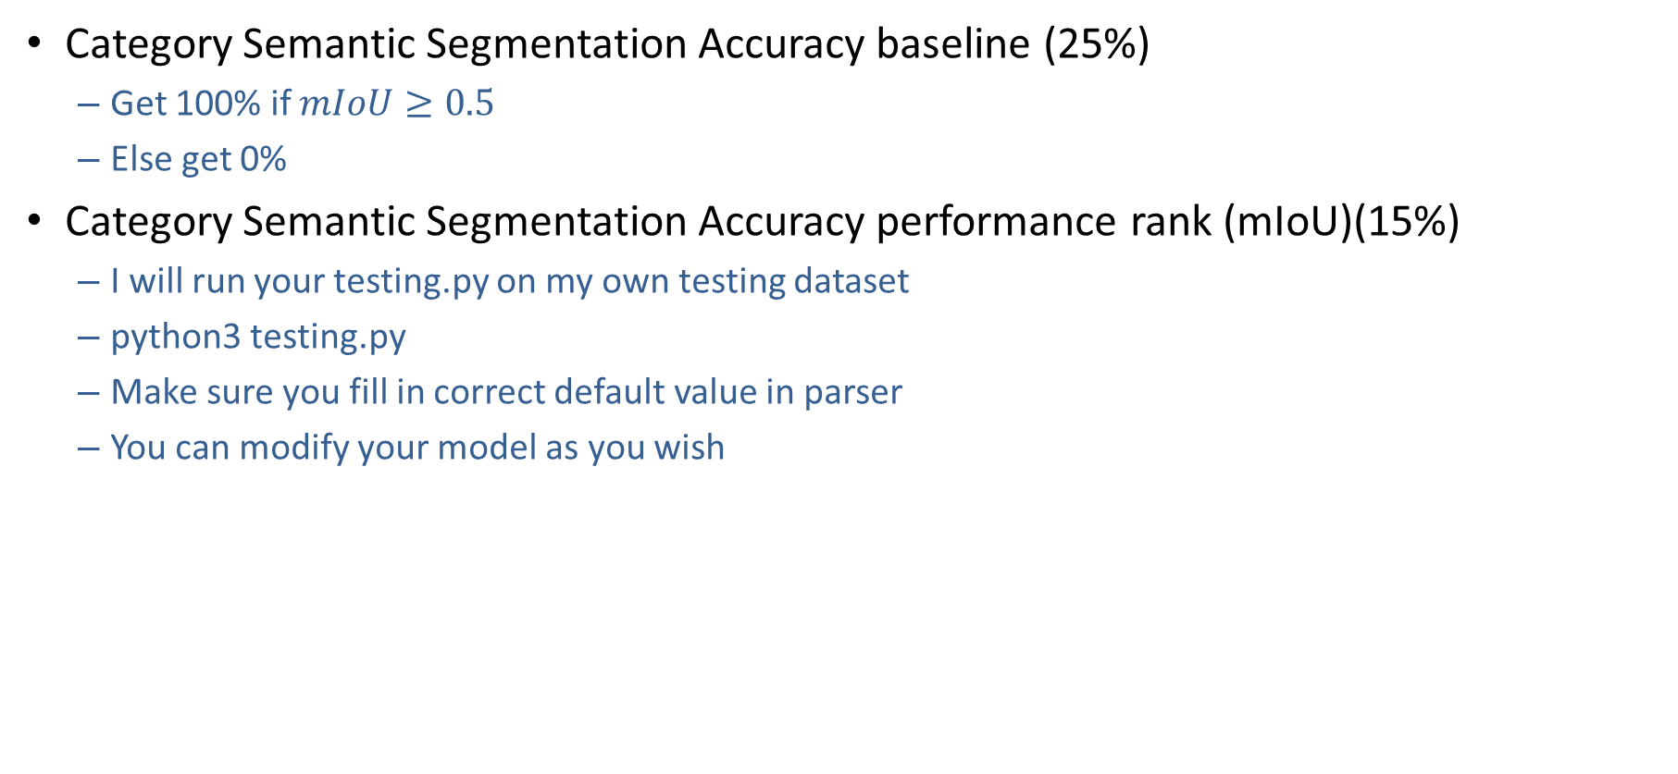
Grading Rules(2/2)
Category Semantic Segmentation Accuracy baseline (25%)
Get 100% if $mIoU≥0.5$
Else get 0%
Category Semantic Segmentation Accuracy performance rank (mIoU)(15%)
I will run your testing.py on my own testing dataset
python3 testing.py
Make sure you fill in correct default value in parser
You can modify your model as you wish

Slide 15
Report Spec.
Show how do you improve your model
Pros and cons of your model
Show how do you improve accuracy
Loss, Optimizer, overcome overfitting ?
Difficulties you encounter and how you solve it
Any other thing you want to tell
At most 5 pages

Slide 16
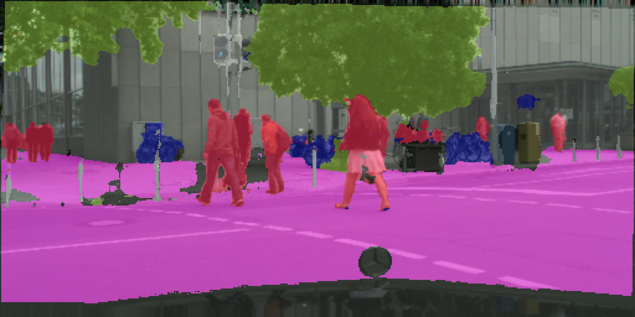
Results:

Slide 17
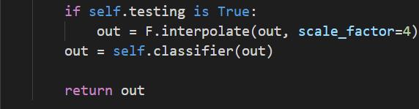
Remainders
I will test your model in original size
It is free to downsample the images for training, but remember to upsample them to the original size for testing!
You can do any off-line transformation in training, but all the testing transformation must be on-line
…

Slide 18
Submission
Student_ID.tar
Include one directory with all the files
Without data files
train.txt shows how to run training
test.txt shows how to run testing
In log/savemodel folder, only your best model can be included
Make sure your testing.py can work(automatically load your best model)
I have give you a image to test testing.py
If testing.py cannot work, you would not get any points
Not only upload the best model to E3, you must also upload the best model to the cloud
Google drive, Dropbox
Student_ID.pdf

Slide 19
Deadline
Submit Deadline : 2 week (10/11/2022 11:59 PM)
Late submission(in 24 hours) will get 30% reduction
You need to submit your code to New E3

Slide 20
Appendix
data directory contains three folders
training, validation, testing
Each directory contains two folders
image, semantic_rgb
All the names of picture are from 0000.png to xxxx.png

Slide 21
Appendix
python3 training.py
Will run at default mode
-b 20
batchsize
-i 256 512
Image size you want to resize
-e 100
Epoch number
-o log_dir
The directory you want to save the log of training and
it will create log_dir/savemodel to save your model
-m UNET
The name you want to save your model (UNET_(current_epoc).pth)
-t cat
Cat for category
-r log_dir/savemode/UNET_10.pth
Resume training from UNET _10.pth
python3 training.py –i 54 54 –b 300 –o log_test –m UNET –t cat

Slide 22
Appendix
python3 testing.py
Will run at default mode
-i 256 512
Image size you want to resize
-o log_dir
The directory you want to save the log of training and
it will create log_dir/prediction to save your labeled images
-m log_dir/savemodel/UNET_1000.pth
Test UNET_1000.pth
-t cat
Cat for category
-v False
True for save your labeled images
python3 testing –i 54 54 –m log_dir/savemodel/UNET_20.pth –t cat

Slide 23
References
[1] CS231n handout http://cs231n.stanford.edu/
[2] Long, Jonathan, Evan Shelhamer, and Trevor Darrell. "Fully convolutional networks for semantic segmentation." Proceedings of the IEEE conference on computer vision and pattern recognition. 2015.
[3] Olaf Ronneberger, Philipp Fischer, Thomas Brox “U-Net: Convolutional Networks for Biomedical Image Segmentation”
[4] Yu, Fisher, and Vladlen Koltun. "Multi-scale context aggregation by dilated convolutions." arXiv preprint arXiv:1511.07122 (2015).

Slide 24
Object Detection

Slide 25
Objectives
Use the pretrained model and modify backbone of the model
Yolov4-lite
To improve accuracy, you can
Modify backbone (mobilenet-v1,v2,v3、user-defined backbone)
Data Augmentation(mosaic)
Learning schedule(Cosine_lr)

Slide 26
Dataset
Car
Class : 8
Motorcycle
Auto
Car
Bus
LCV
Truck
Tractor
Multi-Axle
Image path
Object location + class label

Slide 27
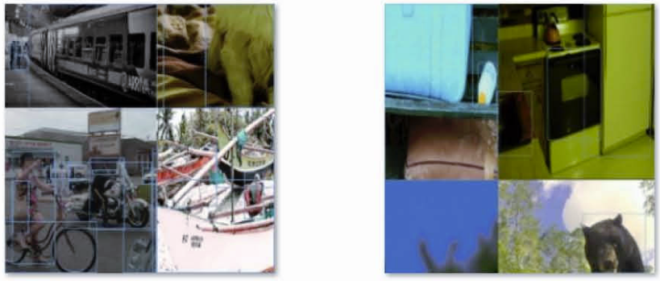
Data Augmentation
Mosaic

Slide 28
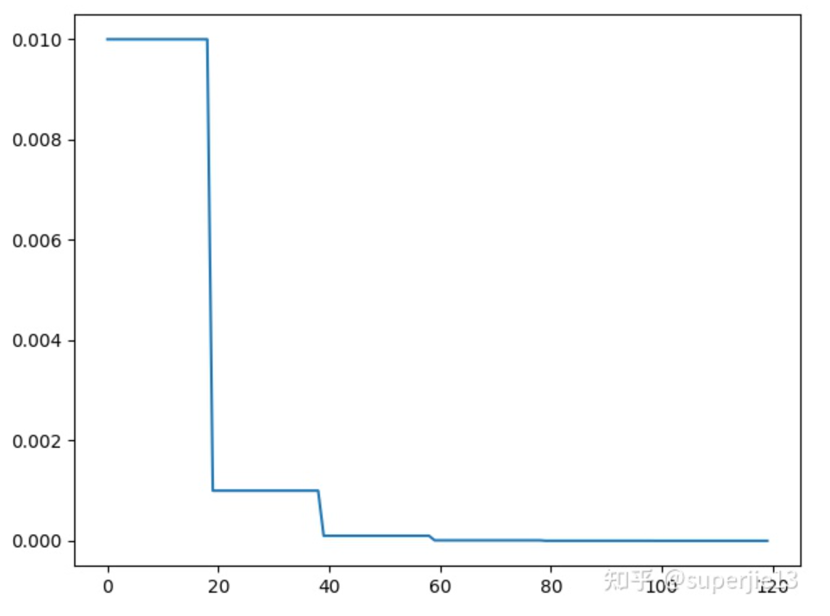
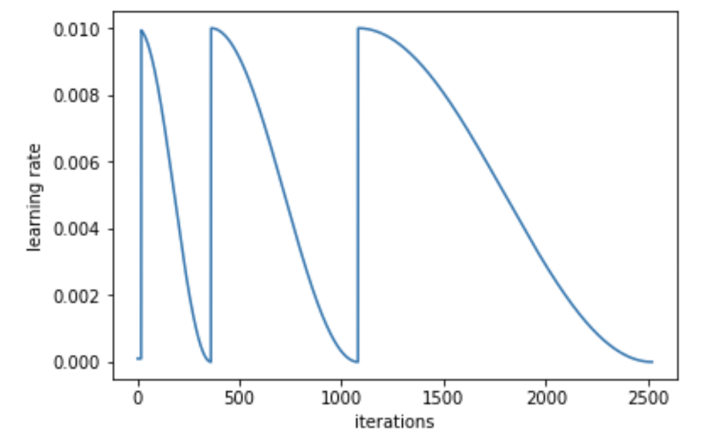
Learning schedule
Step LR
CosineAnnealingLR

Slide 29
train.py & test.py
Test
Display image with predicted bounding box
Train
Data augmentation
Learning rate schedule

Slide 30
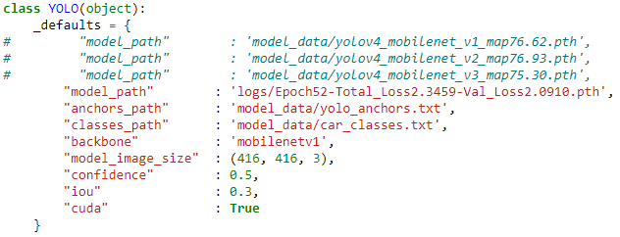
yolo.py (for testing)
You should modify path of pretrained weights and backbone of model.
Model weights for testing

Slide 31
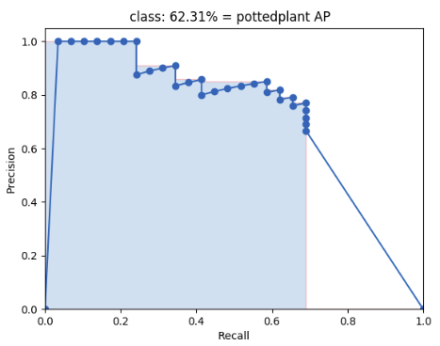
Model Evaluation
Evaluation metric: Mean Average Precision (mAP)
Precision : TP / (TP + FP)
Recall : TP / (TP + FN)
Average Precision (AP) is finding the area under the precision-recall curve

Slide 32
Grading Rules(1/3)
Report (10%)
Show how do you improve your model
Pros and cons of your model
Show how do you improve accuracy
Loss, Optimizer, overcome overfitting, anchor sizes ?
Difficulties you encounter and how you solve it
Any other thing you want to tell
At most 5 pages

Slide 33
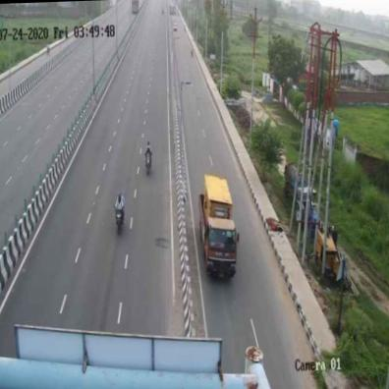
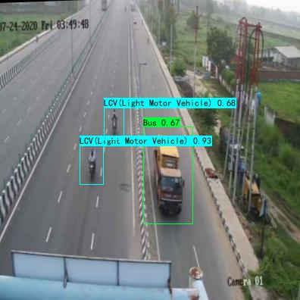
Grading Rules(2/3)
Predict test data (Highway_126.jpg) correctly (20%)

Slide 34


Grading Rules(3/3)
Object Detection Accuracy performance rank (mAP) (20%)
I will run your test.py on my own testing dataset
python3 test.py
You can modify your model as you wish
Make sure your test.py can generate labels in correct format
I have give you a image to test test.py
If test.py cannot work, you would not get any points
mAP
https://github.com/Cartucho/mAP
test_img.txt
img/xxx.jpg
test_labels/xxx.txt

Slide 35
Submission
Student_ID.tar
Include one directory with all the files
Without data files
readme.txt shows how to run training&testing
In logs folder, only your best model can be included
Not only upload the best model to E3, you must also upload the best model to the cloud
Google drive, Dropbox
Student_ID.pdf

Slide 36
Deadline
Submit Deadline : 3 week (17/11/2022 11:59 PM)
Late submission(in 24 hours) will get 30% reduction
You need to submit your code to New E3

Slide 37
Reference
YOLOV4：You Only Look Once目标检测模型-修改mobilenet系列主干网络-在pytorch当中的实现
https://github.com/gaozheng-tech/mobilenet-yolov4-lite-pytorch

