Slide 1
Lab04 Pruning & Quantization

Slide 2
Get the files for Lab04
Decompress the files with command
tar xvf ~dlad22_ta_01/Lab04.tar

Slide 3
Version
pip uninstall torch torchvision torchaudio
pip install torch==1.9.1 torchvision==0.10.1 torchaudio==0.9.1
pip install pysoundfile

Slide 4

DATASET
Speech Commands
TensorFlow released the Speech Commands Datasets. It includes 65,000 one-second long utterances of 30 short words, by thousands of different people.
We only use 10 short words.

Slide 5
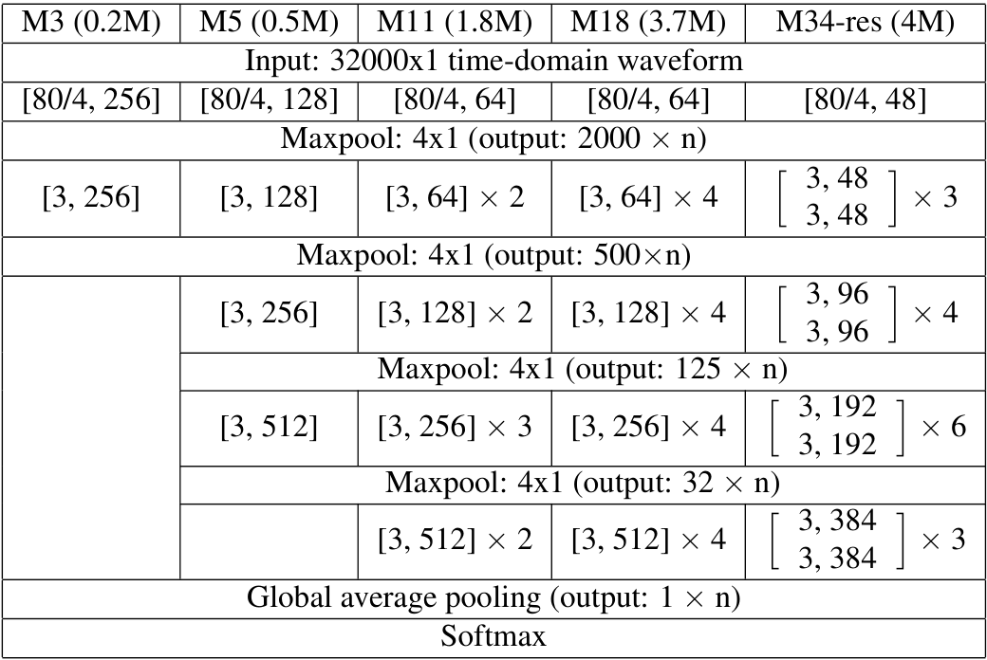
Network
M5
Simple Network consists of 1d convolution, Batchnorm and pooling
Default configuration:
[128, 128, 256, 512]

Slide 6
Pruning Introduction
Why Pruning?
According to “Lottery Ticket Hypothesis” (Frankle & Carbin, 2019), we find that large network is easier to train than small network.
easy to train
hard to train

Slide 7
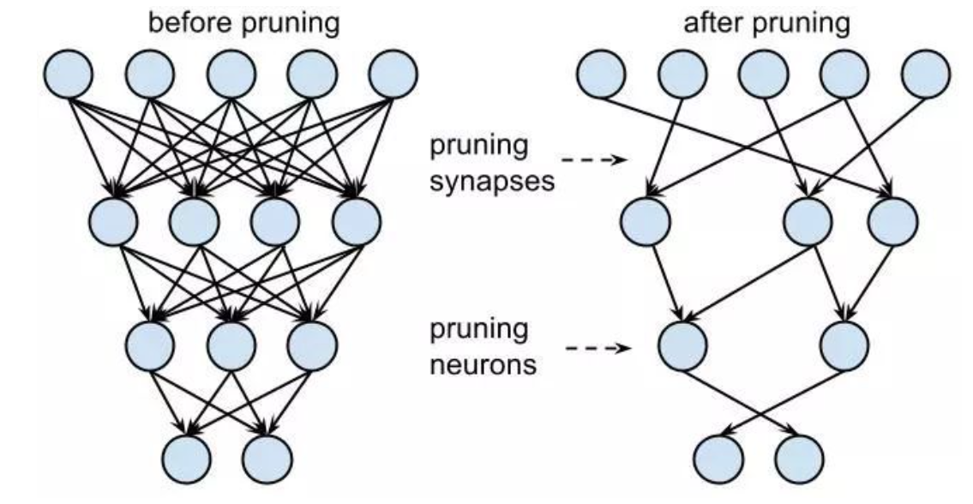
Pruning Introduction
Deep learning models are often over-parametrized
Pruning techniques removes unimportant parameters
Reduce memory, battery, hardware consumption
Without sacrificing too much accuracy

Slide 8
Pruning Introduction
Network pruning is widely used for reducing the heavy inference cost of deep models in low-resource settings. A typical pruning algorithm is a three-stage
pipeline.
Training
Pruning
Fine-tuning
repeat

Slide 9
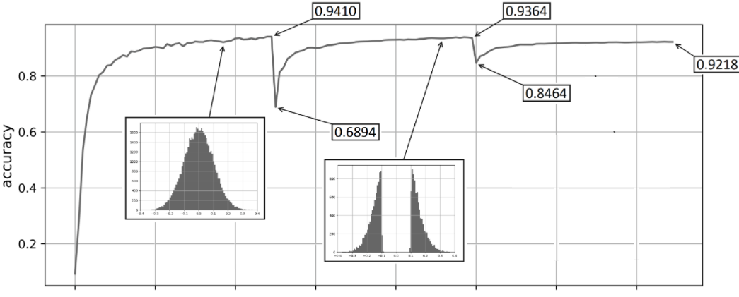
Pruning Introduction
Train
Finetune
Finetune
Prune
Prune

Slide 10
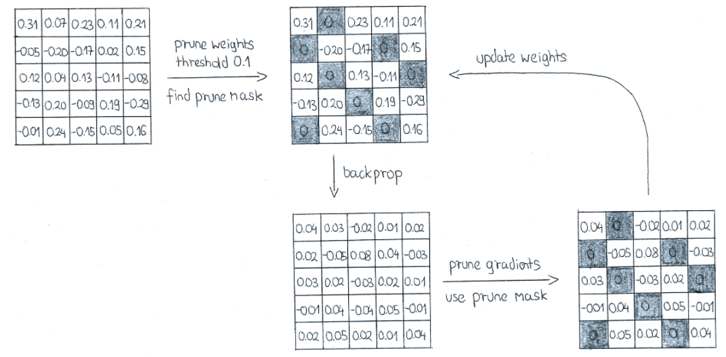
Pruning Introduction
Two step approach
Pruning: set unimportant parameters to zero
Finetuning: retrain remaining parameters for a few epochs to regain accuracy

Slide 11
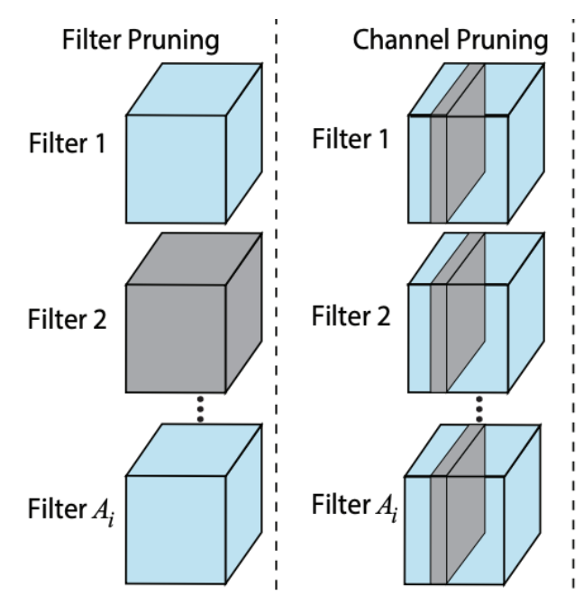
Pruning Introduction
Unstructured (Fine-grained) Pruning
Prune individual parameters
Structured (Coarse-grained) Pruning
Consider parameters in groups - removing channels, or filters
Element-wise Pruning

Slide 12

Recommended Method
Fine-grained pruning:
Select a threshold
Set individual weights smaller than the threshold to zero
Coarse-grained pruning:
Remove filters with a smaller L1 norm
Remove filters based on the weights of the following batchnorm
smaller value of γ => $\hat{X}$ is less important

Slide 13
Task 1 (Training.ipynb)
Train M5 network with default configuration [128, 128, 256, 512]
Test accuracy must be greater than 90%
Save network as ‘best_model_(studentID).pth.tar’
Example: ‘best_model_310510131.pth.tar’

Slide 14
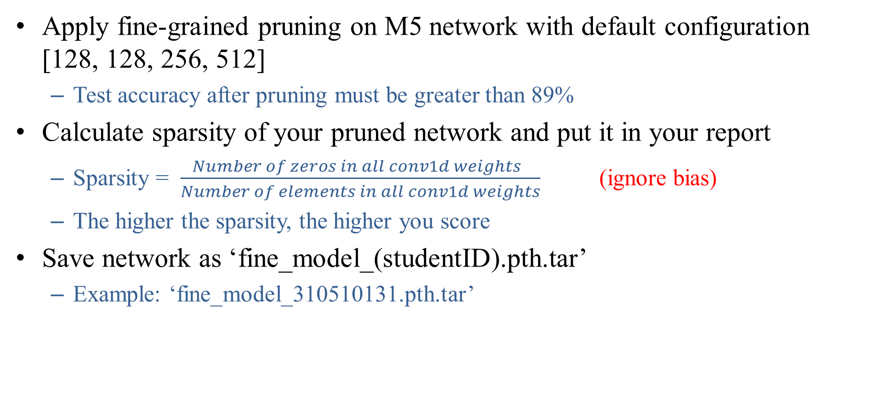
Task 2 (Pruning.ipynb)
Apply fine-grained pruning on M5 network with default configuration [128, 128, 256, 512]
Test accuracy after pruning must be greater than 89%
Calculate sparsity of your pruned network and put it in your report
Sparsity = $\frac{Number of zeros in all conv1d weights }{Number of elements in all conv1d weights}$ (ignore bias)
The higher the sparsity, the higher you score
Save network as ‘fine_model_(studentID).pth.tar’
Example: ‘fine_model_310510131.pth.tar’

Slide 15
Task 3 (Pruning.ipynb)
Apply coarse-grained pruning on M5 network
Test accuracy after pruning must be greater than 89%
The slimmer your network is, the higher you score
Save network as ‘coarse_model_(studentID).pth.tar’
Example: ‘coarse_model_310510131.pth.tar’

Slide 16
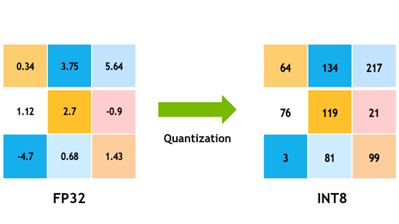
Quantization Introduction
Quantization stores tensors at lower bit-widths than floating point. This allows for a more compact model representation and the use of high performance vectorized operations on many hardware platforms.

Slide 17
Task 4 (Quantization.ipynb)
Apply post-training static quantization on your best M5 network
Run benchmark (inference speed and accuracy) between the following network
‘best_model_(studentID).pth.tar’
‘fine_model_(studentID).pth.tar’
‘coarse_model_(studentID).pth.tar’
Quantized best network

Slide 18
Task 5
Write a report
Details are in later page
Naming rule: ‘report_(studentID).pdf’
Example: ‘report_310510131.pdf’

Slide 19
Score
Task 1: Training
Test Accuracy > 90%, put accuracy in report (10%)
Task 2: Fine-grained Pruning
Test Accuracy > 89%, put accuracy, code and brief explanation in report (15%)
Sparsity Ranking, put sparsity in report (10%)
Task 3: Coarse-grained Pruning
Test Accuracy > 89%, put accuracy, code and brief explanation in report (15%)
Network Size Ranking, put network size in report (10%)
Task 4: Post Training Static Quantization
Benchmark table in report (5%)

Slide 20
Score
Task 5: Report
What are the pros and cons of fine-grained pruning and coarse-grained pruning? Which one is more hardware-friendly and why? (5%)
Give your opinions on the benchmark table. (about speed and accuracy) (5%)
Why do we fuse modules in quantization flow? (5%)
In step 3 of post-training static quantization (PTSQ), we insert observers. What’s the use of these observers? (5%)
We use PTSQ in task 5. What’s the difference between PTSQ and post-training dynamic quantization? Which one is more hardware-friendly and why? (5%)
Other (10%)
Difficulties you encounter and how you solve it
Any improvements, methods you make or try
※Please write your report in order (Task1 to Task5)

Slide 21
Reminder
Submit Deadline : 2 week (2022/12/1 11:59 PM)
Zip the following 7 files into Lab04_(studentID).zip and upload to e3
best_model_(studentID).pth.tar
fine_model_(studentID).pth.tar
coarse_model_(studentID).pth.tar
report_(studentID).pdf
Training_(studentID).ipynb
Pruning_(studentID).ipynb
Quantization_(studentID).ipynb
One naming error = 2pt reduction (-10pt most)

Slide 22
Shut down your kernel !!!!!
Remember to SHUTDOWN the kernel
To release resources for others.

Slide 23
Reference
PRUNING TUTORIAL
https://pytorch.org/tutorials/intermediate/pruning_tutorial.html
Rethinking the Value of Network Pruning
https://github.com/Eric-mingjie/rethinking-network-pruning
M5 Network
VERY DEEP CONVOLUTIONAL NEURAL NETWORKS FOR RAW WAVEFORMS
Post-training Static Quantization — Pytorch
https://medium.com/@sanjanasrinivas73/post-training-static-quantization-pytorch-37dd187ba105
Speech commands
https://arxiv.org/abs/1804.03209

