Slide 1
EE6470 MIDTERM PROJECT
STUDENT: 趙庭慶 109061616

Slide 2
GUIDE LINE
The GaussianBlur Filter(5x5) with grey
HLS :
(1) without pipeline (also without data reuse)
(2) with pipeline
(3) with data reuse
TLM :
(1) with data reuse
The algorithm
Result

Slide 3
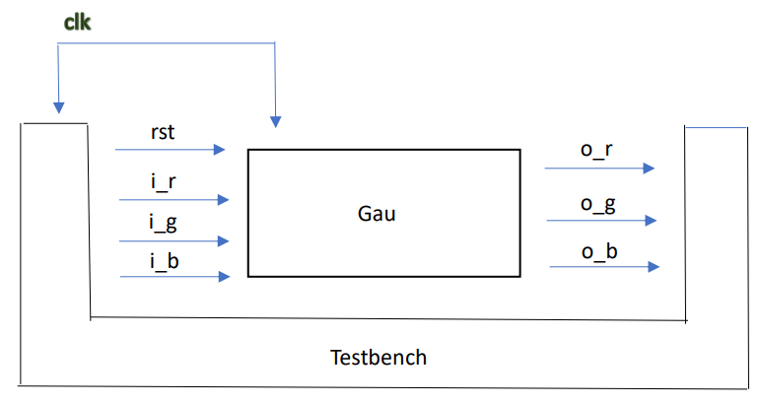
Structural (HLS without pipeline)
(With grey)

Slide 4
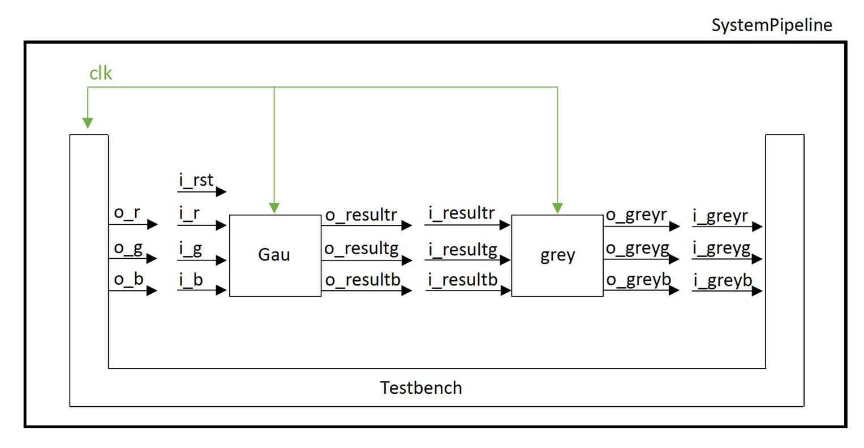
Structural (HLS with pipeline)

Slide 5
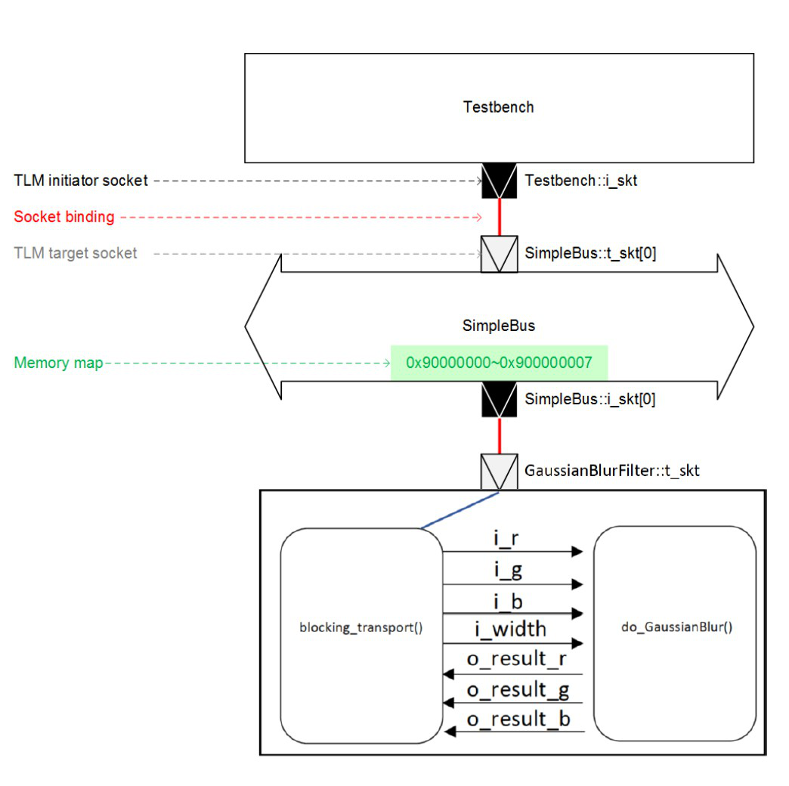
Structural (TLM-2.0 bus)

Slide 6
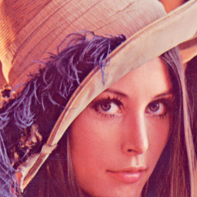
Algorithm (data reuse)
256
256
.bmp
Notes:
The original bmp is 256 x 256

Slide 7
Step.2
256
Step.1
5
{1, 4, 6, 4, 1},
{4, 16, 24, 16, 4},
Conv {6, 24, 36, 24, 6},
{4, 16, 24, 16, 4},
{1, 4, 6, 4, 1}
1 x 256 result
Notes:
First, read 5 rows data.
Then, fetch 3x256 to do conv.
In the 3x256, 2 of 3 rows shift up.

Slide 8
Step.3
5 x 256
Step.4
 |  |  |  |  | …
 |  |  |  |  | …
 |  |  |  |  | …
 |  |  |  |  | …
 |  |  |  |  | …
… | … | … | … | … | …
{1, 4, 6, 4, 1},
{4, 16, 24, 16, 4},
Conv {6, 24, 36, 24, 6},
{4, 16, 24, 16, 4},
{1, 4, 6, 4, 1}
5 x 256
256 x 256

Slide 9
Result
HLS
\ | \ | B | V_BASIC | V_DPA
With pipeline | Area | N/A | 2900 + 1137 = 4039 | 2629 + 862 = 3791
 | Simulated time | 68157530 ns | 84541500 ns | 84541480 ns
Without pipeline (also without data reuse) | Area | N/A | 7042 | 5695.4
 | Simulated time | 68157490 ns | 100925430 ns | 87818230 ns
With data reuse | Area | N/A | 8988 | 6295
 | Simulated time | 5183950 ns | 110845505 ns | 63475265 ns
\ | Simulated time
With data reuse | 1664255 ns

Slide 10


ORIGINAL
AFTER FILTER(3X3)
AFTER FILTER(5X5)

Slide 11
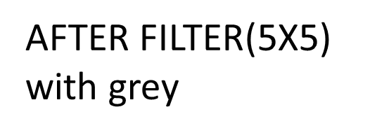
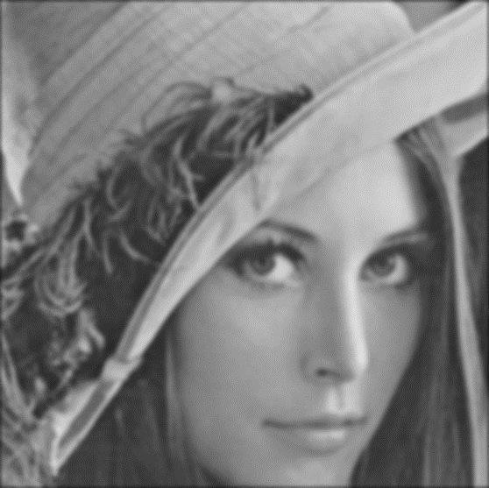
Final

Slide 12
Thank you

