Slide 2
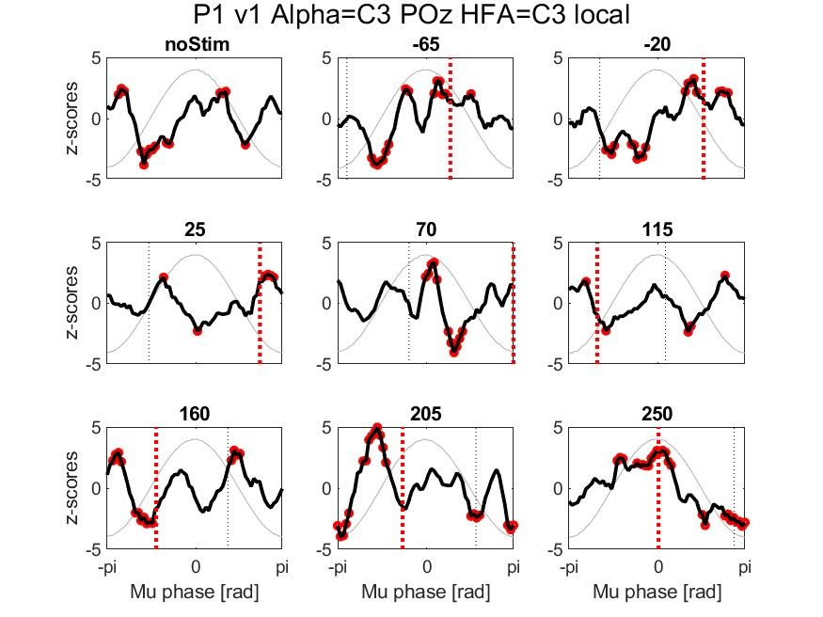
General observation: Deepest trough (= max. inhibition) seems to occur outside of stimulation, apart from maybe in 250
Exception to the deepest trough observation is in 115 and 250 degree
Less consistent for 70, maybe talking?

Slide 3
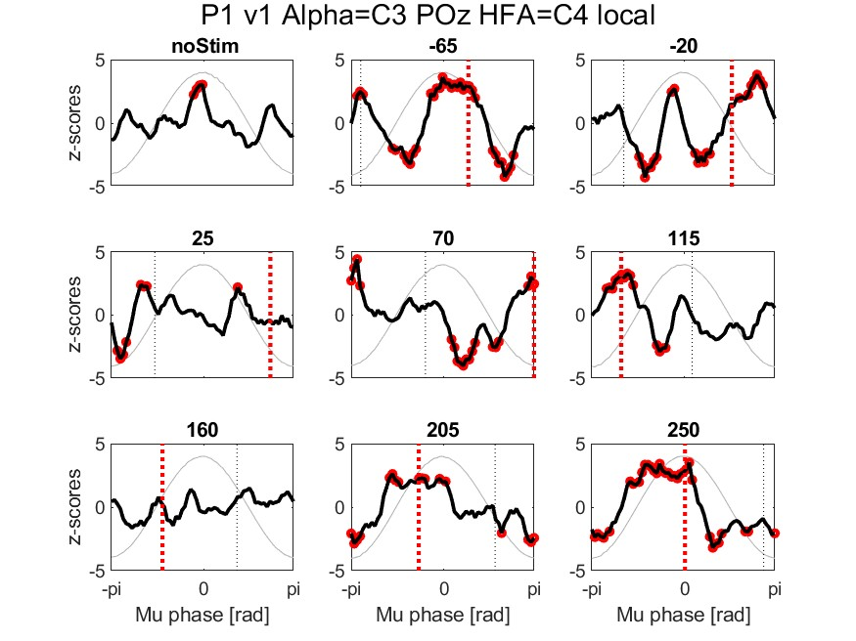
General observation: Deepest trough (= max. inhibition) seems to occur outside of stimulation, apart from maybe in 115 and 250
Exception to the deepest trough observation is in 115 and 250 degree
Peak shifted for 70?
Flat line for 160?

Slide 4
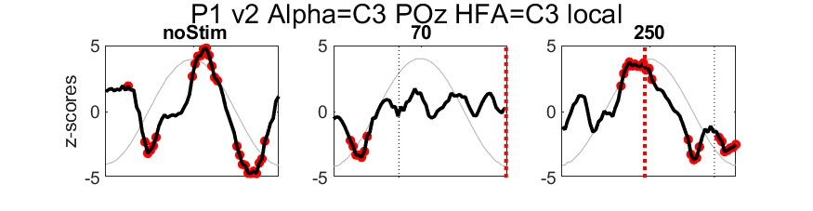
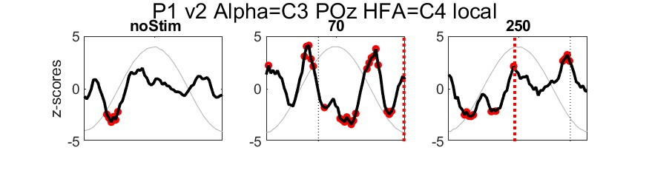
General observation: Deepest trough (= max. inhibition) seems to occur outside of stimulation, apart from maybe in 250
Exception to the deepest trough observation is in 115 and 250 degree
Peak shifted for 70?
Flat line for 160?
More alpha rhythmic in 250?
Less consistent for 70, maybe talking?

Slide 5
Pilot recording (P2, Petra, Eyes Closed)

Slide 6
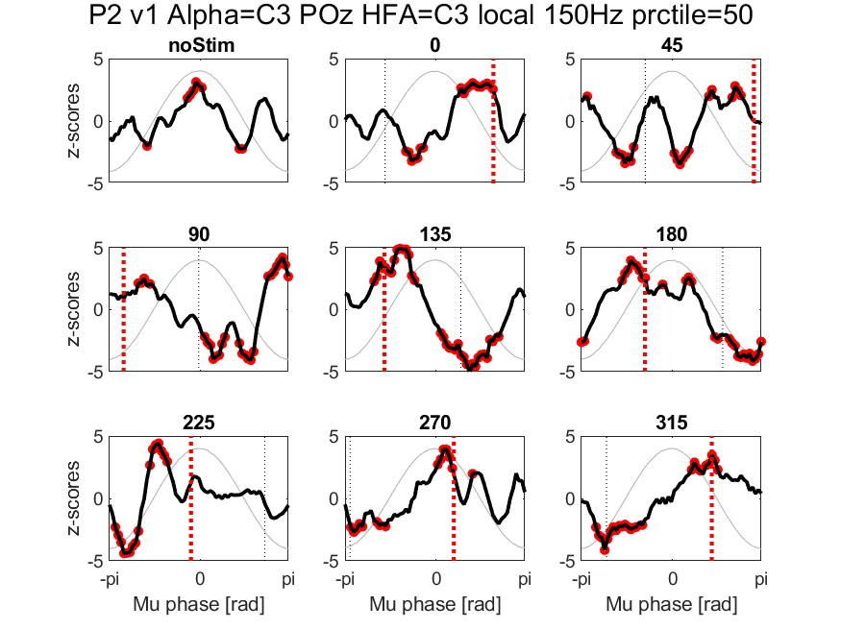
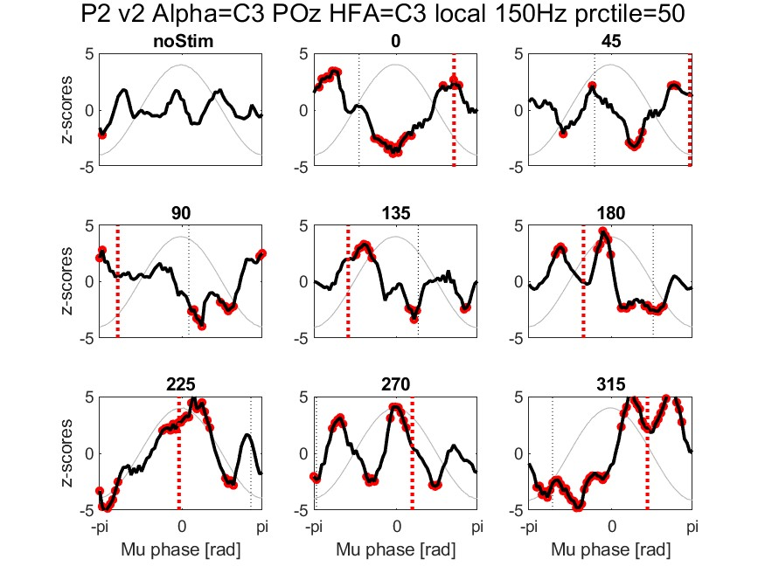

Slide 7
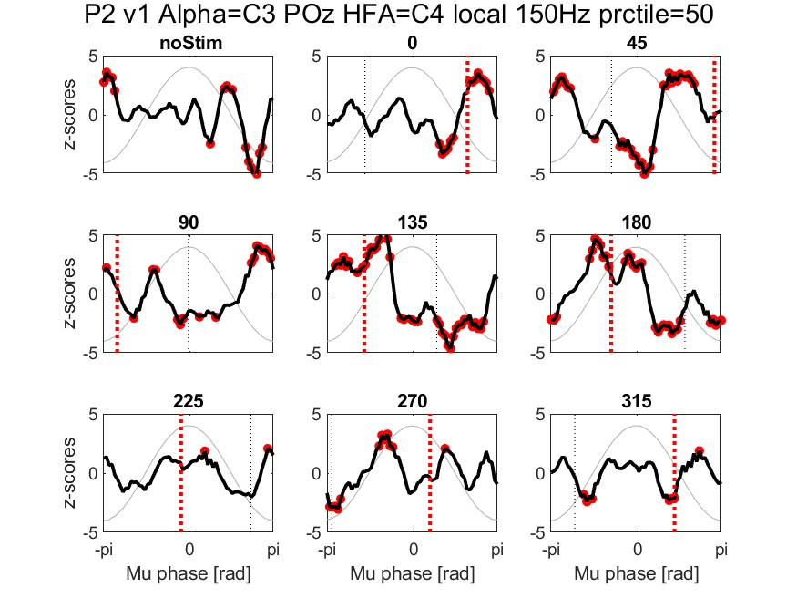
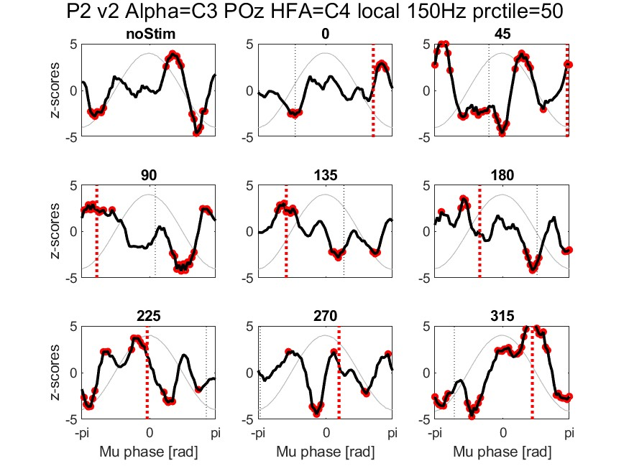

Slide 8
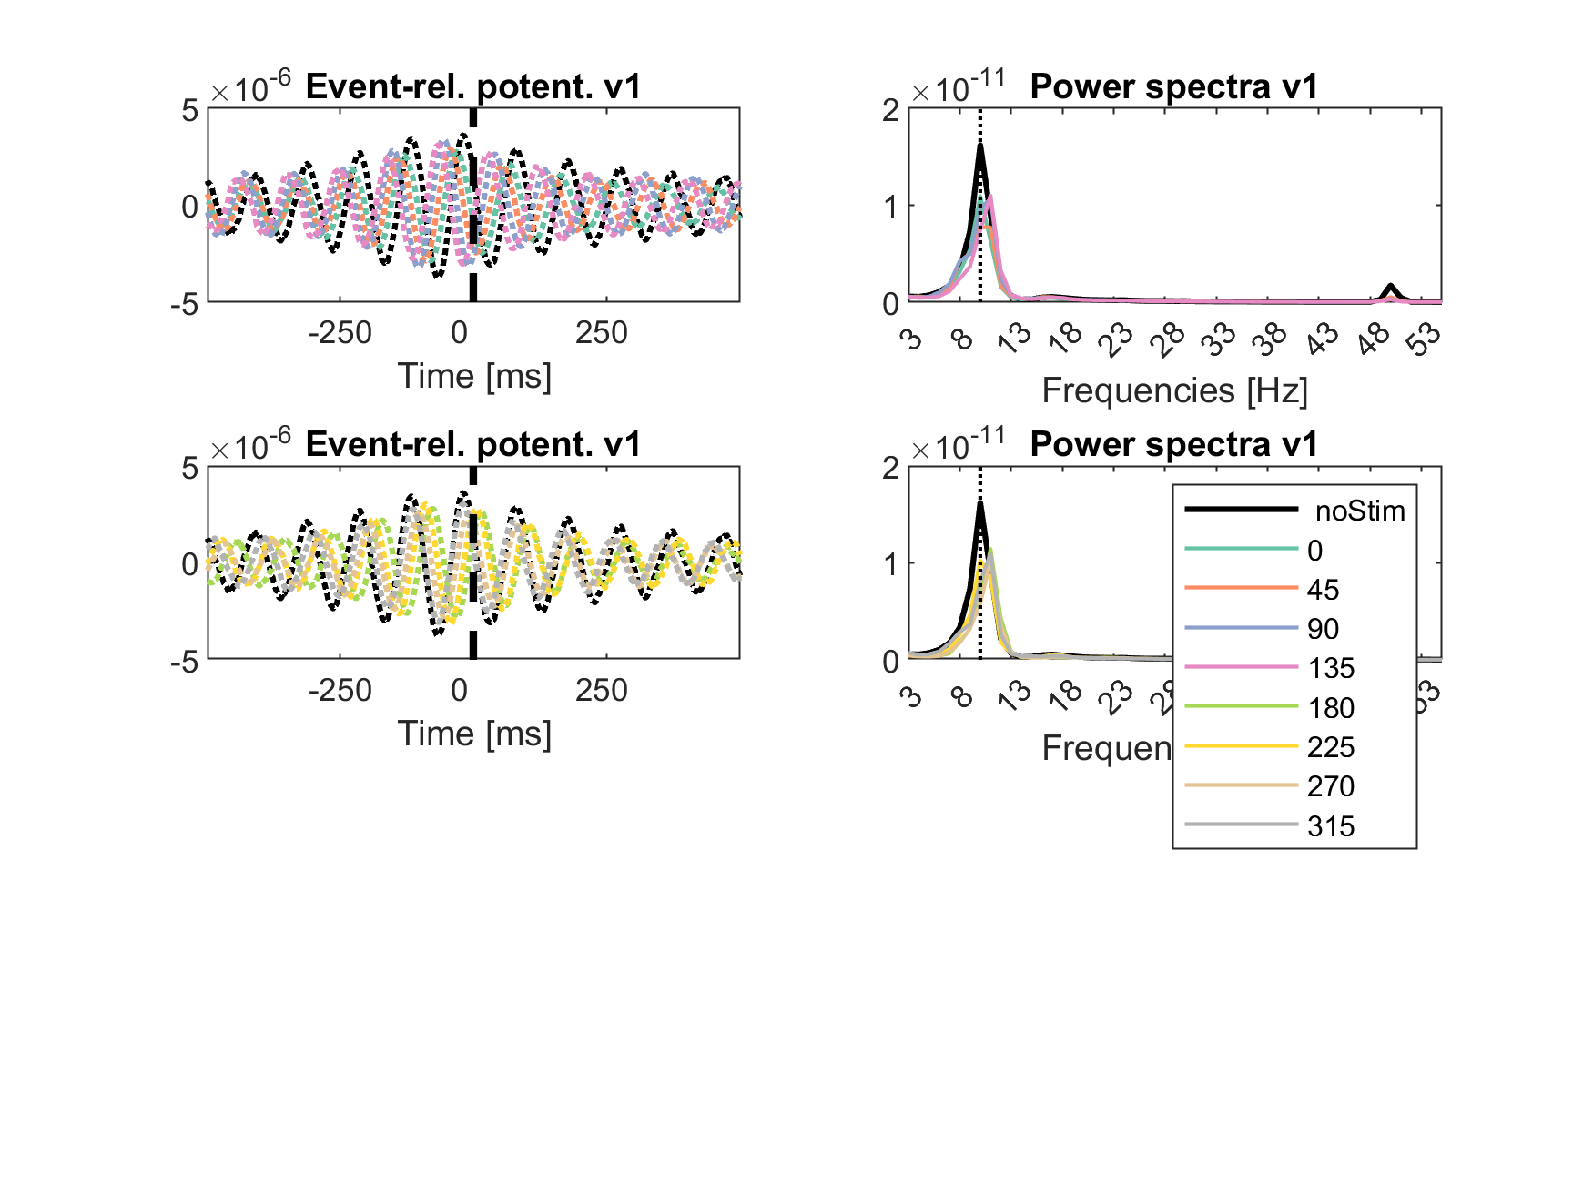
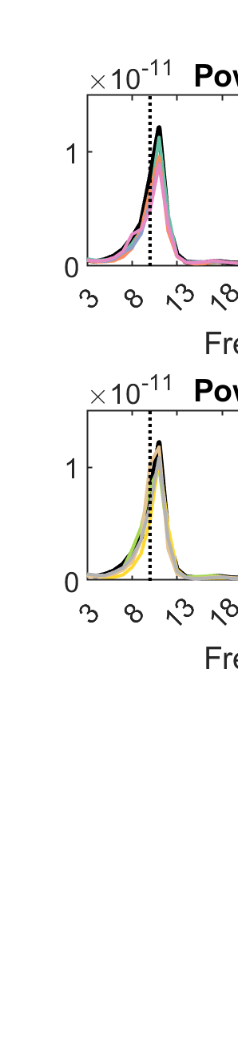

Slide 9
Coding exercise/challenge week 2 for power spectra
Adjust the position of the figure legend: https://www.mathworks.com/support/search.html/answers/1589614-adjust-legend-position-outside-the-figure-layout.html?fq%5B%5D=asset_type_name:answer&fq%5B%5D=category:support/explorati3087&page=1
Keep the y-axis scale the same for both the top and bottom plots and v1 and v2 for the power spectra
Maybe choose better colour instead of brewerMap = brewermap(8,"Set2");
Try to understand the code, and replace the NOSTIM file with the OL_11 Hz file. Hint: You need to change extract_fnames_flt_band()

Slide 11
Coding exercise/challenge week 1
Try to add two semi-transparent rectangles to the plot, which highlight the period of stimulation

Slide 12
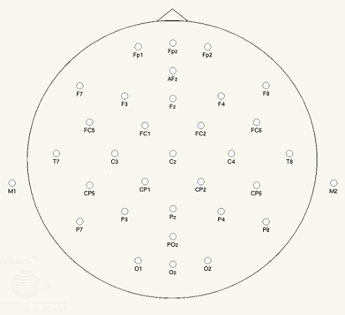
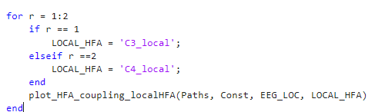
Analysis exercise/challenge
Expand the function return_ref_chan(EEG_LOC, Const)
to include a variety of potential interesting “local reference” configurations, and then use it in the for-loop

Slide 13
Play around with:
HI_PASS_FREQ = 150;
AMPL_PRCTILE = 50;

