Slide 1
EEG recordings from one healthy participant

Slide 2
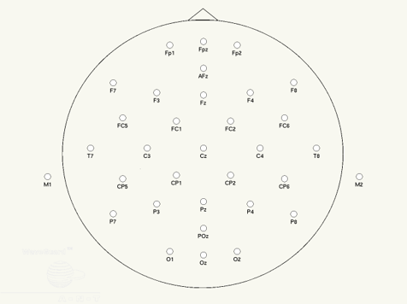
Eyes closed recording (causing high alpha power), tracking signal: C3-Poz 8 different vibrotactile stimulation (VTS) phases
STIM @RIGHT HAND (taped to abductor pollicis brevis muscle), affecting more strongly left hemisphere: C3, CP5, CP1
Motor cortex
Motor cortex
Somatosensory cortex

Slide 3
First we run a consistency check, we obtained two recordings for each stimulation phase (v1 and v2), and the next slide checks how consistently HFA is modulated (over 5 different EEG sites) in response to the different phases.
The data was z-scored relative to a permutation distribution, to correct for shifts in baseline HFA activity, which can occur throughout recordings due to various reasons (change in impedance, head muscle activation, etc.)

Slide 4
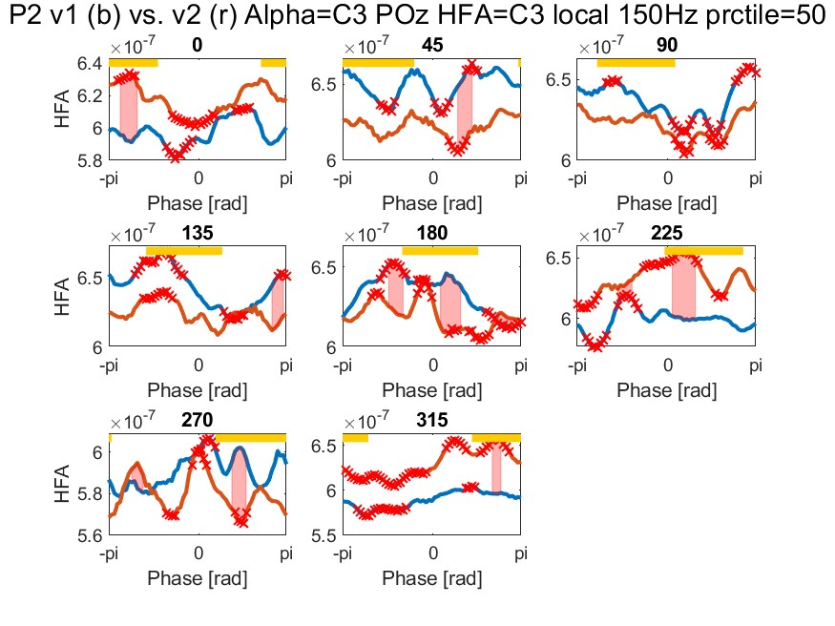
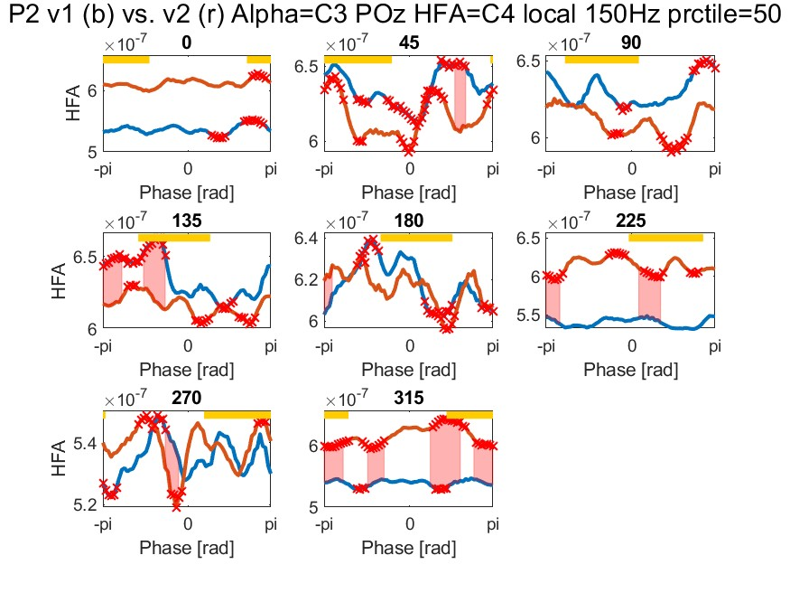
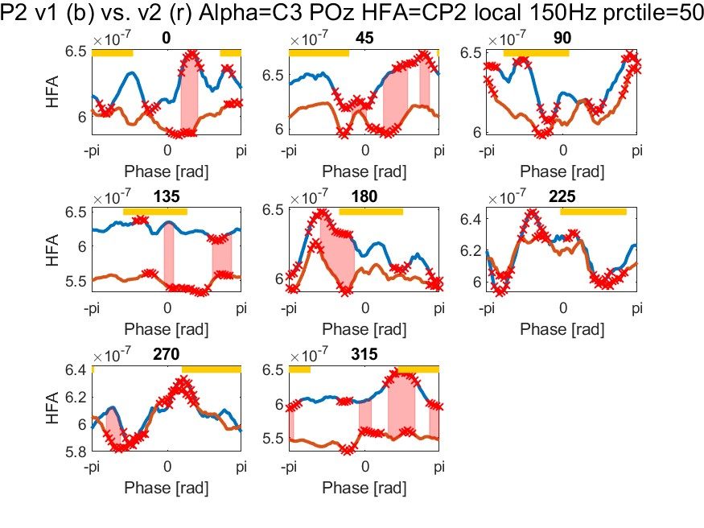
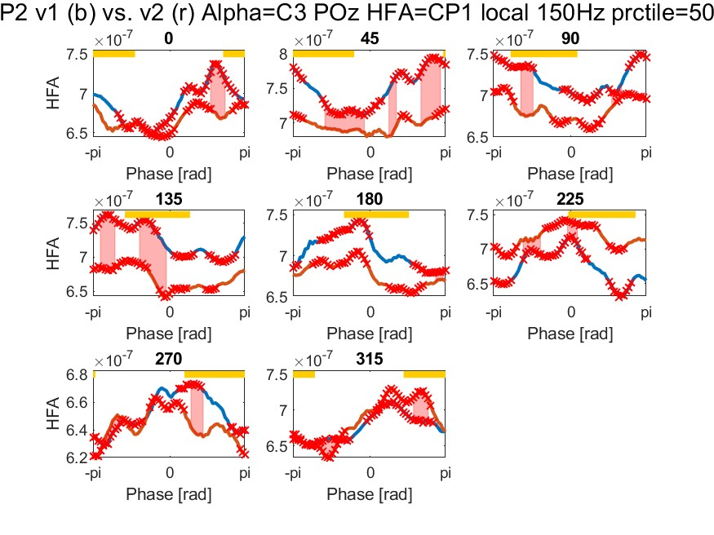
Unnormalized HFA
Best consistency over CP1? → Make this future tracking signal?
To identify the channel most affected by VTS in healthy:
→ Develop a summary metric that quantifies the consistency of the HFA shape across v1 and v2 and for all phases, and also considers the difference in shifts in peaks/troughs to then create a topoplot, so we can visualize this across subjects

Slide 5
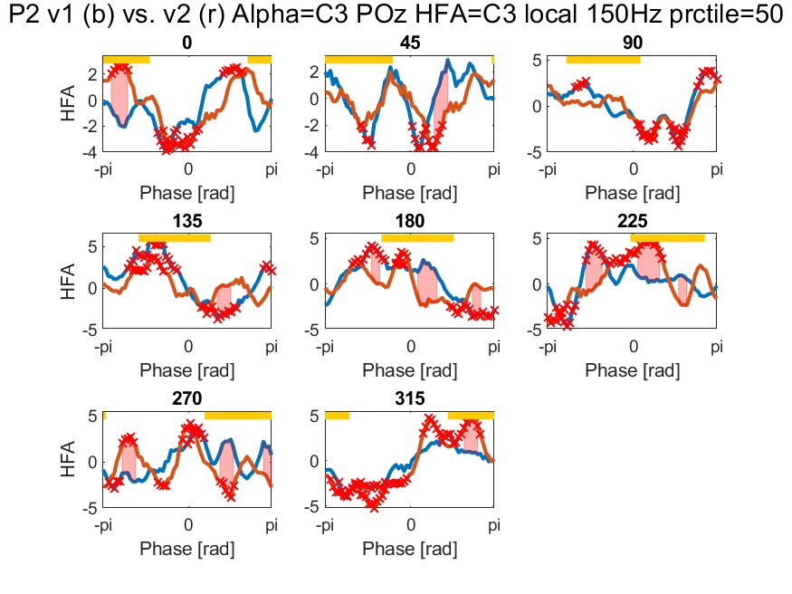
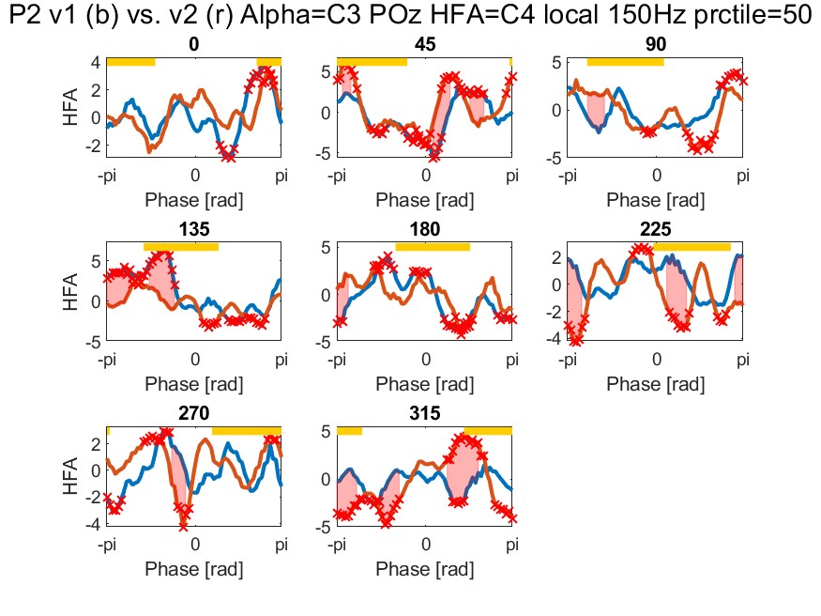
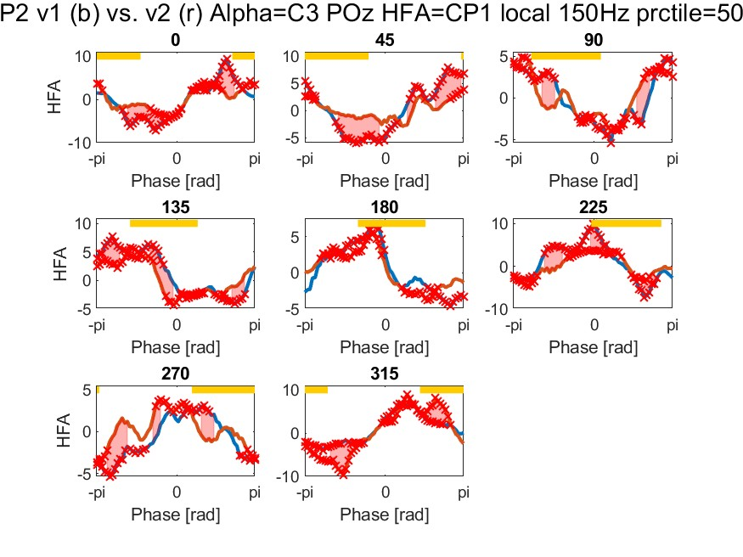
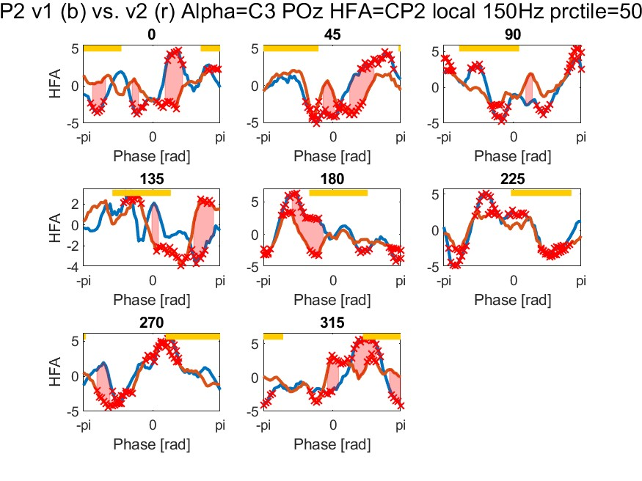
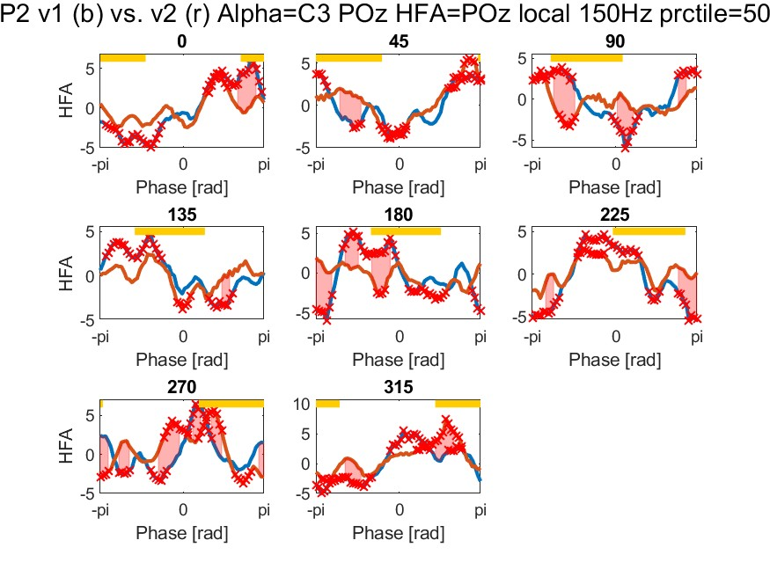
Z-scored HFA
Best consistency and nice alpha modulation over CP1?
To identify the channel most affected by VTS in healthy:
→ Develop a summary metric that quantifies the consistency of the HFA shape across v1 and v2 and for all phases, and also considers the difference in shifts in peaks/troughs to then create a topoplot, so we can visualize this across subjects

Slide 6
Second, we look for significant differences relative to “NoStim”, i.e. how does HFA activity change with phase-specific VTS relative to “baseline” co-fluctuations in neural activity

Slide 7
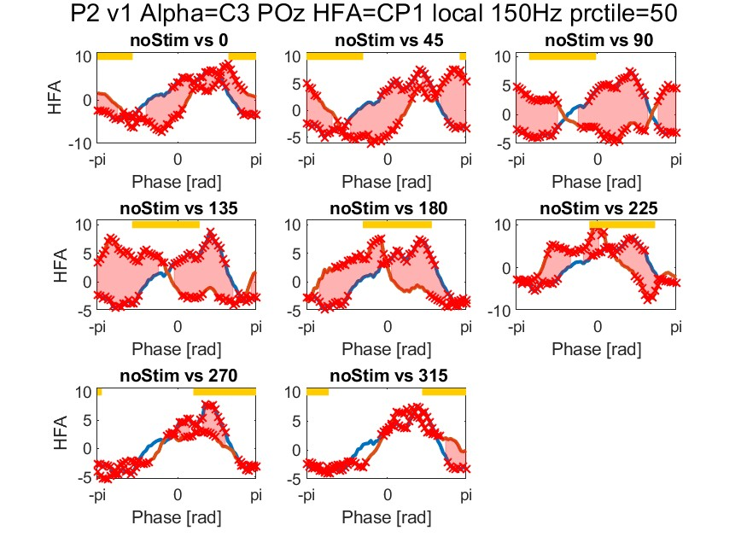
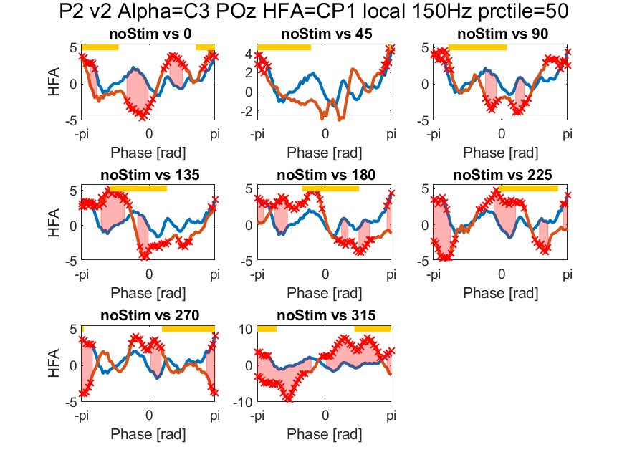
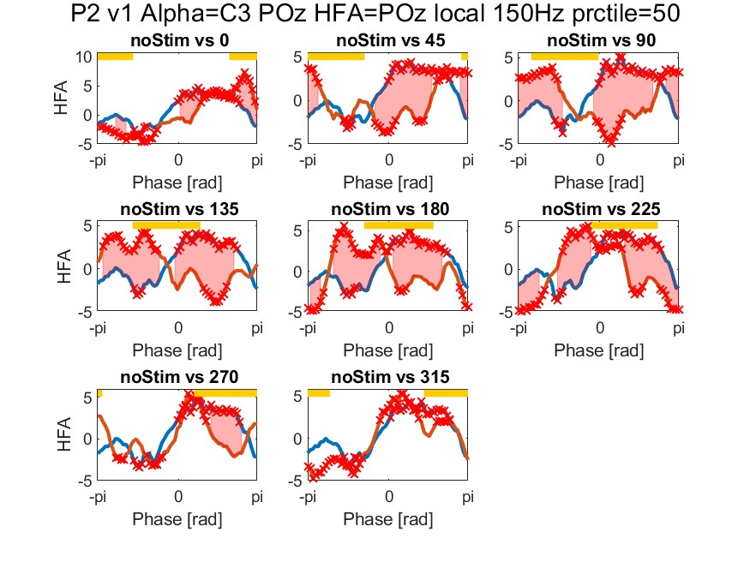
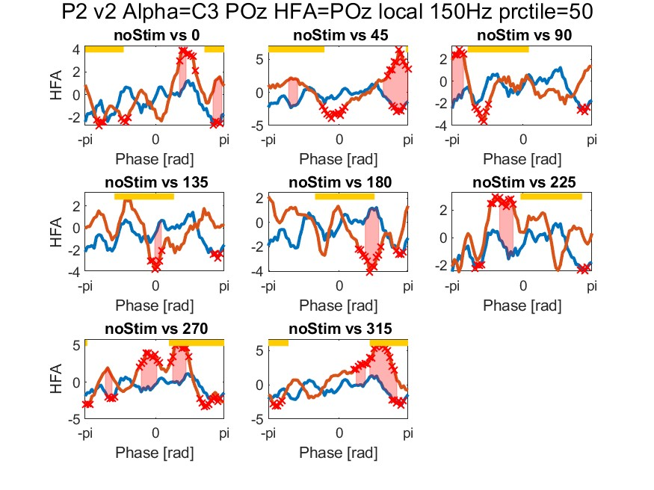
Difference in VTS conditions vs. NoStim, focussing on CP1 (noStim=blue line)
Unfortunately, noStim v1 may not be useable, lots of 50 Hz noise, see next slide, we had a noise source which we only switched off after the first recording

Slide 8
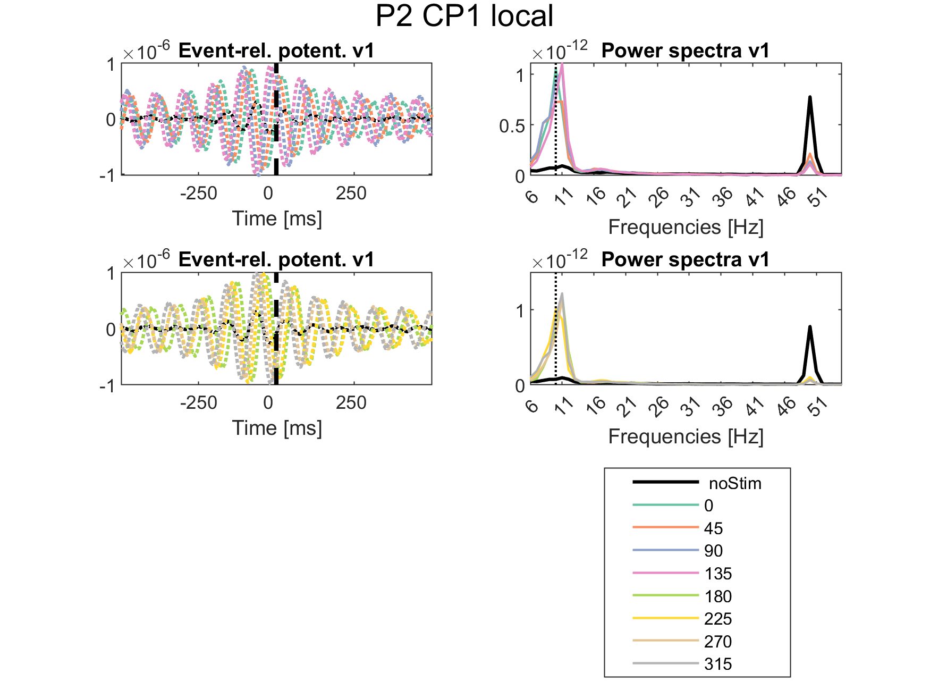
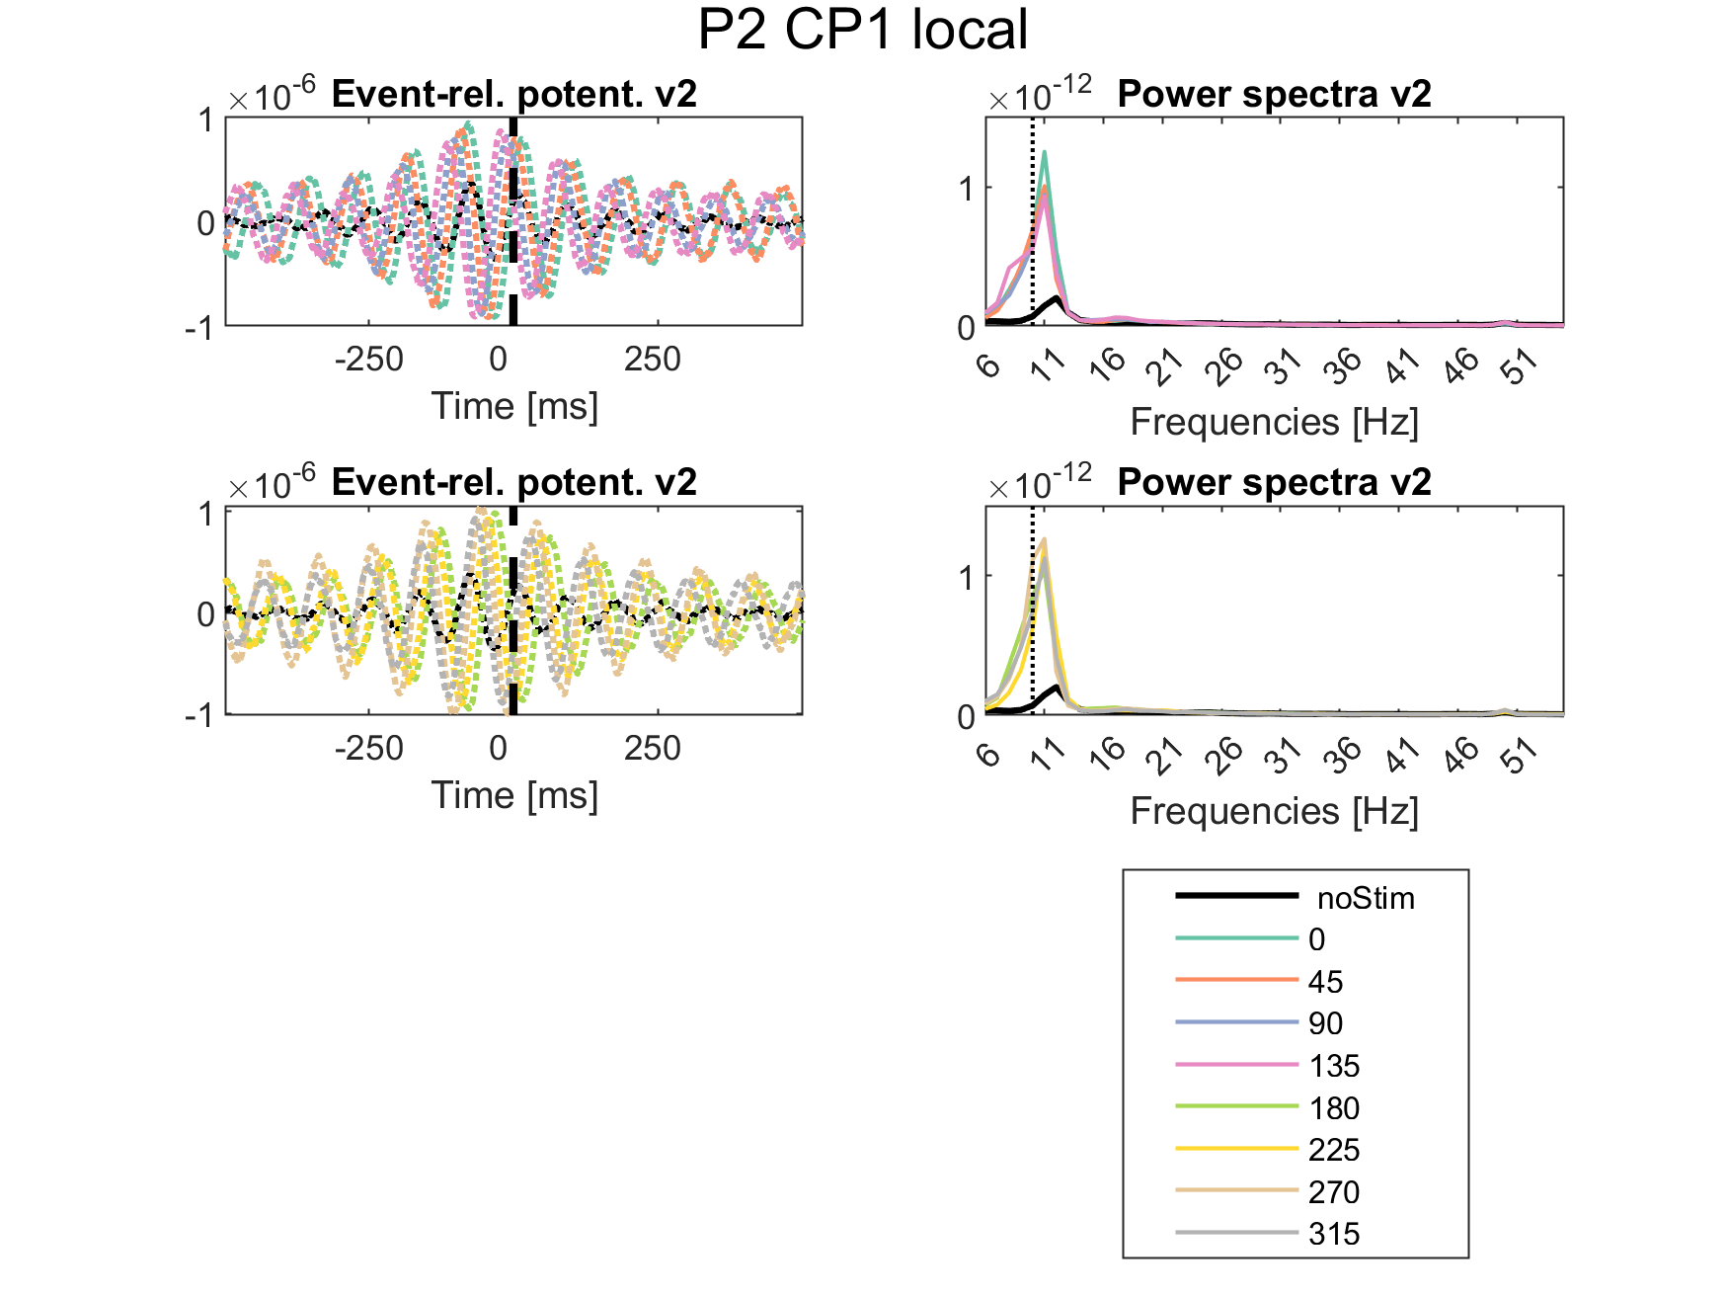
This shows on average where we stimulated

