Slide 1
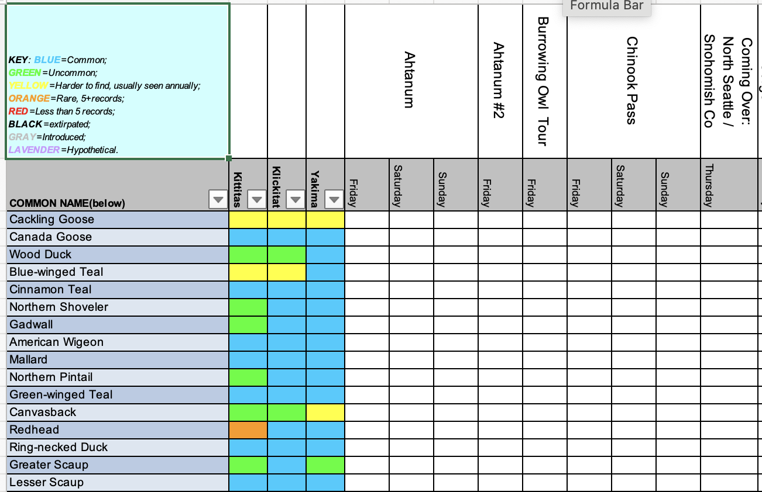
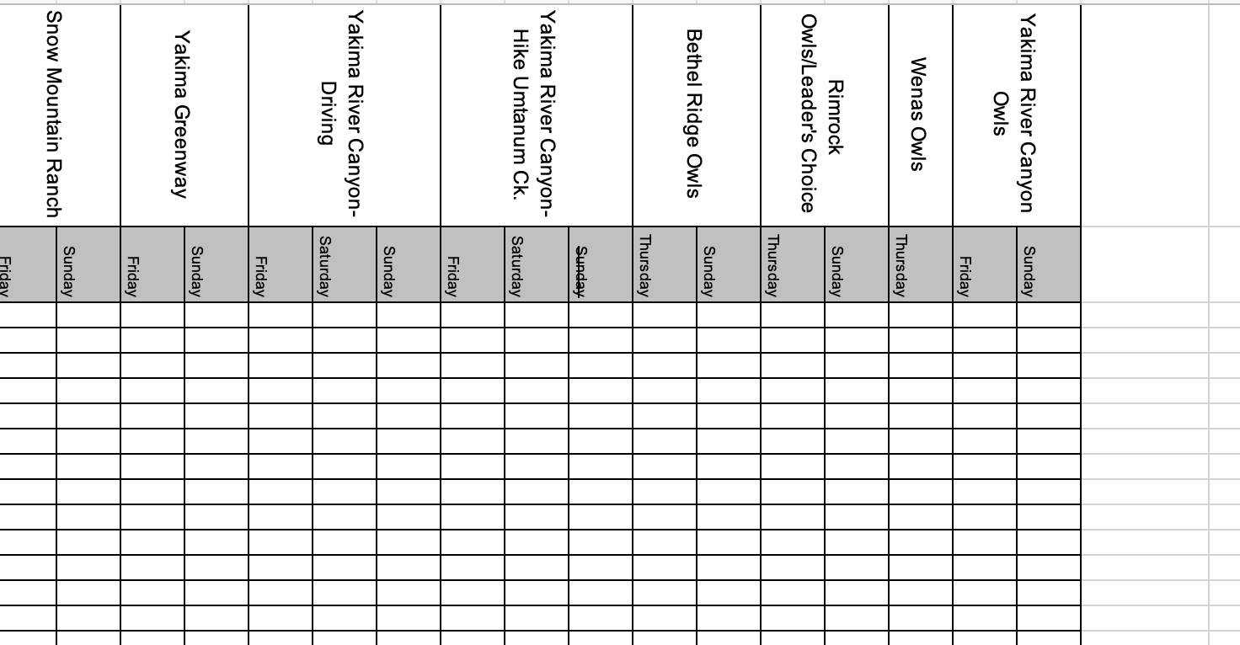
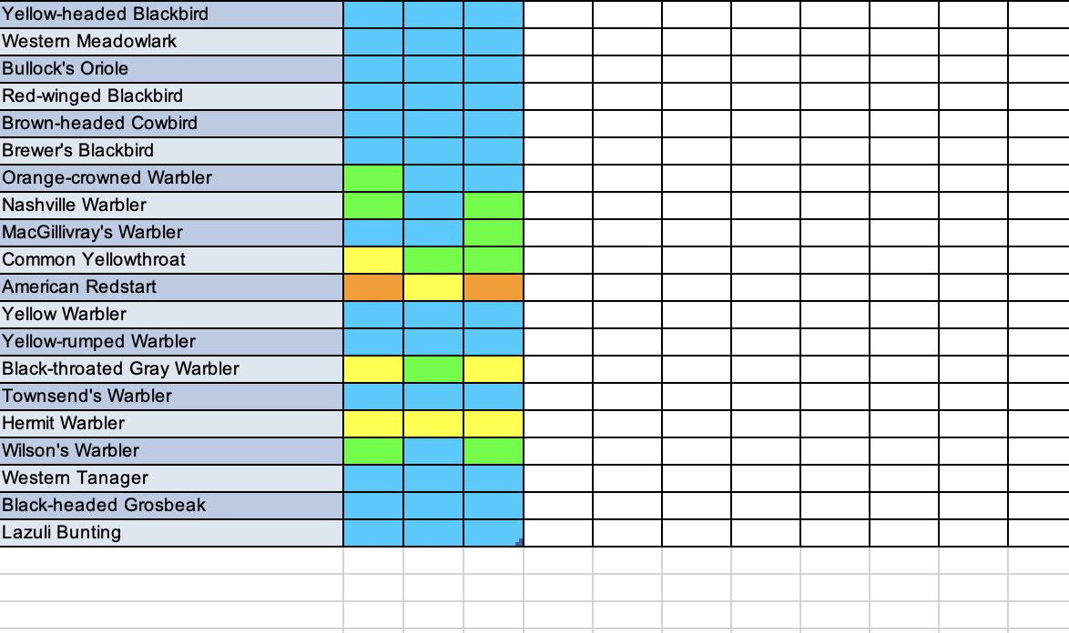
Trip Names
Trip Instances
x
Expected
Species

Slide 2
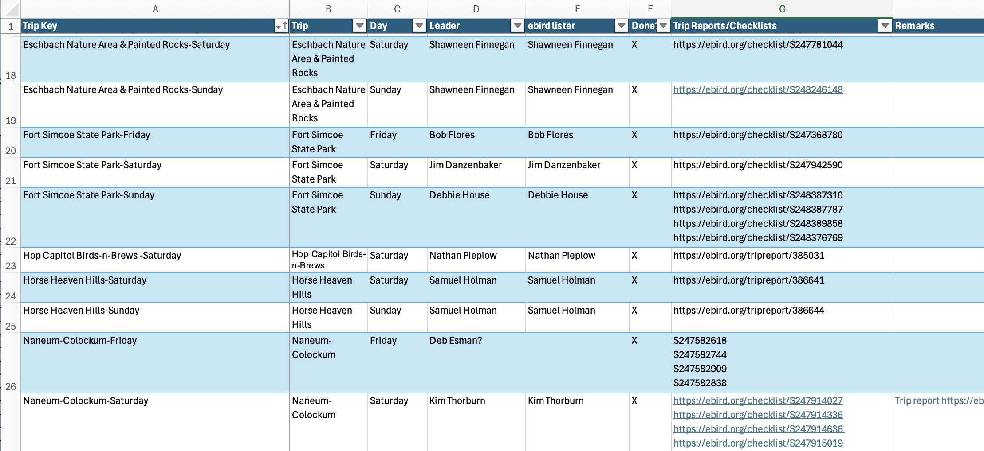

Slide 3
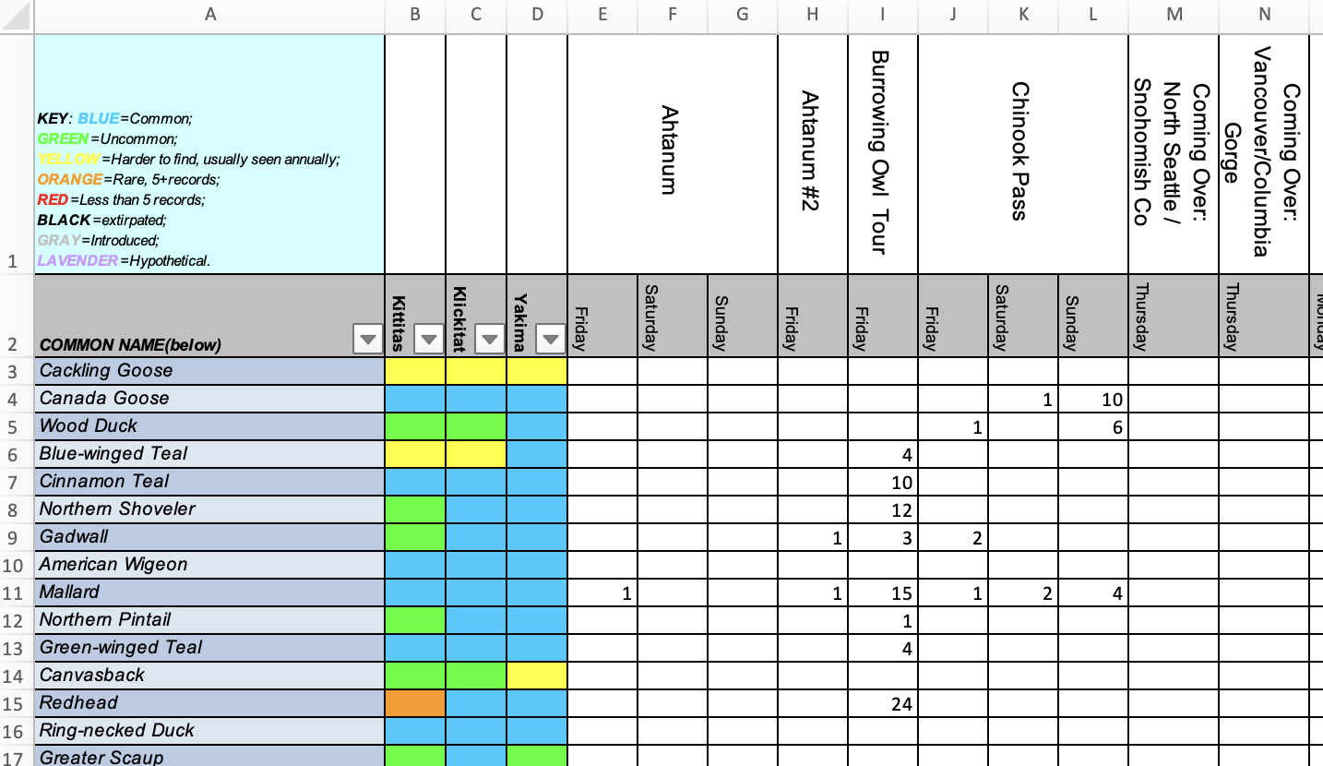
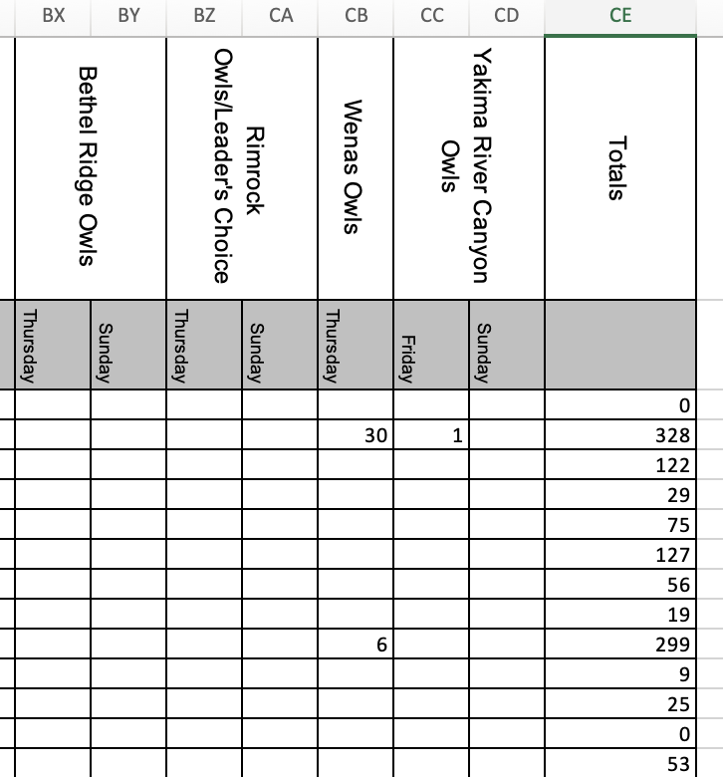
xxxxxx : Count of individuals of this Species on this trip
xxxxxx : Count of individuals of this Species across all trips

Slide 4
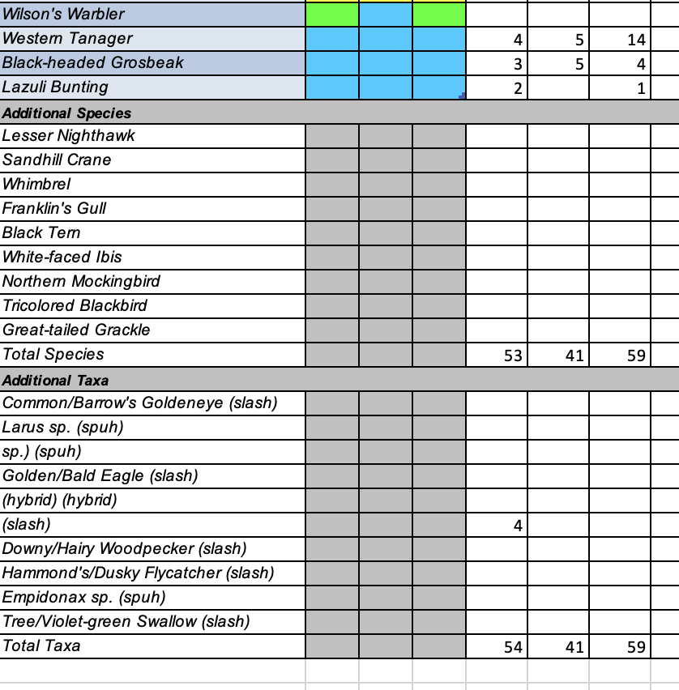
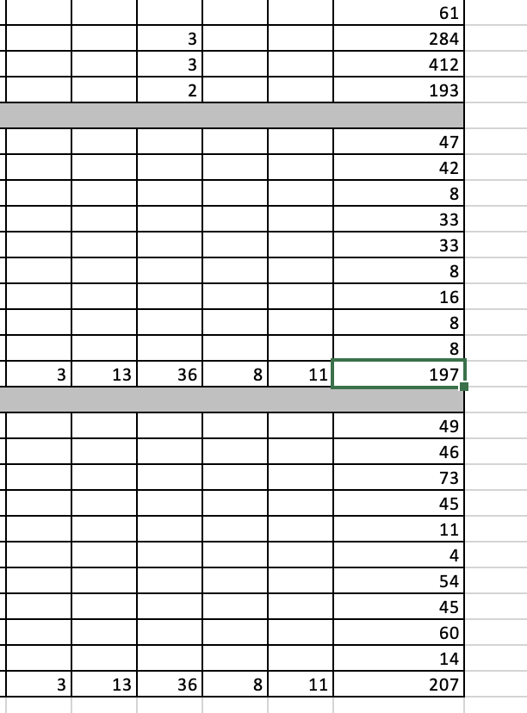
xxxxxx : Additional species seen on field trips
xxxxxx : Additional Taxa seen on field trips
xxxxxx : Count of unique species observed on this trip
xxxxxx : Count of unique species across all trips
xxxxxx : Count of unique taxa observed on this trip
xxxxxx : Count of unique taxa across all trips

Slide 5
