Slide 1
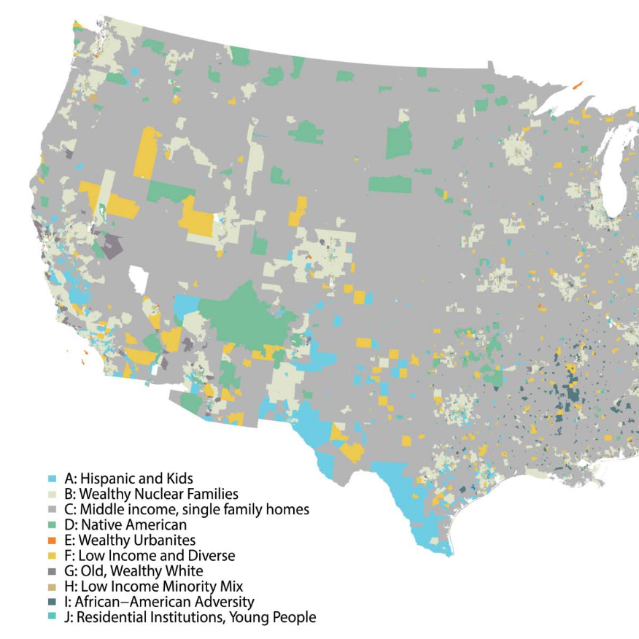




Retail and Geodemographics: A Spatial Data Science Approach
Patrick Ballantyne, University of Liverpool

Slide 2
Retail and Geodemographics: A Spatial Data Science Approach
Today’s workshop:
Concepts, ideas and research
Code, tools and insights

Slide 3
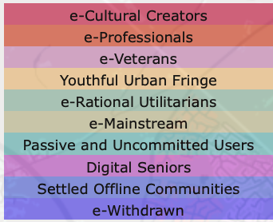
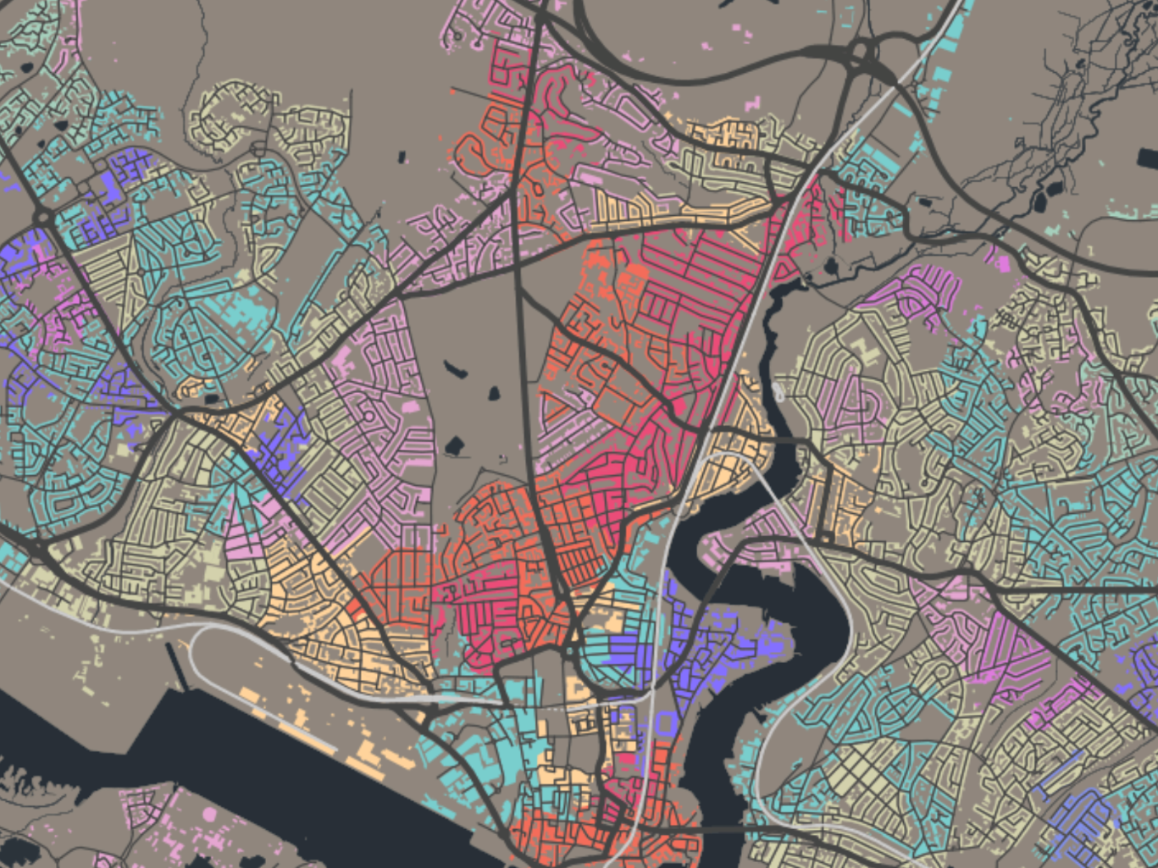
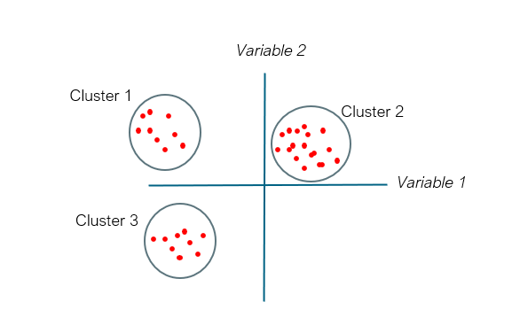
Retail and Geodemographics: A Spatial Data Science Approach
Area | Income | Age | Car | Employment | Degree | Commute
Area1
Area2
Area3
Area4

Slide 4
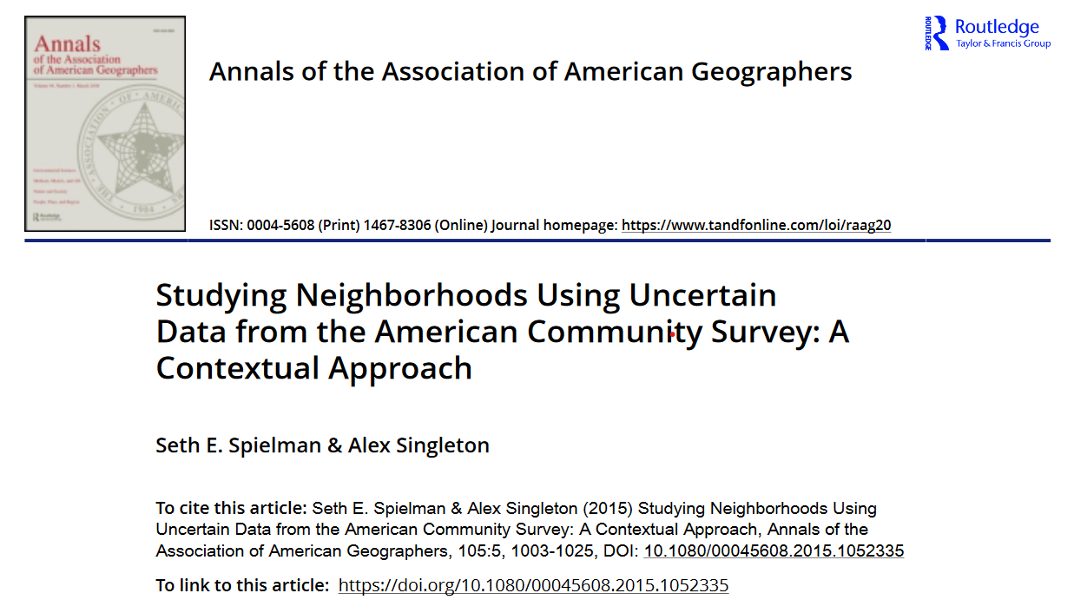
Overview:
Geodemographic classification of census tracts
American Community Survey (ACS)
How many variables? proach

