Slide 1
AZ-900T00 Learning Path 01: Cloud concepts
Notes:
https://docs.microsoft.com/learn/paths/microsoft-azure-fundamentals-describe-cloud-concepts/
The notes section of the PPT will call out any free Learn sandbox exercises available and provide direct links that can be shared with students.

Slide 2

Learning Path Outline

Slide 3

Learning Path 01 - Outline
You will learn the following concepts:
Cloud Computing
What is cloud computing
Shared responsibility
Cloud models
Capital vs Operational costing
Cloud Benefits
Benefits of the cloud
Cloud Service Types
IaaS, PaaS, and SaaS

Slide 4
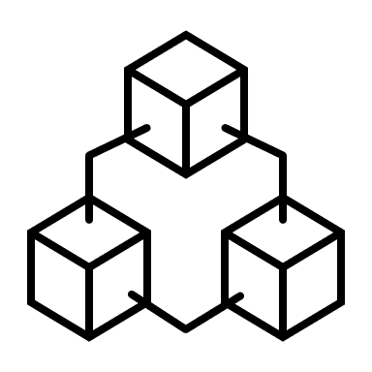
Cloud Computing
Notes:
https://docs.microsoft.com/learn/modules/describe-cloud-compute/

Slide 5
Cloud computing - Objective Domain
Define cloud computing
Describe the shared responsibility model
Define cloud models, including public, private, and hybrid
Identify appropriate use cases for each cloud model
Describe the consumption-based model
Compare cloud pricing models
Notes:
https://docs.microsoft.com/learn/modules/describe-cloud-compute/2-introduction-cloud-compute

Slide 6



What is cloud computing?
Cloud Computing is the delivery of computing services over the internet, enabling faster innovation, flexible resources, and economies of scale.
Compute
Networking
Storage
Notes:
https://docs.microsoft.com/learn/modules/describe-cloud-compute/3-what-cloud-compute
Cloud Computing is:
A model for enabling on-demand access to a shared pool of configurable computing resources – servers, network, storage, applications, and services
Ubiquitous, convenient, on-demand network access
Rapidly provisioned and released with minimal management effort or service provider interaction
Definitions found at:
NIST definition - https://csrc.nist.gov/publications/detail/sp/800-145/final

Slide 7
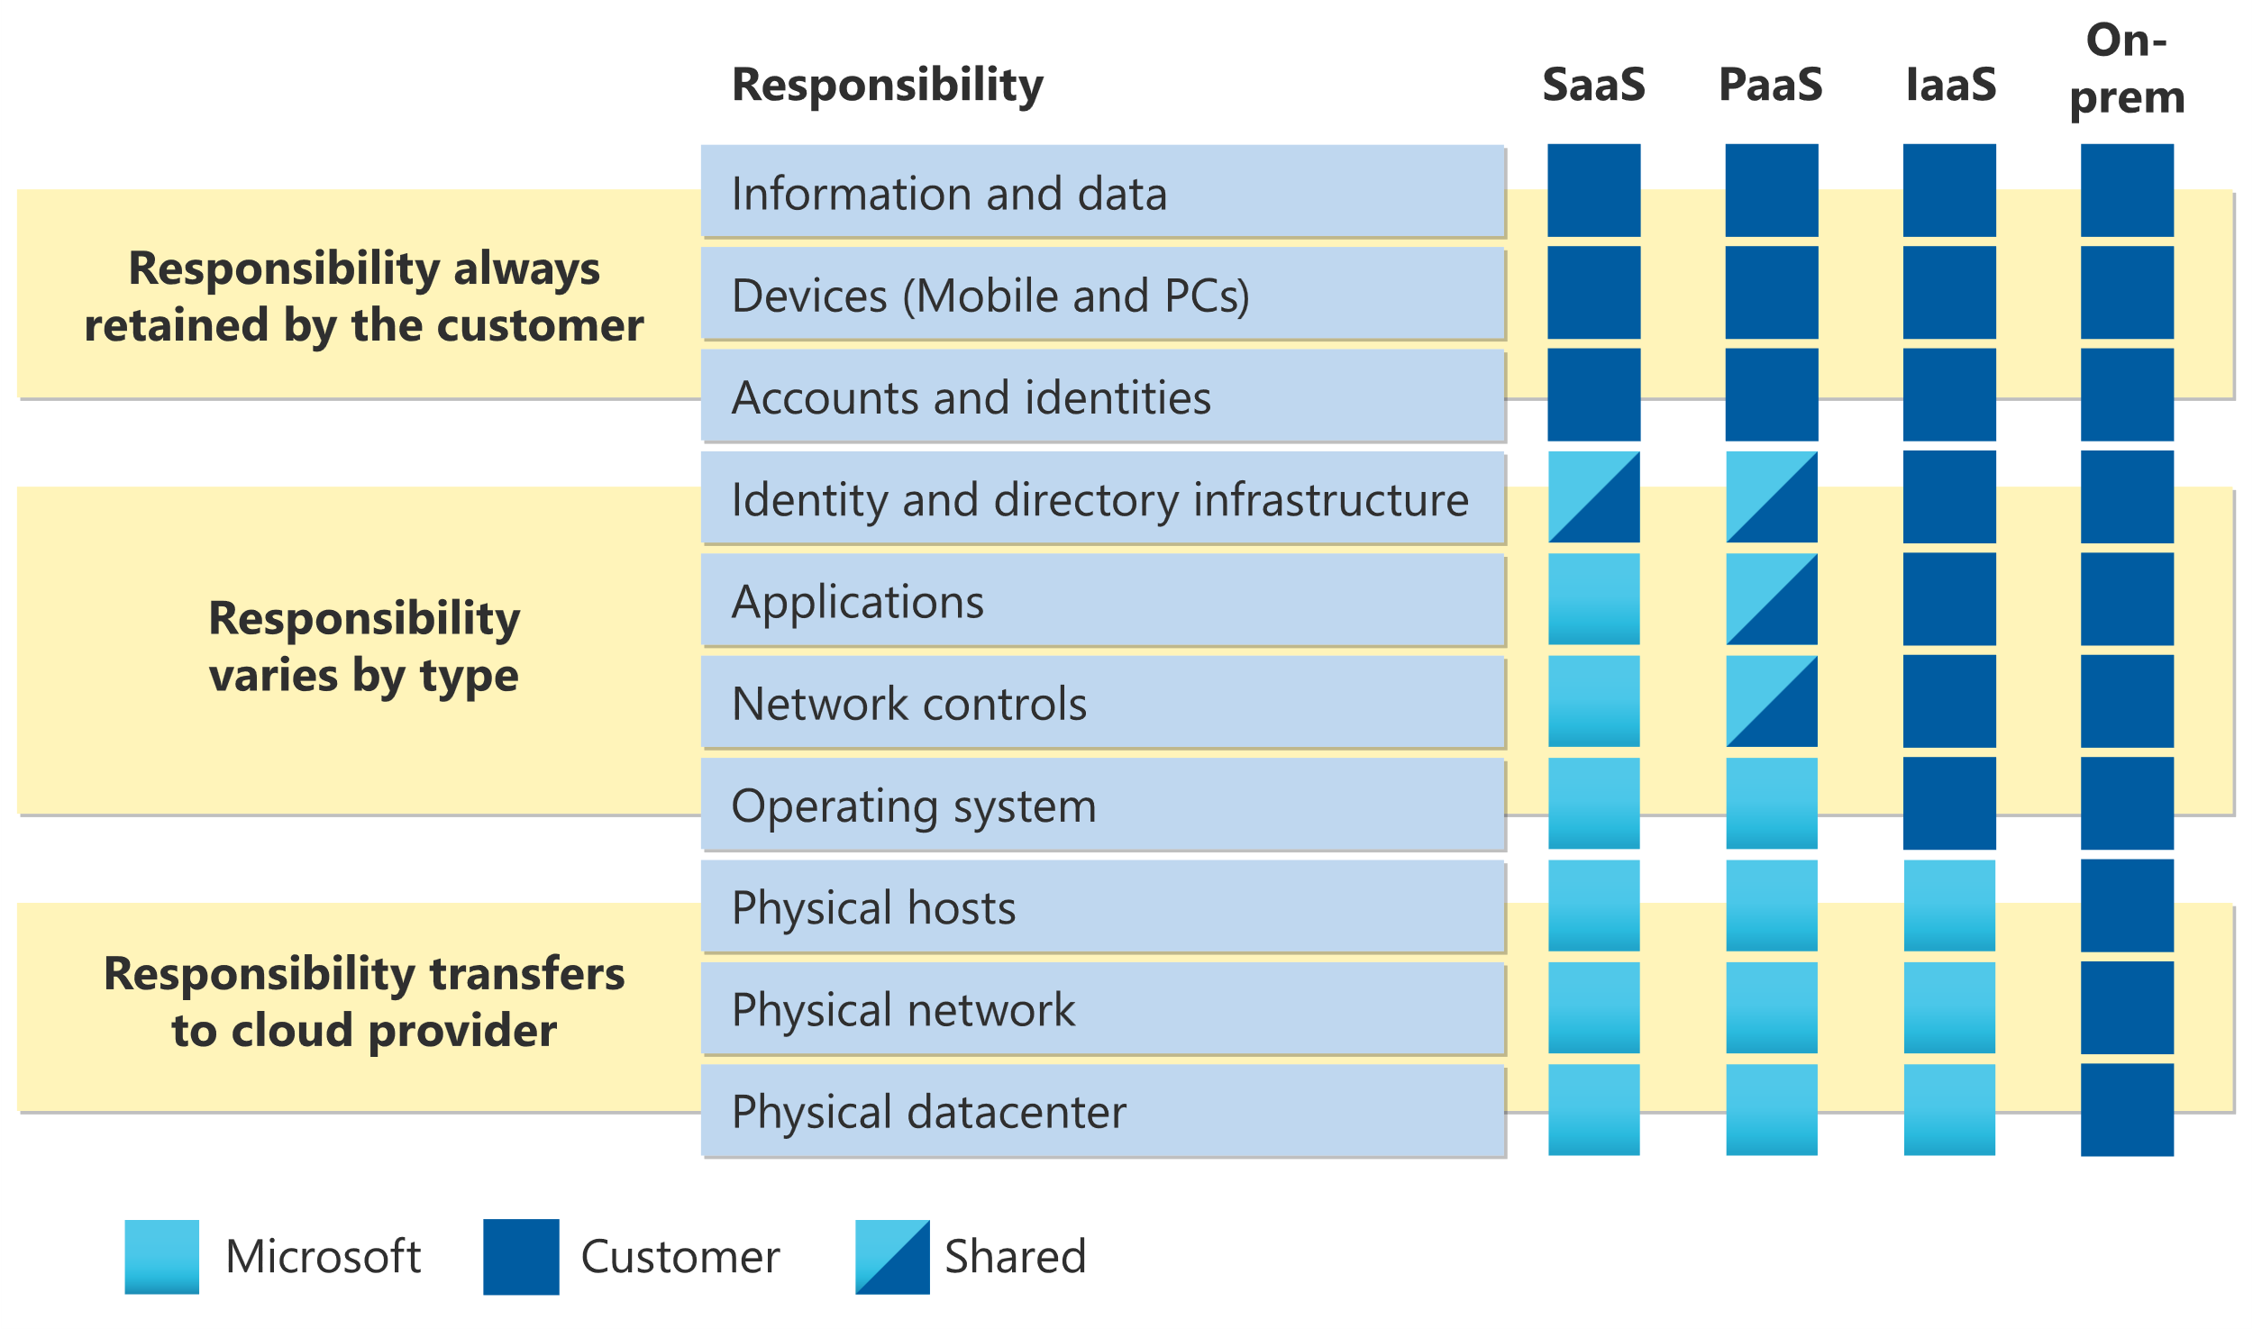
Shared responsibility model
Notes:
https://docs.microsoft.com/learn/modules/describe-cloud-compute/4-describe-shared-responsibility-model
IaaS, PaaS, and SaaS have dedicated topics, coming up.

Slide 8
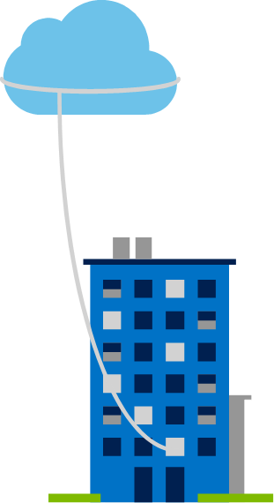
Private cloud
Organizations create a cloud environment in their datacenter.
Organization is responsible for operating the services they provide.
Does not provide access to users outside of the organization.
Notes:
https://docs.microsoft.com/learn/modules/describe-cloud-compute/5-define-cloud-models
Owned and operated by the organization that uses cloud resources.
Organizations create a cloud environment in their datacenter.
Self-service access to compute resources provided to users within the organization.
Organization is responsible for operating the services they provide.

Slide 9
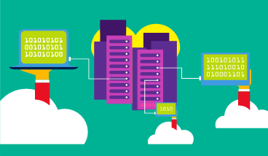
Public cloud
Owned by cloud services or hosting provider.
Provides resources and services to multiple organizations and users.
Accessed via secure network connection (typically over the internet).
Notes:
https://docs.microsoft.com/learn/modules/describe-cloud-compute/5-define-cloud-models
What are public, private, and hybrid clouds? - https://azure.microsoft.com/en-us/overview/what-are-private-public-hybrid-clouds/

Slide 10
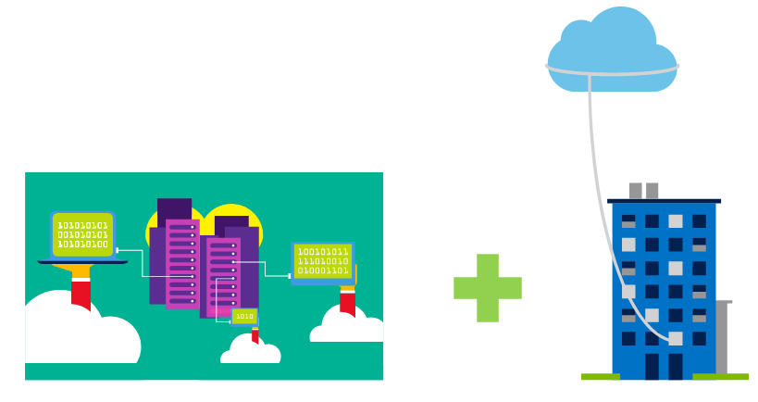
Hybrid cloud
Combines Public and Private clouds to allow applications to run in the most appropriate location.
Notes:
https://docs.microsoft.com/learn/modules/describe-cloud-compute/5-define-cloud-models
Hybrid cloud models have the following characteristics:
Resource location. Specific resources run or are used in a public cloud, and others run or are used in a private cloud.
Cost and efficiency. Hybrid cloud models allow an organization to leverage some of the benefits of cost, efficiency, and scale that are available with a public cloud model.
Control. Organizations retain management control in private clouds.
Skills. Technical skills are still required to maintain the private cloud and ensure both cloud models can operate together.

Slide 11
Cloud model comparison
Public Cloud
No capital expenditures to scale up.
Applications can be quickly provisioned and deprovisioned.
Organizations pay only for what they use.
Private Cloud
Organizations have complete control over resources and security.
Hybrid Cloud
Provides the most flexibility.
Organizations determine where to run their applications.
Organizations control security, compliance, or legal requirements.
Organizations are responsible for hardware maintenance and updates.
Hardware must be purchased for start-up and maintenance.
Notes:
https://docs.microsoft.com/learn/modules/describe-cloud-compute/5-define-cloud-models

Slide 12
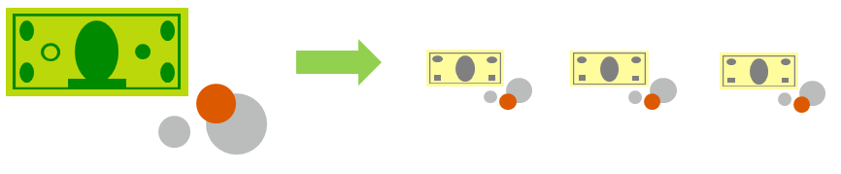
Compare CapEx vs. OpEx
Capital Expenditure (CapEx)
The up-front spending of money on physical infrastructure.
Costs from CapEx have a value that reduces over time.
Operational Expenditure (OpEx)
Spend on products and services as needed, pay-as-you-go
Get billed immediately
Notes:
https://docs.microsoft.com/learn/modules/describe-cloud-compute/6-describe-consumption-based-model
Capital Expenditure (CapEx)
Spend on physical infrastructure upfront.
Deduct the expense from your tax bill.
High upfront cost, but the value of your 6investment reduces over time.
Operational Expenditure (OpEx)
Spend on services or products as needed.
Get billed immediately.
Deduct the expense from your tax bill in the same year.
No upfront cost, pay-as-you use.

Slide 13

Consumption-based model
Cloud service providers operate on a consumption-based model, which means that end users only pay for the resources that they use. Whatever they use is what they pay for.
Better cost prediction
Prices for individual resources and services are provided
Billing is based on actual usage
Notes:
https://docs.microsoft.com/learn/modules/describe-cloud-compute/6-describe-consumption-based-model
This consumption-based model brings with it many benefits, including:
No upfront costs.
No need to purchase and manage costly infrastructure that they may or may not use to its fullest.
The ability to pay for additional resources when they are needed.
The ability to stop paying for resources that are no longer needed.

Slide 14
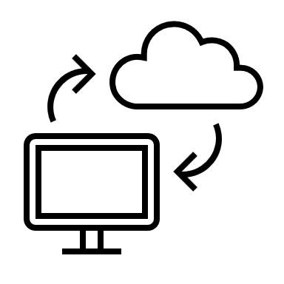
Cloud benefits
Notes:
https://docs.microsoft.com/en-us/learn/modules/describe-benefits-use-cloud-services/

Slide 15
Cloud Benefits - Objective Domain
Describe the benefits of high availability and scalability in the cloud.
Describe the benefits of reliability and predictability in the cloud.
Describe the benefits of security and governance in the cloud.
Describe the benefits of manageability in the cloud.
Notes:
https://docs.microsoft.com/en-us/learn/modules/describe-benefits-use-cloud-services/1-introduction

Slide 16
Cloud Benefits
High availability
Elasticity
Scalability
Reliability
Predictability
Security
Governance
Manageability
Notes:
https://docs.microsoft.com/learn/modules/describe-benefits-use-cloud-services/2-high-availability-scalability-cloud
https://docs.microsoft.com/learn/modules/describe-benefits-use-cloud-services/3-reliability-predictability-cloud
https://docs.microsoft.com/learn/modules/describe-benefits-use-cloud-services/4-security-governance-cloud
https://docs.microsoft.com/learn/modules/describe-benefits-use-cloud-services/5-manageability-cloud

Slide 17

Cloud service types
Notes:
https://docs.microsoft.com/learn/modules/describe-cloud-service-types

Slide 18
Cloud Services - Objective Domain
Describe Infrastructure as a Service (IaaS)
Describe Platform as a Service (PaaS)
Describe Software as a Service (SaaS)
Identify appropriate use cases for each cloud service (IaaS, PaaS, SaaS)
Notes:
https://docs.microsoft.com/learn/modules/describe-cloud-service-types/1-introduction

Slide 19
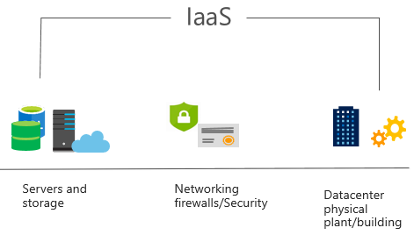
Infrastructure as a Service (IaaS)
Build pay-as-you-go IT infrastructure by renting servers, virtual machines, storage, networks, and operating systems from a cloud provider.
Notes:
https://docs.microsoft.com/learn/modules/describe-cloud-service-types/2-describe-infrastructure-service
For more information on IaaS, visit https://azure.microsoft.com/en-us/overview/what-is-iaas/
Most basic cloud computing services category.
Build pay-as-you-go IT infrastructure by renting servers, virtual machines, storage, networks, and operating systems from a cloud provider.
Instant computing infrastructure, provisioned and managed over the internet.

Slide 20
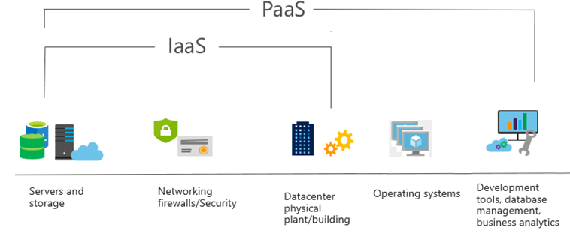
Platform as a Service (PaaS)
Provides environment for building, testing, and deploying software applications; without focusing on managing underlying infrastructure.
Notes:
https://docs.microsoft.com/learn/modules/describe-cloud-service-types/3-describe-platform-service
For more information on PaaS, see https://azure.microsoft.com/en-us/overview/what-is-paas/
Provides environment for building, testing, and deploying software applications.
Helps create applications quickly, without focusing on managing underlying infrastructure.

Slide 21
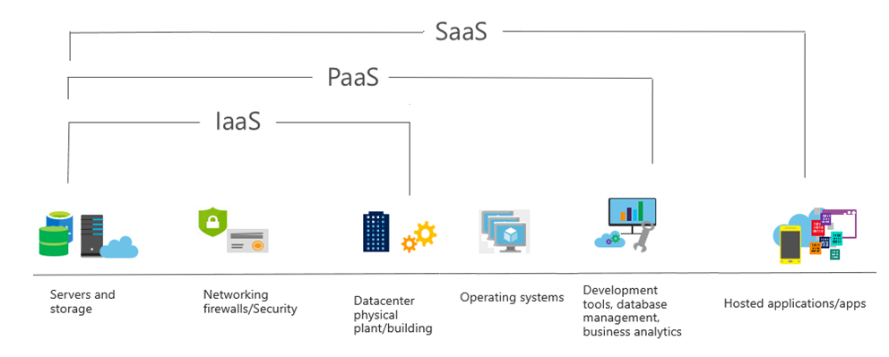
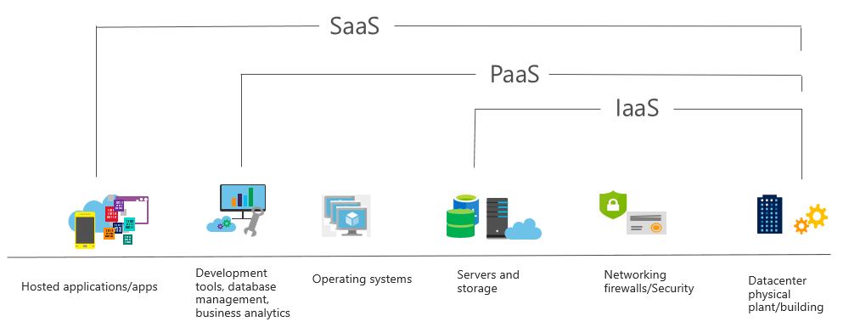
Software as a Service (SaaS)
Users connect to and use cloud-based apps over the internet: for example, Microsoft Office 365, email, and calendars.
Notes:
https://docs.microsoft.com/learn/modules/describe-cloud-service-types/4-describe-software-service
Common usage scenarios:
Examples of Microsoft SaaS services include Microsoft Office 365, Skype, and Microsoft Dynamics CRM Online.
For more information on SaaS, see https://azure.microsoft.com/en-us/overview/what-is-saas/

Slide 22
Cloud service comparison
IaaS
PaaS
SaaS
The most flexible cloud service.
Focus on application development.
Pay-as-you-go pricing model.
You configure and manage the hardware for your application.
Platform management is handled by the cloud provider.
Users pay for the software they use on a subscription model.

Slide 23

Knowledge Check
Populate with instructions to use the polling tool of your choice
Which one?
A). Azure Portal
B). PowerShell
C). Local Tool
Learning Path 1
Use your Smartphones or Mobile Devices
Go to (insert polling app link of your choice)
Enter Code: 123-45-678
Please participate in the quiz for this section
Notes:
WWL recommends using polling to be completed for every 7 – 10 slides and preferably at the end of each section. This helps break classes up and adds more interactivity especially for remote classes.
In order to promote interactivity, WWL suggests the use of Mentimeter, Kahoot or a similar polling technology. Please feel free to adjust this slide as needed and populate with the instructions based on the polling tool of your choice.
https://docs.microsoft.com/learn/modules/describe-cloud-compute/7-knowledge-check
https://docs.microsoft.com/learn/modules/describe-benefits-use-cloud-services/6-knowledge-check
https://docs.microsoft.com/learn/modules/describe-cloud-service-types/5-knowledge-check

Slide 24

Learning Path 01 Review
The shared responsibility model
Public, private, and hybrid-cloud
Benefits of cloud computing
Cloud service types
Microsoft Learn Modules (docs.microsoft.com/Learn)

