Slide 1
AZ-900T00 Learning Path 02: Azure Architecture and Services
Notes:
Learn learning path: https://docs.microsoft.com/learn/paths/azure-fundamentals-describe-azure-architecture-services/

Slide 2

Learning Path Outline

Slide 3

Learning Path 02 – Outline
You will learn the following concepts:
Azure Architectural Components
Regions and Availability Zones
Subscriptions and Resource Groups
Compute and Networking
Compute types
Application hosting
Virtual networking
Storage
Storage services
Redundancy options
File management and migration
Identity, Access, and Security
Directory services
Authentication methods
Security models

Slide 4
Azure Accounts
Azure account
Azure free account
Azure free student account
Microsoft Learn sandbox
Notes:
https://docs.microsoft.com/learn/modules/describe-core-architectural-components-of-azure/3-get-started-azure-accounts

Slide 5
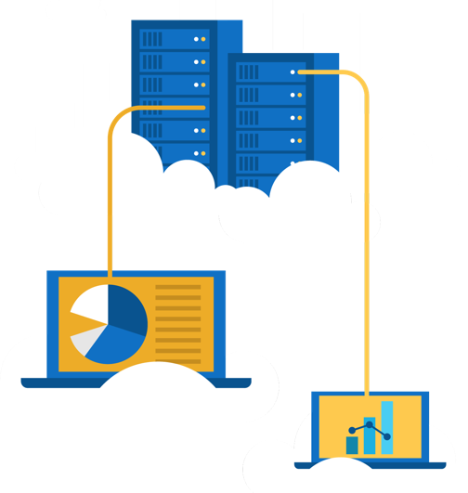
Walkthrough – Create an Azure Account
Create an Azure free account
Create an Azure free account
Notes:
https://docs.microsoft.com/learn/modules/create-an-azure-account/
Most exercises will be in the Learn Sandbox – in the last module, there’s a portion that needs an Azure account or can be converted to Demo. This is an optional exercise to help the students create free accounts. Note: They will need a credit card for this exercise.

Slide 6
Exercise – Explore the Learn sandbox
Explore the Learn sandbox
Activate the sandbox
Use PowerShell
Shift to BASH
Shift to Azure Interactive mode
Navigate the portal
Notes:
https://docs.microsoft.com/learn/modules/describe-core-architectural-components-of-azure/4-exercise-explore-learn-sandbox
NOTE: The Learn Sandbox doesn’t require an Azure account, it will work with a Microsoft Account, if you skipped the previous walkthrough.

Slide 7

Azure architectural components
Notes:
https://docs.microsoft.com/learn/modules/describe-core-architectural-components-of-azure/1-introduction

Slide 8
Core Azure architectural components – Objective Domain
Describe Azure regions, region pairs, and sovereign regions.
Describe Availability Zones.
Describe Azure datacenters.
Describe Azure resources and Resource Groups.
Describe subscriptions.
Describe management groups.
Describe the hierarchy of resource groups, subscriptions, and management groups.
Notes:
https://docs.microsoft.com/learn/modules/describe-core-architectural-components-of-azure/1-introduction

Slide 9
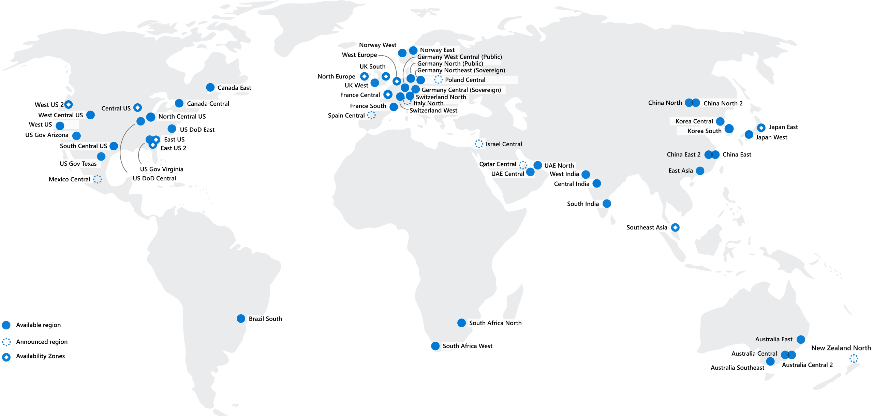
Regions
Azure offers more global regions than any other cloud provider with 60+ regions representing over 140 countries
Regions are made up of one or more datacenters in close proximity.
Provide flexibility and scale to reduce customer latency.
Preserve data residency with a comprehensive compliance offering.
© Copyright Microsoft Corporation. All rights reserved.
Notes:
https://docs.microsoft.com/en-us/learn/modules/describe-core-architectural-components-of-azure/5-describe-azure-physical-infrastructure
A region represents a collection of datacenters.
Provide flexibility and scale.
Preserve data residency.
Select regions close to your users.
Be aware of region deployment availability.
There are global services that are region independent.
A list of regions and their locations is available at https://azure.microsoft.com/en-us/global-infrastructure/locations/
Learn and SkillPipe content order note:
Slides 6-10
https://docs.microsoft.com/en-us/learn/modules/azure-architecture-fundamentals/regions-availability-zones

Slide 10
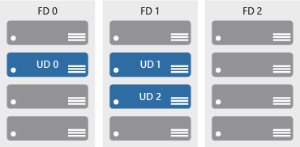

Availability zones
Azure Region
Provide protection against downtime due to datacenter failure.
Physically separate datacenters within the same region.
Each datacenter is equipped with independent power, cooling, and networking.
Connected through private fiber-optic networks.
Availability Zone 1
Availability Zone 2
Availability Zone 3
© Copyright Microsoft Corporation. All rights reserved.
Notes:
https://docs.microsoft.com/learn/modules/describe-core-architectural-components-of-azure/5-describe-azure-physical-infrastructure
Physically separate locations within an Azure region.
Takes availability sets to the next level
Includes one or more datacenters, equipped with independent power, cooling, and networking.
Acts as an isolation boundary.
If one availability zone goes down, the other continues working.
More details about Availability Zones in Azure are available at https://docs.microsoft.com/en-us/azure/availability-zones/az-overview

Slide 11
Region Pairs
Region
North Central US​
East US​
West US 2​
US East 2​
Canada Central​
North Europe​
UK West​
Germany Central​
South East Asia​
East China​
Japan East​
Australia Southeast​
India South​
Brazil South (Primary)​
Region
South Central US​
West US​
West Central US​
Central US​
Canada East​
West Europe​
UK South​
Germany Northeast​
East Asia​
North China​
Japan West​
Australia East​
India Central​
South Central US ​
At least 300 miles of separation between region pairs.
Automatic replication for some services.
Prioritized region recovery in the event of outage.
Updates are rollout sequentially to minimize downtime.
Web Link: https://aka.ms/PairedRegions
© Copyright Microsoft Corporation. All rights reserved.
Notes:
https://docs.microsoft.com/learn/modules/describe-core-architectural-components-of-azure/5-describe-azure-physical-infrastructure
Each Azure region is paired with another region.
Azure prefers at least 300 miles of separation between datacenters in a regional pair.
Some services provide automatic replication to the paired region.
In an outage, recovery of one region is prioritized out of every pair.
Azure system updates are rolled out to paired regions sequentially (not at the same time).
List of geographies, regions, region-pairs, and other details -https://azure.microsoft.com/en-us/global-infrastructure/geographies/
A full list of region pairs is available at https://docs.microsoft.com/en-us/azure/best-practices-availability-paired-regions#what-are-paired-regions

Slide 12
Azure Sovereign Regions (US Government services)
Meets the security and compliance needs of US federal agencies, state and local governments, and their solution providers.
Azure Government:
Separate instance of Azure.
Physically isolated from non-US government deployments.
Accessible only to screened, authorized personnel.
Notes:
https://docs.microsoft.com/learn/modules/describe-core-architectural-components-of-azure/5-describe-azure-physical-infrastructure
Azure Government - https://azure.microsoft.com/en-us/global-infrastructure/government/

Slide 13
Azure Sovereign Regions (Azure China)
Microsoft is China’s first foreign public cloud service provider, in compliance with government regulations.
Azure China features:
Physically separated instance of Azure cloud services operated by 21Vianet
All data stays within China to ensure compliance
Notes:
https://docs.microsoft.com/learn/modules/describe-core-architectural-components-of-azure/5-describe-azure-physical-infrastructure
Azure China 21Vianet - https://docs.microsoft.com/en-us/azure/china/

Slide 14
Walkthrough – Explore the Azure Global infrastructure
Explore the Azure global infrastructure
Select Explore the Globe (after intro).
Notice the different icons (geography, regions, points of presence (PoP), and so on).
Find your location on the globe, then find the nearest PoP and region to your location.
Notes:
You can, alternatively hit Skip Intro (top corner directly under the Microsoft Azure logo)
https://infrastructuremap.microsoft.com/

Slide 15






Azure Resources
Azure resources are components like storage, virtual machines, and networks that are available to build cloud solutions.
Virtual Machines
Storage Accounts
Virtual Networks
App Services
SQL Databases
Functions
Notes:
https://docs.microsoft.com/learn/modules/describe-core-architectural-components-of-azure/6-describe-azure-management-infrastructure

Slide 16
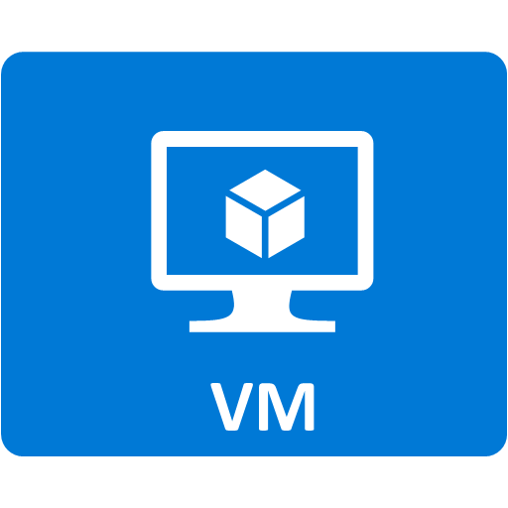


Resource groups
Resource groups (web + DB, VM, Storage) in one group
A resource group is a container to manage and aggregate resources in a single unit.
Resources can exist in only one resource group.
Resources can exist in different regions.
Resources can be moved to different resource groups.
Applications can utilize multiple resource groups.
OR
Web and DB resource group
Virtual machine resource group
Storage resource group
© Copyright Microsoft Corporation. All rights reserved.
Notes:
https://docs.microsoft.com/learn/modules/describe-core-architectural-components-of-azure/6-describe-azure-management-infrastructure
Containers for multiple resources that share the same life cycle.
Aggregates resources into a single manageable unit.
Every Azure resource must exist in one (and only one) resource group.
Secure at the resource group (or resource) level - using role-based access control (RBAC).

Slide 17
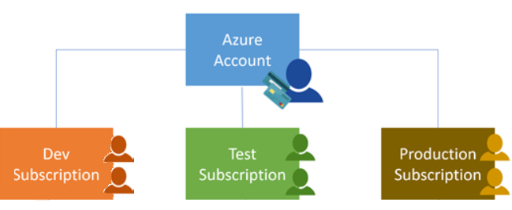
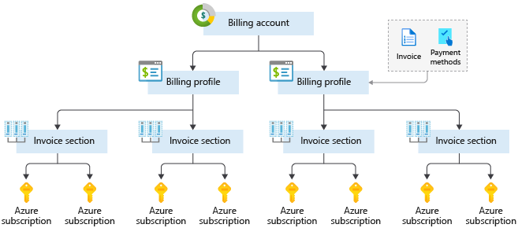
Azure Subscriptions
An Azure subscription provides you with authenticated and authorized access to Azure accounts.
Billing boundary: generate separate billing reports and invoices for each subscription.
Access control boundary: manage and control access to the resources that users can provision with specific subscriptions.
Notes:
https://docs.microsoft.com/learn/modules/describe-core-architectural-components-of-azure/6-describe-azure-management-infrastructure
An account can have one subscription or multiple subscriptions.
Azure subscription offers - https://azure.microsoft.com/en-us/support/legal/offer-details/

Slide 18
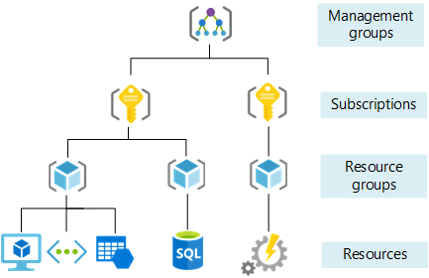
Management Groups
Management groups can include multiple Azure subscriptions.
Subscriptions inherit conditions applied to the management group.
10,000 management groups can be supported in a single directory.
A management group tree can support up to six levels of depth.
Notes:
https://docs.microsoft.com/learn/modules/describe-core-architectural-components-of-azure/6-describe-azure-management-infrastructure
Management groups can include multiple Azure subscriptions.
Subscriptions inherit conditions applied to the management group.
10,000 management groups can be supported in a single directory.
A management group tree can support up to six levels of depth.
Management groups - https://docs.microsoft.com/en-us/azure/governance/management-groups/

Slide 19
Exercise – Create an Azure resource
Create an Azure resource, monitor the resource group for needed resources being created in the same group
Create a virtual machine.
Monitor the resource group.
Notes:
https://docs.microsoft.com/learn/modules/describe-core-architectural-components-of-azure/7-exercise-create-azure-resource/
Lab to create an Azure resource. A key component of this lab is noticing that when a VM is created, Azure automatically creates the necessary components (network, storage, etc) and groups them automatically in the same resource group.

Slide 20
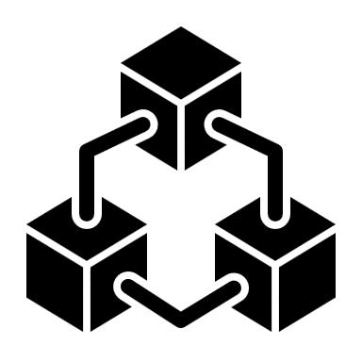
Compute and Networking
Notes:
https://docs.microsoft.com/learn/modules/describe-azure-compute-networking-services/

Slide 21
Compute and Networking- Objective Domain
Describe the benefits and usage of:
Compare compute types, including container instances, virtual machines, and functions.
Describe virtual machine options, including virtual machines (VMs), virtual machine scale sets, virtual machine availability sets, and Azure Virtual Desktop.
Describe resources required for virtual machines.
Describe application hosting options, including Azure Web Apps, containers, and virtual machines.
Describe virtual networking, including the purpose of Azure Virtual Networks, Azure virtual subnets, peering, Azure DNS, VPN Gateway, and ExpressRoute.
Define public and private endpoints.
Notes:
https://docs.microsoft.com/learn/modules/describe-azure-compute-networking-services/1-introduction

Slide 22



Azure compute services
Azure compute is an on-demand computing service that provides computing resources such as disks, processors, memory, networking, and operating systems.
Virtual
Machines
App
Services
Container Instances
Azure Kubernetes Services (AKS)
Azure Virtual Desktop
Notes:
https://azure.microsoft.com/products/category/compute/

Slide 23
Azure virtual machines
Azure Virtual Machines (VM) are software emulations of physical computers.
Includes virtual processor, memory, storage, and networking.
IaaS offering that provides total control and customization.
© Copyright Microsoft Corporation. All rights reserved.
Notes:
https://docs.microsoft.com/learn/modules/describe-azure-compute-networking-services/2-virtual-machines
Development and test – Azure VMs offer a quick and easy way to create a computer with specific configurations required to code and test an application.
Applications in the cloud – Because demand for your application can fluctuate, it might make economic sense to run it on a VM in Azure. You pay for extra VMs when you need them and shut them down when you don’t.
Extended datacenter – Virtual machines in an Azure virtual network can easily be connected to your organization’s network.
Azure virtual machines - https://azure.microsoft.com/en-us/services/virtual-machines/

Slide 24

VM scale sets
Scale sets provide a load-balanced opportunity to automatically scale resources.
Scale out when resource needs increase.
Scale in when resource needs are lower.
© Copyright Microsoft Corporation. All rights reserved.
Notes:
https://docs.microsoft.com/learn/modules/describe-azure-compute-networking-services/2-virtual-machines

Slide 25
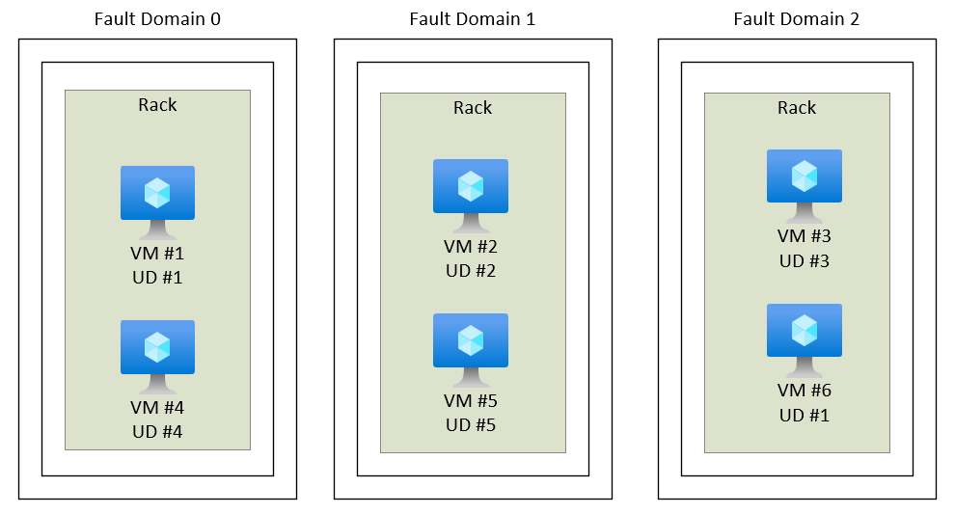
VM availability sets
© Copyright Microsoft Corporation. All rights reserved.
Notes:
https://docs.microsoft.com/learn/modules/describe-azure-compute-networking-services/2-virtual-machines
Update domain keeps VMs grouped if they can be rebooted at the same time without causing an outage.
Fault domains group VMs based on common power and networking.

Slide 26
Exercise – Create a Virtual Machine
Create a virtual machine in the Azure Portal, connect to the virtual machine, install the web server role, and test.
Create the virtual machine.
Install the web server package.
Notes:
https://docs.microsoft.com/learn/modules/describe-azure-compute-networking-services/3-exercise-create-azure-virtual-machine

Slide 27
Azure Virtual Desktop
Azure Virtual Desktop is a desktop and app virtualization that runs in the cloud.
Create a full desktop virtualization environment without having to run additional gateway servers.
Reduce risk of resource being left behind.
True multi-session deployments.
© Copyright Microsoft Corporation. All rights reserved.
Notes:
https://docs.microsoft.com/learn/modules/describe-azure-compute-networking-services/4-virtual-desktop
https://docs.microsoft.com/en-us/azure/virtual-desktop/overview

Slide 28
Azure Container Services
Azure Containers are a light-weight, virtualized environment that does not require operating system management, and can respond to changes on demand.
Azure Container Instances: a PaaS offering that runs a container in Azure without the need to manage a virtual machine or additional services.
Azure Kubernetes Service: an orchestration service for containers with distributed architectures and large volumes of containers.
© Copyright Microsoft Corporation. All rights reserved.
Notes:
https://docs.microsoft.com/learn/modules/describe-azure-compute-networking-services/5-containers
Containers are a virtualization environment. However, unlike virtual machines, you do not manage an operating system. Containers are meant to be lightweight, and are designed to be created, scaled out, and stopped dynamically.
Azure Container Instances - https://azure.microsoft.com/en-us/services/container-instances/
Azure Kubernetes Service - https://azure.microsoft.com/en-us/services/kubernetes-service/

Slide 29

Azure Functions
Azure Functions
Event based code running your service and not the underlying infrastructure.
Notes:
https://docs.microsoft.com/learn/modules/describe-azure-compute-networking-services/6-functions
Serverless computing is the evolution of cloud platforms in the direction of pure cloud native code. Serverless brings developers closer to business logic while insulating them from infrastructure concerns. It's a pattern that doesn't imply "no server" but rather, "less server." Serverless code is event-driven. Code may be triggered by anything from a traditional HTTP web request to a timer or the result of uploading a file. The infrastructure behind serverless allows for instant scale to meet elastic demands and offers micro-billing to truly "pay for what you use." Serverless requires a new way of thinking and approach to building applications and isn't the right solution for every problem.
Azure Functions is code running your service and not the underlying platform or infrastructure. Creates infrastructure based on an event.
Azure Functions - https://docs.microsoft.com/en-us/azure/azure-functions/
Note: For more details about serverless services available with Azure, see https://azure.microsoft.com/en-us/solutions/serverless/

Slide 30
Comparing Azure compute options
Virtual machines
Virtual Desktop
Containers
Cloud based server that supports either Windows or Linux environments.
Provides a cloud based personal computer Windows desktop experience.
Lightweight, miniature environment well suited for running microservices.
Useful for lift-and-shift migrations to the cloud.
Dedicated applications to connect and use, or accessible from any modern browser.
Designed for scalability and resiliency through orchestration.
Complete operating system package, including the host operating system.
Multi-client login allows multiple users to log into the same machine at the same time.
Applications and services are packaged in a container that sits on-top of the host operating system. Multiple containers can sit on one host OS.

Slide 31

Azure App Services
Azure App Services is a fully managed platform to build, deploy, and scale web apps and APIs quickly.
Works with .NET, .NET Core, Node.js, Java, Python, or php.
PaaS offering with enterprise-grade performance, security, and compliance requirements.
© Copyright Microsoft Corporation. All rights reserved.
Notes:
https://docs.microsoft.com/learn/modules/describe-azure-compute-networking-services/7-describe-application-hosting-options

Slide 32
Azure networking services
Azure Virtual Network (VNet) enables Azure resources to communicate with each other, the internet, and on-premises networks.
Public endpoints, accessible from anywhere on the internet
Private endpoints, accessible only from within your network
Virtual subnets, segment your network to suit your needs
Network peering, connect your private networks directly together
Notes:
https://docs.microsoft.com/learn/modules/describe-azure-compute-networking-services/8-virtual-networking

Slide 33
Walkthrough – Configure network access
Configure public access to the virtual machine created earlier.
Verify currently open ports.
Create a network security group
Configure HTTP access (port 80)
Test the connection.
Notes:
https://docs.microsoft.com/learn/modules/describe-azure-compute-networking-services/9-exercise-configure-network-access/

Slide 34

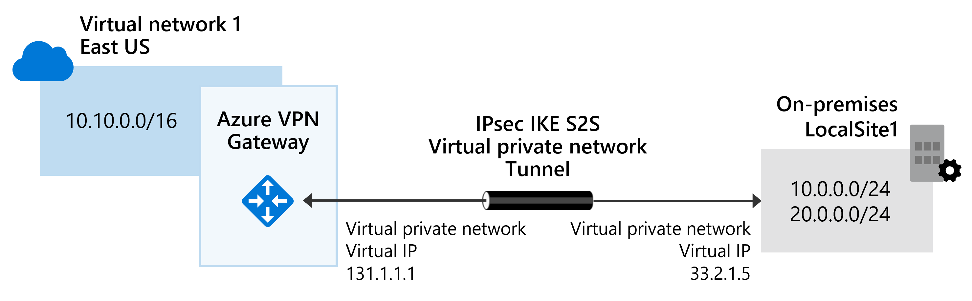
Azure networking services
Virtual Private Network Gateway (VPN) is used to send encrypted traffic between an Azure virtual network and an on-premises location over the public internet.
Notes:
https://docs.microsoft.com/learn/modules/describe-azure-compute-networking-services/10-virtual-private-networks

Slide 35

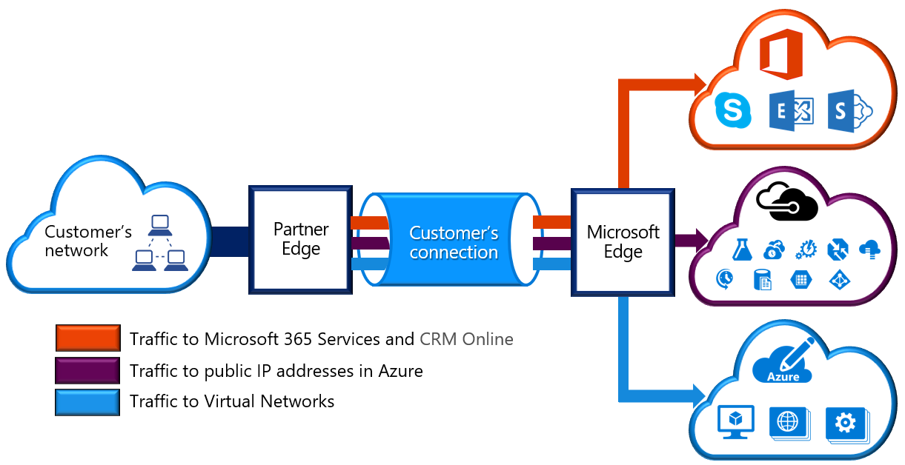
Azure networking services
Azure Express Route extends on-premises networks into Azure over a private connection that is facilitated by a connectivity provider.
Notes:
https://docs.microsoft.com/learn/modules/describe-azure-compute-networking-services/11-expressroute/

Slide 36

Azure DNS
Reliability and performance by leveraging a global network of DNS name servers using Anycast networking.
Azure DNS security is based on Azure resource manager, enabling role-based access control and monitoring and logging.
Ease of use for managing your Azure and external resources with a single DNS service.
Customizable virtual networks allow you to use private, fully customized domain names in you private virtual networks.
Alias records supports alias record sets to point directly to an Azure resource.
Notes:
https://docs.microsoft.com/learn/modules/describe-azure-compute-networking-services/12-domain-name-system

Slide 37
Storage
Notes:
https://docs.microsoft.com/learn/modules/describe-azure-storage-services/

Slide 38
Storage - Objective Domain
Describe the benefits and usage of:
Compare Azure storage services.
Describe storage tiers.
Describe redundancy options.
Describe storage account options and storage types.
Identify options for moving files, including AzCopy, Azure Storage Explorer, and Azure File Sync.
Describe migration options, including Azure Migrate and Azure Data Box.
Notes:
https://docs.microsoft.com/learn/modules/describe-azure-storage-services/1-introduction

Slide 39

Storage accounts
Must have a globally unique name
Provide over-the-internet access worldwide
Determine storage services and redundancy options
Notes:
https://docs.microsoft.com/learn/modules/describe-azure-storage-services/2-accounts

Slide 40
Storage redundancy
Redundancy configuration | Deployment | Durability
Locally redundant storage (LRS) | Single datacenter in the primary region | 11 nines
Zone-redundant storage (ZRS) | Three availability zones in the primary region | 12 nines
Geo-redundant storage (GRS) | Single datacenter in the primary and secondary region | 16 nines
Geo-zone-redundant-storage (GZRS) | Three availability zones in the primary region and a single datacenter in secondary region | 16 nines
Notes:
https://docs.microsoft.com/learn/modules/describe-azure-storage-services/3-redundancy

Slide 41


Azure storage services
Container storage (blob) is optimized for storing massive amounts of unstructured data, such as text or binary data.
Disk storage provides disks for virtual machines, applications, and other services to access and use.
Azure Files sets up a highly available network file shares that can be accessed by using the standard Server Message Block (SMB) protocol.
Notes:
https://docs.microsoft.com/learn/modules/describe-azure-storage-services/4-describe-azure-storage-services

Slide 42
Storage service public endpoints
Storage service | Public endpoint
Blob Storage | https://<storage-account-name>.blob.core.windows.net
Data Lake Storage Gen2 | https://<storage-account-name>.dfs.core.windows.net
Azure Files | https://<storage-account-name>.file.core.windows.net
Queue Storage | https://<storage-account-name>.queue.core.windows.net
Table Storage | https://<storage-account-name>.table.core.windows.net

Slide 43



Azure storage access tiers
Hot | Cool | Archive
Optimized for storing data that is accessed frequently. | Optimized for storing data that is infrequently accessed and stored for at least 30 days. | Optimized for storing data that is rarely accessed and stored for at least 180 days with flexible latency requirements.
You can switch between these access tiers at any time.
Notes:
https://docs.microsoft.com/learn/modules/describe-azure-storage-services/4-describe-azure-storage-services

Slide 44
Exercise - Create a storage blob
Create a storage account with a blob storage container. Work with blob files.
Create a storage account.
Create a blob container.
Upload and access a blob.
Notes:
https://docs.microsoft.com/learn/modules/describe-azure-storage-services/5-exercise-create-storage-blob

Slide 45

Azure Migrate
Unified migration platform
Range of integrated and standalone tools
Assessment and migration
Notes:
https://docs.microsoft.com/learn/modules/describe-azure-storage-services/6-identify-azure-data-migration-options

Slide 46

Azure Data Box
Store up to 80 terabytes of data.
Move your disaster recovery backups to Azure.
Protect your data in a rugged case during transit.
Migrate data out of Azure for compliance or regulatory needs.
Migrate data to Azure from remote locations with limited or no connectivity.
Notes:
https://docs.microsoft.com/learn/modules/describe-azure-storage-services/6-identify-azure-data-migration-options

Slide 47
File management options
AzCopy
Azure Storage Explorer
Azure File Sync
Command line utility
Graphical user interface
(similar to Windows Explorer)
Synchronizes Azure and on premises files in a bidirectional manner
Copy blobs or files to or from your storage account
Compatible with Windows, MacOS, and Linux
Cloud tiering keeps frequently accessed files local, while freeing up space
One-direction synchronization
Uses AzCopy to handle file operations
Rapid reprovisioning of failed local server (install and resync)
Notes:
https://docs.microsoft.com/learn/modules/describe-azure-storage-services/7-identify-azure-file-movement-options

Slide 48

Identity, Access, and Security
Notes:
https://docs.microsoft.com/learn/modules/describe-azure-identity-access-security

Slide 49
Identity, Access, and Security - Objective Domain
Describe the benefits and usage of:
Describe directory services in Azure, including Azure Active Directory (AD) and Azure AD DS, part of Microsoft Entra.
Describe authentication methods in Azure, including single sign-on (SSO), multifactor authentication (MFA), and passwordless.
Describe external identities and guest access in Azure.
Describe Azure AD Conditional Access.
Describe Azure Role Based Access Control (RBAC).
Describe the concept of Zero Trust.
Describe the purpose of the defense in depth model.
Describe the purpose of Microsoft Defender for Cloud.
Notes:
https://docs.microsoft.com/learn/modules/describe-azure-identity-access-security/1-introduction

Slide 50

Azure Active Directory (AAD)
Azure Active Directory (AAD) is Microsoft Azure’s cloud-based identity and access management service.
Authentication (employees sign-in to access resources).
Single sign-on (SSO).
Application management.
Business to Business (B2B).
Business to Customer (B2C) identity services.
Device management.
Notes:
https://docs.microsoft.com/learn/modules/describe-azure-identity-access-security/2-directory-services
Azure AD - https://azure.microsoft.com/en-us/services/active-directory/
Azure tenant
A dedicated and trusted instance of Azure AD that's automatically created when your organization signs up for a Microsoft cloud service subscription, such as Microsoft Azure, Microsoft Intune, or Office 365. An Azure tenant represents a single organization.
Azure AD directory
Each Azure tenant has a dedicated and trusted Azure AD directory. The Azure AD directory includes the tenant's users, groups, and apps and is used to perform identity and access management functions for tenant resources.

Slide 51
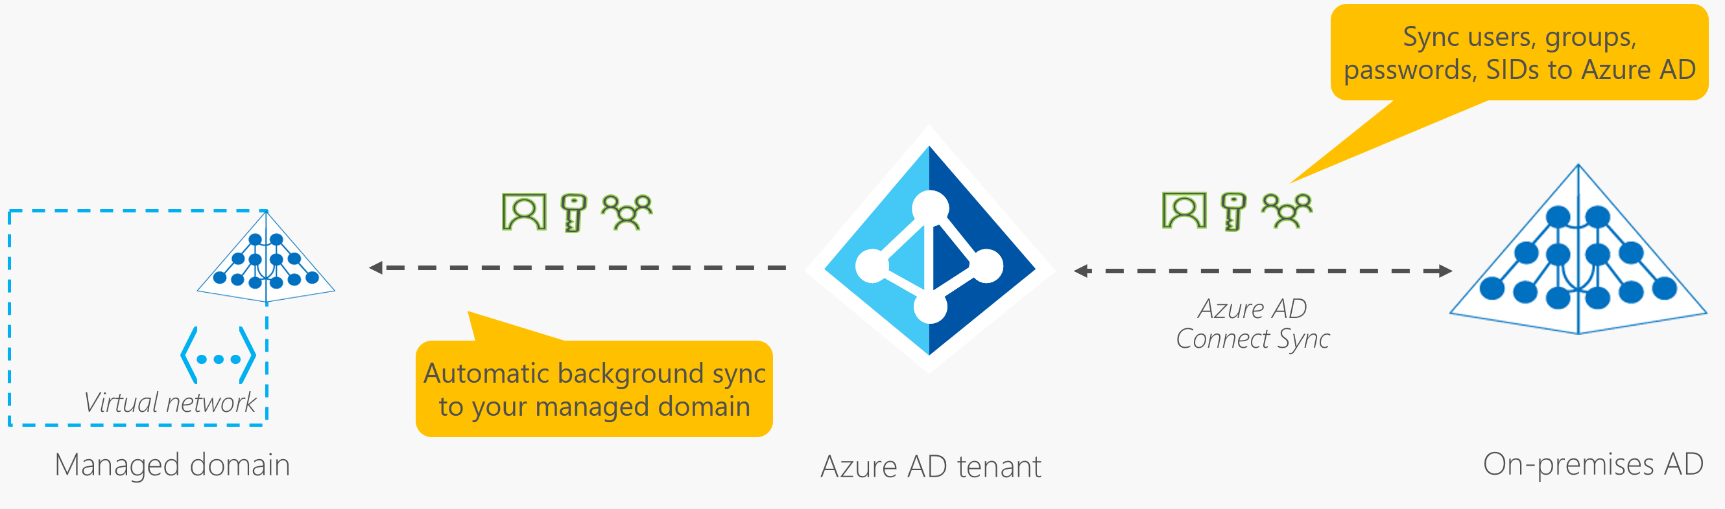
Azure Active Directory Domain Services (Azure AD DS)
Gain the benefit of cloud-based domain services without managing domain controllers
Run legacy applications (that can’t use modern auth standards) in the cloud
Automatically sync from Azure AD
Notes:
https://docs.microsoft.com/learn/modules/describe-azure-identity-access-security/2-directory-services
Azure AD - https://azure.microsoft.com/en-us/services/active-directory/

Slide 52









Compare Authentication and Authorization
Authentication
Identifies the person or service seeking access to a resource.
Requests legitimate access credentials.
Basis for creating secure identity and access control principles.
Authorization
Determines an authenticated person’s or service’s level of access.
Defines which data they can access, and what they can do with it.
Notes:
https://docs.microsoft.com/learn/modules/describe-azure-identity-access-security/3-authentication-methods
✔️Authentication is sometimes shortened to AuthN, and authorization is sometimes shortened to AuthZ.
Authentication
Identifies the person or service seeking access to a resource.
Requests legitimate access credentials.
Basis for creating secure identity and access control principles.
Authorization
Determines an authenticated person’s or service’s level of access.
Defines which data they can access, and what they can do with it.

Slide 53
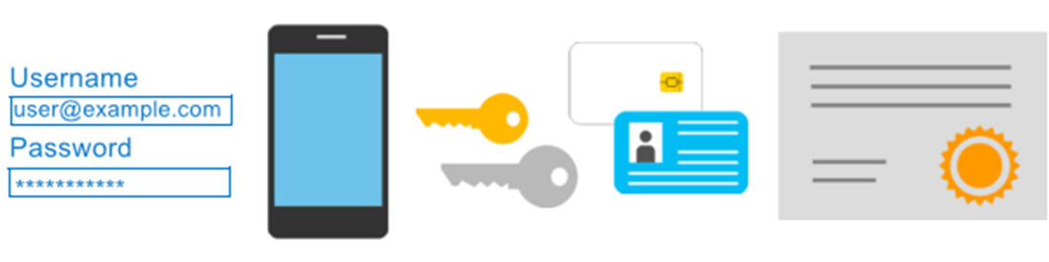
Azure Multi-Factor Authentication
Provides additional security for your identities by requiring two or more elements for full authentication.
Something you know ←→ Something you possess ←→ Something you are
Notes:
https://docs.microsoft.com/learn/modules/describe-azure-identity-access-security/3-authentication-methods
Discuss what could qualify for each of the items listed
Something you know: This could be a password or the answer to a security question.
Something you possess: This might be a mobile app that receives a notification, or a token-generating device.
Something you are: This is typically some sort of biometric property, such as a fingerprint or face scan used on many mobile devices.
MFA - https://docs.microsoft.com/en-us/azure/active-directory/authentication/concept-mfa-howitworks

Slide 54
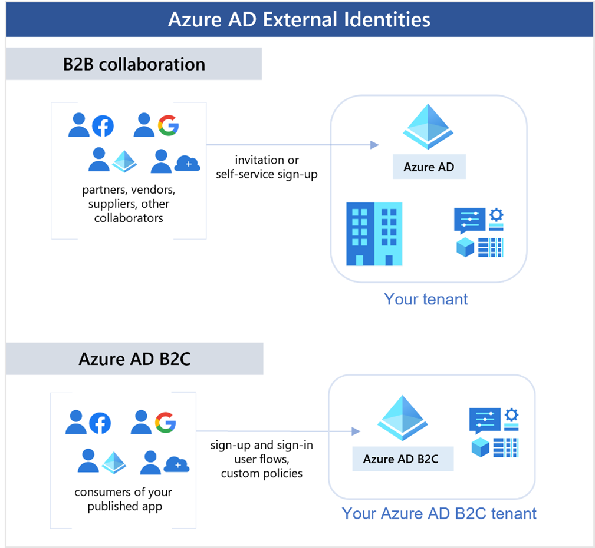
External Identities B2B
Notes:
https://docs.microsoft.com/learn/modules/describe-azure-identity-access-security/4-external-identities

Slide 55
External Identities B2C
Notes:
https://docs.microsoft.com/learn/modules/describe-azure-identity-access-security/4-external-identities

Slide 56
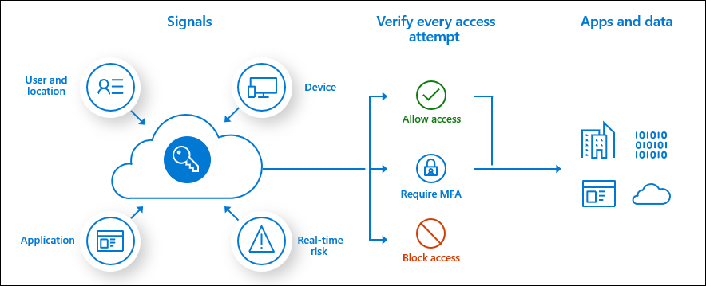
Conditional Access
Conditional Access is used by Azure Active Directory to bring signals together, to make decisions, and enforce organizational policies.
User or Group Membership
IP Location
Device
Application
Risk Detection
Notes:
https://docs.microsoft.com/learn/modules/describe-azure-identity-access-security/5-conditional-access
https://docs.microsoft.com/en-us/azure/active-directory/conditional-access/overview
The modern security perimeter now extends beyond an organization's network to include user and device identity. Organizations can utilize these identity signals as part of their access control decisions.
Conditional Access is the tool used by Azure Active Directory to bring signals together, to make decisions, and enforce organizational policies. Conditional Access is at the heart of the new identity driven control plane.
Conditional Access policies at their simplest are if-then statements, if a user wants to access a resource, then they must complete an action. Example: A payroll manager wants to access the payroll application and is required to perform multi-factor authentication to access it.
Administrators are faced with two primary goals:
Empower users to be productive wherever and whenever
Protect the organization's assets
By using Conditional Access policies, you can apply the right access controls when needed to keep your organization secure and stay out of your user's way when not needed.

Slide 57




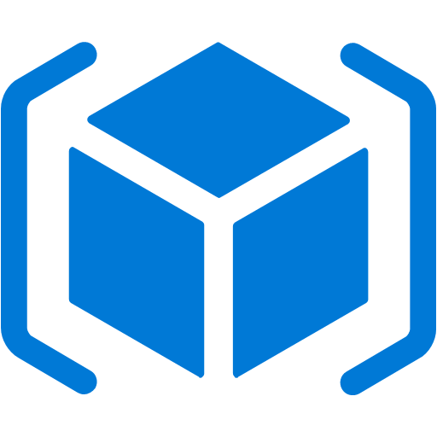
Azure role-based access control (Azure RBAC)
Fine-grained access management.
Segregate duties within the team and grant only the amount of access to users that they need to perform their jobs.
Enables access to the Azure portal and controlling access to resources.
Azure
Active Directory
Azure
subscription
User
Apps
User groups
Resource group
Resource group
Notes:
https://docs.microsoft.com/learn/modules/describe-azure-identity-access-security/6-role-based-access-control
Azure RBAC - https://docs.microsoft.com/en-us/azure/role-based-access-control/overview

Slide 58
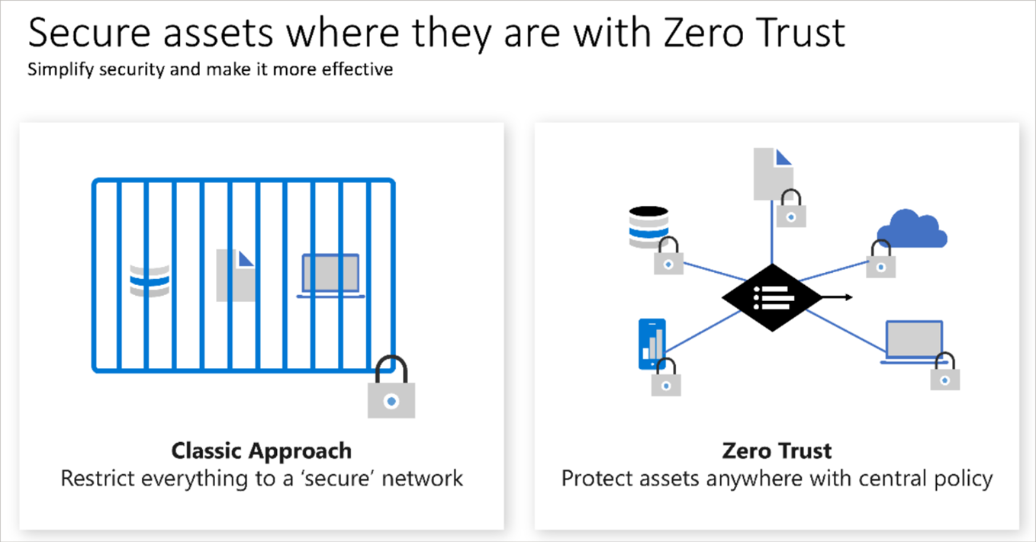
Zero Trust
Notes:
https://docs.microsoft.com/learn/modules/describe-azure-identity-access-security/7-describe-zero-trust-model

Slide 59
Defense in depth
Physical Security
A layered approach to securing computer systems.
Provides multiple levels of protection.
Attacks against one layer are isolated from subsequent layers.
Identity & Access
Perimeter
Network
Compute
Application
Data
Notes:
https://docs.microsoft.com/learn/modules/describe-azure-identity-access-security/8-describe-defense-depth

Slide 60
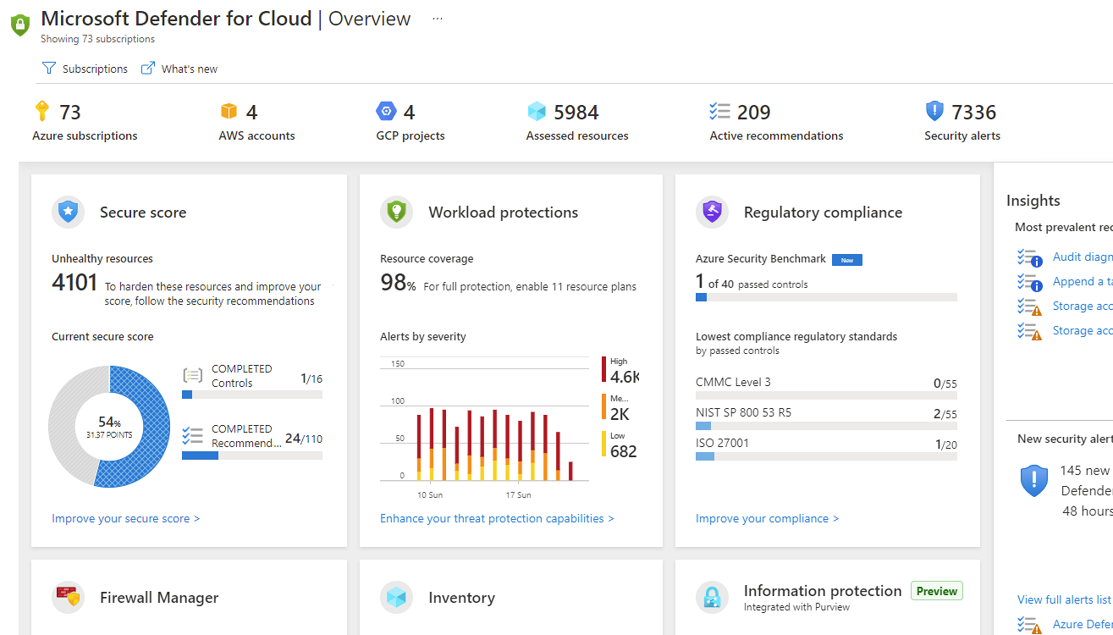
Microsoft Defender for Cloud
Microsoft Defender for Cloud is a monitoring service that provides threat protection across both Azure and on-premises datacenters.
Provides security recommendations
Detect and block malware
Analyze and identify potential attacks
Just-in-time access control for ports
Notes:
https://docs.microsoft.com/learn/modules/describe-azure-identity-access-security/9-describe-microsoft-defender-for-cloud
Microsoft Defender for Cloud is a unified infrastructure security management system that strengthens the security posture of your data centers and provides advanced threat protection across your hybrid workloads in the cloud - whether they're in Azure or not - as well as on premises.
Strengthen security posture: Defender for Cloud assesses your environment and enables you to understand the status of your resources, and whether they are secure.
Protect against threats: Defender for Cloud assesses your workloads and raises threat prevention recommendations and security alerts.
Get secure faster: In Defender for Cloud, everything is done in cloud speed. Because it is natively integrated, deployment is easy, providing you with auto-provisioning and protection with Azure services.
Policy compliance Defender for Cloud is built on top of Azure Policy controls so you can set and monitor your policies to run on management groups, across subscriptions, and even for a whole tenant.
Security alerts Defender for Cloud automatically collects, analyzes, and integrates log data from your Azure resources like firewall and endpoint protection to detect real threats. Then list of prioritized security alerts is shown in Microsoft Defender for Cloud along with the information you need to quickly investigate and remediate an attack.
Secure score Defender for Cloud continually assesses your resources for security issues; then aggregates all the findings into a single score so that you can tell your current security situation.
Microsoft Defender for Cloud - https://azure.microsoft.com/services/defender-for-cloud/

Slide 61

Knowledge Check
Which one?
A). Azure Portal
B). PowerShell
C). Local Tool
Populate with instructions to use the polling tool of your choice
Learning Path 2
Use your Smartphones or Mobile Devices
Go to (insert polling app link of your choice)
Enter Code: 123-45-678
Please participate in the quiz for this section
Notes:
WWL recommends using polling to be completed for every 7 – 10 slides and preferably at the end of each section. This helps break classes up and adds more interactivity especially for remote classes.
https://docs.microsoft.com/learn/modules/describe-core-architectural-components-of-azure/8-knowledge-check
https://docs.microsoft.com/learn/modules/describe-azure-compute-networking-services/13-knowledge-check
https://docs.microsoft.com/learn/modules/describe-azure-storage-services/8-knowledge-check
https://docs.microsoft.com/learn/modules/describe-azure-identity-access-security/10-knowledge-check

Slide 62

Learning Path 02 Review
Physical and management infrastructure of Microsoft Azure
Compute and networking services
Storage services
Identity, access, and security
Microsoft Learn Modules (docs.microsoft.com/Learn)
Notes:
https://docs.microsoft.com/learn/modules/describe-core-architectural-components-of-azure/9-summary
https://docs.microsoft.com/learn/modules/describe-azure-compute-networking-services/14-summary
https://docs.microsoft.com/learn/modules/describe-azure-storage-services/9-summary
https://docs.microsoft.com/learn/modules/describe-azure-identity-access-security/11-summary

