Slide 1
AZ-900T00 Learning Path 03: Management and Governance
Notes:
https://docs.microsoft.com/learn/paths/describe-azure-management-governance

Slide 2

Learning Path Outline

Slide 3

Learning Path 03 – Outline
You will learn the following concepts:
Cost management
Cost and pricing calculators
Cost management and tags
Governance and compliance
Blueprints, policies, and resource locks
Service Trust portal
Resource deployment tools
Portal, PowerShell, CLI, and others
Azure Arc and Azure Resource Manager
Monitoring tools
Azure Advisor, Azure Service Health, and Azure Monitor

Slide 4

Cost management
Notes:
https://docs.microsoft.com/learn/modules/describe-cost-management-azure

Slide 5
Cost management - Objective Domain
Describe factors that can affect costs in Azure.
Compare the Pricing calculator and Total Cost of Ownership (TCO) calculator.
Describe Azure Cost Management Tool.
Describe the purpose of tags.
Notes:
https://docs.microsoft.com/learn/modules/describe-cost-management-azure/1-introduction

Slide 6
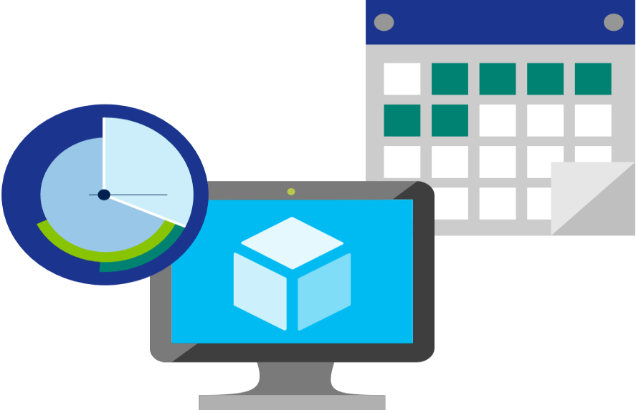
Factors affecting costs (part 1)
These are some of the factors affecting costs:
1) Resource Type | 2) Consumption | 3) Maintenance
Costs are resource-specific, so the usage that a meter tracks and the number of meters associated with a resource, depend on the resource type. | With a pay-as-you-go model, consumption is one of the biggest drivers of costs. | Monitoring your Azure footprint and maintaining your environment can help you identify and mitigate costs that aren’t necessary, such as shutting down under used virtual machines.
Notes:
https://docs.microsoft.com/learn/modules/describe-cost-management-azure/2-describe-factors-affect-costs-azure

Slide 7
Factors affecting costs (part 2)
These are some of the factors affecting costs:
4) Geography | 5) Network traffic | 6) Subscription
The same resource type can cost different amounts depending on the geographic area, so geography has an impact on Azure costs. | While some inbound data transfers are free, the cost for outbound data or data between Azure resources is impacted by Billing zones. | The type and configuration of your subscription can also impact your cost. For example, the free trial lets you explore some Azure resources for free.
Notes:
https://docs.microsoft.com/learn/modules/describe-cost-management-azure/2-describe-factors-affect-costs-azure

Slide 8

Explore Azure Marketplace
Azure Marketplace allows customers to find, try, purchase, and provision applications and services from hundreds of leading service providers, which are all certified to run on Azure.
Open source container platforms.
Virtual machine and database images.
Application build and deployment software.
Developer tools.
And much more, with 10,000+ listings!
Notes:
https://docs.microsoft.com/learn/modules/describe-cost-management-azure/2-describe-factors-affect-costs-azure
Connects end users with Microsoft partners, Independent Software Vendors (ISVs), and start-ups that offer solutions and services for Azure.
Azure customers, IT professionals and cloud developers can find, try, purchase, and provision Azure applications and services from certified service providers.
Includes close to 10,000 product listings.
There is also a Marketplace FAQ available at https://azure.microsoft.com/en-us/marketplace/faq/
Azure Marketplace - https://azuremarketplace.microsoft.com/en-us/

Slide 9
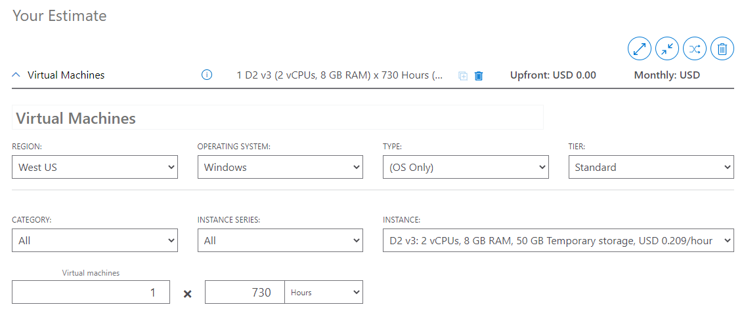
Pricing Calculator
The Pricing Calculator is a tool that helps you estimate the cost of Azure products. The options that you can configure in the Pricing Calculator vary between products, but basic configuration options include:
Region
Tier
Billing options
Support options
Programs and offers
Azure dev/test pricing
Notes:
https://docs.microsoft.com/learn/modules/describe-cost-management-azure/3-compare-pricing-total-cost-of-ownership-calculators
Pricing Calculator: https://azure.microsoft.com/en-us/pricing/calculator/
Note: The pricing calculator provides estimates, and not actual price quotes. Actual prices can vary depending upon the date of purchase, the payment currency, and the type of Azure customer.

Slide 10
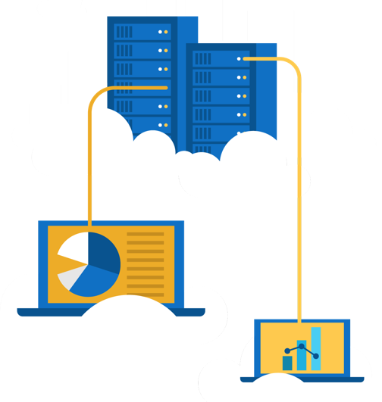
Exercise - Use the Azure Pricing Calculator
Use the Azure Pricing Calculator to generate a cost estimate for an Azure virtual machine and related network resources.
Configure the pricing calculator.
Review the pricing estimate.
Notes:
https://docs.microsoft.com/learn/modules/describe-cost-management-azure/4-exercise-estimate-workload-costs-use-pricing-calculator

Slide 11
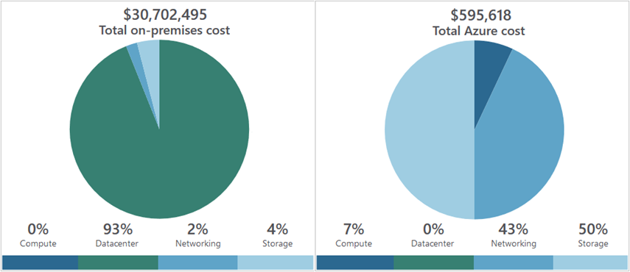
Total Cost of Ownership Calculator
A tool to estimate cost savings you can realize by migrating to Azure.
A report compares the costs of on-premises infrastructures with the costs of using Azure products and services in the cloud.
Notes:
https://docs.microsoft.com/learn/modules/describe-cost-management-azure/3-compare-pricing-total-cost-of-ownership-calculators
TCO calculator - https://azure.microsoft.com/en-us/pricing/tco/calculator/

Slide 12
Exercise - Use the Azure TCO Calculator
Use the Total Cost of Ownership (TCO) Calculator to generate cost comparison report for an on-premises environment.
Configure the TCO calculator.
Review the results and save a copy.
Notes:
https://docs.microsoft.com/learn/modules/describe-cost-management-azure/5-exercise-compare-workload-costs-use-total-cost-ownership-calculator

Slide 13
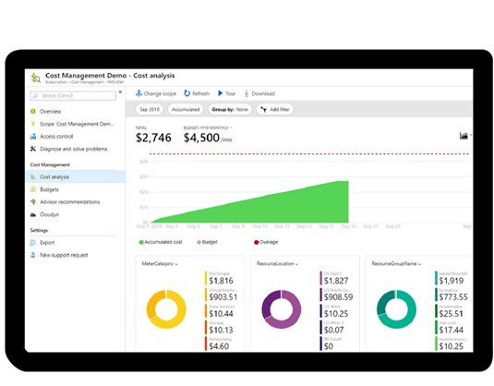
Azure Cost Management
Reporting – billing reports
Data enrichment
Budgets – set spend budget
Alerting – when cost exceed limits
Recommendation – cost recommendations
Notes:
https://docs.microsoft.com/learn/modules/describe-cost-management-azure/6-describe-azure-tool
Note: For more information about Cost Management, refer to https://azure.microsoft.com/en-us/services/cost-management/

Slide 14


Tags
Provides metadata for your Azure resources.
Logically organizes resources into a taxonomy.
Consists of a name-value pair.
Very useful for rolling up billing information.
OR
owner: joe
department: marketing
environment: production
cost-center: marketing
Notes:
https://docs.microsoft.com/learn/modules/describe-cost-management-azure/7-describe-purpose-of-tags
Tags - https://docs.microsoft.com/en-us/azure/azure-resource-manager/resource-group-using-tags

Slide 15
Governance and compliance
Notes:
https://docs.microsoft.com/learn/modules/describe-features-tools-azure-for-governance-compliance

Slide 16
Governance and compliance - Objective Domain
Describe the purpose of Azure Blueprints.
Describe the purpose of Azure Policy.
Describe the purpose of resource locks.
Describe the purpose of the Service Trust portal.
Notes:
https://docs.microsoft.com/learn/modules/describe-cost-management-azure/1-introduction

Slide 17

Azure Blueprints
Azure Blueprints makes it possible for development teams to rapidly build and stand up new environments. Development teams can quickly build trust through organizational compliance with a set of built-in components (such as networking) in order to speed up development and delivery.
Role Assignments
Policy Assignments
Azure Resource Manager Templates
Resource Groups
Notes:
https://docs.microsoft.com/learn/modules/describe-features-tools-azure-for-governance-compliance/2-describe-purpose-of-azure-blueprints
Azure Blueprints - https://azure.microsoft.com/en-us/services/blueprints/

Slide 18

Azure Policy
Azure Policy helps to enforce organizational standards and to assess compliance at-scale. Provides governance and resource consistency with regulatory compliance, security, cost, and management.
Evaluates and identifies Azure resources that do not comply with your policies.
Provides built-in policy and initiative definitions, under categories such as Storage, Networking, Compute, Security Center, and Monitoring.
Notes:
https://docs.microsoft.com/learn/modules/describe-features-tools-azure-for-governance-compliance/3-describe-purpose-of-azure-policy
Azure Policy - https://azure.microsoft.com/en-us/services/azure-policy
Stay compliant with your corporate standards and service level agreements (SLAs) by using policy definitions to enforce rules and effects for your Azure resources.
Evaluates and identifies Azure resources that do not comply with your policies.
Provides built-in policy and initiative definitions, under categories such as Storage, Networking, Compute, Security Center, and Monitoring.

Slide 19
Resource locks
Protect your Azure resources from accidental deletion or modification.
Manage locks at subscription, resource group, or individual resource levels within Azure Portal.
Lock Types | Read | Update | Delete
Delete | Yes | Yes | No
ReadOnly | Yes | No | No
Notes:
https://docs.microsoft.com/learn/modules/describe-features-tools-azure-for-governance-compliance/4-describe-purpose-of-resource-locks
Resource Locks - https://docs.microsoft.com/en-us/azure/azure-resource-manager/resource-group-lock-resources

Slide 20
Walkthrough - Manage Resource Locks
Create a resource add a lock and modification.
Create a resource.
Add a ReadOnly resource lock to prevent resource modification.
Update lock and retest.
Remove the resource lock.
Delete the resource.
Notes:
https://docs.microsoft.com/learn/modules/describe-features-tools-azure-for-governance-compliance/5-exercise-configure-resource-lock
NOTE: This is a bring your own subscription exercise. This will fully work in the Azure free trial, but the learner will need an actual Azure subscription for this exercise. May be better to do as a demo.

Slide 21
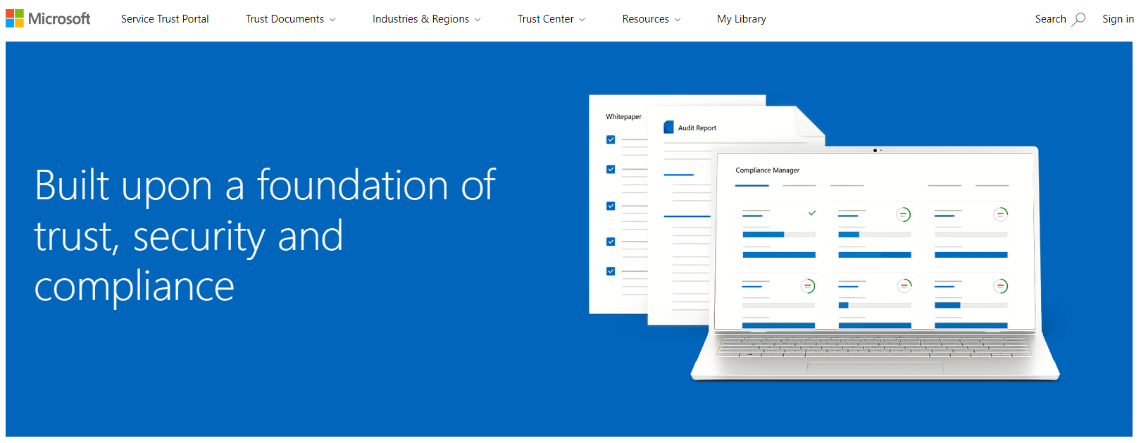
Service Trust portal
Notes:
https://docs.microsoft.com/en-us/learn/modules/describe-features-tools-azure-for-governance-compliance/6-describe-purpose-of-service-trust-portal

Slide 22
Management and deployment tools
Notes:
https://docs.microsoft.com/learn/modules/describe-features-tools-manage-deploy-azure-resources/

Slide 23
Management and deployment tools - Objective Domain
Describe Azure portal.
Describe Azure Cloud Shell, including Azure CLI and Azure PowerShell.
Describe the purpose of Azure Arc.
Describe Azure Resource Manager (ARM) and Azure ARM templates.
Notes:
https://docs.microsoft.com/learn/modules/describe-features-tools-manage-deploy-azure-resources/1-introduction

Slide 24





Tools for interacting with Azure
Azure Portal
Azure PowerShell
Command-Line Interface (CLI)
Azure Cloud Shell
Notes:
https://docs.microsoft.com/learn/modules/describe-features-tools-manage-deploy-azure-resources/2-describe-interacting-azure

Slide 25
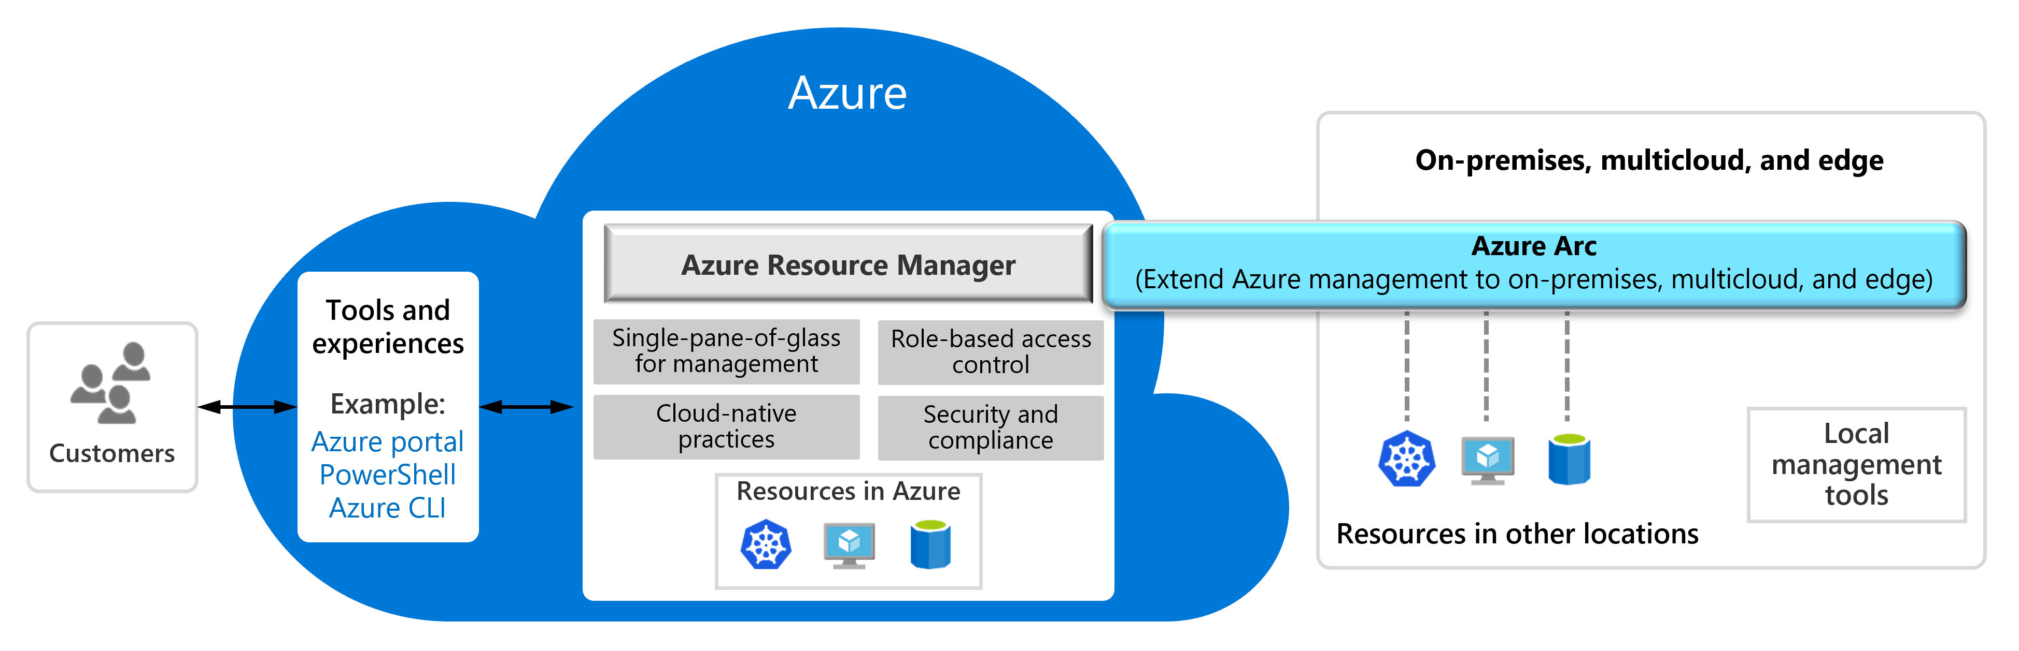
Azure Arc
Notes:
https://docs.microsoft.com/learn/modules/describe-features-tools-manage-deploy-azure-resources/3-describe-purpose-of-azure-arc

Slide 26
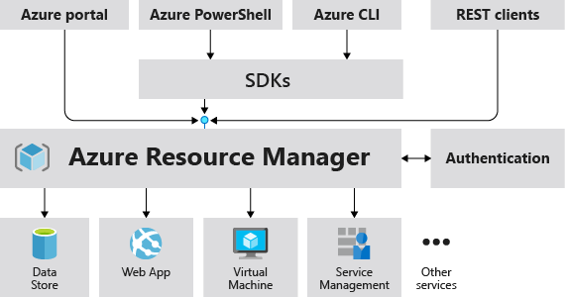
Azure Resource Manager
The Azure Resource Manager (ARM) provides a management layer that enables you to create, update, and delete resources in your Azure subscription.
© Copyright Microsoft Corporation. All rights reserved.
Notes:
https://docs.microsoft.com/learn/modules/describe-features-tools-manage-deploy-azure-resources/4-describe-azure-resource-manager-azure-arm-templates
Provides a management layer that enables you to create, update, and delete resources in your Azure subscription.
Create, configure, manage and delete resources and resource groups.
Organizes resources.
Controls access and resources.
Automates using different tools and SDKs.
Stores layouts in JSON files.
You can view more details about Azure Resource Manager at https://docs.microsoft.com/en-us/azure/azure-resource-manager

Slide 27
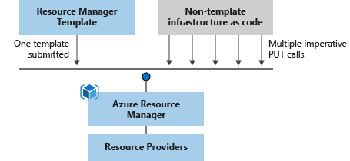
Azure Resource Manager (ARM) templates
Azure Resource Manager (ARM) templates are JavaScript Object Notation (JSON) files that can be used to create and deploy Azure infrastructure without having to write programing commands.
Declarative syntax
Repeatable results
Orchestration
Modular files
Built-in validation
Exportable code
Notes:
https://docs.microsoft.com/learn/modules/describe-features-tools-manage-deploy-azure-resources/4-describe-azure-resource-manager-azure-arm-templates
https://azure.microsoft.com/en-us/features/resource-manager/
https://docs.microsoft.com/en-us/azure/azure-resource-manager/management/overview
https://docs.microsoft.com/en-us/azure/azure-resource-manager/templates/overview
Deploy app resources Azure Resource Manager enables you to repeatedly deploy your app and have confidence your resources are deployed in a consistent state. You define the infrastructure and dependencies for your app in a single declarative template. This template is flexible enough to use for all of your environments such as test, staging or production. If you create a solution from the Azure Marketplace, the solution will automatically include a template that you can use for your app.
Organize resources
Azure Resource Manager makes it easy for you to manage and visualize resources in your app. You no longer have to deploy parts of your app separately and then manually stitch them together. You put resources with a common lifecycle into a resource group that can be deployed or deleted in a single action. You can see which resources are linked by a dependency. You can apply tags to resources to categorize them for management tasks, such as billing.
Control access to resources
With Azure Resource Manager, you can control who in your organization can perform actions on the resources. You manage permissions by defining roles and adding users or groups to the roles. For critical resources, you can apply an explicit lock that prevents users from deleting or modifying the resource. Azure Resource Manager logs all user actions so you can audit those actions. For each action, the audit log contains information about the user, time, events, and status.

Slide 28

Azure monitoring tools
Notes:
https://docs.microsoft.com/learn/modules/describe-monitoring-tools-azure/

Slide 29
Azure Management Tools - Objective Domain
Describe the functionality and usage of:
Describe the purpose of Azure Advisor.
Describe Azure Service Health.
Describe Azure Monitor, including Azure Log Analytics, Azure Monitor Alerts, and Application Insights.
Notes:
https://docs.microsoft.com/learn/modules/describe-monitoring-tools-azure/1-introduction

Slide 30

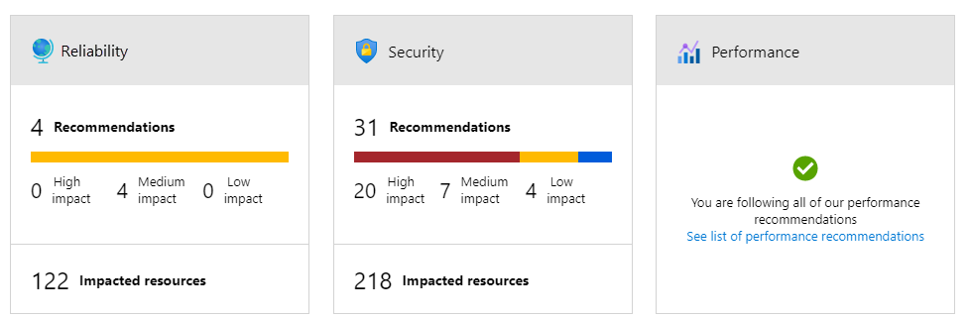
Azure Advisor
Azure Advisor analyzes deployed Azure resources and makes recommendations based on best practices to optimize Azure deployments.
Reliability
Security
Performance
Cost
Operational Excellence
© Copyright Microsoft Corporation. All rights reserved.
Notes:
https://docs.microsoft.com/learn/modules/describe-monitoring-tools-azure/2-describe-purpose-of-azure-advisor
Get proactive, actionable, and personalized best practice recommendations.
Improve the performance, security, and availability of your resources.
Identify opportunities to reduce your Azure costs.
Azure Advisor - https://docs.microsoft.com/azure/advisor/advisor-overview

Slide 31

Azure Service Health
Azure Service Health is a collection of services that keep you informed of general Azure status, service status that may impact you, and specific resource status that is impacting you.
Azure Status: global view of the health of all Azure services across all Azure regions
Service Health: focused view on only the services and regions that you’re using. If a service is experiencing a problem in a region you’re not using, it won’t show up here.
Resource Health: tailored view of your actual Azure resources. It provides information about the health of your individual cloud resources
Notes:
https://docs.microsoft.com/learn/modules/describe-monitoring-tools-azure/3-describe-azure-service-health

Slide 32

Azure Monitor
Azure Monitor maximizes the availability and performance of applications and services by collecting, analyzing, and acting on telemetry from cloud and on-premises environments.
Application Insights
Log Analytics
Smart Alerts
Automation Actions
Customized Dashboards
Notes:
https://docs.microsoft.com/learn/modules/describe-monitoring-tools-azure/4-describe-azure-monitor

Slide 33

Knowledge Check
Which one?
A). Azure Portal
B). PowerShell
C). Local Tool
Populate with instructions to use the polling tool of your choice
Learning Path 3
Use your Smartphones or Mobile Devices
Go to (insert polling app link of your choice)
Enter Code: 123-45-678
Please participate in the quiz for this section
Notes:
WWL recommends using polling to be completed for every 7 – 10 slides and preferably at the end of each section. This helps break classes up and adds more interactivity especially for remote classes.
In order to promote interactivity, WWL suggests the use of Mentimeter, Kahoot or a similar polling technology. Please feel free to adjust this slide as needed and populate with the instructions based on the polling tool of your choice.
https://docs.microsoft.com/learn/modules/describe-cost-management-azure/8-knowledge-check
https://docs.microsoft.com/learn/modules/describe-features-tools-azure-for-governance-compliance/7-knowledge-check
https://docs.microsoft.com/learn/modules/describe-features-tools-manage-deploy-azure-resources/5-knowledge-check
https://docs.microsoft.com/learn/modules/describe-monitoring-tools-azure/5-knowledge-check

Slide 34

Learning Path 03 Review
Cost management
Governance and compliance
Resource deployment tools
Monitoring tools
Microsoft Learn Modules (docs.microsoft.com/Learn)
Notes:
https://docs.microsoft.com/learn/modules/describe-cost-management-azure/9-summary
https://docs.microsoft.com/learn/modules/describe-features-tools-azure-for-governance-compliance/8-summary
https://docs.microsoft.com/learn/modules/describe-features-tools-for-managing-deploying-azure-resources/6-summary
https://docs.microsoft.com/learn/modules/describe-monitoring-tools-azure/6-summary

