Slide 1
AZ-104T00A
Administer PaaS Compute Options

Slide 2
Administer PaaS Compute Options Introduction
Configure Azure App Service Plans
Configure Azure App Services
Configure Azure Container Instances
Lab 09a - Implement Web Apps
Lab 09b - Implement Azure Container Instances
Lab 09c – Implement Azure Container Apps
Notes:
These Learn modules are part of the AZ-104: Deploy and manage Azure compute resources (https://docs.microsoft.com/learn/paths/az-104-manage-compute-resources/) learning path.

Slide 3



Administer PaaS Compute Options whiteboard
Describe the differences between containers and virtual machines.
What is an App Service plan? Things to consider when selecting?
What are deployment slots? Usage cases for slots?
List at least three admin tasks for web apps.
Full control?
No
Web apps, mobile app back ends?
No
Container solutions?
No
Simplified container orchestration?
No
Advanced container orchestration?
Notes:
Optional whiteboard slide to introduce the module or review the content. Use the whiteboard diagram directly or recreate the image during the class.

Slide 4
Configure Azure App Service Plans

Slide 5
Learning Objectives - Configure Azure App Service Plans
Implement Azure App Service Plans
Determine App Service Plan Pricing
Scale Up and Scale Out the App Service Plan
Configure App Service Plan Scaling
Demonstration – Configure Azure App Service Plans
Learning Recap
Implement and manage Azure compute resources (20-25%)
Create and configure Azure App Service
Provision an App Service plan
Configure scaling for an App Service plan

Slide 6

Implement Azure App Service Plans
Determines performance, price, and features
Defines a set of compute resources for a web app to run
  Region where compute resources will be created
  Number of virtual machine instances
  Size of virtual machine instances
  Pricing tier (next slide)
One or more apps can be configured to run in the same App Service plan
Notes:
Azure App Service plan overview - https://docs.microsoft.com/azure/app-service/overview-hosting-plans

Slide 7
Determine App Service Plan Pricing
Selected Features | Free | Shared (dev/test) | Basic (dedicated dev/test) | Standard (production workloads) | Premium (enhanced scale and performance) | Isolated (high-performance, security and isolation)
Web, mobile, or API apps | 10 | 100 | Unlimited | Unlimited | Unlimited | Unlimited
Disk space | 1 GB | 1 GB | 10 GB | 50 GB | 250 GB | 1 TB
Auto Scale | – | – | – | Supported | Supported | Supported
Deployment Slots | 0 | 0 | 0 | 5 | 20 | 20
Max Instances | – | – | Up to 3 | Up to 10 | Up to 30 | Up to 100
Shared compute (Free and Shared). Run apps on
the same Azure VM as other App Service apps, and the resources cannot scale out
Dedicated compute
(Basic, Standard, Premium).
Run apps in the same plan in dedicated Azure VMs
Isolated. Runs apps on
dedicated Azure VMs in dedicated Azure virtual networks
Notes:
App Service pricing - https://azure.microsoft.com/pricing/details/app-service/windows/

Slide 8
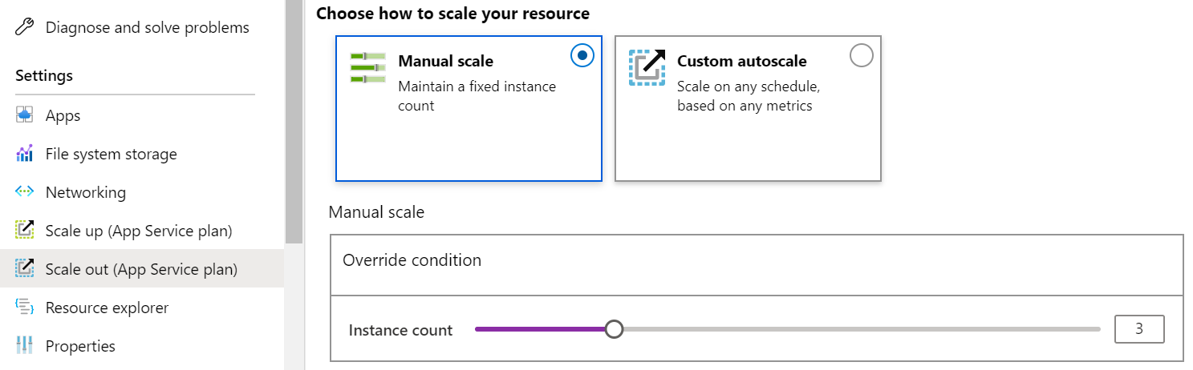
Scale Up and Scale Out the App Service Plan
Scale up (change the App Service plan):
  More hardware (CPU, memory, disk)
  More features (dedicated virtual machines, staging slots, autoscaling)
Scale out (increase the number of VM instances):
  Manual (fixed number of instances)
  Auto scale (based on predefined rules and schedules)
Notes:
Scale up an app in Azure App Service - https://docs.microsoft.com/azure/app-service/manage-scale-up

Slide 9
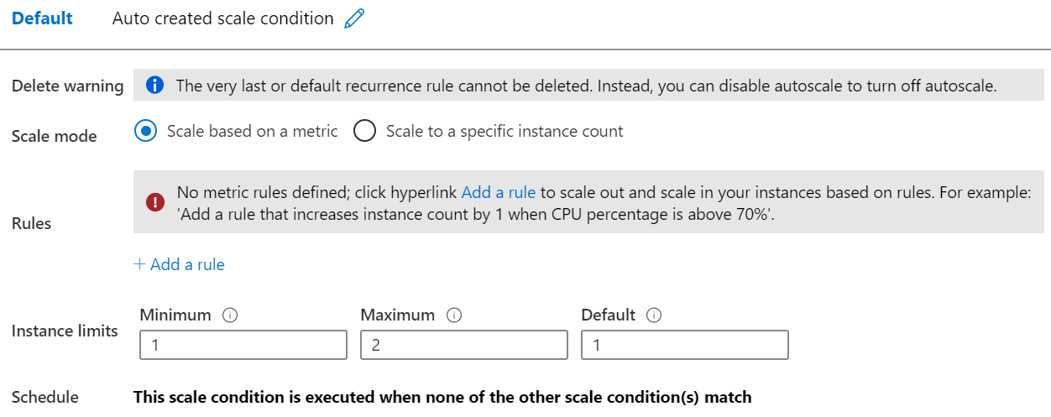
Configure App Service Plan Scaling
Adjust available resources based on the current demand
Improves availability and fault tolerance
Scale based on
a metric (CPU percentage, memory percentage, HTTP requests)
Scale according to a schedule (weekdays, weekends, times, holidays)
Can implement multiple rules – combine metrics and schedules
Don’t forget to scale in
Notes:
Get started with Autoscale in Azure - https://docs.microsoft.com/azure/azure-monitor/platform/autoscale-get-started?toc=/azure/app-service/toc.json

Slide 10
Demonstration – Configure App Service plans
Create and deploy a simple App Service Plan
Review scaling options
Notes:
Demonstration App Service Plans - https://microsoftlearning.github.io/AZ-104-MicrosoftAzureAdministrator/Instructions/Demos/09%20-%20Administer%20PaaS%20Compute%20Options.html#configure-azure-app-service-plans

Slide 11
Learning Recap – Configure Azure App Service Plans
  Scale an App Service web app to efficiently meet demand with App Service scale up and scale out
Notes:
Additional questions are available in Office Forms - https://forms.office.com/Pages/ShareFormPage.aspx?id=v4j5cvGGr0GRqy180BHbR5NEFZBpuAZBgxPOGXi_gX5UQkpEQ0VFUlZRUDM3Q1BCMDZVTEI5WjVORC4u&sharetoken=tbjUH7154spTWZnYjmrj
What is an App Service Plan and what will you consider in deciding which plan to choose?
Answer: An App Service Plan defines a set of compute resources for a web app to run. The plan determines performance, price, and features for a web app. Considerations for which plan to choose include how many web apps you can have, the disk space available to the web apps, if the web app can autoscale, how many deployment slots are available, and how many web app instances can be created.

Slide 12
Configure Azure App Services

Slide 13
Learning Objectives - Configure Azure App Services
Implement Azure App Service
Create an App Service
Create Deployment Slots
Add Deployment Slots
Secure an App Service
Create Custom Domain Names
Backup an App Service
Demonstration – Azure App Services
Learning Recap
Implement and manage Azure compute resources (20-25%)
Create and configure Azure App Service
Create an App Service
Configure certificates and TLS
Map an existing custom DNS name
Configure backup
Configure networking settings
Configure deployment slots

Slide 14
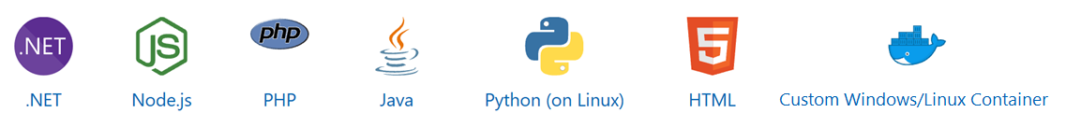
Implement Azure App Service
Includes Web Apps, API Apps, Mobile Apps, and Function Apps
Fully managed environment enabling high productivity development
Platform-as-a-service (PaaS) offering for building and deploying highly available cloud apps
for web and mobile
Platform handles infrastructure so developers focus on core web apps and services
Developer productivity using .NET, .NET Core, Java, Python and a host of others
Provides enterprise-grade security and compliance
Notes:
App Service - https://azure.microsoft.com/services/app-service/

Slide 15
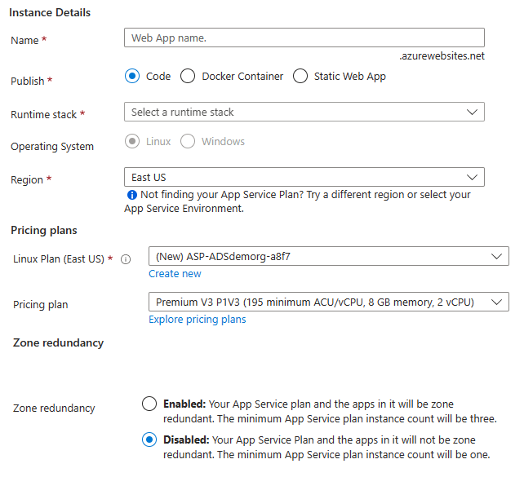
Create an App Service
Name must be unique
Access using azurewebsites.net – can map to a custom domain
Publish Code (Runtime Stack)
Publish Docker Container
Linux or Windows
Region closest to your users
App Service Plan
Notes:
Manage an App Service plan in Azure - https://docs.microsoft.com/azure/app-service/app-service-plan-manage

Slide 16



Create Deployment Slots
Continuous Deployment with Stage Slot
Service Plan | Slots
Free, Shared, Basic | 0
Standard | Up to 5
Premium | Up to 20
Isolated | Up to 20
Developer 1
GitHub
Swap
Staging
Production
Developer 2
Deploy to a different deployment slots (depends on service plan)
Validate changes before sending to production
Deployment slots are live apps with their own hostnames
Avoids a cold start – eliminates downtime
Fallback to a last known good site
Auto Swap when pre-swap validation is not needed
Notes:
Five deployment slots could be: Test, Dev, Q&A, Staging, and Production
Set up staging environments - https://docs.microsoft.com/azure/app-service/web-sites-staged-publishing?toc=%2Fazure%2Fapp-service%2Ftoc.json#add-a-deployment-slot
App Service Web App – block web access to non-production deployment slots - http://ruslany.net/2014/04/azure-web-sites-block-web-access-to-non-production-deployment-slots/
✔ Each App Service plan mode supports a different number of deployment slots. To find out the number of slots your app’s mode supports, see App Service Limits.

Slide 17
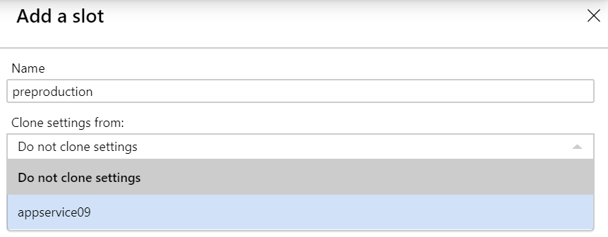
Add Deployment Slots
Select whether to clone an app configuration from another deployment slot
When you clone, pay attention to the settings:
  Slot-specific app settings and connection strings
  Continuous deployment settings
  App Service authentication settings
Not all settings are sticky (endpoints, custom domain names, SSL certificates, scaling)
Review and edit your settings before swapping
Notes:
✔ You can configure app settings and connections to stick to a slot and not be swapped. This done in the App Settings blade. A developer can create new settings for the web app.

Slide 18
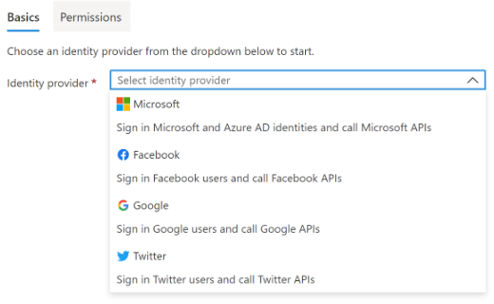
Secure an App Service
Authentication:
  Enable authentication – default anonymous
  Log in with a third-party identity provider
Security:
  Troubleshoot with Diagnostic Logs – failed requests, app logging
  Add an SSL certificate – HTTPS
  Define a priority ordered allow/deny list to control network access to the app
  Store secrets in the Azure Key Vault
Notes:
Security recommendations for App Service - https://docs.microsoft.com/azure/app-service/security-recommendations

Slide 19
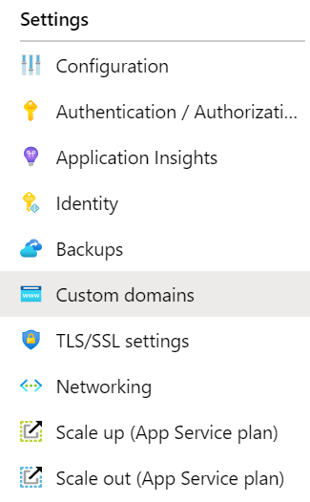
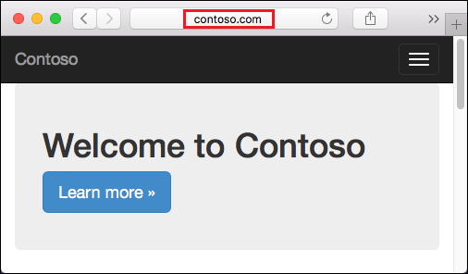
Create Custom Domain Names
Redirect the default web
app URL
Validate the custom domain in Azure
Use the DNS registry for your domain provider – create a CNAME or A record with the mapping
Ensure App Service plan supports custom domains

Slide 20
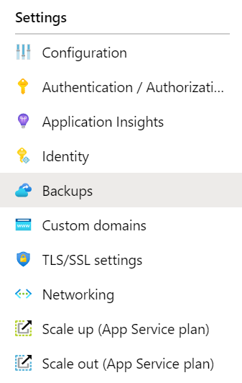
Backup an App Service
Create app backups manually or on a schedule
Backup the configuration, file content, and database connected to the app
Requires Standard or Premium plan
Backups can be up to 10 GB of app and database content
Configure partial backups and exclude items from the backup
Restore your app on-demand to a previous state,
or create a new app
Notes:
Back up your App in Azure - https://docs.microsoft.com/azure/app-service/web-sites-backup
Configure partial backups - https://docs.microsoft.com/azure/app-service/web-sites-backup

Slide 21
Demonstration – Configure Azure App Services
Create a Web App in the Azure Portal
Verify the web app is running
Explore deployment slots
Notes:
Demonstration Create a Web App - https://learn.microsoft.com/training/modules/host-a-web-app-with-azure-app-service/3-exercise-create-a-web-app-in-the-azure-portal?pivots=csharp

Slide 22
Learning Recap – Configure Azure App Services
Host a web application with Azure App Service (sandbox)
Stage a web app deployment for testing and rollback by using App Service deployment slots
Dynamically meet changing web app performance requirements with autoscale rules
A sandbox indicates a hands-on exercise.
Notes:
Additional questions are available in Office Forms - https://forms.office.com/Pages/ShareFormPage.aspx?id=v4j5cvGGr0GRqy180BHbR5NEFZBpuAZBgxPOGXi_gX5UQkpEQ0VFUlZRUDM3Q1BCMDZVTEI5WjVORC4u&sharetoken=tbjUH7154spTWZnYjmrj
List at least three administrator tasks for an organization’s web app.
Answer: If you are administering an Azure web app you will need to monitor, secure, and backup the app. Monitoring includes usage stats, outages, page views, user sessions, performance, and troubleshooting. Securing tasks include access, authentication, certificates, and identity. Backup decisions make sure all parts of the app can be restored, as well as frequency of the backups. Creating a custom domain name is another important task; there are certainly other important tasks.
What are web app deployment slots and how can they be used?
Answer: Deployment slots allow your app to run different instances. For example, a staging instance and a production instance. Deployment slots are live apps with their own hostnames. Deployment slots help you validate changes before making the app live. Slots also avoid a cold start which eliminates downtime. Lastly, slots let you fall back to a known good site.

Slide 23
Configure Azure Container Instances

Slide 24
Learning Objectives - Configure Azure Container Instances
Compare Containers to Virtual Machines
Explore Azure Container Instances Benefits
Implement Container Groups
Understand the Docker Platform (optional)
Demonstration – Configure Azure Container Instances
Manage Containers with Azure Container Apps (new)
Demonstration – Configure Azure Container Apps
Learning Recap
Implement and manage Azure compute resources (20-25%): Create and configure containers in Azure portal
Create and manage an Azure container registry
Provision a container by using Azure Container Instances (ACI)
Provision a container by using Azure Container Apps (ACA)
Manage sizing and scaling for containers, including ACI and ACA

Slide 25
Compare Containers to Virtual Machines
Container
Container
VM
VM
Isolation
Operating System
Deployment
Persistent storage
Fault tolerance
App A
App B
App A
App A
App B
App B
Bins/Libs
Bins/Libs
Bins/Libs
Bins/Libs
Guest OS
Guest OS
Docker Engine
Hypervisor
Host OS
Server
Notes:
This slide replaces a text heavy table slide. The older slide with discussion points is at the end of presentation.
Containers vs. virtual machines - https://docs.microsoft.com/virtualization/windowscontainers/about/containers-vs-

Slide 26
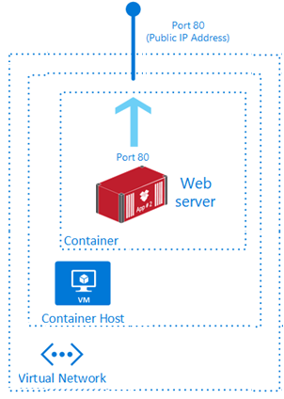
Explore Azure Container Instances Benefits
PaaS Service
Fast startup times
Public IP connectivity and DNS name
Isolation features
Custom sizes
Persistent storage
Linux and Windows Containers
Co-scheduled Groups
Virtual network Deployment
Fastest way to run a container in Azure without provisioning a VM
Notes:
What is Azure Container Instances? - https://docs.microsoft.com/azure/container-instances/container-instances-overview

Slide 27
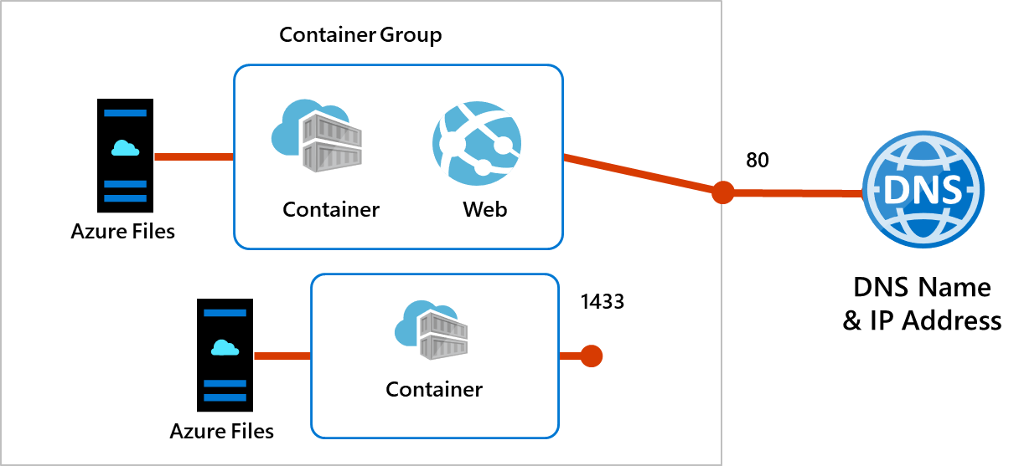
Implement Container Groups
Top-level resource in Azure Container Instances
A collection of containers
that get scheduled on
the same host
The containers in the group share a lifecycle, resources, local network, and storage volumes
Notes:
Quickstart: Deploy a container instance in Azure using the Azure portal - https://docs.microsoft.com/azure/container-instances/container-instances-quickstart-portal

Slide 28
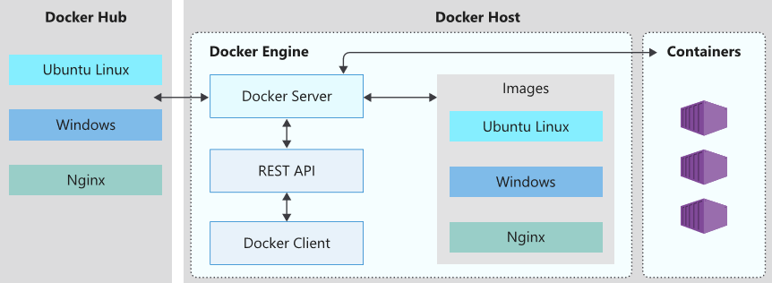
Understand the Docker Platform (optional)
Enables developers to
host applications within
a container
A container is a standardized “unit of software“ that contains everything required for an application to run
Available on both Linux
and Windows and can be
hosted on Azure
Notes:
Docker on Azure - https://azure.microsoft.com/services/kubernetes-service/docker/

Slide 29
Demonstration - Configure Azure Container Instances
Create and configure a container instance
Verify deployment of the container instance
Notes:
Demonstration ACI - https://microsoftlearning.github.io/AZ-104-MicrosoftAzureAdministrator/Instructions/Demos/09%20-%20Administer%20PaaS%20Compute%20Options.html#configure-azure-container-instances

Slide 30

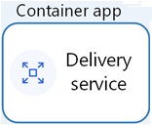

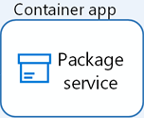
Manage Containers with Azure Container Apps (new)
Alternative to Azure Kubernetes Service
Integrates with Azure Container Registry
Simplifies complex infrastructures
Manages container orchestration
Azure Container Apps environment
Azure Container Registry
Notes:
Deploy microservices with Azure Container Apps - https://learn.microsoft.com/azure/architecture/example-scenario/serverless/microservices-with-container-apps
Azure Container Apps documentation - https://learn.microsoft.com/azure/container-apps/
Learn module: Implement Azure Container Apps - https://learn.microsoft.com/training/modules/implement-azure-container-apps/

Slide 31
Demonstration - Configure Azure Container Apps
Create and deploy a container app
Verify the application URL displays the welcome message
Notes:
Demonstration Container Apps - https://microsoftlearning.github.io/AZ-104-MicrosoftAzureAdministrator/Instructions/Demos/09%20-%20Administer%20PaaS%20Compute%20Options.html#configure-azure-container-apps

Slide 32
Learning Recap – Configure Azure Container Instances
Introduction to Docker containers
Build a containerized web application with Docker
Run Docker containers with Azure Container Instances
Implement Azure Container Apps
Notes:
Additional questions are available in Office Forms - https://forms.office.com/Pages/ShareFormPage.aspx?id=v4j5cvGGr0GRqy180BHbR5NEFZBpuAZBgxPOGXi_gX5UQkpEQ0VFUlZRUDM3Q1BCMDZVTEI5WjVORC4u&sharetoken=tbjUH7154spTWZnYjmrj
Describe at least two differences between containers and virtual machines.
Answer: Containers provide only lightweight isolation, whereas VMs provide complete isolation. VMs run the entire operating systems, but containers only run the OS services that are needed. Containers are deployed with Docker and orchestrated with Azure Kubernetes service. VMs are deployed and managed different tools with Azure. Containers can use local disk storage or file shares. VMs use a virtual hard disk and file shares.

Slide 33
Lab 09a – Implement Web Apps
Lab 09b – Implement Azure Container Instances
Lab 09c – Implement Azure Container Apps

Slide 34
Lab 09a – Implement web apps
Objectives
Task 1: Create an Azure web app
Task 2: Create a staging deployment slot
Task 3: Configure web app deployment settings
Task 4: Deploy code to the staging deployment slot
Task 5: Swap the staging slots
Task 6: Configure and test autoscaling of a web app
You need to evaluate the use of Azure Web apps for hosting Contoso’s web sites, hosted currently in the company’s on-premises data centers. The web sites are running on Windows servers using PHP runtime stack. You also need to determine how you can implement DevOps practices by leveraging Azure web apps deployment slots.
Next slide for an architecture diagram
Notes:
LAB 09a - Implement Web Apps - ESTIMATED DURATION 30 MIN
Lab Repository - https://microsoftlearning.github.io/AZ-104-MicrosoftAzureAdministrator/Instructions/Labs/LAB_09a-Implement_Web_Apps.html

Slide 35







Lab 09a – Architecture diagram
Task 1
az104-09a-rg1
AppService
AppServiceplan
Production slot
Task 6
Task 5
Swap the staging slot
Autoscale rule
Task 2
Staging slot
Task 4
Task 3
php-docs-hello-world
code
Local git
php-docs-hello-world
code

Slide 36
Lab 09b – Implement Azure Container Instances
Objectives
Contoso wants to find a new platform for its virtualized workloads. You identified several container images that can be leveraged to accomplish this objective. Since you want to minimize container management, you plan to evaluate the use of Azure Container Instances for deployment of Docker images
Task 1: Deploy a Docker image by using the Azure Container Instance
Task 2: Review the functionality of the Azure
Container Instance
Next slide for an architecture diagram
Notes:
LAB 09b - Implement Azure Container Instances - ESTIMATED DURATION 20 MIN
Lab Repository - https://microsoftlearning.github.io/AZ-104-MicrosoftAzureAdministrator/Instructions/Labs/LAB_09b-Implement_Azure_Container_Instances.html

Slide 37


Lab 09b – Architecture diagram
Task 1
Task 2
az104-09b-rg1
az104-9b-c1

Slide 38
Lab 09c – Implement Azure Container Apps
Objectives
Task 1: Create and configure the Azure Container App and environment
Task 2: Deploy the Azure Container App
Task 3: Test and verify the Azure Container App
Azure Container Apps enables you to run microservices and containerized applications on a serverless platform. With Container Apps, you enjoy the benefits of running containers while leaving behind the concerns of manually configuring cloud infrastructure and complex container orchestrators.
Notes:
LAB 09c - Implement Azure Container Apps- ESTIMATED DURATION 20 MIN
Lab Repository - https://microsoftlearning.github.io/AZ-104-MicrosoftAzureAdministrator/Instructions/Labs/Lab_09c-Implement-Azure-Container-Apps.md.html

Slide 39
End of presentation

Slide 40
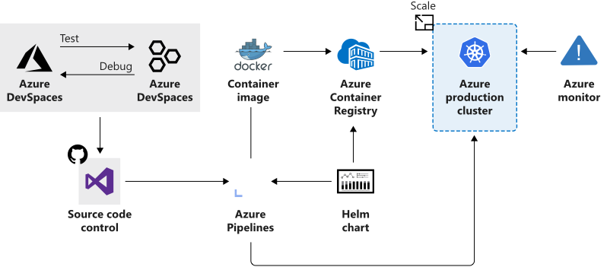
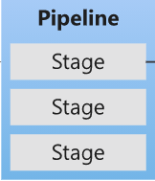
Azure Kubernetes Service
Manages health monitoring and maintenance
Performs simple cluster scaling
Enables nodes to be fully managed by Microsoft
You’re responsible only for managing the agent nodes
You pay only for the agent nodes
Notes:
What is Kubernetes - https://azure.microsoft.com/topic/what-is-kubernetes/

Slide 41
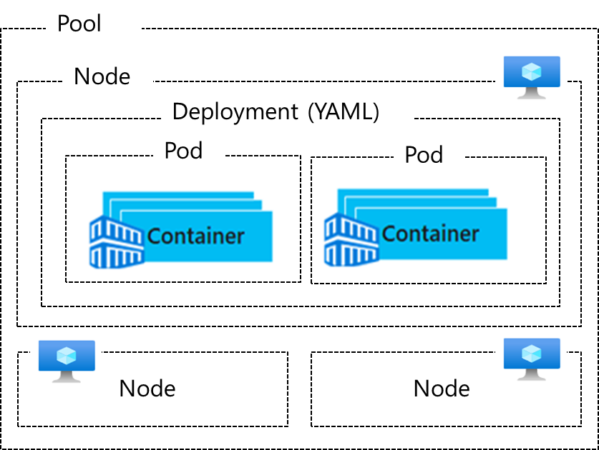
Understand AKS Terminology
Term | Description
Pools | Groups of nodes with identical configurations
Nodes | Individual VMs running containerized applications
Pods | Single instance of an application. A pod can contain multiple containers
Deployment | One or more identical pods managed by Kubernetes​
Manifest | YAML file describing a deployment
Notes:
Kubernetes core concepts for Azure Kubernetes Service (AKS) - https://docs.microsoft.com/azure/aks/concepts-clusters-workloads

