Slide 1
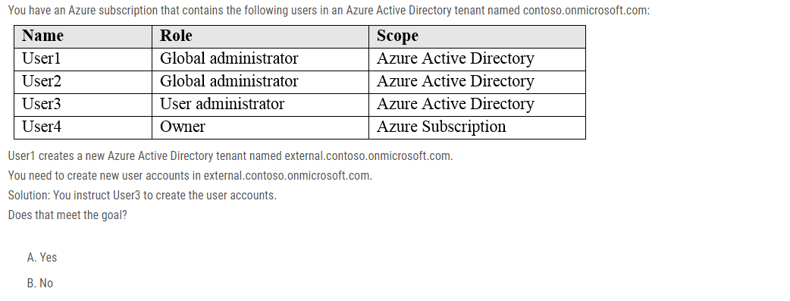
Notes:
Correct Answer: B Only a global administrator can add users to this tenant. Reference: https://docs.microsoft.com/en-us/azure/devops/organizations/accounts/add-users-to-azure-ad

Slide 2
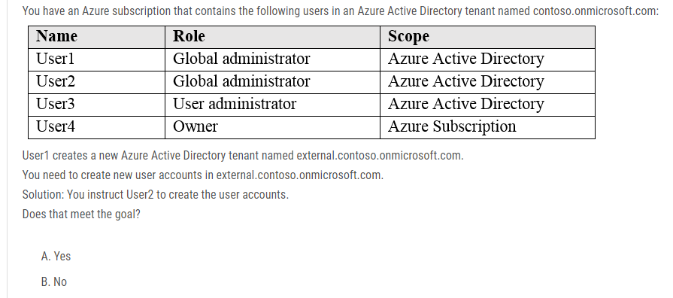
Notes:
Reference: https://docs.microsoft.com/en-us/azure/devops/organizations/accounts/add-users-to-azure-ad
B
Want user2 is geen global administrator in de tweede AD.

Slide 3
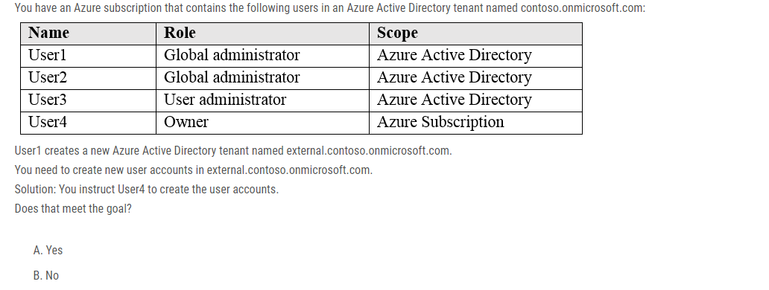
Notes:
Correct Answer: B Only a global administrator can add users to this tenant.

Slide 4
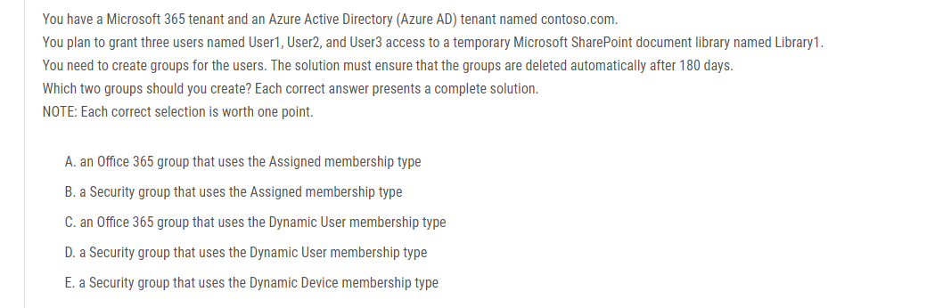
Notes:
Correct Answer: AC You can set expiration policy only for Office 365 groups in Azure Active Directory (Azure AD). Note: With the increase in usage of Office 365 Groups, administrators and users need a way to clean up unused groups. Expiration policies can help remove inactive groups from the system and make things cleaner. When a group expires, all of its associated services (the mailbox, Planner, SharePoint site, etc.) are also deleted. You can set up a rule for dynamic membership on security groups or Office 365 groups. Incorrect Answers: B, D, E: You can set expiration policy only for Office 365 groups in Azure Active Directory (Azure AD). Reference: https://docs.microsoft.com/en-us/office365/admin/create-groups/office-365-groups-expiration-policy?view=o365-worldwide

Slide 5
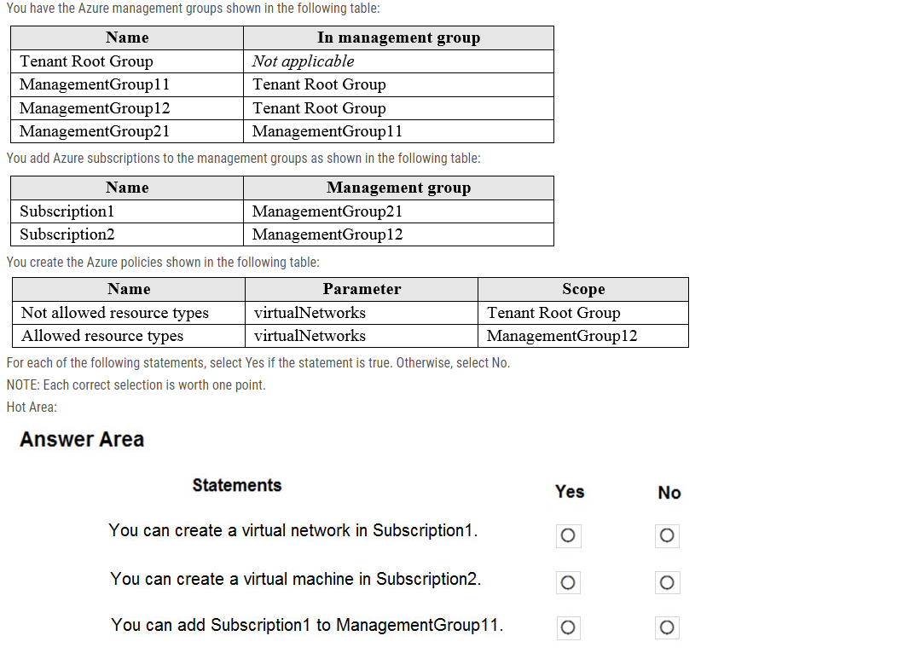
Notes:
NO YES YES
ox 1: No - Virtual networks are not allowed at the root and is inherited. Deny overrides allowed. Box 2: Yes - Virtual Machines can be created on a Management Group provided the user has the required RBAC permissions. Box 3: Yes - Subscriptions can be moved between Management Groups provided the user has the required RBAC permissions. Reference: https://docs.microsoft.com/en-us/azure/governance/management-groups/overview https://docs.microsoft.com/en-us/azure/governance/management-groups/manage#moving-management-groups-and-subscriptions

Slide 6
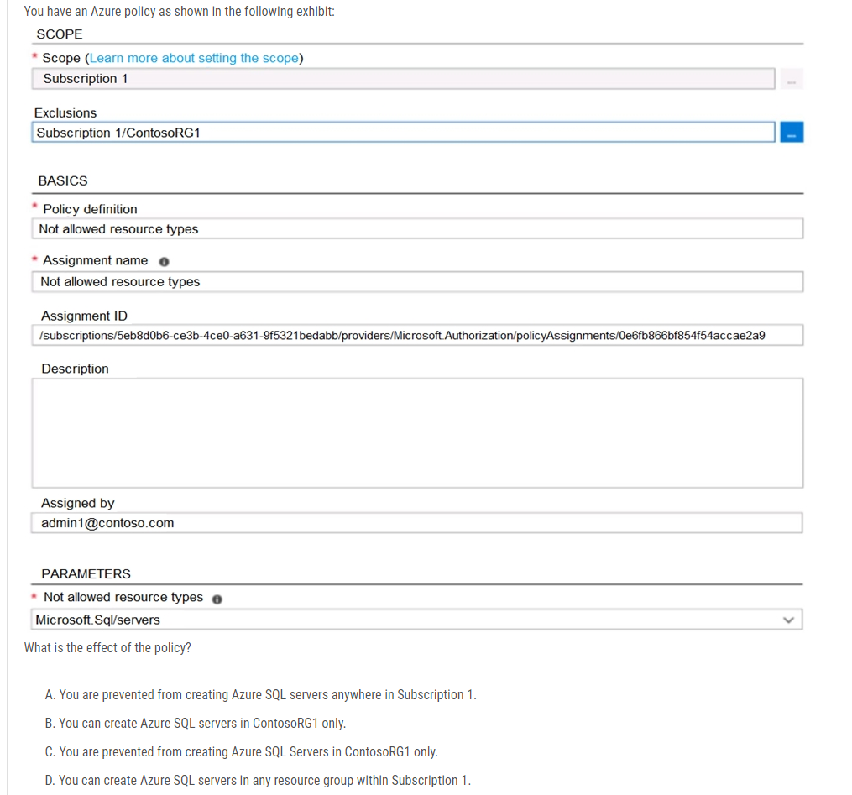
Notes:
Correct Answer: B You are prevented from creating Azure SQL servers anywhere in Subscription 1 with the exception of ContosoRG1

Slide 7
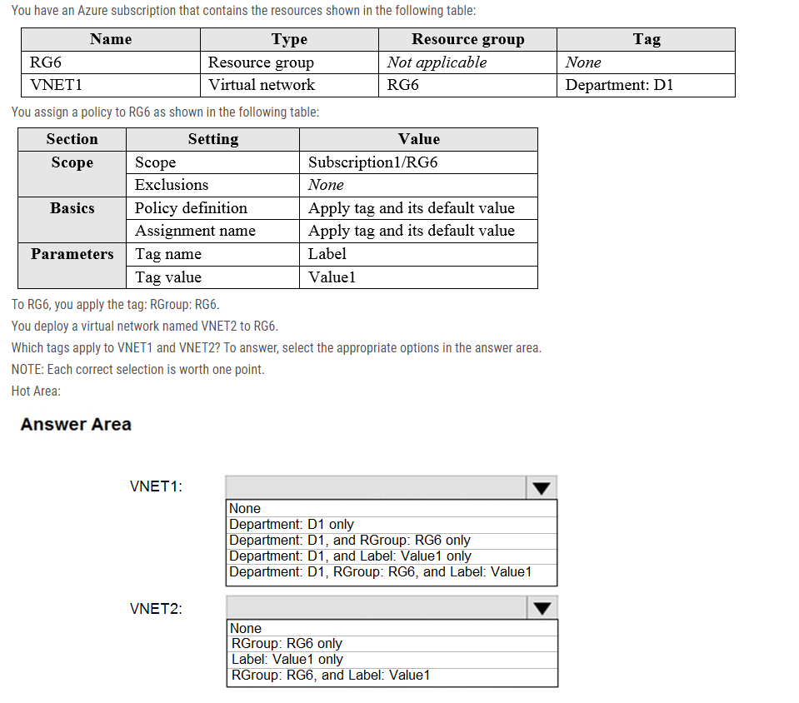
Notes:
Answer is wrong. Tested in MSDN lab in the order set out in the question. After I created the policy and assigned it to the RG the existing vnet still only had the tag of Department:D1. New vnet had the tag label:value1 only. So the answer is Department:D1 only and Label:value1 only

Slide 8
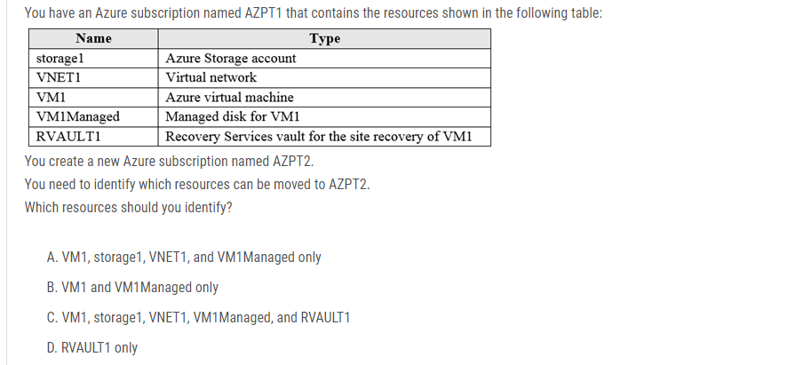
Notes:
Correct Answer: C You can move a VM and its associated resources to a different subscription by using the Azure portal. You can now move an Azure Recovery Service (ASR) Vault to either a new resource group within the current subscription or to a new subscription. Reference: https://docs.microsoft.com/en-us/azure/azure-resource-manager/management/move-resource-group-and-subscription

Slide 9
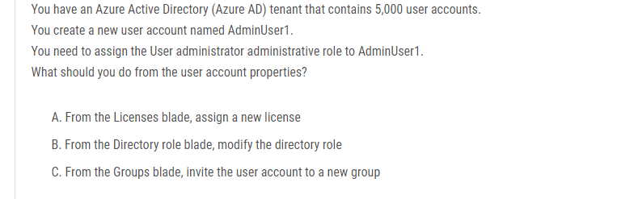
Notes:
Correct Answer: B Assign a role to a user - 1. Sign in to the Azure portal with an account that's a global admin or privileged role admin for the directory. 2. Select Azure Active Directory, select Users, and then select a specific user from the list. 3. For the selected user, select Directory role, select Add role, and then pick the appropriate admin roles from the Directory roles list, such as Conditional access administrator. 4. Press Select to save. Reference: https://docs.microsoft.com/en-us/azure/active-directory/fundamentals/active-directory-users-assign-role-azure-portal

